Slide 1
17
Project Management

Slide 2
Projects
unique, one-time operations
specific set of objectives
limited time frame
Build A
A Done
Build B
B Done
Build C
C Done
Build D
Ship
JAN
FEB
MAR
APR
MAY
JUN
On time!
Notes:
A related term is program. A program is a collection or series of projects

Slide 3
Examples of Projects
Building Construction
Research Project
System, software, new
product development
Event

Slide 4
Performance Goals
Complete the project within
time/ schedule,
cost/ budget,
performance/ quality guidelines.

Slide 5
Project Phases
project initiation
conception
feasibility study
selection
planning and scheduling
execution and control
closeout
activity breakdown
determine resources/costs/risks
schedule/subcontract
purchase
monitor
adjust
ensure completion
paperwork
review

Slide 6
Project Manager
Responsible for:
Work Quality
Human Resources Time
Communications Costs
Notes:
The role of the project manager.
a. The only real influence project managers have is their communication skills and their power of persuasion.
Team members seldom work on just one project; they’re usually assigned to two or three at any given time.

Slide 7
Project Manager’s Abilities
handle failure and fear
motivate
build a team
make trade-off decisions
expedite work
deal with obstacles
solve problems
monitor details
lead
manage conflict
be politically sensitive
adapt to changes
manage change
Notes:
The point is that a project manager needs a lot of skills. It is an exciting, challenging job.

Slide 8
Ethical Issues
Temptation to understate costs
Withhold information
Misleading status reports
Falsifying records
Comprising workers’ safety
Approving substandard work

Slide 9
Project Planning
Project planning
  analyzing the project into work packages & activities, estimating resources, durations, scheduling, etc.
Quality planning
  How project and product quality is to be assured and controlled
Communications planning
  Determining the nature of information needed by stakeholders and how to satisfy these needs
Purchase planning
  What to purchase, specifications, supplier evaluation and selection, awarding contracts

Slide 10
Risk Management Planning
Risk: occurrence of events that have undesirable consequences such as:
  delays
  increased costs
  inability to meet specifications
  project termination
Risk management:
  Identify potential risks
  Analyze and assess risks
  Work to minimize occurrence of risk
  Establish contingency plans

Slide 11
Risk Response
Redundant (backup) systems
Simplify process
Use a more stable supplier
Risk transfer
Risk-sharing (partnering)
Extending the schedule
Creating contingency funds
Clarifying requirements
Improving communication
Reducing project scope
Frequent monitoring to eliminate problems early

Slide 12
Project Management Tools
Work Breakdown Structure (WBS)
Gantt chart
CPM/PERT
Software
(e.g. Microsoft Project)
Notes:
summary slide

Slide 13
Work Breakdown Structure (WBS)
WBS
  A hierarchical listing of what must be done during a project
    Establishes a logical framework for identifying the required activities for the project
      Identify the major components of the project
      Identify the major subcomponents
      Break down subcomponents into work packages
      Break down each work package into a list of the activities that will be needed to accomplish it

Slide 14
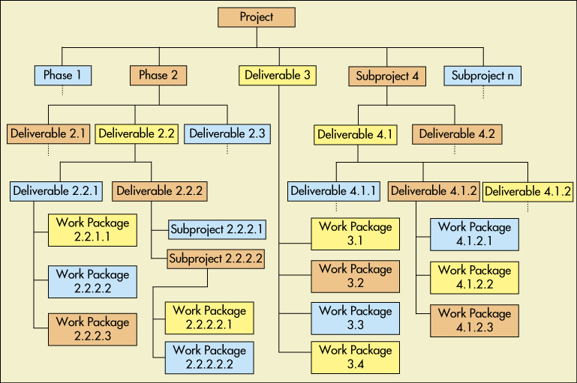
WBS
Notes:
Related to Figure 17-1

Slide 15
Project Scheduling
Determining the
timing of activities of the project
List Activities
List activities defined in WBS
Sequence
Identify logical sequence of activities
Resources
Identify resources needed for each activity
Duration
Identify duration of each activity
Schedule
Develop schedule using PERT/CPM
Modify
Modify as needed (level, compress, etc.)

Slide 16
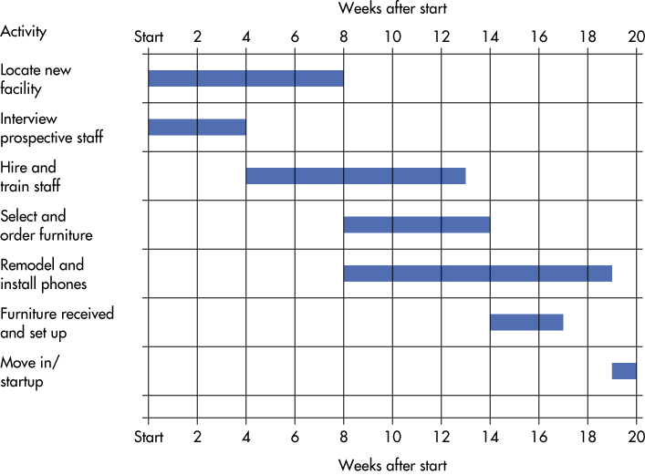
Gantt Chart
Notes:
Fig 17-2,
Advantages: visual and simple
Disadvantage: fails to reveal relationships among activities that can be crucial (e.g. if an early activity suffers a delay, need to be able to easily determine which later activities are affected. Conversely, some activities may safely be delayed without affecting the overall schedule.)
On more complex projects, a precedence network, is used.

Slide 17
PERT and CPM
PERT (program evaluation and review technique) and CPM (critical path method)
techniques used to schedule and control large projects
Provides:
graphical display of activities in sequence
estimate of project length
which activities most critical to timely completion
how long any activity can be delayed

Slide 18
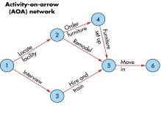
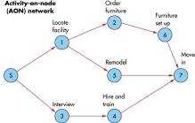
The Precedence Network Diagram
Precedence Network:
  Diagram of project activities that shows sequential relationships by use of arrows and nodes
Activity on arrow (AOA):
  Network in which arrows designate activities
Activity on node (AON):
  Network in which nodes designate activities
Path:
  A sequence of activities that leads from the starting node to the finishing node

Slide 19
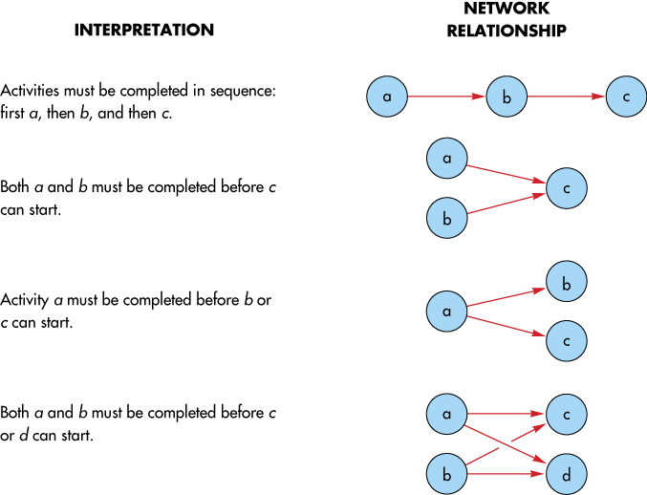
Network Conventions
Notes:
Fig 17-4

Slide 20
Precedence Network
Critical path:
  The longest path from start to end
  determines expected project duration
Critical activities:
  Activities on the critical path
Path slack time:
  Allowable slippage for a path
  length of a path -- length of critical path
Notes:
Note: critical path has 0 slack time

Slide 21
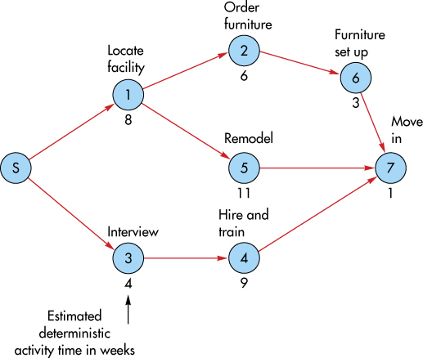
Example: Precedence Network
Critical Path
Path Length (weeks) Path Slack (weeks)
S-1-2-6-7 8 + 6 + 3 + 1 = 18
S-1-5-7 8 + 11 + 1 = 20
S-3-4-7 4 + 9 + 1 = 14
20 − 18 = 2
20 − 20 = 0
20 − 14 = 6

Slide 22
Deterministic Activity Durations
Deterministic
  Time estimates that are fairly certain
Probabilistic
  Time estimates that allow for variation

Slide 23
Solution Technique
Network activities
  ES: earliest time the activity can start
  EF: earliest time the activity can finish
  LS: latest time the activity can start
  LF: latest time the activity can finish
Used to determine
  Expected project duration
  Activity slack times
  Critical path

Slide 24

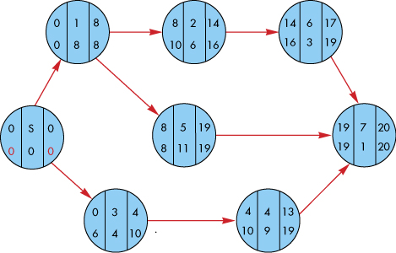
PERT/CPM Solution Technique

Slide 25

Forward Pass: Earliest Start and Finish
  Start at the left side of the precedence network (the start node) and work toward the right side.
For the start activity: ES = 0.
  If an activity has a unique immediately preceding activity:
ES = EF of the immediately preceding activity.
  If an activity has multiple immediately preceding activities:
ES = largest EF of immediate predecessors.
  For each activity:
EF= ES + Activity duration

Slide 26

Backward Pass: Latest Start and Finish
  Start at the right side of the precedence network (the end node) and work toward the left side.
For the end activity: LF = EF
  If an activity has a unique immediate follower:
LF = LS of the immediately follower
  If an activity has multiple immediate followers :
LF = smallest LS of immediate followers.
  For each activity:
LS = LF - Activity duration

Slide 27
Slack and the Critical Path
Slack can be computed one of two ways:
  Slack = LS – ES
  Slack = LF – EF
Critical path
  The critical path is indicated by the activities with zero slack

Slide 28
Using Slack Times
Helps planning of allocation of scarce resources
  efforts directed toward activities that might delay project
  assumption that activities will be started as early as possible and not exceed their expected time
Slack is SHARED
  If two activities on the same path have the same slack,
  this is total slack available to both

Slide 29
Probabilistic Time Estimates
The beta distribution is used to describe the inherent variability in activity durations
The probabilistic approach involves three time estimates:
  Optimistic time, (t_{o})
    The length of time required under optimal conditions
  Pessimistic time, (t_{p})
    The length of time required under the worst conditions
  Most likely time, (t_{m})
    The most probable
    length of time required

Slide 30
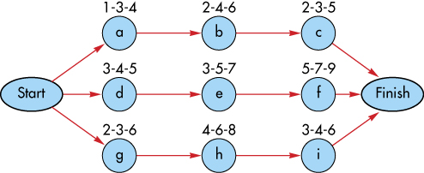
Probabilistic Time Estimates
Optimistic
time
Most likely
time
Pessimistic
time

Slide 31
Probabilistic Time Estimates
The expected time, t_{e} ,for an activity is a weighted average of the 3 time estimates:
The expected duration of a path is equal to the sum of the expected times of the activities on that path:

Slide 32
Probabilistic Time Estimates
The standard deviation of each activity’s time
is estimated as 1/6th of the
difference between pessimistic and optimistic estimates. The variance is the square of the standard deviation:
Standard deviation of the expected time for the path
OR
Notes:
Knowledge of expected path times and their standard deviations enables managers to compute probabilistic estimates about project completion such as:
The probability that the project will be completed by a certain time
The probability that the project will take longer than its expected completion time

Slide 33
Knowledge of Path Statistics
Use path mean & standard deviation to compute:
  probability that the project will be completed by a certain time
  probability that the project will take longer than its expected completion time
assumes independence of path durations
  activity durations must be independent,
  and each activity must be on only one path
Notes:
The assumption of independence can be considered to be met if only a few activities in a large project are on multiple paths

Slide 34
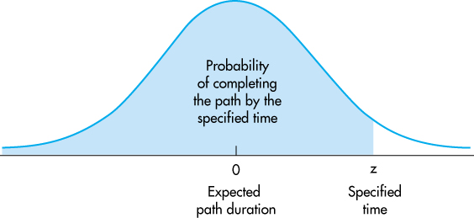
Determining Path Probabilities
Notes:
Fig 17-7 Although path activities are represented by the beta distribution, the path distribution can be represented by a normal distribution

Slide 35
PERT/CPM: Determining Path Probabilities
1. Determine 3 time estimates
2. Calculate Expected Time (Mean)
3. Calculate Activity Variance
4. Calculate Critical Path Variance
(sum of variances of activities on critical path)
5. Calculate Z score of duration
6. Find Area of Z score (Appendix B: Normal table)
7. probability that time will be within specified = area
probability that time will exceed specified = 1 – area
Notes:
15
Summary or procedure. See example6 in text

Slide 36
Project Completion Time
To determine the probability that the project will be completed within the specified time
  Calculate probability that each path will be completed within the specified time
  Multiply these probabilities
Notes:
A project is not complete until all project activities are complete
It is risky to only consider the critical path when assessing the probability of completing a project within a specified time.

Slide 37
Determining Path Probabilities
17
Weeks
1.00
a-b-c
Weeks
10.0
d-e-f
Weeks
16.0
1.00
g-h-i
13.5
Weeks
Notes:
Ex 6

Slide 38
Determining Path Probabilities
15
Weeks
1.00
a-b-c
Weeks
10.0
0.1587
d-e-f
Weeks
16.0
0.9192
g-h-i
13.5
Weeks
P(D < 15) = 1 x 0.1587 x 0.9192 = 0.1459
P(D > 15) = 1 - 0.1459 = .8541
Notes:
Ex 6

Slide 39
Time-Cost Trade-Offs: Crashing
Crashing
  Shortening activity durations
Motivations:
  Avoid late penalties
  Monetary incentives for early completion
  Free resources for other projects
  Reduce indirect costs
Options:
  Add more personnel
  More (or more efficient) equipment
  Relax specifications

Slide 40
Crashing Decisions
To make decisions concerning crashing requires information about:
  Regular time and crash time estimates for each activity
  Regular cost and crash cost estimates for each activity
  A list of activities that are on the critical path
    Critical path activities are potential candidates for crashing
    Crashing non-critical path activities would not have an impact on overall project duration

Slide 41
Costs Related to Crashing Activities
Crashing reduces indirect, but increases direct costs
Total cost is minimized at optimum amount of crashing
C
O
S
T
Total Cost
Cumulative
(direct)
cost of crashing
Shorten
Shorten
Expected
indirect
Costs
CRASH
Shorten
Optimum
Project Length
Notes:
11
Fig 12-3

Slide 42
Crashing: Procedure
Crash least expensive activity on the critical path
After each crash, recalculate critical path
start with the activity
with the lowest
crash cost per period
if more than one critical path, crash the cheaper of
a common activity shared by the critical paths
sum of least expensive activities on each critical path
Crash activities on critical path one period at a time, until crash cost > benefit

Slide 43











Crashing Example
Activity | Normal Duration | Crash Duration | Cost per Day to Crash
a | 6 | 6 | -
b | 10 | 8 | 500
c | 5 | 4 | 300
d | 4 | 1 | 700
e | 9 | 7 | 600
f | 2 | 1 | 800
6
10
a
b
2
f
s
5
4
9
c
d
e
Notes:
Example 7

Slide 44
Example: Project Crashing
Activity | Immediate Predecessors | Duration (weeks) | Available weeks to crash | Crash Cost per week
A | — | 3 | 0 | NA
B | — | 2 | 1 | $800
C | B | 2 | 1 | 1000
D | A, B | 4 | 1 | 1000
E | C | 3 | 1 | 1000
F | C | 4 | 2 | 1200
G | D, F | 5 | 3 | 1500
H | E, G | 2 | 1 | 3200
Crash the project to 10 weeks duration.
44
Notes:
New Example
If crash cost is < indirect cost of extra time, or penalty cost, or other benefit from earlier finish, do it.

Slide 45
Example: Project Crashing
E
B
C
Start
F
H
A
D
G
#wks | 3 | 2 | 2 | 4 | 3 | 4 | 5 | 2 | Path
 |  | B | C |  |  | F | G | H | 15
 |  | B | C |  | E |  |  | H | 9
 |  | B |  | D |  |  | G | H | 13
 | A |  |  | D |  |  | G | H | 14
$crsh |  | 800 | 1000 | 1000 | 1000 | 1200 | 1500 | 3200
45
Notes:
Start with B as it is cheapest on critical path

Slide 46
Example: Project Crashing
Crash B 1 week =$800
 | 3 | 1 | 2 | 4 | 3 | 4 | 5 | 2
 |  | B | C |  |  | F | G | H | 14
 |  | B | C |  | E |  |  | H | 8
 |  | B |  | D |  |  | G | H | 12
 | A |  |  | D |  |  | G | H | 14
$crsh |  | 800 | 1000 | 1000 | 1000 | 1200 | 1500 | 3200
Crash G 3 weeks = $4500
 | 3 | 1 | 2 | 4 | 3 | 4 | 2 | 2
 |  | B | C |  |  | F | G | H | 11
 |  | B | C |  | E |  |  | H | 8
 |  | B |  | D |  |  | G | H | 9
 | A |  |  | D |  |  | G | H | 11
$crsh |  | 800 | 1000 | 1000 | 1000 | 1200 | 1500 | 3200
46
Notes:
Finally crash C and D 1 week each for $2000
46

Slide 47
Example: Project Crashing
Crash C and D 1 week = $2000
 | 3 | 1 | 1 | 3 | 3 | 4 | 5 | 2
 |  | B | C |  |  | F | G | H | 10
 |  | B | C |  | E |  |  | H | 7
 |  | B |  | D |  |  | G | H | 8
 | A |  |  | D |  |  | G | H | 10
$crsh |  | 800 | 1000 | 1000 | 1000 | 1200 | 1500 | 3200
Crash Cost = $800 + 4500 + 2000 = 7300
47
Notes:
47

Slide 48
The Jewellery Store
Additional example for presentation in class

Slide 49
The Jewellery Store
night patrolman every 50 minutes
external store alarm, jewellery safe, office alarm, office safe full of cash
What activities need to be completed to completely clean out the store?
Notes:
This example is based on the scenario and numbers found in
Decision Sciences Journal of Innovative Education Spring 2004 Volume 2 Number 1 p65-69
Introducing Project Management Concepts using a Jewelry Store Robbery
By
Edward D. Walker II, Ph.D.
Department of Information Systems and Logistics
College of Business Administration
Georgia Southern University
P. O. Box 8152
Statesboro, GA 30460
(912) 681-5085
edwalker@GeorgiaSouthern.edu

Slide 50
The Jewellery Store
Can we do the job successfully?
Activity
Time (Mins)
Immed. Pred.
A. disarm exterior alarm system
20
None
B. disarm office alarm system
7
A
C. crack office safe
6
B
D. clean out office safe
1
C
E. crack jewelry safe
14
A
F. clean out jewelry safe
4
E
G. gather loot and exit
10
D,F
A(20)
B(7)
C(6)
D(1)
G(10)
E(14)
F(4)
Notes:
Total = 62. Should it be aborted as > 50?
Decide order.

Slide 51
The Jewellery Store
Critical Path = Longest Path = minimum Completion Time
Activity
Time (Mins)
Immed. Pred.
A. disarm exterior alarm system
20
None
B. disarm office alarm system
7
A
C. crack office safe
6
B
D. clean out office safe
1
C
E. crack jewelry safe
14
A
F. clean out jewelry safe
4
E
G. gather loot and exit
10
D,F
A(20)
B(7)
C(6)
D(1)
G(10)
E(14)
F(4)
A-B-C-D-G = 44 min
A-E-F-G = 48 min
Notes:
Total = 62. Should it be aborted as > 50?
Decide order.
Ask what would happen if it took longer to disarm the exterior alarm.
- as on CP, would affect time
What would happen if it took longer to disarm office alarm?
Can take an extra 4 minutes and not affect time = path slack

Slide 52
The Jewelry Store: Variable Time Estimates
Activity
Mean
Optimistic
Most Likely
Pessimistic
Var
A. disarm exterior alarm system
20
15
21
21
1.00
B. disarm office alarm system
7
5
7
9
.45
C. crack office safe
6
4
6
7
.25
D. clean out office safe
1
1
1
2
.03
E. crack jewelry safe
14
13
13.5
17
.45
F. clean out jewelry safe
4
4
4
4
0
G. gather loot and exit
10
8
10
12
.45
= 1.9
= √1.9
(Sum the variance along the critical path.)

Slide 53
Probability critical path over 50 minutes
For critical path AEFG
---------- .5 ------------
------- .4265 ----------
t
T_{E} = 48
D=50
p(Z < 1.45) = .5 + .4265
= .9265 or 92.65 %
For this path, probability duration < 50 = 1 - .9265 = .0735
There is a 7.35% probability that we will be caught!

Slide 54
Probability other path and total project duration (D > 50)
For ABCDG path
---------- .5 ------------
------- .4999 ----------
t
T_{E} = 44
D=50
p(Z < 4.06) ≈ .5 + .4999
≈ 1 or 100%
For project
The probability that both paths finish on time =.9265 x 1
There is a 7.35% probability that we will be caught!
Notes:
Note: as the 2 paths do have some activities in common, they are not independent and thus this method of calculating probabilities (multiplying them together) may be inaccurate. However, as it is fairly certain the other path will finish on time it does not affect the overall probability and the independence assumption is still reasonable.

