Slide 1
Player Piano
Kurt Vonnegut

Slide 2
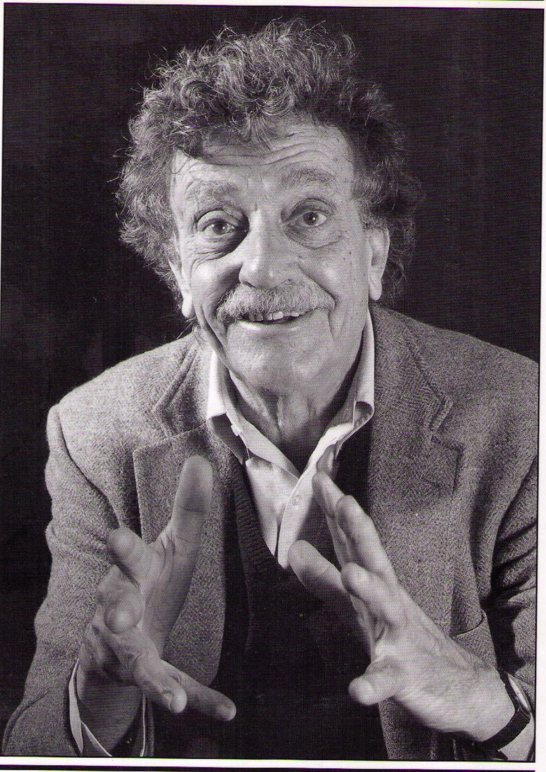
Kurt Vonnegut
Born November 11, 1922 to third-generation German immigrants.
After high school, he went to Cornell to study chemistry at his father’s urging.
While at Cornell, he enlisted in the army and fought in the Battle of the Bulge where he was captured by German forces.
Imprisoned in Dresden, Vonnegut survived the infamous firebombing which became the basis for his most famous work, Slaughterhouse Five.

Slide 3
Kurt Vonnegut
After the war, Vonnegut studied anthropology at the University of Chicago.
His masters thesis was rejected, but later on his novel Cat’s Cradle was accepted instead, so he finally got his MA in 1971.
After his thesis was rejected , Vonnegut went to Schenectady, New York to work in public relations for General Electric’s research plant.
Working here provided the inspiration for his first novel, Player Piano.

Slide 4
Player Piano & G.E.
In a 1973 interview with Playboy, Vonnegut described how he was inspired to write Player Piano:
In Schenectady, he saw a machine designed to automatically cut rotor blades for jet engines and gas turbines, formerly a difficult, expensive job for human machinists.
“This was in 1949 and the guys who were working on it were foreseeing all sorts of machines being run by little boxes and punched cards. Player Piano was my response to the implications of having everything run by little boxes. The idea of doing that, you know, made sense, perfect sense. To have a little clicking box make all the decisions wasn’t vicious thing to do. But it was too bad for the human beings who got their dignity from their jobs” (Wampeters, Foma & Granfalloons 261).

Slide 5
Vonnegut & Technology
Much of Vonnegut’s work in general (and Player Piano in particular) explores the problematic relationship between human beings and their technological creations.
Initially, a young Vonnegut saw immense value in technology, but became distrustful.
“The bombing of Hiroshima compelled me to see that a trust in technology, like all the great religions of the world, had to do with the human soul. … How sick was the soul revealed by the flash at Hiroshima? … It was the soul of every highly industrialized nation on earth, whether at war of at peace. How sick was it? It was so sick it did not want to live anymore?” (Palm Sunday 69-70).

Slide 6
Vonnegut & Technology
Cat’s Cradle (1963) depicts an apocalypse brought about by human technology – specifically Ice-9, a form of water that is a solid crystal at room temperature.
In the novel, it is developed by a scientist, Dr. Felix Hoenikker, who was based on the prominent researcher for G.E., Dr. Irving Langmuir who presented the idea of Ice-9 to a visiting H.G. Wells.
Hoenikker represents, for Vonnegut, the scientific establishment’s lack of concern for the human world, which is sacrificed for the pursuit of science and technology for its own sake.

Slide 7
Vonnegut & Science Fiction
Like Bradbury, Vonnegut bristled at being labeled a science fiction writer, a categorization he felt was due to the literary world’s devaluation of technology – the mirror image of the separation of the human and the technical in Hoenikker.
Vonnegut used scientific subjects as a way of bridging these two worlds: “I’ve brought scientific thinking to literature” (A Man Without A Country 16).
In an essay for the New York Times, Vonnegut describes the genre as a “file drawer” mistaken by critics for a toilet and that he was assigned to it simply because he talked about technology in his works.

Slide 8
Vonnegut & Science Fiction
Vonnegut felt that the world he describes in Player Piano was not some abstract future, but rather a depiction of G.E.’s labs at Schenectady as it was then – except that it has expanded to encompass all of America.
Vonnegut believed that the attraction of science fiction was that it represented hope for the future: “the steady promise of futures which they, just as they were, could handle” (New York Times).
However, this hope is revealed to be an illusory dream; that unchecked progress will result in dehumanization.

Slide 9
Two Views on Technology
In 1995, the magazine Inc. interviewed both Kurt Vonnegut and Tom Clancy on the subject of technology.
Clancy expresses a firm belief in the idea that technological improvement is inherently good: “Our tools keep getting better, and as a result of that, our lives keep getting better.”
  He sets up a false dichotomy between an unquestioning faith in technology’s ability to improve our lives and a reactionary desire to destroy all technology.
  This dichotomy is also present in Player Piano as shown in the division between the religious devotion to technology of the Ilium Works and the Meadows and the Luddism of the Ghost Shirt Society.

Slide 10
Two Views on Technology
In his interview, Vonnegut talks of a need for a middle ground that tempers technological innovation with a concern for its effects on people.
“I believe half of the duty of every inventor is to make a product that is better and cheaper, and the other half is to create a job that is more satisfying. We only do half of it. … Technocrats don’t give a damn about anything but the machines.”
Whereas Clancy extols the informative powers of television and the Internet, Vonnegut is more critical.
“Electronic communities build nothing, you wind up with nothing. We’re dancing animals. How beautiful is it to get up and go do something [gets up and dances a jig].”

Slide 11
Player Piano
The idea that technology undermines physical communities is a central theme of Player Piano.
In the novel, we are presented with a society that has been completely subjugated to technology.
Ilium is divided into three parts:
  NW: Managers and engineers
  NE: Machines
  S (Homestead): Everyone else.
  Little communication between the north and south sides of the river.
With their jobs made obsolete by mechanization, most of the people of Homestead are engaged in make-work projects of the Reconstruction and Reclamation Corps.

Slide 12
Player Pianos
The mechanization of work is symbolized in the novel’s title.
The player piano (pianola) was one of the first automated devices.
Developed in the 19th Century, a key innovation in the device came in 1904 when a German inventor, Edwin Welte, devised a method for recording a specific pianist’s performance on the paper roll used to control the machines.
Through this technology, every home could be the venue for a performance by a renowned pianist: the mechanized piano replaces live, amateur music.
Standardized performances: through the mass-reproduction of rolls, individual pianolas would all perform a given piece in the exact same way.

Slide 13
Player Pianos
The inclusion of the player piano in the novel, however, is ironic.
At the time of writing, player pianos were already obsolete, having been replaced by the jukebox.
Rudy Hertz, the man whom Proteus, Finnerty, and Shepherd had used as the basis for their automated lathes takes particular delight in the machine: “Makes you feel kind of creepy, don’t it, Doctor, watching them keys go up and down? You can almost see a ghost sitting there playing his heart out” (31).
Reveals the absence of the human whose trace is erased into a “ghost”.
Human presence is re-injected later on when Finnerty sits down to improvise on the piano (105).

Slide 14
Player Pianos
The mechanization of the player piano functions as a symbol of the mechanization of society itself.
Like the ghostly pianist, Rudy Hertz exists as a ghost in the tape loops of Building 58.
The tape loop represents an encoding of Hertz into a machine:
“This was the essence of Rudy as far as his machine was concerned, as far as the economy was concerned, as far as the war effort had been concerned” (10).
This “essential” Rudy is a dehumanized version of the man: he has been reduced to the economic and industrial actions of his work.

Slide 15
Player Pianos
As far as the tape is concerned, “Rudy” is nothing more than the assemblage of his physical actions – his human character is irrelevant and redundant:
“The tape was the essence distilled from the small, polite man with the big hands and black fingernails; from the man who thought the world could be saved if everyone read a verse from the Bible every night; from the man who adored a collie for want of children; from the man who…” (11).
Paul is aware that he himself could be made redundant by machines: “If policy is ironclad, why not let a machine make the decisions” (77).
This prophecy appears to be about to be fulfilled by EPICAC XIV.

