Slide 1
Fahrenheit 451
Ray Bradbury

Slide 2
Society
Dominated by mass media
Fake world of television has taken over daily life.
  Mildred wants a fourth television wall so that she can literally live inside the television: “If we had a fourth wall, why it’d be just like this room wasn’t ours, but all kinds of exotic people’s rooms” (20-21).
  Escape from self – parallels Mildred’s suicide attempt.
  TV characters become a surrogate family (44).
    Compare with the McClellans: real extended family engaged in conversations.
    TV takes over running the household – raises children (96).

Slide 3
Mass Media
Mildred is participating in the television show: “They write the script with one part missing. It’s a new idea. The homemaker, that’s me, is the missing part. When it comes time for the missing lines, they all look at me out the three walls and I say the lines” (20).
Audience’s responses have been pre-scripted and are completely standardized.
The teleplay is a readerly text rather that a writerly one.
  Roland Barthes: “The writerly text is ourselves writing … But the readerly texts? They are products” (S/Z 5).
What is the play actually about?
  Nothing: “There are these people named Bob and Ruth and Helen” (20).

Slide 4
Mass Media
With all aspects of society taken over by television, society has become a spectacle.
Politics: President Noble vs. Hubert Hoag
  Television has made politics utterly superficial.
  Mrs. Bowles: “I voted last election, same as everyone, and I laid it one the line for President Noble. I think he’s the nicest-looking man ever became president” (96).
  Opponent, Hubert Hoag, is short and scruffy – implication that the election is rigged: Hoag’s party is the “Outs”.
  Anticipation of the Kennedy-Nixon debates of 1960.

Slide 5
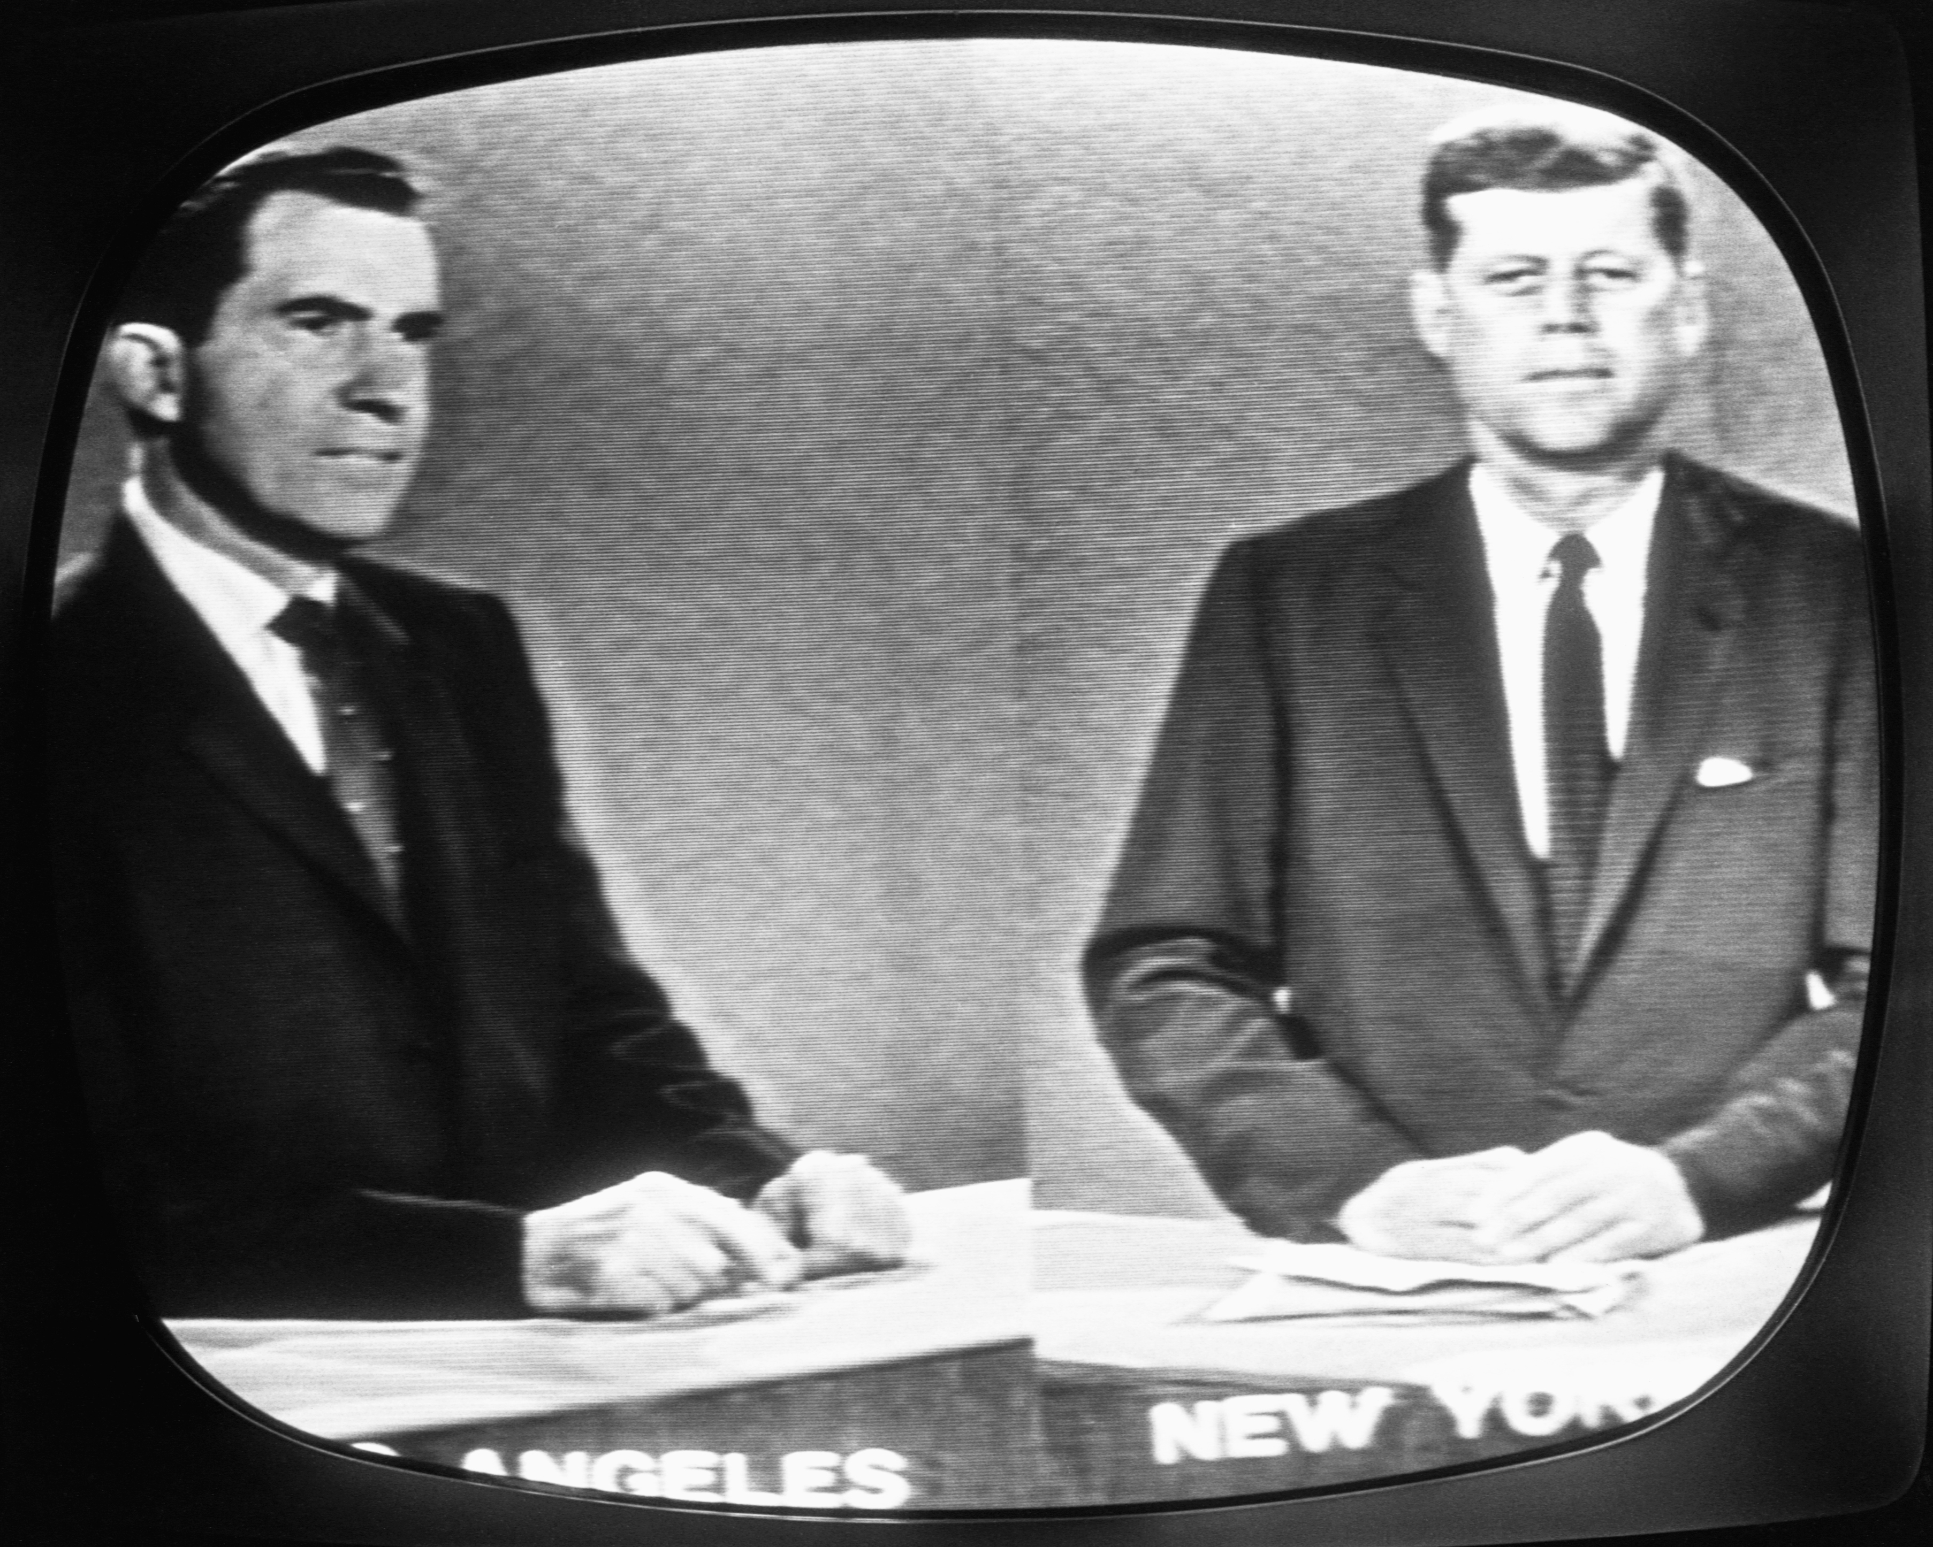
Mass Media
“It was that TV would prove so entirely in Kennedy’s favour that he would win the election. Without TV, Nixon had it made.”
- Marshall McLuhan, Understanding Media (1964), 287.

Slide 6
Mass Media
The threat of imminent war is discussed as if it were just another television show.
Mrs. Phelps: “It’s always someone else’s husband that dies, they say” (94).
Since war is experienced through media, it creates a perceived distance between it and the audience: it’s something that happens to somebody else.
  Frequent bomber flights are just background noise.
Discussion of war opens up a moment for possible genuine conversation: Mrs. Phelps mentions remarrying should her husband be killed.
  But this is immediately cut off when it instead reminds Mildred of a television show (95).

Slide 7
Mass Media
The criminal justice system is just spectacle.
  Role of the firemen is just to provide a theatrical display of state power.
    Faber: “You firemen provide the circus now and then at which buildings are set off and crowds gather for the pretty blaze, but it’s a small sideshow indeed, and hardly necessary to keep things in line” (87).
  Montag’s chase and execution is essentially a crime show to be consumed by the masses in their TV parlors.
    Montag watches his own chase and is distanced from the events: “It seemed so remote, and no part of him; it was a play apart and separate, wondrous to watch, not without its strange pleasure” (134).

Slide 8
Mass Media
Unlike Mildred in the teleplay, however, Montag doesn’t play the part as scripted, so a stand-in is unknowingly recruited and executed in his place.
Fulfills the narrative of the medium.
Granger: “They’re faking. … They know they can hold their audience only so long. The show’s got to have a snap ending, quick!” (148).
Executed man’s face is blurred: “They scramble it enough to let the imagination take over” (150).
  But this is no writerly text: the imagination’s response too is pre-scribed – it’s to be seen as Montag.

Slide 9
Alienation
Montag’s complaint to Faber: “Nobody listens any more. I can’t talk to the walls because they’re yelling at me. I can’t talk to my wife; she listens to the walls. I just want someone to hear what I say” (82).
Montag’s estrangement from his wife is indicated when he first enters the bedroom: described as “cold” like a “mausoleum” and with “the windows tightly shut” it is “a tomb world where no sound from the great city could penetrate” (11).
Isolation symbolized by the “Sea Shell” ear buds.
Montag and Mildred can’t remember how they met.
Estrangement glimpsed in the other families: mothers hate their children, couldn’t care if their husbands died.

Slide 10
Alienation
No genuine individual communication.
This is what sets Clarisse apart – she talks to Montag in a way that genuinely connects with him.
  Ironically, this capacity for feeling and contemplation is what deems her “antisocial” (29).
Clarisse’s simple question – “Are you happy?” (10) – is the catalyst for Montag’s awakening: it is an attempt to forge a deeper interpersonal relationship.
Comparison to Mildred: “she talked about this and that and it was only words”.
  Words without any thought or feeling: what Orwell would term “duckspeak”.

Slide 11
Remaking Society
Return to Oral Culture.
Literature has been preserved in the memories of the Harvard Hoboes.
With the demise of literature comes a reawakening of memory.
  Granger: “All of us have photographic memories, but spend a lifetime learning how to block off all the things that are really in there” (151).
Reversal of the identification of book with individual person.
  Rather than the book representing the author, now the reader represents the book – Granger: “I am Plato’s Republic. Like to read Marcus Aurelius? Mr. Simmons is Marcus” (151).

Slide 12
Remaking Society
Authors and their texts are the product of their readers.
  James Joyce: “My consumers, are they not my producers?”
  Text is produced by the reader’s activity with and within the text.
    Random Cloud: “The struggle for the text is tne text.”
    Roland Barthes: “The reader is the space on which all the quotations that make up a writing are inscribed without any of them being lost; a text’s unity lies not in its origin, but in its destination. … The birth of the reader must be at the cost of the death of the Author” (“The Death Of The Author”148).
    “Why is the writerly our value? Because the goal of literary production (of literature as work) is to make the reader no longer a consumer, but a producer of the text” (S/Z 4).

Slide 13
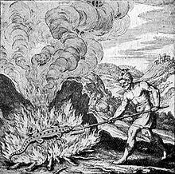
Remaking Society
Symbology of Fire
Salamander:
  Not the actual amphibian, but the legendary beast that was said to live in fire.
  Symbolizes the ability to resist destruction in fire.

Slide 14
Remaking Society
The Phoenix
  Legendary bird that would periodically die in fire, and then be reborn from its own ashes.
  Symbol of rebirth through destruction.
  “In monumental statuary, in pyramids of stone, and as mummies, the Egyptians sought eternal life; it seems only natural, then, that it should be Egypt where the myth of an immortal, periodic bird was born” (Borges 157).
  In the Firemen’s view, their stable, happy society is a phoenix born from the ashes of books.
  However, this society is also subject to fiery death in the atomic bombing.

Slide 15
Remaking Society
Possible rebirth opened up by the destruction of the nuclear war – a new re-literatized society will presumably be reborn from these ashes.
  Predicted by Faber (89).
Montag sees the exploded city as a phoenix: “And in that instant saw the city, instead of the bombs, in the air. They had displaced each other” (160).
Granger: awareness of history will enable them to break the cycle: “Someday we’ll stop making the goddamn funeral pyres and jumping in the middle of them” (163).
Fire as destructive force: likened to entropy (141).
Phoenix symbolizes how destruction is necessary part of the universe.

Slide 16
Remaking Society
Montag as Phoenix:
  Initial catalyst is Clarisse – presents him with a vision of genuine human connection.
  Sedition furthered by Faber.
    Montag – named after a paper company
    Faber – named after a pencil manufacturer
      Also: possibly a reference to the publishing company Faber & Faber
      “faber” – Latin for “artisan” or “workman” – same root as “fabricate”, “fabric” – text(ile)
      Similar etymology to “poesis” (“making”) – root of “poetry”
  Montag is the blank slate upon which Faber can inscribe his ideas.

Slide 17
Remaking Society
When he is caught being a reader, the process becomes irreversible.
Montag burns away his former life – destroys home and Captain Beatty.
But this destruction opens up the possibility of rebirth when he jumps in the river and emerges a new man (in Faber’s clothes).
When he joins the Harvard Hoboes, he becomes a man of letters.
He becomes the Book of Ecclesiastes and the Book of Revelations.
  Revelation: describes the rebirth of the world after the Apocalypse.
  Ecclesiastes: describes the best way of life in light of the fact that all will die.
  Final lines: “And the leaves of the tree were for the healing of nations” (165).

