Slide 1
William Morris
News From Nowhere

Slide 2
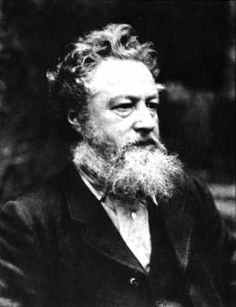
William Morris
Born 1834 into an upper-class family.
Studied theology at Oxford.
Read John Ruskin’s The Stones of Venice:
“You must either make a tool of the creature, or a man of him. You cannot make both. Men were not intended to work with the accuracy of tools, to be precise and perfect in all their actions. If you will have that precision out of them, and make their fingers measure degrees like cog-wheels, and their arms strike curves like compasses, you must unhumanize them. All the energy of their spirits must be given to make cogs and compasses of themselves.”

Slide 3
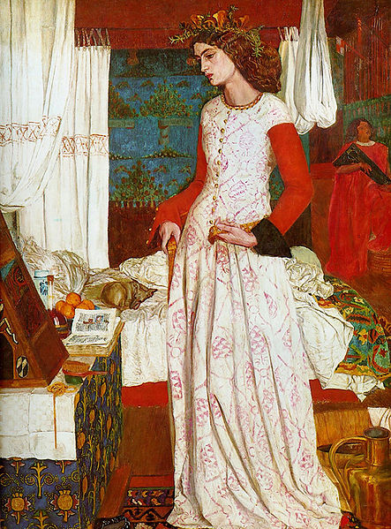
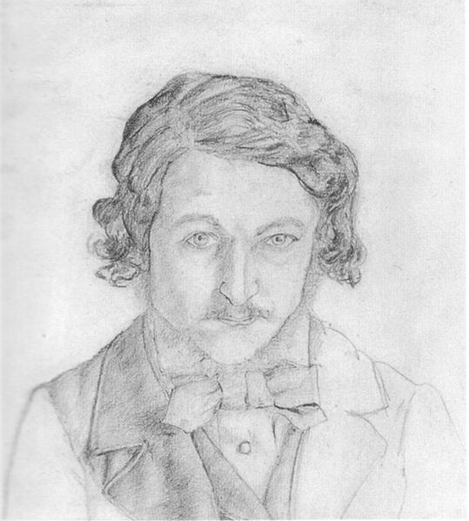
William Morris
These studies furthered Morris’s fascination with the mediaeval world; later on, he would learn Icelandic and translate several Icelandic sagas.
Associated with Pre-Raphaelites such as Dante Gabriel Rossetti and Edward Burne-Jones and began writing poetry in the 1850s.
In 1859, he married Jane Burden, a daughter of a stableman and a model for Rossetti.
Not a happy marriage, but they couldn’t divorce due to social pressure.

Slide 4
William Morris
In the 1860s, Morris became interested in design and the decorative arts and set up the company Morris, Marshall, Faulkner & Co. (aka The Firm).
Led to the development of the Arts & Crafts movement.
Inspired by Ruskin, they advocated traditional craftsmanship and use of mediaeval or folk styles of decoration in reaction to the increasingly ornate and artificial designs that were popular in the mid Nineteenth Century.
Not just an aesthetic movement, A&C also had political and social implications:
      Criticism of mechanized production as dehumanizing to individual craftsmen.
      Stood against needless luxury as well as cheap goods for mass markets.

Slide 5
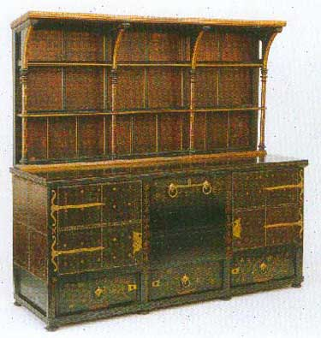
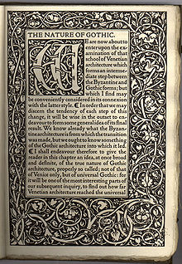
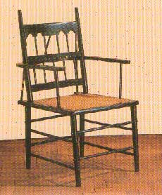
Arts & Crafts

Slide 6
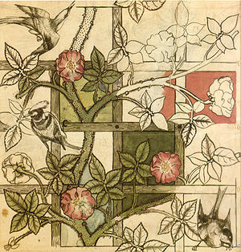
Arts & Crafts

Slide 7
Morris & Socialism
In the 1880s, Morris became more politically radical and switched from Liberal Party to socialism, and joined the Democratic Federation (later the Social Democratic Federation) in 1883.
The group was full of faction and by the end of 1884, a group of 10 of the Federation’s leaders – including Morris and Eleanor Marx – left to form the Socialist League.
The Socialist League published a journal called Commonweal edited and funded by William Morris.
Mixed group: the Socialist League included Fabian Socialists, Marxist Revolutionary Socialists, and Anarchists.
By 1888 the Anarchist faction began to outnumber the socialists which led to the dissolution of the group.
Morris himself left in 1890 (just after the publication of News From Nowhere) to form the Hammersmith Socialist Society.

Slide 8
Morris & Socialism
Unlike the Anarchists, who espoused a radical individualism, Morris still valued the concept of community: “As Socialists, we say, that society is embodied for two purposes, the increase of wealth by means of the combination and co-operation of the varying powers and capacities of men, and the equitable distribution of the wealth so produced.”
Being a member of a society means having a claim “to a full share of the sum of benefits produced by it.”
Contemporary capitalist society was not a true society: “The workers therefore, we repeat, are not a part of capitalist society, since they do not share in the wealth produced for it, they are but its machinery, and are not protected or sustained by it; for them it has ceased to be a society, and has become a tyranny; and it is a tyranny whose subjects are not an inferior race of feeble and incapable persons, but the useful part of the population.”

Slide 9
The Industrial Revolution
First begun in late 18th Century with technological developments in the weaving industry.
Steam-powered looms first appeared in the 1820s, relocating textile production from home handlooms to large factories, particularly in the north of England.
Led to creation of massive urban slums with poor sanitary conditions, intense overcrowding, and industrial pollution.
Second phase began in the 1840s with the expansion of rail networks which linked cities (and replaced canals as the primary means of transport) and stimulated the iron and coal industries.
In 1845, Friedrich Engels, a German who had gone to Manchester in Northern England to study the cotton industry, published his The Condition of the Working Classes in England in 1844 in which he documented his appal at the conditions of the urban, industrialized poor.

Slide 10
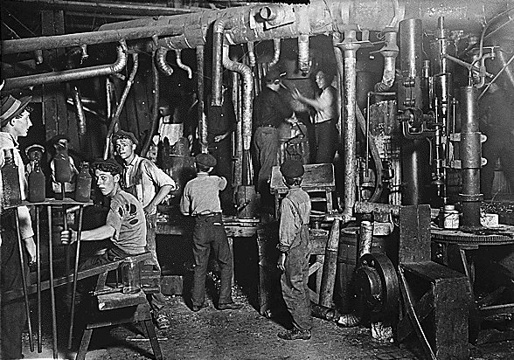
The Industrial Revolution

Slide 11
The Industrial Revolution
Engels noted how city design enabled the upper and middle classes to ignore the plight of the working class slums.
Benjamin Disraeli’s novel, Sybil, described England as “Two Nations” – the Rich and the Poor:
  “Yes, two nations; between whom there is no intercourse and no sympathy; who are as ignorant of each other’s habits, thoughts, and feelings, as if they were dwellers in different zones, or inhabitants of different planets; who are formed by a different breeding, are fed by different food, are ordered by different manners, and are not governed by the same laws.”

Slide 12
Past & Present
The rapid change from an agrarian rural economy to a machined, factory economy produced a reaction from various critics and writers that looked back to the old mediaeval order as a source of stability and harmony.
  Perhaps the clearest and most explicit example of this is Thomas Carlyle’s Past & Present.
Carlyle argued that contemporary society was breaking down as the traditional agrarian bonds of landowner and peasant were replaced with what he termed the “cash-payment nexus”.
“We call it a Society; and go about professing openly the totalest separation, isolation. Our life is not a mutual helpfulness; but rather, cloaked under due laws-of-war, named ‘fair competition’ and so forth, it is a mutual hostility.” (148)

Slide 13
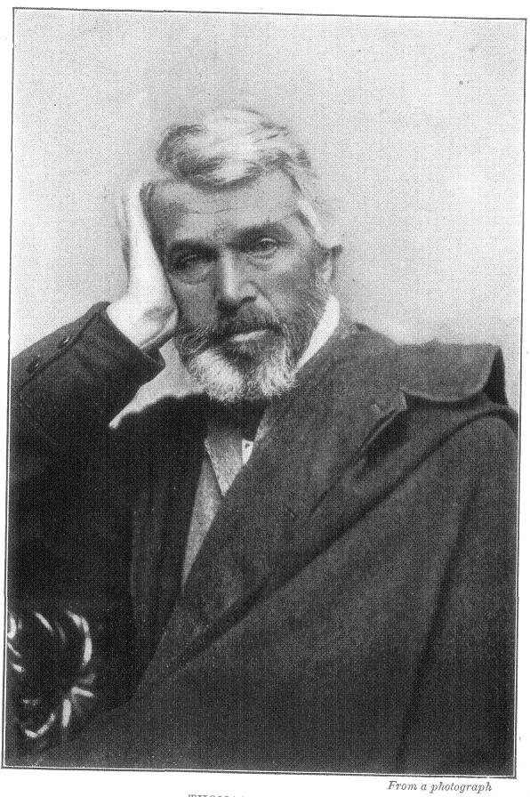
Past & Present
    In Past & Present, Carlyle contrasts this new world with his idealized vision of mediaeval life based on a 12th Century manuscript describing life in an East Anglian abbey.
    Feudal order a more natural way of organizing society as the nobility took care of poor:
      Lord = Law-ward
      Lady = hlaf-dig (loaf giver)
    Example of Gurth the Thrall:
      “Gurth is now ‘emancipated’ long since; has what we call ‘Liberty.’ Liberty, I am told, is a divine thing. Liberty when it becomes the ‘Liberty to die by starvation’ is not so divine!” (211)

Slide 14
Alienation of Labour
Carlyle saw immense value in work as an ennobling device, but the “Cash-payment nexus” produces alienated labour.
Marxist concept: Not being in control of the means of production, workers are alienated from the products they produce.
When a worker exchanges labour for wages, this labour becomes a commodity itself. Thus, the worker is alienated not only from the product, but from the labour process itself.
  “The alienation of the worker in his product means not only that his labour becomes an object, an external existence, but that it exists outside him, independently as something alien to him, and that it becomes a power of its own confronting him; it means that the life which he has conferred on the object confronts him as something hostile and alien” (Economic and Philosophic Manuscripts of 1844, 72).

