Slide 1
UTOPIA

Slide 2
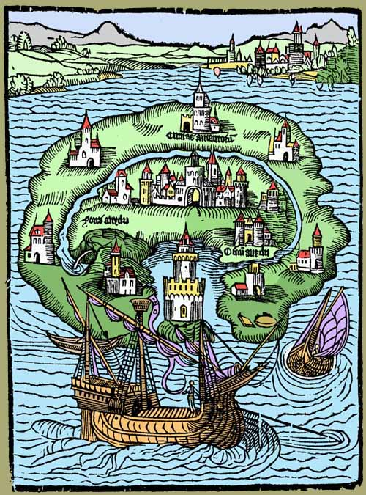
Geography
Conquered by Utopus (c.244 BCE)
Originally Abraxa
  A (no) + Brakae (breeches)
  = Sanscullotia
Why an island?
  Easier for defense
  Separates it from continent and the real world.
  Tradition of mystical islands in the Atlantic: Atlantis, Avalon, Isles of the Blessed, Thule, etc…
  Analogy for England

Slide 3
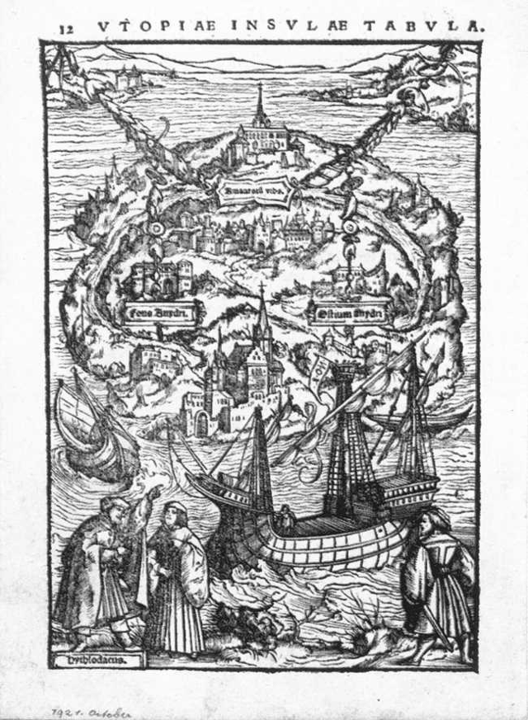
Geography
Conquered by Utopus (c.244 BCE)
Originally Abraxa
  A (no) + Brakae (breeches)
  = Sanscullotia
Why an island?
  Easier for defense
  Separates it from continent and the real world.
  Tradition of mystical islands in the Atlantic: Atlantis, Avalon, Isles of the Blessed, Thule, etc…
  Analogy for England

Slide 4
Politics
Organized around the family
  Master / Mistress + 40 others
  Patriarchal: governed by the oldest man
Magistrates
  “They affect rather to be called fathers” (61).
  Syphogrant (per 30 families)
    Supheos (pig sty) + kerantor (ruler) = Styward
  Tranibor (per 10 Syphogrants)
  Prince
    Selected from four candidates by 200 Syphogrants
  Syphogrants and Tranibors selected yearly by secret ballot; Prince rules for life.

Slide 5
Politics
Political decision making is relatively decentralized.
  Prince / Tranibors cannot impose tyranny.
  Key political decisions made by Syphogrants.
    Only “upon great occasions” is “the matter referred to the council of the whole island” (33).
    Later, we are told that the Great Council at Amaurot determines provisions indicating a centrally planned economy (42).
  Debates are not hurried: deliberated on over a period of several days.
    This ensures things aren’t decided to rashly: Moderation, “sober second thought”.

Slide 6
Work
Everyone practices agriculture.
  In addition, each individual has a specific art/trade.
  These arts are hereditary.
    But if someone demonstrates a particular nature, they are adopted into a family that practices that art.
Working Day:
  6 hrs of work (3 in am, 3 in pm).
  8 hrs of sleep
  10 hrs of “leisure”
    “Yet they are not to abuse that interval to luxury and idleness” (34).
    Reading, attending public lectures, “music or discourse”.
    Use this time to practice their secondary arts.

Slide 7
Economy
Rations determined by Great Council at Amaurot.
Goods distributed at “markets” in the centre of town.
  Really more like co-ops: people don’t trade, but take what they need.
  “No danger of a man’s asking for more than he needs; they have no inducements to do this, since they are sure they shall always be supplied” (38).
  Desire for more is motivated by pride: outlawed in Utopia.
    “Pride thinks its own happiness shines the brighter by comparing it with the misfortunes of other persons; that by displaying its own wealth, they may feel their poverty more sensibly” (84).
    Human nature “corrected” by legislation, though it is unclear how this is enforced.

Slide 8
Economy
No money is used in Utopia: gold and silver are used only to hire mercenaries.
Value is determined by use value, not exchange value.
  Hence, iron is valued more than gold.
  “The folly of men has enhanced the value of gold and silver, because of their scarcity” (43).
  Still, the Utopians have to be conditioned to not want gold and silver objects.
    Used to make toilets, chains for slaves, and children’s toys.
    Example of Anemolians: “They were set out with all those things that, among the Utopians, were either the badges of slavery, the marks of infamy, or the playthings of children” (44).
      Anemos (wind) = Flatulentines

Slide 9
Law
Simple legal code:
  “They have but few laws” (61).
  Simple wording means everyone can understand it.
  Eliminates need for lawyers “whose profession is to disguise matters” (61).
Except for adultery and premarital sex, no fixed punishments.
  Determined by Senate on a case-by-case basis.
  Main punishment is slavery.
    Serves public benefit.
    Is a visual deterrent.

Slide 10
International Relations
Set up colonies on the mainland to absorb excess population and repopulate Utopia in the event of some disaster.
  Assimilate natives if they wish to integrate into Utopian society.
  Otherwise, they are driven off the land.
Liberal foreign policy: overthrow tyrants.
Never enter into alliances.
  “They think leagues are useless things, and believe that if the common ties of humanity do not knit men together, the faith of promises will have no great effect” (62-3).
  Sarcastic reference to Europe’s habit of breaking treaties.
  Treaties presuppose hostility between nations.

Slide 11
International Relations
Distaste for war: “There is nothing more inglorious than that glory that is gained by war” (64).
  Use of cunning rather than strength.
    Conflict aimed at rulers rather than people (policy of assassination and inciting insurrection).
Utopian foreign policy aimed at enforcing justice.
  They punish fraudulent trade against friends by going to war.
Use of mercenaries: Zapolets
  Poletes (seller) = Venalians (Mercenaries)
  Avaricious and extravagant
  Utopians use them in order to “deliver the world from such a lewd and vicious sort of people” (68).

Slide 12
Philosophy
Focus on pleasure.
  Man is meant to be happy.
  Virtue motivated by desire for pleasure after death.
  Similarities to Epicureanism:
    School of philosophy based on the teachings of Epicurus (341-270 BCE).
    Believes the greatest happiness to be freedom from fear and bodily pain.
    Utopian’s greatest pleasure: “lively health” – the opposite of pain and sickness.
      All other bodily pleasures (eating, drinking, sex) are aimed at achieving this.

Slide 13
Philosophy
The aim of Utopian society is to maximize pleasure for all its citizens:
  “They infer that if a man ought to advance the welfare and comfort of the rest of mankind, there being no virtue more proper and peculiar to our nature, than to ease the miseries of others, to free from trouble and anxiety, in furnishing them with the comforts of life, in which pleasure consists” (48).
  Altruism is motivated by pleasure:
    1. will be repaid in kind
    2. self-satisfaction of having done “good”
    3. reward in afterlife

Slide 14
Philosophy
Similar to Utilitarian philosophy:
  “The ultimate end … is an existence exempt as far as possible from pain, and as rich as possible in enjoyments … This, being according to the utilitarian opinion, the end of human action, is necessarily also the standard of morality; which may accordingly be defined, the rules and precepts for human conduct, by the observance of which an existence such as has been described might be, to the greatest extent possible, secured to all mankind; and not to them only, but, so far as the nature of things admits, to the whole sentient creation.” (Mill, “Utilitarianism” 283)

Slide 15
Religion
Religious pluralism and toleration:
  Utopians worship a variety of things, but the majority worship an abstract monotheistic deity – “Father of All”: Mithras
  Universalist view of religion: all religions come from the same god “who might inspire men in a different manner, and be pleased with this variety” (73).
  Temples are non-denominational: “There is nothing to be seen or heard in their temples in which the several persuasions among them may not agree” (79).
  “Marketplace of ideas” – all viewpoints allowed so that through the strength of argument “the native force of truth would at last break forth and shine bright” (73).

Slide 16
Religion
Only viewpoint that is not tolerated is atheism.
  Seen as a danger to the stability of society.
  Not despised, but reasoned with to persuade them to forsake atheism.
Religion is valued not for its inherent truth, but its social utility.
  Various rituals undertaken during festivals are done “not out of any imagination that such oblations can add anything to the divine Nature, which even prayers cannot do; but as it is a harmless and pure way of worshipping God, as they think those sweet savours and lights, together with some other ceremonies, by a secret and unaccountable virtue, elevate men’s souls, and inflame them with greater energy and cheerfulness during the divine worship” (80).

Slide 17
Closing Remarks
Hythloday: Utopia is “the only commonwealth that truly deserves that name” (81).
  All things held in common.
  Republic = res (things) + publica.
  “All other governments that I see or know … are a conspiracy of the rich, who on pretence of managing the public only pursue their private ends” (82-3).
More’s thoughts:
  Seems absurd – largely because of the strange customs.
  But the biggest problem is the lack of private property, which More sees as unrealistic.
  Private property is the means “by which all nobility, magnificence, splendor, and majesty, which, according to the common opinion, are the true ornaments of a nation” (84).

