Slide 1
Sir Thomas More
UTOPIA

Slide 2
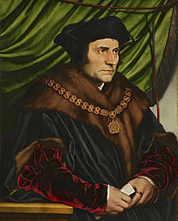
Biography
Born February 7, 1478; Died July 6, 1535
1490-2: served as a page for John Morton.
After attending Oxford, he was called to the bar in 1502.
Considered leaving public life to become a
monk.
First married in 1505; had three daughters and a son.
Took an interest in the education of women.
1514: appointed to Privy Council.
1523: elected Speaker of the House of Commons.
1529: became Lord Chancellor after the fall of Cardinal Wolsey.

Slide 3
Biography
A staunch Catholic, More believed the Reformation to be heresy.
Resigned Chancellorship in 1532 due to his inability to support Henry VIII’s break from Rome.
Refused to take the Oath of Supremacy and was imprisoned in the Tower of London.
Put on trial on July 1, 1535 and sentenced to death.
Executed July 6, 1535.

Slide 4
Utopia
Written 1515-1516 while More was an envoy for the King in Flanders.
First published in Holland by Erasmus in 1516.
  More had a revised version published in 1518.
First English translation in 1551.
Though not included in our edition, Utopia is often prefaced with two fake letters.
The letters are intended to make the story more plausible.

Slide 5
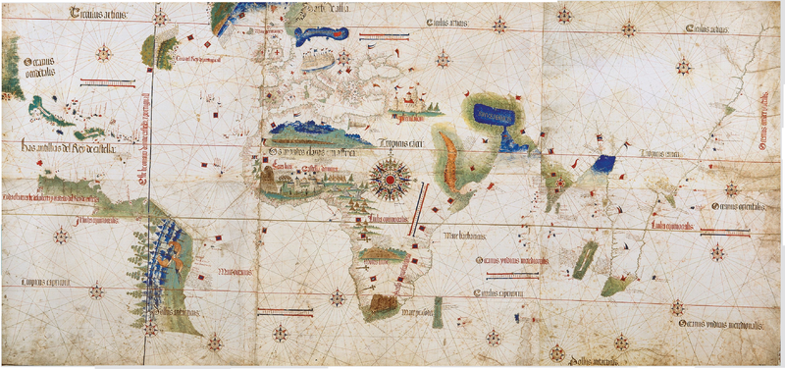
Utopia: Context
First paragraph describes More’s visit to Antwerp.
  More did actually go to Antwerp at this time.
  Antwerp was a centre of international trade during the Age of Exploration and was a very cosmopolitan city.

Slide 6
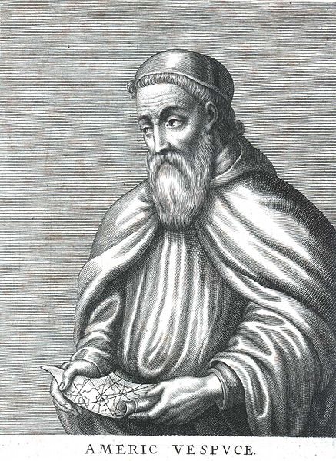
Amerigo Vespucci
Hythloday’s travels are grafted on to the New World discovery acccounts of Amerigo Vespucci.
Vespucci claimed to have made four voyages to the New World between 1497 and 1504 in two letters attributed to him.
Whether Vespucci actually made those voyages is now in dispute.

Slide 7
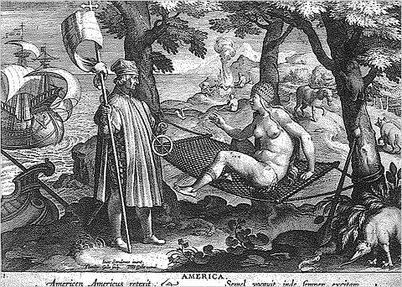
Amerigo Vespucci
Whereas Columbus’s accounts described the vast wealth of the “Indies”, Vespucci’s letters titillated Europeans with tales of cannibalism and free sexuality of the natives.

Slide 8
Amerigo Vespucci
These letters were bestsellers for the early printing industry and spurred European interest in the New World.
  Indeed, Vespucci’s first letter, Mundus Novus, coined the term “New World”.
  A German printer, Martin Waldseemüller, produced a map of the world in 1507 with the New World, which he called “America” in honour of Vespucci.

Slide 9
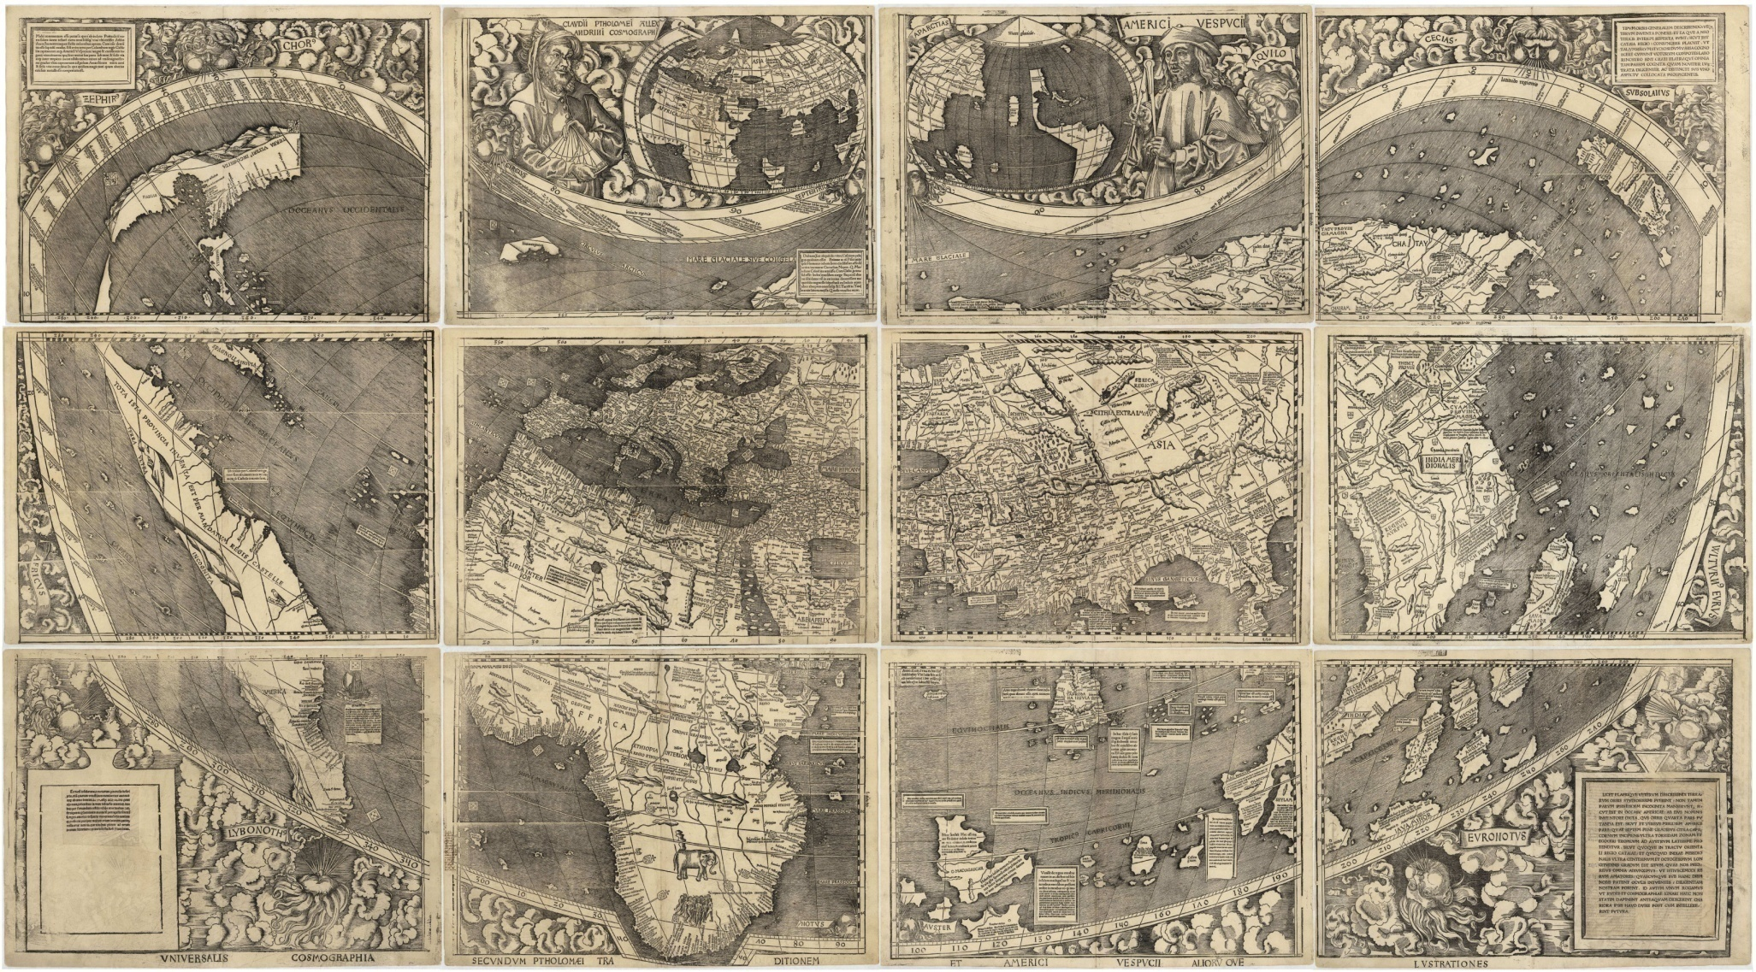
Waldseemüller’s Map (1507)

Slide 10
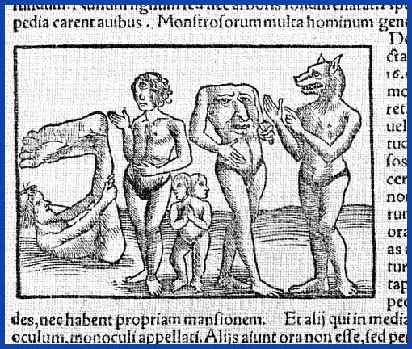
“Fantastical Travellers’ Tales”
Antecedents:
Pliny’s Natural History
The Travels of Sir John Mandeville

Slide 11
Raphael Hythloday
Raphael:
  Hebrew for “God has healed”.
  Appears in the Book of Tobit as an angelic guide who cures Tobit’s blindness.
Hythloday:
  From Hythlodaeus
  Hythlo (nonsense) + daio (to distribute)
Safety of second-hand narrator: allows More to put unorthodox views into the mouth of a fictional character.
  The Utopian poetry extract reveals “he” to mean “I” in the Utopian language

Slide 12
Utopia: Book I
Though Hythloday has all sorts of stories, More and Giles are most interested in his descriptions of “civilized nations”.
  “We asked him many questions concerning all these things, to which he answered very willingly; only we made no inquiries after monsters, than which nothing is more common; for everywhere one may hear of ravenous dogs and wolves, and cruel men-eaters; but it is not so easy to find states that are well and wisely governed.” (4)
  Aim of the book: “… so he reckoned up not a few things from which patterns might be taken for correcting the errors of these nations among which we live” (4).

Slide 13
Utopia: Book I
More uses Hythloday to critique European (and, in particular, English) society.
Hythloday’s critique of the death penalty for theft:
  Equates human life with money.
  Encourages murder (to dispose of witnesses).
  Doesn’t address the causes of theft: economic inequality.
Debate widens in scope from a simple question of what to with thieves to the larger issue of social justice.

Slide 14
Roots of Economic Inequality
Parasitic noblemen
Danger of standing armies
Increase in pasture (enclosure)
Extravagant luxury

Slide 15
Hythloday’s Suggestion
Follow the example of the Polylerits.
Polylerits:
  Polus (much) + leros (nonsense)
  = Tallstorians
Theft is punished by paying restitution to victim and working as a slave for the public.
  “Repairing the injuries they have formerly done to society” (14).

Slide 16
Hythloday as Philosopher
More and Giles try to persuade Hythloday to use his wisdom by advising kings. Hythloday refuses:
  Princes are not concerned with governing, only war.
  Wants to avoid court rivalries and intrigues.
  Has learned from Plato: his ideas are too radical for European courts and would be laughed at.

Slide 17
Hythloday as Philosopher
Critique of Imperialism:
  Example of Achorians.
    Achoria: a (not) + chora (country)
    = Nolandia
  Caring for two kingdoms distracts King from governing properly.
  Improvement of kingdom is more important than expansion.

Slide 18
Hythloday as Philosopher
Critique of Fiscal Policy
  Aimed at making the King rich and not the country.
  Some of the charges Hythloday makes were real policies used by European kings, notably Henry VII.
  Example of Macarians
    Macarians: makar (happy)
    = Happilanders
  King cannot possess more than 1000 pounds of gold (or equivalent value).

Slide 19
Hythloday as Philosopher
Conclusion: “There is no room for philosophy in the Courts of Princes” (22).
More’s answer: “Yes, there is, but not for this speculative philosophy that makes everything to be alike fitting at all times: but there is another philosophy that is more pliable, that knows its proper scene, accommodates itself to it, and teaches a man with propriety and decency to act the part which has fallen to his share.” (22)

Slide 20
Hythloday as Philosopher
More is arguing for a moderation of philosophy.
Moderated reform is preferable (and more practical) than radical overhaul.
More understands the limits of political reform:
  “For except all men were good everything cannot be right, and that is blessing that I do not at present hope to see” (22).
Hythloday counters with reference to Christianity as being just as radical as his Utopian suggestions.

Slide 21
Hythloday as Philosopher
Despite More’s insistence that injustice is ultimately unavoidable, Hythloday announces the foundational principle of Utopia that allows it to be just society:
  No private property.
  Without abolishing property, all reforms treat the symptoms of injustice rather than curing the cause.
More takes a more realist view:
  Men need to be spurred by the “hope of gain.”
  Need inequality: social hierarchy provides order and stability.

Slide 22
Kant: “To Eternal Peace”
Whether the above satirical inscription, once put by a certain Dutch innkeeper on his signboard on which a graveyard was painted, holds of men in general, or particularly the heads of states who are never sated with war, or perhaps only of those philosophers who are dreaming that sweet dream of peace, may remain undecided. However, in presenting his ideas, the author of the present essay makes one condition. The practical statesman should not, in case of a controversy with the political theorist, suspect that any danger to the state lurks behind the opinions which such a theorist ventures honestly and openly to express. Consistency demands this of the practical statesman, for he assumes a haughty air and looks down upon the theorist with great self-satisfaction as a mere theorizer whose impractical ideas can bring no danger to the state, since the state must be founded on principles derived from experience. The worldly-wise statesman may therefore, without giving himself great concern, allow the theorizer to throw his eleven bowling balls all at once. By this “saving clause” the author of this essay knows himself protected in the best manner possible against all malicious interpretation.

Slide 23
Kant: “To Eternal Peace”
Whether the above satirical inscription, once put by a certain Dutch innkeeper on his signboard on which a graveyard was painted, holds of men in general, or particularly the heads of states who are never sated with war, or perhaps only of those philosophers who are dreaming that sweet dream of peace, may remain undecided. However, in presenting his ideas, the author of the present essay makes one condition. The practical statesman should not, in case of a controversy with the political theorist, suspect that any danger to the state lurks behind the opinions which such a theorist ventures honestly and openly to express. Consistency demands this of the practical statesman, for he assumes a haughty air and looks down upon the theorist with great self-satisfaction as a mere theorizer whose impractical ideas can bring no danger to the state, since the state must be founded on principles derived from experience. The worldly-wise statesman may therefore, without giving himself great concern, allow the theorizer to throw his eleven bowling balls all at once. By this “saving clause” the author of this essay knows himself protected in the best manner possible against all malicious interpretation.

Slide 24
Poetry and “Truth”
The fictional Hythloday is a stand-in for More.
Fiction is used to express a deeper truth.
Sir Philip Sidney: “An Apology For Poetry” (1580-1/1595):
  Poetry and philosophy aren’t opposed, but work together.
  Poetry makes philosophy amenable to masses: “But the poet is the food for the tenderest stomachs, the poet is indeed the right popular philosopher.”
  Emotional appeal of poetry makes it useful “Moving is of a higher degree than teaching, it may by this appear that is well nigh the cause and the effect of teaching. For who will be taught if he be not moved with desire to be taught.”

