Slide 1


Motivation at Work
Chapter 5

Slide 2

Motivation
The set of processes that arouse, direct, and maintain human behavior toward attaining some goal.
Components:
  Arousal
  Direction
  Maintenance

Slide 3
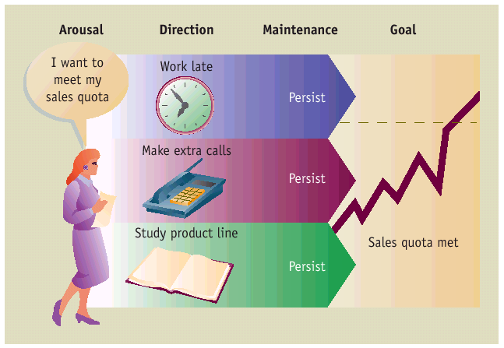
Components of Motivation

Slide 4
MOTIVATIONAL THEORIES
Needs Theories
  Identify variables within the individual, typically deficiencies, that give rise to motivation
  Maslow, ERG, McClelland, Herzberg
Process Theories
  Identify how internal factors interact with the environment to influence motivation
  Adams’ equity theory, Expectancy theory
Notes:
3

Slide 5

Content (Need) Theories of Motivation:
Maslow
Alderfer
McClelland
Herzberg

Slide 6
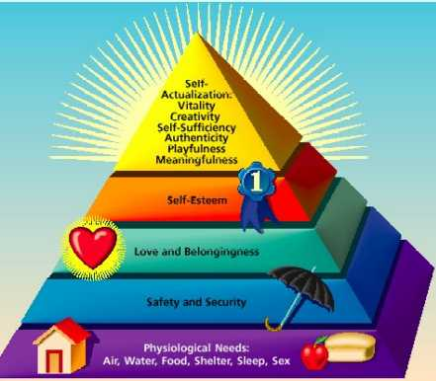
Maslow’s Theory
Specifies that there are five human needs and that these are arranged in such a way that lower, more basic needs must be satisfied before higher-level needs become activated.

Slide 7
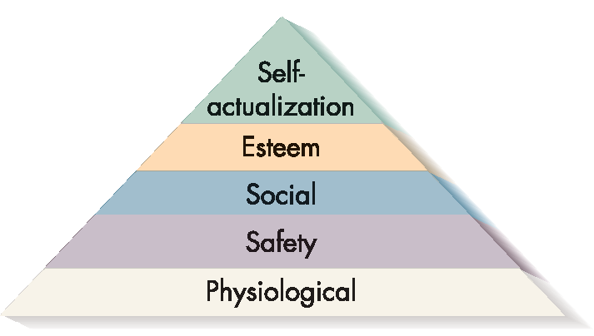
Maslow’s Hierarchy of Needs

Slide 8

Deficiency Needs
The needs that must be met in order for people to develop in a healthy fashion.
Physiological: Fundamental biological drives, such as the need for food, air, water, and shelter.
Safety: The need for a secure environment and to be free from threats of physical or psychological harm.
Social: The need to be affiliative – that is, to have friends, and to be loved and accepted by other people.

Slide 9

Growth Needs
The needs that must be met in order for a person to reach his or her full potential.
Esteem: The need to develop self-respect and to gain the approval of others.
Self-Actualization: The need to discover who we are and to develop ourselves to the fullest potential.

Slide 10

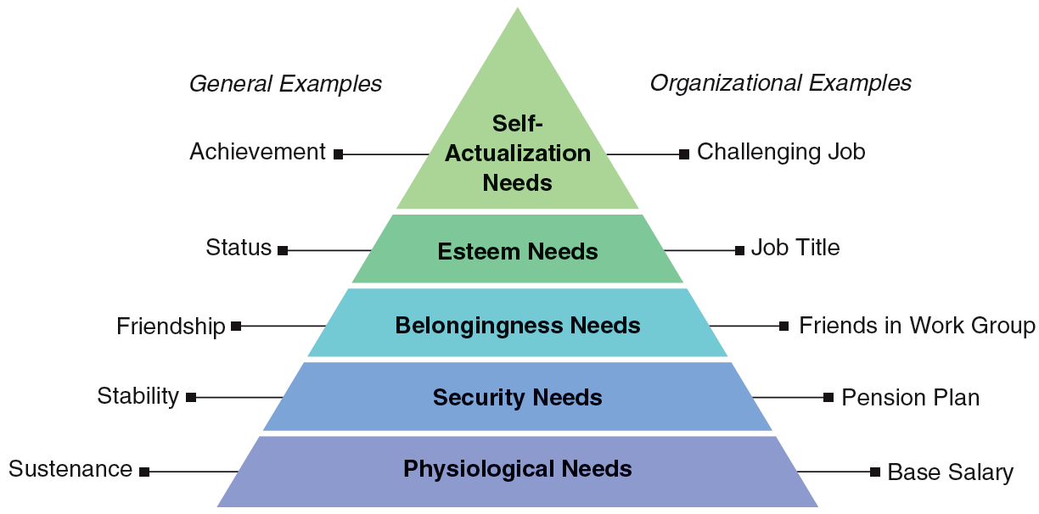

4.2 The Hierarchy of Needs
Reference: Adapted from Abraham H. Maslow, “A Theory of Human Motivation,” Psychological Review, 1943, vol. 50, pp. 374–396.

Slide 11

Maslow- Basic Principles
1. Lowest level unsatisfied need: greatest motivating potential.
2. Once needs at a particular level are satisfied, they are no longer motivating (deficit principle).
3. Needs exist in a strictly ordered hierarchy. A need at one level becomes activated only when needs at lower levels are satisfied (progression principle).

Slide 12
Alderfer’s ERG Theory
Growth
Relatedness
Existence
Notes:
10

Slide 13
ERG Theory (Clayton Alderfer)
Assumptions:
  More than one need may motivate a person at the same time
  frustration-regression –Frustration of a higher-level need can lead to efforts to satisfy a lower-level need

Slide 14
McClelland’s Need Theory
3main categories of learned needs
Achievement
Power
Affiliation
Andresr/ShutterStock

Slide 15
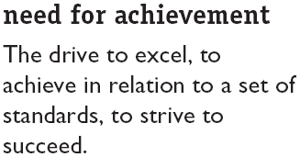
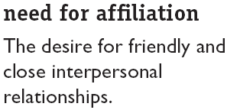
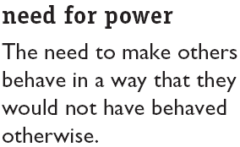
McClelland’s Theory of Needs
nPow
nAch
nAff

Slide 16
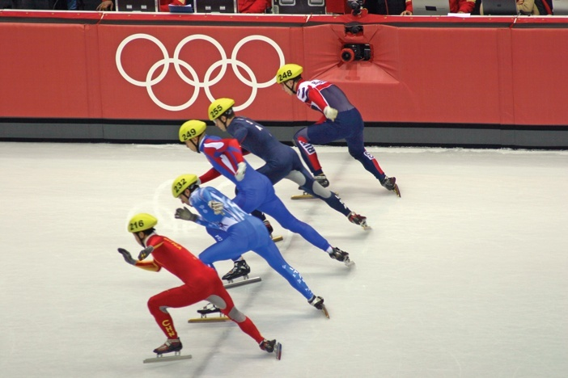

Need for Achievement McClelland
Characteristics of High Need for Achievement (Nach):
  1. Set realistic goals
  2. Desire feedback
  3. Motivated by intrinsic reinforcement
  4. Persistent

Slide 17

Intrinsic Motivation
Motivation that stems from the direct relationship between the worker and the task and is usually self-applied.
Examples include:
  Feelings of achievement, accomplishment, challenge, and competence derived from performing one’s job, and the sheer interest in the job itself.

Slide 18

Extrinsic Motivation
Motivation that stems from the work environment external to the task. It is usually applied by others.
Examples include:
  Pay, fringe benefits, company policies, and various forms of supervision.

Slide 19

Herzberg’s Two-Factor Theory
.
Hygiene factors
  contribute to employee
  not feeling dissatisfied
  contribute to absence of
  complaints
Motivation factors
  contribute to employee feeling satisfied
  lead to superior performance
  & effort
Both are work conditions, but each addresses a different part of an employee’s experience

Slide 20
Motivation–Hygiene Theory
Company policy and
administration
Supervision
Interpersonal relations
Working conditions
Salary
Status
Security
Motivation factors increase job satisfaction
Achievement
Achievement recognition
Work itself
Responsibility
Advancement
Growth
Salary?
Hygiene factors avoid job dissatisfaction
Notes:
13
10
SOURCE: Adapted from Frederick Herzberg, The Managerial Choice: To be Efficient or to Be Human. (Salt Lake City: Olympus, 1982). Reprinted by permission.
Questions/criticisms on Herzberg’s theory:
Is salary a hygiene or a motivational factor?
What role do individual differences (age, sex, social status, education) play?
What role do intrinsic job factors like work flow process play?

Slide 21
Process Theories of Work Motivation
Motivation theories that specify the details of how motivation occurs.
  Equity theory
  Expectancy theory

Slide 22
Equity Theory
Individuals are motivated by a sense of fairness in rewards distribution
This sense of fairness results from a social comparison with others, i.e., the referent(s)

Slide 23
Equity Theory (cont’d)
The social comparison process (reminder):
Your reward
(money, recognition, perks…)
His/her reward
You: Referent Other:
Outcomes vs. Outcomes
Inputs Inputs
Your contribution
(loyalty, education, effort, training, skills…)
His/her contribution

Slide 24
Equity Theory
States that job satisfaction stems from a comparison of the inputs one invests in a job and the outcomes one receives in comparison to the inputs and outcomes of another person or group.

Slide 25
Distributive Fairness
  Fairness in who gets what
  Fairness that occurs when people receive what they think they deserve from their jobs.

Slide 26
Procedural Fairness
Fairness in HOW THINGS ARE DONE
Fairness that occurs when the process used to determine work outcomes is seen as reasonable.
It is concerned with how outcomes are decided and allocated.

Slide 27
Procedural Fairness
Occurs when the employer:
  Gives adequate reasons for his/her decisions
  Follows consistent procedures
  Uses accurate information and appears unbiased
  Allows two-way communication during the allocation process
  Welcomes appeals of the procedure or allocation

Slide 28
Interactional fairness
Fairness in how people are treated
Are employees treated with politeness, dignity, and respect?

Slide 29
Correcting Inequity Feelings
Actions to correct inequity
Example
Reduce our inputs | Less organizational citizenship
Increase our outcomes | Ask for pay increase
Increase other’s inputs | Ask coworker to work harder
Reduce other’s outputs | Ask boss to stop giving other preferred treatment
Change our perceptions | Start thinking that other’s perks aren’t really so valuable
Change comparison other | Compare self to someone closer to your situation
Leave the field | Quit job

Slide 30
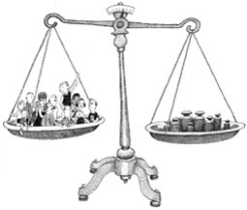
COMPARABLE WORTH

Slide 31
Comparable worth
Focuses on paying an entire profession or occupation the same wage rate as a second profession or occupation, both of which are determined by some outside authority to be of the same value to an employer.

Slide 32
Pay Difference Explanations
Firm Differences
Strategy
Technology
Size
Ability to Pay
Pay Policy
Employee
Education
Seniority
Qualifications
Union
Membership
Employee
Differences
Performance
Absenteeism
Turnover
Pay Differences
Discrimination
Labor
Market
Work Differences
Skill, effort, responsibility,
working conditions

Slide 33
Job Evaluation Point System
Points are awarded for different job criteria:
  skill
  effort
  responsibility
  working conditions

Slide 34

Expectancy Theory (Victor Vroom
Focuses on personal perceptions of the performance process:
What do I have to do?
Can I achieve it?
What happens when I am successful?
Is it worth the effort?
Stock Connection/Jupiter Images

Slide 35
Expectancy Theory (Victor Vroom)
A process theory that states that motivation is determined by the outcomes that people expect to occur as a result of their actions on the job.

Slide 36
EXPECTANCY THEORY
Expectancy
Instrumentality
Effort
Perform-ance
Outcome
Valence
Motivated?
E➔P Expectancy:
Can I achieve desired level of performance?
P➔O Instrumentality: If I perform at that level, what will happen? What work outcomes will be achieved?
Valence: How much do I value the outcomes?
M= E x I x V

Slide 37

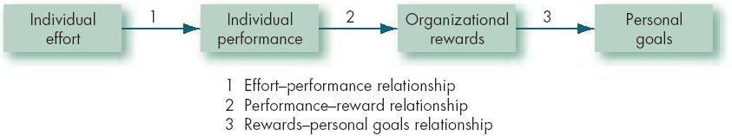
Expectancy Theory
Two questions:
  Can I achieve the goal?
  How attractive are the outcomes?

Slide 38
Factors that Influence and Employee’s Expectancy Perceptions
9-15
Self-efficacy (self-confidence)
Previous success at the task
Help received from a supervisor and subordinates
Information necessary to complete the task
Good materials and equipment to do work with

Slide 39
Strengthening the Link between Effort and Results
Managers can:
match people to jobs & tasks.
provide training, resources & support so employees believe they can be successful.
respond to strong, moderate, and weak performances differently.
be sensitive to the valence of various rewards to individuals and use appropriate rewards.

