Slide 1

Attitudes Emotions & Ethics
Chapter 4

Slide 2
Attitudes
Attitudes
Evaluative statements or judgments concerning objects, people, or events.
Cognitive component
The opinion or belief segment of an attitude.
Affective Component
The emotional or feeling segment of an attitude.
Behavioral Component
An intention to behave in a certain way toward someone or something.

Slide 3
Model of an Attitude
B
A
C
A
FFECT
How the person feels about the target; the emotional component
I don’t like my boss
I want to transfer to another department
B
EHAVIOURAL
INTENTIONS
What the person intends to do as result of feelings and beliefs
What the person thinks about the target; perceptions, beliefs
I believe my boss plays favourites
C
OGNITION
Notes:
3
SOURCE: Adapted from M. J. Rosenberg and C. I. Hovland, “Cognitive,
Affective, and Behavioral Components of Attitude,” in M. J. Rosenberg, C. I. Hovland, W. J. McGuire, R. P. Abelson, and J. H. Brehm, Attitude Organization and Change (New Haven, Conn.: Yale University Press, 1960). Copyright 1960 Yale University Press. Used with permission.

Slide 4
What Is Job Satisfaction?
A collection of attitudes that workers have about their jobs.
Facet satisfaction refers to the tendency for an employee to be more or less satisfied with various facets of the job.

Slide 5

Psychological Contract
Based on a mutual understanding between employee and employer about their reciprocal expectations.

Slide 6
MEASUREMENTS OF JOB SATISFACTION
Job Descriptive Index (JDI) is a questionnaire designed around five facets of job satisfaction which includes:
  Work
  People
  Promotions
  Supervision
  Pay

Slide 7
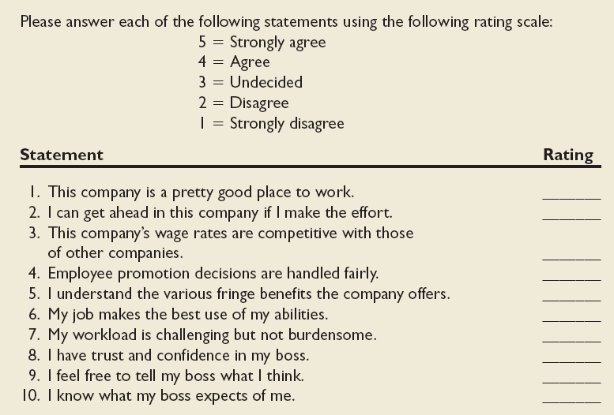
Sample Attitude Survey

Slide 8

Influences on Satisfaction
Depends on individual
  Personality,
  education, needs
Commonly linked to:
  Interesting work
  Relations with management
  Coworker support
  Pay & security
Andresr/Shutterstock
Notes:
6

Slide 9
Discrepancy Theory
A theory that job satisfaction stems from the discrepancy between the job outcomes wanted and the outcomes that are perceived to be obtained.

Slide 10
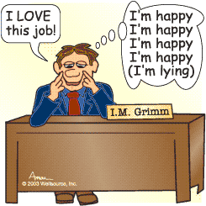
Disposition
The dispositional view of job satisfaction is based on the idea that some people are predisposed by virtue of their personalities to be more or less satisfied with their job.

Slide 11

Consequences of Job Satisfaction
  Absence from work
  Turnover
  Mental & physical health
  Performance(not a strong predictor)
  Organizational citizenship behaviour
  Customer Satisfaction

Slide 12
Job Satisfaction and Customer Satisfaction
Satisfied employees increase customer satisfaction because:
  They are more friendly, upbeat, and responsive.
  They are less likely to turnover which helps build long-term customer relationships.
Dissatisfied customers increase employee job dissatisfaction.

Slide 13

Job satisfaction
leads to
Organizational Citizenship Behaviour OCB)
©Lise Gagne/iStockPhoto
  OCB: behaviour above and beyond the call of duty
  Workplace deviance: voluntary counterproductive behaviour that violates norms & causes some harm

Slide 14
Organizational Citizenship Behaviour (OCB)
Behaviour that is above and beyond the call of duty.
  Ex: helping co-workers, encouraging others
Job satisfaction is strongly related to OCB.

Slide 15

Job (Dis)satisfaction
[Dissatisfied Workers]
©Angel Herrero de Frutos/iStockPhoto
Skip work
Quit
Report more psychological and medical problems
Leads to workplace deviance

Slide 16

Workplace Deviant Behaviour

Slide 17
Production Deviance
Leaving early
Taking excessive breaks
Intentionally working slow
Wasting resources
2

Slide 18
Property Deviance
Sabotaging equipment
Accepting kickbacks
Lying about hours worked
Stealing from company
2

Slide 19
Political Deviance
Showing favoritism
Gossiping about coworkers
Blaming coworkers
Competing nonbeneficially
2

Slide 20
Personal Aggression
Sexual harassment
Verbal abuse
Stealing from coworkers
Endangering coworkers
2

Slide 21
Normative
Commitment
Perceived
obligation
to remain
Affective
Commitment
Desire
to
remain
Organizational
Commitment
The strength of an
individual’s
identification with
an organization
WORK ATTITUIDES
C0MMITMENT
Continuance
Commitment
Cannot afford
to leave

Slide 22
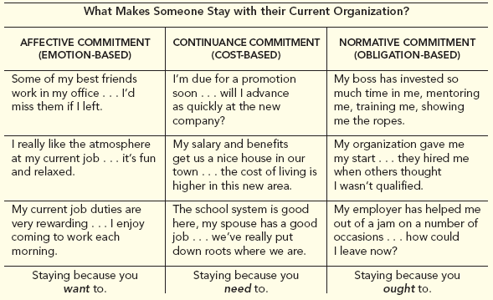
Three Types of Organizational Commitment
Table 3-1

Slide 23
Emotional Intelligence
A set of abilities related to the understanding and management of emotions in oneself and others

Slide 24
More potent predictors of career success ARE
Ability to handle frustrations
manage own emotions
manage own social skills
Do you know any highly intelligent
people who aren’t socially adept?

Slide 25

Emotional Intelligence
self-awareness,
self-regulation,
motivation,
empathy,
social skill.
Kurhan/Shutterstock

Slide 26
Model of Emotional Intelligence
Highest
Relationship Management
Managing other people’s emotions
Social Awareness
Perceiving and understanding the meaning of others’ emotions
Self-management
Managing our own emotions
Self-awareness
perceiving and understanding the meaning of your own emotions
Lowest

Slide 27
Emotional Contagion
The tendency for moods and emotions to spread between people or throughout a group.
Teams experiencing more positive affect tend to be more cooperative, helpful, and successful, all of which contributes to job satisfaction.

Slide 28
Emotional Regulation
The requirement for people to conform to certain “display rules” in their job behaviour in spite of their true mood or emotions.

Slide 29
Attitudes and Attitude Change

Slide 30
Changing Attitudes
The traditional approach to organizational attitude-change programs is to first change beliefs and/or values in order to change attitudes and behaviour.
Cognitive dissonance theory suggests an alternative approach.

Slide 31
Cognitive Dissonance Theory
Cognitive dissonance refers to a feeling of tension experienced when certain cognitions are contradictory or inconsistent with each other.
Dissonance theory suggests that it might be possible to change a person’s attitudes by first changing their behaviour.

Slide 32
Cog. Dissonance(2)
Dissonance produces tension
Reducing Dissonance ⬇ reduces tension
Change the behaviour
Change the attitude
External Justification ⬇ reduces dissonance

Slide 33
Cog. Dissonance(3)
Teach individuals specific behaviours that they can apply on the job that correspond to the desired attitude change.
When trainees find these behaviours to be effective they will change their attitudes to correspond to the newly learned behaviours.

Slide 34

Ethical Behaviour
Acting consistently with one’s personal values and the commonly held values of the organization and society.

Slide 35
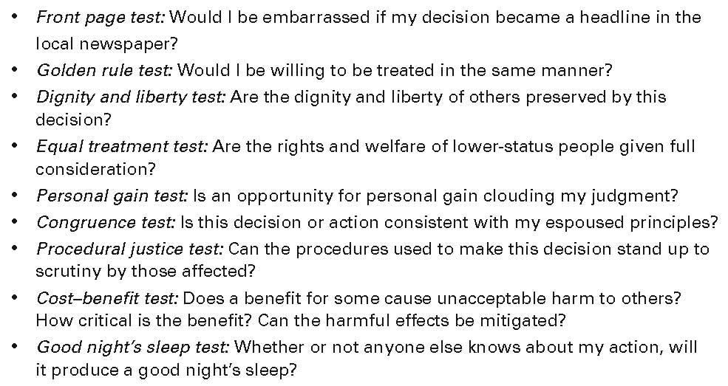
Guidelines for Ethical Decision Making

Slide 36
The Need for Corporate Ethics Programs
Organizations should develop an organizational ethics program by establishing, communicating, and monitoring uniform ethical values and legal requirements
A strong ethics program includes:
  Written code of conduct
  Ethics officer to oversee the program
  Care in the delegation of authority
  Formal ethics training
  Auditing, monitoring, enforcement, and revision of program standards

Slide 37

Corporate Codes of Ethics
Often contain six core values
  Trustworthiness
  Respect
  Responsibility
  Fairness
  Caring
  Citizenship
Source: Triangle Images

