Slide 1


Personality, Perception and Attribution
Chapter 3

Slide 2
PERCEPTION:
“The process through which people select, organize and interpret information from their environment”
Selection: a filtering process
Organization and interpretation: a creative process

Slide 3
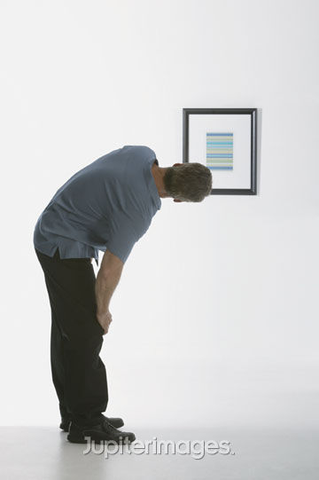
Components of perception
Perceiver
(personality, experience, needs, emotions?)
Target
(what info is provided? clear or ambiguous?)
All 3 influence the perceiver’s impression of the target
Situation
(setting adds info about the target?)
© 2010 Jupiterimages Corporation

Slide 4
The Perceiver
Past experiences lead the perceiver to develop expectations that affect current perceptions. = Perceptual set
Needs unconsciously influence perceptions by causing us to perceive what we wish to perceive.
Emotions, such as anger, happiness, or fear, can influence our perceptions.

Slide 5
Perceptual Defence
The tendency for the perceptual system to defend the perceiver against unpleasant emotions.
People often “see what they want to see” and “hear what they want to hear.”

Slide 6
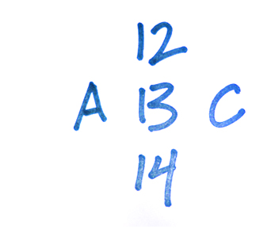
The Situation
Perception occurs in some situational context, and this context can affect what is perceived.

Slide 7
The Target
The target involves interpretation and addition of meaning
Demographic information- ex: age, status, appearance

Slide 8
PERCEPTUAL ERRORS barriers to social perception:
Stereotypes
Halo Effect
Projection
Primacy/Recency Effect
Self-fulfilling Prophecy
For other errors see text

Slide 9
Stereotyping
The tendency to generalize about people in a social category and ignore variations among them.
Categories on which people might base a stereotype include race, age, gender, ethnic background, social class, occupation, and so on.

Slide 10
Stereotyping (continued)
Stereotypes help us develop impressions of ambiguous targets.
Most stereotypes are inaccurate, especially when we use them to develop perceptions of specific individuals.

Slide 11
Stereotypes in Business
Gender
Age

Slide 12
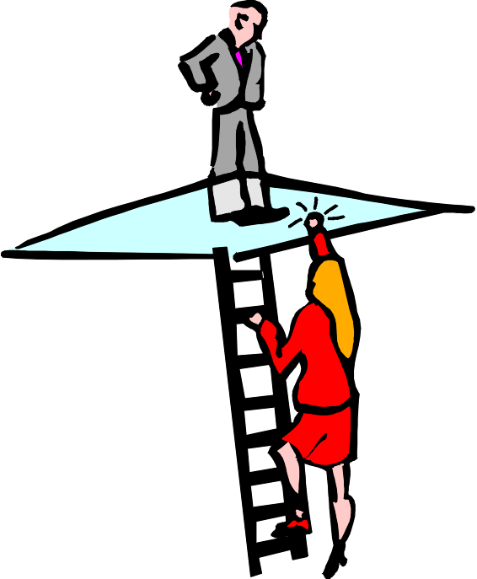
The Glass Ceiling

Slide 13
The GLASS CEILING
WOMEN: barriers to progress
Lack of role models in business
  traditional job stereotypes
No track record
  Hiring through the “old boys network”
Feeling isolated/little peer support
  Little advice, “sponsorship”

Slide 14
barriers to progress … (2)
Concentrated in areas not leading to upper level positions
  assigned to less visible jobs
“Invisible Women” syndrome
  difficulty showing competence
Use of “fit” criteria
  “good qualifications but will she fit in?”

Slide 15
Gender Pay Differentials
Canadian women, on average, earn less than men

Slide 16
Possible contributing factors:
More women work part-time.
Women are less likely to work on teams.
Women are clustered in low-wage industries.
38% of wage gap still remains unexplained..

Slide 17
Reducing stereotypes
The detrimental effects of gender stereotypes are reduced or removed when decision makers have good information about the qualifications and performance of particular women and an accurate picture of the job that they are applying for or seeking promotion into.

Slide 18
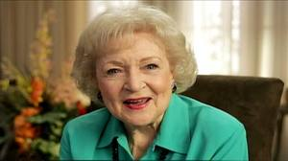
Age Stereotypes
Knowing that a person falls into a certain age range, we have a tendency to make certain assumptions about the person’s physical, psychological, and intellectual capabilities.
Older workers are seen as having less capacity for performance.

Slide 19
Age Stereotypes
Older workers are viewed as less productive, creative, logical, and capable of performing under pressure, and as having less potential for development.
They are perceived as more rigid and dogmatic, and less adaptable to new corporate cultures than younger workers.
Older workers are perceived as more honest, dependable, and trustworthy.

Slide 20
Projection
The tendency for perceivers to attribute their own thoughts and feelings to others.

Slide 21
Halo Effect
The creation of an entire impression based on one attribute or trait

Slide 22
Primacy and Recency Effects
The reliance on early cues or first impressions is known as the primacy effect.
Primacy often has a lasting impact.
The tendency for a perceiver to rely on recent cues or last impressions is known as the recency effect.

Slide 23
Self-Fulfilling Prophecy
The effect of labelling on performance

Slide 24
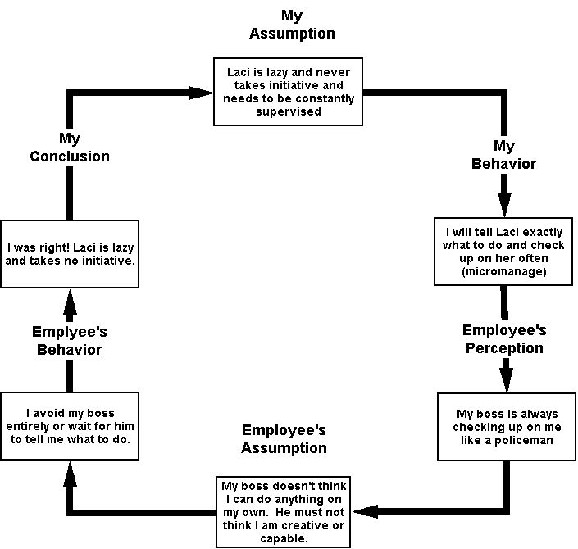

Slide 25
Attribution Theory
Attribution Theory
explains how individuals pinpoint the causes of their own behaviour or that of others.

Slide 26
Attribution
Attribution is the process by which we assign causes (motives) to explain behaviors of others.
We make
Dispositional attributions: person acts a certain way b/c of internal characteristics (personality, values, intelligence, desires, etc.)
OR
Situational attributions: person acts a certain way b/c of the situation or the environment

Slide 27
To answer the question,
Attribution Theory uses the:
COVARIATION PRINCIPLE:
Consistency
Consensus
Distinctiveness

Slide 28

Information Cues
  Consensus
    Was the same behaviour evident in other people?
  Consistency
    Was the same behaviour repeated over time?
  Distinctiveness
    Was similar behaviour evident in other situations?

Slide 29
Attribution (cont’d)
Characteristics of the behavior determine attributions:
Cues | High | Low
Consistency : That particular behaviour is usual for that person (every time) | Likely dispositional | Likely situational
Distinctiveness: That person does not act that way in most situations | Likely situational | Likely dispositional
Consensus: Everyone acts that way in that situation | Likely situational | Likely dispositional

Slide 30
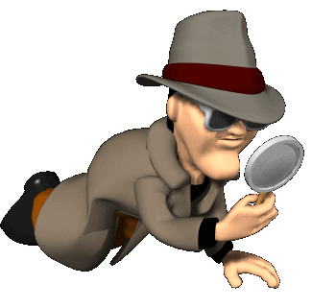
Analyze the Behaviour:
IF:
Consistent? YES
Consensus? NO
Distinctiveness? NO
THEN:
Behaviour is attributed to
INTERNAL CAUSE

Slide 31

Analyze the Behaviour:
IF:
Consistent? NO
Consensus? YES
Distinctiveness? YES
THEN:
Behaviour is attributed to
EXTERNAL CAUSE

Slide 32
Ann is angry with her secretary
INTERNAL:
Consistent: YES-Ann is always angry with her secretary.
Consensus: NO- other people get along well with the secretary.
Distinctiveness: NO- Ann gets angry with everyone.
GET A LIFE,ANN

Slide 33
Ann is angry with her secretary
EXTERNAL:
Consistent: No-Ann is not always angry with her secretary.
Consensus: YES- other people are also angry with the secretary.
Distinctiveness: YES- Ann gets angry only with the secretary.
Fire the secretary!

Slide 34
ATTRIBUTION ERRORS:
Fundamental attribution error:
Person overemphasizes internal factors as the cause of behaviour
We often discount the strong effects that social cues can have on behaviour.
2. Actor-Observer Bias
  Actor: A person attributes his/her own behaviour to external causes
  Observer: A person attributes behaviour of others to internal causes

Slide 35
An example:
The behaviour: Skipping your Management Class
ACTOR’S ATTRIBUTION:
“ I skipped class because the teacher is boring” (External cause)
OBSERVER’S ATTRIBUTION:
“He skipped class because he is lazy” (Internal cause)

Slide 36
Self-Serving Bias
The tendency to take credit for successful outcomes and to deny responsibility for failures.

Slide 37

Diversity
Workplace diversity refers to differences among employees (potential or actual) in characteristics such as gender, age, ethnicity, etc.
© 2010 Jupiterimages Corporation
As the composition of the population is changing, workplace diversity is increasing; organizations can no longer simply tolerate diversity, they must embrace it
3

Slide 38
The Changing Workplace
The workforce is becoming more diverse:
  The number of visible minorities in Canada is expected to double by 2017.
  In less than a decade, 48 % of the working-age population will be between the ages of 45 and 64.
  Many organizations are seeking to recruit more representatively.
  Many employees are required to interact with one another or work in teamwork.
Notes:
The Canadian population and labour force is becoming increasingly multicultural and multiethnic.

Slide 39
Benefits of Diversity
Cost: better integrated employees saves costs
Human Resources: best candidates attracted, more positive employee attitudes, better retention
Marketing: better understanding and service of customers, more positive org image
Creativity : different perspectives leads to more creative decision making
Problem solving : more critical analysis of issues leads to better problem solving
Flexibility: system more fluid, able to react to environmental changes
Higher performance, competitiveness and stock prices

Slide 40
How to manage diversity
Establish Diversity Training Programs
A few key elements:
Make managers accountable for diversity
Review Communication and HRM practices
Beneficially Diverse Organization
Build a culture that embraces diversity
Be systematic: assess needs, set goals, measure results

Slide 41
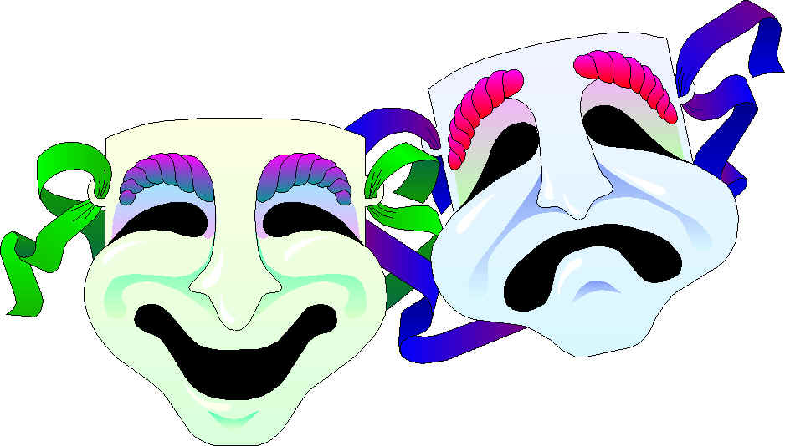
Personality:
A relatively stable set of characteristics that influences an individual’s behaviour.
Influenced by both environment and heredity

Slide 42
Personality Traits:
The Five-Factor Model (Big 5)
Trait | Description
Openness | Curious, original, creative, open-minded (vs. dull, unimaginative)
Conscientiousness | Dependable, responsible, organized (vs. careless, impulsive)
Extraversion | Sociable, talkative, enjoys social situations (vs. withdrawn, shy)
Agreeableness | Tolerant, cooperative, trusting, altruistic (vs. cold, rude)
Emotional Stability (opposite: Neuroticism) | Stable, confident, even-tempered (vs. depressed, anxious)
Notes:
Extravert: outgoing, energetic, assertive, joyful
Introvert: quiet, calm, reserve
Emotionally stable: appropriate emotional control, self-confident, self-esteem
Neurotic: stressed, impulsive, self-doubt, depressive, anxious, hostile, insecure, more negative
Agreeable: cooperative, friendly, approachable, altruistic, sympathetic
Less agreeable: cold, argumentative, inflexible, intolerant, uncooperative
Conscientious: responsible, hard-working, disciplined, achievement-oriented
Less conscientious: irresponsible, lazy, impulsive
Open: flexible, receptive to new ideas, creative, trying out something different
Less open: prefer status quo
5 dimensions are independent and on a continuum.

Slide 43
Other Personality Traits
Locus of control
  People’s beliefs about the location of factors that control their behaviour:
    fate, luck, powerful others (external LOC)
    vs.
    personal actions, self-initiative, free will (internal LOC)
Self-monitoring
  Extent to which people regulate how they appear and behave in social settings:
    control their behaviours to fit in (high self-monitors)
    vs.
    act how they feel no matter what (low self-monitors)
Self-esteem
  Degree to which we have a positive self-evaluation (i.e., how much we like ourselves)
  Behavioural plasticity theory: those with low self-esteem are more susceptible to external and social influences

Slide 44
Locus of Control
A set of beliefs about the source (control) of a behaviour.
High External Control High Internal Control
Fate
Luck
Other people
Initiative
Personal action
Free will
Notes:
Beliefs about whether one’s behaviour is controlled mainly by internal or external factors.
Internals believe that the opportunity to control their own behaviour resides within themselves.
Externals believe that external forces determine their behaviour.
Locus of control is introduced using the examples of Laurie, a hard-working, driven individual who believes that she controls her destiny, and Stan who believes that luck is what provides advancement opportunities. These two examples are used to show the differences between an external locus of control (Start) and an internal locus of control (Laurie).
Locus of control is a set of beliefs about whether one’s behaviour is controlled mainly by internal or external forces. High “externals” see their behaviours controlled by factors like fate, luck and powerful people. High “internals” see stronger effects on their behaviour as a consequence of self-initiative, personal actions and free will.
Research:
Locus of control influences organizational behaviour in a variety of occupations.
Internals are more satisfied with their jobs, earn more money, and achieve higher organizational positions.
Internals perceive less stress, cope with stress better, and engage in more careful career planning.
Internals are less likely to be absent from work and are more satisfied with their lives
But to be 100 % internals isn’t necessarily good… at times, it’s not always “our fault”

Slide 45
Locus of Control
Internal
External
I control what
happens to me!
People and circumstances outside of my control dictate my fate!
Notes:
9
9
9
8

Slide 46

Self-Monitoring
The extent to which people observe and regulate how they appear and behave in social settings and relationships.
High self-monitors take great care to observe and control the images that they project.

Slide 47
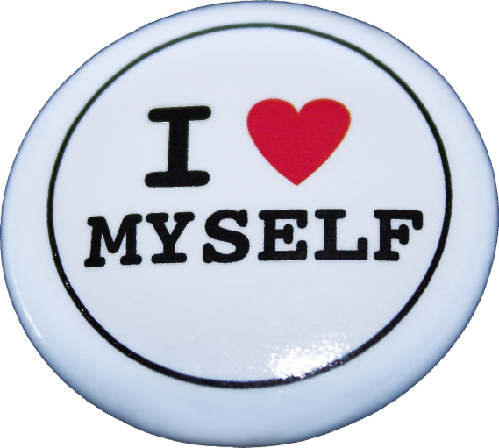
Self-Esteem
The degree to which a person has a positive self-evaluation.
People with high self-esteem have favourable self-images.
People with low self-esteem have unfavourable self-images.

Slide 48
Self-Esteem
Failure tends
to decrease
self-esteem
Success tends
to increase
self-esteem
Notes:
11
11
11
10

Slide 49

Myers-Briggs Personality Type Indicator
MBTI
©Gina Sanders—Fotolia.com

Slide 50
MBTI Preferences
Briggs & Myers developed the MBTI to understand individual differences by analyzing the combinations of preferences.
Notes:
18
18

Slide 51
Extraversion
or
Introversion
E -I

Slide 52
E
Needs relationships
Feels pulled outward
by external conditions
Energized by other
people,
external experiences
Expresses
emotion
Acts, then maybe
reflects

Slide 53
I
Feels pushed inward
by external claims
and intrusions
“Needs” privacy
Reflects,
then (maybe)
acts
Bottles up
emotions
Energized by inner
resources,
internal experiences

Slide 54
Judgment
or
Perception
J-P

Slide 55
J
Handles deadlines,
plans in advance
Likes to clear
limits and categories
Feels comfortable
establishing closure
Likes to have life
under control
Likes definite order
and structure
Prefers an organized lifestyle
Enjoys being decisive

Slide 56
P
Meets deadlines by
last minute rush
Feels comfortable
maintaining openness
Likes freedom to explore
without limits
Likes going with the flow
Prefers
to experience
life as it happens
Prefers a flexible lifestyle
Likes to be
open for more
information

Slide 57
Thinking
or
Feeling
T-F

Slide 58
T
2 x 2 = 4
x + y = 43
thesis
proposition
9 x 9
Sees things as an onlooker
from outside a situation
Good at analyzing
plans
Goes by logic
Decides with the head
Concerned with
truth and justice
Takes a long view
Spontaneously finds
flaws and criticizes

Slide 59
F
Sees things as a
participant from within
Good at understanding
people
Decides with
the heart
Goes by personal
convictions
Concerned with
relationship and harmony
Takes an immediate
and personal view
Spontaneously
appreciates

Slide 60
Mottos
Extraverts “Let’s talk this over.” | Introverts “I need to think about this.”
Sensors “Just the facts, please.” | Intuitives “I can see it all now.”
Thinkers “Is this logical?” | Feelers “Will anyone be hurt?”
Judgers “Just do something.” | Perceivers “Let’s wait and see.”

Slide 61
Uses of MBTI
Understand individual differences
Identify learning and teaching styles
Conflict management
Understanding management styles
Building teams
©Gina Sanders—Fotolia.com

Slide 62
Personality inventories must be
Reliable
Valid

