Slide 1

MANA 202 AA
Human Behaviour in Organizations

Slide 2
Mana 202/2 AA
Professor: Tima Petrushka
Telephone: (514) 848-2424 Ext. 2946
Email: t.petrushka@concordia.ca
Office -MB 13-339
Office Hours: Monday 1-2 or by appointment

Slide 3

Textbook:
ORGB, 2nd CDN ED 2015
Ann Armstrong; Joan Condie; Debra L Nelson; James Campbell Quick
Student companion website
Class notes on Moodle
Additional readings/cases/exercises will be posted in your moodle folder or distributed in class.

Slide 4
Course Evaluation
Midterm Exam-40%
October 20, 2016
Participation 5%
Final Exam-55%
Final Exam Period

Slide 5

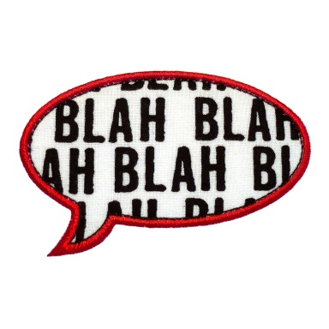


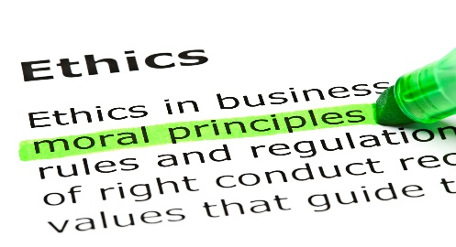
Some topics in this course
Job Satisfaction
Communication
Motivation
Job Design/Job Enrichment
Stress
Business Ethics
Conflict/resolution

Slide 6

What motivates employees today
Camaraderie, peer motivation
- Intrinsic desire to a good job
- Feeling encouraged and recognized
- Having a real impact - Growing professionally
- Meeting client/customer needs
- Money

Slide 7
Chapter 1
Organizational Behaviour and Opportunity

Slide 8
What do managers do?

Slide 9

Mintzberg’s Study
How many hours do managers work per week? ------
How many activities do these managers average per workday?
  Foreman ---
  Area supervisors---
  General managers ----
  Presidents----

Slide 10
Manager Activities
Adventures in multitasking
  Activity characterized by variety, fragmentation, and brevity
  Less than nine minutes on most activities
  Managers shift gears quickly
Life on speed dial
  Work at unrelenting pace
  Interrupted by disturbances
  Always working (catching up)

Slide 11
What percent of a manager’s time is spent in:
Scheduled meetings --;
unscheduled meetings --;
desk work ---
telephone conversations -------
What percent of a manager’s time is spent in dealing with
  Subordinates -----
  Supervisors -----
  Peers ------

Slide 12

The Manager’s job: Folklore and Fact
Henry Mintzberg

Slide 13

MYTH:
Managers engage in reflective planning
Fact:
Managers are action-oriented and their activities are brief

Slide 14

MYTH:
Managers rely on formal management information systems
Fact:
Managers get most of their information from verbal communication

Slide 15

MYTH:
Management is a science
Fact:
Managers rely heavily on judgement or intuition

Slide 16
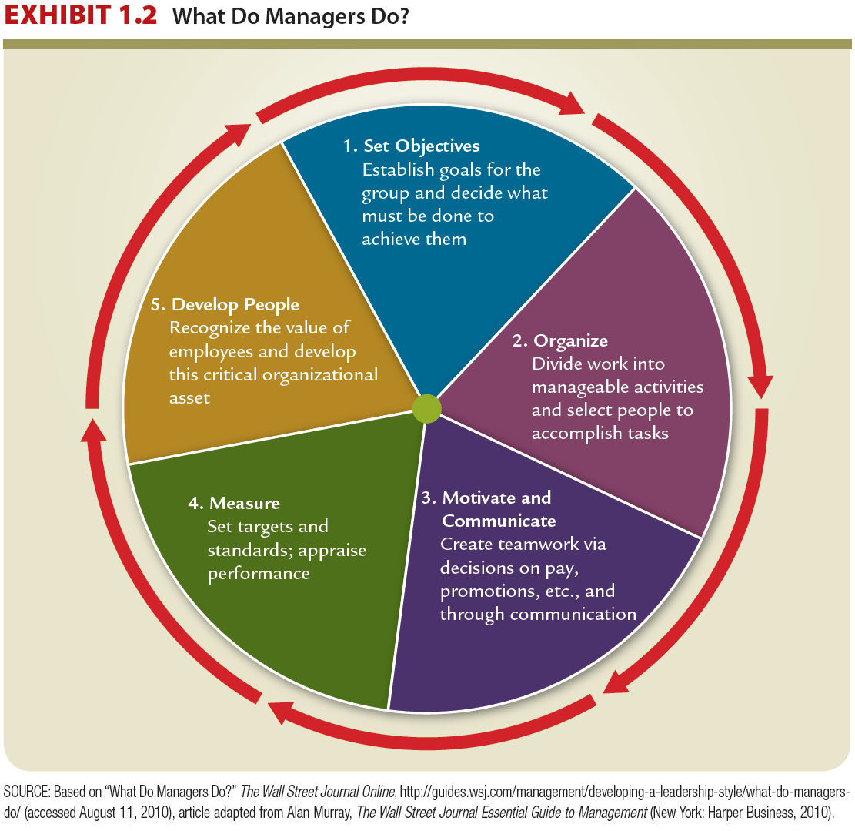
What Do Managers Do?

Slide 17
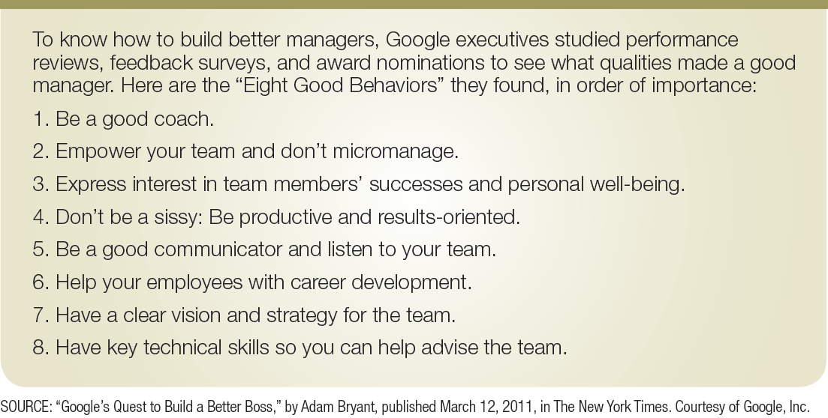
1.5 - Google’s Rules: Eight
Good Behaviors for Managers

Slide 18
The Rigour of Organizational Behaviour
OB Looks at Consistencies
  What is common about behaviour, and helps predictability?
OB Looks Beyond Common Sense
  Systematic study, based on scientific evidence
    Evidence-based management (EBM)
OB Has Few Absolutes
  Few, if any, simple and universal principles that explain OB
OB Takes a Contingency Approach
  Considers behaviour in context
Notes:
This slide relates to LO #2 of chapter 1.
Material pertinent to this discussion is found under “OB: Making Sense of Behaviour in Organizations.”
This would be a good place to get students’ views on questions such as: (1) Are happy workers always productive workers? (2) Are individuals always more productive when their boss is a real “people person?” (3) Does everyone want a challenging job?

Slide 19
Contingency Approach
Behaviour in organizations is a complex function of many interacting factors. For example:
  Personal characteristics
  organizational culture
  organizational structure
  group processes
  external factors (job market, gov’t. restrictions)

Slide 20
An Integrative Model
Three Levels of Analysis:
  Individual
  Group
  Organization

Slide 21
OB Levels:
Individual
Attitudes
Motivation
Group
Organization
Culture
Organizational Structure
Leadership
Change
Group
Teams
Communication
Job Design

Slide 22
Critical Managerial Skills
Technical | Skills necessary to accomplish specific tasks within the organization
Interpersonal | Skills used to communicate with, understand, and motivate individuals and groups
Conceptual | Skills used in abstract thinking
Diagnostic | Skills to understand cause-effect relationships and to recognize optimal solutions to problems

Slide 23

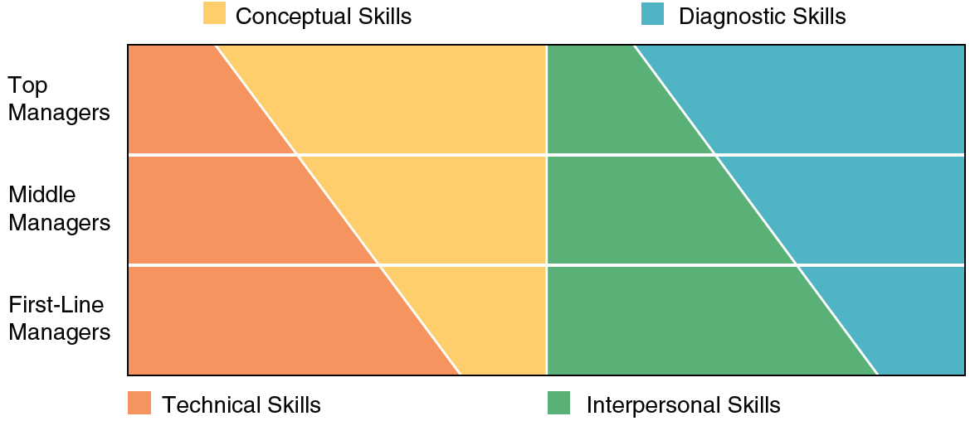

1.3 Managerial Skills at Different Organizational Levels

Slide 24

The Open System View
LO 4
Notes:
The open systems framework derives from the models of ecosystems in biology, so that organizations are viewed as living organisms, interacting with their environment and requiring balance to survive. This notion fits well with the competing values framework discussed earlier in the chapter and outlined in Exhibit 1.2. In this framework effective managers focus both inside and outside their organization and also try to balance the need for stability with the need for adaptability.

Slide 25
The Systems Approach to Organizations

Slide 26

0
Formal Organization :
The official, legitimate, and most visible part of the system.
Informal Organization:
The unofficial and less visible part of the system.

Slide 27
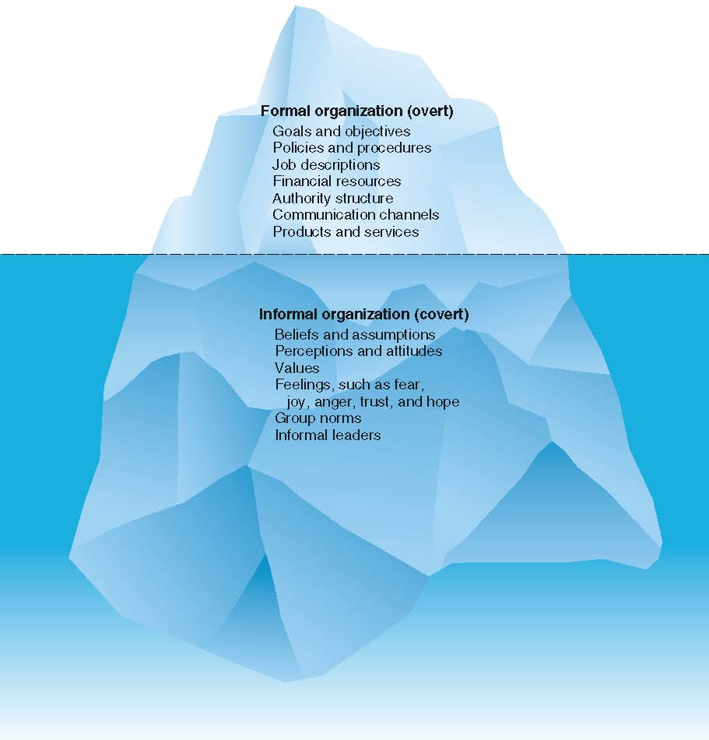
Formal versus Informal Organizations
LO 5

Slide 28
The Hawthorne Studies
  Worker productivity was measured at various levels of light illumination.
  Researchers found that regardless of whether the light levels were raised or lowered, worker productivity increased.

Slide 29
The Hawthorne Studies
Human Relations Implications
  Hawthorne effect the effect of attention on performance

Slide 30
The Hawthorne Studies
Implications
Behavior of managers and workers in the work setting is as important in explaining the level of performance as the technical aspects of the task

Slide 31

Some Contemporary Management Concerns
  Diversity
  Globalization
  Employee-Organization Relationships
  Talent Management
  Ethics-Corporate Social Responsibility (CSR)

Slide 32

Diversity
Organizational behaviour is concerned with issues that have to do with the management of a diverse workforce and how to benefit from the opportunities that a diverse workforce provides.

Slide 33
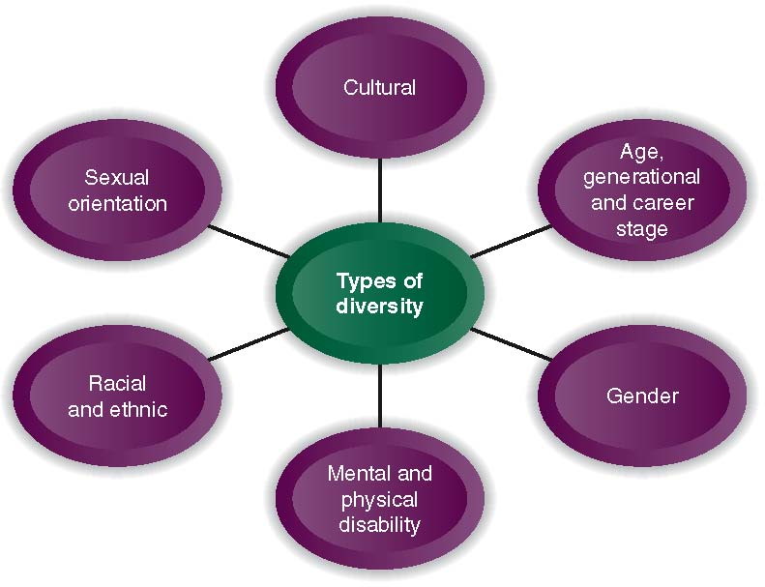
Workforce Diversity
LO 6

Slide 34
The Challenges of Global Competition
Increased global competition is driving radical change in North America resulting in:
  Pressure on all categories of employees
  Demand for increased productivity & value
  Need to be customer focused
  Create a focus on quality

Slide 35
Employee-Organization Relationships
Downsizing, restructuring, re-engineering, and outsourcing
Major structural changes in work arrangements (e.g., part-time, temporary, contract work).
Changes in the workplace have changed the nature of employee-organization relationships.

Slide 36
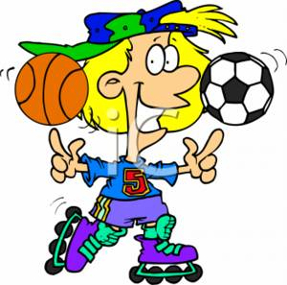
Talent Management
Talent management refers to an organization’s processes for attracting, developing, retaining, and utilizing people with the required skills to meet current and future business needs.

Slide 37
Talent Management (continued)
Two most important management challenges:
  Recruitment of high-quality people
  Improving the appeal of the company culture and work environment

Slide 38

Ethics & Corporate Social Responsibility (CSR)
CSR refers to an organization taking responsibility for the impact of its decisions and actions on its stakeholders.
It extends beyond the interests of shareholders to the interests and needs of employees and the community in which it operates.

