Slide 1
BCH2333 GIANT REVIEW
MT 1

Slide 2
LECTURE 1
ORIGINS OF LIFE
BASIC BUILDING BLOCKS OF LIFE
WATER ← MOST IMPORTANT OF THESE

Slide 3
WHAT IS BIOCHEM
It is the study of life using physical and chemical principles of biology at the molecular level to predict behavior
These principles are common to all living organisms → these are what refined evolution
ORIGIN OF LIFE → Direct evidence of earth’s age comes from radioactive decay →U230 decays to Pb206
Evidence of life on earth isn’t as strong since it is extracted from indirect evidence (unlike the age of earth) → gathered from fossils → we infer by theories

Slide 4
PRIMORDIAL EARTH → HALDANE HYPOTHESIS
Primordial earth’s atmosphere was composed of : H2O, N2. CO2, NH3, CH4, SO4 → These are highly reducing chemicals -> it lacked oxygen
Any oxidative compounds were unstable and immediately reacted into the atmosphere→ lack of plants meant lack of supply of oxidative chemicals
Also lacked complex molecules → organic compounds
Oparin and Haldane propose the following: Energy + Reducing atm + time → complex molecules

Slide 5
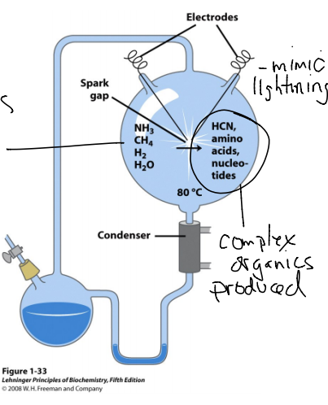
UREY AND MILLER EXPERIMENT
Urey and Miller redesigned primordial earth in a lab and found that with time, the primordial earth’s atmospheric conditions allowed for the development of complex molecules that were the organic building blocks of life:
  Amino acids (AA)
  Carbs (CHO)
  Nucleotids (Ntd) (from HCN)
  HCN
  Organic Acids (Fatty acids)

Slide 6
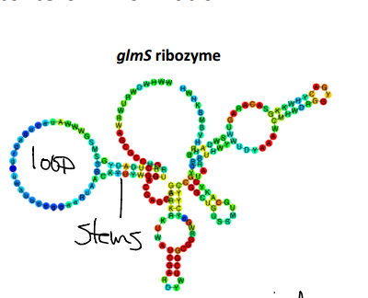
CHEMICAL EVOLUTION AND RNA WORLD HYPOTHESIS
The challenge after the UM experiment was, “how did polymers form?”
  As building block concentrations increased, they began to combine chemically to form polymers → this observation lead to the RNA world Hypothesis
RNA world Hypothesis
  RNA is very foldable to a specific 3D structure governed by its rNTD sequence
  This structure is very stable → Less sensitive to degradation
  & can have catalytic properties → Like a Ribozyme
  Nucleic acids like to form Loops and Stems when single stranded (ss) which results in this resistive and stable structure
  The important part is that, unlike peptides, nucleic acids allow for the templation of their own polymeric sequence. Therefore, the Ribozyme is it’s own genetic code and a catalytic enzyme

Slide 7
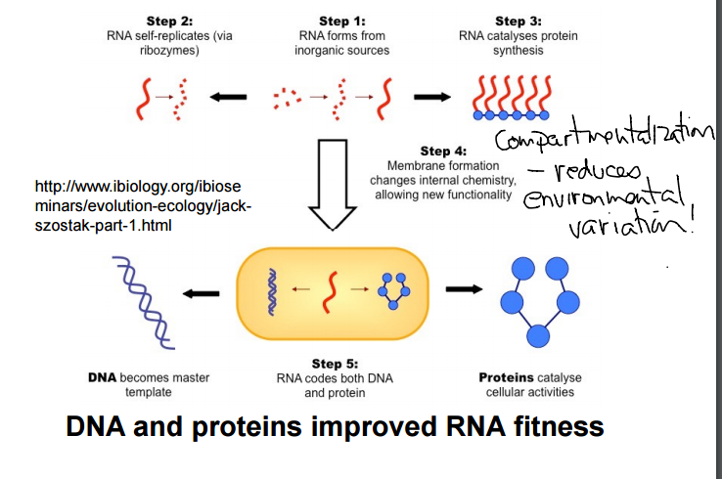
RNA WORLD HYPOTHSIS → DNA AND PROTEINS
ENCAPSULATION OF RNA + BUILDING BLOCKS LEAD TO POLYMER FORMATION
  DNA = GENETIC STORAGE (REFINED EARLY RNA)
  PROTEIN = CATALYSIS AND CELLULAR ACTIVITY (REFINED EARLY RNA)
  RNA = MIDDLE MOLECULE AND REGULATOR FOR EXPRESSION

Slide 8
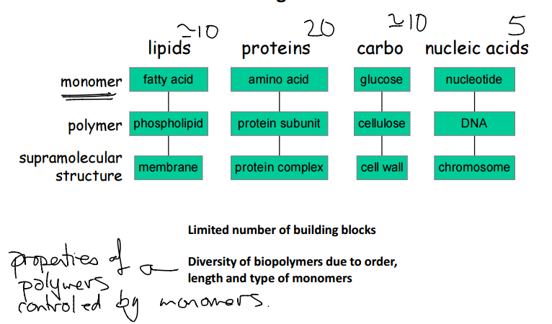
CELLS ARE COMPLEX, HOW CAN WE UNDERSTAND THEM?
Fundamental chemical principles are what govern biochemistry (bch)
There are common themes across our bch make up
  Cells are a construction of molecules and their interactions
  Polymers themselves are built up of a limited number of blocks
  The diversity of interactions arises from:
    Order of monomers
    Length of polymer
    Structure type (AA and 1, 2, 3, 4)
  PROPERTIES OF POLYMERS ARE GOVERNED BY THEIR MONOMERS

Slide 9
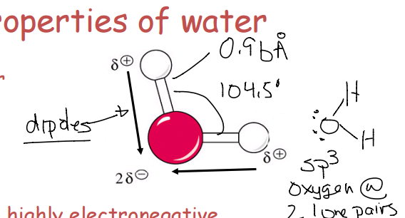
PROPERTIES OF WATER **
Very polar
High EN of Oxygen gives its polarity
Remember:
  Length of O-H bond is 0.9 A
  Andgle between bonds is 104.5
  Sp3 hybridized → electron configuration is tetrahedral, geometeric configuration is bent

Slide 10
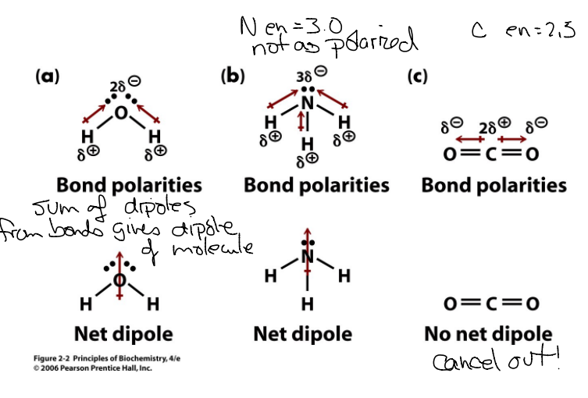
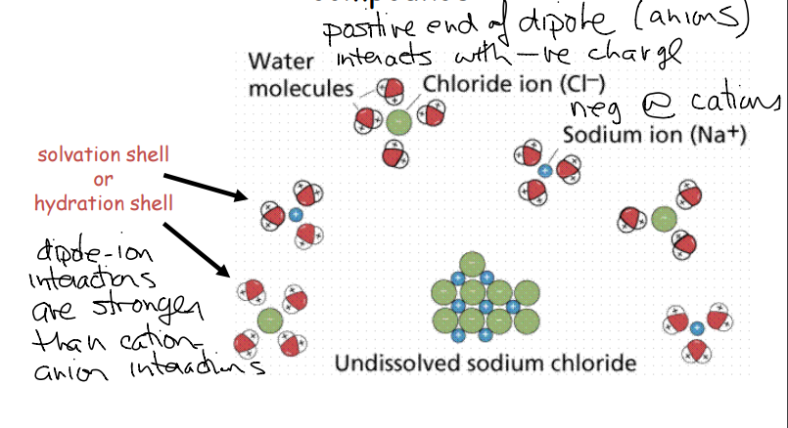
NET DIPOLES AND WATER’S DISSOLVING ABILITY
Charged solutes can be stabilized by water solvent
  For this to happen, the dipole-ion interaction must be stronger than the ion-ion interactions → therefore forms a hydration shell around the salts

Slide 11
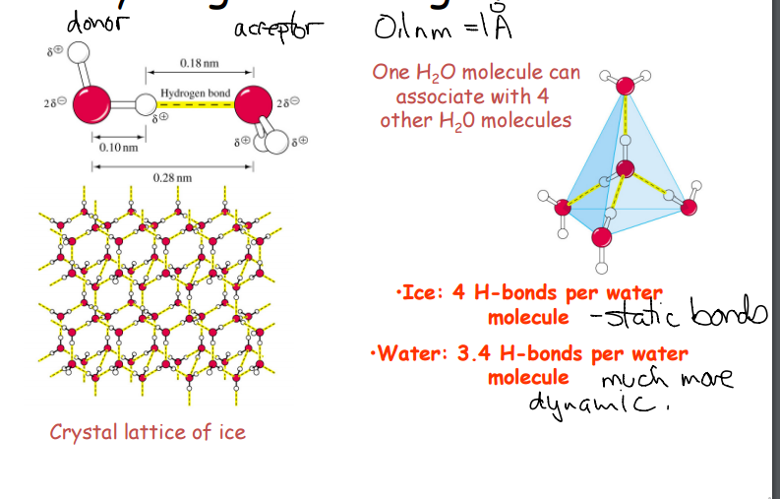
H-BONDING OF WATER **
One H2O molecule can associate with 4 other H2O mol in a tetrahedral manner
In ice → water expands to a crystalline form, rather thanthe dynamic property it holds in liquid water. This forces it to create static H-bonds in the tetrahedral manner observes
In liquid → the bonds are very dynamic and yield a net H-bonding interaction of 3.4 per mol

Slide 12
BIOMOLECULE INTERACTIONS ARE MEDIATE BY 4 TYPES OF NON-COVALENT BONDS
These are responsible for the overall shape and interaction among biomolecules and can be modified by thermal energy aka heat
1. Electrostatic
2. H-Bonding
3. VDW
4.Hydrophobic effect (not an actual bond)

Slide 13
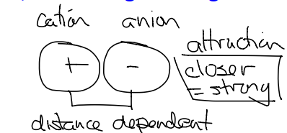
1.Electrostatic
Governed by coulombs law → the closer the moelcules … to a degree, the stronger the bond → Dielectric constant D
  D refers to the shielding effect of electrons on the positive nucleus of an atom. It is a property of the medium in which the molecule sits in. → the permeability of the charge across that medium.
The emphasis is on radius
Responsible for salt linkages
Optimal distance is 2.8 A

Slide 14
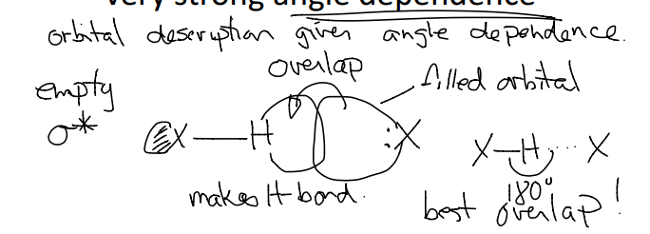
H-Bonding
Must be a highly polarized molecule → refer to net dipoles slide
H-donor → must be polarized enough topull electrons (e-) away from H → weakly acidic
H-acceptor →must have a good lone pair (LP) of e- → weakly basic
VERY STRONG ANDLE DEPENDENCE

Slide 15
LECTURE 2
IMF
Acids and Bases

Slide 16
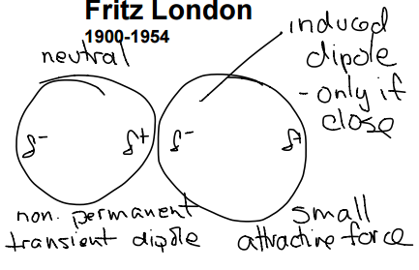
VAN DER WAALS ATTRACTIONS (VDW)
All that are non-ionic and non-Hbonding interactions
London forces are categorized under this AKA dipole moment attractions… etc
Induced dipole by properties of the atom/molecule result in a polarized moment between two atoms → enough to generate a transient attraction

Slide 17
VDW CONTROLLING FACTORS
Large/small atoms
  Larger atoms provide more surface for polarizability, therefore stronger VDW attraction
  Smaller have less chance of polarizing electrons
Packing of molecules
  Linear is much more closely packed than branched
  Thing of saturated vs polyunsaturated FA

Slide 18
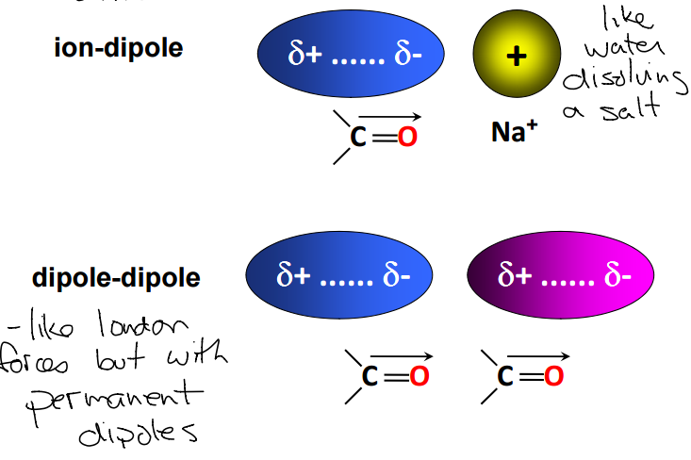
ION-DIPOLE VS DIPOLE-DIPOLE
H2O DISSOLUTION FACTOR
PERMANENT

Slide 19
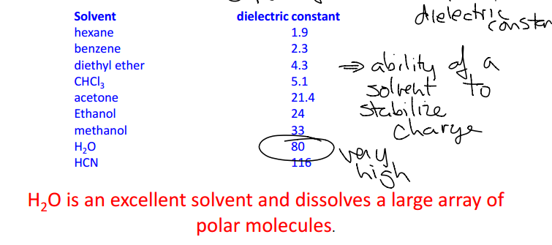
DIELECTRIC CONSTANTS
This is a unit-less number administered to common solvents dictating the degree at which they can stabilize a charge
Higher number means greater stabilization ability
Impacted by dipole moments in the molecular solvent
Note that H2O has a high DE constant → meaning it is able to weaken the other non-covalent forces holding the compound together → enough to form a hydration shell to dissolve it → this is why polymerization often exclused H2O → to avoid decomposition

Slide 20
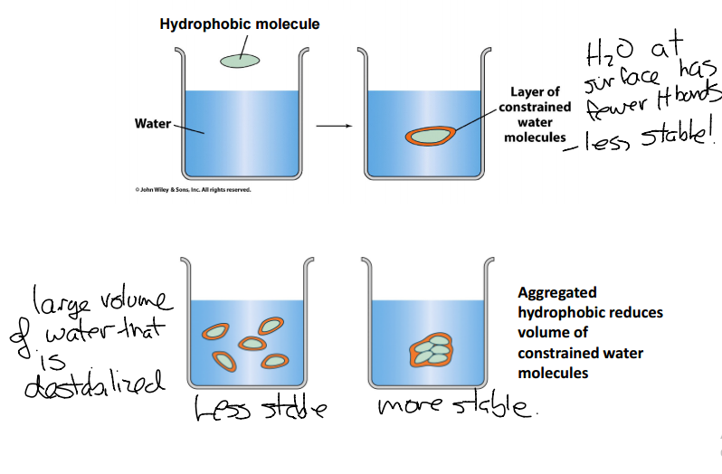
HYDROPHOBIC INTERACTIONS
Non-polar groups cluster together in a unified response to their repulsion to water/polar solvents.
This is not due to cohesive nature of NP compound, but to Polar solvent’s repulsion factor AKA hydrophobic collapse
Water tries to reduce SA taken up of NP compound therefore they aggregate
H-bond is so strong that to conserve it’s nature → NP are forced together

Slide 21
REMEMBEER
HYDROPHOBIC EFFECT VS HBONDING is a major driving force in biopolymerization
→ Destabalizing H-bonds within the polar solution results in a disrupted solvation shell, around the NP compounds, this is propagated over multiple layers → to reduce this it increases entropy slightly, but reduce enthalpy significantly to achieve a low energy form of an aggregated NP substance in water
THIS ISN’T THAT IMPORTANT

Slide 22
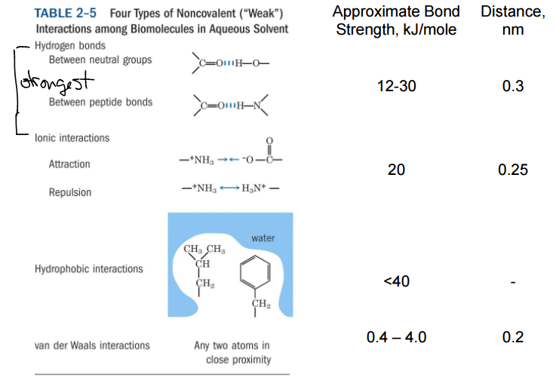
MEMORIZE THESE NUMBERS JUST INCASE

Slide 23
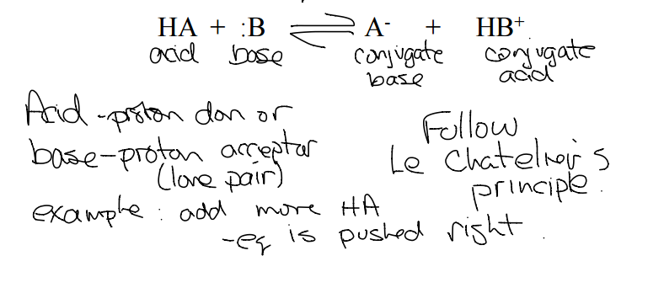
ACID-BASE CHEMISTRY
FUNCTIONS OF AB IN THE BIOLOGICAL SYSTEM
  Maintenance of internal ionic composition (homeostasis) → pH is critical for structure and function of many biomolecules
BRONSTED LOWRY ACIDS AND BASES
  Acid → donates a proton
  Base → accepts the protons

Slide 24
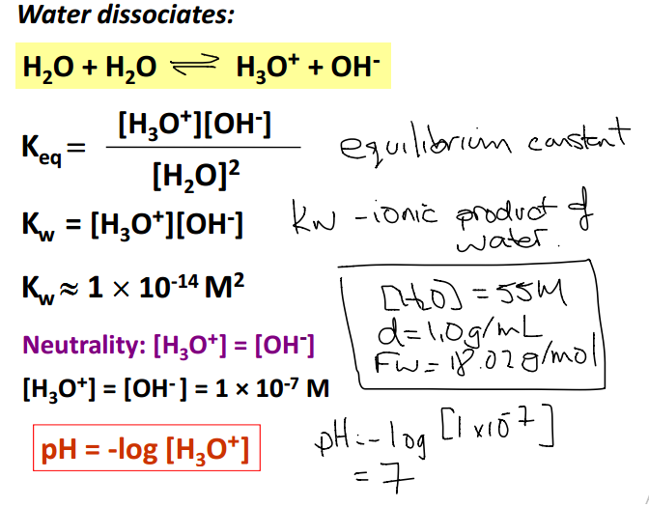
WATER DISSOCIATION CONSTANT
WHAT IS THE CONCENTRAITON OF WATER IN SOLUTION?
DENSITY X MM → g/L x g/mol
1 / 18.02
→ 55M

Slide 25
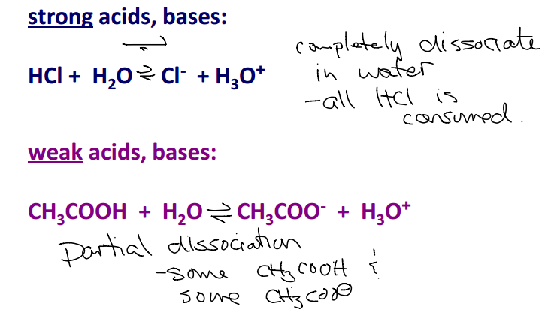
STRENGTH OF AN ACID → QUALITATIVE MEASURE
STRONG ACIDS/BASES
  Completely dissociative
WEAK A/B
  Partially dissociative

Slide 26
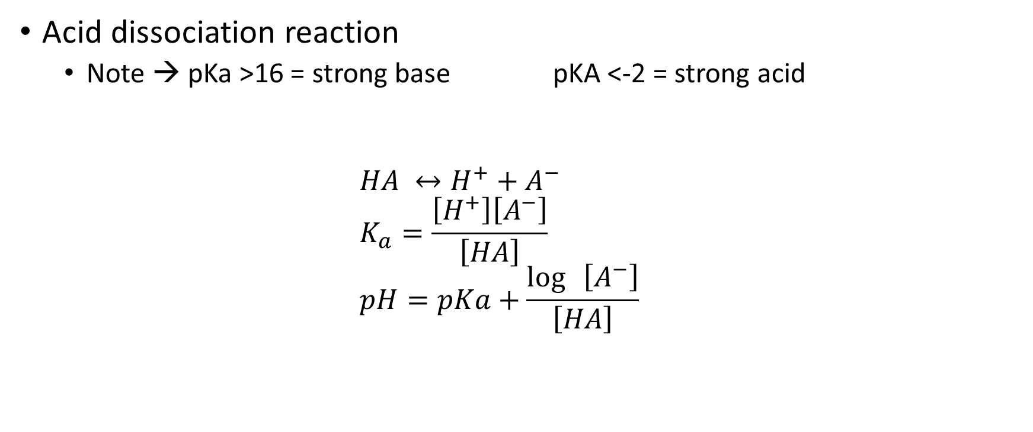
STRENGTH OF A/B → QUANTITATIVE MEASURE
Acid dissociation reaction
  Note → pKa >16 = strong base pKA <-2 = strong acid
  $$HA ↔H^{+}+A^{−} \\ K_{a}=\frac{\left[H^{+}\right]\left[A^{−}\right]}{\left[HA\right]} \\ pH=pKa+\frac{\log{ \left[A^{−}\right]}}{\left[HA\right]}$$

Slide 27
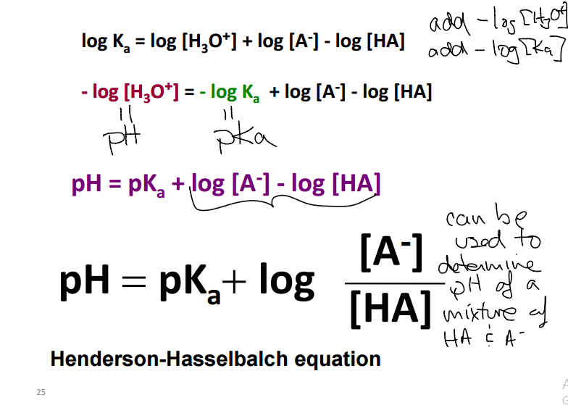
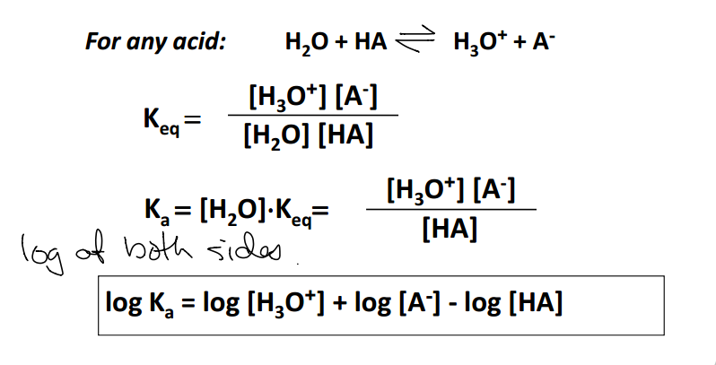
DERVIING THE HH EQUATION

Slide 28
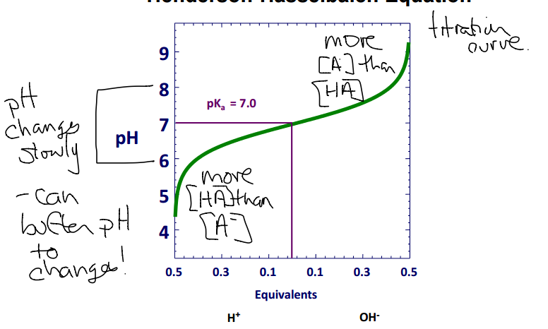
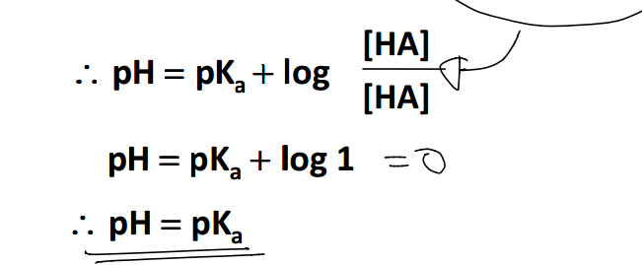
WHAT DOES Pka MEAN?
pKa is the midpoint of titration → BCH loves mid point values in graphs → Tm, pKa, Kd, Km
It is the pH at which the acid is half dissociated

Slide 29
LECTURE 3
Buffers
Amino Acids

Slide 30
BUFFERS ***
Buffers are solutions that are resistant to pH shifts with added A/B
Typically composed of a weak acid and its conjugate base
A solution of a weak acid with a pH near its pKa suggests that it has an equivalent amount of A- as HA
A weak acid is in its useful buffer range within 1 pH unit of its pKa → remember this for AA section

Slide 31

PRACTICE QUESTION 1

Slide 32
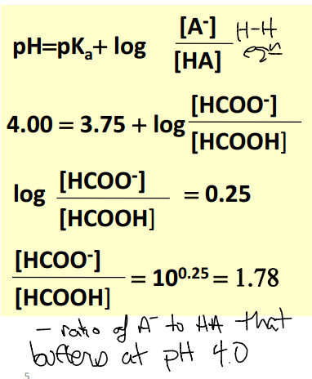
FIND THE RATIO USING HH

Slide 33
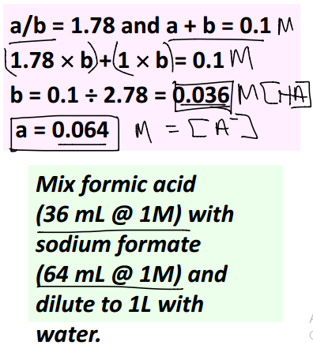
FIND THE ABSOLUTE VALUES FOR A AND CB
[A-] + [HA] = 0.1M

Slide 34
QUESTION FROM MT 1
How would you prepare 4 liters of 0.45M acetate buffer at pH 4.57 starting with 1.5 M solution of acetic acid, a 2.0 M solution of NaOH and water? The pKa for acetic acid is 4.72.

Slide 35
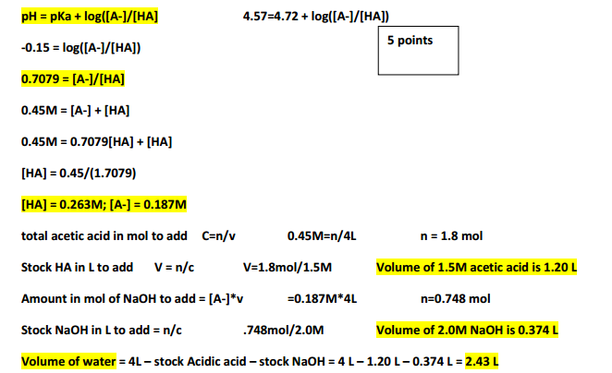
SOLUTION

Slide 36
AMINO ACIDS (AA)
20 standard Amino acids → 3 main groups
  Non-polar side chains
    Aromatic vs aliphatic
  Polar UNCHARGED
  Polar CHARGED
    Acid
    Base

Slide 37
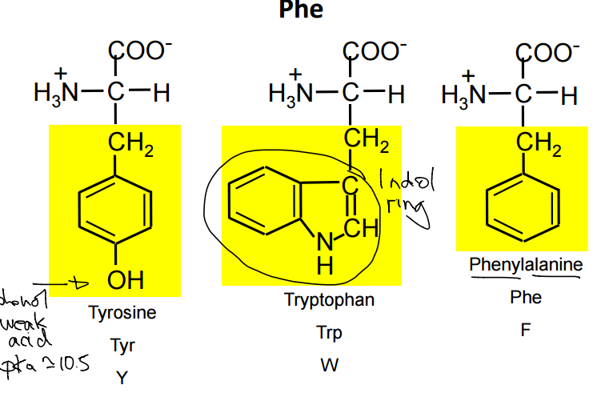
PRACTICE TIME!
Draw all non-polar aromatic amino acids with single letter and 3 letter name → provide any relevant pKa’s

Slide 38
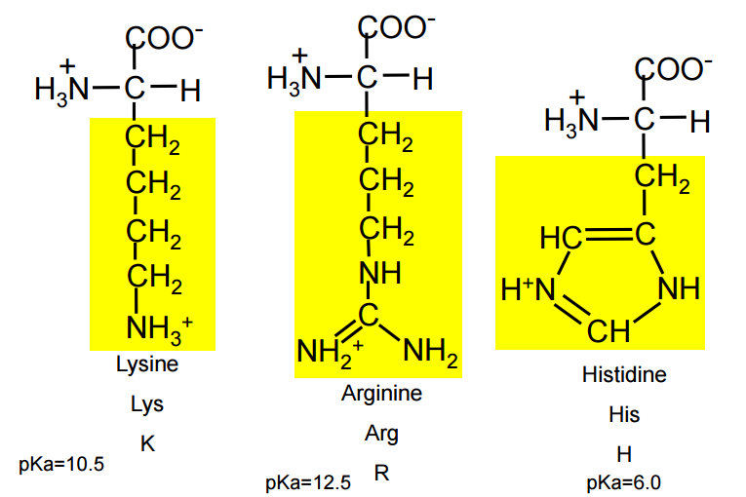
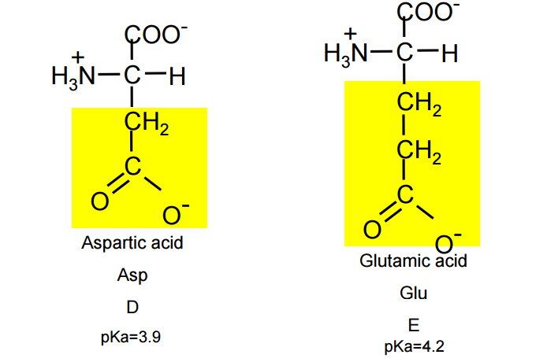
Draw all charged polar AA

Slide 39
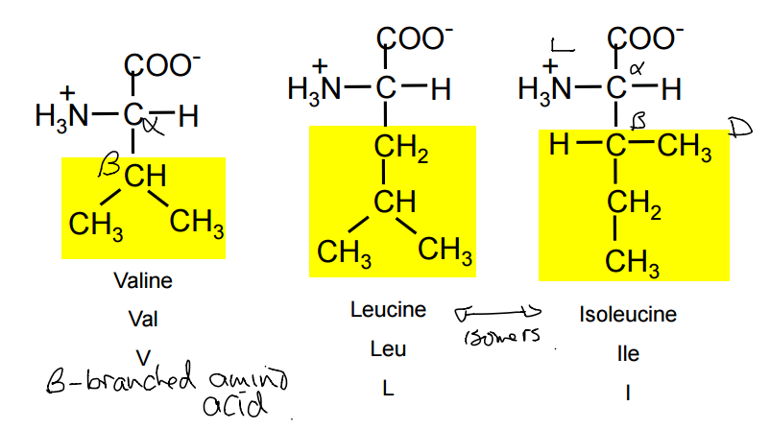
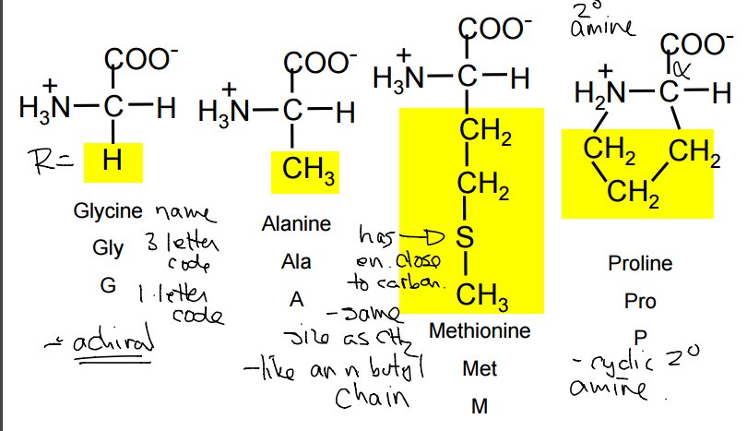
Draw NP aliphatic AA. Which are B-Branched
List any special characteristics
Secondary alpha AA
Achiral

Slide 40
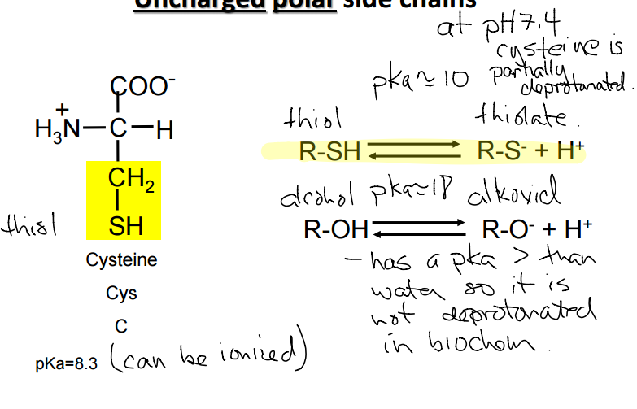
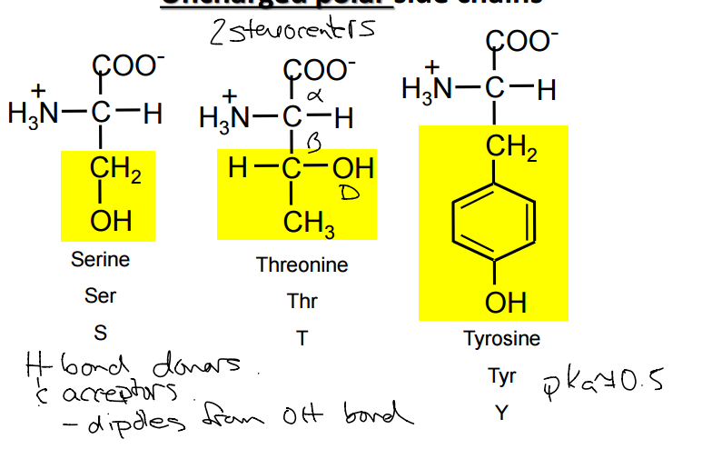
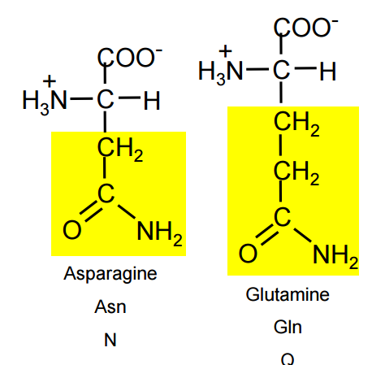
Draw all polar uncharged AA

Slide 41
AA TRIVIA
3. Identify which answer(s) has (have) only one letter codes for amino acids containing aromatic rings?
a. W, T, F
b. H, N, P
c. P, Y, W
d. H, W, Y
e. none of the above
d

Slide 42
4. What is the pKa for the alpha amino group and carboxylic acid common to all amino acids?
a. 4.2 and 7.4
b. 10.5 and 8.1
c. 9.4 and 2.2
d. 6.0 and 9.4
c

Slide 43
5. What non-covalent force can occur between the side chains of Thr and Gln?
a. electrostatic interactions
b. London Forces
c. dipole-ion interactions
d. hydrogen bonds
B & d

Slide 44
7. What is the charge on the peptide NSFC at pH 10.5?
a. +2
b. +1
c. 0
d. -1
e. -2
8. What is the charge on the peptide NCWDA at pH 7.0?
a. +2
b. +1
c. 0
d. -1
e. -2
E & d

Slide 45
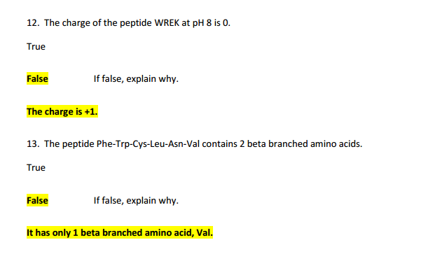
12. The charge of the peptide WREK at pH 8 is 0. T or F
13. The peptide Phe-Trp-Cys-Leu-Asn-Val contains 2 beta branched amino acids. T or F

Slide 46
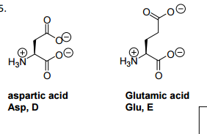
13. Draw the structure of and give the name, 3 letter code and 1 letter code for up to two amino acids that would be ideal for making a buffer at pH 4.5.

Slide 47
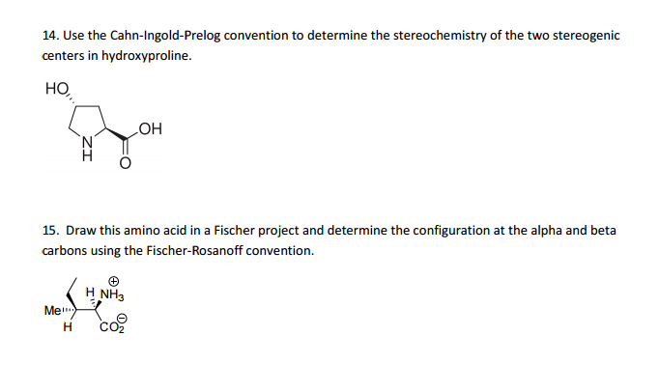

Slide 48
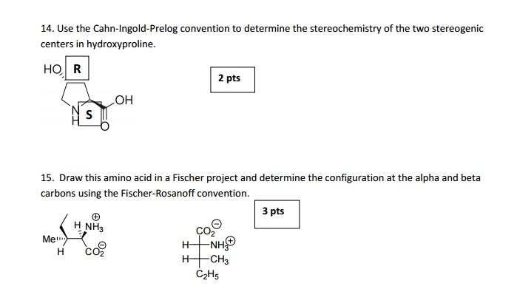

Slide 49
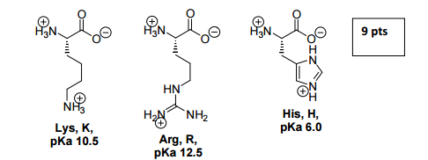
Draw the structures, give the three letter codes, and give the 1 letter codes for the three charged basic proteinogenic amino acids. Provide the pKas for their side chain ionizable groups.

Slide 50
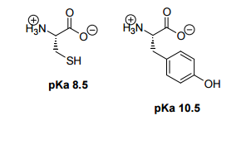
19. Draw the 2 amino acids with ionisable side chains that are neutral at pH 5. Give the side chain pKas.

Slide 51
21 A. Draw the structure of the heptapeptide shown below at pH 7.4. Isoleucine-Serine-Tryptophan- Asparagine- Glycine-Proline-Methionine

Slide 52
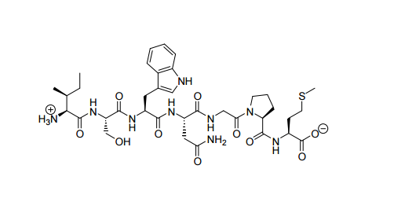

Slide 53
LECTURE 4
Amino Acids
Nucleic Acids

Slide 54
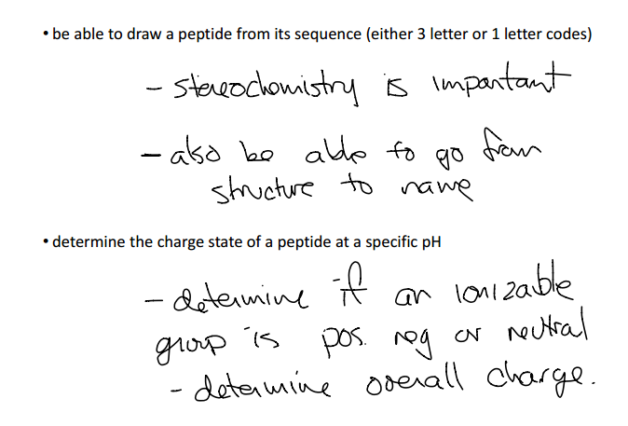
Expectations

Slide 55
Nucleic acids we will revisit near the end of the PPT presentation
For now
Nucleoside = Base+ Sugar
Nucleotide = Base + Sugar + Phosphate
Anomeric carbon is one bound to multiple EN atoms ex) O or N

Slide 56
PRACTICE!
Draw Guanine and Adenine + at least one tautomer
Draw all pyrimdines + at least one tautomer → which is only in DNA and which is only in RNA?

Slide 57
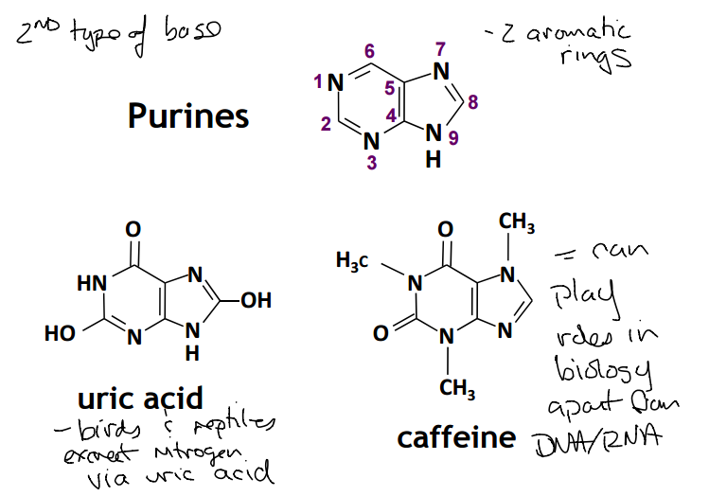
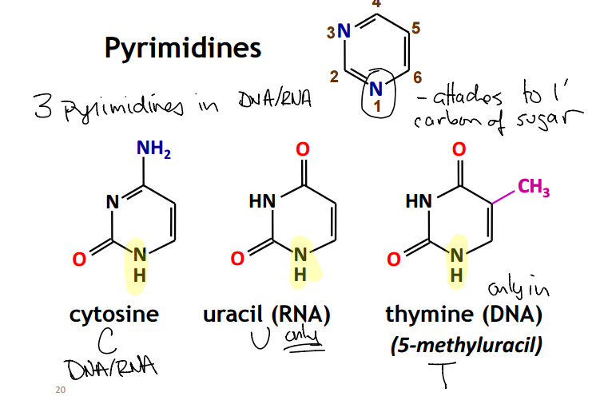

Slide 58
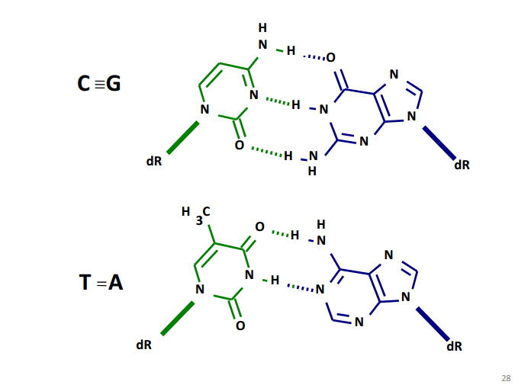
DRAW C bound to G or A bound to T

Slide 59
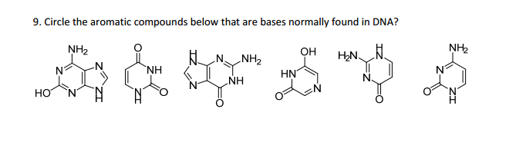
PRACTICE
6. Which bases pair together in DNA?
a. Guanine and Cysteine
b. Thymine and Adenine
c. Adenine and Uracil
d. Guanine and Adenine

Slide 60
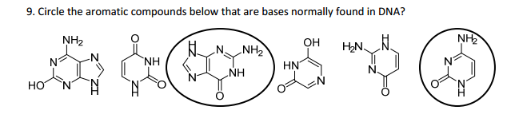
A and B

Slide 61
14. RNA and DNA are stereoisomers of each other.
True False If false, explain why.

Slide 62
False.
They are not stereoisomers or isomers at all. They have different molecular formulas.

Slide 63
Draw the sugar from RNA and the enantiomer of the sugar from DNA.
Draw the structure of adenosine monophosphate hydrogen bonded to thymine monophosphate.

Slide 64


