Slide 1
Infrastructure
Chapter 12
Opening Case:
Cloud Computing in Canada

Slide 2
Chapter Twelve Overview
SECTION 12.1 – MANAGING INFRASTRUCTURE
  Introduction
  Enterprise Architecture
  Agile MIS Infrastructure
  Open Systems
SECTION 12.2 – INFRASTRUCTURE TRENDS
  Infrastructure Trends
  Service-Oriented Architecture
  Web Services
  Virtualization
  Grid Computing
  Cloud Computing
Notes:
Enterprise architecture refers to the plans for how an organization will build, deploy, use, and share its data, processes, and IT assets. It allows us to design better systems by:
Meeting system requirements and objectives: Both functional and non-functional requirements can be prioritized as "must have", "should have" or "want", where "must have" identifies properties that the system must have in order to be acceptable.
An architecture allows businesses to evaluate and make trade-offs among requirements of differing priority. Though system qualities (also known as non-functional requirements) can be compromised later in the development process, many will not be met if not explicitly taken into account at the architectural level.
Enabling flexible partitioning of the system: A good architecture enables flexible distribution of the system by allowing the system and its constituent applications to be partitioned among processors in many different ways without having to redesign the distributable component parts. This requires careful attention to the distribution potential of components early in the architectural design process.
Reducing cost of maintenance and evolution: Architecture can help minimize the costs of maintaining and evolving a given system over its entire lifetime by anticipating the main kinds of changes that will occur in the system, ensuring that the system's overall design will facilitate such changes, and localizing as far as possible the effects of such changes on design documents, code, and other system work products. This can be achieved by the minimization and control of subsystem interdependencies.
Increasing reuse and integration with legacy and third party software: An architecture may be designed to enable and facilitate the (re)use of certain existing components, frameworks, class libraries, legacy or third-party applications, etc.

Slide 3
Learning Outcomes
Explain enterprise architecture and how global concerns can magnify the challenges associated with enterprise architecture management.
Describe agile MIS architecture.
Describe the business value in deploying a service-oriented architecture and Web services.
Describe a virtualized environment and its business benefits.
Explain the business benefits of grid computing and cloud computing.
Notes:
A detailed review of the learning outcomes can be found at the end of the chapter in the textbook in the section headed, “Summary of Key Themes”.

Slide 4
SECTION 12.1
MANAGING INFRASTRUCTURE
Notes:
CLASSROOM OPENER
Neil Young: The Old Man Uses Java
In his 1972 hit song "Old Man," rock legend Neil Young sings out: "Old man take a look at my life. I'm a lot like you ..." Indeed, it is Young who is now an "old man" of sorts and has compiled 45 years of archives about his music career on Blu-ray discs using Java technology.
Young joined Sun Microsystems CEO and President Jonathan Schwartz and Rich Green, the company's executive vice president for software, on stage during the JavaOne conference opening keynote to announce the new archive project and demonstrate some of the interactive features of his upcoming Blu-ray disc box set.
Young also announced his collaboration with Sun and Reprise/Warner Bros. for the release of the upcoming Neil Young Archive series on Blu-ray disc, powered by Java technology. Visit: www.java.com or www.neilyoung.com for more information.
Young said the Blu-ray format delivers both unsurpassed 192/24 audio quality and high-definition video, capturing the quality of the original analog master recordings in the best digital format available today. The first Neil Young Archive release will be a 10 Blu-ray disc set available this fall from Reprise/Warner Bros. Records, covering Young's career from 1963-1972.
"Previously, there was no way to browse archival material on a disc and listen to a song in high resolution at the same time," said Young. "The technology had not yet evolved to that capability. It is important for me that the user experience the high-resolution music along with the archival visual material. Previous technology required unacceptable quality compromises. I am glad we waited and got it right. "
Moreover, "We needed technology to go through this chronological thing like a video game," Young said. "And Java technology made it possible to do things we couldn't do just a few years ago. Java allows us to play the music and walk through the archives. We wanted to do this in the '80s, but the DVD wasn't good enough; we were defeated by the technology

Slide 5

Introduction
Enterprise Architecture
  Plans for how an organization builds, deploys uses and shares its data, processes and IT architecture
Recent Advances
  Low-cost computing promotes shift towards more distributed processing
  Internet technologies provide low-cost connection for everyone on the same network
  New technologies add to, improve and interconnect old technologies
  Complex applications can be built from re-usable modules
12.1
Notes:
This chapter covers the basics of enterprise architecture, including terminology, characteristics, and associated managerial responsibilities for building a solid enterprise architecture.

Slide 6
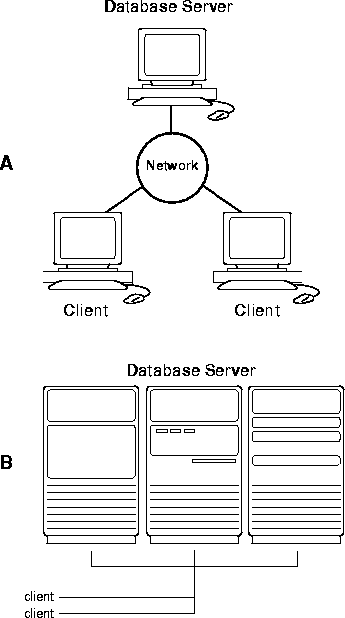
Distributed processing is the use of more than one processor to perform the processing for an individual task
12.1
Notes:
This chapter covers the basics of enterprise architecture, including terminology, characteristics, and associated managerial responsibilities for building a solid enterprise architecture.

Slide 7
Enterprise Architecture
Enterprise architecture (EA) is a discipline for proactively and holistically leading enterprise responses to disruptive forces by identifying and analyzing the execution of change toward desired business vision and outcomes. Source: Gartner
EA delivers value by presenting business and IT leaders with signature-ready recommendations for adjusting policies and projects to achieve target business outcomes that capitalize on relevant business disruptions. Source: Gartner
12.1
Notes:
Some companies, such as Best Buy, Circuit City, Office Depot, and Sears, have their physical and online stores integrated. These companies have been the fast movers because they already had an area in their stores for merchandise pickup (usually for big, bulky items such as TVs and appliances), and because long before the Web, they had the architecture in place that facilitated the transfer of data reflecting a sale from one store to another.
To take on the challenge of business integration, an organization needs a secure and reliable enterprise architecture.

Slide 8
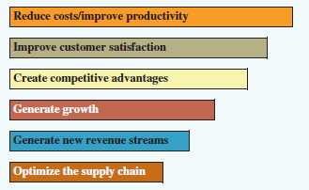
Enterprise Architecture
Unified Enterprise Architecture
  Standardizes hardware and software across the business
  Can make IT cheaper, more strategic and more responsive to customers
Enterprise Architect
  Provides the bridge between IT and the business
  Grounded in technology, fluent in business
  A patient diplomat
12.1
Primary Business Goals of Enterprise Architecture
Figure 12.1
Notes:
Some companies, such as Best Buy, Circuit City, Office Depot, and Sears, have their physical and online stores integrated. These companies have been the fast movers because they already had an area in their stores for merchandise pickup (usually for big, bulky items such as TVs and appliances), and because long before the Web, they had the architecture in place that facilitated the transfer of data reflecting a sale from one store to another.
To take on the challenge of business integration, an organization needs a secure and reliable enterprise architecture.

Slide 9
Global Enterprise Architecture
Challenges
  Technically complex with an overlay of potential political and cultural stumbling blocks
  Enterprises face possible higher prices, tariffs, import restricts and long lead times for government approvals
  Difficulty in estimating operational expenses across network
Benefits
  Internet links tens of millions of users in hundreds of countries
  Internet provides a business environment free of traditional boundaries and geographic limits
  Unprecedented opportunity for expanding markets, reducing costs, direct communications with stakeholders around the world
12.1
Notes:
list of categories of information that needs to be managed. Some answers will include:
Different languages and regional dialects.
Social and business etiquette in written communication.
Different units of measure. Besides metric versus British, there are local variations.
Exchange rates, not only from Canadian currency to a foreign one but also exchanges of foreign currencies as services are purchased by the Canadian company in one country and used in another.
Standards for logistics: rules and regulations of various highways, railways, ports, airports etc.
Laws and Regulations pertaining to contracts, promotions, importing and exporting, human resources, among others.

Slide 10
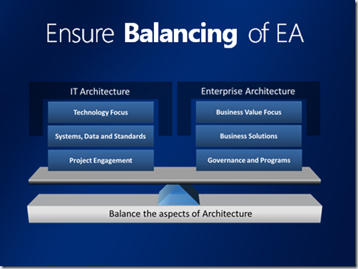
Enterprise Architecture
12.1

Slide 11
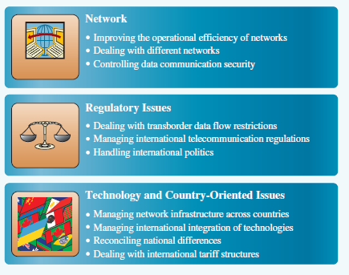
Top International Telecommunications Issues
12.1
Figure 12.2
Notes:
Since the Internet arrived in China in 1994, the state has attempted to block websites and control its access by individuals in an effort manage criticism of the government and communist philosophy. Internet Service Providers must be licensed and internet traffic go through state-owned or controlled telecommunications companies. Among the myriad of things that are deemed “harmful activities” and “harmful information” are include the use the Internet to overthrow the government, injuring the reputation of the state organizations, and “split the nation”, which appears reasonable. However, what constitutes these activities is at the discretion of the state.
China’s implementation of these regulations has been aggressive with heavy censoring of specific content. Large fines, arrests, and the shutting down of sites have made users wary and conservative. State agencies have also used Spoofing techniques to redirect traffic from web sites considered suspicious to state approved web sites. Other computer attacks and abuses have made operating a site within China difficult.
In 2006, Google agreed to block content that the Chinese government deemed illegal to be permitted to establish operations on Chinese soil. In 2010, they moved their servers to Hong Kong in response to alleged computer attacks. For Google’s story, an example of Chinese censorship, see http://googleblog.blogspot.com/2010/01/new-approach-to-china.html#!/2010/01/new-approach-to-china.html

Slide 12
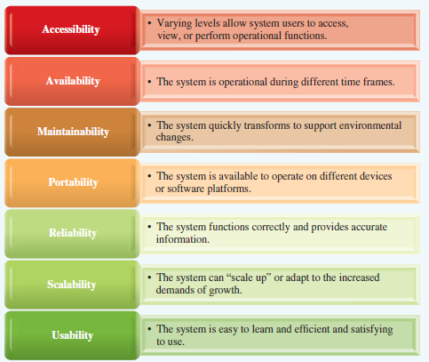
Agile MIS Infrastructure Characteristics
12.2
Figure 12.3
Notes:
Agile MIS Infrastructure includes hardware, software and telecommunications equipment that, when combined, provides the underlying foundation to support the organization’s goals.
Agile means flexible and quick to respond to changes in key factors. Consider a heating system in your home. It responds quickly to dropping temperatures. Agility is enhanced if the heating system goes off and the air conditioning goes on as temperatures rise. Continuing, the system might respond to heating/cooling different rooms only as they were being used. A truly agile system would be one that could switch its fuel source electricity, gas, etc. in response to changing prices.

Slide 13
Agile MIS Infrastructure Characteristics
Accessibility
  Meets each person’s different system needs, requirements and authorization level.
  Administrator Access provides reduced restrictions to allow administrators to set passwords, delete accounts etc.
  Web Accessibility facilitates connection for people with physical, neurological and mental challenges.
  Web Accessibility Initiative (WAI) brings global stakeholders together to create resources to improve web accessibility
Availability
  High Availability means the system is operational at all times.
  Challenge to find opportunities for maintenance downtime
12.2

Slide 14
Agile MIS Infrastructure Characteristics
Maintainability
  Allows easy updates, changes and reconfigurations for unexpected or environmental changes.
Portability
  Recognizes and adapts the use of wireless, mobile and other distance technologies.
  Allows the use of business software on all approved devices.
Reliability (or Accuracy)
  Inaccurate or out-of-date information puts a company at risk of losing customers, costly overstocks or out-of-stock, and poor business decisions.
  Vulnerability is a weakness in the system that can be exploited by a threat
12.2
Notes:
Portability: Have students brainstorm to come up with tasks for every function (Accounting, Marketing, Finance, HR, R&D, Sales etc.) that are carried out away from the office but require connection to the enterprise’s data services.
What are some key factors that have to be taken into consideration when mobilizing a workforce? Availability, Security (many considerations here), device distribution, control and maintenance, privacy and confidentiality, among others.

Slide 15
Agile MIS Infrastructure Characteristics
Scalability
  Performance is the speed of transactions processing
  Capacity represents the maximum amount a system or system component can handle
  Throughput is the maximum amount a system or system component can process at one time
  Capacity Planning determines the future capacity and performance of the system; a critical strategic decision
Usability
  Simplify user interface with one-touch operability & intuitive navigation
  Serviceability refers to how quickly a system can be adapted for a users’ specific needs and requirements
12.2
Notes:
Usability has been a key issue in keeping MIS Infrastructure agile. Unless users can quickly incorporate changes in their operations, the new systems, for all its potential benefits, has failed. Ben Shneiderman, professor at the University of Maryland has been a pioneer in computer-human interactions. Have students access the following link that lists his “Eight golden rules of interface design”.
http://faculty.washington.edu/jtenenbg/courses/360/f04/sessions/schneidermanGoldenRules.html

Slide 16
Open Systems
Non-proprietary software and IT hardware whose design, standards, and procedures are made available to the public
Open Source
  Any program whose source code is made available for use or for modification by other developers
  Often developed by public collaboration
Design of Open Systems
  Allows for data sharing across multiple platforms
  Not constrained to one component manufacturer
  Lower prices due to competition
  Innovation driven by communities of developers
12.2
Notes:
Open system integration is designed to:
Allow systems to seamlessly share data
Capitalize on enterprise architecture
Eliminate proprietary systems and promote competitive pricing

Slide 17
OPENING CASE QUESTIONS
Cloud Computing in Canada
How can an organization use cloud as its enterprise architecture to protect its IT investment?
How can an organization protect the security of its data in the cloud?
What are the benefits for Canadian companies of developing a cloud computing strategy?
How can Canadian companies use cloud computing to deliver on the seven aspects of agile MIS infrastructure?
Notes:
OPENING CASE QUESTIONS
Cloud Computing in Canada
How can an organization use cloud as its enterprise architecture to protect its IT investment?
Student’s answers to question will vary depending on their focus. Many answers may focus on cost as cloud based architectures generally reduce the costs associated with developing and purchasing the architecture. Better answers would focus on the fact that the cloud provider deals with putting in place backup and recovery plans and infrastructure along with disaster recovery plans. Additionally the cloud provider will deal with system redundancies that are associated with cloud technology like the connections to the cloud servers and making sure that there is redundancy in with these connections.
How can an organization protect the security of its data in the cloud?
By using the cloud an organization passes along much of the protection of the security of its data to the cloud provider. This being said there are some unique issues that surround data on the cloud, including making sure data complies with privacy legislation, such as PIPEDA and issues around how the organization and the cloud provider work together to manage compliance. Additionally, the management of proprietary information can also be a security issue unique to the cloud as an organization's data that is on the cloud is not fully under the organization's control.
What are the benefits for Canadian companies of developing a cloud computing strategy?
The key areas that Canadian businesses need to deal with to protect and strengthen their infrastructure architecture are:
Flexibility – make sure the systems are flexible enough to meet all types of business challenges
Scalability – make sure the systems can adapt to increasing demands that result from growth
Reliability – ensure that systems are functioning correctly and giving you accurate information
Availability – ensure that systems can be accessed by users when they need them
Performance – make sure the systems perform the needed processes or transactions efficiently in terms of both speed and throughput
How can Canadian companies use cloud computing to deliver on the seven aspects of agile MIS infrastructure?
One of the key elements of cloud computing is that companies that adopt cloud computing transfer much of the responsibility of each of the seven aspects to the cloud provider. That being said it is important that the company makes sure that the provider they have chosen is taking responsibility for these key aspects and monitors the service to make sure that the company is receiving the service it expects and to which it is contractually obligated.
Accessibility – This is a shared responsibility between the company and its cloud provider and is negotiated in the contractual arrangements that are made.
Availability – A cloud provider allows for 24/7/365 operation of the system.
Maintainability – The company does not need to manage this aspect as the cloud provider takes on this responsibility, and since the cloud provider has multiple clients with differing needs the cloud provider needs to pay close attention to maintainability.
Portability – Cloud environments are generally set up to be device-friendly and this removes the need for the company to manage this aspect of the system.
Reliability – Companies need to make choices as to the number of 9s in terms of reliability. Providers with greater numbers of 9s give the company more reliability.
Scalability – Scalability is also a feature of cloud providers and some provide greater scalability than others through the packages they offer to their clients.
Usability – This aspect is closely linked to the choice a company makes with the cloud provider as the usability of the system is dependent on the choices made by the cloud provider.

Slide 18
SECTION 12.2
INFRASTRUCTURE TRENDS
Data Warehousing
Notes:
CLASSROOM OPENER
Top Ten Data Failure Stories
10. PhD Almost an F -- A PhD candidate lost his entire dissertation when a bad power supply suddenly zapped his computer and damaged the USB Flash drive that stored the document. Had the data not been recovered, the student would not have graduated.
9. Suffering from Art -- While rearranging her home office, a woman accidentally dropped a five pound piece of clay pottery on her laptop, directly onto the hard drive area that contained a book she'd been working on for five years and 150 year-old genealogy pictures that had not yet been printed.
8. Domestic Dilemma -- A husband deleted all of his child's baby pictures when he accidentally hit the wrong button on his computer. His wife hinted at divorce if he did not get the pictures back.
7. Bite Worse than Bark -- A customer left his memory stick lying out and his dog mistook it for a chew toy.
6. Don't Try This at Home -- A man attempting to recover data from his computer on his own found the job too challenging mid-way through and ended up sending Ontrack his completely disassembled drive -- with each of its parts in a separate baggie.
5. Out of Time -- A clockmaker suffered a system meltdown, losing the digital designs for all of its clocks. Ontrack literally beat the clock recovering all their data just in time for an important international tradeshow.
4. Drilling for Data -- During a multi-drive RAID recovery, engineers discovered one drive belonging in the set was missing. The customer found the missing drive in a dumpster, but in compliance with company policy for disposing of old drives, it had a hole drilled through it.
3. Safe at Home -- After one of their executives experienced a laptop crash, the Minnesota Twins professional baseball team called on Ontrack to rescue crucial scouting information about their latest prospects. The team now relies on Ontrack for all data recoveries within its scouting and coaching ranks.
2. Hardware Problems -- A frustrated writer attacked her computer with a hammer. When the engineers received the computer, the hammer imprint was clearly visible on the top cover.
1. La Cucaracha -- In hopes of rescuing valuable company information, a customer pulled an old laptop out of a warehouse where it had been sitting unused for 10 years. When engineers opened the computer, it contained hundreds of husks of dead and decaying cockroaches.

Slide 19

Infrastructure Trends
Four quickly emerging infrastructure trends:
  Service-oriented architecture (SOA)
  Virtualization
  Grid Computing
  Cloud computing
BYOD – Bring your own device
  Bring your own device is gaining popularity
  Infusions of new technology
  Employee buy-in to new infrastructure
  Often more affordable for business
12.3
Notes:
Many educational institutions used to “lease” a specific make and model to students upon registration to be used when connected to the institution’s network and LMS. Today, interoperability software allows students to BYOD. What advantages does this provide the institution’s administration including IT, teachers and students? What disadvantages does this create or the institution’s administration including IT, teachers and students?

Slide 20

The Service-Oriented Architecture
A business-driven IT architectural approach
Views a business as linked, repeatable tasks or services
A service is a self-contained application that produces a specific result or performs a specific business task
Allows users to combine services to create more complex applications to achieve specific operations outcomes as needed
12.3
Notes:
SOA is not a concrete architecture or a tangible tool or framework to be purchased. It is an approach, a way of thinking, a value system that leads to certain concrete decisions when designing a concrete architecture.
For an example at the simplest level, consider a “service” that computes the days between dates. This small app may have been purchased or designed to calculate the time between invoicing a customer and receiving their payment because credit terms might dictate that if the payment is made within 5 days, the customer gets a 2% discount and if the payment is made after 30 days, the customer is assessed a 1.8% interest charge. However, this functionality is also useful for calculating days between dates for accounts payable, invoices the company must pay, for calculating days between dates for customer orders, information that sales representatives would like to know and days between dates for the analysis of employee absenteeism for HR etc. When this functionality resides in an SOA, it no longer is an accounts payable app, becomes accessible to many tasks and a part of different collections of services.

Slide 21
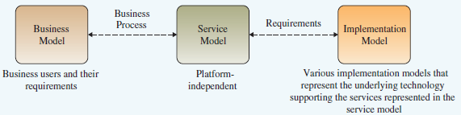
SOA Key Technical Concepts
Services are business tasks.
Interoperability is the capability of two or more systems to share data and resources even if they are from different manufacturers
Loose coupling allows services to be joined together on demand to create composite services, or disassembled and reconfigured
12.3
The Service-Oriented Architecture
Figure 12.4
Notes:
SOA is particularly effective when existing architecture needs to remain in place to support critical business processes. By coupling service modules into existing infrastructure, enterprises can adapt to the changing needs of a dynamic environment. in Figure 12.4, the process arrows joining Business Model, Service Model and Implementation Model operate in both directions. Development is not linear. It iterates between the models. For example, new services may initiate a reappraisal of the business process and a redefinition of the business model. Competition might impact what is required at the front-end, the Implementation model, changing Requirements and necessitating a different configuration of the Service Model.

Slide 22
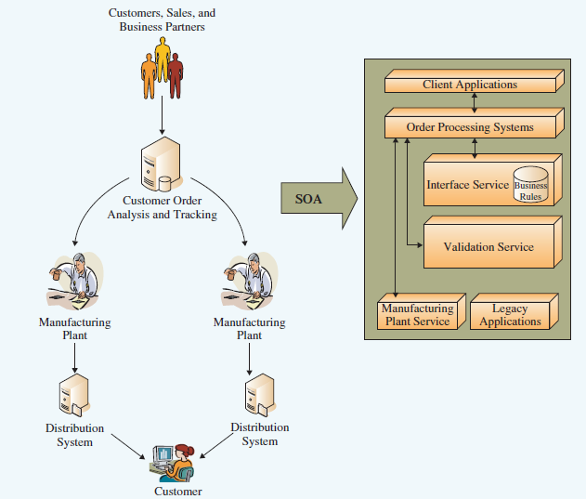
SOA Integration
12.3
Figure 12.5
Notes:
This diagram displays a number of areas where SOA is effective. It can bring together current applications so that the data and resources can be shared.

Slide 23
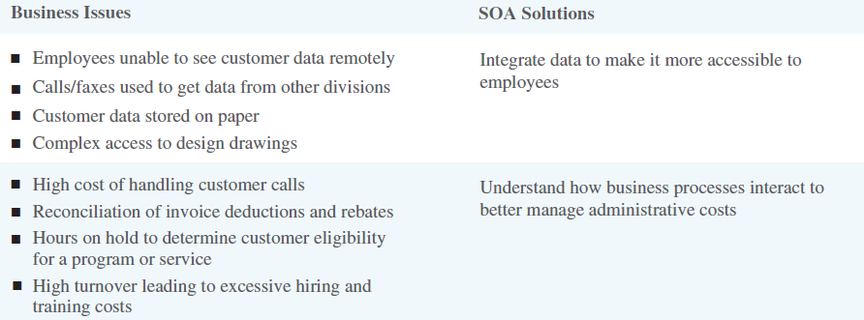
Business Issues & Associated SOA Solutions
12.3
From Figure 12.6
Notes:
To be successful SOA demands that IT have a understanding of business processes at a granular level so that an appropriate service can be deployed in an effective manner. for example, supporting a million cell phone subscribers does not require that the cell phone service provider support a million live connections; it requires supporting only the number of simultaneous conversations at any given time.

Slide 24
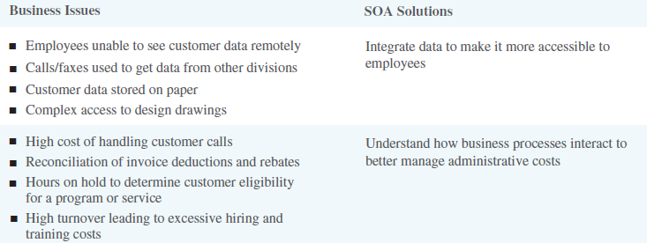
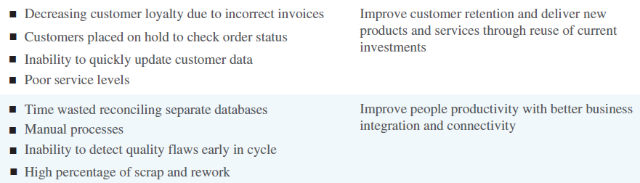
Business Issues & Associated SOA Solutions
12.3
From Figure 12.6
Notes:
SOA is an evolution. It builds on current technologies in the marketplace such as Web Services (discussed next), transactions technologies and object-oriented design.
Have students review the Service-Oriented Architecture section in the text for interesting analogies and business examples.

Slide 25
Web Services
Contain a repertoire of Web-based data and procedural resources that use shared protocols permitting different applications to share data and services.
  An individual web service can be thought of as software performing a single task available to any user who needs it
Types of Web Services
  Events detect threats and opportunities and alert those who can act on the information
  Services are re-usable coding projects that appeal to a broad audience
12.3
Notes:
Web Services can be applications developed internally and made available across the intranet within a company to those business processes that can use them. Rapidly expanding is the availability of services provided by third-party developers on open platforms that can be accessed and used by businesses as required. Web services can be small apps or large, complex software applications.

Slide 26
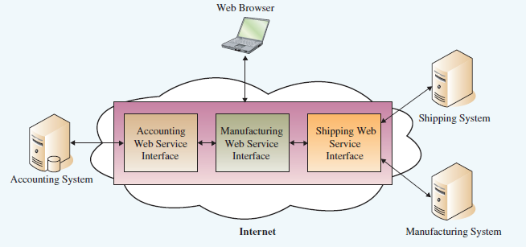
Web Services
12.3
Figure 12.7
Notes:
It may be useful to understand that an enterprise can take advantage of applications found on the Internet to improve the efficiency and effectiveness of their operations. For example, in this diagram, the Accounting, Shipping and Manufacturing information system applications are controlled by the company. The servers managing the data and transactions processing are pictured here. To have them run more efficiently requires applications that will integrate their data processing. Instead of developing the systems in house, applications that are already developed can be accessed from the Internet and used to achieve the integration objective. The applications create an interface between the company systems.

Slide 27
Virtualization
Dividing the resources of a computer or system into multiple executional environments
  Maximizes the use of physical resources and hardware investment
  Created with the use of virtualization software
System Virtualization
  Presents the resources of a single computer as if it is a collection of separate machines each with its own virtual CPU, network interfaces, storage and operating systems
  Appears to both the user within the IS and externally to the network, as separate computers, each with its own network identity
12.4
Notes:
advantages to virtualization. Some suggestions: Security: documents can be backed up to the “other” machine which will be protected from a virus or worm infecting the source partition. A partition could be used as a “cold-site” or “hot-site” for Disaster Planning and act as a “fail-over” from the partition suffering denial of service. Efficiency: Machines can be partitioned and each assigned to more than one employee whose work could not be accessed by the other employee. One virtual machine could continuously run a large program while the other virtual machine(s) could run another application simultaneously without conflict or interference from the first.

Slide 28
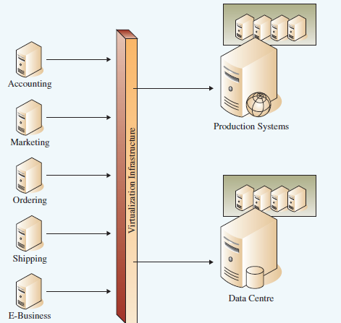
Virtualized Architecture
12.4
Figure 12.8
Notes:
Virtualization software—runs on one machine but emulates multiple pieces of hardware.
Emulator—hardware or software that duplicates(emulates) the functions of one device in another.

Slide 29
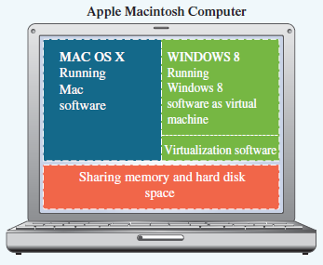
Virtualization Allows An Apple Macintosh Computer to Run Mac OS X and Windows 8
12.4
Figure 12.9
Notes:
Most computers and even servers typically run only one operating system, such as Windows or Mac OS, and only one application.
However, a MAC can be “partitioned” to run the Windows operating system and Microsoft software by means of Boot Camp software. The partition creates a virtual computer within a computer.
When a company invests in a large system such as inventory management, it dedicates a single server to house the system.
This ensures the system has enough capacity to run during peak times and to scale to meet demand.
Also, many systems have specific hardware requirements along with detailed software requirements, making it difficult to find two systems with the same requirements that could share the same machine.
Through the use of virtualization, computers can run multiple operating systems along with multiple software applications—all at the same time.

Slide 30
Virtualization Business Benefits
Push to Virtualization
  Exponential power growth of computers resulting in underused hardware
  Data centers running out of space while machines are at 10-15% capacity; perform server consolidation & virtualization
  Increasing energy costs and systems administration costs
Additional Benefits
  For server administration: rapid application deployment, dynamic load balancing, and streamlined disaster recovery, improved service management
  Reduces software test and deployment time as users can test and qualify software in isolation from main server activity
12.4
Notes:
Why can virtualization be seen as a “green” approach to computing?

Slide 31
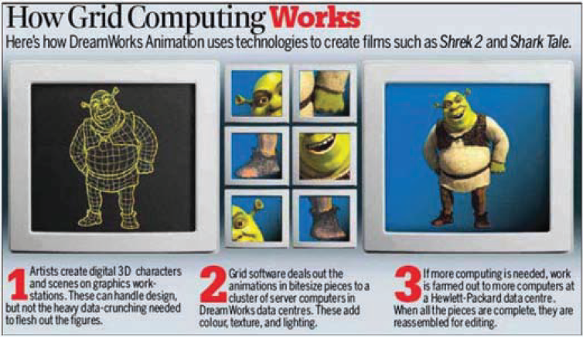
Grid Computing
A coordinated aggregation of geographically dispersed computing and network resources, delivering improved performance, easier data access and higher quality of service
12.5
Figure 12.10
Notes:
With grid computing, the user works with a single system image despite the fact that the services requirements may be spread over the network to a number of servers to manage the needed capacity and through-put, or to provide several different specialized services at the same time. Have students “walk through” the DreamWorks example to gain insight into the benefits of grid computing.

Slide 32
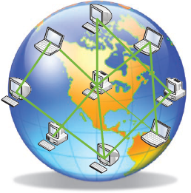
Grid Computing Business Benefits
Optimizes computing and data resources
  Pools resources for large capacity workloads
  Shares resources across the network
  Enables collaboration
Open standards allow for communication across geographically dispersed locations
Builds flexible architectures
Leverages capital investment
Virtualization of
Grid Computing
12.5
Figure 12.11
Notes:
Computers typically use less than 25 percent of their processing power, leaving more than 75 percent available for other tasks. By taking advantage of open standards and virtualization, grid computing can utilize this unused processing power by linking thousands of individual computers around the world to create a “virtual supercomputer” that can process intensive tasks.
Discuss some real-world examples of grid applications (not mentioned in the book):
A company needing to reach a decision on the placement of a new factory invokes a sophisticated financial forecasting model from an Application Service Provider (ASP), providing the ASP with access to appropriate proprietary historical data from a corporate database on storage systems operated by a Storage Service Provider (SSP). During the decision-making meeting, what-if scenarios are run collaboratively and interactively, even though the division heads participating in the decision are located in different cities. The ASP itself contracts with a cycle provider for additional "oomph" during particularly demanding scenarios, requiring of course that cycles meet desired security and performance requirements.
An industrial consortium formed to develop a feasibility study for a next-generation supersonic aircraft undertakes a highly accurate multidisciplinary simulation of the entire aircraft. This simulation integrates proprietary software components developed by different participants, with each component operating on that participant’s computers and having access to appropriate design databases and other data made available to the consortium by its members.
A crisis management team responds to a chemical spill by using local weather and soil models to estimate the spread of the spill, determining the impact based on population location as well as geographic features such as rivers and water supplies, creating a short term mitigation plan (perhaps based on chemical reaction models), and tasking emergency response personnel by planning and coordinating evacuation, notifying hospitals, and so forth.
Thousands of physicists at hundreds of laboratories and universities worldwide come together to design, create, operate, and analyze the products of a major detector at CERN, the European high energy physics laboratory. During the analysis phase, they pool their computing, storage, and networking resources to create a "Data Grid" capable of analyzing petabytes of data.

Slide 33


Cloud Computing
Software applications and computing services run on the Internet instead of on user infrastructure
  Common cloud applications include: email, social media
  Users are not bound to a single computer or network and can access resources as needed
  Applications and data are stored in the cloud servers, not on the users’ machines
Multi-tenancy refers to a single instance of a system serving multiple customers such as Gmail
Cloud Fabric is the supporting software
Cloud Fabric controller is like a server administer but manages the cloud resources: load-balancing, updating the system and ensuring
http://money.cnn.com/2014/09/03/technology/enterprise/what-is-the-cloud/index.html
12.5
Notes:
A quick, current and easy to understand video describing what the cloud is physically can be found on CNN’s website at http://money.cnn.com/2014/09/03/technology/enterprise/what-is-the-cloud/index.html The video is 1 min 17 seconds (but students should be warned that it immediately rolls into the next video in an on-going loop).
-Paas
-Iaas
-Daas (database as service)
-Saas (software as service)

Slide 34
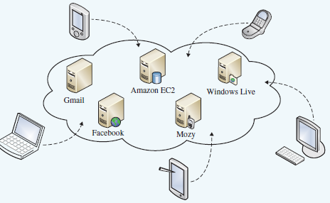
Cloud Computing Benefits
Higher availability, greater reliability, improved accessibility, easy service distribution & collaboration, affordable high-speed access
No installation, upgrade or storage costs, pay only for access
Highly scalable and easy to drop or add services
12.5
Cloud Computing Example
Figure 12.12
Notes:
As quoted in the text, from IDG Enterprise and its Cloud Computing Trends and Future Effects Report:
49% of executive-level managers see cloud computing as transformational to their business. Of the other 51%:
40% are currently investigating the potential of cloud to their business
5% don’t see cloud as an option
6% aren’t sure
The top four drivers of cloud computing investments are”
Enabling business continuity (43%)
Greater flexibility to react to changing markets (40%)
Speed of deployment (39%)
Improving customer support or services (40%)
The top four benefits for cloud-based applications are
Accelerating business value through the access to critical data and applications (56%)
Serving as a source of IT innovation (56%)
Enabling better employee collaboration (54%)
Enabling higher levels of IT agility (54%)
A lower total cost of ownership is one of the top selling points for cloud computing

Slide 35
Cloud Computing Benefits
As quoted in the text, from IDG Enterprise and its Cloud Computing Trends and Future Effects Report:
49% of executive-level managers see cloud computing as transformational to their business. Of the other 51%:
  40% are currently investigating the potential of cloud to their business
  5% don’t see cloud as an option
  6% aren’t sure
The top four drivers of cloud computing investments are”
  Enabling business continuity (43%)
  Greater flexibility to react to changing markets (40%)
  Speed of deployment (39%)
  Improving customer support or services (40%)
The top four benefits for cloud-based applications are
  Accelerating business value through the access to critical data and applications (56%)
  Serving as a source of IT innovation (56%)
  Enabling better employee collaboration (54%)
  Enabling higher levels of IT agility (54%)
A lower total cost of ownership is one of the top selling points for cloud computing
12.5

Slide 36
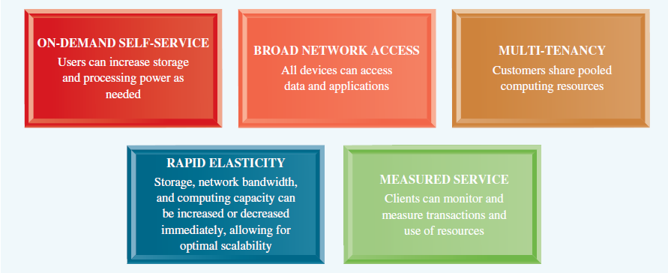
Benefits of Cloud Computing
12.5
Figure 12.13
Notes:
With cloud computing, an individual or business pays only for the services they need, when they need them and where, much as we use and pay for electricity. In the past, a company would have to pay millions of dollars for the hardware, software, and networking equipment required to implement a large system such as payroll or sales management. A cloud computing user can simply access the cloud and request a single license to a payroll application. The user does not have to incur any hardware, software, or networking expenses. As the business grows and the user requires more employees to have access to the system, the business simply purchases additional licenses. Rather than running software on a local computer or server, companies can now reach to the cloud to combine software applications, data storage, and considerable computing power.
Utility computing Offers a pay-per-use revenue model similar to a metered service such as gas or electricity.

Slide 37
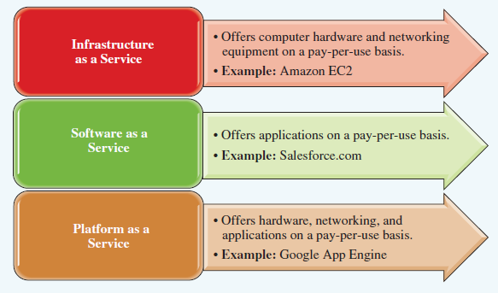
Cloud Service Delivery Models
12.5
Figure 12.14
Notes:
These delivery models are most often known by their acronyms IaaS, SaaS and PaaS.
Students are already familiar with Outsourcing as an option for systems development. Cloud Services are outsourcing options facilitated by the data transfer and security capabilities of the Internet.

Slide 38

Cloud Services Deliver Models
Infrastructure as a Service (IaaS)
  Delivers hardware and networking capabilities including server services and storage
  Cost efficient as the user does not have to pay for excess capacity, unused utility costs, etc.
  Pay-as-you-use model
  Highly scalable
Software as a Service (SaaS)
  Software is priced on a per-use basis
  Flexible, scalable, easy to try before rolling out
  Offers Help Desk and other IT support
12.5
Notes:
Total Cost of Ownership (TCO) which includes both the initial upfront development and installation costs of infrastructure as well as the on-going maintenance and operating costs, is often cited as one of the principle reasons for using IaaS. Scalability and responsiveness are also significant motivators. Can students think of disadvantages to IaaS? Considerations may include lack of competitive edge as the configuration of IaaS is available to all, security, control of electronic assets, lower balance sheet asset levels making the company look less valuable.

Slide 39

Cloud Services Deliver Models
Platform as a Service (PaaS)
  Supports the deployment of entire systems including software, hardware and networking
  Pay-as-you-use model
  Lifts the burden of buying, managing, and maintaining IS
  Benefits:
  Increased security
  Access to information anywhere/anytime
  Centralized information management
  Easy collaboration with partners, customers, suppliers
  Increased speed to market at less cost
12.5
Notes:
While the link to Google’s App Engine is designed for programmers writing apps to be deployed primarily as SaaS, students might benefit from listening to it as the speaker talks about the benefits of using Google App Engine as PaaS and covers many of the benefits of this cloud delivery model and also the functions of a cloud fabric controller. (estimated time 5 min)
https://cloud.google.com/appengine/docs?csw=1

Slide 40
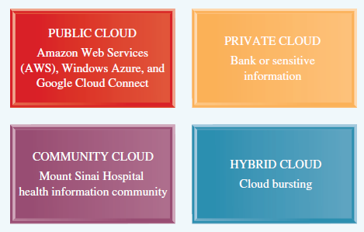
Cloud Computing Environments
12.5
Figure 12.15
Notes:
Public Cloud promotes massive, global and industry-wide applications offered to the general public
Private Cloud serves only one customer or organization and can be located on the customer’s premises or off.
Community Cloud serves a specific community with common business models, security requirements, and compliance considerations. Non-profit organizations are emerging as users of community clouds for the stakeholders they serve providing them access to services and secure channels of communication.
Hybrid Cloud includes two or more private, public or community clouds. For example, a company may keep sensitive information on a private cloud and public information on a public one.
Cloud Bursting occurs when a company uses its own IS infrastructure but accesses the cloud at peak capacity to ensure seamless service to its customers.

Slide 41
Cloud Computing Considerations
Advantages
  Convenience of access to applications and data from any networked client device
  Often significant costs savings in not buying infrastructure and more efficient use of electrical and other resources
  Reduces capital expenditure
Disadvantages
  Loss of control over applications
  Requires trust in providers for security and confidentiality
  Risks denial of access to company data if conflict with the service provider occurs
Trends
  Projected to be the fastest growing form of computing
12.5
Notes:
Ask students for their experiences with cloud computing. Do they have a blog on www.blogspot.com, hosted by Google? What email service do they use? MSN stores messages on Microsoft servers. What other cloud providers are represented by student applications?

Slide 42
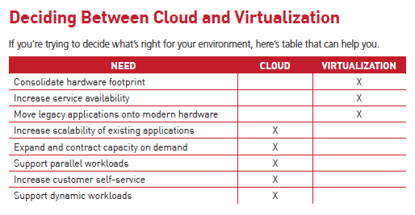
Cloud Computing vs Virtualization
12.5
Source: Rackspace Support

Slide 43
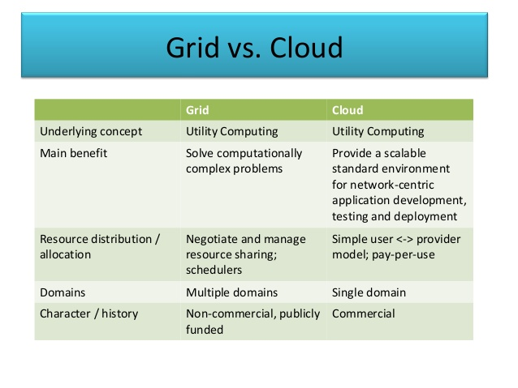
Cloud Computing vs Grid Computing
12.5
Source: internet

Slide 44
OPENING CASE QUESTIONS
Project Management
Explain advantages in using a cloud computing architecture.
Explain the business drivers for using cloud computing.
What business benefits might Canadian businesses experience deploying grid computing?
What business benefits might Canadian businesses experience deploying virtualization?
Notes:
OPENING CASE STUDY
Cloud Computing in Canada
Explain the advantages in using a cloud computing architecture.
Cloud computing can allow Canadian businesses to plug in or unplug new services or upgrade existing services in a granular fashion. This enables Canadian businesses to address the new business requirements, provides the option to make the services consumable across different channels, and exposes the existing enterprise and legacy applications as services, thereby safeguarding existing IT infrastructure investments.
Explain the business drivers for using cloud computing.
The business drivers for Canadian businesses using cloud computing would be those that would help it deal with growing data while not needing to expand its data centres and dealing with rising energy and system administration costs.
What business benefits might Canadian Businesses experience deploying grid computing?
The business benefits of deploying grid computing for Canadian businesses stem mostly from grid computing's ability to help companies work in heterogeneous application environments, which businesses in Canada could experience with partnership and alliance business models. Another benefit of grid computing is its ability to help companies better operate in geographically disperse environments.
What business benefits might Canadian Businesses experience deploying virtualization
Besides cost savings that are associated with cloud computing Canadian businesses can gain benefits from the ability of employees to use applications that are Internet based off of clients

Slide 45
CLOSING CASE ONE:
Virtualization at Ontario’s Workplace Safety and Insurance Board
Review the five characteristics of infrastructure architecture and rank them in order of their potential impact on the WSIB’s business.
What precautions did the WSIB need to take to ensure 100 percent security?
If the WSIB decided to go to 100 percent virtualization in their data centre, what concerns beyond security would they need to address?
Explain how the data centre enabled the WSIB’s new business mission.
How might the WSIB be able to take advantage of cloud computing and/or grid computing to further its business strategy?
Notes:
CLOSING CASE ONE
Virtualization at Ontario’s Workplace Safety and Insurance Board
Review the five characteristics of infrastructure architecture and rank them in order of their potential impact on WSIB’s business.
The following are the five primary characteristics of solid infrastructure architecture:
Flexibility
Scalability
Reliability
Availability
Performance
Student rankings will vary. The important part of the answer is their justification for the ranking. This can make for an excellent classroom debate.
What precautions does WSIB need to take to ensure 100 percent security?
Some of the security precautions include firewalls, physical security of the servers, and authentication.
If the WSIB decided to go to 100 percent virtualization in their data centre what concerns beyond security would they need to address?
The main concerns would be factors like connectivity, maintaining uptime on the servers, and also concerns around protecting the integrity of sensitive data.
Explain how the data centre is enabling WSIB’s new business mission.
The data centre is allowing the WSIB to focus on its business mission and allowing for cost savings that can also be used to further support that mission.
How might WSIB be able to take advantage of Cloud Computing and/or Grid Computing to further their business strategy?
Student answers will vary but both cloud computing and grid computing could allow WSIB to achieve even greater cost saving in their virtualization efforts, assuming that the right security and other concerns are addressed, such as up-time and connectivity.

Slide 46
CLOSING CASE TWO:
Pandora’s Music Box
List the ways that an agile MIS infrastructure supports Pandora’s business.
Describe the reasons Pandora would create a disaster recovery plan and a business continuity plan.
Apply the concepts of cloud computing to Pandora’s business model.
Develop a way that Pandora could benefit from grid computing.
Assess the use of virtualization to support Pandora’s business growth while helping the environment.
Notes:
CLOSING CASE TWO
Pandora’s Music Box
List the ways that an agile MIS infrastructure supports Pandora’s business.
An agile MIS infrastructure supports change. An agile MIS infrastructure includes the hardware, software, and telecommunications equipment that, when combined, provides the underlying foundation to support the organization’s goals. An agile MIS infrastructure includes all of the following:
Accessibility refers to the varying levels that define what a user can access, view, or perform when operating a system.
Availability refers to the time frames when the system is operational.
Maintainability (or flexibility) refers to how quickly a system can transform to support environmental changes.
Portability refers to the ability of an application to operate on different devices or software platforms, such as different operating systems.
Reliability (or accuracy) ensures a system is functioning correctly and providing accurate information.
Scalability describes how well a system can “scale up” or adapt to the increased demands of growth.
Usability is the degree to which a system is easy to learn and efficient and satisfying to use.
Student answers to how an agile MIS infrastructure supports Pandora will differ depending on their personal view of this business. Students who are familiar with Pandora and are using the service will know intimately how an agile MIS infrastructure supports a customer’s needs. Students who are unfamiliar with Pandora might have different views on what the customer wants and the important part of this exercise is ensuring the students include their analysis and justification for each component.
Describe the reasons Pandora would create a disaster recovery plan and a
business continuity plan.
A company can create a disaster recovery plan, which is a detailed process for recovering information or a system in the event of a catastrophic disaster. This plan includes such factors as which files and systems need to have backups and their corresponding frequency and methods along with the strategic location of the storage in a separate physical site that is geographically dispersed. A company might strategically maintain operations in New York and San Francisco, ensuring that a natural disaster would not impact both locations. A disaster recovery plan also foresees the possibility that not only the computer equipment but also the building where employees work may be destroyed. A hot site is a separate and fully equipped facility where the company can move immediately after a disaster and resume business. A cold site is a separate facility that does not have any computer equipment but is a place where employees can move after a disaster. A warm site is a separate facility with computer equipment that requires installation and configuration.
Pandora would need to create a disaster recovery plan to ensure that all customers have continuous listening capabilities, regardless of what was occurring at Pandora. Just like customers expect to have electric or cable 24x7, radio listeners expect to have service 24x7, a disaster recovery plan or a continuity plan would ensure that 24x7 service occurs.
Apply the concepts of cloud computing to Pandora’s business model.
Marketing materials continually promote new technologies that promise to radically change the way businesses operate; unfortunately, these devices rarely live up to the hype. However, it might actually be true for one new development making this promise. Cloud computing could change not only the way businesses operate, but also the way people interact with technology. Cloud computing refers to the use of resources and applications hosted remotely on the Internet. The term comes (at least in part) from the image of a cloud to represent the Internet or some large networked environment. Users connect to the cloud from their personal computers or portable devices using a client, such as a Web browser. To these individual users, the cloud appears as their personal application, device, or document. It is like storing all of your software and documents “in the cloud” and all you need is a device to access the cloud. No more hard drives, software, or processing power—that is all located in the cloud, transparent to the users.
Develop a way that Pandora could benefit from grid computing.
Combating e-waste, energy consumption, and carbon emissions requires a firm to focus on creating sustainable MIS infrastructures. A sustainable MIS infrastructure identifies ways that a company can grow in terms of computing resources while simultaneously becoming less dependent on hardware and energy consumption. The components of a sustainable MIS infrastructure include:
Grid computing is a collection of computers, often geographically dispersed, that are coordinated to solve a common problem. A smart grid delivers electricity using two-way digital technology. It is meant to solve the problem of the world’s outdated electrical grid, making it more efficient and reliable by adding the ability to remotely monitor, analyze, and control the transmission of power.
Cloud computing: A smart grid delivers electricity using two-way digital technology. It is meant to solve the problem of the world’s outdated electrical grid, making it more efficient and reliable by adding the ability to remotely monitor, analyze, and control the transmission of power. Utility computing offers a pay-per-use revenue model similar to a metered service such as gas or electricity.
Virtualized computing creates multiple “virtual” machines on a single computing device.
Additional business benefits of grid computing include:
Improved productivity and collaboration of virtual organizations and respective computing and data resources.
Allowing widely dispersed departments and businesses to create virtual organizations to share data and resources.
Robust and infinitely flexible and resilient operational architectures.
Providing instantaneous access to massive computing and data resources.
Leveraging existing capital investments, which in turn help to ensure optimal utilization and costs of computing capabilities.
Assess the use of virtualization to support Pandora’s business growth while helping the environment.
Through the use of virtualization, computers can run multiple operating systems along with multiple software applications—all at the same time. Virtualization creates multiple “virtual” machines on a single computing device. A good analogy is a computer printer. In the past you had to purchase a fax machine, copy machine, answering machine, and computer printer separately. This was expensive, required enough energy to run four separate machines, not to mention created additional amounts of e-waste. Today, you can buy a virtualized computer printer that functions as a fax machine, answering machine, and copy machine all on one physical machine, thereby reducing costs, power requirements, and e-waste. Virtualization is essentially a form of consolidation that can benefit sustainable MIS infrastructures in a variety of ways, for example:
By increasing availability of applications that can give a higher level of performance depending on the hardware used.
By increasing energy efficiency by requiring less hardware to run multiple systems or applications.
By increasing hardware usability by running multiple operating systems on a single computer.

Slide 47
CLOSING CASE THREE:
The U.S. Open Supports SOA
Review the five characteristics of infrastructure architecture and rank them in order of their potential impact on USOpen.org.
What are the USTA security concerns regarding interoperability between the tournament database and its website?
How could the USTA benefit from virtualization?
Identify the value of integrating the tournament data with the USTA site, USOpen.org.
Why would a sudden surge in server usage during the middle of the U.S. Open spell disaster for the USTA?
Why is loose coupling a critical business component to the USTA architecture?
Notes:
CLOSING CASE THREE
The U.S. Open Supports SOA
Review the five characteristics of infrastructure architecture and rank them in order of their potential impact on the USOpen.org.
The following are the five primary characteristics of solid infrastructure architecture:
Flexibility
Scalability
Reliability
Availability
Performance
Student rankings will vary. The important part of the answer is their justification for the ranking. This makes for an excellent classroom debate.
What are the USTA security concerns regarding interoperability between the tournament database and its website?
By having interoperability between the tournament database and its web site the data in the tournament database become accessible by all the visitors to the web site and would cause security concerns about both the historical and current data in the database.
How could the USTA benefit from virtualization?
The USTA could benefit from virtualization mostly by saving operating (energy, systems administration, etc.) costs which is an important factor in the operation of most not-for-profit organizations in today’s economy. It would also help them deal with the surges in demand that happens during the US Open tournament in early September.
Identify the value of integrating the tournament data with the USTA site, USOpen.org
The benefit is in customer service so that visitors to the web site can get instant, real-time scores form all courts during the tournament.
Why would a sudden surge in server utilization during the middle of the U.S. Open spell disaster for the USTA?
Not only could this result in an outage on the web site which would affect customer service but more importantly it could cause outages where referees cannot enter data into the database and this would result in problems with tournament operations.
Why is loose coupling a critical business component to the USTA architecture?
Again since the demand cycle for the systems is variable which time of very large demand during the US Open tournament and much less demand during the rest of the year the use of loose coupling in its architecture is a critical component.

