Slide 1
Lecture 13-17
Pattern formation in Drosophila

Slide 2
Developmental Genetics
of Multicellular Organisms
So far we have discussed:
How cells are directed to be different. Fate specification
How cells come to be different. Differentiation
How cell division is regulated.

Slide 3
Pattern Formation
How does a developing organism coordinate the fate
of a large number of cells into a pattern or body plan to
promote morphogenesis?

Slide 4
Pattern Formation
Zygote Adult
One cell 3x10¹³ cells
No shape or form complex shape and form
One cell type many different cell types

Slide 5
Gene B
TF2
TF1
Motif 2
Motif 1
enhancer
promoter
exon 1
intron
exon 2
Gene B is transcribed only in cells having both transcription factor 1 and transcription factor 2.

Slide 6
Drosophila embryo
= cells with transcription factor 1
= cells with transcription factor 2
= Expression domain of gene B

Slide 7
Principles of pattern formation
1. Must establish positional information (spatial information) within the developing embryo—(morphogen? environmental signals).
2. Direct simple patterns (anterior—posterior, dorsal--ventral) early and use to elaborate more complex pattern.
3. Use a cascade of determination events to coordinate timing.
4. Use master regulatory proteins each of which will be expressed in specific groups of cells marking them for a particular fate.

Slide 8
Pattern Formation in Drosophila
Lecture 13 Objectives
What are the key events during Drosophila embryogenesis?
Does Drosophila use cytoplasmic determinants to direct developmental pattern?
At what stage are the fates of cells fixed during Drosophila embryogenesis?

Slide 9
Pattern formation during Drosophila embryogenesis
What are the key steps early in
Drosophila embryogenesis?

Slide 10
Drosophila Development
Oocyte cell is fertilized to generate the zygote.
Following fertilization, the zygotic nucleus (and all progenitor nuclei) undergoes 13 rounds of mitotic divisions without any cytokinesis—forming a syncytial blastoderm.

Slide 11
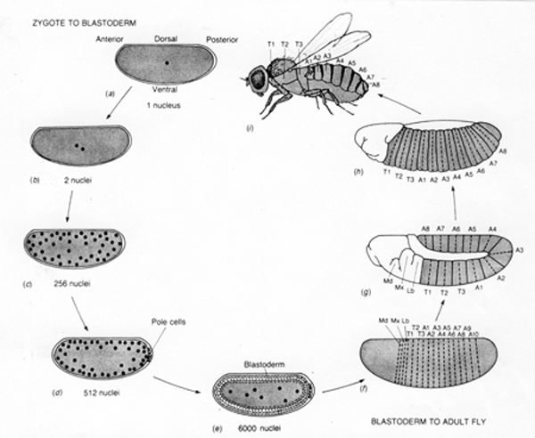
Drosophila life cycle
From Genetics, 1987, G. Zubay, Benjamin Cummings

Slide 12
Drosophila Development
Oocyte cell is fertilized to generate the zygote.
Following fertilization, the zygotic nucleus (and all progenitor nuclei) undergoes 13 rounds of mitotic divisions without any cytokinesis—forming a syncytial blastoderm.
http://www.youtube.com/watch?v=XSKh-GLQn4E&feature=related

Slide 13
Gap 1
Phase (G1)
2n
2n
growth
2n
2n
DNA
replication
Synthesis
Phase (S1)
Mitotic
Phase (M)
mitosis
cytokinesis
4n
4n
Gap 2
Phase (G2)

Slide 14
Drosophila Development
Oocyte cell is fertilized to generate the zygote.
Following fertilization, the zygotic nucleus (and all progenitor nuclei) undergoes 13 rounds of mitotic divisions without any cytokinesis—forming a syncytial blastoderm.
3. By the 9th or 10th round of divisions the nuclei migrate to the periphery and the pole cells (germ line precursors) are formed.

Slide 15
Drosophila life cycle
From Genetics, 1987, G. Zubay, Benjamin Cummings

Slide 16
Drosophila Development
Oocyte cell is fertilized to generate the zygote.
Following fertilization, the zygotic nucleus (and all progenitor nuclei) undergoes 13 rounds of mitotic divisions without any cytokinesis—forming a syncytial blastoderm.
3. By the 9th or 10th round of divisions the nuclei migrate to the periphery and the pole cells (germ line precursors) are formed.
4. At the end of the 13th round of division (about 6000 nucleii) cellularization occurs producing ---the cellular blastoderm.

Slide 17
Drosophila life cycle
From Genetics, 1987, G. Zubay, Benjamin Cummings

Slide 18
Drosophila Development
Oocyte cell is fertilized to generate the zygote.
Following fertilization, the zygotic nucleus (and all progenitor nuclei) undergoes 13 rounds of synchronous mitotic divisions without any cytokinesis—forming a syncytial blastoderm.
3. By the 9th or 10th round of divisions the nuclei migrate to the periphery and the pole cells (germ line precursors) are formed.
4. At the end of the 13th round of division (about 6000 nucleii) cellularization occurs producing ---the cellular blastoderm.
Cell division, and migration occurs during gastrulation producing a segmented larva with shape and form.
http://www.youtube.com/watch?v=j87y7EAj8qE&feature=related

Slide 19
Drosophila life cycle
From Genetics, 1987, G. Zubay, Benjamin Cummings

Slide 20
Pattern formation during Drosophila embryogenesis
2 major axes are set up early in embryogenesis:
Anterior-Posterior
Dorsal-Ventral
Clicker Question
When are these axes determined?
  Oocyte
  Zygote.
  Syncytial Blastoderm.
  Cellular Blastoderm.
  Gastrula.
Notes:
Answer = A

Slide 21
Drosophila life cycle
From Genetics, 1987, G. Zubay, Benjamin Cummings

Slide 22
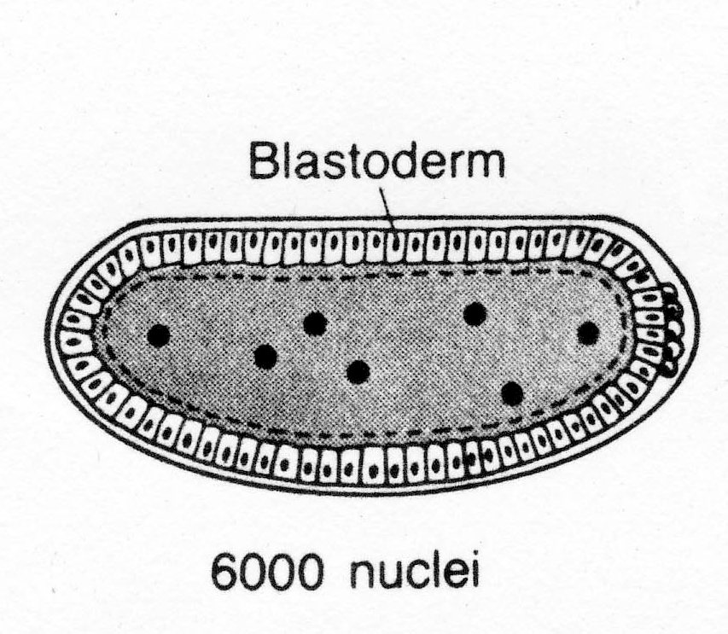
Drosophila cellular blastoderm
Are developmental fates of blastoderm cells fixed?

Slide 23
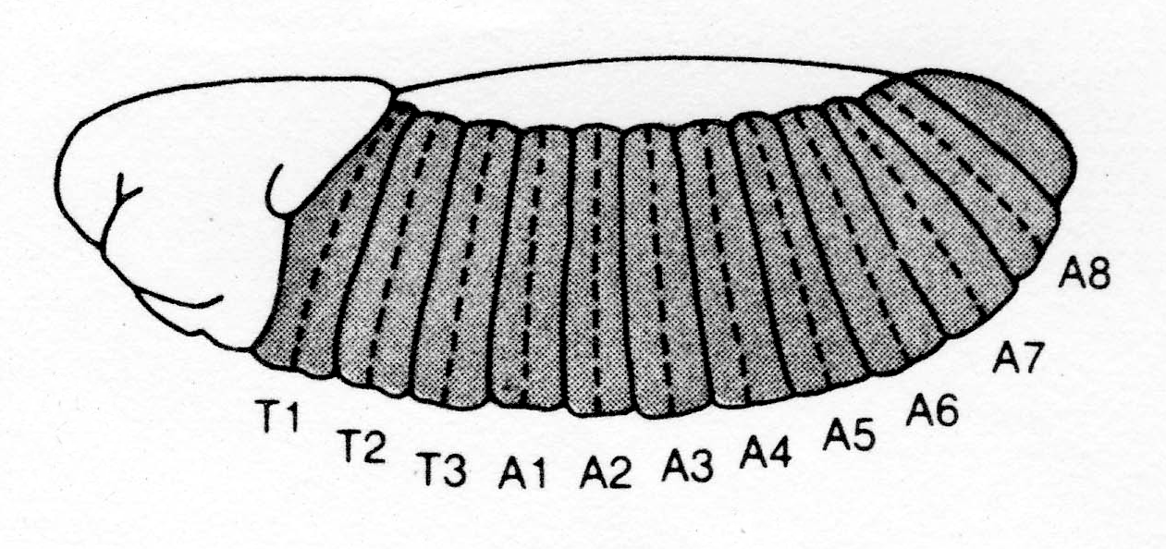
Blastoderm cell fates
cellular blastoderm
Transfer blastoderm cells
to larval abdomen
larva
Result: anterior cells develop as head and thoracic
Structures in the abdomen of the developing larva.
Conclusion: anterior posterior cell fate is fixed in the cellular blastoderm

Slide 24
Blastoderm cell fates
cellular blastoderm
Allow blastoderm to develop
= defective segment
larva
Result: -anterior cell ablation results in a partly defective anterior segment
    -posterior cell ablation results in a partly defective posterior segment
    -a stripe of four blastoderm cells in width
    gives rise to 1 segment in the larva
Conclusion: segmentation is already determined in the cellular blastoderm

Slide 25
Blastoderm cell fates summary
At the cellular blastoderm stage:
The anterior-posterior and dorsal-ventral axes have been set up.
Segmentation is determined.
Broad morphological decisions are made at an early stage.

Slide 26
Drosophila life cycle
From Genetics, 1987, G. Zubay, Benjamin Cummings

Slide 27
Are there cytoplasmic determinants in the zygote?
Anterior
Posterior
A
zygote
P
Allow to develop
to gastrulation
Embryo develops
with no head or thorax
but a normal abdomen

Slide 28
Are there cytoplasmic determinants in the zygote?
Anterior
Posterior
A
zygote
P
Allow to develop
to gastrulation
Embryo develops
with no abdomen but a normal head and thorax

Slide 29
A
zygote 1
P
Anterior
Posterior
A
zygote 2
P
P
Allow to develop
to gastrulation
Embryo develops with
posterior segments on both ends

Slide 30
Clicker Question
If a scientist uses a laser to ablate fifty nucleii in the anterior region of a Drosophila 256 nucleii syncytial blastoderm and then allows the embryo to develop further, which of the following would be the most likely result?
A. embryo develops with a defective head.
B. embryo develops with a defective abdomen.
C. embryo develops normally.
Notes:
Answer = A or C

Slide 31
Conclusion：
Cytoplasmic determinants are localized in the anterior and posterior regions of the zygote.
The developmental decisions affected by the cytoplasmic transfer experiments are broad ones.

Slide 32
Clicker Question
How are you going to identify the morphological determinants?
A. Biochemical approach.
B. Genetic approach.
Notes:
Answer = B

Slide 33
How does one identify morphological determinants?
Biochemistry: Typically too little material to work with and hard to purify
Genetics: - isolate mutants that are defective in morphogenesis.
- use the mutant phenotype to clone the gene required
for morphogenesis. Use the cloned gene to deduce the
function of the product and time and place of expression

Slide 34
Summary Lecture 13
During development, multicellular organisms must establish spatial and temporal cues using positional information and a cascade of master regulatory proteins.
Following fertilization in Drosophila, a series of embryonic nuclear divisions and migrations produce a syncytial blastoderm with nucleii lying close to the membrane. Subsequently, nucleii are enclosed by membranes such that a blastoderm of 6000 cells results. Morphogenesis is not apparent until much later during gastrulation.
Determinants, required to establish anterior-posterior morphological pattern, are present in the zygote.
Anterior-posterior fates and segmentation pattern are determined by the cellular blastoderm stage.

