Slide 1
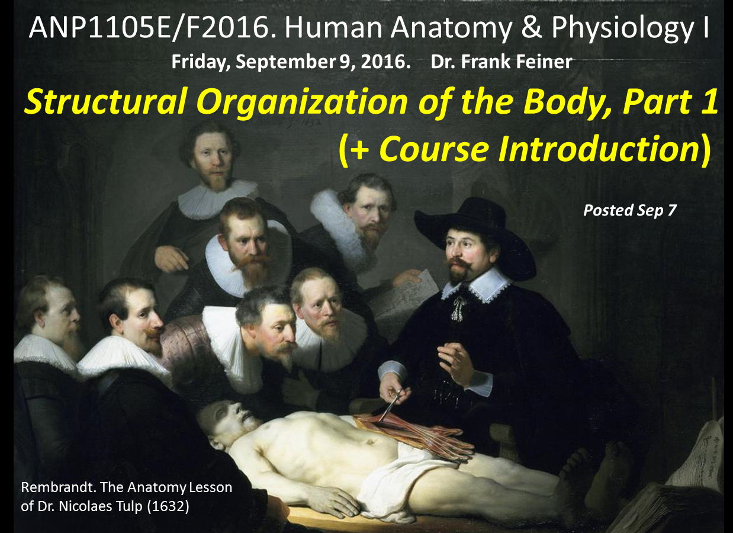

Slide 2
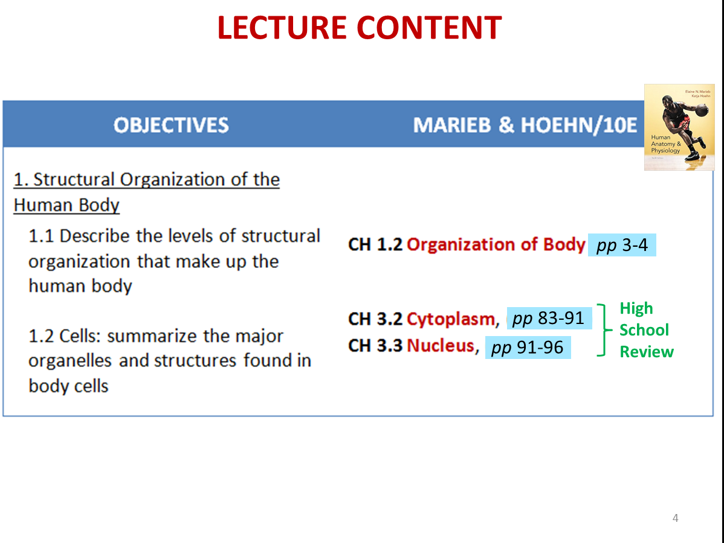

Slide 3
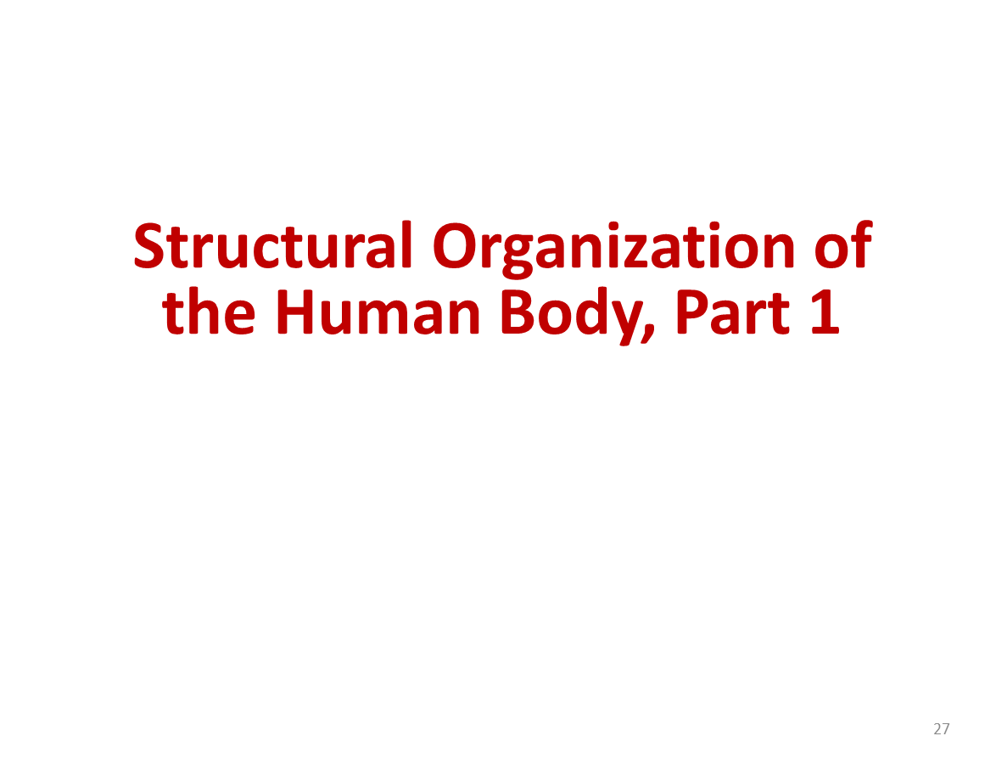

Slide 4
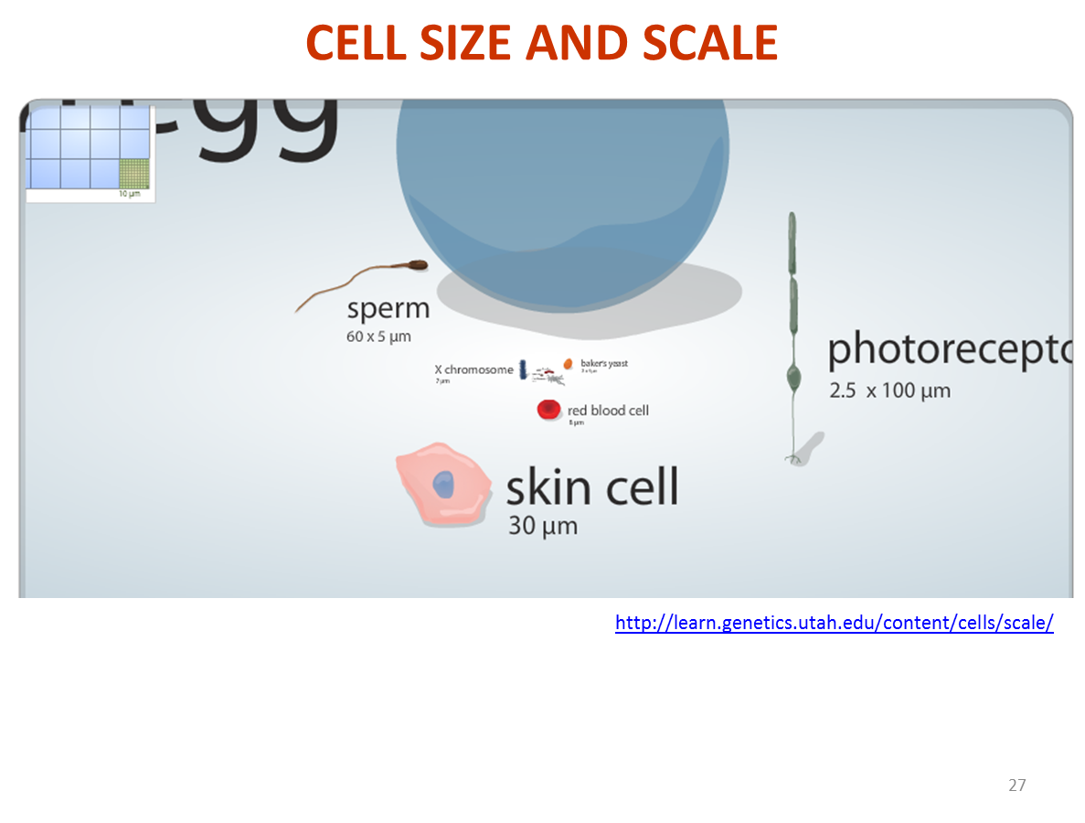
http://learn.genetics.utah.edu/content/cells/scale/

Slide 5
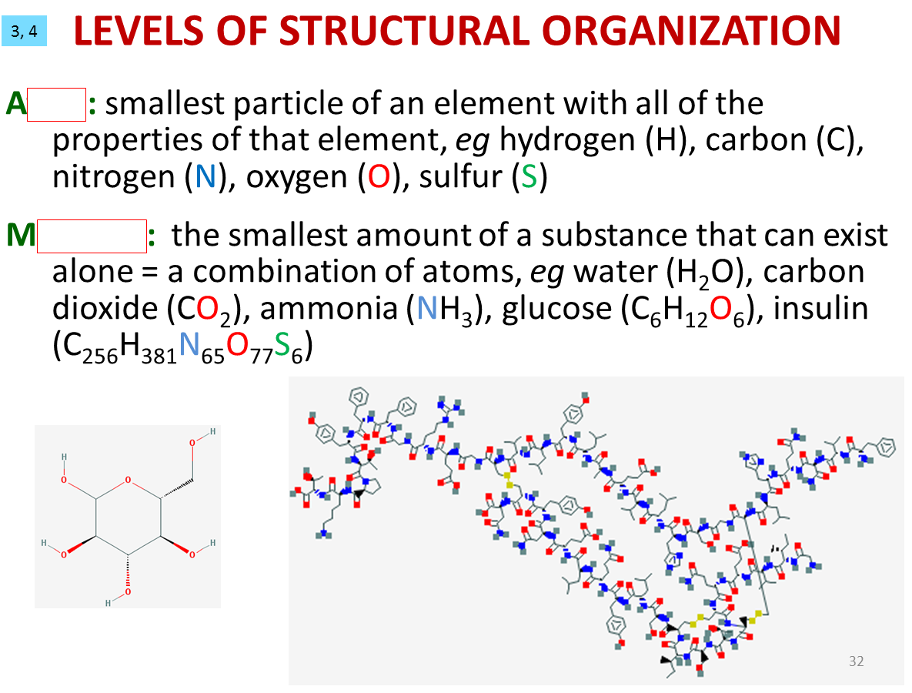
tom
olecule

Slide 6
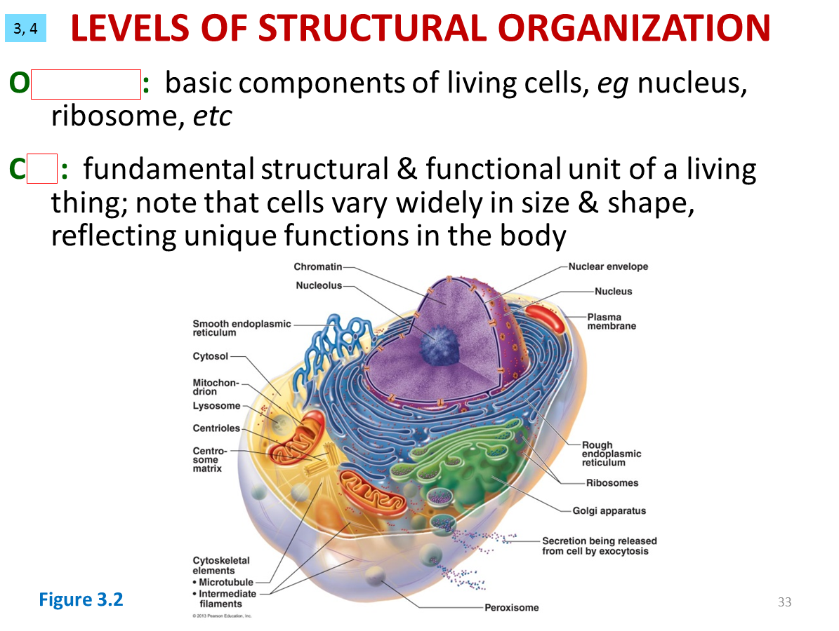
rganelle
ell

Slide 7
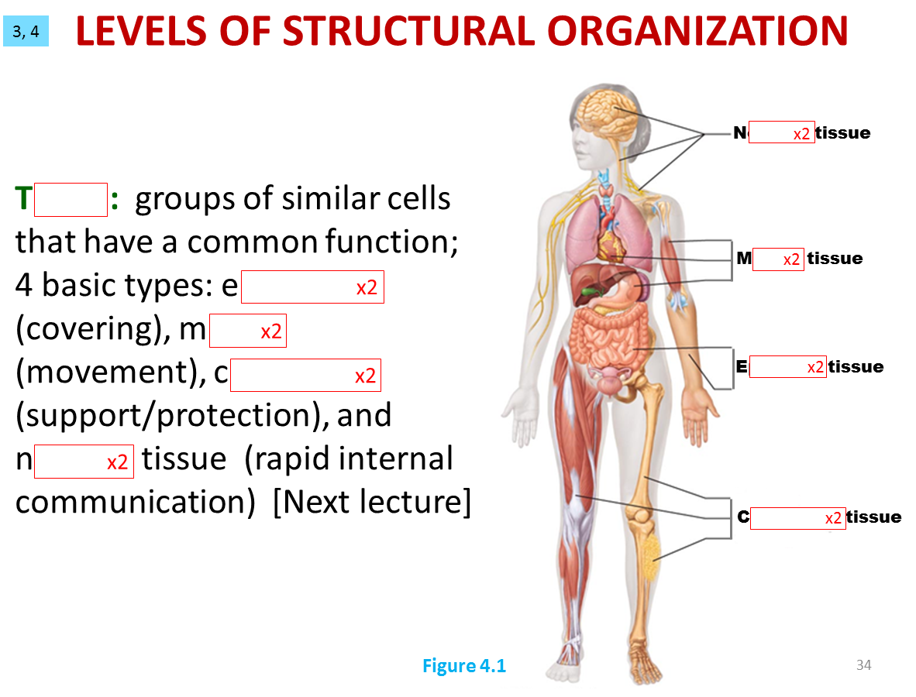
ervous
issue
uscle
pithelial
uscle
onnective
pithelial
ervous
onnective

Slide 8
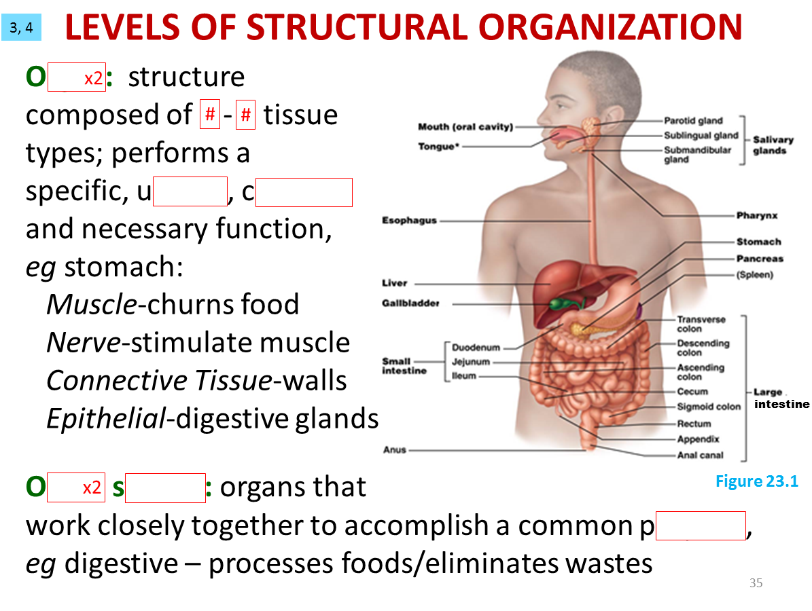
rgan
1
4
nique
omplex
rgan
ystem
urpose

Slide 9
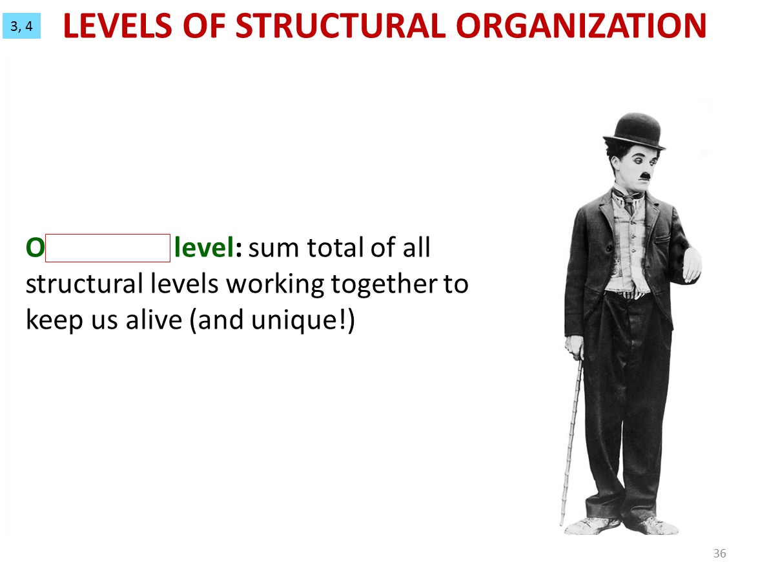
rganismal

Slide 10
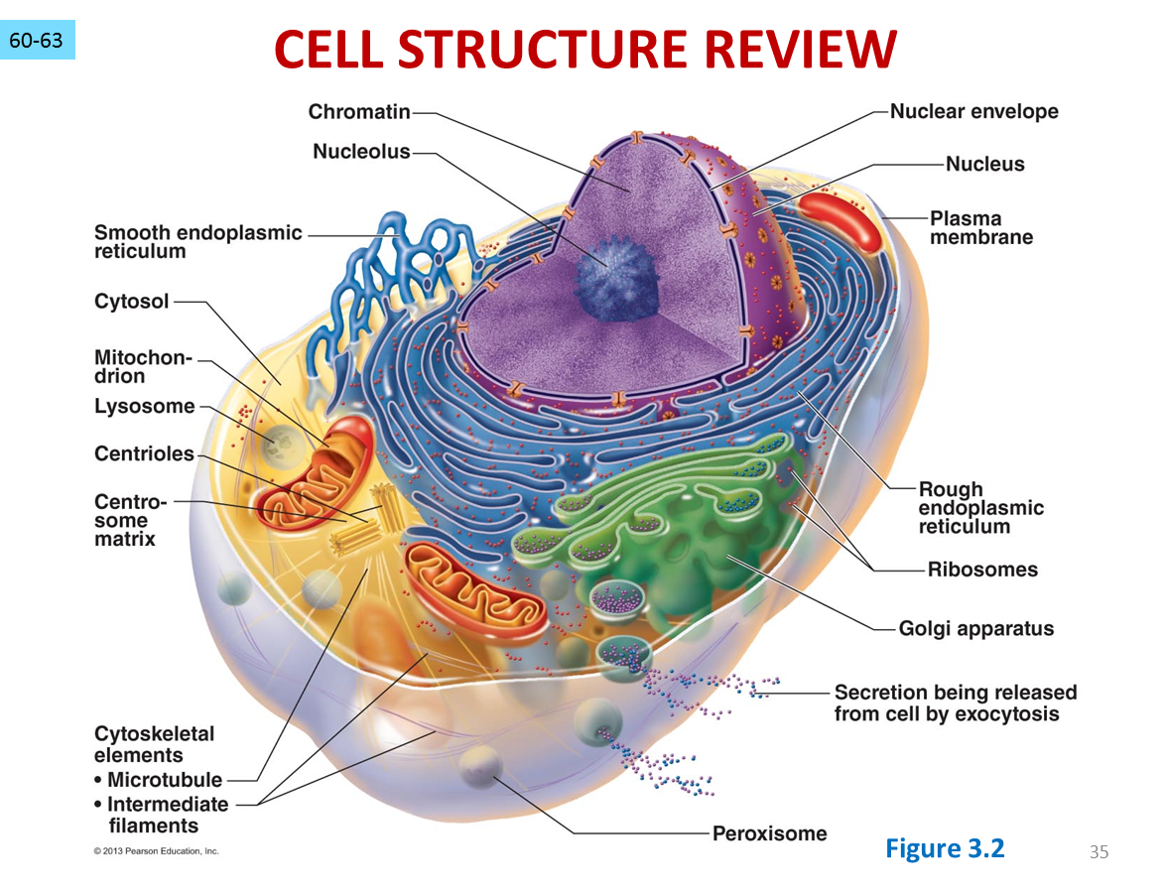

Slide 11
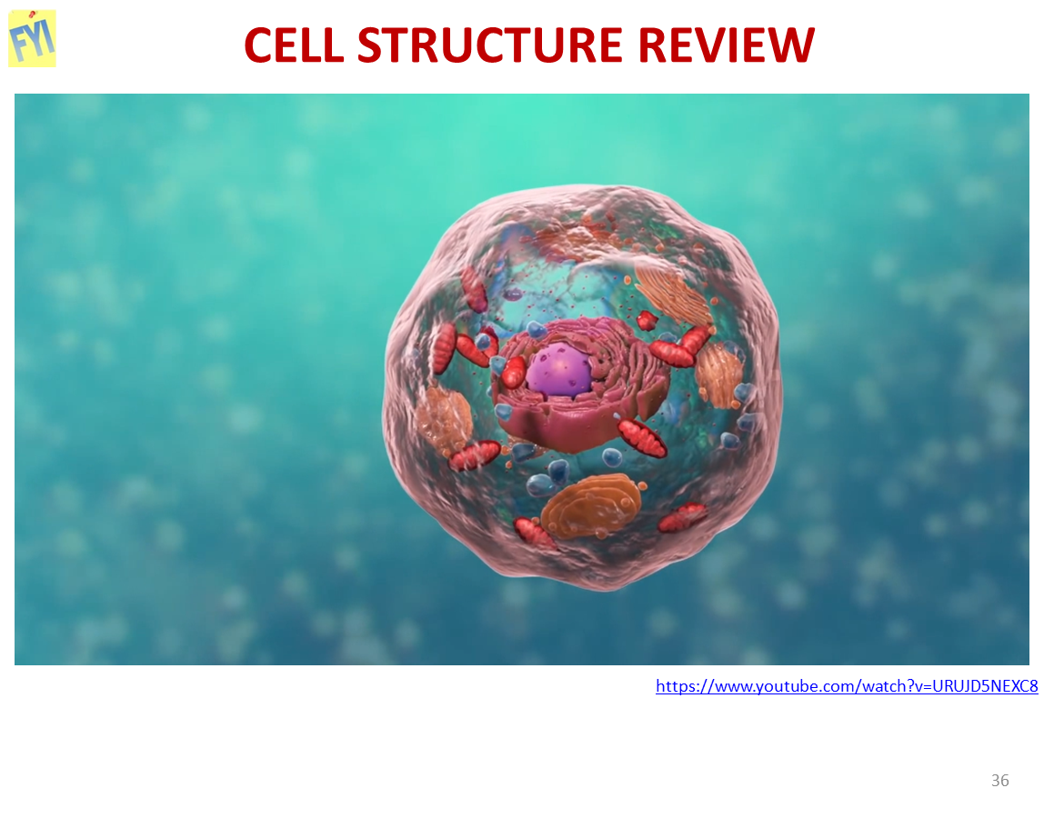
https://www.youtube.com/watch?v=URUJD5NEXC8

