Slide 1
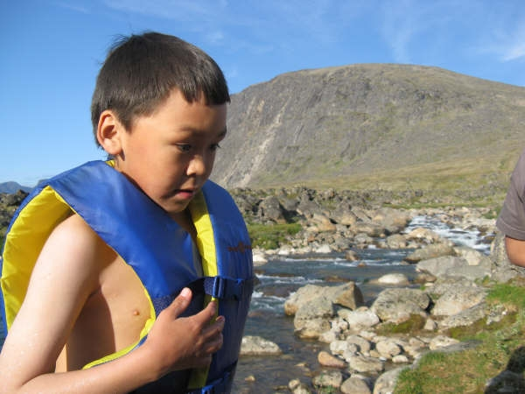
Sport for Development
Week 10, Lecture 2

Slide 2
The Game Plan
Announcements?
Name that Tune x 2
Sport for Development I
Group work
Take home messages

Slide 3
Kabeer, 1994
DEVELOPMENT: “A planned process by which RESOURCES , techniques and expertise are brought together to bring about improved rates of economic growth in an area variously designated as the 3RD WORLD, the developing world, the periphery, the South…it refers to a purposeful project…with unacknowledged assumptions and unanticipated outcomes. Development then becomes the broader processes of SOCIAL TRANFORMATION” (p. 69; my emphasis)

Slide 4
Kabeer: Development
Enriches a few, impoverishes MANY
Erodes cultural and BIOLOGICAL diversity
Grants and loans contingent on purchase of goods from DONAR countries
Silent on GENDER issues
Development is not NEUTRAL and objective

Slide 5
Where’s gender in development?
Country’s economic growth viewed as measure of development
GNP seen as “objective”
Relies on “neutral” market forces
But it assigns a value ONLY “to goods and services which are offered for sale in response to market signals” (p. 77)
Women’s work in the home: black hole, not included in GNP estimates, positioned as “unproductive”
e.g., when man marries his housekeeper, decline in GNP, free services now that he had to purchase previously

Slide 6
Sport for Development
Not sport development
AKA: sport for development and peace, sport-in-development
The use of sport to promote development goals – typically health,education , social cohesion

Slide 7
Sport for Development Con’t
Sport practitioners are not practitioners
New role for both?

Slide 8
Sport for Development: National
Recreation/sport used as tool for development for aboriginal peoples
Based on deficiency approach
Canadian Heritage: Sport for Development and Peace division: int’l only
e.g., Alberta’s Future Leaders Program, NWT Above-Ground Pool Program, CAAWS’ Team Spirit, Motivate Canada’s Gen 7 and Active Circle, Little NHL, Outside Looking In

Slide 9
Sport for Development for Indigenous Self-Determination?
Lead to self-determination?
Potential factors: culturally-relevant/ physical practices, use of traditional knowledge, inclusion of elders, base on
strengths perspective
Designed by and for indigenous peoples

Slide 10
International Uses
Commonwealth Games Canada &
Kicking AIDS Out:
Right to Play:
What impact does a speed skater have on children in Africa?
Use of local physical practices?

Slide 11
Ishraq & MYSA
ishraq : Upper Egypt, very conservative
Mathare Youth Sports Assoc.: kenya
Both provide “safe spaces” for girls
Needed to develop space free of harasment , trauma, psychologically supportive
Gave girls opportunity to claim space
Girl Effect:

Slide 12
Spaces for Girls and Women (Brady, 2005)
Adolescence: world EXPANDS for boys and contracts for girls
Results in limited spaces for girls and women to be ACTIVE
Can be used to develop SAFE SPACES for girls
Needed to develop space free of harasment/trauma
Gave girls oppurtunities to claim space

Slide 13
Group Work

Slide 14
Take Home Messages
Guest lecture next class
Review

