Slide 1
Child & Health
Week 6, Lecture 1
Notes:
Trends, orders, statistics, video clips, txtbook, slides,

Slide 2
Game Plan
Evaluation: Dr. Porter
Announcements?
Name that Tune!
Children and health
Take home messages
Notes:
Was at track meet, Feb. 4th determinants of health

Slide 3
Main Messages
Approximately 10.8 million children around the world die before their fifth birthday
Many deaths are preventable
Communicable diseases are the leading cause of death among children in developing countries
Poverty, inadequate nutrition, lack of access to safe water, sanitation, health services, and education are important risk factors for morbidity and mortality among children
Little progress has been made

Slide 4
Main Messages Continued
Reduce neo-natal death to make major dent in infant and child mortality
Take family and community-based approaches
Focus on well-known cost-effective interventions and emerging evidence on newborns

Slide 5
Key Terms
Perinatal: refers to the first week of life
Neonatal: refers to the first month of life
Infant: refers to the first year of life
Under-five: refers to children 0 to 4

Slide 6
Statistics
99 % of the annual deaths of children under 5 happen in 42 low- or middle-income countries
50% happen in 5 countries: India, Nigeria, China, pakistan, & Democratic Republic of Congo
Causes of death vary by region
41% of under-5 child deaths occur among neonates
To reduce child death rates, need to reduce neonatal death rates

Slide 7
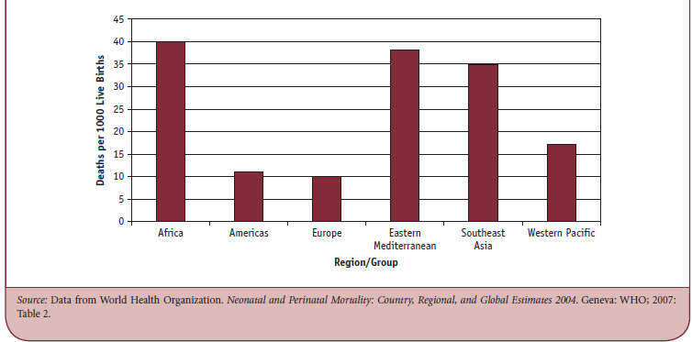
Figure 10.1: Neonatal Mortality Rate, by WHO Region, 2004

Slide 8
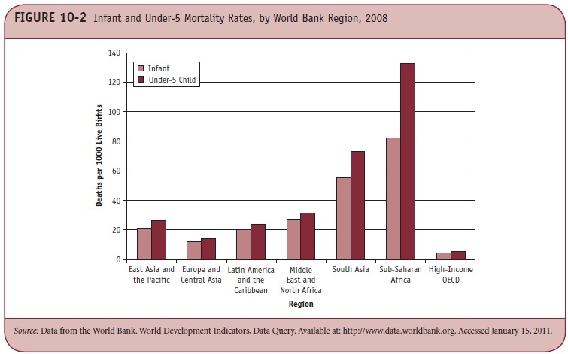
Figure 10.2: Infant and Under-5 Mortality

Slide 9
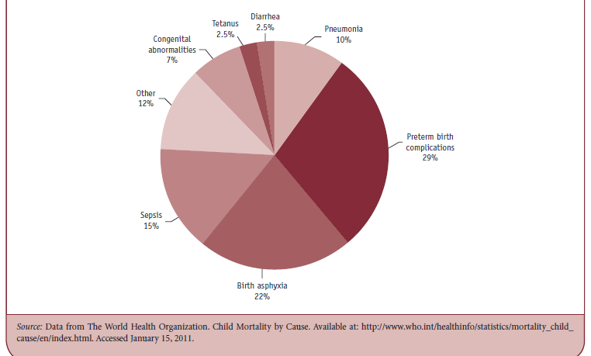
Figure 10.4: Causes of Neonatal Deaths, by Percentage, 2008

Slide 10
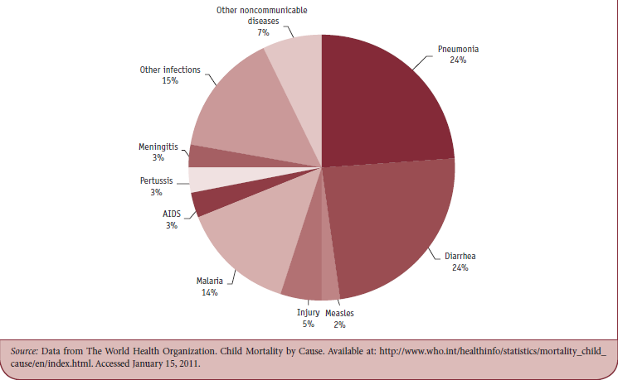
Figure 10.5: Causes of Postneonatal Deaths in Children under 5, by Percentage, 2008

Slide 11
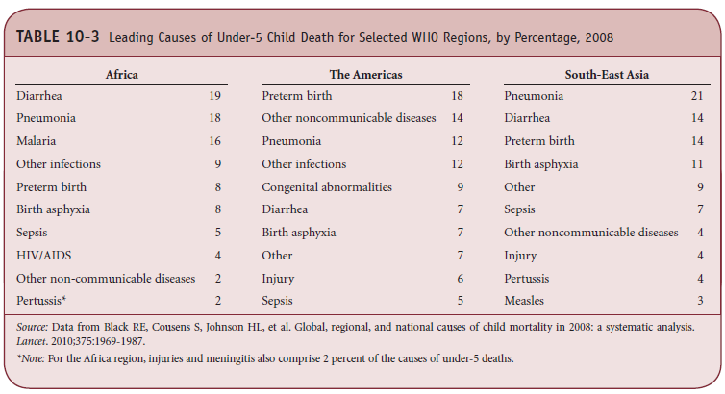
Table 10.3: Leading Causes of Under-5 Child Death for Selected WHO Regions, by Percentage, 2008

Slide 12
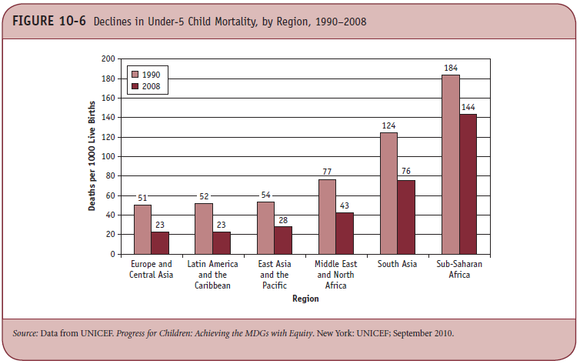
Figure 10.6: Declines in Under-5 Child Mortality, by Region, 1990-2008

Slide 13
Risk Factors for Neonatal, Infant, and Child Deaths
Poverty: Inadequate nutrition; Poor access to safe water and sanitation, health services, and education
Family income: strong correlation between family income and survival(health care setting and attendant at birth)
educational status of mother: correlation with survival ( ditto)
Nutritional status: powerful determinant of birthweight and survival
Malaria: (ditto)
HIV:( ditto)

Slide 14
Additional Comments on Selected Causes of Morbidity and Mortality
Acute Respiratory Infections
Leading cause of death in low- and middle-income countries
More severe and cause higher rates of death in low- and middle-income countries than in high-income countries
Upper respiratory tract infections include the common cold and ear infections, lower respiratory infections include bronchiolitis and pneumonia

Slide 15
Additional Comments on Selected Causes of Morbidity and Mortality
Diarrhea
Caused by bacteria, viruses, protozoa, and helminths
Causes dehydration loss of nutrition or wasting, and damage to the intestines
Infants 6-11 months are particularly vulnerable because they have been introduced to unsafe water and foods

Slide 16
Additional Comments on Selected Causes of Morbidity and Mortality
Malaria
750000 children die from malaria each year
A child in sub-Saharan Africa is likely to have a case every 40 days
Associated with premature birth and intrauterine growth retardation, which reduce chances of survival

Slide 17
Additional Comments on Selected Causes of Morbidity and Mortality
HIV/AIDS
Can be transmitted from mother to child during birth or breastfeeding
Number of HIV-infected children has
grwon, particularly in sub-Saharan Africa

Slide 18
Additional Comments on Selected Causes of Morbidity and Mortality
Measles
Acute respiratory infection with complications including pneumonia, diarrhea, encephalitis, and blindness
Children who are vitamin A deficient or infected with HIV are more at risk of death
Extremely contagious if a population is not vaccinated

Slide 19
Additional Comments on Neonatal Mortality
41% of children under 5 who die annually, actually die in the first month
Little progress in reducing neonatal death rate
Every day that a child lives increases the likelihood that he or she will stay alive
To reduce childhood death rates, the world needs to focus more precisely on when the deaths occur

Slide 20
The Costs and Consequences of Child Morbidity and Mortality
Direct and indirect costs of caring for a sick child: very high, multiple bouts of sickness each year, strain on financial resources
Medium and long-term consequences of some childhood illnesses: can lead to permanent disability, cognitive deficits, growth retardation, etc.
Social costs and consequences: high fertility to “compensate” for child deaths, stress

Slide 21
Children in Armed conflicts (1990s) (UNICEF)
2 million killed;
4 -5 million disabled;
12 million left homeless;
1 million orphaned or separated from their parents;
10 million psychologically traumatized

Slide 22
What is a child soldier? (UNICEF)
Illegal under international law – but used in 50 countries
child soldier: a person under the age of 18 who directly or indirectly participates in an armed conflict as part of an armed force or group.
some children wield assault rifles, machetes, or rocket propelled grenades on the frontline
others are used in "combat support“: messengers, spies, cooks, mine clearers, porters and sexual slaves
common for them to participate in killing and raping.
an estimated 300,000 children are active participants in combat.

Slide 23
A Long Way Gone
http://www.youtube.com/watch?v=5K4yhPSQEzo&feature=fvw

Slide 24
Addressing Key Challenges in Child Health
Critical child health interventions: improve mothers’ health status, monitoring of newborn, skilled attendance at delivery, manage complications, warmth, provide antibiotics, reduce diarrhea, immunizations
Community-based approaches to improving child health: engage family and community to promote hygiene, breastfeeding
Integrated management of childhood illness (IMCI): horizontal integration, whole child

Slide 25
Key Interventions
Nutrition of women , pregnant women, and children from conception to years
Exclusive breastfeeding for 6 months
Continuum of care for newborn - keep warm, avoid neonatal tetanus, and treat pneumonia
Immunization
ORT – oral rehydration treatment
Package for prevention and treatment of malaria

Slide 26
Take Home Messages
Know the key issues with child health
Come to office hours if you have questions
I DO have office hours this week

