Slide 1
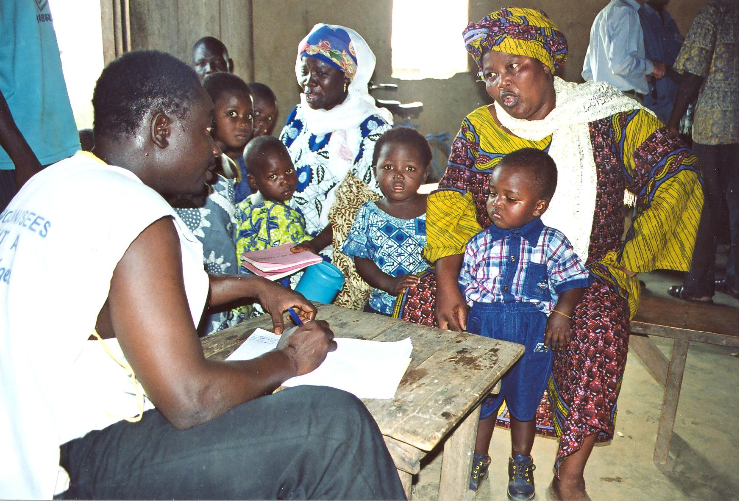

Slide 2
Health: A Global Context
APA 1122
Professor: Ken Porter, D.Phil.

Slide 3


Slide 4
Today
Administrivia
Quick review – value of life
Who’s who in international health
The Millennium Development Goals
The Copenhagen Consensus
How to measure the burden of disease

Slide 5
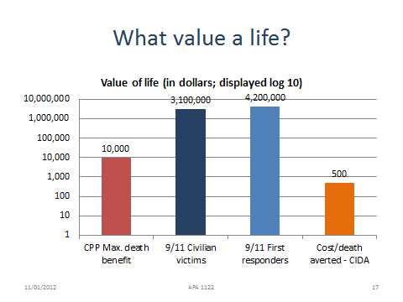
Assessing Value

Slide 6
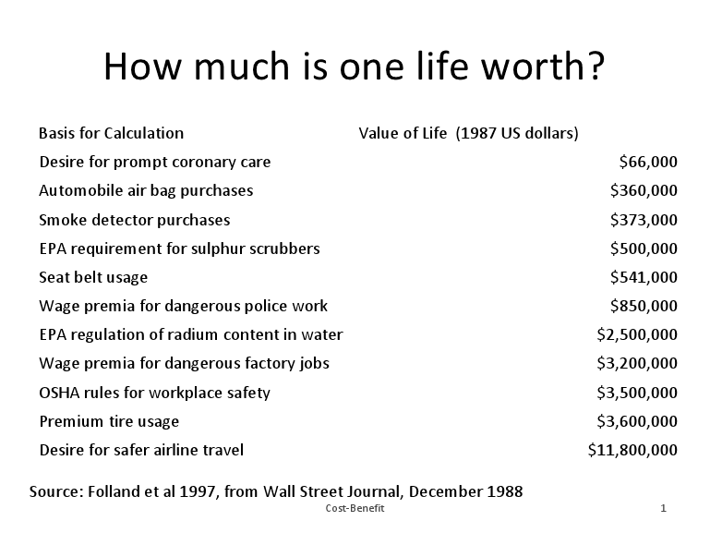
Administrivia
Health Issue Assignment
  Reviewed options?
  Considered data sources?
  If in doubt about topic, contact me.
  Sub-Saharan Africa and South Asia
Text is Global Health by Richard Skolnik
  Make sure that you have the 2012 edition

Slide 7

Who does what in international health?
World Health Organization
Agency of the UN
Data and statistics
Capacity building
Publication and advocacy
Emergency response
Sets norms on
  Treatment protocols
  Drug regimes

Slide 8

Who does what in international health? cont’d
UNICEF (United Nations Children’s Fund)
Child survival and development
Basic education and gender equality
Immunisation
Child protection
Health and nutrition
Watsan
Statistics
Sport for development

Slide 9

Who does what in international health? cont’d
World Food Programme
Major arm of FAO
Food aid response in emergencies
Food security strategies
Donations in cash and kind
Operational research on nutritional needs

Slide 10


Who does what in international health? cont’d
The Red Cross Movement
ICRC
  Power under Geneva Conventions
  First responders in war
  Family reunification
  Visitation of detainees
IFRC
  Work with national societies
  Natural disaster response
  Family reunification
  Capacity building
  Work in areas affected by war
National Red Cross Societies
  Work with civil authorities
  Use volunteer network for emergency response

Slide 11






Who does what in international health? cont’d
Countless NGOs, inter alia:

Slide 12
Millennium Development Goals
Generally known as the MDGs
Why were they established?
  In ‘90s international concern over growing inequity of health treatment and high mortality rates in developing countries
Who established them?
  In 2000 all 193 UN members signed the Millennium Project
How are they achieved?
  Using 1990 figures as baseline goals were set by action area
  Target date to attain goals - 2015
  Countries committed to direct ODA to MDG targets

Slide 13
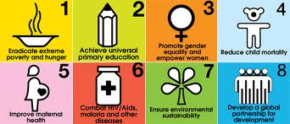
MDGs 1-8

Slide 14
MDG 1 – Eradicate Extreme Poverty & Hunger
Halve the population living on less than $1/day
  Proportion of population under $1/day
  Reduction in poverty gap ratio
Decent employment for women, men & young adults
  GDP growth/person
  Employment rate increase
Halve the number hungry
  Halve number of underweight U5s
  Proportion of population below minimum dietary energy

Slide 15
MDG 2 – Achieve Universal Primary Education
All children to be able to have full primary education
  Enrolment in primary school
  Completion of primary school
  Literacy for all 15-24y

Slide 16
MDG 3 – Promote Gender Equality and Empower Women
Improve ratio of girls to boys at all levels of education
Wage-earning in non-agricultural sector
Increase number of women in national parliaments

Slide 17
MDG 4 – Reduce Child Mortality Rates
Between 1990 and 2015 reduce U5 mortality by 2/3
  U5 mortality rate (U5MR)
  Infant (under 1) mortality rate (IMR)
  Reduce by 2/3 the number of 1y not immunised against measles

Slide 18
MDG 5 – Improve Maternal Health
Between ‘90 and ‘15 reduce maternal mortality ratio (MMR) by 75%
  Reduce MMR
  Increase number of births attended by skilled health attendants
By 2015 achieve universal access to reproductive health
  Contraceptive prevalence rates
  Adolescent birth rate
  Antenatal care coverage
  Access to family planning

Slide 19
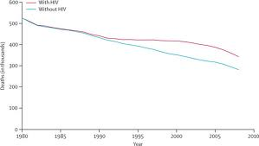
MDG 5 – Trends in MMR 1990-2010

Slide 20
MDG 6 – Combat HIV/AIDS, Malaria and other Diseases
Stop then reverse the spread of AIDS by 2015
  HIV prevalence among 15y – 24y
  Increased condom use in high risk sex
  Better knowledge of HIV among 15y – 24y
By 2010 universal access to HIV treatment
  Proportion of pop, with advanced HIV with access to anti-retrovirals
By 2015 have stopped, then reduced, the incidence of malaria and other diseases
  For prevalence and deaths due to malaria and TB
  Percent of U5s sleeping under LLINs
  Proportion of U5s with fever who are treated with anti-malarials
  Proportion of people with TB treated by DOTS

Slide 21
MDG 7 – Ensure Environmental Sustainability
Lots of generalities
Halve the number who have no access to clean drinking water
  Increase the proportion with access to improved drinking water
  Proportion of urban population with improved sanitation

Slide 22
MDG 8 – Develop a Global Partnership for Deveopment
Lots of fine words and lofty goals

Slide 23
Copenhagen Consensus
What is it?
A think tank attached to the Copenhagen Business School
Full name: Copenhagen Consensus Centre
Led by Bjørn Lomborg, Danish statistician and academic
Examines competing expenditure priorities

Slide 24
Copenhagen Consensus, cont’d
What does it do?
  Establishes spending priorities in international development based on cost-benefit analyses
  Supports broad approaches to comparative analyses

Slide 25
Copenhagen Consensus, cont’d
What is the approach?
Determines the themes/topics to be analysed
Selects a world expert (or expert team) to prepare a challenge paper to calculate the cost-benefit of interventions
Selects one or more independent experts to corroborate the data and present opposing ideas
Refines a selection list of issues for final consideration
Authors present their papers twice: once to imminent economists; once to an international youth forum
The economists rank the proposals according to cost-benefit

Slide 26
Copenhagen Consensus, cont’d
2008 – 1st to 3rd Best Interventions
2008 – 4th to 6th Best Interventions
1st – Micronutrient supplementation of children with Vitamin A and zinc
2nd – Breaking down trade barriers – the Doha Development Agenda
3rd – Micronutrient fortification with iodine and iron
4th - Expanded immunisation coverage for children
5th – Bio-fortification of foods
6th - Deworming and other school nutrition programmes

Slide 27
Copenhagen Consensus, cont’d
Q. Will there be a new Consensus?
Not in the present format – at least not immediately.
Q. Will the Copenhagen Consensus Centre close?
A. No. Its next project is RethinkHIV.

Slide 28
Measuring Health
Incidence - rate at which (risk of) new cases of a disease occur in a population
Prevalence - Proportion of a population suffering from a disease at any given time

Slide 29
Measuring Health – cont’d
Birth rate – number of live births each year relative to the population size
General fertility rate - the number of live births in a geographic area in a year per 1000 women of childbearing age, usually 15 to 44 years
Infant mortality rate (IMR) - ratio of the number of deaths in one year of children less than one year of age to the number of live births in that year (usually expressed per 1,000)

Slide 30
Measuring Health – cont’d
Under 5 mortality rate (U5MR) – ratio of number of children under 5 who die before age 5 with the number of live births in a five year period
Neonatal mortality rate (NMR) - ratio of number of deaths of children less than 28 days old to the number of live births that year

Slide 31
Measuring Health – cont’d
Maternal Mortality Rate (MMR) - numerator is the number of maternal deaths ascribed to puerperal causes in one year; number of live births in that year is often used as the denominator, for a true rate the denominator should be the number of pregnancies (live births plus fetal deaths).

Slide 32
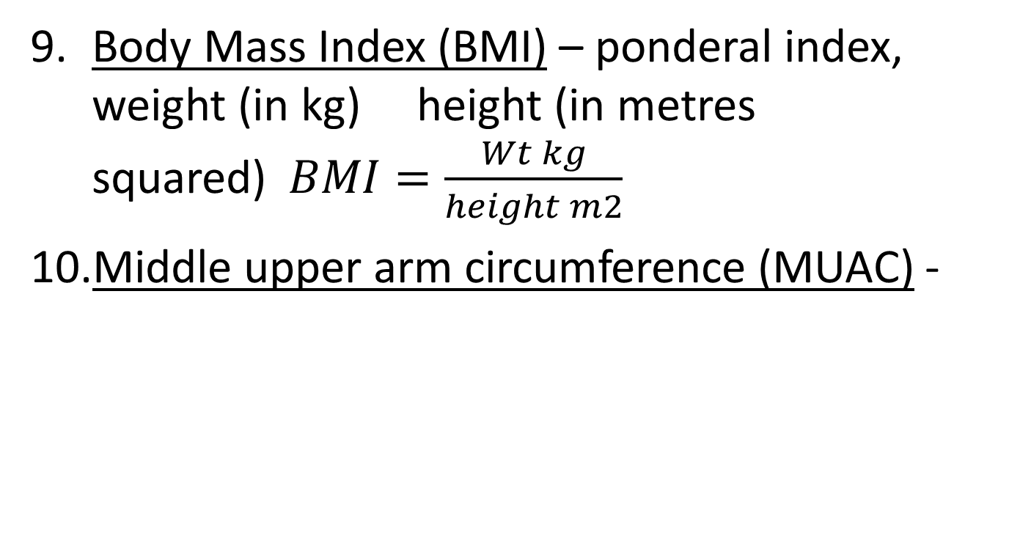
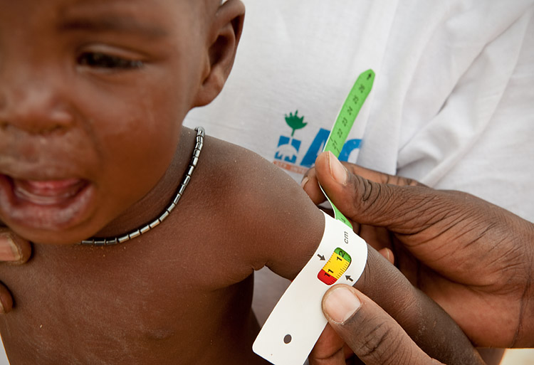
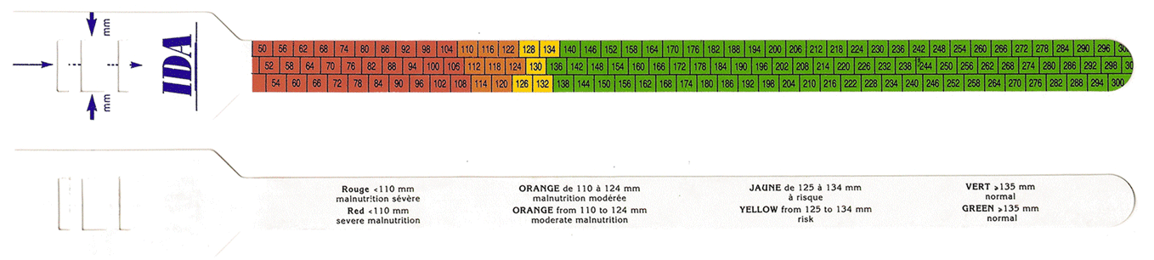
Measuring Health – cont’d

Slide 33
Measuring Health – cont’d
Height for age (H/A) - indicator of chronic malnutrition. A child with long-term exposure to inadequate nutrition will have a reduced growth – thus be shorter compared to other children of the same age (stunting).
Weight for age (W/A) - a composite indicator of both long-term malnutrition (deficit in height/"stunting") and current malnutrition (deficit in weight/ "wasting").
Notes:
Detailed growth data are available from NCHS and WHO websites

Slide 34
Measuring Health – cont’d
For all 3 indicators (W/H, W/A, H/A), compare individual measurements to international reference values for a healthy population (NCHS/WHO/CDC reference values).
Notes:
In emergencies, W/H is the best indicator as:
- it reflects the present situation;
- it is sensitive to rapid changes (problems and recovery);
- it is a good predictor of immediate mortality risk;
- it can be used to monitor the evolution of the nutritional status of the population.

Slide 35
Next Class
Case Study – nutrition in a refugee operation
Key micronutrients
Read before next class:
  Skolnik 129-144 – Nutrition chapter

