Slide 1
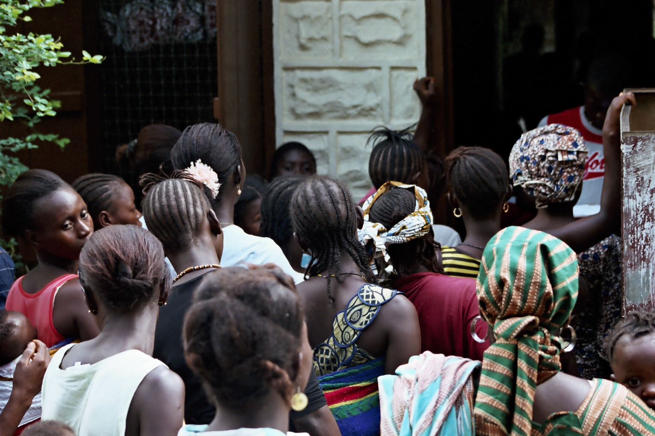

Slide 2
Health: A Global Context
APA 1122
Professor: Ken Porter, D.Phil.

Slide 3





Please…..
.
Notes:
Facebook, Twitter, Cellphone or smart phone, Ipods or MP3, texting

Slide 4
Who am I?
I am Ken Porter
Education:
  Bachelor of Physical Education (BPE) – U Alberta
  Masters of Arts (MA - PE) – unfinished – U Alberta
  Doctorate (DPhil) – University of Oxford
  Post-Doctorate – University of Oxford

Slide 5
Who am I? cont’d
Thesis title: Growth, health and physical work capacity of adolescents in refugee and non-refugee communities in Tanzania.
Professional life:
  Worked for Games organising committees in:
    Montréal – Olympics
    Edmonton – Commonwealth Games
    Brisbane, Australia – Commonwealth Games

Slide 6
Who am I? cont’d
Professional Life – cont’d
  8 ½ years with Sport Canada
  2 years with various national sport organisations
  3 years in humanitarian relief work
  8 ½ years with CIDA, programme responsibilities in health and nutrition

Slide 7
Who am I? cont’d
Outside the Office:
  Coaching in track and field
    Club, university and national coach
  Sport administration
    Various levels
    Master course conductor in track and field

Slide 8
Administrivia
Required Texts:
Skolnik, R. (2012). Global health 101. Sudbury, MA: Jones & Bartlett. (Available at the Campus Bookstore)
Rogers, D. (2010). The last resort: A memoir of mischief and mayhem on a family farm in Africa. New York: Three Rivers. (Available at the Campus Bookstore)

Slide 9
Administrivia – cont’d
Ways to contact me:
My office: Montpetit 349
My office hours: Wednesdays, 1:30 – 3:30, or by appointment
My email: kporter@uottawa.ca

Slide 10
Health Issue Assignment
You choose one topic/issue
You prepare 1,300 word paper
Bullet form can be used
Value of paper 25% of final grade
Submit not later than Friday, February 10 in both hard copy and electronic formats

Slide 11
Health Issue Assignment – cont’d
Health Issue Assignment to contain
Why the health issue is important.
Incidence and demographic characteristics.
Costs to society if no action is taken.
Interventions available to address the health issue.
The costs of any intervention and the benefits to be gained.

Slide 12
Health Issue Assignment – cont’d
Choose assignment topic from:
Policy and governance
  Millennium Development Goals
  Copenhagen Consensus
Nutrition – Micronutrient-related health issues
  Vitamin A deficiency (VAD)
  Iron deficiency anaemia (IDA)
  Iodine deficiency disorder (IDD)
  Therapeutic use of zinc
  Maternal micronutrient status and pregnancy outcome

Slide 13
Health Issue Assignment – cont’d
Nutrition and food security
  Stunting and wasting
Infectious and vector & water-borne diseases
  Measles
  Malaria – Reducing exposure
  Malaria – bed nets
  Malaria – treatment
  HIV/AIDS

Slide 14
Health Issue Assignment – cont’d
Other
  Tuberculosis
  Diarrhoea
  Orphaned diseases
  Pneumonia
  Folic acid deficiency
  Non-HIV/AIDS-related STIs

Slide 15
Organisation of Course
Week 1
  Health issue assignment
  Major international and national health agencies
  Measuring health outcomes
Week 2
  Nutrition-related health problems
Week 3
  Infectious and water-borne diseases
Week 4
  Other diseases
  Summary

Slide 16
Questions
How much should society pay to compensate for a death?
How much should society pay to avoid a death?

Slide 17
What value a life?
Notes:
Information on 9/11 figures is drawn from the Rand Corp. analysis retrieved from http://www.rand.org/pubs/research_briefs/RB9087/index1.html.

Slide 18
Ethical Issues
Sophie’s Choice – which of your children will you allow to die?
Does every life have equal value?
If resources are limited who sets priorities?
To what degree can a community demand that one receive health treatment?

Slide 19
Before Friday
Read Skolnik pages 3 to 11
Read the ‘About’ link on the Copenhagen Consensus website (www.copenhagenconsensus.org)
Read about the Millennium Development Goals http://www.un.org/millenniumgoals/bkgd.shtml

Slide 20
On Friday
Who does what and why in international and national health?
What drives health policy decisions?
Who bears the burden of death and illness?

