Slide 1
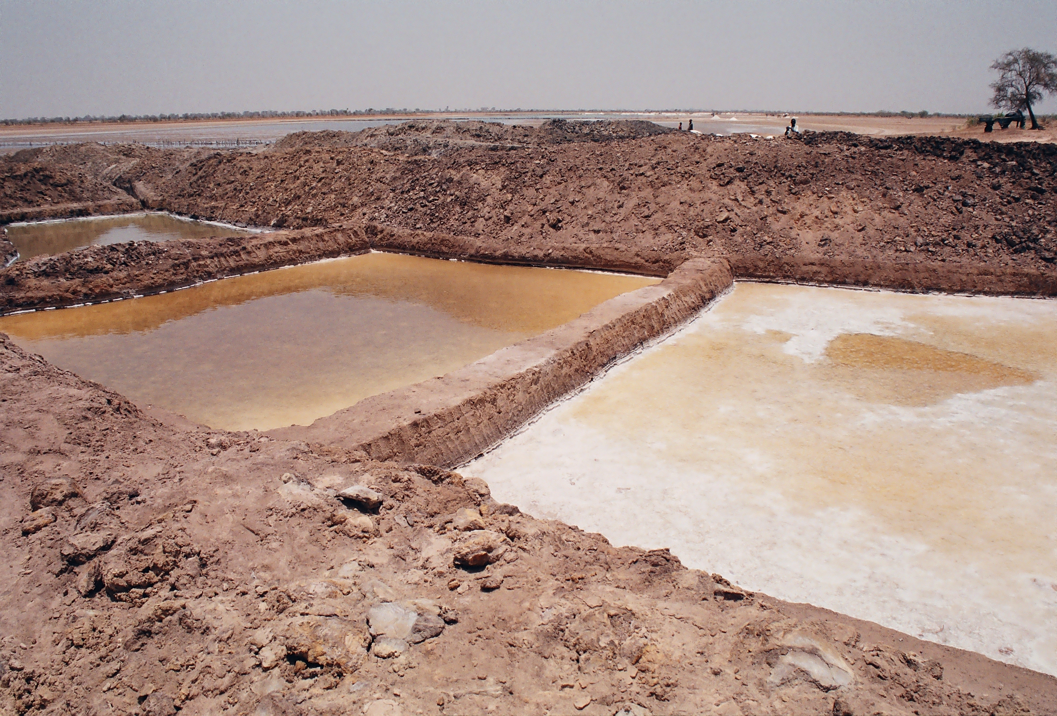

Slide 2
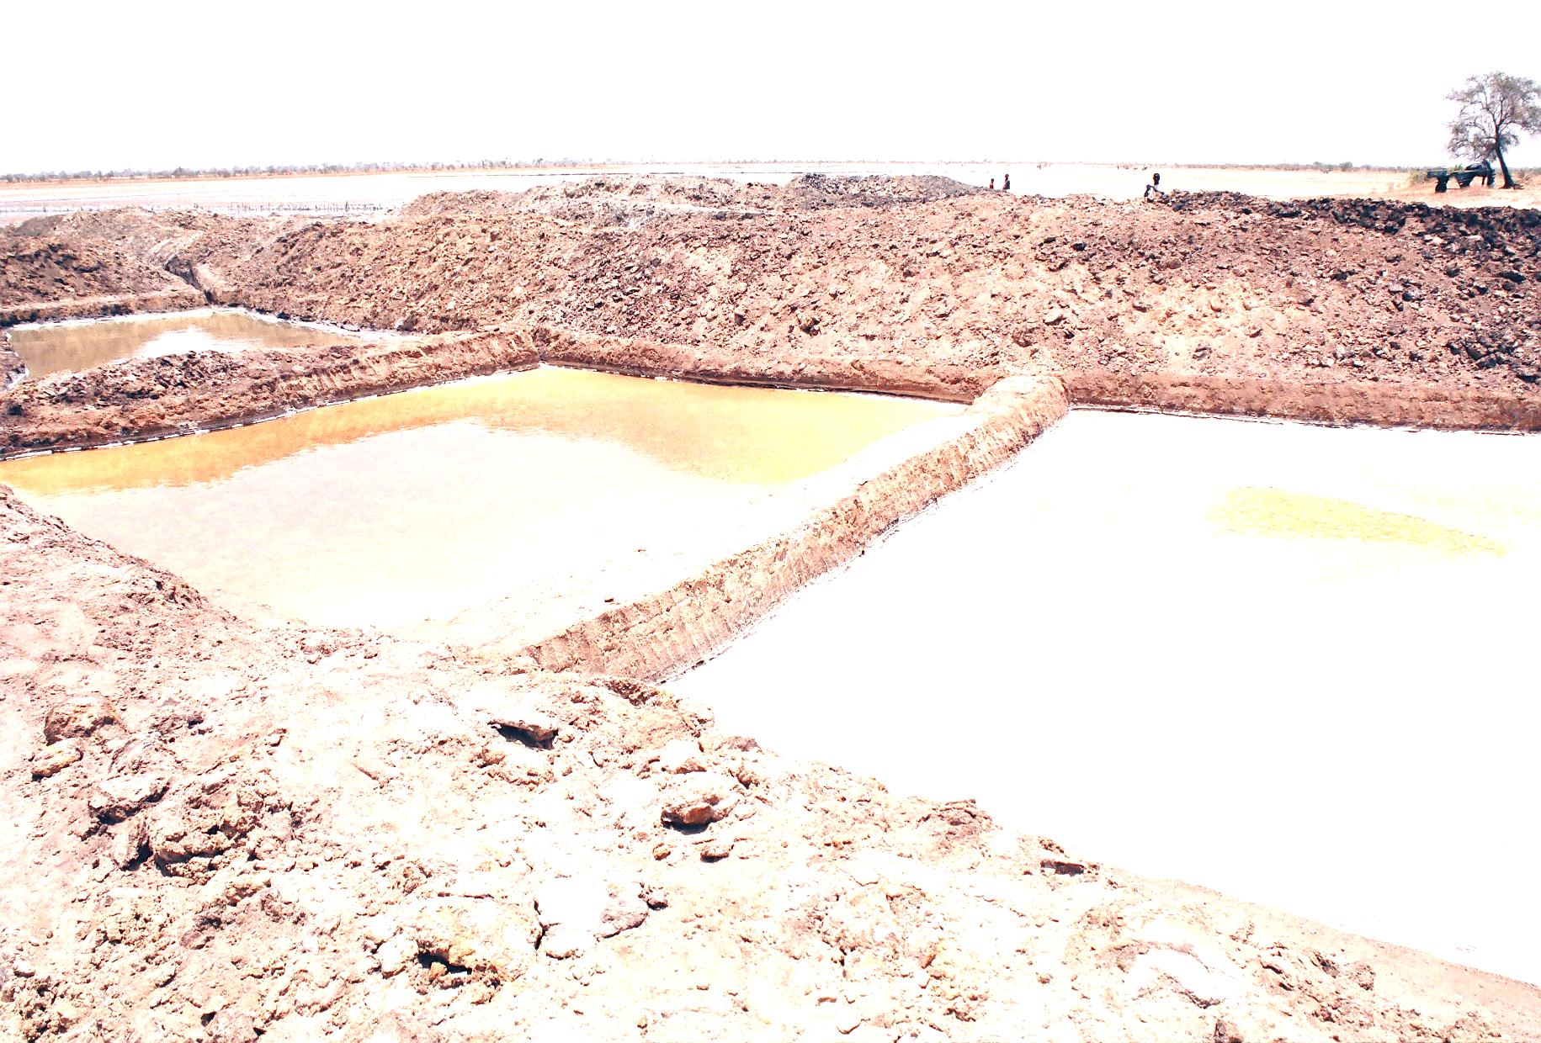
Health: A Global Context
APA 1122
Professor: Ken Porter, DPhil

Slide 3
Today
Administrivia
Preparing a better paper
Review of past lectures

Slide 4
Administrivia
Health Issue Assignment due in 7 days
  In hard copy and e-copy formats
  Leave hard copy in Montpetit 349
  Email e-copy to kporter@uottawa.ca
Dr Audrey Giles takes over on Feb 8
My questions will be on mid-term and final

Slide 5
Preparing a Better Paper
General Comments:
Avoid hyperbole
  ‘…still have a lot of progress to make…’
  ‘All the efforts and sacrifices made up to now will quickly disappear…’
  Minimise use of adjectives and adverbs
Avoid contractions
  ‘Do not’ not ‘Don’t’; ‘it is’ not ‘it’s’
  Its is also a possessive pronoun used without an apostrophe
Never use lower case to start proper names

Slide 6
Preparing a Better Paper
Subject must agree in number with verb
  ‘One in five of all childhood deaths in Africa are caused by malaria…’ should be…
  ‘One in five of all childhood deaths in Africa is caused by malaria…’
Do not be prolix just to get to the word count max
  ‘An explanation of why mosquito nets are important’ could be ‘The importance of mosquito nets’.
  ‘Children under the age of 5 years old’ could be ‘Children under 5’

Slide 7
Preparing a Better Paper
The word data is the plural of datum.
  E.g. The data are robust.
When a number begins a sentence it is to be written in full.
  E.g. ‘Sixteen attended.’ Not, ‘16 attended.’
Small numbers (usually 1 to 10) should be written in full when used in a sentence.
Know the difference between ‘few’ and ‘less’

Slide 8
Preparing a Better Paper
Do not use an acronym without having used the full name first.
  E.g. On first use - the International Committee of the Red Cross (ICRC)
  On subsequent uses – the ICRC
Vary your references, particularly if source is selling an product or service

Slide 9
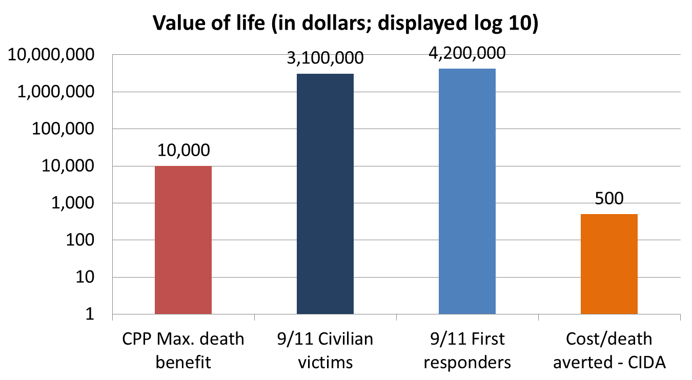
Review – Class 1

Slide 10
Review – Class 1
Context needed to value a life
Decisions are often based on most served
Contending/competing priorities in international health

Slide 11
Review – Class 2
Important international players in health

Slide 12

Review – Class 2
World Health Organization
Agency of the UN
Data and statistics
Capacity building
Publication and advocacy
Emergency response
Sets norms on
  Treatment protocols
  Drug regimes

Slide 13

Review – Class 2
UNICEF (United Nations Children’s Fund)
Child survival and development
Basic education and gender equality
Immunisation
Child protection
Health and nutrition
Watsan
Statistics
Sport for development

Slide 14

Review – Class 2
World Food Programme
Major arm of FAO
Food aid response in emergencies
Food security strategies
Donations in cash and kind
Operational research on nutritional needs

Slide 15


Review – Class 2
The Red Cross Movement
ICRC
  Power under Geneva Conventions
  First responders in war
  Family reunification
  Visitation of detainees
IFRC
  Work with national societies
  Natural disaster response
  Family reunification
  Capacity building
  Work in areas affected by war
National Red Cross Societies
  Work with civil authorities
  Use volunteer network for emergency response

Slide 16






Review – Class 2
Countless NGOs, inter alia:

Slide 17
Review – Class 3
Micronutrients vs macronutrients
Standard refugee food basket
  Cereal (300g), pulse (100g), oil (10ml)
  1950 kcal/day (if available)
  Balance not always possible
Consistent availability of food and growth

Slide 18
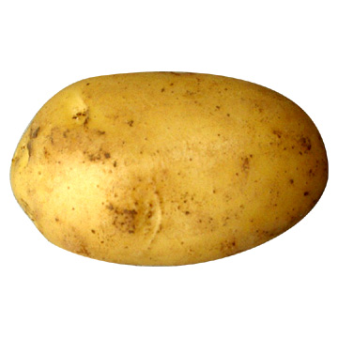
Micronutrients (MN)
Humans need micronutrients as much as calories
MNs are vitamins and minerals
MN deficiencies referred to a ‘hidden hunger’

Slide 19
Height Comparisons - Boys

Slide 20
Review – Class 4
Iodine deficiency disorder (IDD)
How it is caused
What physical effects
IDD and cognition

Slide 21
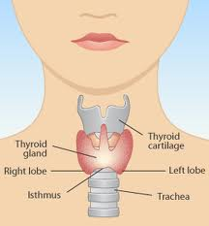
Goitre
Thyroid gland
  On neck below laryngeal prominence
  Controls energy use
  Make proteins
  Controls sensitivity to other hormones
Notes:
In iodine replete countries goitre is usually Hashimoto’s thyroiditis, an auto-immune condition.

Slide 22
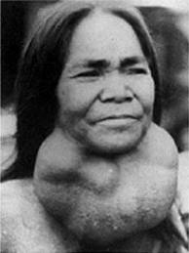

Iodine Deficiency - Effects
Goitre
Cretinism

Slide 23
Iodine Deficiency and Cognition
10 – 15 IQ points lost to children of IDD mothers (many sources)
Maternal IDD affects brain development beginning in the 2nd trimester (Sethi & Kapil)
In utero IDD protection is associated with additional 0.36 yrs of schooling (more for girls than boys) (Field, Robles & Torero)
Repletion of mildly IDD NZ children (10 to 13) results in stat sig improvement in tests of cognitive ability – 0.19 SD higher (Gordon et al.); similar results in Albania (Zimmermann et al.)
Notes:
Field et al in TZ study.

Slide 24
Review – Class 5
Malaria
Only female anopheles mosquitos carry malaria parasite
Four types of malaria
  Vivax
  Ovale
  Malariae
  Falciparum
P. falciparum is the most deadly of forms

Slide 25
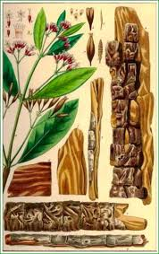
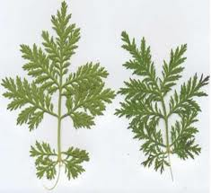
Principal Treatments
Cinchona
Artemisia

Slide 26
Quinine-based Medications
Quinine still used in some cases
Chloroquine remains first line drug in much of Asia for p. vivax and p. malariae
Drug resistance limits use of quinine-based medications in SSA
Others include
  Mefloquine (Lariam)
  Primaquine

Slide 27
Artemisinin-based Therapies
Used by Chinese for 2000 years
Derived from artemisia annua
Fast-acting, effective, particularly in combination with other medications
Few side effects
First line treatment for p. falciparum in many parts of SSA

Slide 28
Protections by Bed Nets
Modern bednets are 100% polyethylene
Impregnated with deltamethrin or permethrin
Nets must repel, disable and/or kill mosquitos
Effective net life 4-5 years
Rectangular shape is preferred
Can be washed 20 times without loss of killing capacity

Slide 29
Protections by Bed Nets – cont’d
LLINs reduce malaria U5 mortality by 55%
Coverage of 60% of community confers protection on the rest (herd immunity)
Wt for age Z-score improved for children under nets (Lengeler, 2009)
Higher Hb for children under nets
Kills other insects that cause disease

Slide 30
Cerebral Malaria
Most serious form of p. falciparum.
Coma - increased mortality despite treat­ment
Altered consciousness, delirium, ab­normal behaviour
Onset gradual or sudden. There may be convulsions
Tendon reflexes variable
Fundus may show retinal haemorrhages
Possible residual neurologic deficit, blindness, deafness

Slide 31
Review – Class 6
Helminths
Water-borne diseases

Slide 32
Review – Class 6
Tapeworms
Can grow to 4 m
Each segment can, independently, produce eggs
Poor hygiene
May not be evident until defecation
Treatment is easy
Pinworms
Small intestinal worms
Most common worms in West
Intense itching at night around anus
Treated with mebendazole which kills worms but not eggs
Second treatment needed

Slide 33
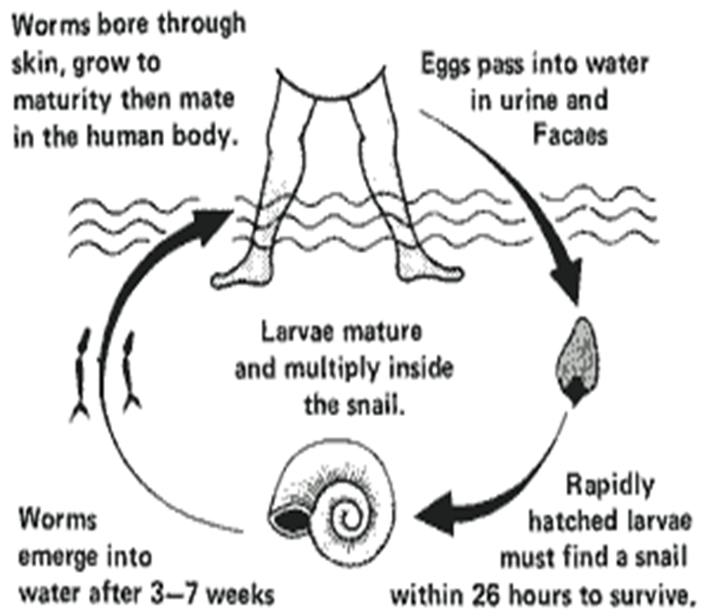
Review – Class 6
Bilharzia or Schistosomiasis
Water-borne
Snails intermediate host
Parasite enters through skin
Serious if untreated
Can be fatal

Slide 34
Review – Class 6
Cholera
Bacterium vibrio cholerae
Infection of small intestine
Increased discharge of water in stool
Caused by contaminated water or food
Rapid dehydration can lead to death
1994 – 9,000 died in one day in camps near Goma, DR Congo
Symptoms appear in 4-5 hours to 3-5 days
Typhoid
Bacterial infection (Salmonella typhi) of digestive tract
Faeces and urine in water is then ingested
Due to contaminated water or food
Incidence 17M each yr worldwide
No vaccine provides full protection
Scrubbing and disinfection to remove bacterium

Slide 35
Review – Class 7
Maternal health
  MN deficiencies (vitamin A, iodine, iron, folate)
Health and physical work capacity
  Relationship between growth and performance

Slide 36
Review – Class 7
Lack of access to obstetric services leading cause of maternal and infant mortality
Blood services and screening problematic
Maternal MN status very important
PMTCT of HIV

Slide 37
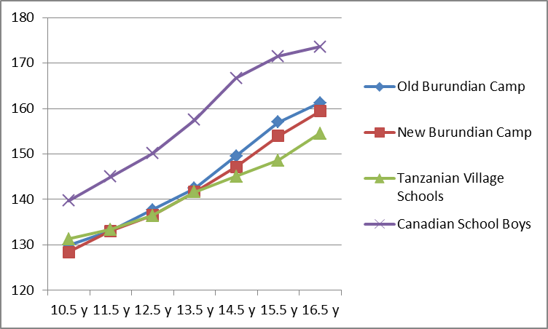
Health and Physical Work Capacity
Height Comparison
Canadian and African Boys
Notes:
Canadian data from Measurement in Pediatric Exercise Science, Docherty, 1996

Slide 38
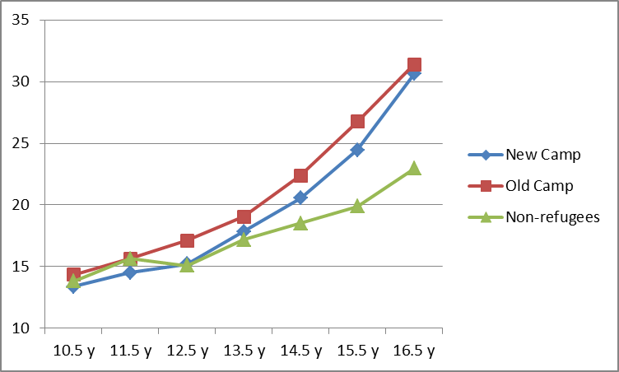
Health and Physical Work Capacity Grip Strength – African Boys

Slide 39
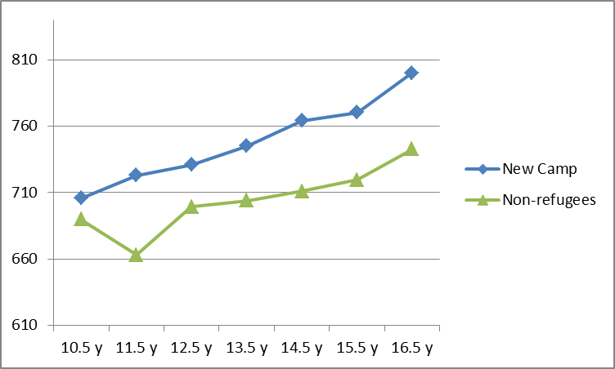
Health and Physical Work Capacity –
3-minute Shuttle Run - Boys

Slide 40
Thanks!!!

