Slide 1
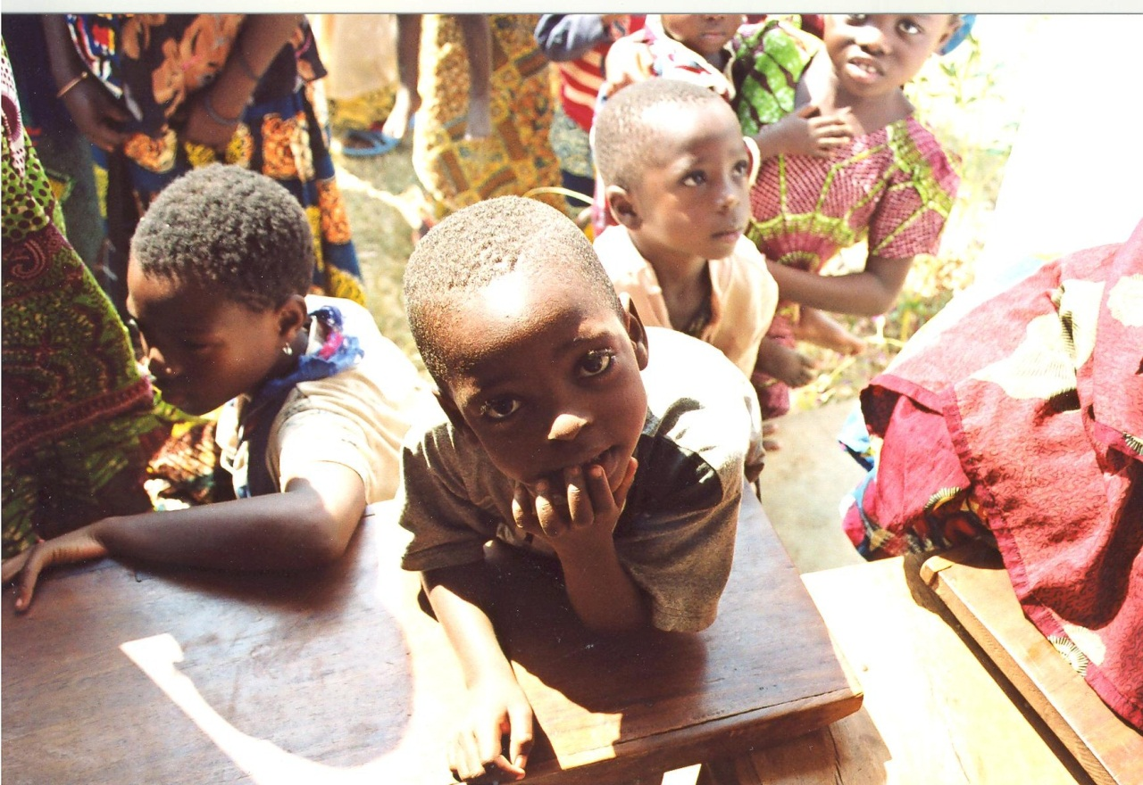

Slide 2
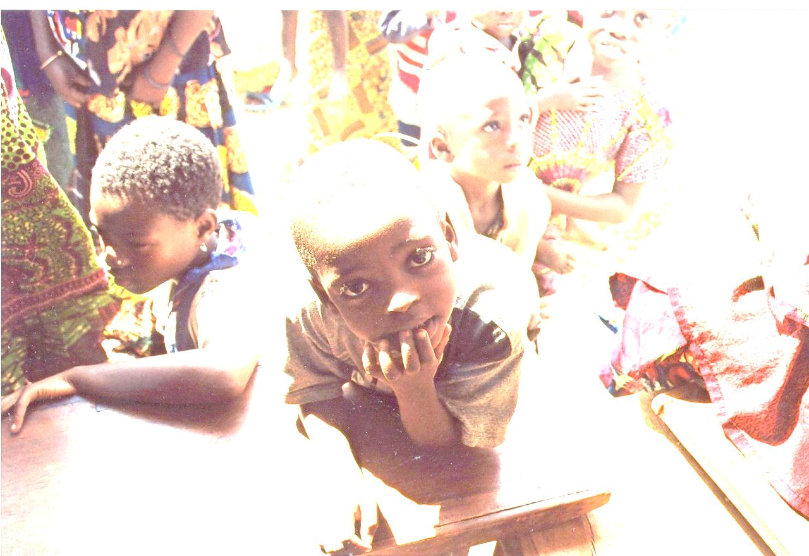
Health: A Global Context
APA 1122
Professor: Ken Porter, DPhil.

Slide 3
Today
Administrivia
Maternal health
Health and physical work capacity

Slide 4
Administrivia
9 days to submit the Health Issue Assignment
Last of my classes is Friday
Will keep office hours next week: Wednesday, Montpetit 349, 1:30 to 3:30

Slide 5


Slide 6
Maternal Health Issues
Blood screening
  ABO and rhesus systems
  Needed for HIV, Hepatitis C, syphilis, gonorrhoea detection
Vitamin A status
  Newborns have no VA store
  Require retinol in breast milk

Slide 7
Maternal Health Issues
Preventing mother-to-child transmission (PMTCT)
  Without treatment 15-30% of infants acquire HIV
  A further 5-20% infected through breastfeeding
  Women with advanced HIV need daily ARV drugs to reduce MTCT
  Single dose neviropine to mother and newborn 50% effective in PMTCT

Slide 9
Learn Independently
What is puerperal fever? Why is it important in maternal health?
What are causes and treatments for maternal haemorrhaging?
Definitions for:
  Neonatal mortality rate (NNMR)
  Infant mortality rate (IMR)
  Under-5 mortality rate (U5MR)
  Maternal mortality rate (MMR)
  Secular change

Slide 10
Maternal Health Issues
Child Immunisations
Country | Measles | Polio | DTP | Hib
Canada | 93 | 80 | 80 | 80
Ethiopia | 73 | 86 | 80 | 86
Sierra Leone | 82 | 89 | 90 | 90
India | 81 | 70 | 72 | n/a
Notes:
DTP – diphtheria, tetanus, pertussis

Slide 11
Maternal Health Issues
Fertility & Mortality Rates
Country | Life Expectancy | Fertility Rate | Adolescent Fertility Rate/1000 | NNMR per 1000 live births | U5MR
Canada | 81 | 1.6 | 14 | 4 | 6
Ethiopia | 54 | 5.2 | 109 | 35 | 106
Sierra Leone | 49 | 5.2 | 146 | 45 | 174*
India | 65 | 2.7 | 46 | 32 | 63
Notes:
Was 276 in 1990
Data from WHO

Slide 12
Health Issues
Country | Prevalence HIV 15-49y (%) | Children U5 Overweight M/F (%) | Children U5 Stunted M\F (%) | Children U5 Wasted M/F (%)
Canada | 0.2 | 9.5/5.2 | 8.4/6.5 1972 | 1.2/1.1 1972
Ethiopia | n/a | 2.0/1.5 | 51.8/49.6 | 13.7/10.8
Sierra Leone | 1.6 | 10.3/9.9 | 39.5/39.4 | 10.4/10.6
India | 0.3 | 2.2/1.7 | 47.9/48.0 | 20.7/19.3

Slide 13
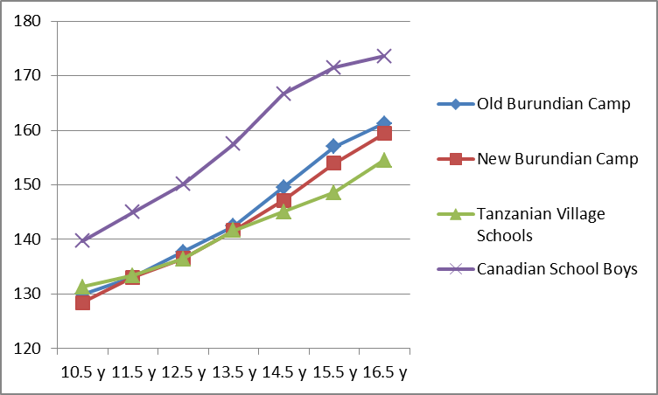
Health and Physical Work Capacity
Height Comparison
Canadian and African Boys
Notes:
Canadian data from Measurement in Pediatric Exercise Science, Docherty, 1996

Slide 14
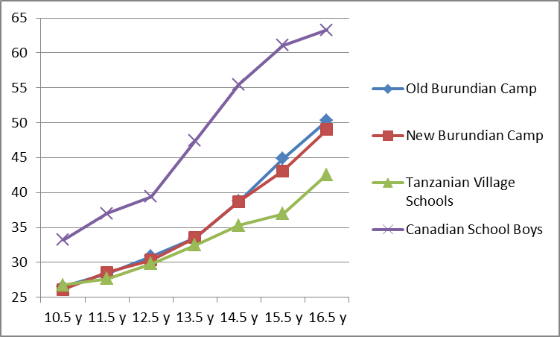
Health and Physical Work Capacity
Weight Comparison
Canadian and African Boys

Slide 15
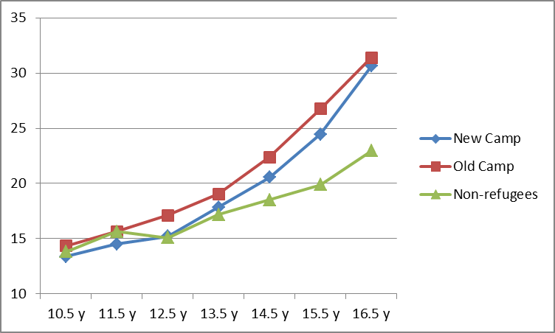
Health and Physical Work Capacity Grip Strength – African Boys

Slide 16
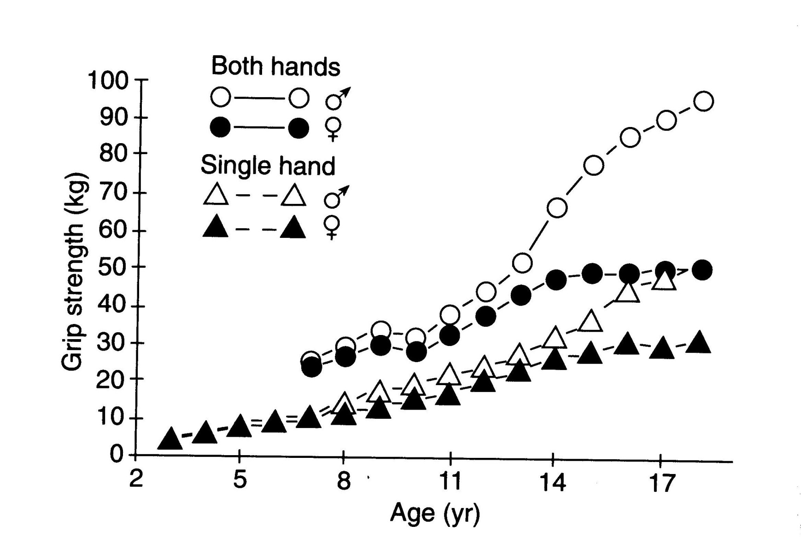
Health and Physical Work Capacity Grip Strength – Canadian Children
Notes:
From Measurement in Pediatric Exercise Science – David Docherty, Ed.

Slide 17
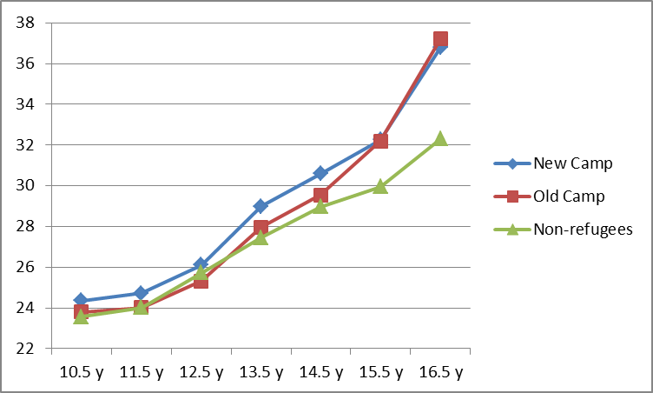
Health and Physical Work Capacity – Vertical Jump - Boys

Slide 18
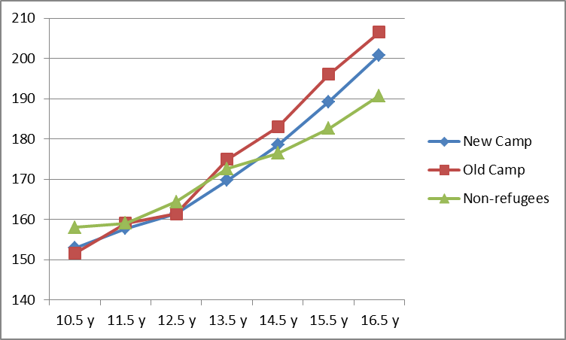
Health and Physical Work Capacity – Horizontal Jump - Boys

Slide 19
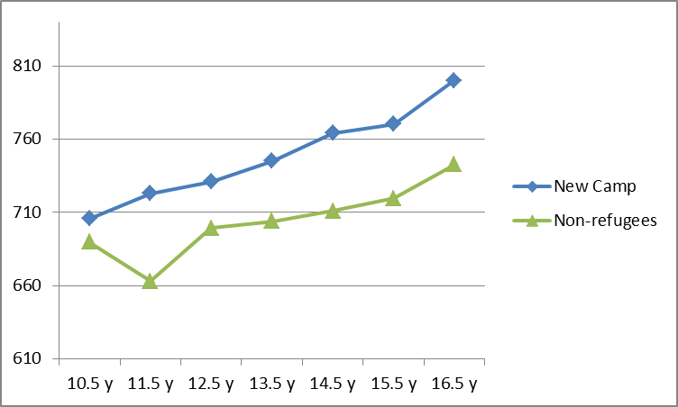
Health and Physical Work Capacity –
3-minute Shuttle Run - Boys

Slide 20
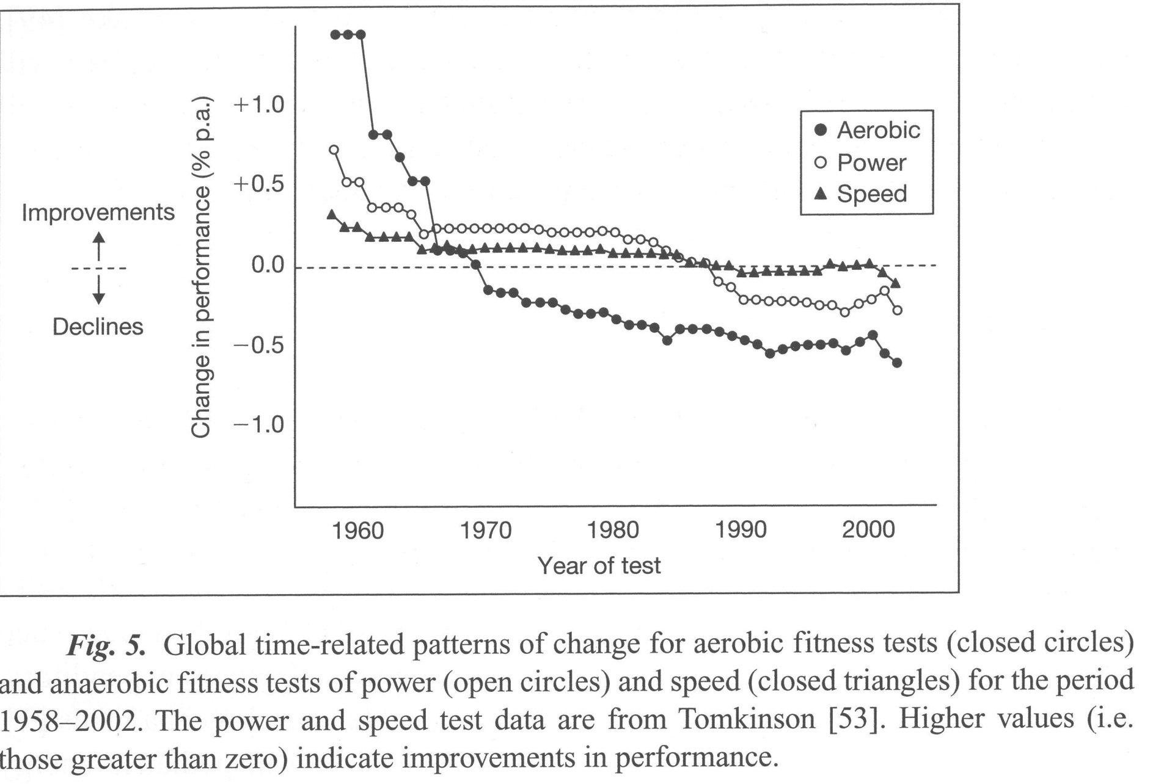
Secular Change in Fitness

Slide 21
On Friday
Miscellaneous diseases and miseries
Review of materials covered

