Slide 1
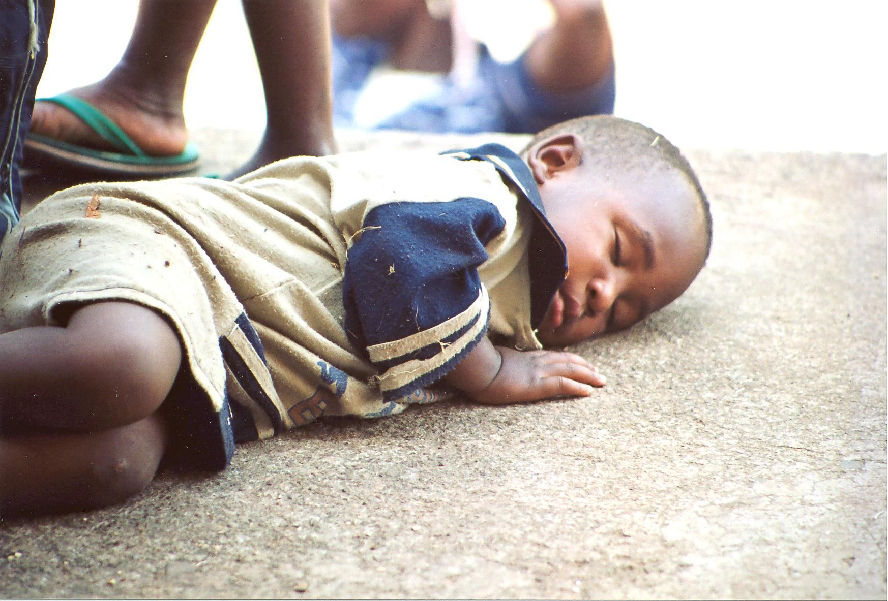

Slide 2
Health: A Global Context
APA 1122
Professor: Ken Porter, DPhil

Slide 3
Today
Administrivia
Malaria – continued
Adolescent Health Problems – case study
Intestinal and other parasites
Water-borne diseases

Slide 4
Administrivia
Health Issue Assignment – due in two weeks
  Hard-copy and electronic copy sent to me at kporter@uottawa.com
February 1, Day of Action – Student fee protest

Slide 5
Principal Health Problems

Slide 8
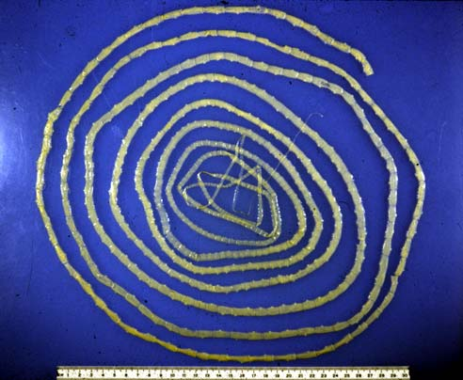

Slide 9
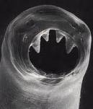
Helminths
Hookworm (nematode)
Worm-like parasites
Bisexual or hermaphroditic
3 types
  Flukes (trematodes)
  Tapeworms (cestodes)
  Roundworms (nematodes)
Notes:
Hooks to stomach and lungs… debilitating. Can live in dogs and cats.

Slide 10
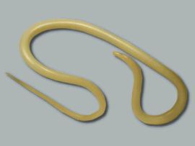
Helminths
Ascarius lumbricoides (roundworm)
Ascarius grow to 49 cm
Larval worm enters bloodstream at duodenum
Carried to heart and liver
Fertilised female can produce 200K eggs/day/year

Slide 11
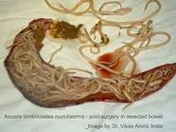
Helminths
A. lumbricoides affects 1 B world-wide
Often fecal-borne
Treated with mebendazole or albendazol

Slide 13

Helminths
Tapeworms
Can grow to 4 m
Each segment can, independently, produce eggs
Poor hygiene
May not be evident until defecation
Treatment is easy

Slide 15
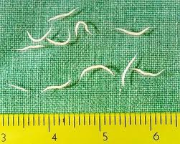
Helminths
Pinworms
Small intestinal worms
Most common worms in West
Intense itching at night around anus
Treated with mebendazole which kills worms but not eggs
Second treatment needed
Notes:
Usually more than one in the family is infected.

Slide 16
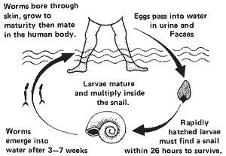
Helminths
Bilharzia or Schistosomiasis
Water-borne
Snails intermediate host
Parasite enters through skin
Serious if untreated
Can be fatal

Slide 17
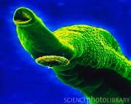
Bilharzia Fluke – Mouth and Sucker

Slide 18

Neglected Tropical Diseases

Slide 19
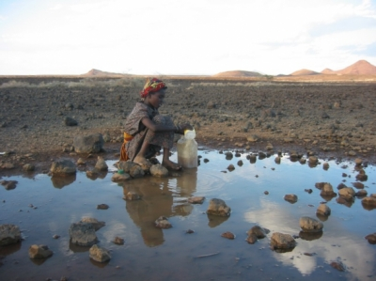
Water-borne Diseases

Slide 20
Cholera
Bacterium vibrio cholerae
Infection of small intestine
Increased discharge of water in stool
Caused by contaminated water or food
Rapid dehydration can lead to death
1994 – 9,000 died in one day in camps near Goma, DR Congo
Symptoms appear in 4-5 hours to 3-5 days

Slide 21
Typhoid
Bacterial infection (Salmonella typhi) of digestive tract
Faeces and urine in water is then ingested
Due to contaminated water or food
Incidence 17M each yr worldwide
No vaccine provides full protection
Scrubbing and disinfection to remove bacterium
Notes:
If water is chlorinated the transmission is be food handlers.
Typhoid Mary. Mary Mallon (aka Mary Brown) 3 decades in quarantine. She was cook in prominent US families all of whom developed typhoid.

Slide 22
Onchoceriasis (River Blindness)
Parasitic disease
Onchocerca volvulus is a thin parasitic worm transmitted by bites from the black fly
Can grow to 50 cm
Blackflies lay eggs in fast-flowing rivers
Adults in 8-12 days
Blackflies transmit from infected to uninfected
1-2 yr for worm to mature; can reach 50 cm
Can cause blindness
Larvicide to control flies; ivermectin to treat humans

Slide 23
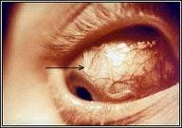
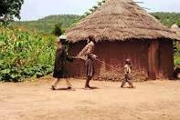
Onchoceriasis (River Blindness)
Parasite in Eye
Child leading the Blind

Slide 24
Next Wednesday
Health and physical work capacity
Measuring health – MICS and DHS
Readings:
Skolnik – read chapter on Environment and Health

