Slide 1
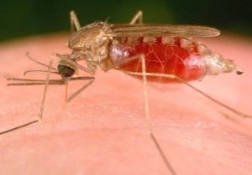

Slide 2
Health: A Global Context
APA 1122
Professor: Ken Porter, DPhil

Slide 3
Today
Administrivia
Malaria
The mosquito and its life cycle
Plasmodium
  Life cycle
  Types
Treatment and issues

Slide 4
Administrivia
References are available online or in Morisset
Copy into browser, or follow Library system
Health Issue Assignment - 2 weeks, 2 days
Contact me if you need help: kporter@uottawa.com

Slide 5
“Mala aria”
Word derived from Italian ‘bad air’
Reported for ‘000s of years
Chills, fevers, sweating, joint and back pains, vomiting, delirium
Extant in S Ontario from late 1700s
Principal cause of death during building of the Rideau Canal
Patrick Manson hypothesised the spread by mosquitos (1894)

Slide 6
The Malaria Vector
The Mosquito
Of more than 400 species of mosquito about 100 could carry the malaria parasite; 30-40 do
Genus: Anopheles
Most common: A gambiae, A funestus, A arabiensis
Other genera (e.g. culex, aedes) can transmit viruses

Slide 7
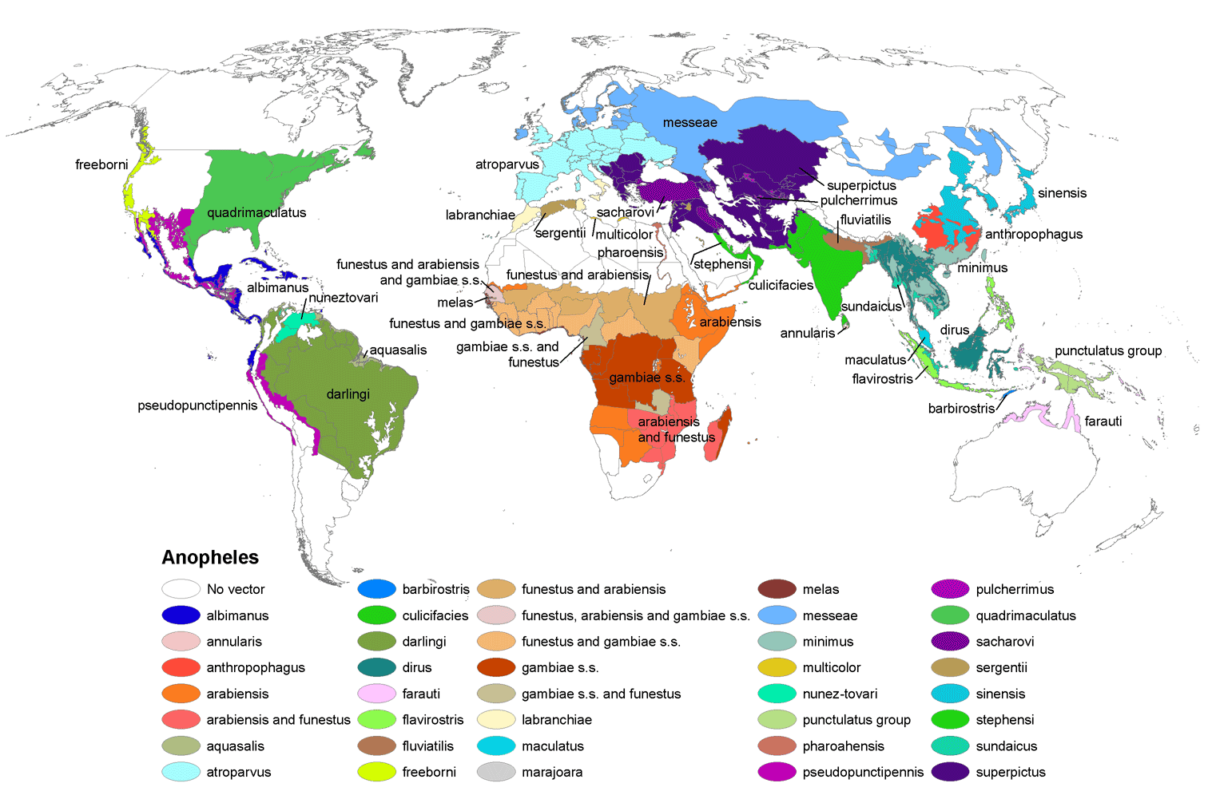
Anopheles by Region

Slide 8
Mosquito Life Cycle
Female lays 50 to 200 eggs in water
Eggs become larvae
Larvae become pupae
Pupae become adults
Eggs to adults in 10-14 days in tropical areas
After 1 week, females mate
Need blood meal for eggs to develop; 1-2 days
Females die within a month

Slide 9
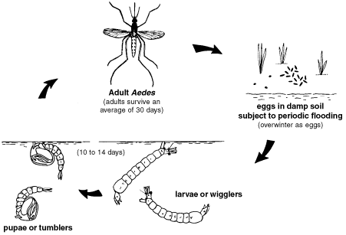

Slide 10
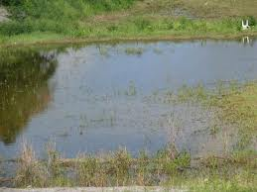
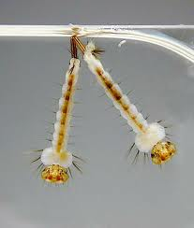
Breeding Grounds

Slide 11
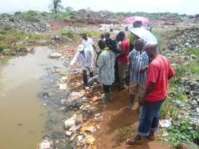
Breeding Sites

Slide 12

Plasmodium Life Cycle

Slide 13
Plasmodium
P. Vivax
P. Ovale
Common in Americas, SE Asia; less common in Africa
Historically called tertian (2 day) fever
Debilitating but rarely fatal
Incubation period 10-17 days
W Africa and Indonesia, low prevalence
Can recur if untreated
Similar to P. vivax in presentation and treatment

Slide 14
Plasmodium – cont’d
P. Malariae
P. Falciparum
Widespread but low prevalence in SS Africa, SE Asia and Pacific islands
Historically known a quartan (3 day) fever
Incubation from 16-59 days
Debilitating but rarely fatal
‘Malignant’ malaria
75% of cases in Africa
Cause of most malaria deaths
Incubation in 6-14 days

Slide 15
Genetic Protection
Selective pressure gives some genetic protection to some people
  Sickle cell anaemia
  Thalassaemias
Scientists are working to create malaria immune transgenic mosquitos
Notes:
Different shape of the cell makes it harder to absorb oxygen and thus to support the parasite.

Slide 16
Protection – Environment Alteration
Control of standing water
  Draining of marshes
  Improved irrigation practices
Indoor residual spraying
  Pyrethroid insecticides sprayed on indoor walls
Stock ponds and lakes with larvophages

Slide 17
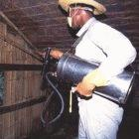
Indoor Residual Spraying

Slide 18
Protections by Bed Nets
Modern bednets are 100% polyethylene
Impregnated with deltamethrin or permethrin
Nets must repel, disable and/or kill mosquitos
Effective net life 4-5 years
Rectangular shape is preferred
Can be washed 20 times without loss of killing capacity

Slide 19
Protections by Bed Nets – cont’d
LLINs reduce malaria U5 mortality by 55%
Coverage of 60% of community confers protection on the rest (herd immunity)
Wt for age Z-score improved for children under nets (Lengeler, 2009)
Higher Hb better for children under nets
Kills other insects that cause disease

Slide 20
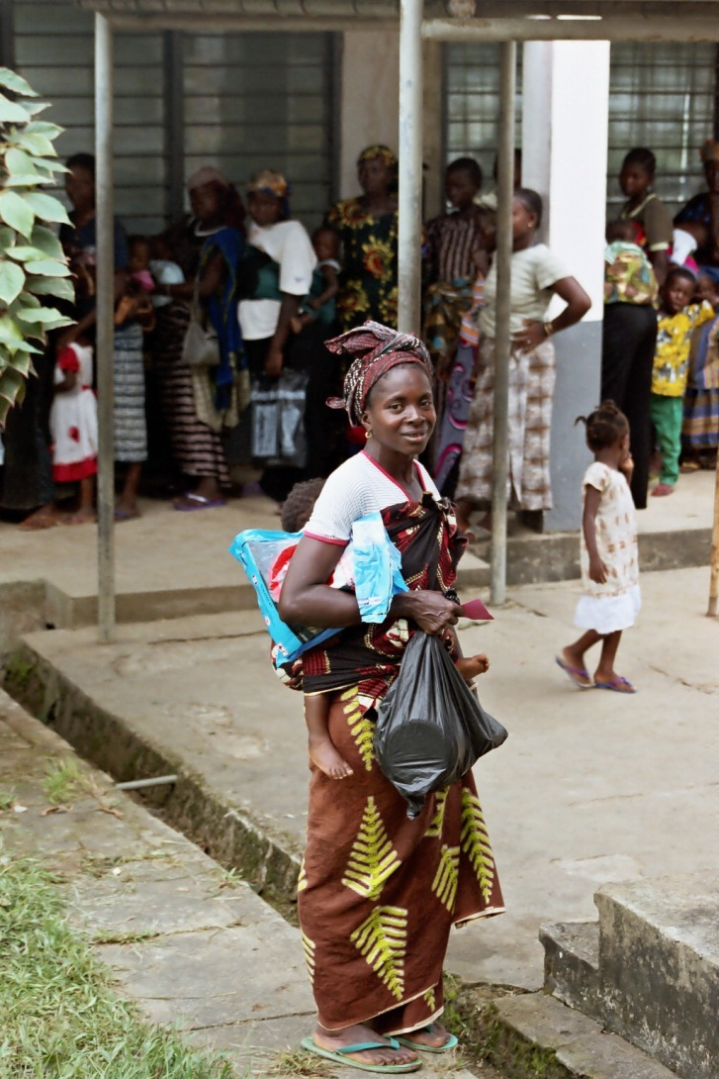

Slide 21
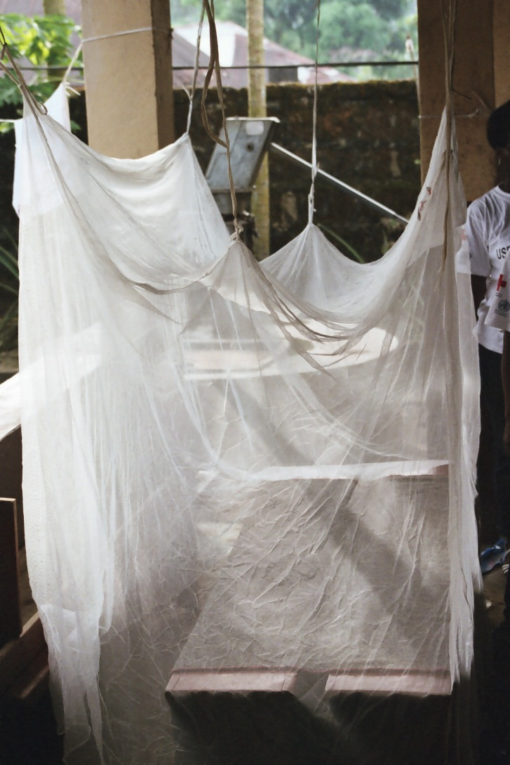
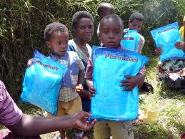

Slide 22
Cost Benefits of LLINs
Campaign cost about US$7.50 delivered/unit
‘Hang-up, keep-up’ campaign for 5 years - $0.40/household
Total cost/household less than $1.60/year
Incidence of malaria reduced for entire household by 50%
Death averted for every 21 nets used by two U5s for five years (Lengeler 2004)

Slide 23
Challenges of Bed Net Programmes
Replacement
Continued correct usage
Insecticide resistance in mosquitos
Integration in primary health care

Slide 24
Historical Treatment
Plants continue to be used in traditional medicines
Ancient use in Peru of cinchona bark infusion
Quinine alkaloids extracted from cinchona bark by French scientists in early 1800s
Quinine provides bitter flavour in tonic water
Variants used widely ever since

Slide 25
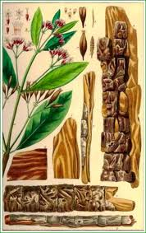
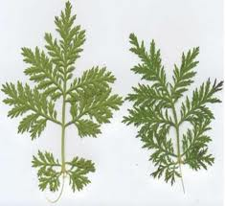
Principal Treatments
Cinchona
Artemisia

Slide 26
Quinine-based Medications
Quinine still used in some cases
Chloroquine remains first line drug in much of Asia for p. vivax and p. malariae
Drug resistance limits its use of quinine-based medications in SSA
Others include
  Mefloquine (Lariam)
  Primaquine

Slide 27
Artemisinin-based Therapies
Used by Chinese for 2000 years
Derived from artemisia annua
Fast-acting, effective, particularly in combination with other medications
Few side effects
First line treatment for p. falciparum in many parts of SSA

Slide 28
Artemisinin-based Therapies – cont’d
Greater effectiveness when used in combination
Some artemisinin-based compounds
  Artemether
  Artesunate
  Dihydratartemisinin
  Arteether

Slide 29
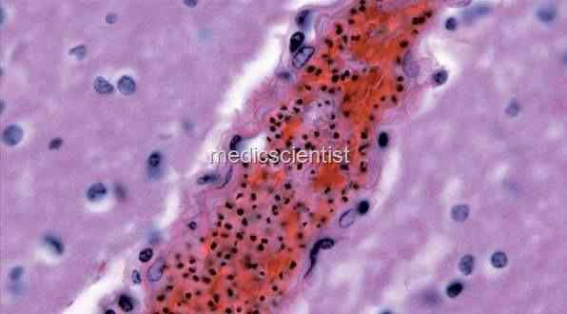
Cerebral Malaria

Slide 30
Cerebral Malaria
Most serious form of p. falciparum.
Coma - increased mortality despite treat­ment
Altered consciousness, delirium, ab­normal behaviour
Onset gradual or sudden. There may be convulsions
Tendon reflexes variable
Fundus may show retinal haemorrhages
Possible residual neurologic deficit, blindness, deafness

Slide 31
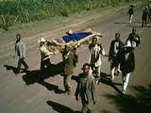
Treatment of Severe/Complicated Malaria
Immediacy of treatment
Able to receive treatment
Appropriate medications
Compliance
Follow-up

Slide 32
Practical Problems in 3rd World Context
Lack of local health facilities/services
Transportation
Cost
Time

Slide 33
Clinical Trial – Rectal Artesunate
Goal
  Does immediate treatment of severe malaria with rectal suppositories reduce likelihood of death
Method
  Double blind study in 3 countries
  Subjects to be unconscious, vomiting w no injections available
  Insertion of suppository, transport to medical post for follow-up

Slide 34

Clinical Trial – Rectal Artesunate

Slide 35
Clinical Trial – cont’d
Results
  Lower mortality in treated group
  Faster recover time
  No neurological complications

Slide 36
Why use Compound Therapies?
Each part targets a different element of the plasmodium parasite
By attacking all elements the parasite is cleared from system
Development of parasite resistance to a drug is slowed.

Slide 37
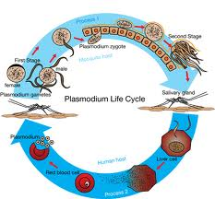
Plasmodium Life Cycle Revisited

Slide 38
Friday
In Class: Helminths and water borne disease
Read: Skolink on water supply and helminths

