Slide 1
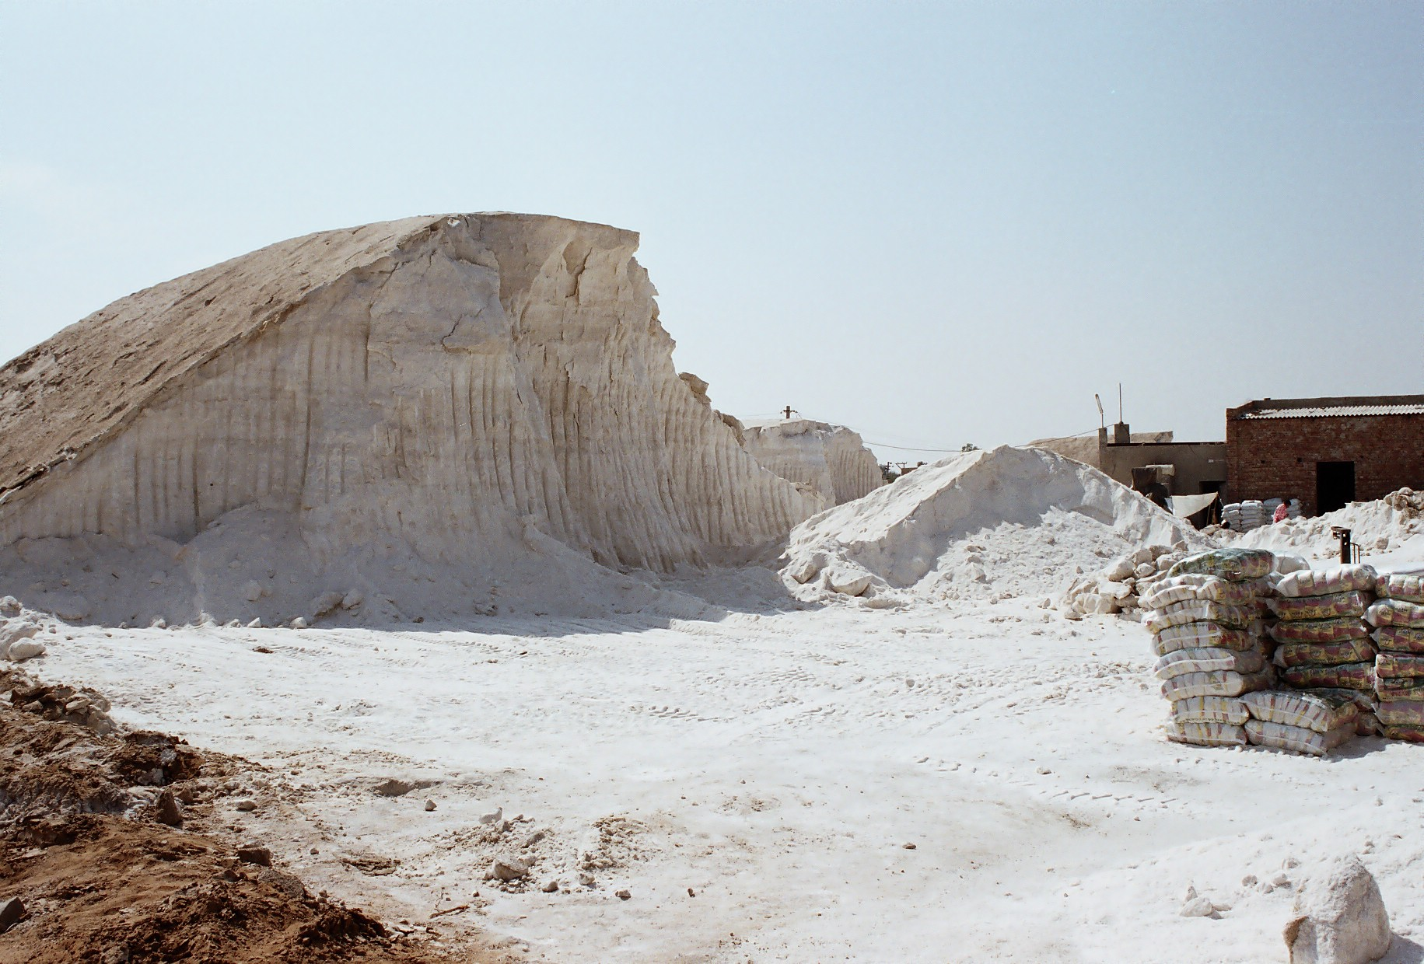

Slide 2
Health: A Global Context
APA 1122
Professor: Ken Porter, DPhil

Slide 3
Today
Administrivia
Iodine deficiency

Slide 4
Administrivia
Health Issue Assignment
1. Why the health issue you have chosen is important. If you have delimited the issue/topic explain why.
2. The incidence and demographic characteristics.
3. The costs to society if no action is taken.
4. The interventions available to address the health issue.
5. The costs of any intervention and the benefits to be gained.
NB Issues from the Policy and Governance category will have a less scientific focus but must include a critical analysis of the evaluation of effectiveness.

Slide 5
Administrivia – cont’d
Health Issue Assignment
Project due three weeks from today – February 10.
Clarification
Zinc: Although my findings suggest that unbalanced supplementation without zinc may cause growth faltering, there has not been corroboration in other studies.

Slide 6
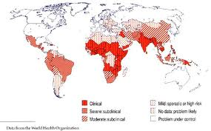
Iodine Deficiency

Slide 7
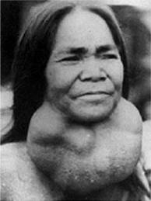

Iodine Deficiency - Effects
Goitre
Cretinism

Slide 8
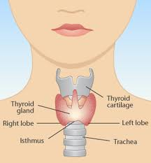
Goitre
Thyroid gland
  On neck below laryngeal prominence
  Controls energy use
  Make proteins
  Controls sensitivity to other hormones
Notes:
In iodine replete countries goitre is usually Hashimoto’s thyroiditis, an auto-immune condition.

Slide 9
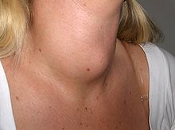
Goitre – cont’d
  Swelling of the thyroid gland
  90% of the world’s goitre is caused by iodine deficiency
  If iodine repletion is gained, goitre may remain
Notes:
In iodine replete countries goitre is usually Hashimoto’s thyroiditis, an auto-immune condition.

Slide 10
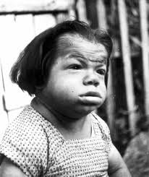
Cretinism
Severe physical and mental stunting
Deaf mutism
Squint
Disorders of gait and stance
Paracelsus noted link between goitrous parents and cretinous children in 16C
Notes:
Diderot used the term crétins des Alpes. Remote alpine valleys.

Slide 11
Iodine Deficiency
20 million are born each year at risk of permanent brain damage from IDD
More than 1.5 billion people are mildly, moderately or severely IDD at any one time
Even developed countries are at risk of IDD (e.g. New Zealand, UK)

Slide 12
Uses of Salt
Pulp and paper production
Road salt
Soaps and detergents
Helps dyes set in fabric
Chemical industry
Bath salts and cosmetics
Medical uses
Human consumption (just 3% of European production)

Slide 13
Production of Iodised Salt
Mining
  Harvesting of surface salt
  Sub-surface mining
Evaporation
  Salt pans (solar evaporation)
  Heat evaporation
Crushing/processing/iodising/packaging

Slide 14
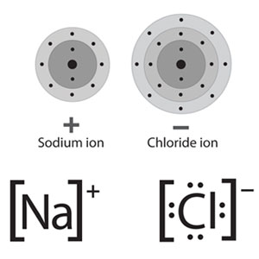

Iodised Salt
Table Salt
Potassium Iodate

Slide 15
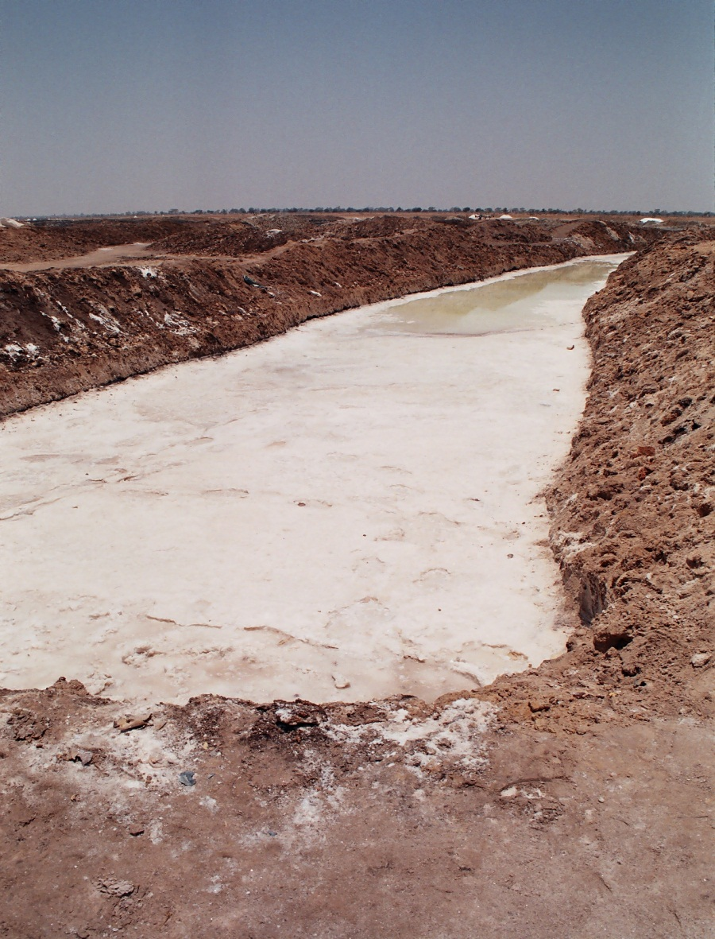
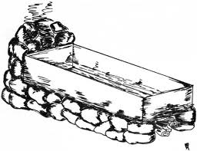
Evaporation

Slide 16
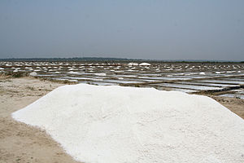
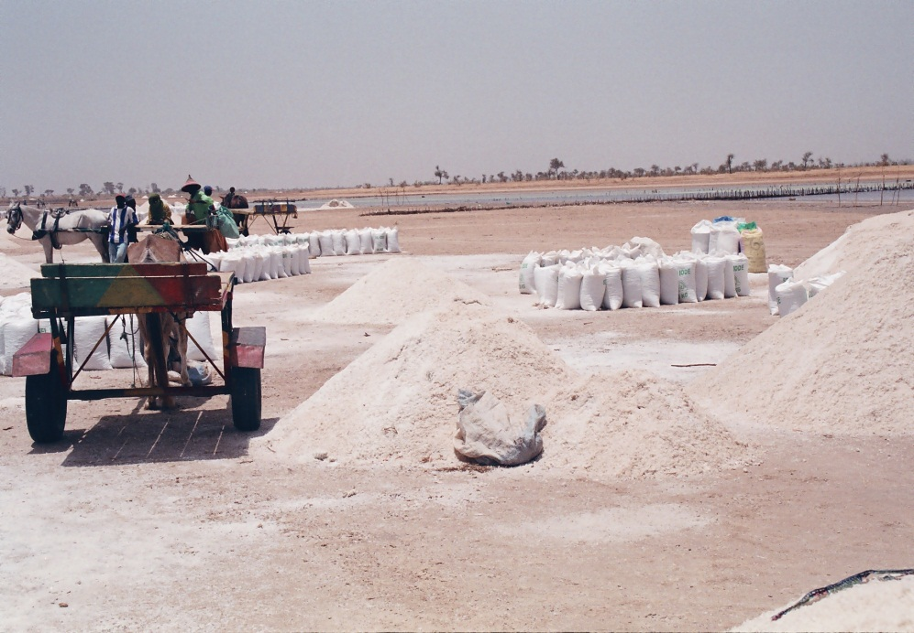
Evaporation
Notes:
Calcium carbonate, bromine (bromide), potassium are by-products of evaporation.

Slide 17
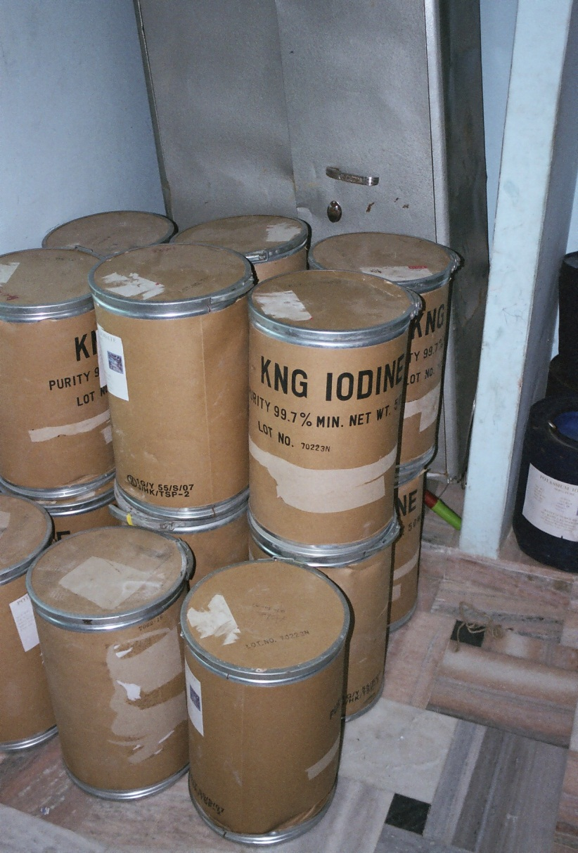
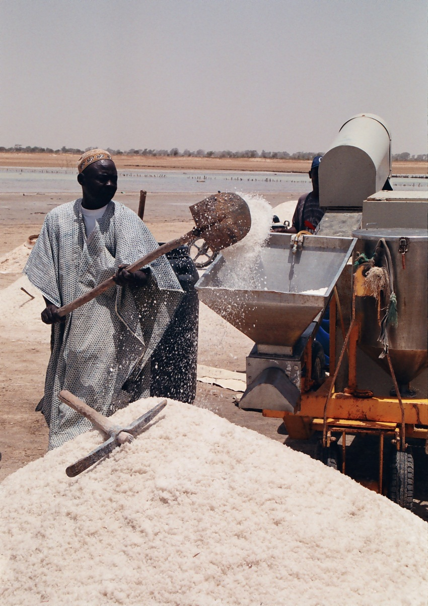
Iodising

Slide 18
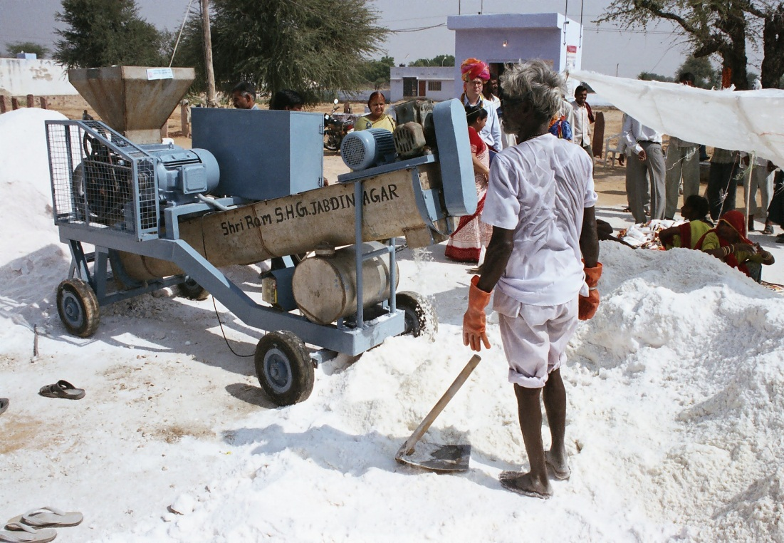
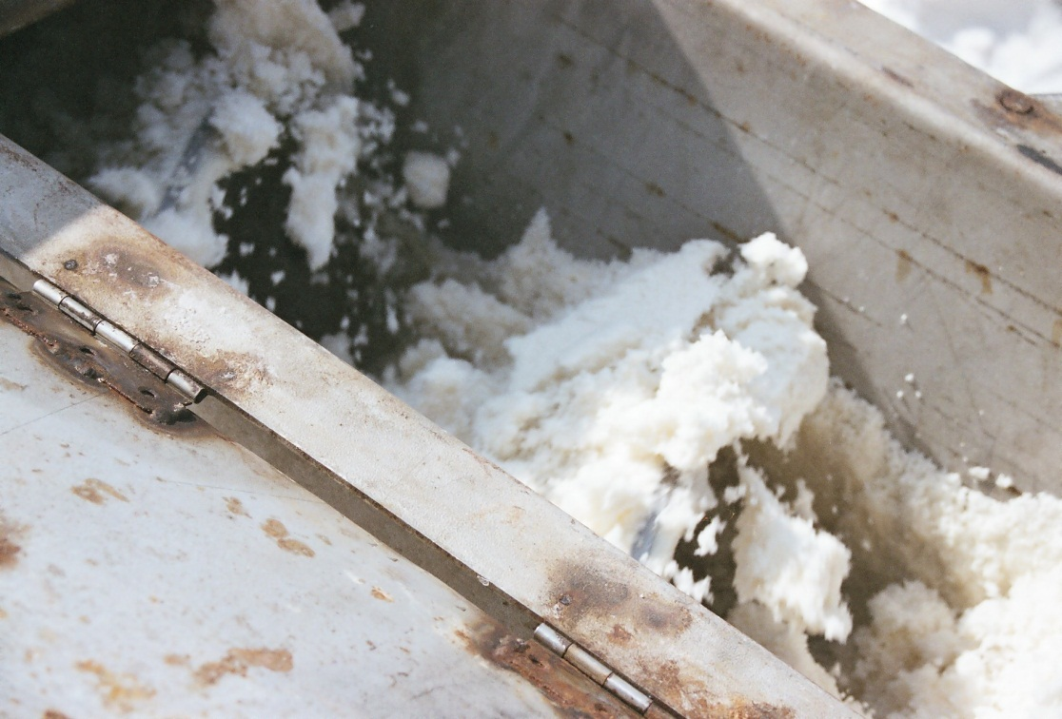
Processing

Slide 19
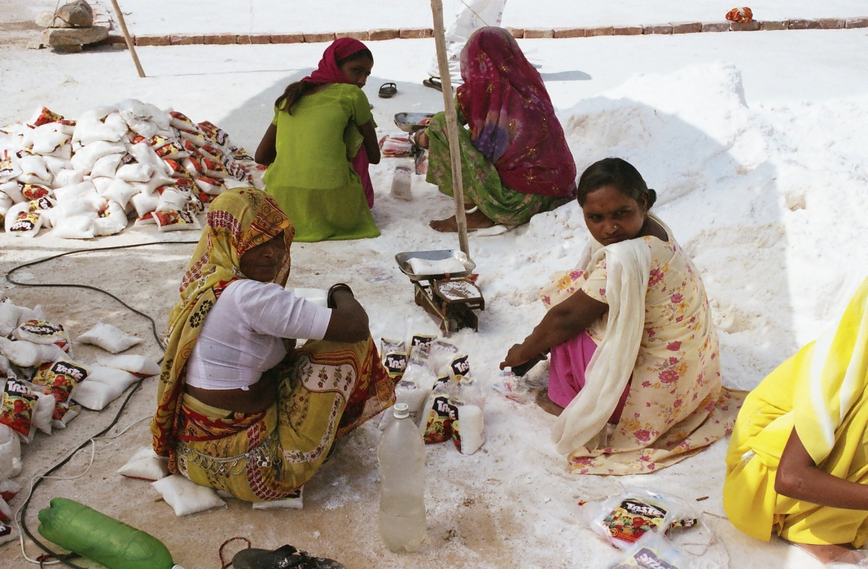
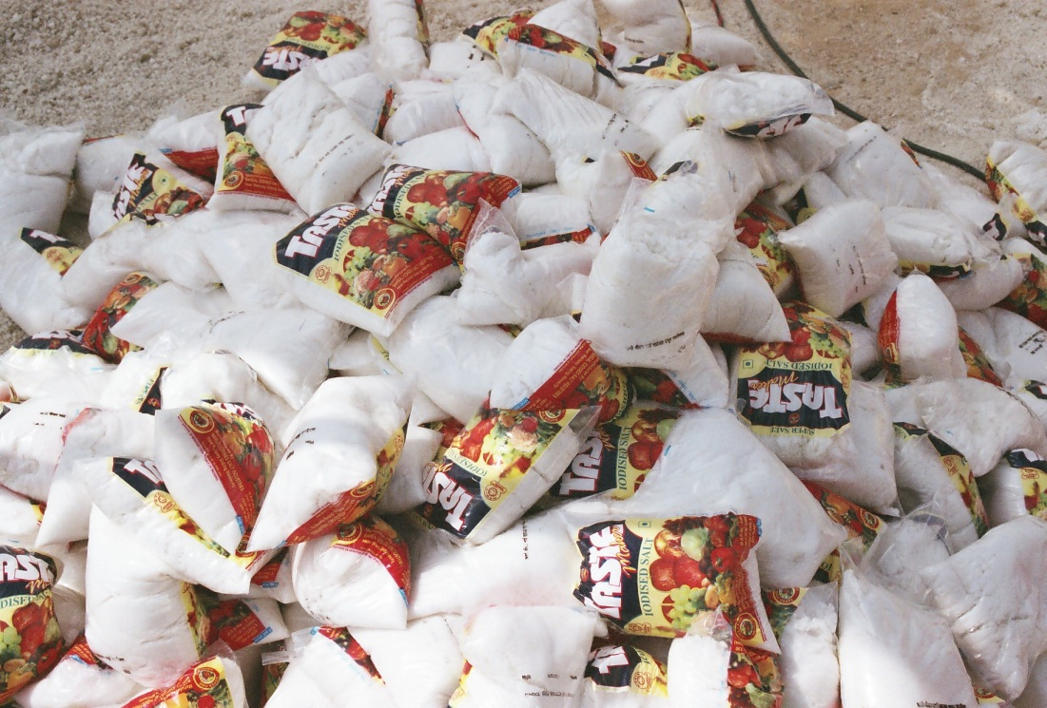
Packaging

Slide 20
Iodine Deficiency and Cognition
10 – 15 IQ points lost to children of IDD mothers (many sources)
Maternal IDD affects brain development beginning in the 2nd trimester (Sethi & Kapil)
In utero IDD protection is associated with additional 0.36 yrs of schooling (more for girls than boys) (Field, Robles & Torero)
Repletion of mildly IDD NZ children (10 to 13) results in stat sig improvement in tests of cognitive ability – 0.19 SD higher (Gordon et al.); similar results in Albania (Zimmermann et al.)
Notes:
Field et al in TZ study.

Slide 21
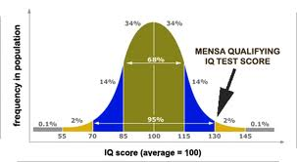
Standard Distribution - IQ
Notes:
Average IQ for university student is 110-120

Slide 22
What Impediments to Iodisation?
Lack of knowledge of importance of iodine
Small portion of production destined for the table
Organisation of small-scale producers
Cost to small producers
Technology needed for iodisation
Cultural norms
Political impediments – eg Afghanistan, Ethiopia
Regulation and monitoring

Slide 23
For Next Wednesday
Skolnik – all references to malaria (use index)
Gomes MF et al. Pre-referral rectal artesunate to prevent death and disability in severe malaria: a placebo-controlled trial; Lancet. 2009 February 14; 373(9663): 557–566. doi: 10.1016/S0140-6736(08)61734-1

