Slide 1


Slide 2

Health: A Global Context
APA 1122
Professor: Ken Porter, DPhil

Slide 3
Today
Administrivia
Case Study: Nutrition in a refugee context
Micronutrients:
  Related diseases
  Effects on growth

Slide 4
Administrivia
Health Issue Assignment
  Due Feb 10 – just 3 weeks away
  See me if you diverge much from the options
  kporter@uottawa.ca or
  Wednesdays, Montpetit 349, 13:30 to 15:30

Slide 5
Administrivia – contd
Added to Virtual Campus
  Links to various health databases
  Most are user friendly

Slide 6
Nutrition and Health - Example
You must live most of your life with a single food
That food is the potato
How much would you need daily to survive well

Slide 7
Nutritional Information
1 medium-sized baked potato (raw weight 173 gm) contains:
  161 kilocalories
  5 gm protein
  37 gm carbohydrate
37 medium-sized potatoes contain
  5957 kilocalories
  185 gm of protein
  1369 gm carbohydrate

Slide 8
Irish Potato Famine
Began in 1845 continued 6 years
Potato blight destroyed the potato crop
1+ million died, I+ million emigrated
Population of Ireland in 1845 – est. 8 million
Population of Ireland in 1852 – est. 5.8 million

Slide 9
Effects on Growth and Development of Refugee Children
Compare anthropometric measurements of adolescent children in
  A Burundian refugee camp established 1993
  A Burundian refugee camp established 1996
  Schools in 3 Tanzanian villages surrounding the camps
  Data collected in 1998

Slide 10
Refugee Food Basket
Available bi-weekly
Based on the number in the household
Cereal (corn, wheat, rice etc.) – 300 gm/person/day
Pulse (dried beans, peas, lentils) – 100 gm/person/day
Oil (corn, palm, canola) – 10 ml/person/day
At a distribution a household of 8 would receive
  33.6 kg of cereal
  11.2 kg of pulse
  1.2 ml of oil

Slide 11
Height Comparisons - Boys

Slide 12
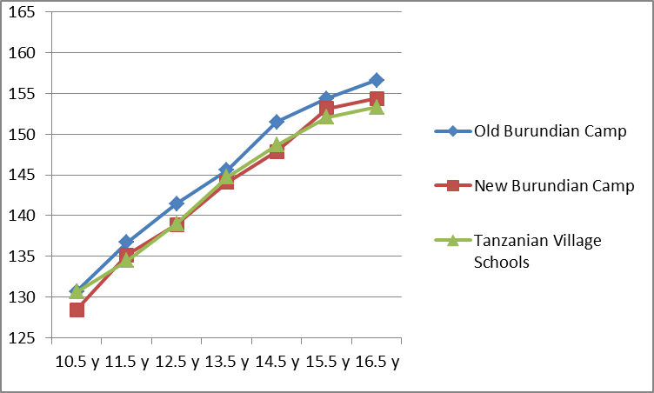
Height Comparisons - Girls

Slide 13
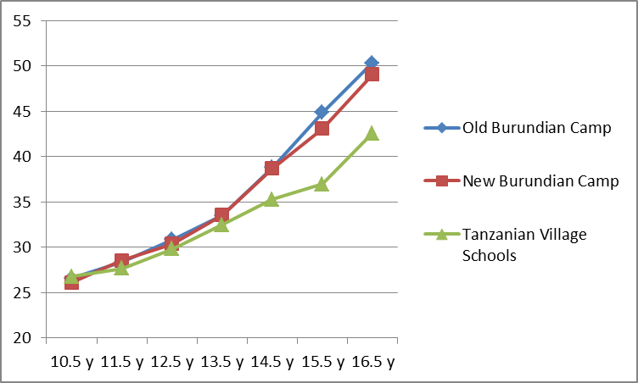
Weight Comparisons - Boys

Slide 14
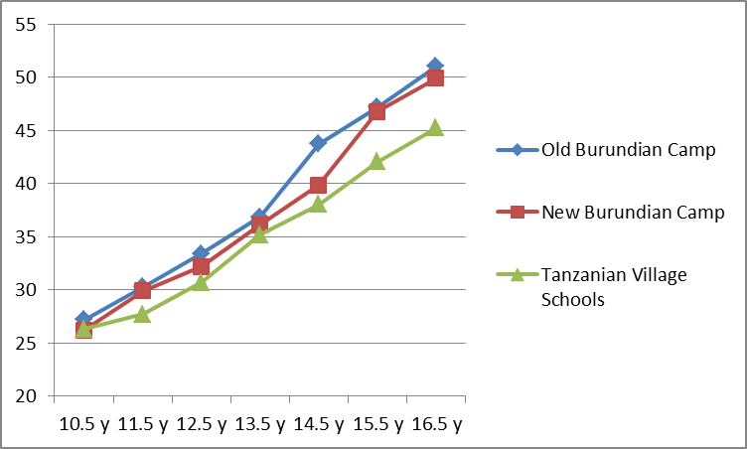
Weight Comparisons - Girls

Slide 15
Effects of Malnutrition in History
Thomasschule
  Choirboys moved from soprano to alto as their voices changed
  One of JS Bach’s choirs in a Leipzig kept records of the section the boys were in
  For a period of 8 years during the War of the Austrian Succession the average age of transition moved from 16 year to almost 17 years
  The age reverted after the War ended
Notes:
From Tanner, JM History of Human Growth

Slide 16
Effects of Malnutrition in History – cont’d
Dutch famine – 1944 - 45
  Began November 1944
  Continued to May 1945
  Rations dropped to 400-800 kcal/day
  18,000 deaths attributed to malnutrition

Slide 17
Effects of Malnutrition in History – cont’d
Dutch Famine Cohort Study
  Examines effects of nutrition a points in pregnancy on childhood and adult development
  Offspring of mothers who were pregnant during the famine have more diabetes
  Exposure to famine mid-gestation develop more obstructive pulmonary disease and microalbuminuria.
  Exposure in early gestation have more atherogenic lipid profile, altered clotting, more obesity, and a 3-fold increase in cardiovascular disease
  Epigenetic transfer (intergenerational transfer)

Slide 18
Nutrition and Menarche
Fat levels trigger onset (and maintenance) of menstruation (see Frische and McArthur, ‘74; Frische and Rivelle, ’70)
Refugee comparisons
  Tanzanian non-refugees 15 years 8.5 mos
  New Burundian refugee camp 15 years 2 weeks
  Old Burundian refugee camp 14 years 8 mos
US median onset of menarche 12 years 6 mos
Amenorrhea (cessation of menstruation) begins when under-nutrition persists
Notes:
US data from NIH; refugee data from TKP
Male equivalent of menarche is spermarche (first nocturnal emission or ‘wet dream’). Generally occurs 2 years later than menarche in women and about 2 years after the first appearance of the onset of puberty.

Slide 19
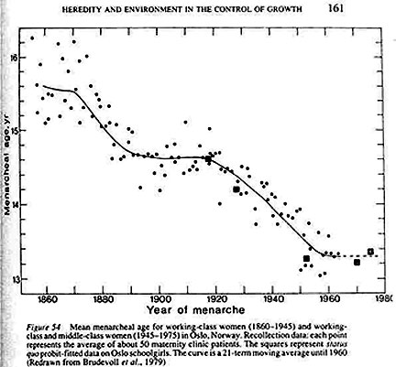
Secular Change - Norway
Notes:
From ‘Heredity and environment in the control of growth’

Slide 20
Micronutrient Disorders
Iron Deficiency Anaemia (IDA)
Folate Deficiency
Iron needed to make Hb
If pregnant, has higher risk of premature delivery and underweight baby
Heart murmurs
Delays in growth & development
Fatigue, lower productivity
In Canada: 20% women, 50% pregnant, 3% men
Principal cause of neural tube defects in utero.
Increases risk of arteriosclorosis

Slide 21
Micronutrient Disorders – cont’d
Vitamin A Deficiency (VAD)
Iodine Deficiency Disorder (IDD)
Xerophthalmia (night blindness)
Low resistance to infections
VA important for tissue growth
Goitre
Impaired cognition
Miscarriages
Premature birth
Cretinism
Notes:
Skin and hair fragility are signs of VAD.
VAD increases the likelihood of blindness in measles.

Slide 22
Case Study – Growth Faltering
Background
Health officers felt that children among new camp arrivals were failing to thrive
Additional rations were given to school children in the new camp
Appropriate number of kcal was not known
6 week intervention with high energy biscuits
  One school received 244kcal/day
  One received 366 kcal/day
  One received 488 kcal/day
Biscuit eaten in call under supervision of teacher

Slide 23
Case Study – Growth Faltering cont’d
Measurements undertaken 12 mos later as part of a school study
Four separate groups were identified
  3 groups who had received supplementation
  Those who were now in school but hadn’t been during the intervention and hadn’t received biscuits – the control
  The 4 groups had approximately the same n.

Slide 24
Case Study – Growth Faltering cont’d
Findings
No differences were expected after one year.
Iatrogenic (dose-related) effects were found.
Measurements of height, weight, and MUAC were lowest in the group that received the most (488 kcal/day)
Highest levels of height, weight and MUAC in those who received nothing

Slide 25
Case Study – Growth Faltering cont’d
Possible Causes
The biscuits contained no zinc.
Zinc is needed for body growth and repair.
The body has no zinc store.
Giving other nutrients but no zinc diluted the zinc available for growth. Faltering began.

Slide 26
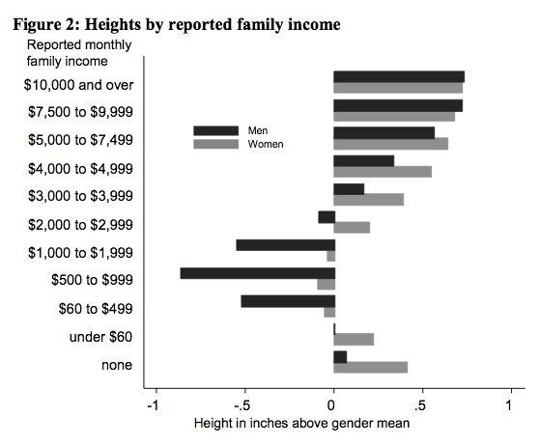
Growth Related to Income

Slide 27
For Friday
Determine you Health Issue topic
Read:
  Gordon, R., Rose, M., Skeaff, S., Gray, A., Morgan, M., and Ruffman, T.; 2009. Iodine supplementation improves cognition in mildly iodine-deficient children, American Journal of Clinical Nutrition 2009;90:1264–71.

