Slide 1
BIO1130 LAB 4
MICROEVOLUTION

Slide 2
Objectives of the lab:
Understand various concepts of microevolution using simulated populations:
Allelic and genotypic frequencies
Hardy-Weinberg (HW) equilibrium
Evolutionary forces such as:
  Genetic drift
  Mutation and Selection
Effect of population size on evolutionary forces

Slide 3
Definitions
Locus (pl. loci): any particular location in the genome (ex: green or blue loci in this lab).
Allele: different possible forms (=sequences) that are present at one locus (ex: G or g at the green locus)
Genotype: type of allele(s) present at one locus in one individual (ex: GG, Gg and gg).
Allele frequency: number of one type of allele relative to the total number of alleles (at the same locus) present in the population
  ex: number of g divided by the number of G+g in the population
Genotype frequency: number of one type of genotype relative to the total number of genotypes at one locus.
  Ex: number of GG divided by number of genotypes at the Green locus in the population.

Slide 4
Program of the lab
3 distinct parts in the lab:
    Prelab quiz: 5 questions (15% of this lab mark) on the lab objectives and methods (from the lab manual text)
    In-class simulation of a fish population
    Computer simulation using Populus software.
Parts 2 and 3: You will work in groups of two students and will hand in ONE questionnaire per pair of students at the end of the lab

Slide 5
PART I: In-class fish population (1/2)
At the beginning of the lab, each student pair will be given a card representing a fish genotype with 3 attributes:
- Blue locus genotype (B/b)
- Green locus genotype (G/g)
- Mating Type (XX / XY)
Then, the fish population will undergo several rounds of allele exchange (reproduction) under various conditions and will experience genetic drift, mutation and selection processes.

Slide 6
PART I: In-class fish population (2/2)
Small squares of cardboard will represent alleles used for the allele exchange process.
Each allele exchange round is done simultaneously by the whole class.
After 3 rounds of allele exchange, genotypes will be counted. Then, the new fish population will be characterized by calculating allele and genotype frequencies.
Follow step by step instructions from lab manual and progressively answer to questions.

Slide 7
Allele exchange procedure
Take both blue allele from card
  Mate 1 randomly picks blue allele 1 from Mate 2
  Mate 2 randomly picks blue allele 2 from Mate 1
Put back blue alleles on card
Repeat with green alleles
Repeat blue + green for 2nd offspring
You keep same mating type throughout experiment.

Slide 8
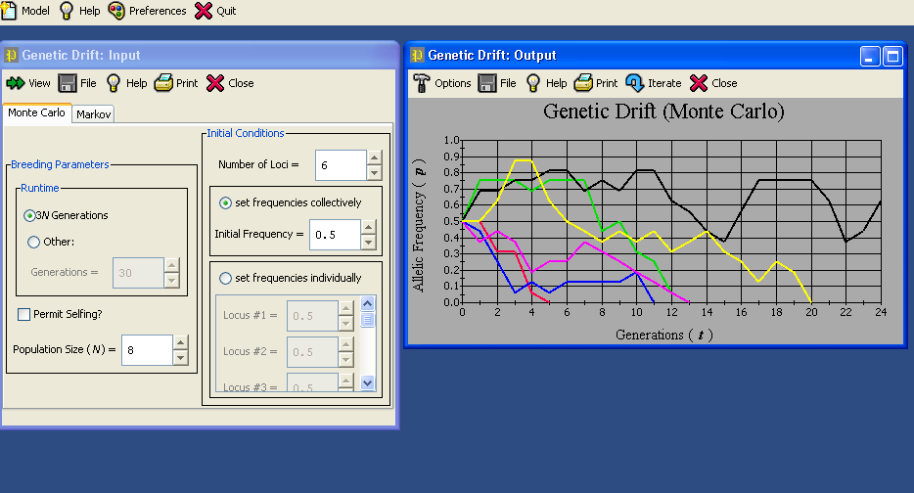
Part II: Computer Simulation using Populus
(http://www.cbs.umn.edu/populus/)
To run populus, click on the “Populus” link located in the application launcher window on the desktop. The populus interface:
Output window
Input Window

Slide 9
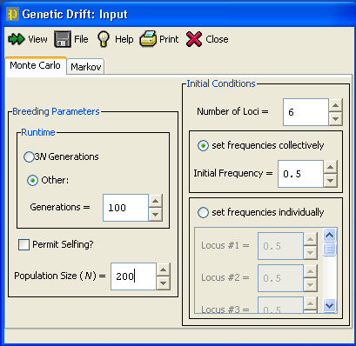
Genetic drift: Input window
Input Window:
Enter values for each parameter as indicated in the manual:
Runtime= number of generations the simulation runs for.
Population size (N)
Number of Loci (=number of populations in our exercise)= 6
Initial frequency (p)
Press View to open the output window or to refresh / iterate the simulation

Slide 10
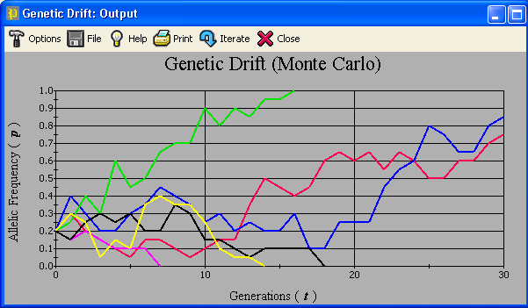
Genetic drift: Input window
Allele is Fixed
Allele is Lost
Each coloured line represents one population
Due to genetic drift (allele frequency variation due to random transmission), an allele may become FIXED if its frequency p=1 (green population on the screen capture), or LOST if p=0 (pink, yellow and black populations). These events have an impact on the genetic diversity of a population.

Slide 11
Your assignment
Before the lab:
Read your lab manual, lecture notes and/or relevant chapters in text book regarding microevolution, Hardy-Weinberg equilibrium, genetic drift and selection.
You can download Populus and try it at home (http://www.cbs.umn.edu/populus/)

Slide 12
Your assignment
During the lab:
Hand in your questionnaire at the end of the lab.
One questionnaire per student pair
There will be a Quiz at the beginning of the lab about objectives, procedures and main concepts covered during the lab. Arrive on time or you’ll miss the quiz
There is no lab report for this lab.
Questionnaires will be available to pick up in about 2 weeks (date and location TBA)
Marks will be posted on the lab website in about 2 weeks.

