Slide 1
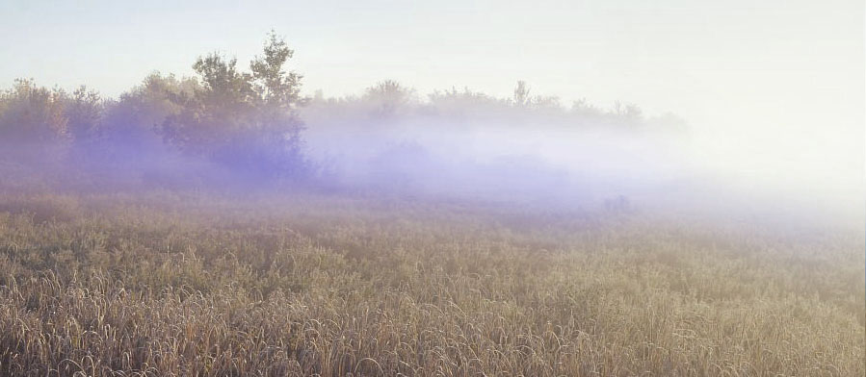
Lab1: Field trip to Mer Bleue

Slide 2
Lab objectives
Identify dominant plant species in Mer Bleue
Summarize and report quantitative data efficiently and accurately in graphs and tables.
Understand how sampling variability influences our ability to elaborate and test scientific hypotheses.
Formulate an hypothesis concerning the factors limiting the distribution of different plant species.
Predict the effect of a change in water levels in Mer Bleue on the distribution of different plant species.

Slide 3
Lab1: Field trip to Mer Bleue
Starts on Sept. 19th and will run for 2 weeks
Meeting point: In front of Lamoureux Hall (LMX)
Arrive at 2:20PM in front of LMX
The Mer Bleue Lab starts at 2:30PM for all section (no 4PM sections)
Meet your TAs in front of your assigned bus. Do not get on the bus without talking to a TAs first!
Assigned bus list is on the lab website

Slide 4
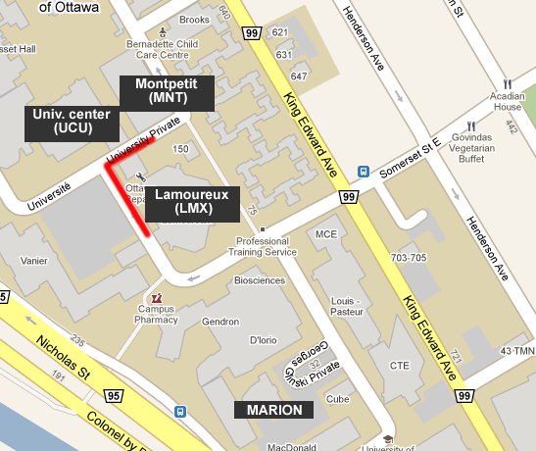
buses
BSC CENTRE

Slide 5
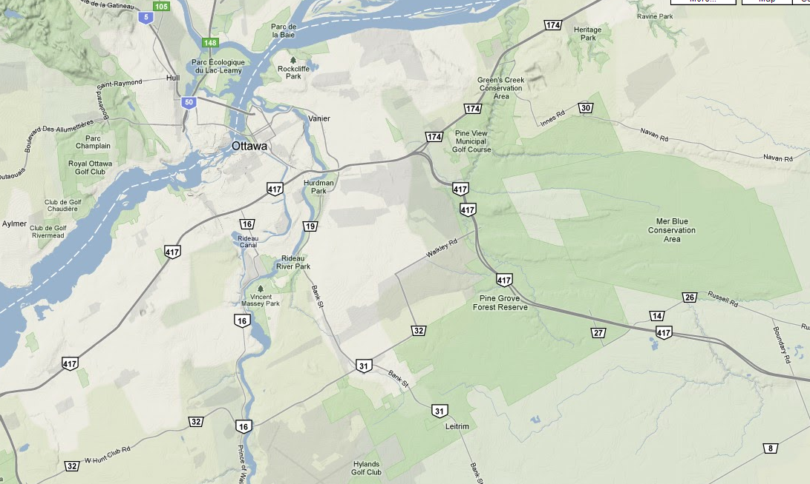
Mer Bleue site
campus
Mer Bleue

Slide 6
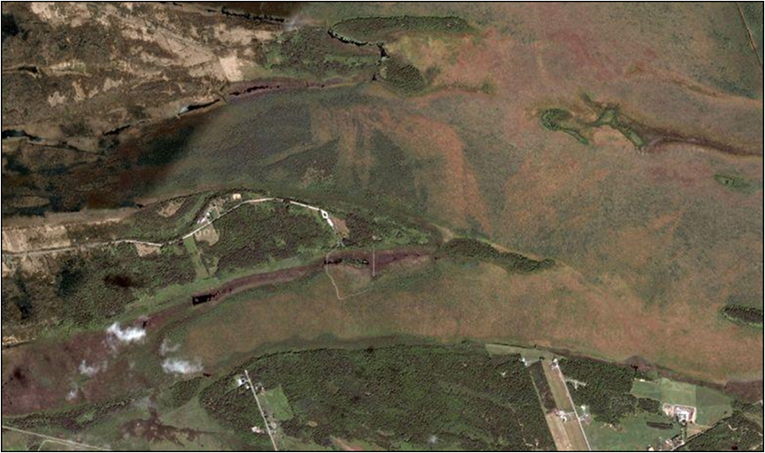
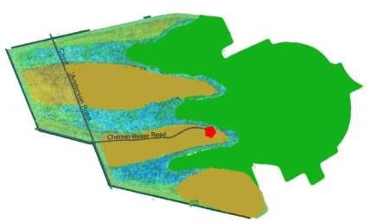
Mer Bleue Site
crête Dolman
Bog
crête Borthwick
500 m

Slide 7
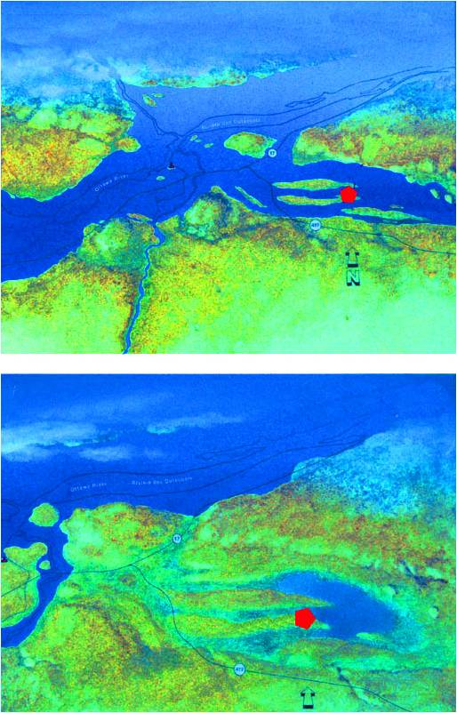
Sand dune formation
Following glacier retreat, Ottawa River was much larger than today
Sand dunes formed by south channel of river.
Uplift of terrain caused south channel to dry out then forming a small, shallow lake colonized by bulrushes.
9500 years ago
8000 years ago

Slide 8
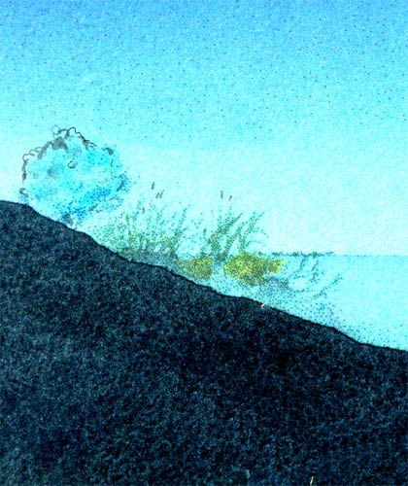
Bog formation
Bulrush roots and shoreline plants form a support for sphagnum mosses
Willow
Bulrush

Slide 9
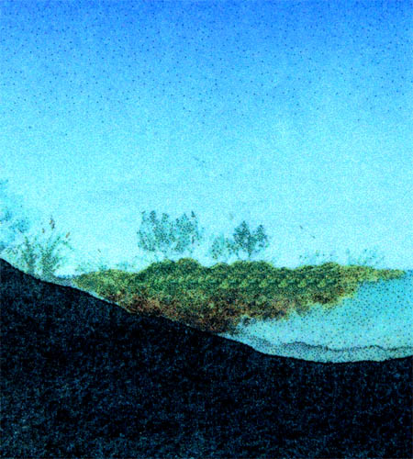
Bog formation
A floating carpet of vegetation begins to grow toward the center of the bog.
Deoxygenated water (no O₂ input) slows down decomposition, resulting in acidic conditions.
Organic matter accumulates at bottom
Labrador tea
Cassandra
Sphagnum
moss

Slide 10
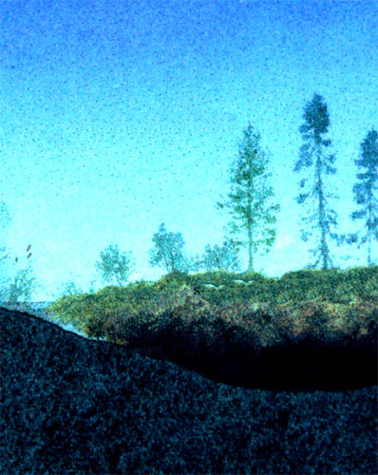
Bog evolution (cont’d)
Water surface completely covered with sphagnum resulting in raised surface, colonization by trees
Mineral salts derived from precipitation only.
Age: about 5000 years
Black spruce
Larch
Sphagnum
Peat

Slide 11
Your task
Predict the impact of a water drainage from Mer Bleue on the abundance of one particular plant species (« Your plant ») in the zone where its current incidence is highest.

Slide 12
Procedure
Make observations of all plants in 5 different stations in Mer Bleue
Produce a graph presenting the distribution of one particular plant (=your plant)
Formulate a hypothesis regarding the role of water availability on the abundance of your plant
Predict the effect of a change in the water level in Mer Bleue on your plant

Slide 13
Observations
Observe plant species in an area of 10m² (2m x 5m) at each station.
Record the presence or absence (no quantification) of each plant on the data sheet (you record all the plants you recognize, not only YOUR plant)
2m
5m

Slide 14
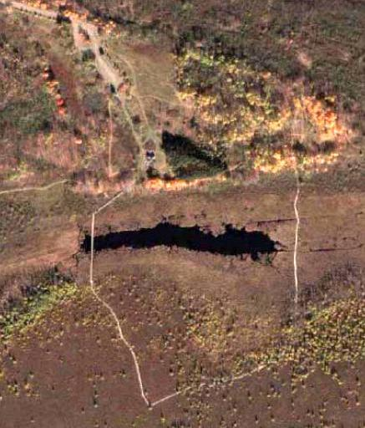

Sampling stations
Parking
5
1 – Old field
2 – Marsh
3 – Bog
4 – Ecotone
5 – Forest
1
2
3
4

Slide 15
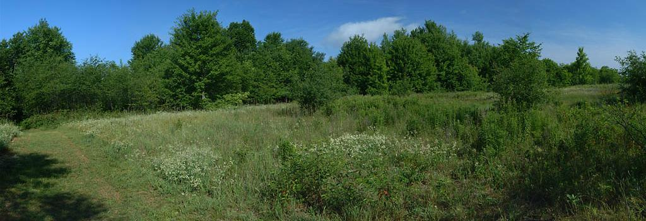
Station 1: The old Field
Dry, located on top of sand dune
2 juillet 2003, © Antoine Morin (amorin@uottawa.ca)
Notes:
27

Slide 16
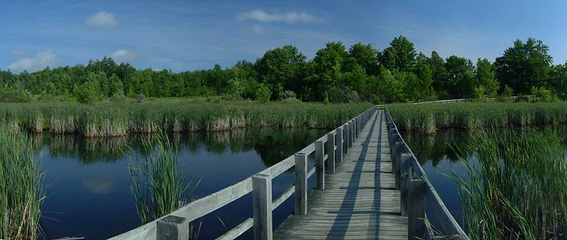
Station 2: The marsh
Pseudoaquatic environment
2 juillet 2003, © Antoine Morin (amorin@uottawa.ca)
Notes:
28

Slide 17
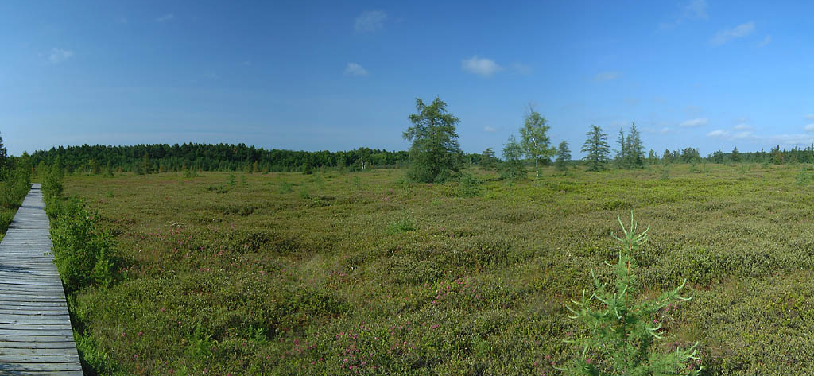
Station 3: The bog
Several metres of peat moss covered by sphagnum moss and other plants
2 juillet 2003, © Antoine Morin (amorin@uottawa.ca)
2 juillet 2003, © Antoine Morin (amorin@uottawa.ca)
Notes:
29

Slide 18
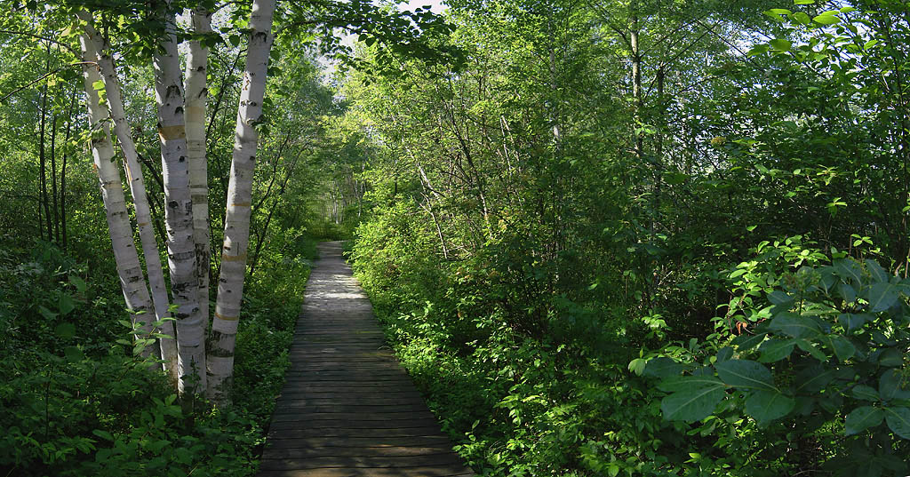
Station 4: The ecotone
Ecotone: sandy area located in between the bog and the marsh (transition zone)
2 juillet 2003, © Antoine Morin (amorin@uottawa.ca)
Notes:
30

Slide 19
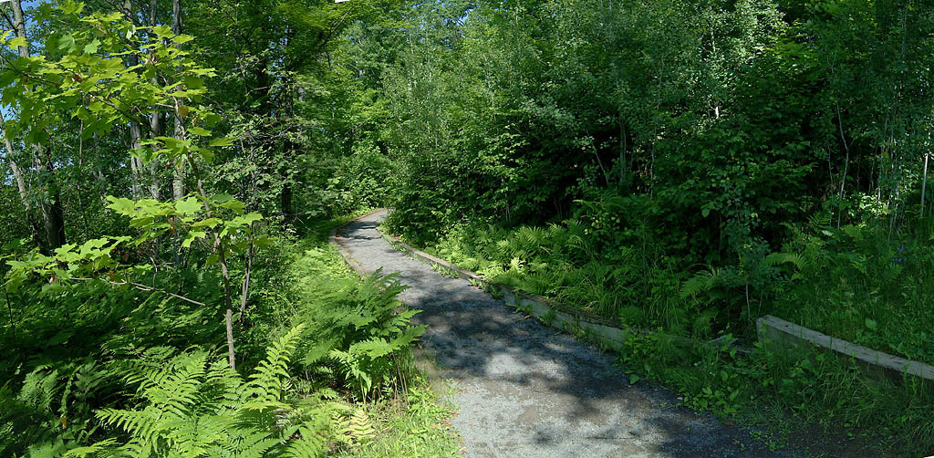
Station 5: The Forest
Higher forest
Lower forest
Two distinct environments:
-Lower Forest: relatively humid, close to condition found in the ecotone (but more sandy soil)
- Higher forest: dry and shaded environment on top of sandy hill
2 juillet 2003, © Antoine Morin (amorin@uottawa.ca)
Notes:
31

Slide 20
What is the source of water ?
Not the same in all stations
Stations at different elevation
Lower stations (bog, ecotone, lower forest) receive water from march and rain
Higher stations (field, high forest) only receive rain water
→Some stations are drier than others (which ones?)

Slide 21
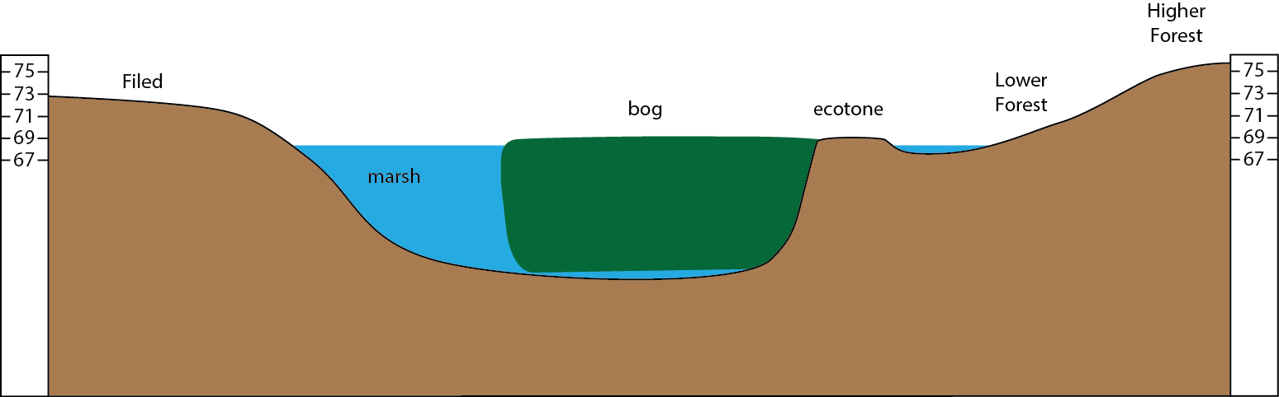
Mer Bleue site elevation map
Approx. altitude
Field
Notes:
Plus seche : champ, haut, pas d’arbre donc tres sec
Foret: haute: tres seche mais un peu humide sous les grands arbres
Ecotone: assez humide surtout du cote de la tourbiere
Tourbiere: extrement humide
Marais: semi aquatique (sur les bords) et aquatique (au centre)

Slide 22
Back from Mer Bleue …
Submit your observations the lab website before noon the day after your field trip to MB in order to combine class data (before noon the next day)
Find out which plant you’ve been assigned for your report (you can do that anytime) using the plant assignment tool on the Lab website (lab1 → assignment tool)
Download the combined data file from website to plot your graph
One week after the lab: hand in your report

Slide 23
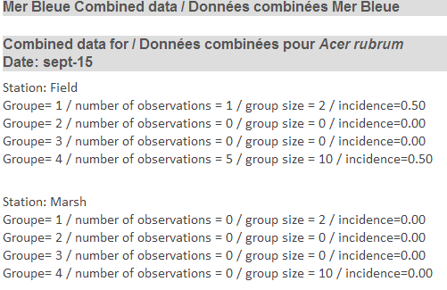
Combined data file
Available after 4PM the day following your field trip
This is the incidence you need to plot
4 or 5 groups depending on the days
Plot groups individually (no average)
Repeat for all stations (5 in total)
Data continues and shows 3 more stations

Slide 24
Instructions regarding the graph
Scatterplot showing the incidence of your plant in each station
Stations on the X axis must be ordinated along a moisture gradient (dry →moist) = semi quantitative axis
Incidence of your plant presented on the Y axis
Read carefully instructions in the appendix of lab manual (even if you think you know how to graph data) + Graphing module on lab website

Slide 25
Example: Kalmia angustifolia
1.0
0.8
0.6
Incidence
SAMPLE GRAPH (contains errors)
READ INSTRUCTIONS FORM LAB MANUAL
0.4
0.2
0.0
Old field Forest
Ecotone
Bog
Marsh
Station
Caption of the graph

Slide 26
Mer Bleue Report: content
A title page (see example in lab manual intro)
A graph showing the distribution of your plant in the 5 stations of Mer Bleue
Answers to the questions printed in the instruction file (on website) : Hypothesis and prediction

Slide 27
Mer Bleue Report: timeline
Before noon the day after your field trip: enter data on virtual campus (better if done right after trip)
Combined data will be available the day after field trip after 5PM.
1 week after field trip: Hand in version 1 of lab report
2 weeks: corrected version1 handed back (during lab2)
3 weeks: Hand in version 2 of lab report(optional)
Mer Bleue final mark = V1+V2 or 2xV1

Slide 28
Field trip instructions
Dress appropriately for field conditions!
In case of rain bring only necessary items on the field.
You can store your effects in the lockers located in the hallway of the 3rd floor BSC building (BRING a lock!) for the time of the lab
Be on time
Everyone must take the bus to and from the site (no exception)
Stay on the paths, trails and boardwalks.
Do not pick any flowers or remove vegetation.
Do not leave anything behind, including garbage.
Use the same bus going to and returning from the site.
Take a plastic bag to store items in case of rain (wallet, phone)

Slide 29
To do before the field trip
Learn to identify major plants of Mer Bleue (lab manual and web site)
Read the documents posted on the “Lab1” page of the website.
Check what is your assigned plant (for your report)
Arrive at 2:20 and go to your assigned bus in front of Lamoureux Hall

