Slide 1
Course Introduction
ADM1340: Introduction to Financial Accounting
Winter 2017
Qiu Chen Ph.D., MSc.

Slide 2
Required Course Materials
Text Book + WileyPlus
Financial Accounting: Tools for Business Decision-making (Kimmel et al. 6th Canadian edition, Wiley)
  Hardcopy: available at the University Bookstore and you must purchase the access code to Wileyplus.
  e-copy: please see how to purchase and log in WileyPlus on Blackboard under “WileyPlus Instructions”.
Course Pack: Class Slides + In-Class Exercise Questions
  Available on Blackboard.
Calculator

Slide 3
Course Assessment
1. Online Assignments: WileyPlus (10%)
2. Midterm Exam (35%)
  You must receive a minimum of 45% on the midterm exam in order to qualify to write the final exam
3. Final Exam (55%)
Assignment | Due date
Assignment 1 | Feb 5 @ 11:59 pm
Assignment 2 | Feb 26 @ 11:59 pm
Assignment 3 | Mar 12 @ 11:59 pm
Assignment 4 | Mar 26 @ 11:59 pm
Assignment 5 | April 9 @ 11:59 pm

Slide 4
Echo360
Practice MCQs in Class
Take Attendance
  More than 5 unexcused absences may prevent you from taking the final exam
Login: wait for the email invitation

Slide 5
Lab (DGD)
Please attend any of the DGDs (starting next week)
Time | Location
Monday 17:30 - 19:00 | UCU 205
Wednesday 13:00 - 14:30 | UCU 205
Wednesday 17:30 - 19:00 | SMD 222 or | SMD 226
Wednesday 19:00 - 20:30 | UCU 205
Thursday 16:00 - 17:30 | SMD 227
Thursday 17:30 - 19:00 | UCU 205 or | SMD 221
Friday 11:30 - 13:00 | TBT 323

Slide 6
How to succeed in this course
Qiu’s Office hours (DMS7160)
  Monday 13:00-14:00
  Wednesday 16:10-17:10
  Or by appointment
Suggested Learning Method
  Before class: prepare
  During class: concentrate
  After class: PRACTICE!!!

Slide 7
Chapters 1 & 2: Introduction to Accounting and Financial Statements
ADM1340: Introduction to Financial Accounting
Winter 2017
Qiu Chen Ph.D., MSc.

Slide 8
Course in a Nutshell
Ch 1 & 2: A Statement of Income
A Statement of Changes in Shareholders’ Equity
A Statement of Financial Position
Ch 13: A Statement of Cash Flow
Ch 14: Financial Statement Analysis
Final Products:
Financial Statements
Theories & Assumptions to Generate Financial Statements
Ch 3: The Accounting Information System
Ch 4: Accrual Accounting
Ch 5: Revenue & Cost of Goods Sold
Ch 6: Inventory
Ch 8: Cash & Account and Notes Receivable
Ch 9: Property, Plant and Equipment and Intangibles
Ch 10: Liabilities
Ch 11: Shareholders’ Equity
Detailed Techniques
to Prepare Financial Statements

Slide 9
Ch 1 & 2: Learning Objectives
Introduction to financial accounting
Accounting principles in Canada
Construct the three financial statements
  The statement of income
  The statement of changes in shareholders’ equity
  The statement of financial position
  The relationships between the above financial statements
Calculate ratios related to liquidity analysis

Slide 10
Ch 1 & 2: Learning Objectives
Introduction to financial accounting
Accounting principles in Canada
Construct the three financial statements
  The statement of income
  The statement of changes in shareholders’ equity
  The statement of financial position
  The relationships between the above financial statements
Calculate ratios related to liquidity analysis

Slide 11
What is Financial Accounting?
Company
Identifies
Records
Communicates
External decision makers
A system
Financial statements
Statement of income
Statement of changes in shareholders’ equity
Statement of financial position (a.k.a. Balance Sheet)
Statement of cash flows
Notes to financial statements

Slide 12
Who Use Financial Accounting Information?
External users
  Shareholders/ owners/investors
  Potential investors
  Creditors (bankers or suppliers)
  Others:
    Tax authorities
    Competitors
    Credit rating agencies (e.g., S&P , Moody’s)
    Labour union
Internal users
  Board of directors
  Management

Slide 13
Ch 1 & 2: Learning Objectives
Introduction to Financial Accounting
Accounting principles in Canada
Construct the three financial statements
  The statement of income
  The statement of changes in shareholders’ equity
  The statement of financial position
  The relationships between the above financial statements
Calculate ratios related to liquidity analysis

Slide 14
Generally Accepted Accounting Principles
Chartered Professional Accounts Canada Handbook
(i.e., CPA Canada Handbook)
Publicly accountable companies
Part I of CPA Handbook: International Financial Reporting Standards (IFRS)
Private companies
Part II of CPA Handbook: Accounting Standards for Private Enterprises (ASPE)
Nonprofit organizations
Part III of CPA Handbook: Accounting Standards for Not-for-profit Organizations
Notes:
90 countries

Slide 15
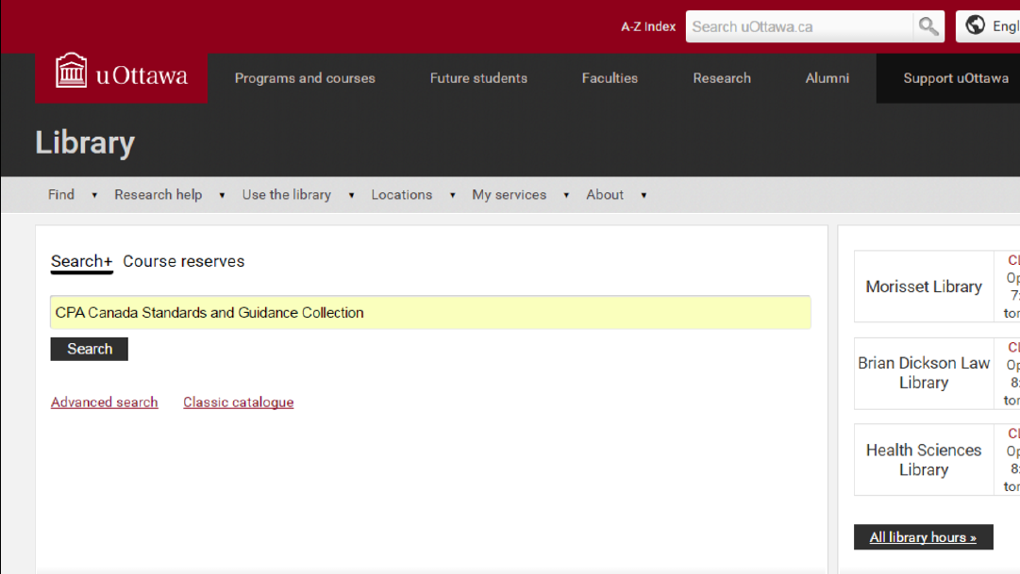
Where to Find CPA Canada Standards

Slide 16
Ch 1 & 2: Learning Objectives
Introduction to Financial Accounting
Accounting principles in Canada
Construct the three financial statements
  The statement of income
  The statement of changes in shareholders’ equity
  The statement of financial position
  The relationships between the above financial statements
Calculate ratios related to liquidity analysis

Slide 17
Income Statement
Income statement shows the operation performance of a company over a specific period of time (monthly, quarterly, or yearly, typically the fiscal year of the company).
Life of the Business
a fiscal year
a fiscal year
a fiscal year
a fiscal year
a fiscal year
2007
2008
2009
2010
2011
2012
2013

Slide 18
Business Model
Manufacturing-sector companies provide tangible products that have been converted to a different form from that of the products purchased from suppliers
Service-sector companies provide services or intangible products to their customers
  E.g. Audit or legal services
Merchandising-sector companies provide tangible products they have previously purchased in the same basic form from suppliers
  E.g. retailers, distributors or wholesalers

Slide 19
Income Statement - Format
How to measure the performance?
-
Revenues
Expenses

Slide 20
Income Statement- Elements
Revenues: sales made from the sale of goods or services for a specific period of time.
  Do not necessarily correspond to cash received...
    inflows of assets (e.g., inflow of cash or other assets)
    settlement of liabilities
Classification
    Revenues from principal businesses : sales revenue,
    Revenues from other businesses: rent revenue, interest revenue

Slide 21
Income Statement- Elements
Expenses: the dollar amount of resources used up by the entity to earn revenues for a specific period of time.
  Do not necessarily correspond to cash paid...
    outflows of assets (e.g., pay cash for insurance, cost of goods sold)
    incurrence of liabilities (e.g., wage payable)
Classification
  Expenses from principal businesses: cost of goods sold (COGS), operating expenses (e..g, salary, advertisement expense)
  Other expenses: interest expense
  Income tax expense: petax profit × corporate income tax rate

Slide 22
Income Statement - Format
Coffee Shop Co.
Income statement
 | For the year ended December 31st 2016
 | Sales | 100,000
– | Cost of goods sold | 60,000
= | Gross profit | 40,000
– | Operating expenses
 | Salary expense | 11,000
 | Depreciation | 4,000
 | Insurance expense | 2,000
 | Rent expense | 8,000
= | Operating income | 15,000
+/– | Other revenues & expenses
 | Interest expense | 5,000
 | Interest revenue | 8,000
 | Rent revenue | 1,000
= | Net Income before taxes | 19,000
– | Income tax expense (40%) | 7,600
= | Net income | 11,400
Name of company
Name of statement
Fiscal year
-
Revenues
Expenses

Slide 23

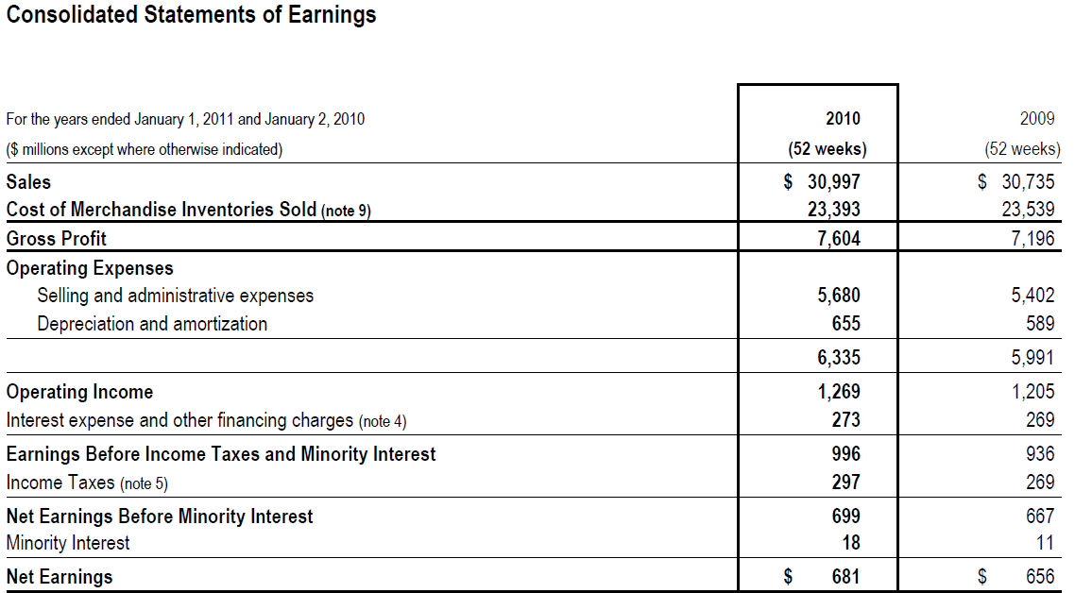
Loblaw’s Statement of Income

Slide 24
In-Class Exercise
Q1-1

Slide 25
Summary – Income Statement
Measures the operation performance over a period of time
  Name of Company
  Name of Statement
  Date (for the year ended….)
  Revenues – Expenses = Net Income or Net Loss (use this number for the Statement of Changes in Shareholders’ Equity)

Slide 26
Ch 1 & 2: Learning Objectives
Introduction to Financial Accounting
Accounting principles in Canada
Construct the three financial statements
  The statement of income
  The statement of changes in shareholders’ equity
  The statement of financial position
  The relationships between the above financial statements
Calculate ratios related to liquidity analysis

Slide 27
Statement of Changes in Shareholders’ Equity
Presents a reconciliation of each account in shareholders’ equity from the beginning of year balance to the end of year balance.
Elements:
  Capital stock (or Share capital, Common shares):
    The investment made by shareholders in the company
    Increases when new shares are issued by the company
    Decreases when the company repurchases the shares from shareholders
  Retained earnings:
    Accumulated earnings of a corporation not distributed to its shareholders since its inception

Slide 28
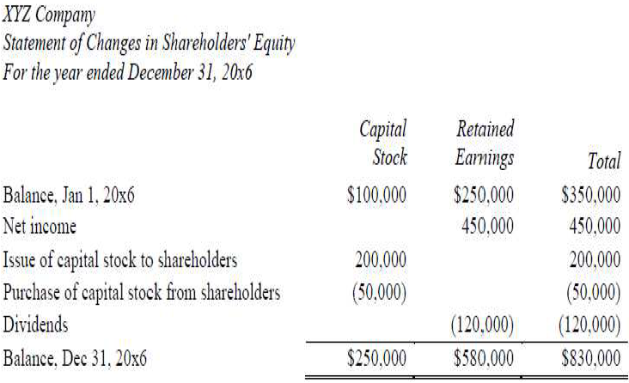
Statement of Changes in Shareholders’ Equity - Format
Capital Stock:
 | Beginning balance of capital stock
+ | Issue of capital stock during the current fiscal year
- | Purchase of capital stock during the current fiscal year
= | Ending balance of capital stock
Retained Earnings:
 | Beginning balance of retained earnings
+ | Profit of the current fiscal year (earnings or loss)
- | Dividens distributed during the current fisical year
= | Ending balance of retained earnings

Slide 29
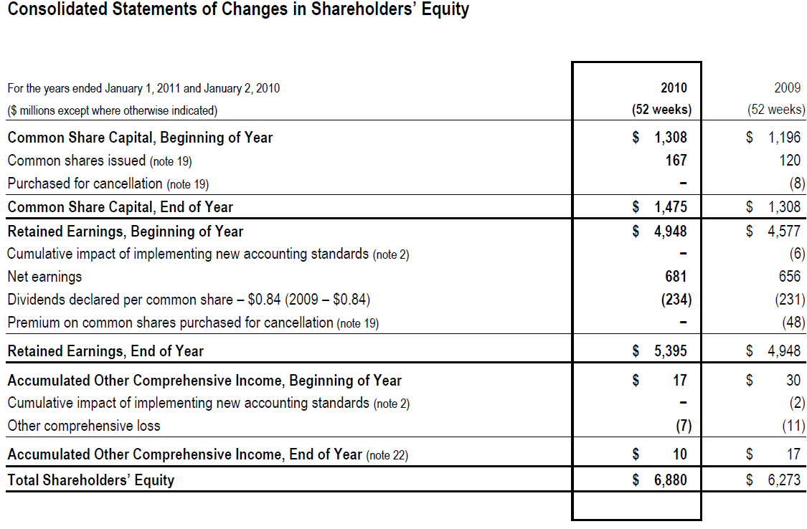
Loblaw’s Statement of Changes in Shareholders’ Equity

Slide 30
In-Class Exercise: Q1-1

Slide 31
Summary – Statement of Changes in S/E
Reconciles each account in shareholders’ equity from the beginning of year balance to the end of year balance
  Name of Company
  Name of Statement
  Date (for the year ended….)
  Ending capital stock and ending R/E balances: use these numbers for the Statement of Financial Position

Slide 32
Ch 1 & 2: Learning Objectives
Introduction to Financial Accounting
Accounting principles in Canada
Construct the three financial statements
  The statement of income
  The statement of changes in shareholders’ equity
  The statement of financial position
  The relationships between the above financial statements
Calculate ratios related to liquidity analysis

Slide 33
Statement of Financial Position
Provides a snapshot of a company’s financial position at a particular point in time (e.g., at the end of the fiscal year).
  Economic resources controlled by the company (assets)
  Economic resources borrowed from creditors (liabilities)
  Economic resources invested by shareholders (shareholders’ equity)

Slide 34
Structure of Statement of Financial Position
Accounting Equation:
Structure:
Assets | = | Liabilities | + | Equity
Economic Resources Controlled | = | Economic Resources Borrowed | + | Economic Resources Contributed by Shareholders
Company’s name
Statement of Financial Position
As at MM/DD/YY
Assets: |  | Liabities:
Current Assets |  | Current Liabilities
 |  | Noncurrent Liabilities
 |  | Shareholders' Equity:
Noncurrent Assets |  | Contributed Capital
 |  | Retained Earnings

Slide 35
Elements of Statement of Financial Position - Assets
Current Assets:
Used, sold, or turned into cash within one year
Noncurrent Assets:
Used, sold, or turned into cash over a period longer than one year
Cash
Short-term Investments
Account Receivable
Inventory
Prepaid Expenses
Property, Plant & Equipment (except for land, other PPEs have accumulated depreciation to get the Net Book Value)
Intangible Assets (e.g., patents, trademarks, copyrights…)
Long-term Investments

Slide 36
Elements of Statement of Financial Position - Liabilities
Current Liabilities:
Come due or have to be settled within one year
Noncurrent Liabilities:
Come due or have to be settled beyond one year
Accounts Payable,
Taxes Payable
Salaries Payable
Dividends Payable
Unearned Revenue
Bonds Payable
Long-term Notes Payable

Slide 37
Elements of Statement of Financial Position – Shareholders’ Equity
Shareholders’ Equity
Capital Stock: Any amounts invested in the company by shareholders
Retained Earnings: The cumulative total of the net income earned by a company but not distributed to shareholders since its inception

Slide 38
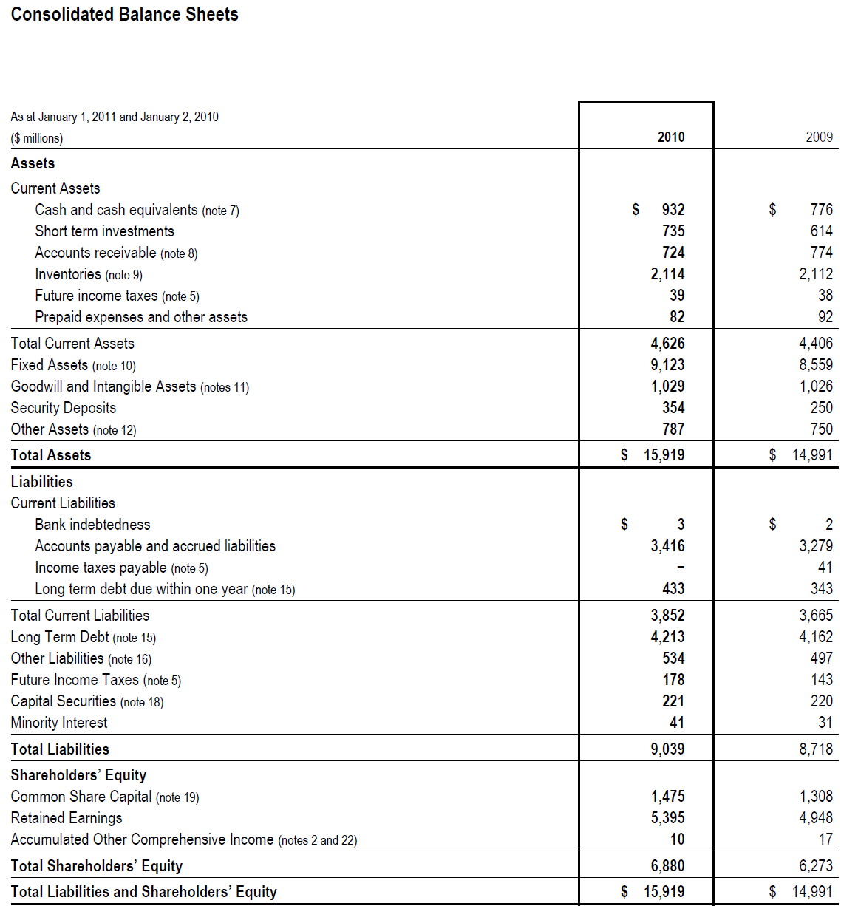
Loblaw’s Statement of Financial Position

Slide 39
In-Class Exercise: Q1-1

Slide 40
Summary- Statement of Financial Position
Name of Company
Name of Statement
Date (As at ….)
Accounts are listed under the right category (e.g., current/non current)
Total assets = total liabilities + total S/E

Slide 41
Ch 1 & 2: Learning Objectives
Introduction to Financial Accounting
Accounting principles in Canada
Construct the three financial statements
  The statement of income
  The statement of changes in shareholders’ equity
  The statement of financial position
  The relationships between the above financial statements
Calculate ratios related to liquidity analysis

Slide 42
Relationships Among the Statements
Income Statement
Revenues | $100,000
Expenses | 90,000
Profit | $10,000
Statement of Changes in Equity
Beginning share capital | $50,000
New shares issued this year | 20,000
Ending share capital | $70,000
Beginning retained earnings | $58,000
Profit | 10,000
Dividends | 6,000
Ending retained earnings | $62,000
Statement of Financial Position
Assets | $162,000
Liabilities | $30,000
Shareholders' Equity
Share capital | 70,000
Retained earnings | 62,000
Total Liabilities and Equity | $162,000

Slide 43
Ch 1 & 2: Learning Objectives
Introduction to Financial Accounting
Accounting principles in Canada
Construct the three financial statements
  The statement of income
  The statement of changes in shareholders’ equity
  The statement of financial position
  The relationships between the above financial statements
Calculate ratios related to liquidity analysis

Slide 44
Ratios analysis – Financial Strength
Evaluate the firm’s financial strength:
Liquidity: nearness to cash, ability of the firm to pay current debt
Solvency: ability of the firm to pay both current and long-term debt

Slide 45
Liquidity Analysis- Is the company able to satisfy its short-term obligations?
Working capital = Current assets – Current liabilities
Current Ratio = Current Assets
  Current Liabilities
Quick Ratio (a.k.a. acid test ratio)
  = (Cash + Short-term Investments + Accounts Receivables)
  Current Liabilities

Slide 46


Homedepot vs. Lowe’s in 2013
Assets Revenues
Homedepot $40.5 b $78.8b
Lowe’s $32.7 b $53.4b
Notes:
American chain of retail home improvement

Slide 47
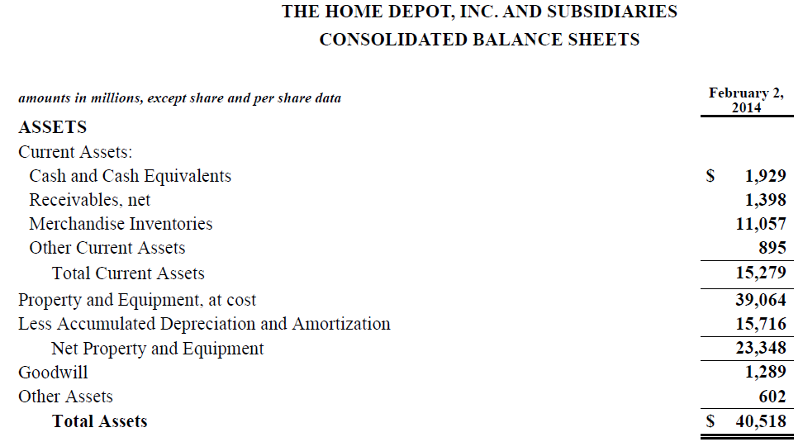

Slide 48
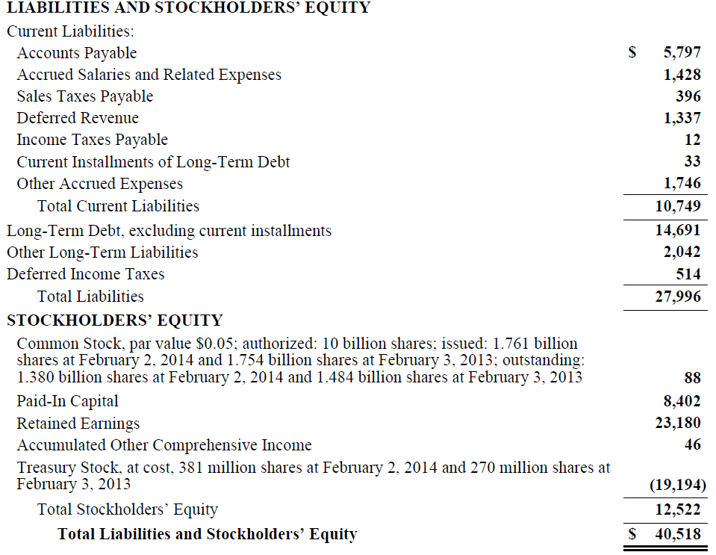

Slide 49
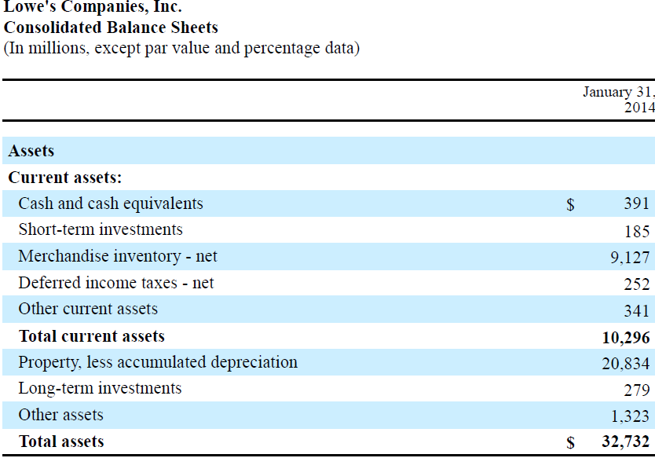

Slide 50
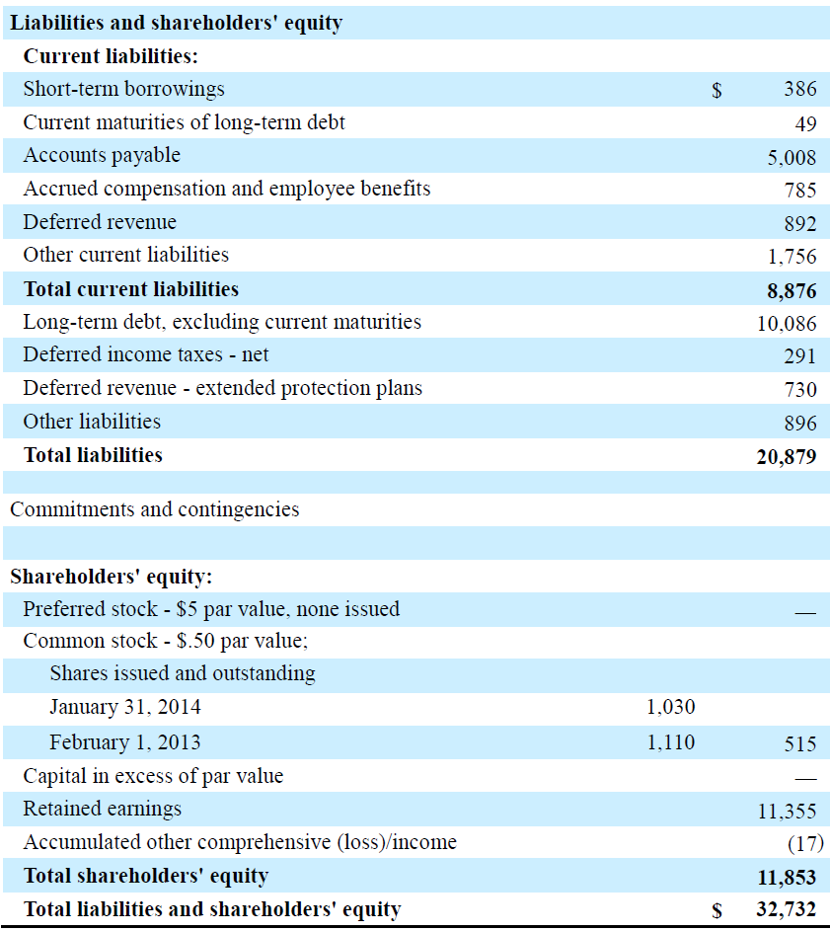

Slide 51
Exercise: Ratio Analysis
Working capital = Current assets – Current liabilities
Homedepot: $ 15,279 - $10,749 = $ 4,530 million
Lowe’s: $10,296 - $8,876 = $1,420 million

Slide 52
Exercise: Ratio Analysis
Current Ratio = Current Assets
  Current Liabilities
  Homedepot: $ 15,279/$10,749 = 1.42
  Lowe’s: $10,296 /$8,876 = 1.15

Slide 53
Exercise: Ratio Analysis
Quick Ratio
  = (Cash + Short-term Investments + Accounts Receivables)
  Current Liabilities
  Homedepot: ($1,929 + 0 + $1,398)/$10,749= 0.31
  Lowe’s: ($391 + $185 + 0)/$ 8,876 = 0.06

Slide 54
  Where to Find Financial Statements
Canadian Public Companies:
http://www.sedar.com/
US Public Companies:
http://www.sec.gov/edgar.shtml
Company’s website—investor relations

Slide 55
Homework
All assigned questions in the Course Outline (p.9 )
Chapter 1:
  E5-4, E5-8, E5-12, E5-13
  P5-2A, P5-7A, P5-10A, P5-14A
Chapter 2:
  BE2-1, BE2-5, BE2-6, BE2-7, BE2-9,
  E2-1, E2-2, E2-3,
  E2-5, E2-9,
  P2-2A, P2-4A, P2-7A

