Slide 1
COMM 226
Assignment 1 Part B:
Clarifications and tips
Chitu Okoli
Associate Professor in Business Technology Management
John Molson School of Business, Concordia University, Montréal

Slide 2
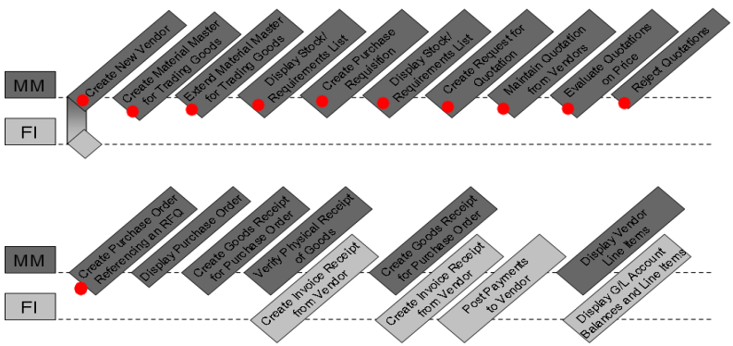
Which tasks in the ERP process are you modeling?
Draw a BPMN diagram that shows the following processes of the MM case study (The diagram should only include the main tasks) (20 marks):
  Create a new vendor
  Create Material Master for Trading Goods
  Extend Material Master for Trading Goods
  Display Stock/Requirements List (Inventory Supervisor)
  Create Purchase Requisition
  Display Stock/Requirements List (Technical Office Assistant)
  Create Request for Quotation
  Maintain Quotations from Vendors
  Evaluate Quotations on Price
  Reject Quotations
  Create Purchase Order Referencing an RFQ
MMCaseStudy.pdf
Page 2

Slide 3
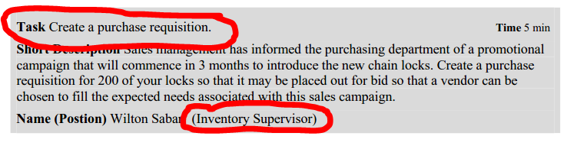
Positioning tasks in BPMN lanes
Task in BPMN: Task in the SAP process
  E.g. Create a purchase requisition
Lane in BPMN: Role in the SAP process
  E.g. Inventory Supervisor
NOTE: Other pools and lanes may exist!
  These are just helpful tips, not the full solution

