Slide 1
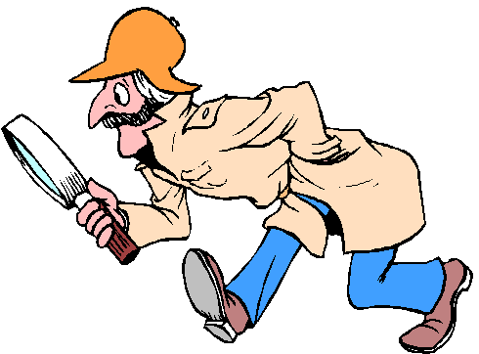
THE NATURE AND EXTENT OF CRIME IN CANADA

Slide 2
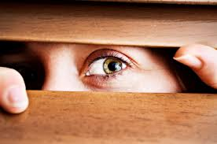
IS THE RATE OF CRIME INCREASING OR DECREASING? Decreasing
Is the fear of crime increasing or decreasing in society?
Fear-inducing activities?
Walking alone at night
In da hood
Being home alone
Taking public transportation at night

Slide 3

DO YOU ENGAGE IN ANY. . .
AVOIDANCE BEHAVIOURS
Lifestyle changes designed to reduce one’s risk of becoming a victim of crime
DEFENSIVE BEHAVIOURS
Specific anti-crime measures designed to reduce one’s risk of becoming a victim of crime

Slide 4
HMMM. . . .
What is the most common offence reported to the police?
1. Theft
2.mischief
3.assualt
What are the top 3 offences heard in court?
1. DUI ( impaired driving)
2. Theft
3. Failure to comply

Slide 5
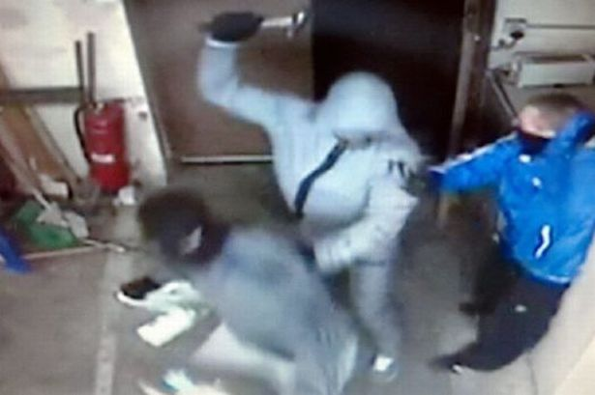
WHAT ARE 4 TYPES OF CRIMES AGAINST THE PERSON?
1. Sexual assault
2. Robbery
3. Assault
4. Homicide

Slide 6
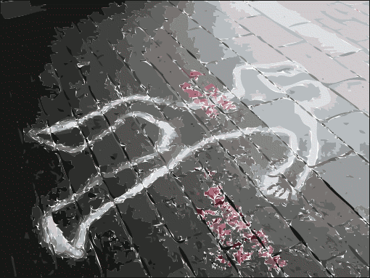
HOMICIDE
Directly or indirectly, by any means, causes the death of a human being
1ST Degree Murder
Killing a police officer, peace officer or correctional guard
Planned and deliberate
During Kidnapping
25 years before eligible for parole
2nd Degree Murder
Intent to harm (malice) but not premeditated
10-25 years before eligible for parole
Manslaughter:
Not intended to cause death
Criminal negligence
Infanticide :
Death of child (under 1) by biological mother

Slide 7
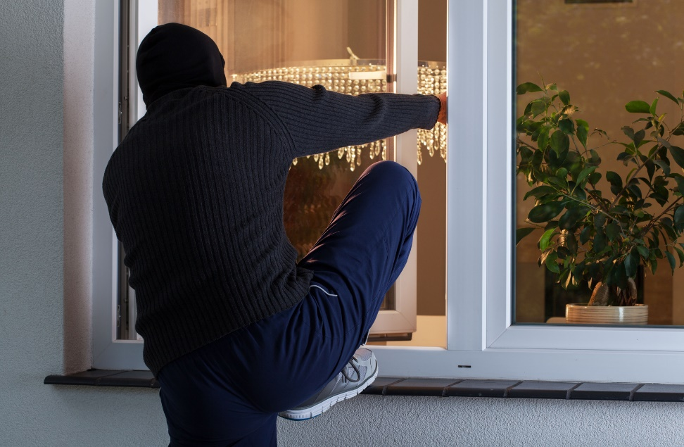
HMMM. . . .
Why are violent crimes more likely to be solved than property crimes?
Why are adults convicted of property crimes more likely to receive prison sentences than those convicted of violent crimes?
Notes:
2. Because they are more likely to do it again

Slide 8
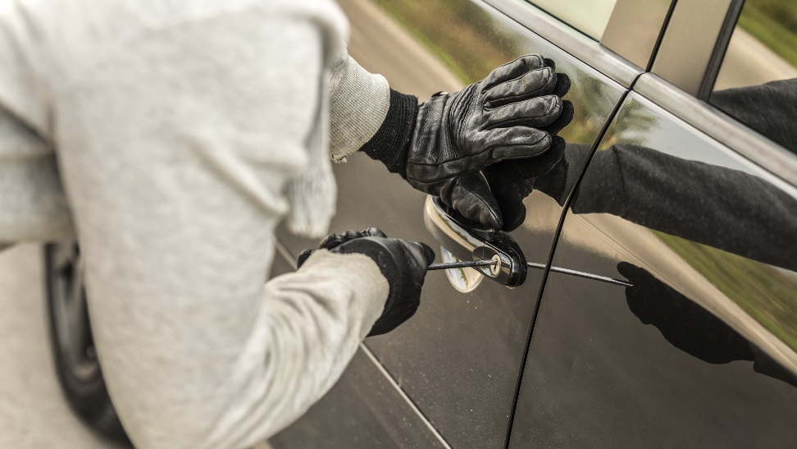
PROPERTY CRIME
Committed with the intent to acquire property without violence or the threat of violence
1.
2.
3.

Slide 9
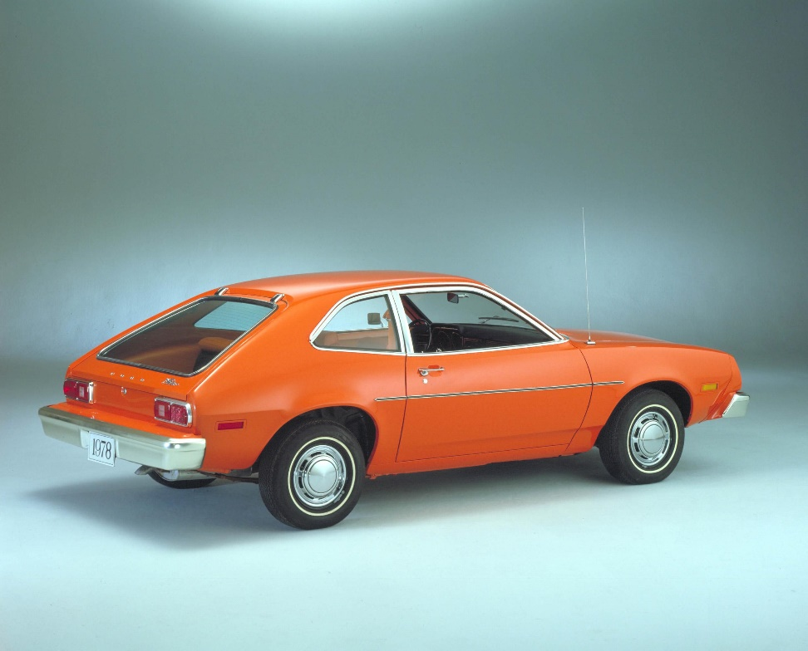
CRIMES OF THE POWERFUL
1.
2.
3.
4.

Slide 10

ORGANIZED CRIME

Slide 11
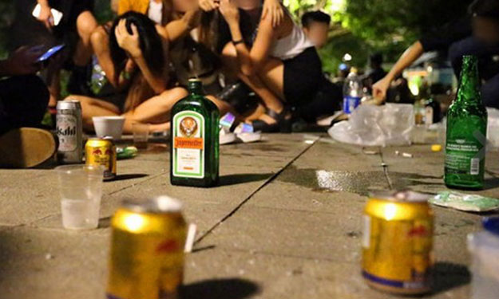
ANTI-SOCIAL BEHAVIOUR
Conduct that can be disruptive and reduce our quality of life
1.
2.
3.

Slide 12
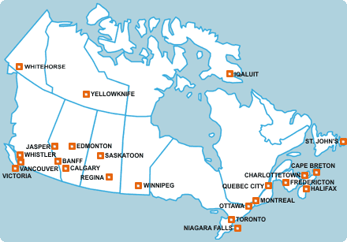
HMMM. . .
What Canadian city has the highest rate of homicide? Highest rate of crime? Winnipeg, Regina
What Canadian city has the lowest rate of homicide? Lowest rate of crime? St johns, Toronto

Slide 13
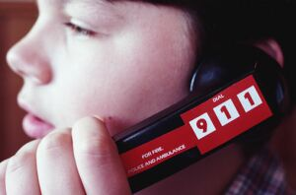
THE UNIFORM CRIME REPORTING SYSTEM (UCR)
Why do victims report to the police?
The crime must be reported/discovered
justice
Offence most reported to the police?
Limitations?
Dark figure of crime ( undetected crimes)
Police discretion
Only most serious offence counted (one with most severe sentence)

Slide 14
HOW TO CALCULATE THE CRIME RATE
# of offences * 100,000
------------------------------------
                Population
Halifax: 5 homicide * 100,000/ 414000 = 1.2
Montreal: 39 homicides * 100,000/40271000

Slide 15
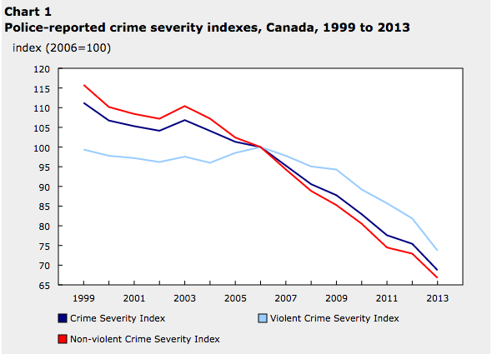
CRIME SEVERITY INDEX
Measures the volume of crime reported to the police
Applies a weight to different types of crime

Slide 16

VICTMIZATION SURVEYS
Collected every 5 yrs. for those 15 years and older
Top 2 reasons why people would not report crime to the police?
Police would not consider incident serious enough
Lack of evidence
Advantages-Limitations?
Addresses the dark figures of crime

Slide 17

RISK FACTORS ASSOCIATED WITH VICTIMIZATION
Relationship status
Age
Gender
Males are more likely to be victims of crimes
Residence status
Renter is meant to be the victim of crime
Season : summer

Slide 18

SELF-REPORT SURVEYS

