Slide 1

LEGAL FOUNDATIONS OF CRIMINAL JUSTICE

Slide 2
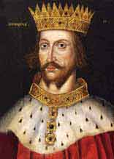
WHERE DID CANADIAN CRIMINAL LAW COME FROM?
Derived from British common law
Originated during the
reign of Henry II (1154)
Re-defined private wrongs as crimes against the state
Circuit judges→ replaced informal methods of seeking justice based on local practises
Stare decisis-
Deciding cases on the basis of situations of similar facts
Why is this important?

Slide 3
TWO TYPES OF CRIMINAL LAW:
Substantive Law: consists of written rules that declare which would be punished by the state. ( Crime) criminal code of Canada
Procedural Law: Tells us how the rights and duties of individuals can be enforced (Due process) charter of rights of freedom (1982)

Slide 4
CANADIAN CHARTER OF RIGHTS AND FREEDOMS (1982)
7. Life, liberty and security of a person
8. Search or seizure ( Privacy)
9. Detention or imprisonment (Police officers cannot take u without having a good reason)
10. Arrest or detention ( A, B, C) rights when you’re arrested Habeas corpus – rights against detention
11. proceedings in criminal and penal matters (a-i)
12. Treatment of punishment
13. Self- incrimination
14. interpreter

Slide 5

RULE OF LAW
Scope of the law
All citizens are subject to the
law.
There should be no privileged exception from the law
Character of the law
We live in a society where the law should be public and understandable
Institution of the law : Certain rules must exist for the law to be fair and just

Slide 6


Slide 7

RAPE LAWS:
Prior to 1983
The complainant had to be female
The accused had to be male
The complainant and the victim must not be married together
sexual intercourse occurred
Victim’s sexual history could be brought up in court
Implied consent accepted “honest belief
Intoxication as an excuse

Slide 8
SEXUAL ASSAULT LAWS:
After January 1, 1983
Bill c-127 - Changes in substantive law
Rape was replaced with 3 degrees of sexual assault
Level 1 – The victim suffers the least physical injury 10yrs
Level 2 – involves threat or use of a weapon and bodily harm is incurred. (More than one person ) 14yrs
Level 3 – this is when a person is sexually assaulted and resulted in permanent harm (life in prison)
Procedural Issues
1. Sex of the abused and perpetrator could be any
2. Relationships could be any
3. Rape shield law – The court can no longer bring up the victims sexual history
4. Implied vs actual consent ( diminished capacity)
5. Intoxication not an excuse22

Slide 9
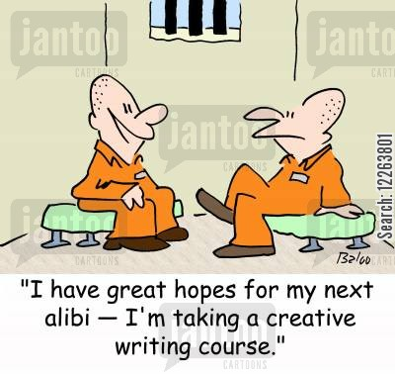
WHAT IS AN ALIBI?
Story told to the court - a claim or piece of evidence that one was elsewhere when an act, typically a criminal one, is alleged to have taken place.

Slide 10

LEGAL DEFENCES AND THE LAW
EXCUSE DEFENCES
Conduct is wrong but certain circumstances exists and the actor is excused from criminal liability ( no criminal intent)

Slide 11
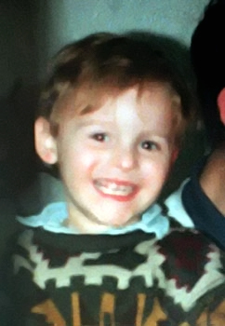
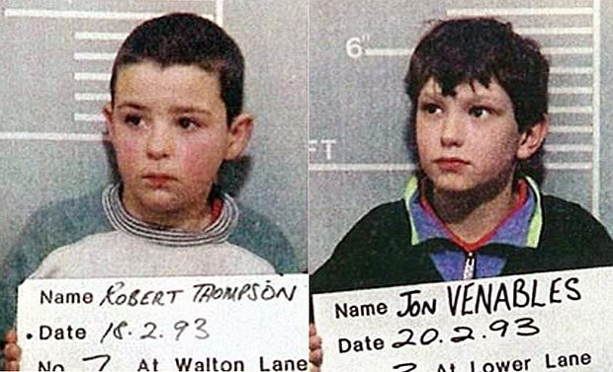

Slide 12
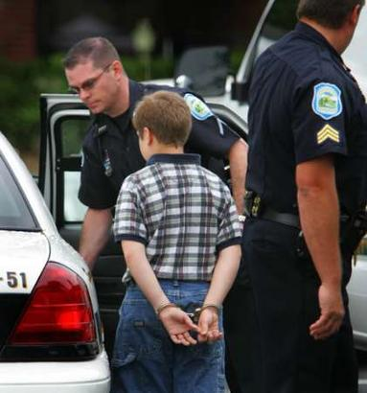
EXCUSE DEFENCES
Age
3 distinct stages
Youth – 12-17 (held accountable but limited
responsibility)
Adult – 18 – infinity (full legal rights)
Mental disorder : Incapable of appreciating the nature and quality of the act/omission (NCR)
Automatism : unconscious/ involuntary actions e.g. sleepwalking
Mistake of fact
Honest mistake
Limits- sexual assault cases Underage relationship
Mistake of law
Ignorance of the law is NO excuse
PMS? Intoxication?

Slide 13
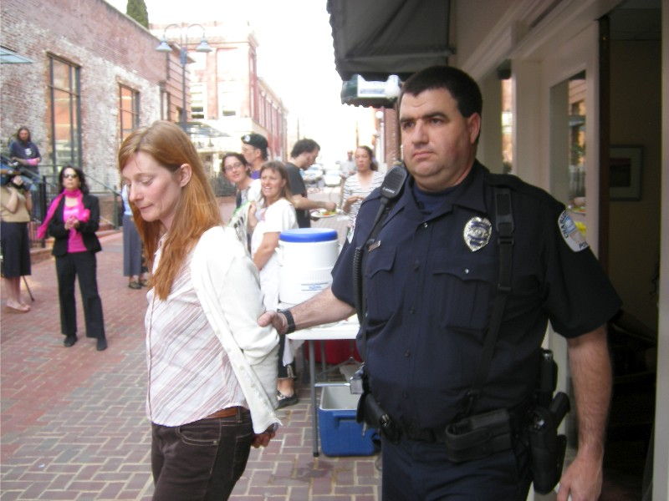
LEGAL DEFENCES AND THE LAW
JUSTIFICATION DEFENCES
Defendant admits to committing the crime (accepts responsibility), but argues that act was justified under the circumstance

Slide 14
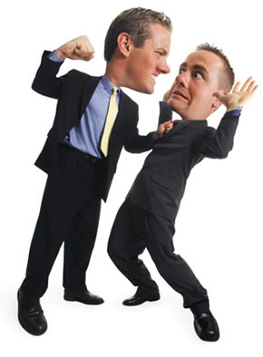
JUSTIFICATION DEFENCES
Consent
Conduct was permitted by victim
Duress:
Acting in response to threats
Necessity: an illegal act that was committed to prevent a more serious harm
Self-defence : when you are defending yourself because of reasonable fear of death or body harm.

Slide 15
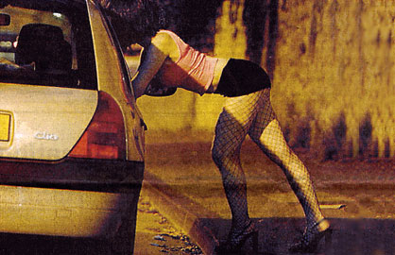
JUSTIFICATION DEFENCES
Provocation : a wrongful act/insult sufficient to deprive an ordinary person of the power of control. ( results in a lesser charge) (Texas man kills man raping daughter)
Entrapment : inducement to crime by police officer Used only after the accused is found guilty

Slide 16
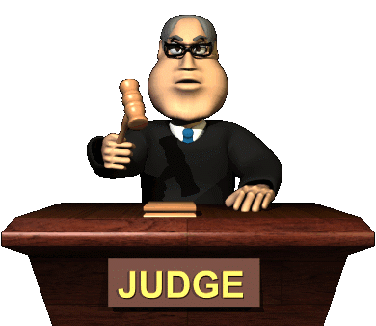
CLASSIFICATION OF OFFENCES
SUMMARY OFFENCES (ratchet) :
Trial by provincial court judge
Incarceration not exceeding 6 months
Maximum fine $2000
Charges must be laid within 6 months of the commission of the offence
INDICTABLE OFFENCES (serious):
Maximum life
E.g.. Murder, kidnapping .
Serious offences heard before a federally appointed judge and/or jury
Notes:
In order for your case to be heard before a judge and jury, you have to have a minimum 5yrs of incarceration

Slide 17
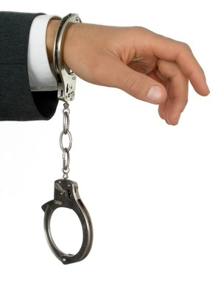
HYBRID OFFENCES
Prosecutors have discretion to proceed with the case as a summary or indictable offence
Based on aggravating and mitigating factors.
Aggravating factors : factors that could lead to a more harsh and severe punishment. E.g.
Does the individual have a serious criminal record? Violence in the offence? Planning and organization? Vulnerability of the victim? Abuse of authority ?GangX3
Examples of hybrid include sexual assault, max 18 months
Mitigating factors : factors that could lead to a less severe punishment. E.g. Good social standing in the community, showing remorse

Slide 18
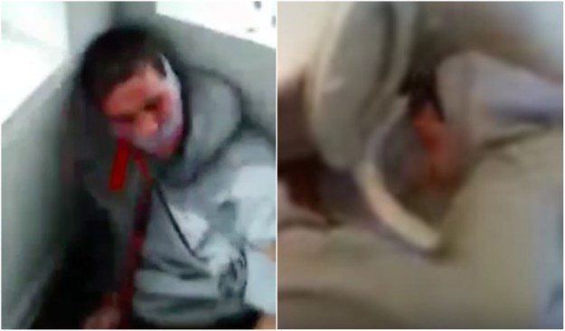
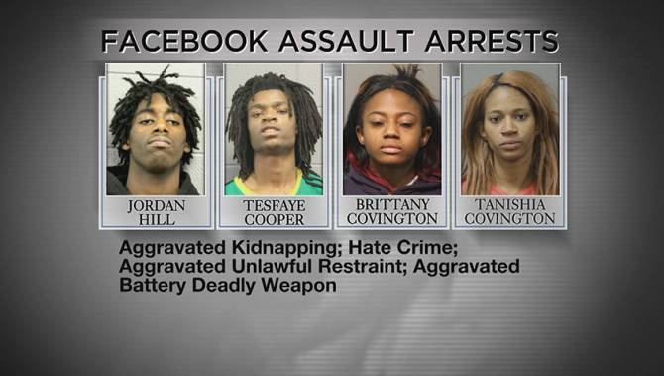
WHAT ARE. . .
Hate crimes : crimes committed because of who the victim is. Could be against a person or property

Slide 19
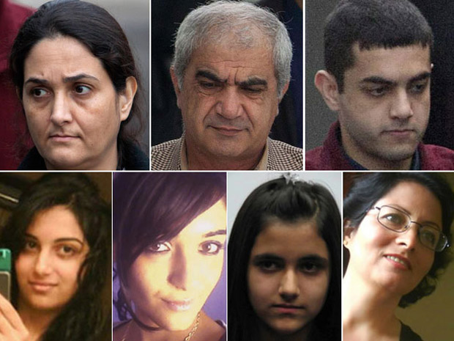
WHAT ARE . . .
Honour crimes
Killings of family members suspected of bringing shame or dishonour to a family.

Slide 20
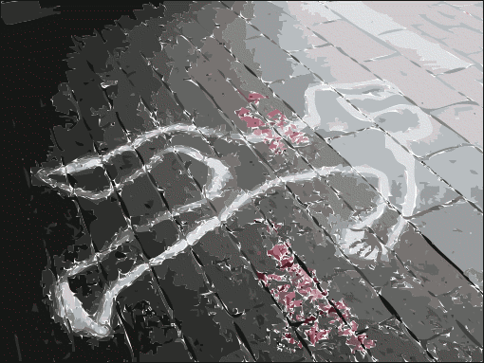
VARYING DEGREES OF SERIOUSNESS
Homicide
1st Degree Murder
2nd Degree Murder
Manslaughter
Infanticide

Slide 21
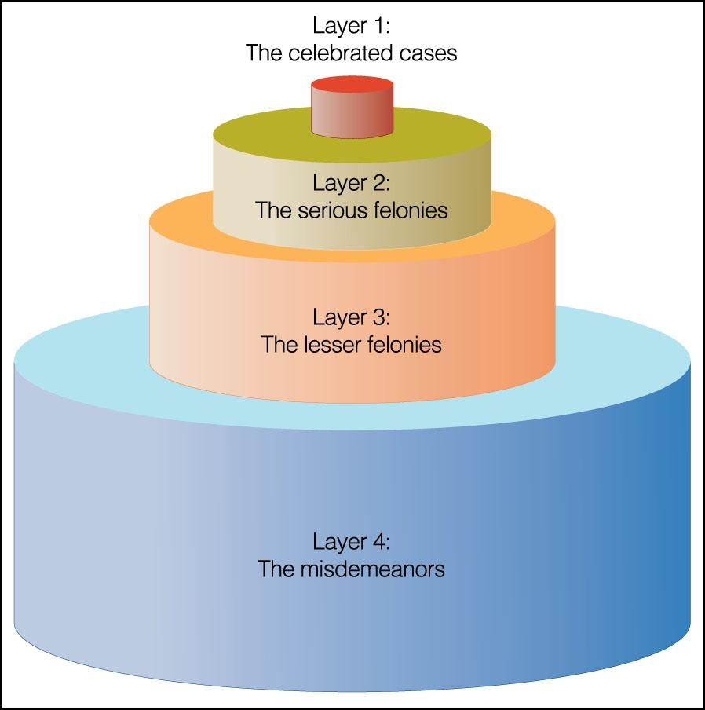
CRIMINAL JUSTICE WEDDING CAKE

