Slide 1
Engineering Economics
ECO 1192
Topic 1: Introduction
Claude Théoret
University of Ottawa

Slide 2
General Information
Availability
  Weekly office hours
    Instructor & TAs: tba
    Consult course website for locations and times.
Final Grade
  Two (2) compulsory mid-term examinations: 2 x 15% = 30%
  Two (2) compulsory assignments: 2 x 15% = 30%
  One (1) compulsory final examination: 1 x 40%.

Slide 3
Recommended textbook
Fraser and Jewkes, Engineering Economics, 6th edition, Pearson, Toronto, Ontario, 2017
  Available at the Agora and University bookstores.
Access to an “engineering economics” text is highly recommended.

Slide 4
Course website: ECO 1192C
PowerPoint lecture notes.
Calendar of key events
  Lectures and references
  Review sessions: dates and location
  Examinations: coverage, dates and location
  Background documents
Excel applications.
Two typical “problem-and-solution” sets
  Each set covers about 50% of the course.

Slide 5
Engineering Economics (ECO 1192) COURSE CALENDAR Instructor: Claude Théoret All references are to the recommended course textbook by N.M. Fraser, E.M. Jewkes and M.Pirnia, Engineering Economics, 6th edition, Pearson, Toronto, Ontario, 2017. Please consult the ECO1192 website for TA/instructor office schedules. Date: August 11, 2016.
Topics | Lectures, Assignments and examinations | Dates
1 | Engineering Decision Making (Ch. 1) | September 13
First Assignment Compulsory Availability: ECO 1192A Website from September 16 Due date: October 18. Each student will be randomly assigned ONE of THREE (3) colour-coded assignments (Blue; Pink; White). Assignments and their random allocation will be posted on the course website in mid-September. Students will use colour-coded Scantrons (answer sheets) to submit their answers. The colour-coded Scantrons will be distributed and collected at the beginning of the October 18 lecture. Absolutely no late assignments and email submissions. ……………

Slide 6
Recommended reading
Fraser et al. chapter 1
  Newnan et al. chapter 1
  Park chapter 1

Slide 7
Lecture objectives
Provide overview of economics.
Describe
  science and engineering
  engineer economic studies
Show the importance of time in decision-making.
Provide a first look at cash flows.
Project analyses.

Slide 8
Engineering Economics
Engineering economics is the science that deals with techniques of quantitative analysis useful for selecting the preferred competing alternative.
Several decades ago, engineers focused almost exclusively on a project’s physical efficiency (outputs & inputs) without much concern for its economic efficiency (value & cost).
Today new dimensions such as environmental and political concerns have been added to engineering economics.

Slide 9
Economics
The study of
  the choices made by individuals, businesses, governments, and societies as they cope with scarcity.
  scarcity and efficiency.
Scarcity
  the inability to satisfy all of a society’s wants (needs) at a point in time.
Efficiency
  Using available resources to satisfy the most needs (knowing that all needs cannot be satisfied).

Slide 10
Economic problem
Scarcity ➔ economic problem
  societal wants exceed resources available to produce goods and services to satisfy them
    wants are satisfied from the consumption of goods and services
Rich and poor alike face scarcity
  no one can satisfy his or her wants or desires at a point in time.

Slide 11
Economic objective
Satisfy as many societal wants as possible from available (although limited) productive resources (land, labour, capital and entrepreneurial spirit)
Make the best possible decisions when confronted with several projects or investments
  Avoid producing commodities which society does not value
  Produce the commodities that society wants as efficiently as possible.

Slide 12
Economic way of thinking
Scarcity involves making choices
Choices involve costs
  Choosing an alternative means dropping other alternatives.
  Thursdays between 7 and 0 pm
    Options include movies; live theater, lecture, sports …
Choices are tradeoffs
  give up something to get something else
  The highest-valued activity given up is the opportunity cost of the activity chosen

Slide 13
The Economic Problem
Inputs
Land
Labour
Capital
Entrepreneurial spirit
(used to produce outputs)
Outputs
(Goods & services)
Bread
Books
Computers
…
Health services
Education
…
?
?
?
?
?
Unlimited
Limited/Scarce
The economic problem: Consumers want an unlimited quantity of goods and services to satisfy their wants and desires. However, there is a limited quantity of inputs to produce goods and services.
The outcome: Decisions are required (choices must be made) by individuals, businesses and governments to ensure the largest number of wants will be satisfied (knowing that it is impossible to satisfy all wants).

Slide 14
Physical and economic efficiency
Physical efficiency (all points on PPF)
  measure of the success of engineering activity in the physical environment
  ratio of outputs to inputs
  maximum physical efficiency ratio is 1 (or 100%)
  physical units include BTUs, kw-hours, etc.
Economic efficiency (most-valued point on PPF)
  ratio of value or worth to cost.
  must exceed 1 (or 100%) to be successful.

Slide 15

The Engineer’s Role
Use
Scientific
Knowledge
To
Satisfy Needs
Engineers
Identify
Societal
Needs
(Goods &
Services)
Impossible to satisfy all societal needs or wants ➔ choices

Slide 16
Engineering and science
Engineers
apply science to satisfy human wants and desires
have the dual task of determining
  what society wants (its needs) and
  the best combination of materials and forces etc. needed to produce the goods and services desired by society.
Scientists
  discover laws of behaviour
  expand the body of knowledge
Science is the foundation upon which the engineer builds toward the advancement of mankind.
The engineer applies this knowledge to produce products and services that satisfy more human wants and desires.
  Engineering activities are a means of satisfying human wants, and are not ends themselves.

Slide 17
Evolution of Economic and Physical Efficiency
Today
1950s
ECONOMIC
SPHERE
Efficiency
ENGINEERING
SPHERE
(Economic
efficiency)
ENGINEERING SPHERE
(Physical efficiency)
ECONOMIC SPHERE

Slide 18
The engineering process
Key steps by the engineering community to ensure that their activities will satisfy societal needs (wants).
  Economic efficiency
All activities (including engineering) not valued by society WASTE scarce (limited) resources.
  Increase the gap between societal wants and the capacity to satisfy them.

Slide 19
Engineering Process
Key steps by the engineering community to ensure that their activities
will satisfy societal needs (removing barriers).
Alternatives (A, B ..D) for satisfying human needs
Identification
of a societal
need
X
X
A
Satisfaction
of a societal need.
X
X
B
X
X
C
X
D
A, B, C and D are competing alternatives for satisfying needs
X ≡ Obstacle;
≡ Obstacle overcome
X

Slide 20
The engineering process
1. Engineering community identifies societal wants
  how can engineering contribute to the satisfaction of these wants?
2. Identification of all limiting factors (obstacles) and strategic factors (obstacles that can be overcome).
  Some obstacles can be eliminated (overcome).
    Financial requirements; zoning bylaws; environmental regulations
3. Determination of means or proposals
  study and investigation of how to eliminate limiting factors
    basically a set of engineering proposals

Slide 21
The engineering process
4. Evaluation of alternatives
  a conversion step to bring all engineering proposals to common denominators
    Decision criteria (e.g., Present Worth and Annuities)
5. Decision-making
  select the best proposal (economically efficient)
This course focuses on steps 4 and 5.

Slide 22
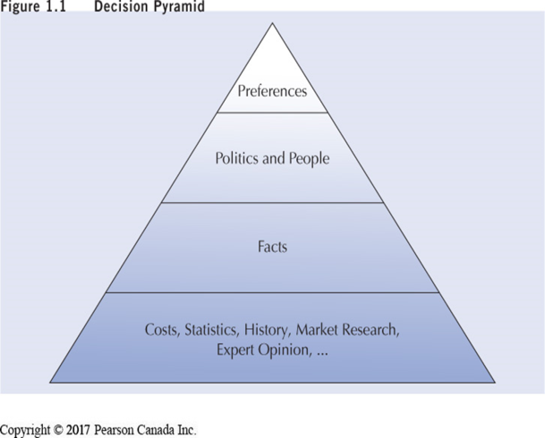
Decision Pyramid
Decisions are made on basis of belief, but “facts should be “foundation” of belief.
Economic analysis deals with the “facts” about a project’s costs and benefits.
Decisions may be made on basis of preferences, politics and people, but economic analysis establishes the basis for a decision.
These facts should tend to control politics, people, and preferences

Slide 23
Dealing With Abstractions
When dealing with the complexities of reality, it is advisable to use a model.
Models
  simplifications of reality that capture information useful and appropriate for a specific purpose.
  can be used to analyze a situation and make predictions about the real world.
Engineering economic models typically represent a project through estimates of its costs / benefits over time.

Slide 24
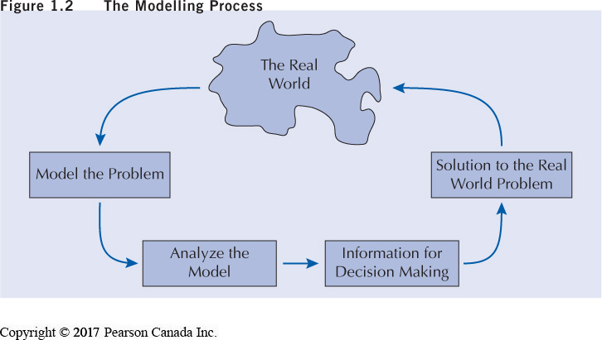
The Modelling Process

Slide 25
The Moral Question
Complex decisions often have an ethical component.
Important issue for engineers because society relies on them to stick to the “truth”.
As guardians of knowledge, engineers have a vital responsibility to society to behave ethically and responsibly in all ways.

Slide 26
Definitions of cost and profit
Accounting
  cost and profit mainly in terms of cash flows
    explicit (tangible) monetary transfers from one party to another.
    examples: wages paid, payment for goods purchased.
Economic
  cost = explicit cash flows + implicit cost
  Implicit cost example: the wages and interest income not received by a firm’s owner(s)

Slide 27
Accounting vs Economic Cost
Paul
  quits his public service employment to purchase and operate a convenience store (C-store).
  earned $50,000 annually as a public servant.
  rented the retail space which he owned while a public servant for $24,000 annually.
  sets up his C-Store in the retail space which he owned.
In the first year of operating the C-Store, Paul
  had revenues of $100,000.
  paid himself a salary of $40,000.
  had other expenses totalling $25,000.

Slide 28
Accounting vs Economic Cost
Paul’s
  accounting cost = 40,000+25,000 = $65,000
  accounting profit
    Revenues – accounting costs
    100,000 – 40,000 – 25,000 = $35,000
  economic cost = accounting cost + implicit cost (forgone revenues)
    = 65,000 + (50,000-40,000)+24,000 = $99,000
  economic profit = 100,000-99,000=$1,000

Slide 29
Time value mechanics: capturing the importance of time in decision-making
Time is a critical factor in engineering economic studies.
  Reflects the preference for consuming goods and services sooner than later
  the stronger the preference for consuming now over consuming later, the more important is time in investment decisions
The amount and timing of a project’s cash flows (operating expenses; revenues/sales) are crucial to the value of a project’s worth.

Slide 30
Time value mechanics: Rate of interest
The importance of time in engineering economic studies is captured by the rate of interest
  a cost to the borrower, a source of income to the lender.
The market rate of interest has three components: real; inflation; risk of default.
This course focuses mostly on applications of rates of interest in inflation- and risk-free environments.

Slide 31
Key project parameters
First or initial cost (P); $
Salvage value (SV); $
Operating revenue (OR or AOR); $
Operating cost (OC or AOC); $
Rate of interest or MARR (i%)
The rate of interest will be known as the MARR -- an acronym which stands for Minimum Acceptable Rate of Return

Slide 32
Example 1: Importance of Time
Project Parameters |  | Project A | Project B
First cost or initial cost (P) |  | $10,000 | 10,000
Salvage value (SV; $) |  | $0 | 0
Life (N; years) |  | 5 years | 5 years
Net end-of-year (EOY) cash flows
Year 1 ($) | Revenues – operating costs = 3,000 |  | 5,000
Year 2 ($) | 3,000 |  | 4,000
Year 3 ($) | 3,000 |  | 3,000
Year 4 ($) | 3,000 |  | 2,000
Year 5 ($) | 3,000 |  | 1,000

Slide 33
Example 1: Importance of Time
Elements common to projects A & B
  first or initial costs (i.e., $10,000)
  duration or life of projects (5 years)
  cumulative cash flows over 5 years (i.e., $15,000).
If i = 0%, projects A & B are equivalent
  indifferent between projects A or B
If i > 0%, project A is superior to project B (see next slide).
Negative interest rates (i% < 0%) have no economic meaning or significance.

Slide 34
Interest Rates & Value Today
Rate of interest | Project A’s current value | Project B’s current value
0% | $5,000 | $5,000
5% | 638 | -919
10% | - 876 | -1,453
15% | -1,471 | -4,743
20% | -3,238 | -6,927

Slide 35
Example 2: Importance of Time
Goal: $1 million retirement fund after working 40 years
  8% rate of interest compounded annually (interest paid on interest income)
  contributions to the retirement fund at the end of each year
  the initial contributions to the fund are paid at the of the first year of work.
Option | Contributions at end of years 1 to 9 inclusively | Contributions at end of years 10 to 40 inclusively
Option 1 (Good Times Now) | $0 | $7,368
Option 2 (Good Times Later) | $8,107 | $0
Contributions in option 1 total about $228,000 compared to $73,000 for option 2.
Interest income generated by early contributions is responsible for the difference in
required contributions.

Slide 36
Types of project analyses
Financial
  Considers project-generated cash flows only
  Objective: maximize profit
Economic
  Considers all project effects (both explicit and implicit) on society’s economic well-being
  Objective: maximize economic well-being

Slide 37
1. Financial analysis of projects
Exclusive focus: cash flows
  Cash outflows (outlays or expenses)
    Initial investments
    Annual costs
    Salvage values if negative
  Cash inflows
    Annual revenues
    Salvage values if positive
  Find a project’s NPW, AEW …..

Slide 38
1. Financial analysis of projects
Quantitative approach (tangible or explicit cash flows only)
  NPW, AEW, IRR, ERR
Qualitative considerations can be used to tweak (adjust) the quantitative results
  based on the experience/judgment of the decision-makers
Hence, cash flows have priority in the decision-making process.

Slide 39
Example 1. Financial analysis of snow clearing public roads
Cost and benefits | How measured
1. Noise pollution; interferes with sleep of residents | Public complaints; hard to quantity
2. Snowplow damage to roads and to residential property | Observation of damage
3. Fewer accidents; reduced material damages | Difference in number by experiment
4. Visible demonstration of property tax use | Political benefit
5. Snow in driveways; cost of removal | Cost of removal
Considers cash flows only.

Slide 40
Example 2: Financial analysis of information kiosks along major highways
Cost and benefits | How measured
1. Cost of maps, etc. | Cost of purchase: price x quantity
2. Telephone costs | Telephone bills
3. Insurance costs | Insurance premiums
4. More tourists in territory; tourists may stay for longer periods | Survey information
5. Tourists may return more frequently | Survey information
6. Advertising for campsites, hotels, restaurants …. | Survey information
7.Healthy to stop and stretch | Difficult to measure
Only cash ($) flows are considered.

Slide 41
Example 3: Financial analysis of a community re-cycling proposal
Revenues and Costs | How measured
1. Cost: Need for specialized equipment for collecting, sorting and processing newspapers … | Obtain price estimates of equipment and building costs (if required).
2. Cost: purchase of recycling boxes and “composters” for each household (provided free of charge). | Total cost = number of households multiplied by cost of boxes and “composters”.
3. Costs by households (time, smells) of sorting garbage weekly. | Cost = Time required multiplied by an appropriate wage.
4. Benefits: sale of newspapers, cardboard, metal cans … | Estimate quantity recycled per household multiplied by the number of households and sale price of recycled material.
5. Savings: Landfill site will have longer life➔ longer land purchase and acquisition costs. | Estimates of yearly waste volumes saved.
6. Savings: Reduced tipping fees. | Forecast reduction in waste volume brought to landfill site.
7. Reduced air and water pollution. | Surveys

Slide 42
1. Financial analysis: Pros and Cons
Advantages
Single model (only one approach).
Cash flows are somewhat reliable and readily available.
Simple calculations.
Disadvantages
Risk of wrong decision by excluding intangible information (e.g., value of time savings)
More difficult to explain project selection (value judgments can bias conclusion).

Slide 43
2. Economic Analysis
Measures a project’s benefits and costs on a target population’s well-being
  E.g., wearing protective headgear is made compulsory for cyclists.
All tangible and intangible impacts on the well-being of cyclists would be identified and measured
    Value of
      goods and services
      resources (labour, physical capital …)

Slide 44
Example 1: Economic analysis of snow clearing public roads
Cost and benefits | How measured
1. Noise pollution; interferes with sleep of residents | Public complaints; hard to quantity
2. Snowplow damage to roads and residential property | Observation of damage
3. Fewer accidents; reduced material damages | Difference in number by experiment
4. Visible demonstration of property tax use | Political benefit
5. Snow in driveways; cost of removal | Cost of removal
All explicit and implicit project impacts on the well-being of a target population must be considered.
Explicit =Tangible; Implicit = Intangible

Slide 45
Example 2: Economic analysis of information kiosks along major highways
Major benefits to visitors
  Provision of maps and brochures
  Campground and hotel reservations
Major cost
  Staffing, building (capital) and maintenance
Any other costs and benefits?
Are the costs and benefits measurable?

Slide 46
2. Economic analysis: Information kiosks at border crossings
Cost and benefits | How measured
1. Cost of maps, etc. | Cost of purchase: price x quantity
2. Telephone costs | Telephone bills
3. Insurance costs | Insurance premiums
4. More tourists in territory; tourists may stay for longer periods | Survey information
5. Tourists may return more frequently | Survey information
6. Advertising for campsites, hotels, restaurants …. | Survey information
7.Healthy to stop and stretch | Difficult to measure

Slide 47
Example 3: Economic analysis of a proposed re-cycling program
A city is proposing a new recycling and composting program.
City residents will be responsible for separating
  newspaper, cardboard, and metallic cans from regular waste which will be recycled by the city
  “compostable” waste from other waste which they will be responsible for composting
The city will
  provide residents with recycling bins and composting units.
  Collect recycled material weekly which will be sorted and sold by the city.
Your Task
  Identify program benefits and costs.
  Discuss how program benefits and costs will be measured?

Slide 48
Example 3: Economic analysis of a proposed re-cycling program
Revenues and Costs | How measured
1. Cost: Need for specialized equipment for collecting, sorting and processing newspapers … | Obtain price estimates of equipment and building costs (if required).
2. Cost: purchase of recycling boxes and “composters” for each household (provided free of charge). | Total cost = number of households multiplied by cost of boxes and “composters”.
3. Costs by households (time, smells) of sorting garbage weekly. | Cost = Time required multiplied by an appropriate wage.
4. Benefits: sale of newspapers, cardboard, metal cans … | Estimate quantity recycled per household multiplied by the number of households and sale price of recycled material.
5. Savings: Landfill site will have longer life➔ longer land purchase and acquisition costs. | Estimates of yearly waste volumes saved.
6. Savings: Reduced tipping fees. | Forecast reduction in waste volume brought to landfill site.
7. Reduced air and water pollution. | Surveys

Slide 49
Economic Analysis: Pros and Cons
Advantages
All project impacts (positive and negative) on the economic welfare of a target population are taken into account.
Disadvantages
Range of values for most intangible impacts (e.g., disagreement over the value of a life)
Disagreement over the discount rate to be used for public projects.
Major emphasis on economic efficiency ➔ little concern for distributional issues
  Who benefits? The rich? The poor? An influential political class?

Slide 50
Course overview
Many sections of this course can be applied to personal financial decisions. For example,
  mortgage payment calculations
  bond yields
  financial & real property investments
  effective credit card or car payment interest rates
  …

Slide 51
Sample personal applications
Mary paid $9,775 for a $10,000 10-year Canada Bond which pays $500 annually.
  Her broker stated that the investment would yield x% but was unable to provide calculation details.
  Would you
    calculate the rate yourself?
    accept the broker’s word?
You are planning a major vacation in five years which you expect to cost $30,000. What annual savings are needed if money earns 5% annually?
How much of this month’s mortgage payment is
  Equity (repayment of the mortgage)?
  Interest on the outstanding (unpaid) mortgage?

Slide 52
Typical cash flow patterns
1. Single sums (PW & FW)
2. Uniform series (annuities)
3. Linear gradient (arithmetic) series
4. Geometric gradient series
5. Irregular series
Note:
Shortcuts for calculations of summary measures (e.g., NPW) are only possible for categories 1 to 4.
This section is irrelevant if NPW and other calculations are performed with a computer or financial calculator.

Slide 53
Cash flow patterns
A single disbursement (money spent) or receipt (money received)
A set of equal disbursements or receipts over a sequence of periods, referred to as an annuity
A set of disbursements or receipts that change by a constant amount from one period to the next in a sequence of periods, referred to as an arithmetic gradient series
A set of disbursements or receipts that change by a constant proportion from one period to the next in a sequence of periods, referred to as a geometric gradient series.

Slide 54
Cash flow diagram
Present Worth (PW)
$1,000
PW = ??
≡
0
1
2
3
4
5
0
5
What is the value TODAY or NOW (time = 0) of $1,000 in five
years for a given interest rate (e.g., 10%) compounded annually?

Slide 55
Cash flow diagram
Future Worth (FW)
FW = ??
$1,000
≡
0
1
2
3
4
5
0
5
How much will $1,000 TODAY or NOW be worth in five years (t=5)
for a given interest rate (e.g., 10% compounded annually)?

Slide 56
Cash Flow Diagram:
Present Worth of an annuity
PW = ??
PATTERN
➔ Shortcut
$1,000
$1,000
$1,000
$1,000
$1,000
≡
0
1
2
3
4
5
0
5
What is the value today (t=0) of five yearend deposits of $1,000 for a given rate of interest (e.g., 10% compounded annually)?

Slide 57
Cash Flow Diagram:
Future Worth (FW)
FW = ??
$1,000
$1,000
$1,000
$1,000
$1,000
≡
0
1
2
3
4
5
0
5
What will be the value in five years of five yearend deposits of $1,000 for a given compound interest rate (e.g., 10% compounded annually)?

Slide 58
Cash Flow Diagram:
Converting a present value to an annuity
Present Worth = $4,000
A = Annuity
A
A
A
A
A
≡
0
(years)
5
0
1
2
3
4
5
What annual cash flow over five years can be generated by $4,000 today at a given interest rate?

Slide 59
Cash Flow Diagram: Linear Gradient Series
(Arithmetic Series)
Constant $ gradient = +$250
$1000
$750
$500
$250
0
1
2
3
4
An arithmetic (or gradient) series can be increasing (as shown) or decreasing.
The dollar difference between any two adjacent members must be the same.

Slide 60
Cash Flow Diagram: Geometric Series
10% rate of growth (increase).
$110 = 100(1+k)¹
$121 = 110(1+k)¹ = 100(1+k)²
k ≡ rate of growth (or decay) of series
$146.41
PATTERN
➔ Shortcut
$133.10
$121
$110
$100
0
1
2
3
4
5
A series that increases (shown) or decreases at a given rate (e.g., 5% or -20%).

Slide 61
Cash Flow Diagram:
Irregular Series (No pattern)
300
No Pattern → No Shortcut
200
100
1
2
3
4
5
-200
-300

Slide 62
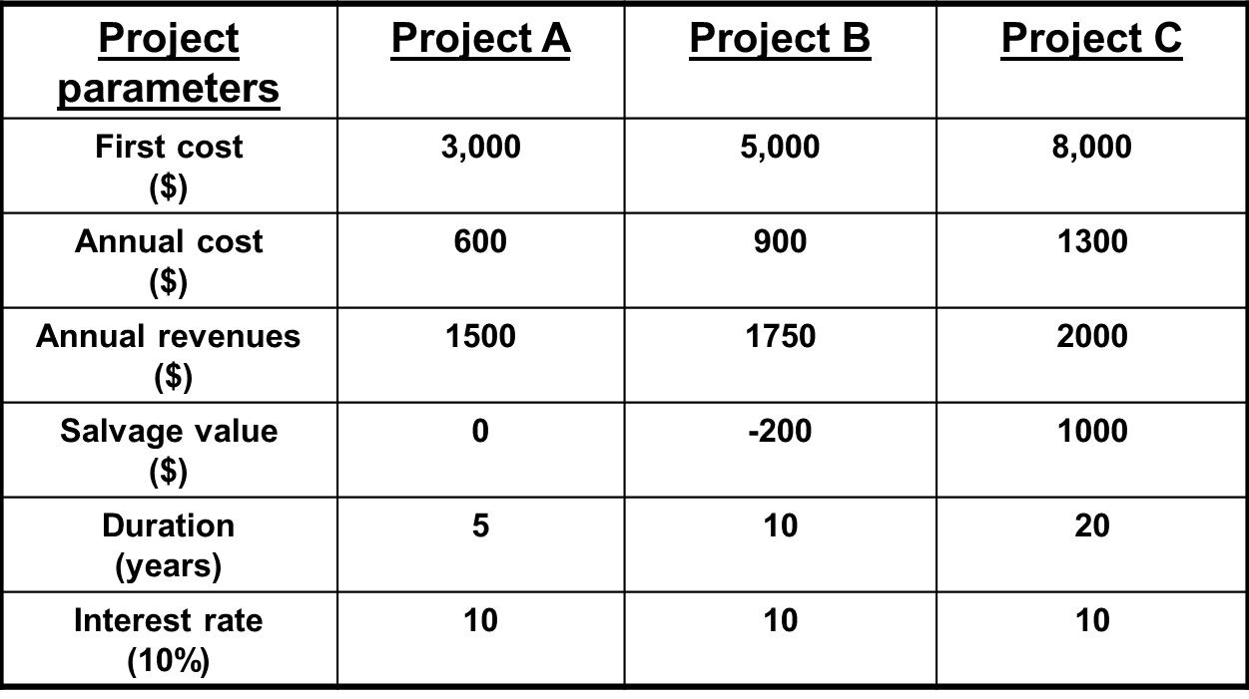
Which projects are valid?
Which project (if any) is best?
Difficult task because the projects have different parameters (identifiers)
  Except for the interest rate
A project conversion process is required (i.e., to summary measures) to reduce the projects to a common denominator such as a single sum (present or future worth).

Slide 63
Our objective for lectures 1 to 4
Define interest rates
Develop major summary measures of project evaluation (decision criteria)
  single sums (present and future worth)
  annual or periodic equivalent
  internal rate of return
  external rate of return
  payback (simple and discounted)
Working Assumptions
No uncertainty, no risk
No government (no tax-deductible depreciation charges; no income taxes)
No debt capital (only equity capital)
No price changes (no inflation/deflation)
Single business objective
  Maximise profits
  Minimise costs

Slide 64
Factors underlying decisions
Engineering analysis is forward looking in that it focuses on future projects.
This means that project analysts must consider, for example, cash flows which will probably be sensitive to
  Price changes (deflation/inflation)
  Exchange rates (the value of the CDN $ relative to the US $)
  Changing interest and income tax rates.
  Changing competitive environment from new competitors and product substitutes.
  …
We need ways to integrate these risks and uncertainties in our project decision-making.

Slide 65
Next week: Topic 2
Time-Value Mechanics

Slide 66
Engineering Economics
ECO 1192
Topic 1: Introduction
Claude Théoret
University of Ottawa

Slide 67
Decision Pyramid
Decisions are made on basis of belief, but “facts should be “foundation” of belief.
Economic analysis deals with the “facts” about a project’s costs and benefits.
Decisions may be made on basis of preferences, politics and people, but economic analysis establishes the basis for a decision.
These facts should tend to control politics, people, and preferences

Slide 68
Dealing With Abstractions
When dealing with the complexities of reality, it is advisable to use a model.
Models
  simplifications of reality that capture information useful and appropriate for a specific purpose.
  can be used to analyze a situation and make predictions about the real world.
Engineering economic models typically represent a project through estimates of its costs / benefits over time.

Slide 69
The Modelling Process

Slide 70
The Moral Question
Complex decisions often have an ethical component.
Important issue for engineers because society relies on them to stick to the “truth”.
As guardians of knowledge, engineers have a vital responsibility to society to behave ethically and responsibly in all ways.

