Slide 1
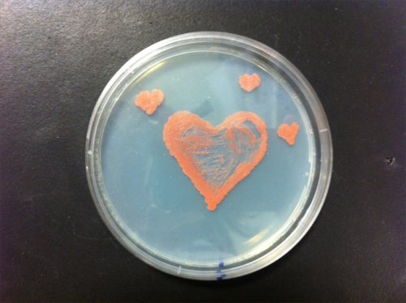
L8Non-Eukaryote Recombination

Slide 2
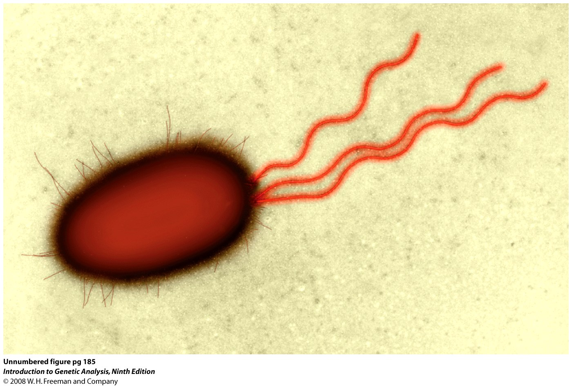
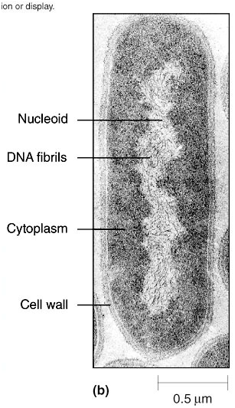
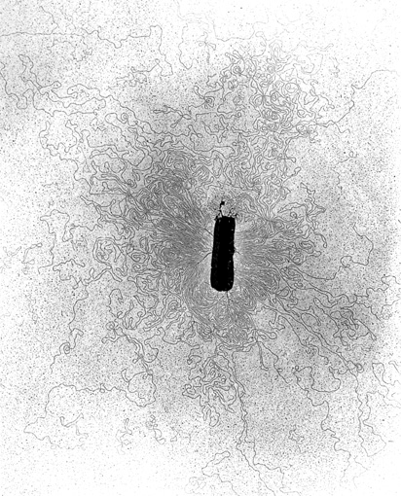
Model Organism E. Coli
1

Slide 3
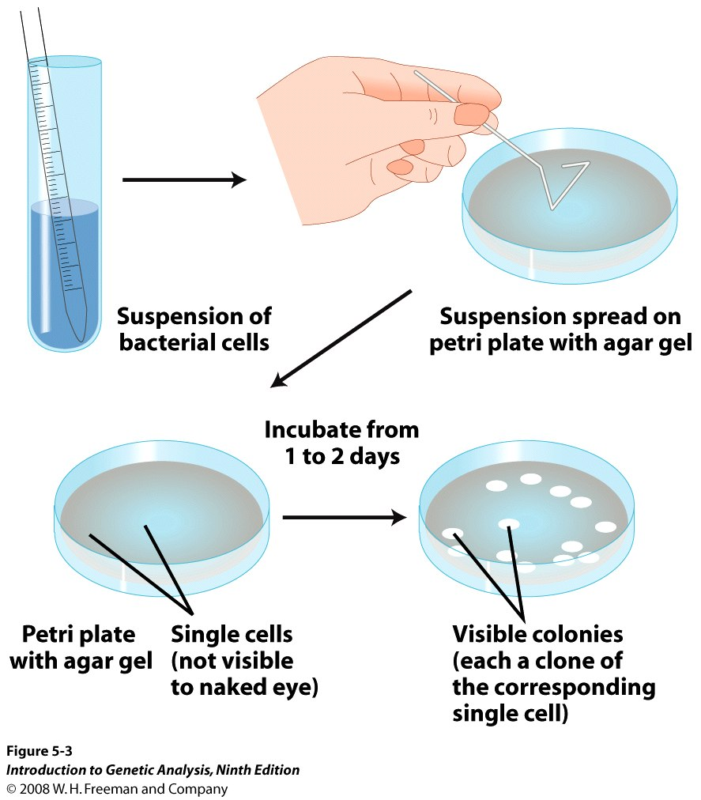
Figure 5-3
Bacterial colonies, each derived from a single cell
2

Slide 4
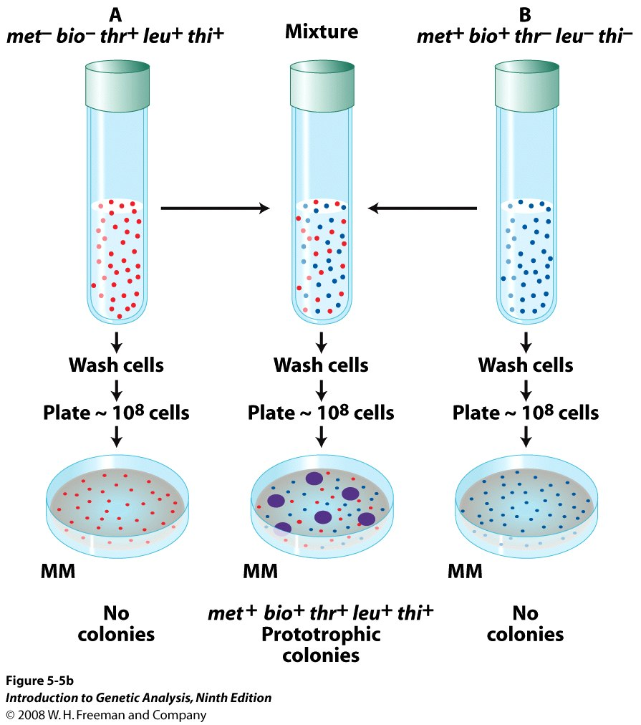
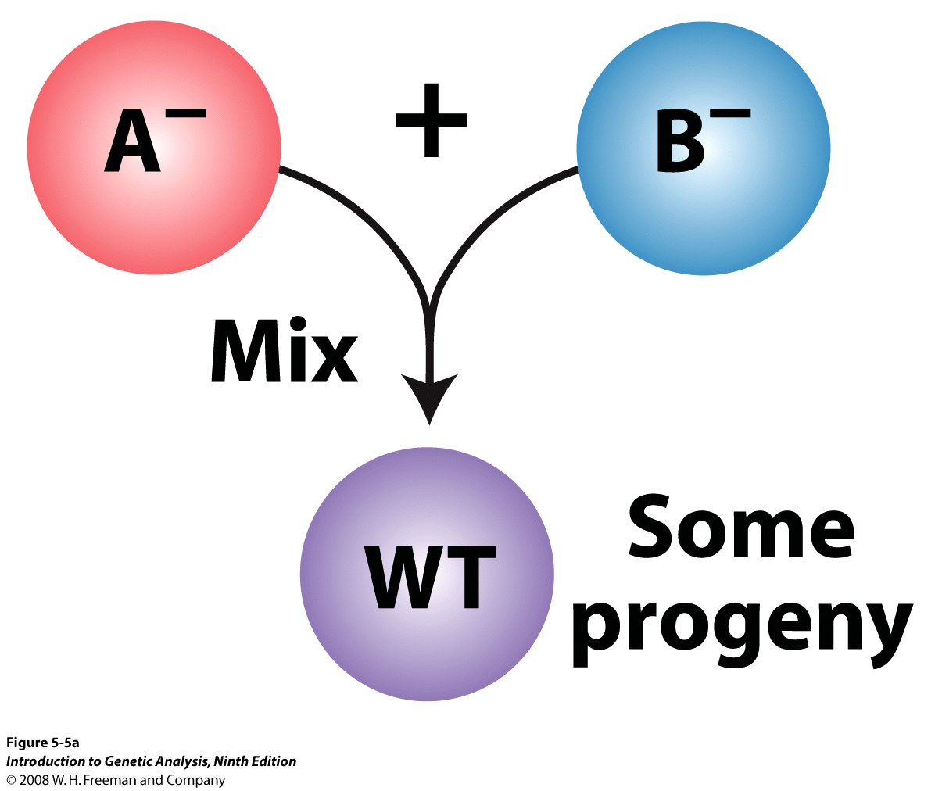
Figure 5-5b
Mixing bacterial genotypes produces rare recombinants-
Bacteria have both asexual derived & sexual –derived
descendents
4
Notes:
Lederburg and Tatum in 1946

Slide 5
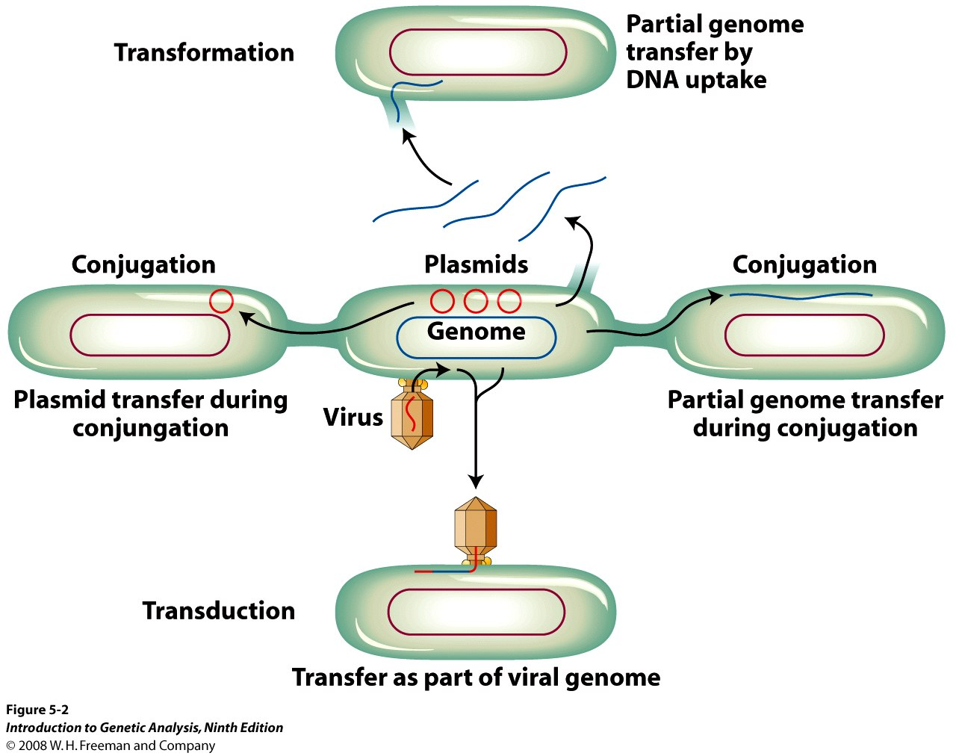
Bacteria exchange DNA by several processes,
usually the recombination of a host genome
with a ‘foreign’ chromosome fragment
6

Slide 6
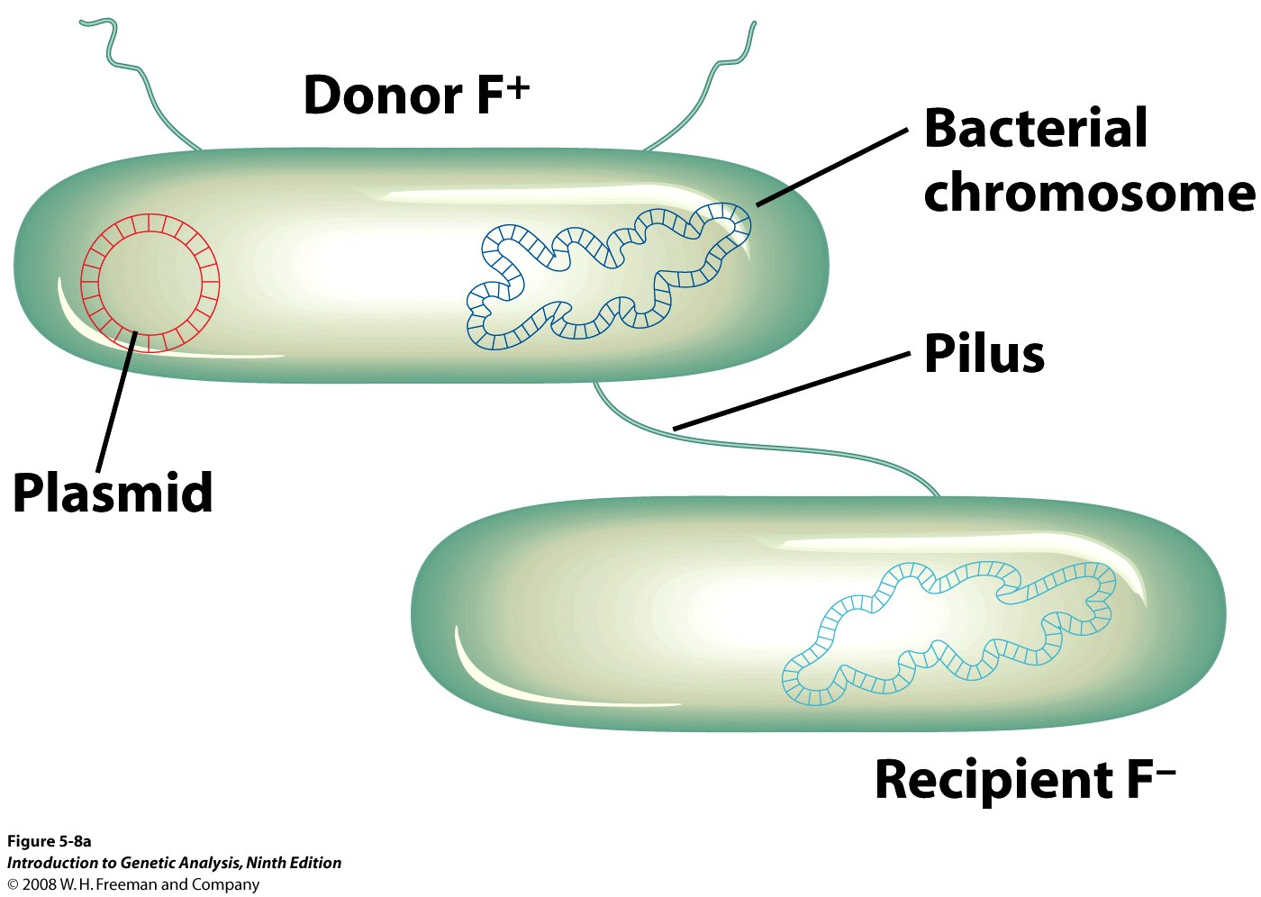
CONGUGATION :Transfer is not reciprocal: a donor F+ (Fertility) and a recipient (F-)
F - Plasmid
8
Notes:
F plasmids transfer during conjugation f- small plasmid that can replicate autonomously, it directs the synthesis of the pilli

Slide 7
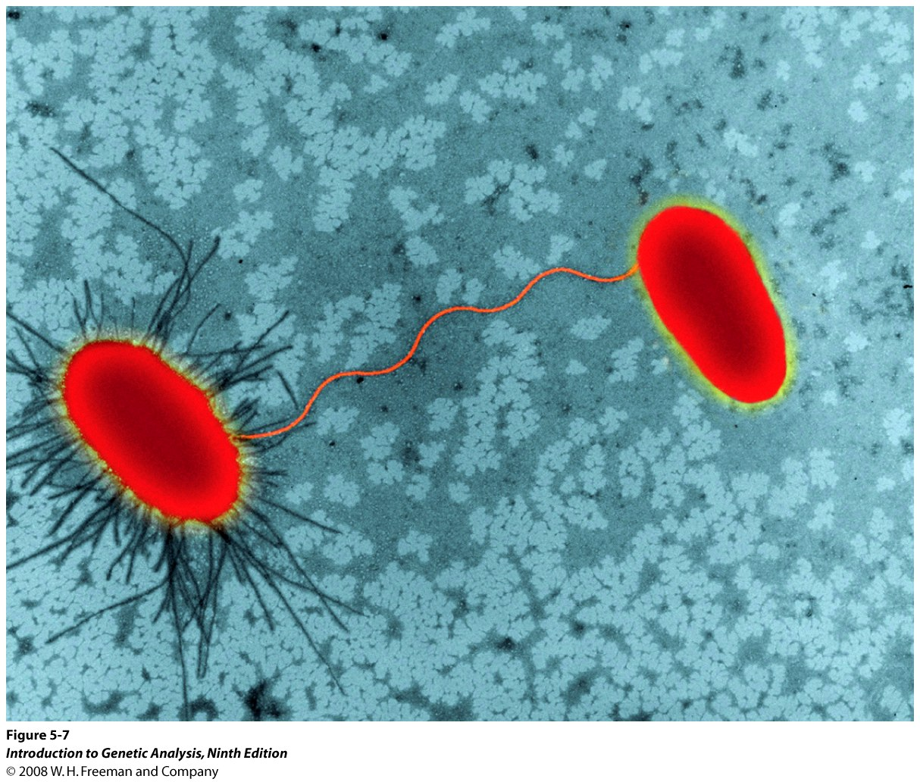
Bacteria conjugate through pili – a cell surface appendage, its synthesis controlled by genes on a small circular molecule called the F factor (plasmid).
7

Slide 8
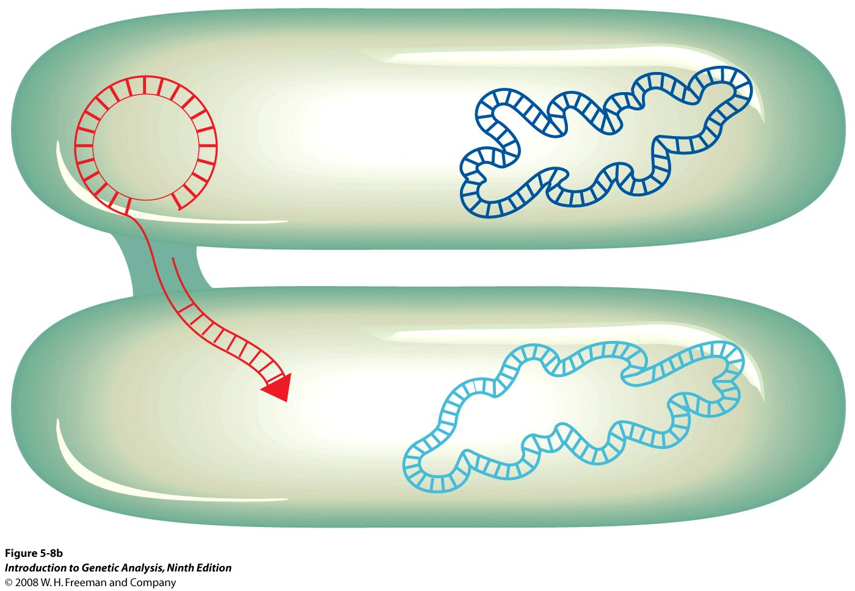
F plasmids transfer during conjugation using the rolling circle mechanism – the circular F factor rolls, unwinds one strand of DNA, replicates the missing donor strand, and the strand in the host is replicated by the host.
Donor
F- cell is converted to an F+ cell
Host
9

Slide 9
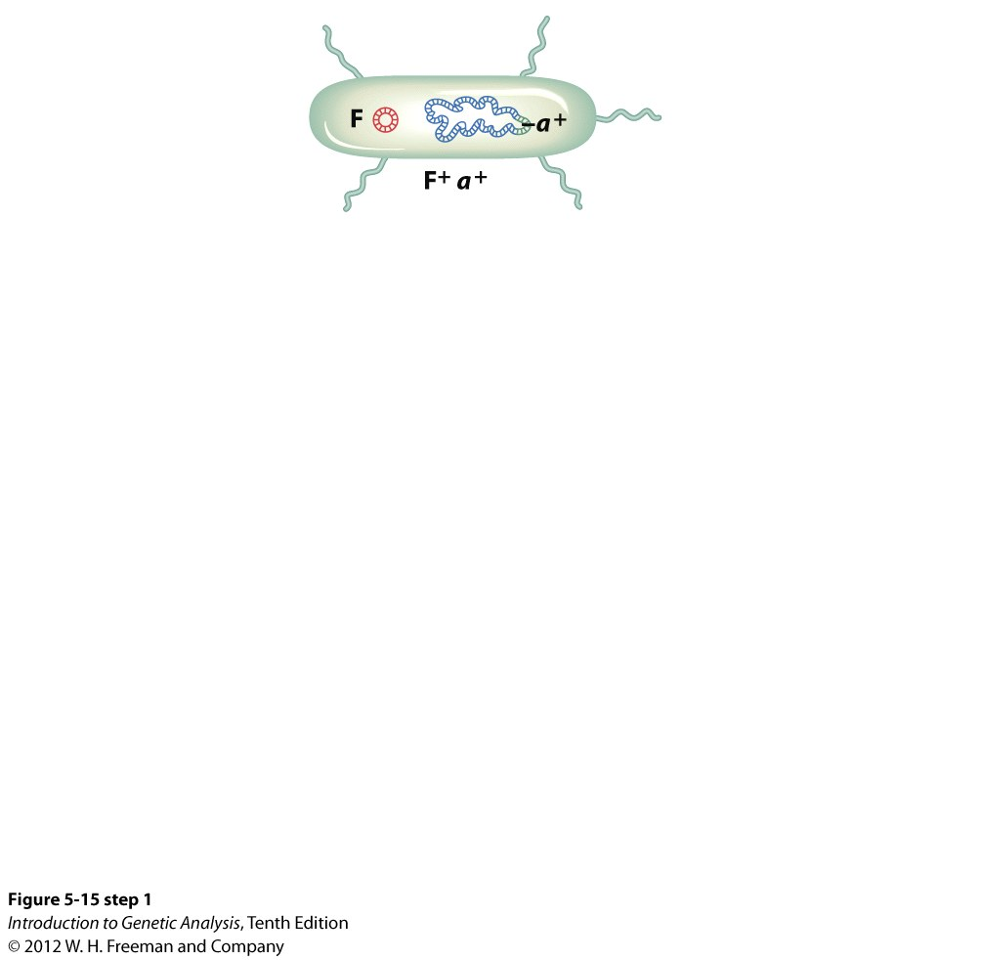
A second type of DNA transfer can take place during conjugation
10

Slide 10
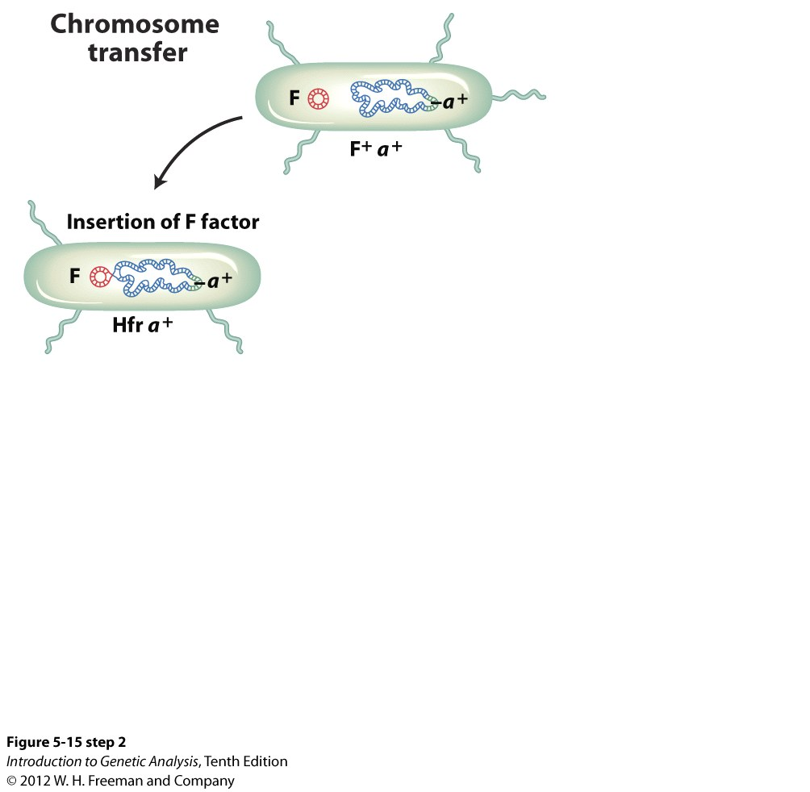
The F factor inserts and integrates into the donor bacterial chromosome producing a HFr strain (high frequency recombination) because the whole host chromosome can replicate and transfer (generally) part and rarely the whole donar chromosome to another bacteria…
11

Slide 11
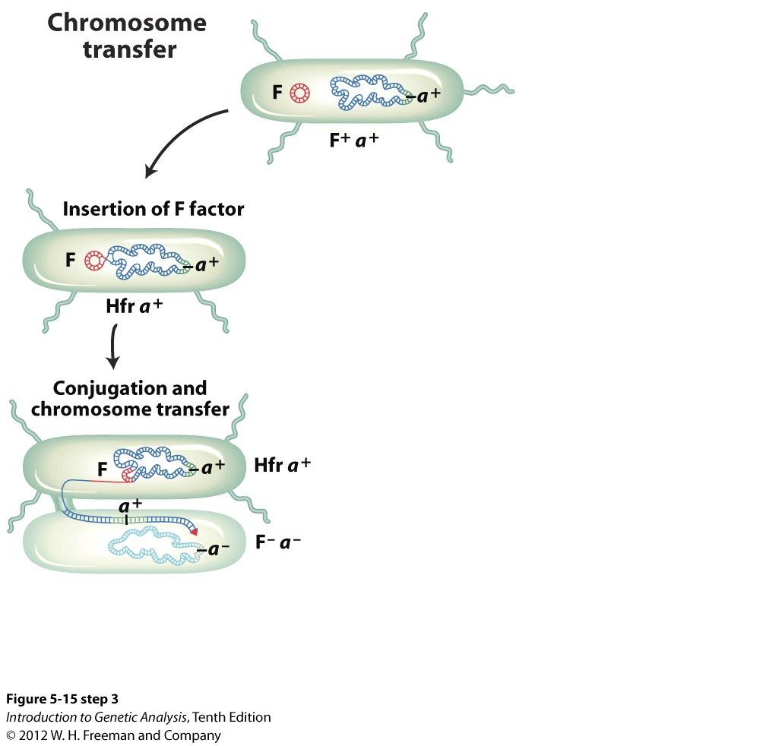
F factor unrolls, dragging (part of) the donor genome with it and moves into the host, creating a partial diploid or merozygote which is usually unstable, but may initiate recombination
12

Slide 12
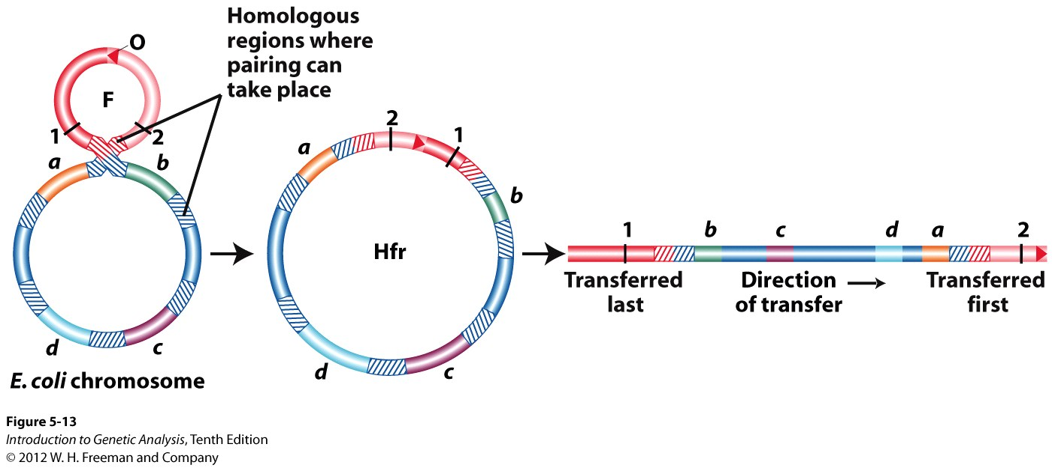
A single crossover (circular plasmid) inserts F at a specific locus, which then determines the order of gene transfer
Hfr cells rarely convert the host to Hfr
Transfer initiated at OriT, within the F factor. The origin (Ori) is transferred first, followed by chromosomal DNA and the rest of F factor (T= terminus) last….The F factor can orient in different directions depending on pairing.
16

Slide 13
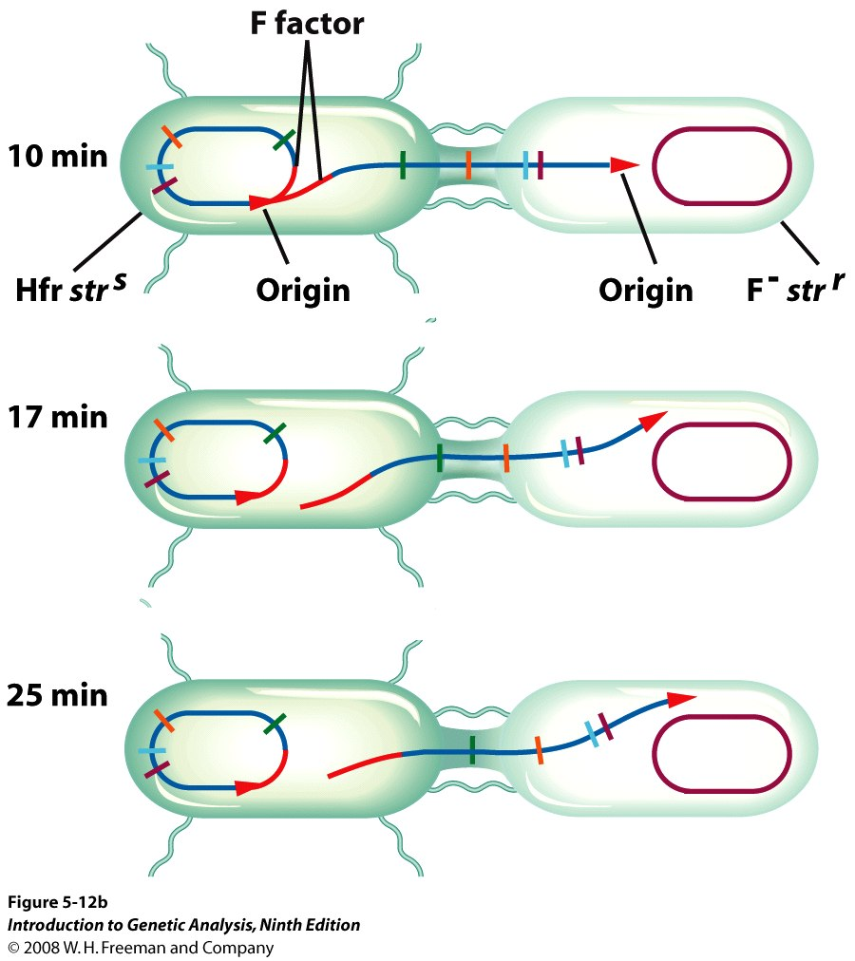
Assuming 1 Hfr site, the tracking time of marker entry generates a chromosome map:
(A) Cross strain 1 and 2 (mix)
(1)O_{Hfr} thr+ leu+ azi^{r} ton^{r} lac ⁺ gal⁺str^{s}
F- thr- leu- azi^{s} ton^{s} lac⁻ gal⁻ str^{r}
+ = wild, s = sensitive,
- = defective r= resistant
(B) Plate onto media containing:
(1)streptomycin -kills str^{s} –cells,
(2) lacking threonine and leucine
18
Notes:
Azi s- sensitivity to sodium azide, ton – sensitivity to bacteriophage T1 and sensitivity to streptomycin, lac and gal + ability to utilize lactose and galactose (r resistance , - inability to metabolize

Slide 14
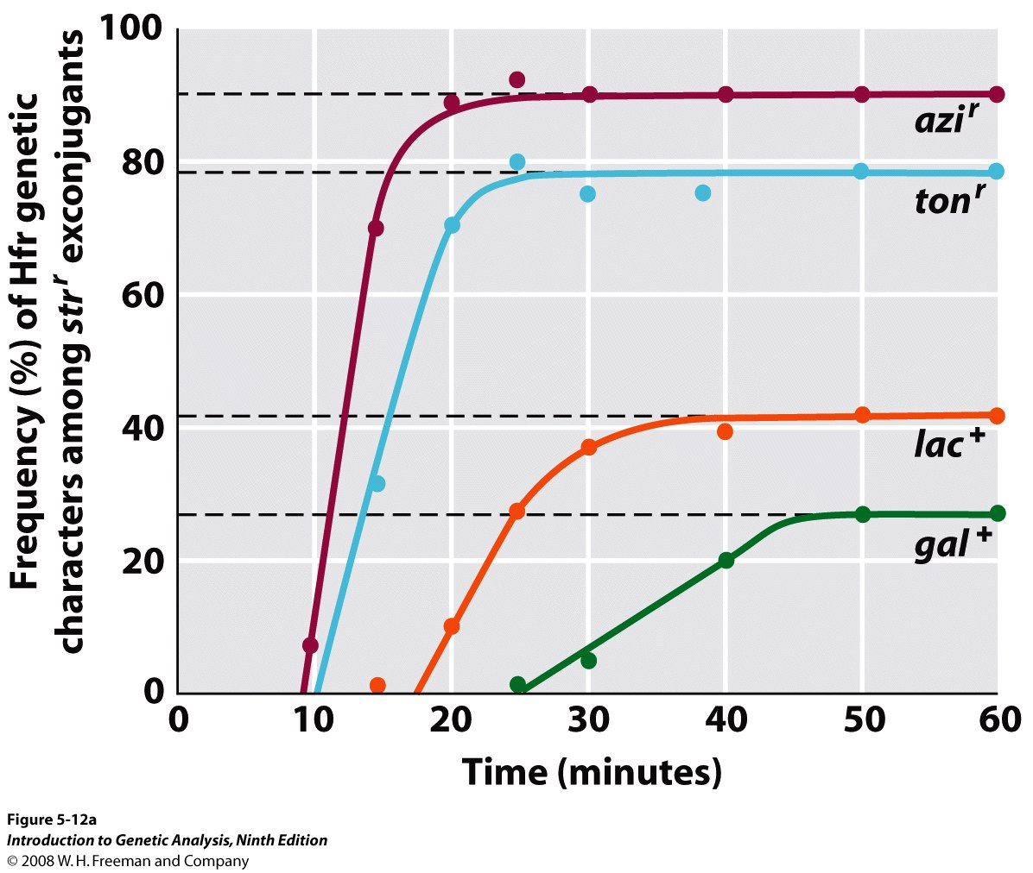
Broad Scale Mapping Tracking time of marker entry generates a chromosome map
What is the order of genes ?
Early (close to OriT)
- frequency ?
Late –distant,
Frequency ?
19

Slide 15
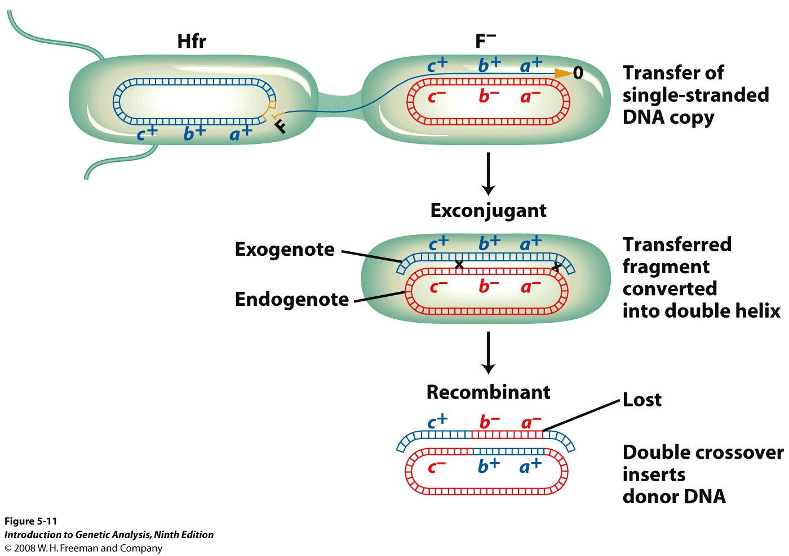
Fine – Scale Mapping Parts of the transferred donor fragment may be integrated into the host genome through a double crossover
Note – recombination does not produce partial diploids
20

Slide 16
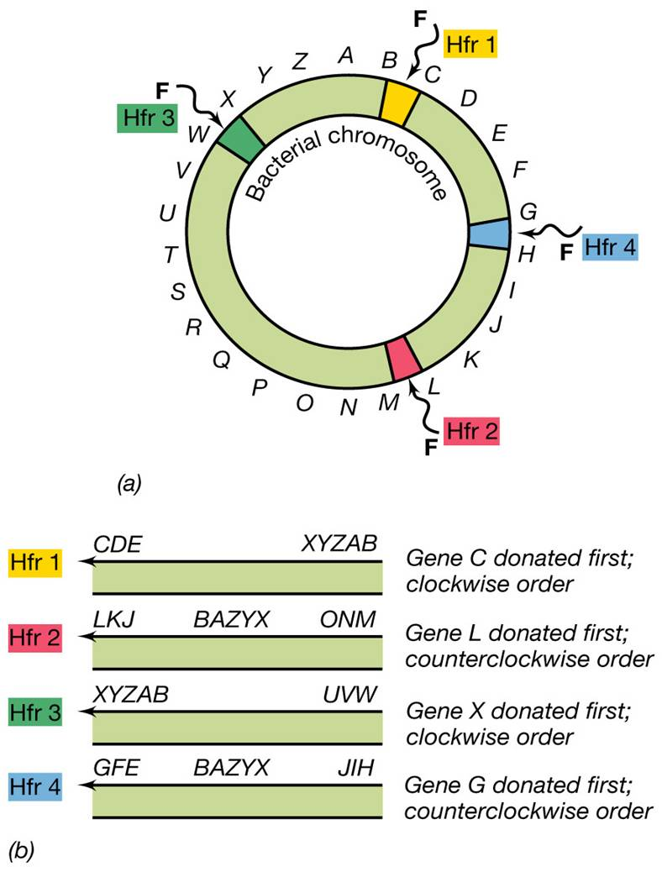
A second way of determining order use multiple Hfr strains.
The order remains the same but, the direction of transfer may differ between strains (Hfr₁₋₄ ), depending on the site of F integration, and more accurately the orientation of the F factor.
17

Slide 17
Fine Scale (Recombination) Mapping
Select the last marker transferred (leu+)
Remember larger recombination distance = double crossover is more likely, but a 4 crossover event is less likely than a double crossover.

Slide 18
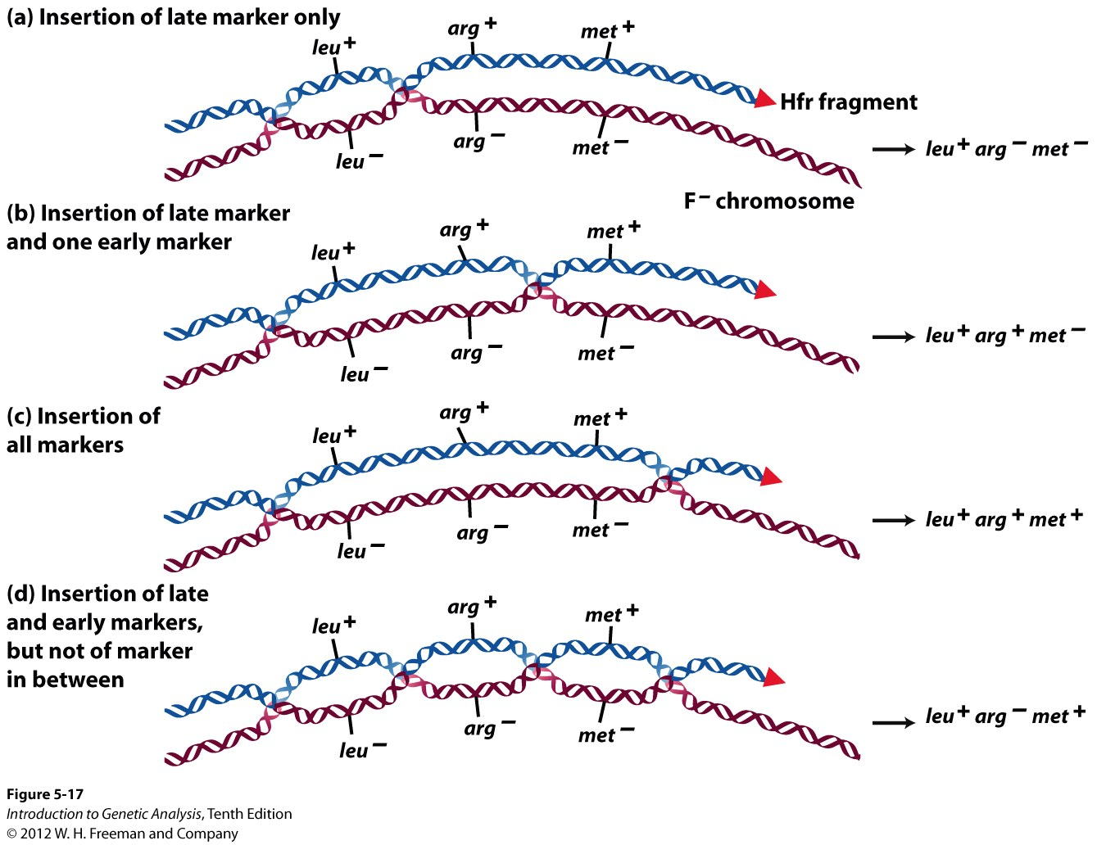
A single crossover opens a circular chromosome, 2 (or an even number) keeps it closed.
Linear fragments are degraded
4%
9%
87%
.01%
22

Slide 19
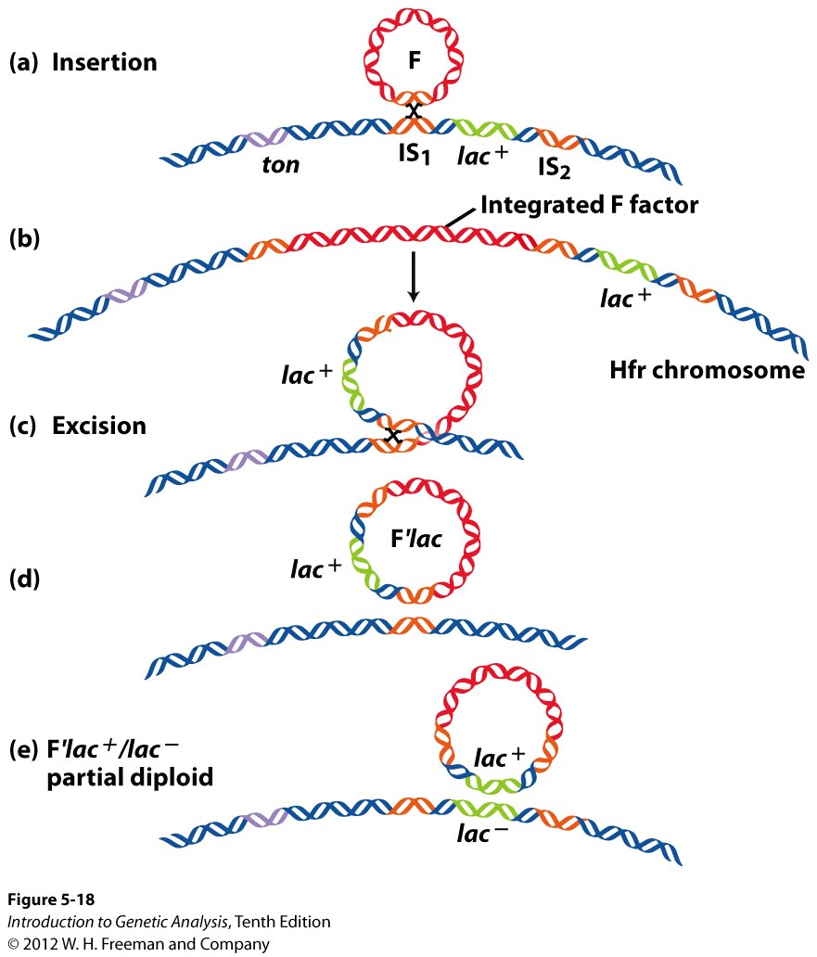
Third possibility in an Hfr strain F plasmid ->F’ plasmid
F’ Plasmid - a plasmid carrying bacterial DNA.
Produced by outlooping
Cause stable partial diploids (merozygotes) in lineages of E coli
23

Slide 20
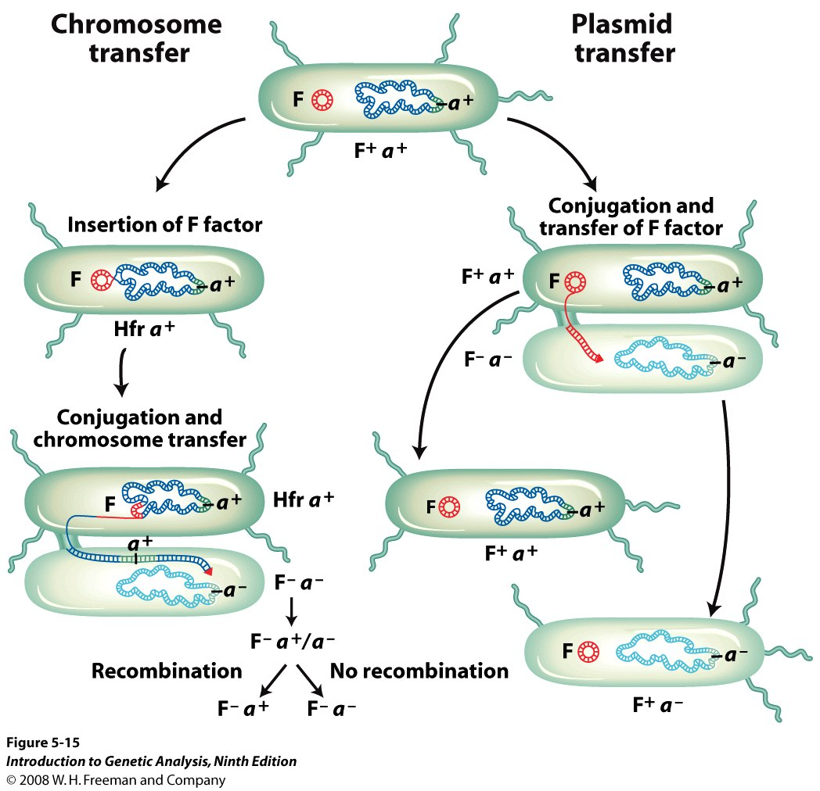
Episomes exist in 2 states: (1) integrated & (2) autonomous
Insertion
Crossover
15
Notes:
Plasmids such as the F that are also capable of integrating into the bacterial genome are called episomes

Slide 21
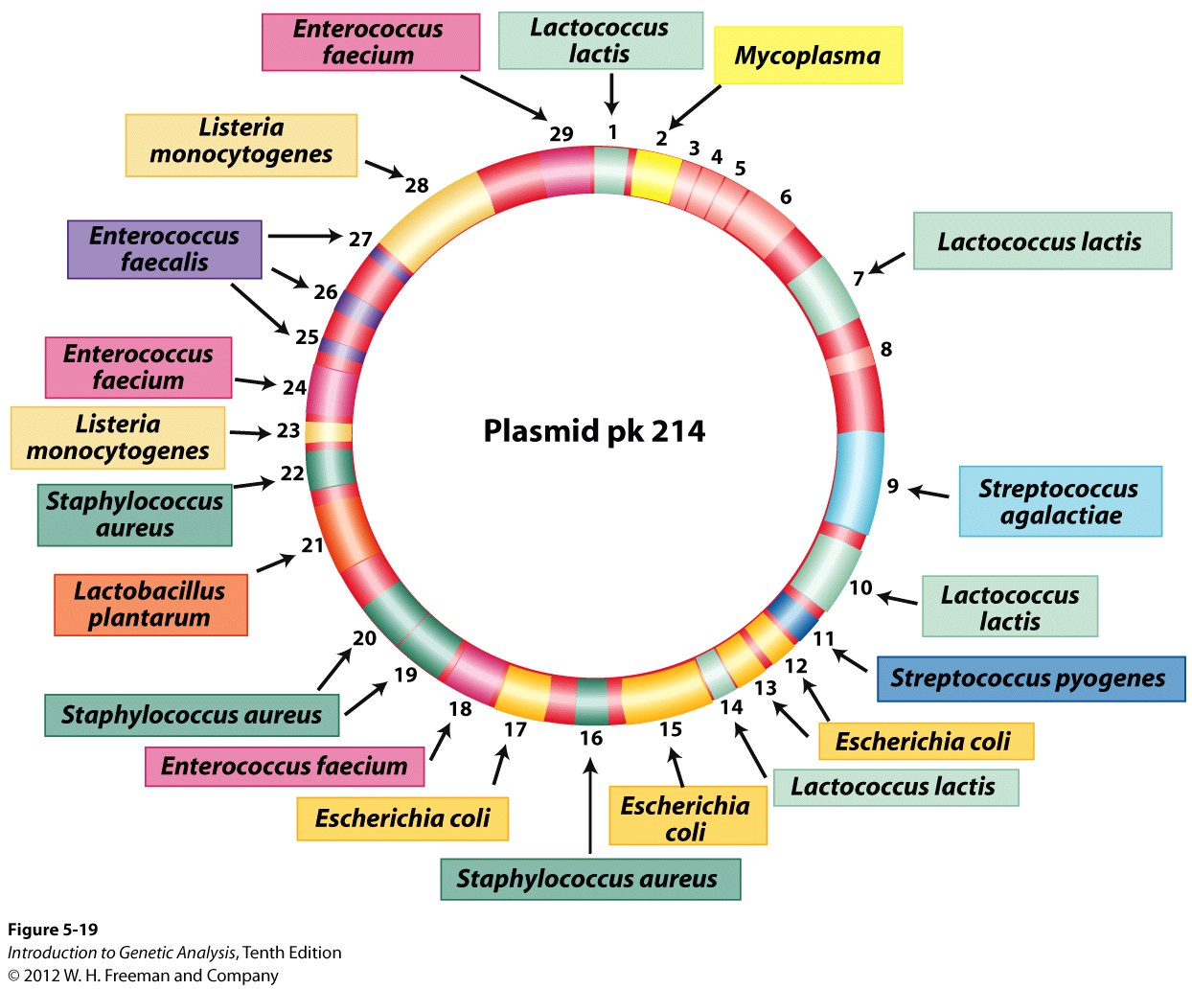
Multiple –resistance R- Plasmids.
A plasmid with segments from many former bacterial hosts
24

Slide 22
Fine scale – map using recombination frequency
Remember:
(1) Broad-scale mapping- time of entry : the closer a gene is to the origin (OriT), the more likely it will be transferred, and the frequency of excongugates is higher.
(2) Fine scale recombination mapping: the closer 2 genes the less likely they will recombine, triple crossovers are less likely.
(3) If pieces of chromosome do not recombine into the host chromosome they will be degraded. Most linear segments of DNA are degraded.
(4) A stable merozygote indicates an outlooped F’ plasmid
21

Slide 23
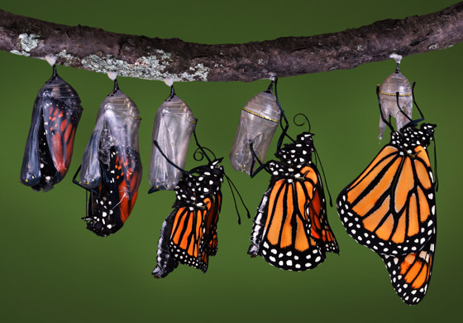
Transformation –bacteria may take fragments of DNA from their environment and integrate part of them into their genome, transforming their native genotype if there is recombination.
25

Slide 24
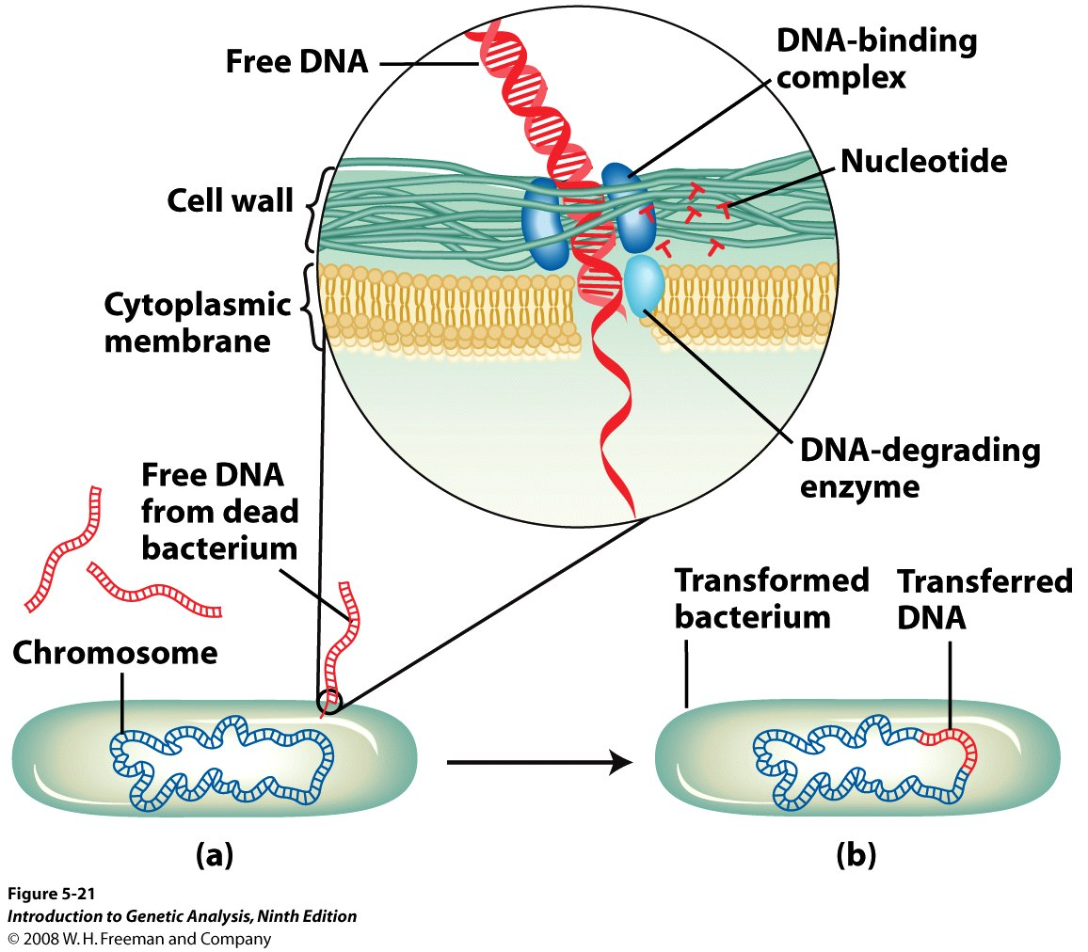
Transformation: Mechanism of DNA uptake by bacteria
REQUIRES A DOUBLE CROSSOVER
26

Slide 25
Generalized Transduction

Slide 26
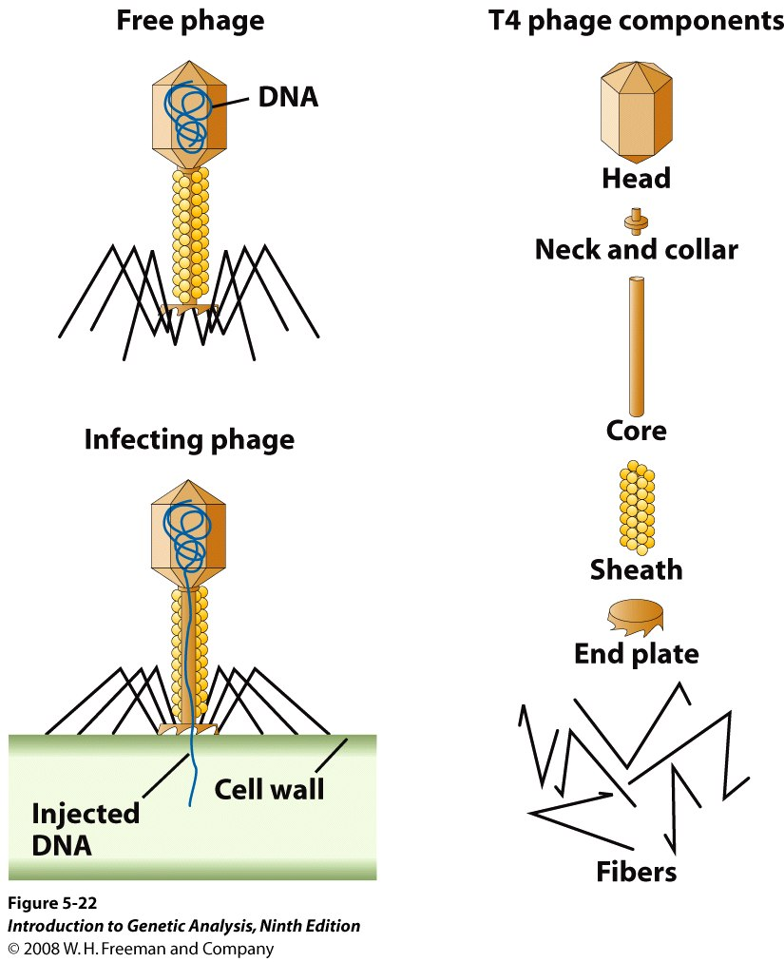
Figure 5-22
Structure and function of phage T4
27

Slide 27
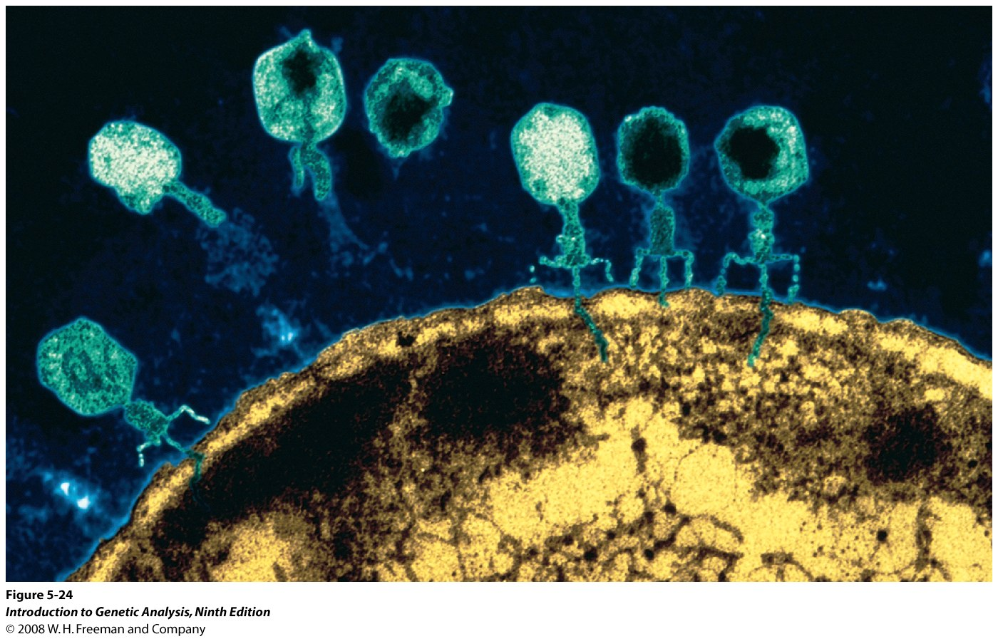
Electron micrograph of phage infection
28

Slide 28
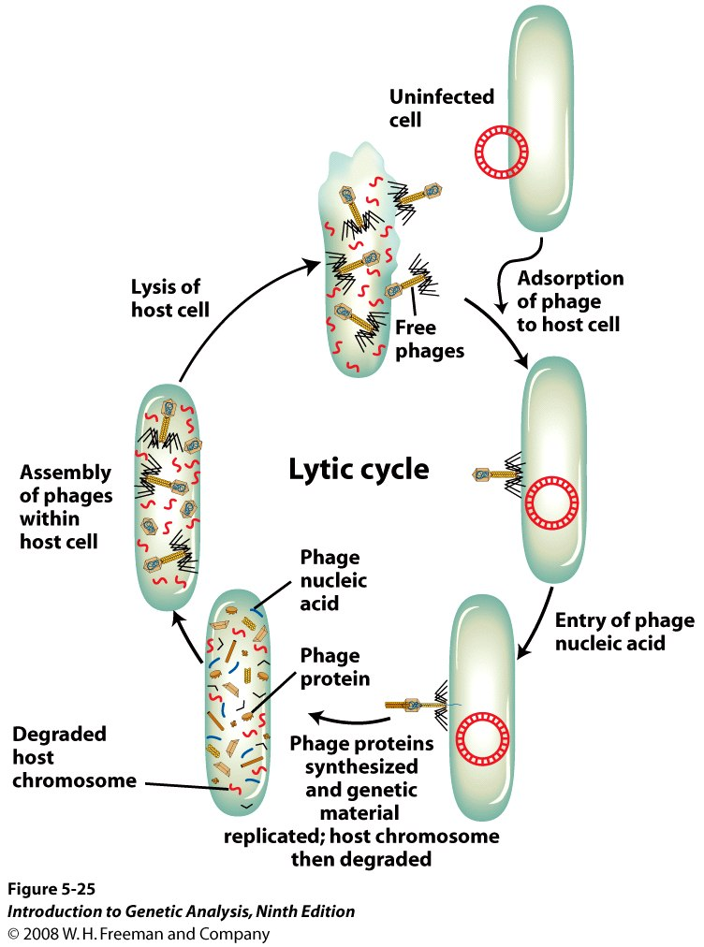
Figure 5-25
Cycle of a phage that lyses the host cells
29

Slide 29
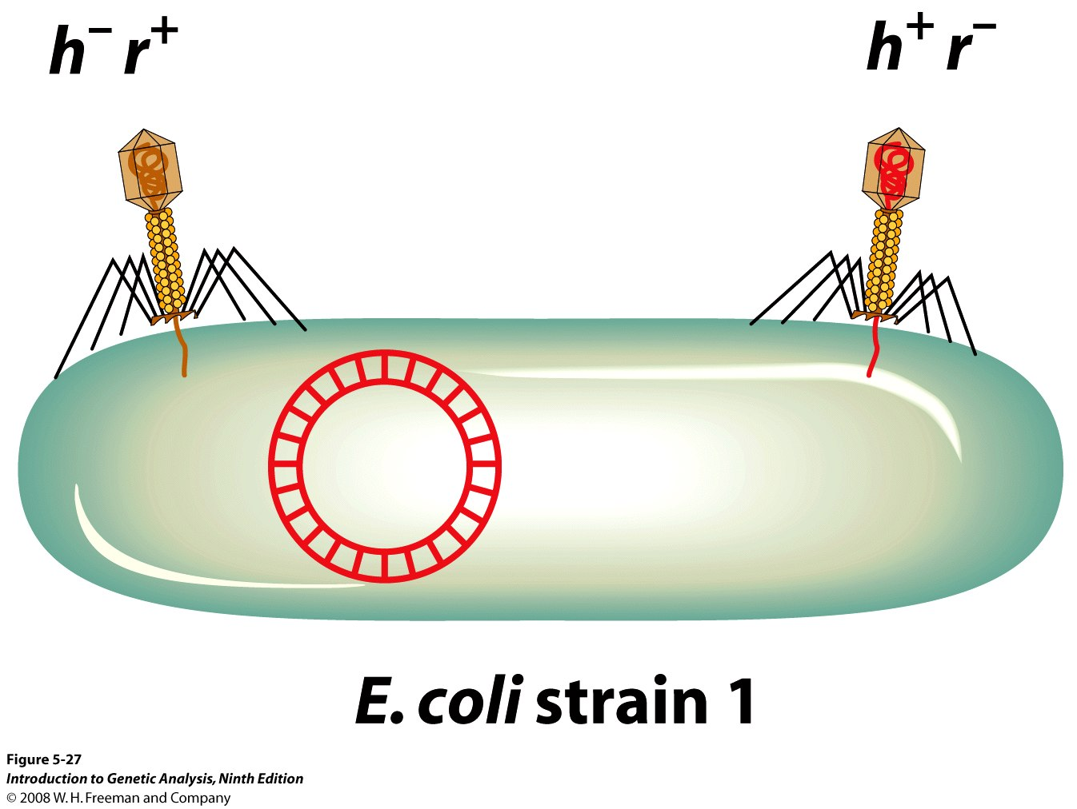
A phage cross made by doubly infecting the host cell with
parental phages
30

Slide 30
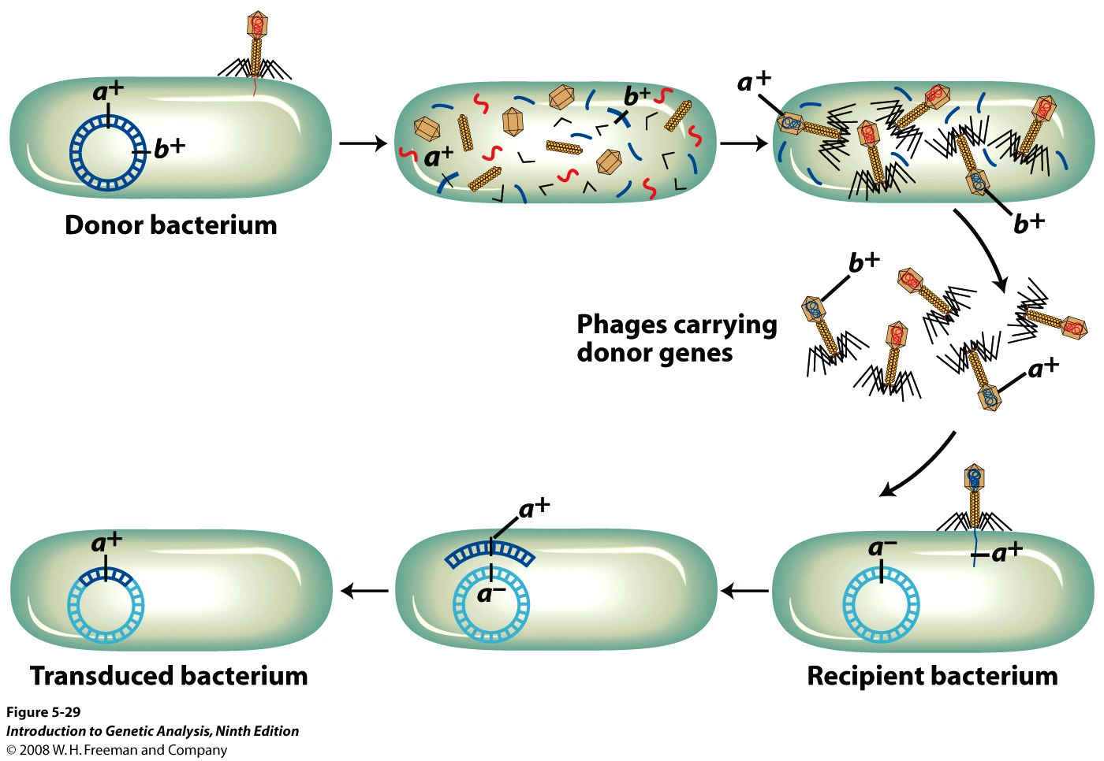
Generalized transduction by random incorporation of bacterial
DNA into phage heads, during phage assembly
Key -Phages pick up random fragments of donor DNA
32
Notes:
- Key genes that are closer are more likely to be co-transduced

Slide 31
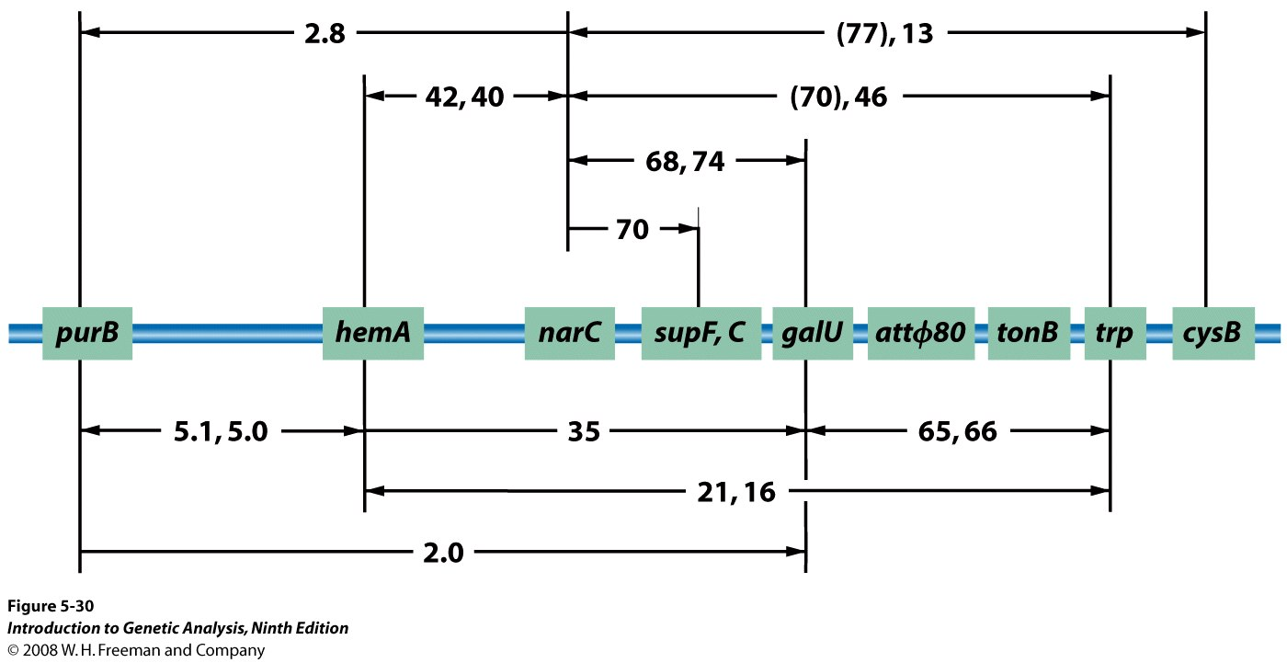
Generalized transduction:
From high cotransduction frequencies, close linkage is inferred,
Alternatively, lower cotransduction, more distant linkage is inferred,
33

Slide 32
Specialized transduction moves (transduces) only small segments on either side of specific sites where the prophage integrates into the host genome and then drags flanking areas with it when it excises (leaves) in a process similar to F’ plasmids that incorporate host DNA
Some phages integrate into specific parts of the host genome
34

Slide 33
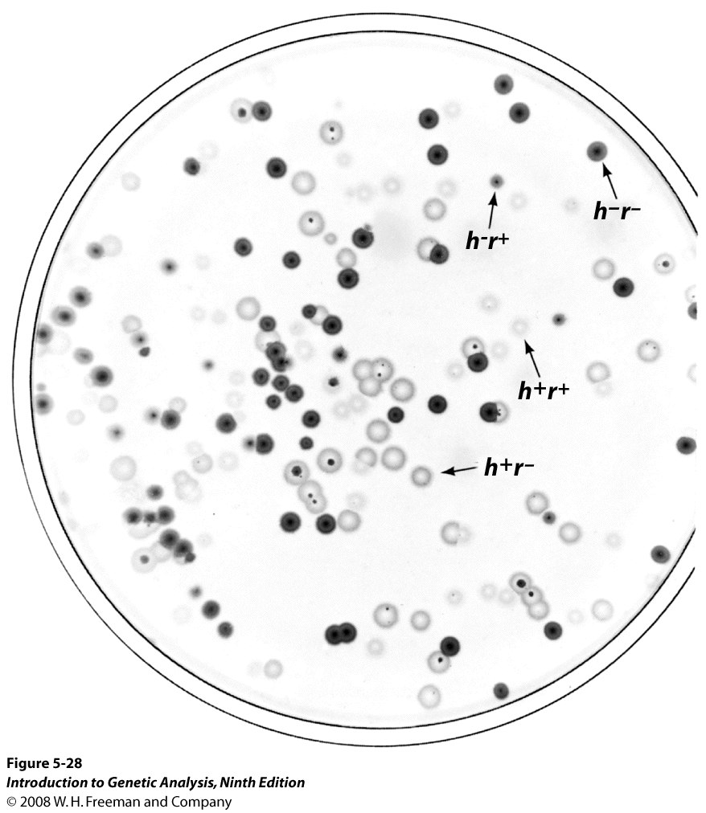
Figure 5-28
Plaques from recombinant and parental phage progeny
h+ - infects 1 strain
h- infects 2
r- large plaques
r+ small plaques

