Slide 1
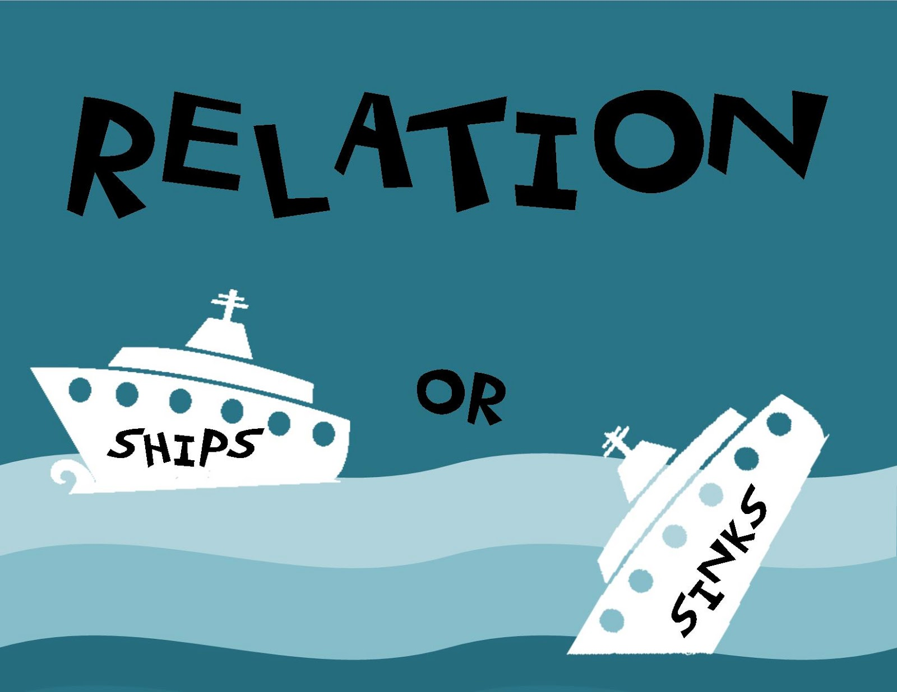
midterm 1 review:
CH 1 – 4
Prof. Yaroslav Konar
PSY3102

Slide 2
Chapter 1

Slide 3
What types of relationships are we studying?
Close relationships
“The close relationship is one of strong, frequent, and diverse interdependence that lasts over a considerable period of time” (Kelley et al, 1983)

Slide 4
Coan et al (2006) study
Women tested in fMRI while experiencing shock
Conditions were: holding spouse’s hand or stranger’s hand, or no hand-holding
What did they find?

Slide 5
Need for affiliation (Schachter, 1959)
Schlachter conducted several studies to determine whether fear of uncertainty would drive people to pair up
What was found in the 1st study?
What was found in the 2nd study?
Notes:
First finding – hypothetical while waiting they were given a questionnaire
Second finding : congruency – ppl want to be with someone sahring the same fate

Slide 6
Kulik & Mahler, 1989
Tested bypass surgery patients on the same question
What was found?
Notes:
They didn’t want to face death with someone who might die. They rather spend time with someone who already survived the surgery. Holding on to something positive.

Slide 7
Does need for affiliation account for intimate relationship formation?
If yes, how so?
If not, what alternatives exist?
Notes:
No its not suffeient enough theory.
Need for intimacy is a better theory -

Slide 8
Have we explained everything about intimate relationships with need based theories?
Sociology lends a hand
    Homans’ principles
Notes:
We interact with ppl who have similar status to us
More interactoin = more liking = more likelyhood to form relationshiip
General rules that guide our behavior

Slide 9
The more they change, the more they stay the same
Relationships have been evolving and will continue to evolve
Field needs to keep up so we understand all stages of these evolutionary changes
Notes:
Women in traditoinal families are more satisified In their relatioship than women looking for equality

Slide 10
Chapter 2

Slide 11
Steps in a scientific method
Observation of phenomenon
Formulate hypothesis to explain observation
Make prediction based on hypothesis
Test prediction: via further observations or data collection
Analyze results, form conclusion, accept or reject hypothesis
Revise if necessary, and communicate results to others
Notes:
Is not the way to study relatinoship – it’s the way to study science.

Slide 12
What methods have we learned about?
Notes:
Archival data – don’t need to collect they are already vaialble for you
meta-analysis
Correlations (cant have a cause effect relationship) – therefore, use true experiments to find causatoin

Slide 13
How are data collected?
Notes:
Surveys – recall and our memories are not perfect. So reconstructed experience is one way we can collect information
Speed dating
Online data sources/archives
Hypothetical situation/ scenario and asked to answer questoins about relationships
Idealized situation – ppl will react differently in hypothetical situatoin than in relaity
Alternative methods – to avoidd problems of finding info from the past
interviews

Slide 14
Chapter 3

Slide 15
Evolutionary Psychologists
Find evidence for attraction as being innate, universal (for the most part)
Facial and body attraction are important to potential mates

Slide 16
Physical attraction
Both genders prioritize different aspects when looking for a partner
Men: look for large eyes, small noses, big lips, and overall youthful features
Women: look for a a provider of food, territory, and shelter, as well as looks

Slide 17
Evolutionary principles guiding perceptions of attractiveness
What are some findings from evolutionary psychology that show various human adaptations in regard to attractiveness?
Notes:
Hip tp waist ratio
Red make women more attractive
Sexy clothing during fertile period
Girls on pill seems to change men preference
Strippers who are not on the pill make more money. Ovulating/fertile stripppers made more money. Either their behav. Or pheromones change \
Scent of symetrical men

Slide 18
What kinds of body types are usually preferred?

Slide 19
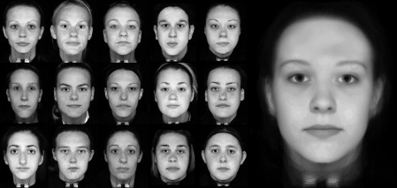
What do we look for in faces?

Slide 20
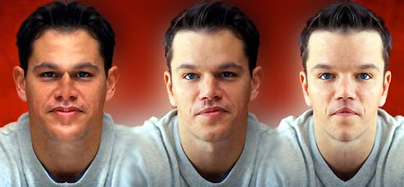
What do we look for in faces?

Slide 21
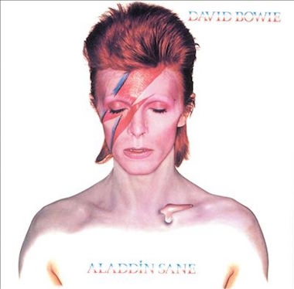
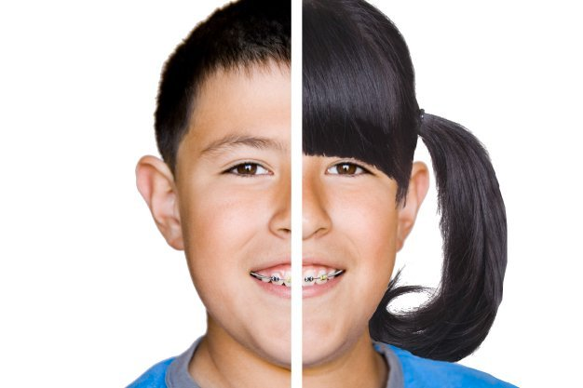
What do we look for in faces?
Notes:
Sexual dymorphisim

Slide 22
Things that affect our judgements of attractiveness
Birth control pill, context, dispositions, relationship status

Slide 23
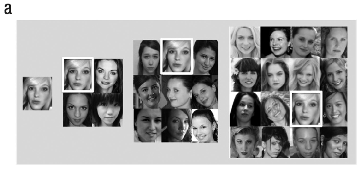
How does contrast effect influence facial attractiveness?

Slide 24
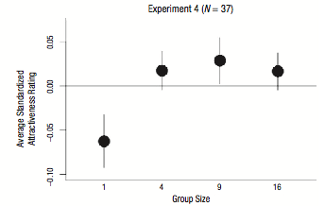
How does contrast effect influence facial attractiveness?
Notes:
Women in isolation – less attractive than when surrouneded by other women
Contrast effects – adaptatin study: short term effect

Slide 25
Are attractiveness preferences engrained and unchangeable?
Notes:
No because our preference flucuate even tho we innately prefer attractive faces

Slide 26
Do we all end up with the most attractive mates?

Slide 27
Chapter 4

Slide 28
What do learning theories have to say about attraction?

Slide 29
What is misattribution of arousal and how does this concept relate to attraction?
Shaky bridge study lends support for this concept

Slide 30
What finding supports that our liking of someone is flexible?

Slide 31
Do birds of a feather flock together?
Or do Opposites attract?

Slide 32
Do opposites attract?
Mostly no
Most people pair up due to similarities
    Complementarity can be discovered later on in relationship
Even if mismatched in appearance, men can get a higher value mate by making more money

Slide 33
Proximity or similarity important in relationship formations?
Both seem to be important

Slide 34
Does liking always result from exposure to others and their opinions?

Slide 35
Which strategy is best:
Play hard-to-get
Play easy-to-get
Play moderately-hard/easy-to-get

