Slide 1

ANP 1106: Topic 3B
Anatomy of the Skeletal System
Throughout this section, refer to table 6.1: Bone Markings – you are responsible for being able to define all of these bone markings

Slide 2
THE SKELETON (Chapter 7)
• 206 bones in human skeleton - make up about 20% of body weight
• grouped into axial and appendicular skeletons
axial skeleton = bones of skull, vertebral column, rib cage
appendicular skeleton = bones of upper & lower limbs + pectoral/pelvic girdles (attach limbs to axial skeleton)
AXIAL SKELETON
80 bones
SKULL
most complex
2 sets of bones: cranial + facial = 22 bones
most skull bones are flat bones; (except mandible);united by sutures
facial bones form anterior part of skull & cranial bones form the rest
skull has eye orbits & paranasal sinuses, houses organs of hearing, has 85 openings for nerves, blood vessels & spinal cord
Notes:
0-2:50 we cover pretty everything in chapter 7. Gonna go through all 206 bones. Mandible is an irregular bone and is the only moveable bone.

Slide 3
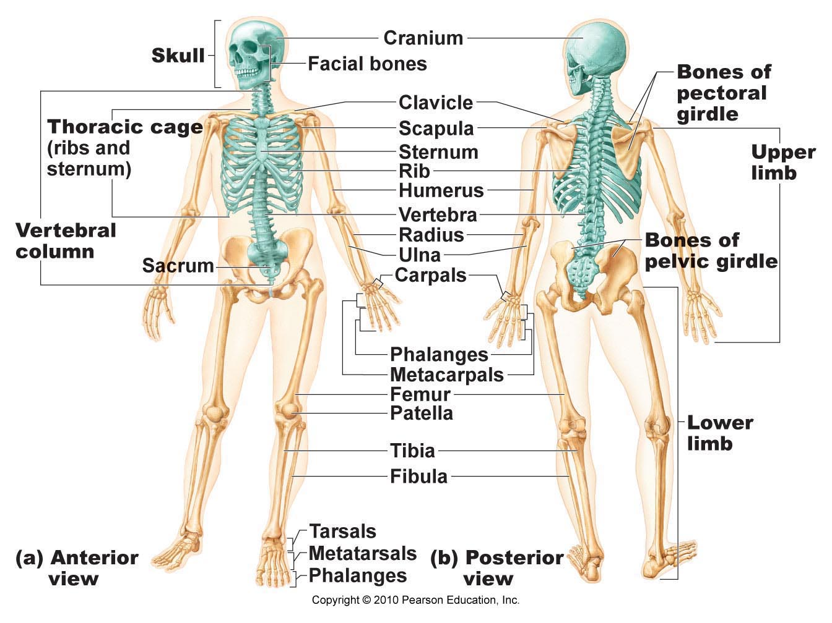
Fig 7.1
Notes:
2:50-3:36 Shoulders also part of the appendicular.

Slide 4
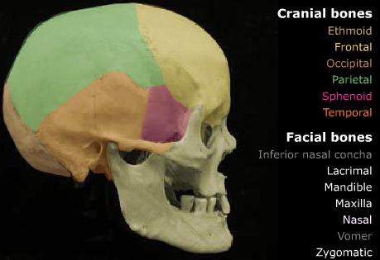
A) Cranium:
• cranium can be divided into a vault & a base
• vault: forms superior, lateral & posterior aspects of the skull + forehead
• base: inferior aspect of skull
• cranium surrounds & protects brain & organs of hearing & balance
• internally, 3 bony ridges divide the cranial base into 3 distinct areas: anterior (highest) fossa, middle fossa & posterior (lowest) fossa
Notes:
3:36-7:52 Ones not in colour are facial bones. 3 fossa are indentations that help to support the brain.

Slide 5
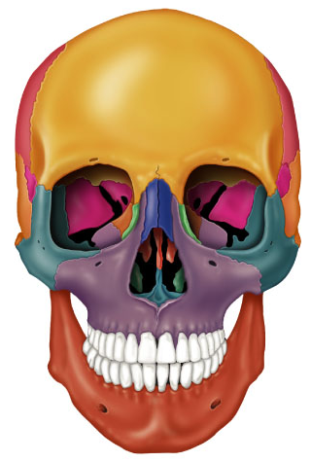
B) Facial bones or Face:
form framework of the face
contain the cavities for the sensory organs of sight, smell & taste
provide openings for passage of air & food
secure the teeth
anchor the facial muscles that we use to show our feelings
Fig. 7.4a
Notes:
7:52-11:11 On midterm wont be in colour though. Facial muscle anchored into skin?

Slide 6
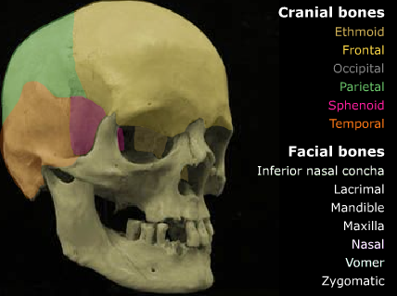
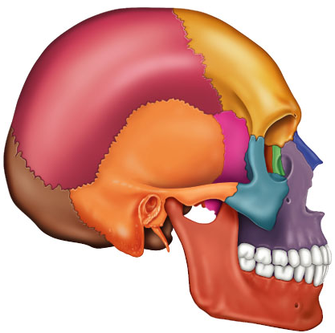
Cranium: 8 cranial bones are the paired parietal & temporal bones & the unpaired frontal, occipital, sphenoid & ethmoid bones
curvature allows them to be self-bracing; can be strong while being quite thin
Fig. 7.5a
Notes:
11:11-12:45 two temporal bones. Single sphenoid and ethmoid bones.

Slide 7
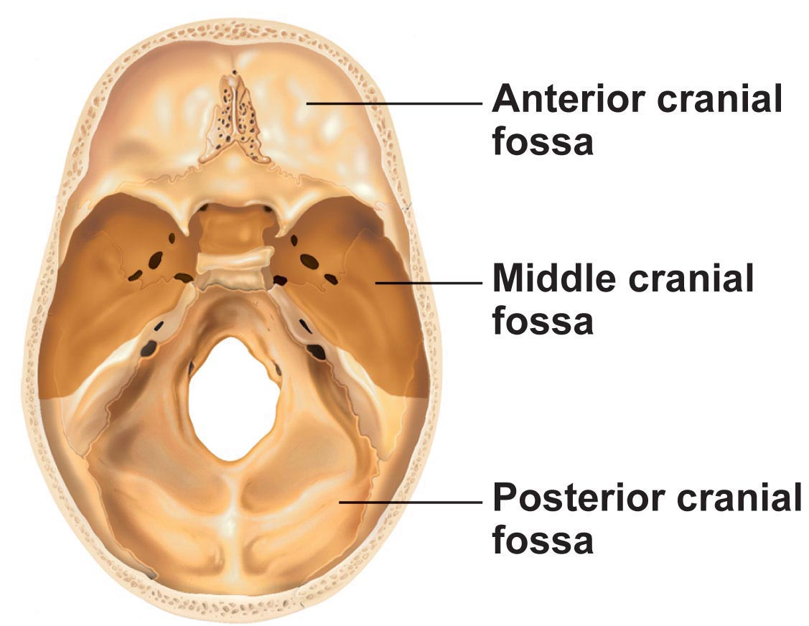
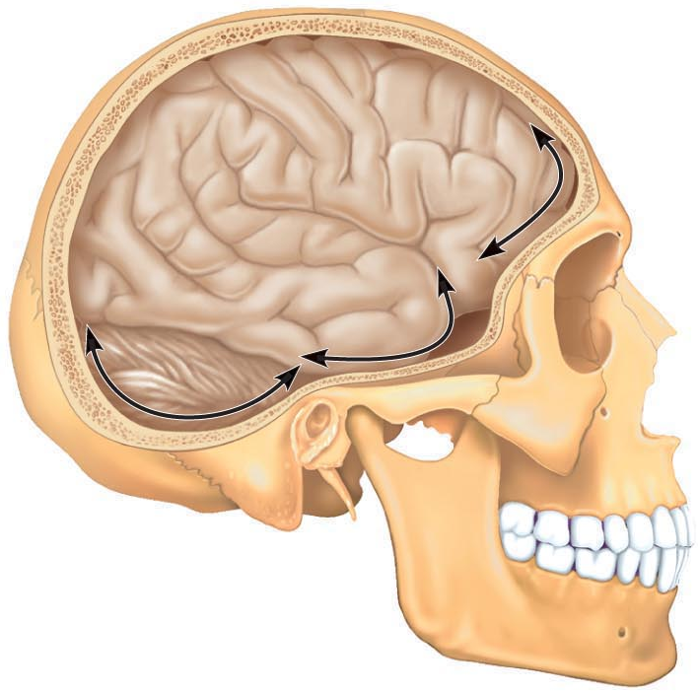
Fig. 7.2C
Fig. 7.4a
(i) Frontal Bone:
dome-shaped bone; also forms the roof of the orbits & anterior cranial fossa
articulates with paired parietal bones posteriorly
note supraorbital margin, supraorbital foramen, and glabella
area lateral to glabella has left & right frontal sinus within bone
Notes:
12:45-18:00 (funny) Frontal bone forms the orbits (eye sockets). Suture stitching occipital and frontal bone. Supra=above? Supraorbital foramen for nerves? Glabella above sinus.

Slide 8
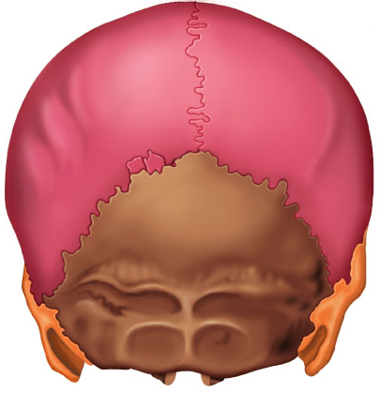
Parietal Bones
paired - form superior & lateral aspects of skull
therefore form bulk of cranial vault
Fig. 7.4b
Fig. 7.5a
(iii) Occipital Bone:
single bone at base of skull;helps form post aspect of skull
also forms walls of the post cranial fossa
attaches anteriorly to the 2 parietals & 2 temporals & attaches to sphenoid
Notes:
18:00-19:40 parietal in pink, occipital bone brown.

Slide 9
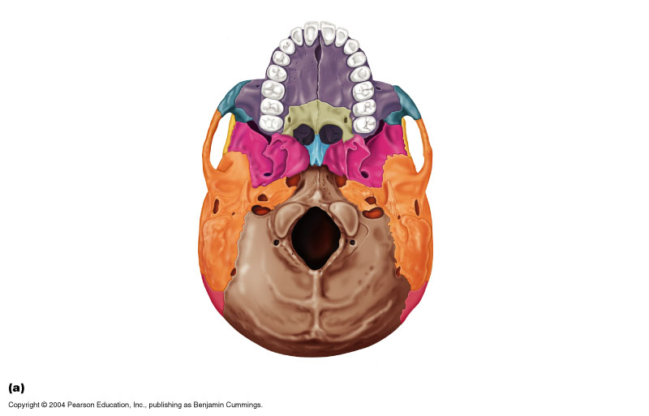
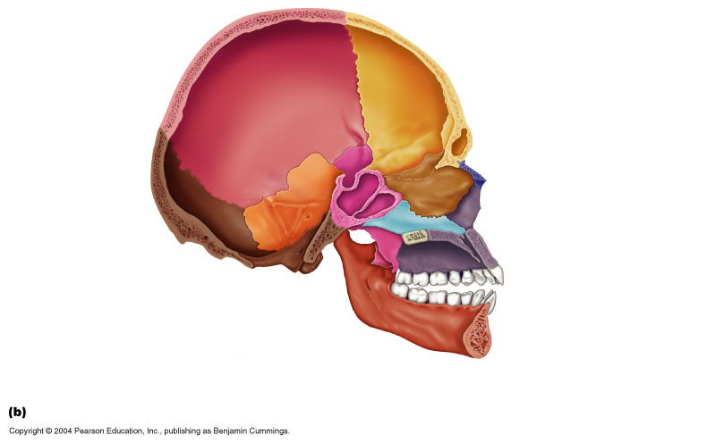
Fig. 7.6a
(iii) Occipital Bone (cont.)
large hole at base = foramen magnum (passage for..spinal cord)
occipital condyles on each side of foramen magnum = site of articulation with first cervical vertebra
external occipital protuberance = projection at back of skull - more prominent in males
Link to slide 21
(iv) Temporal Bones
paired; form inferior & lateral aspects of skull and parts of the cranial floor
located just below the 2 parietal bones; have 3 very different areas or regions
Fig. 7.5b
Notes:
19:40-24:09 the mandible is removed on left diagram. Foramen magnum= big hole foramena is plural. Circle is where its starting to bend behind? Temporal orange. Cleft palate when.. the… hole on the hard palate is…

Slide 10
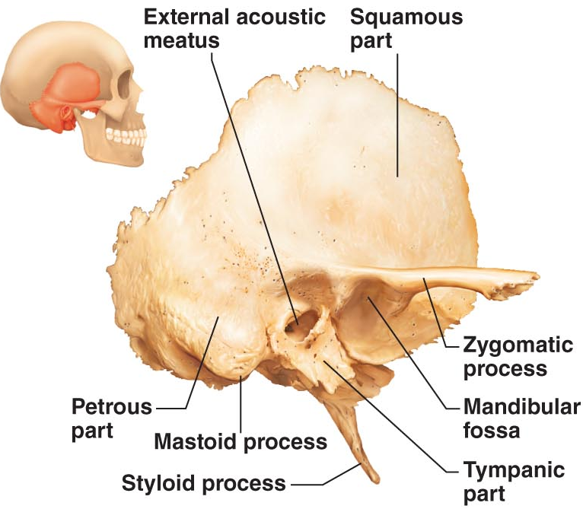
1) Squamous region: flattened
zygomatic process to cheekbone (zygomatic bone)
mandibular fossa receives condyle of mandible
Tympanic region: surrounds external acoustic meatus
Petrous region is on internal aspect of temporal bone
contributes to cranial base; houses middle and inner ear cavities
mastoid process is attachment site for some neck muscles
Fig. 7.8: Temporal Bone
styloid process is attachment area for muscles of the tongue
several important foramina associated with this part of the temporal bone: jugular foramen, carotid canal, internal acoustic meatus
Notes:
24:09-29:50 Temporal bone. Suture is called squamous suture. Temporalmadibluar allow u to chew. Meatus skinny canal or passageway. Mastoid process under ear. Don’t have to label the bones in the last sentence but should know that they are associated with the temporal

Slide 11
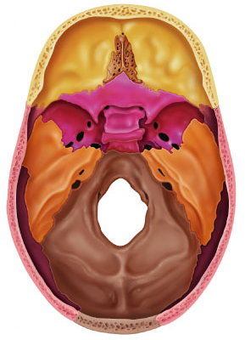
Sphenoid Bone:
complex bone; difficult to visualize; articulates with all other cranial bones
forms base of middle cranial fossa; contributes to base of anterior cranial fossa
Fig 7.7a: Superior view of floor of cranial cavity
Notes:
29:50-30:46

Slide 12
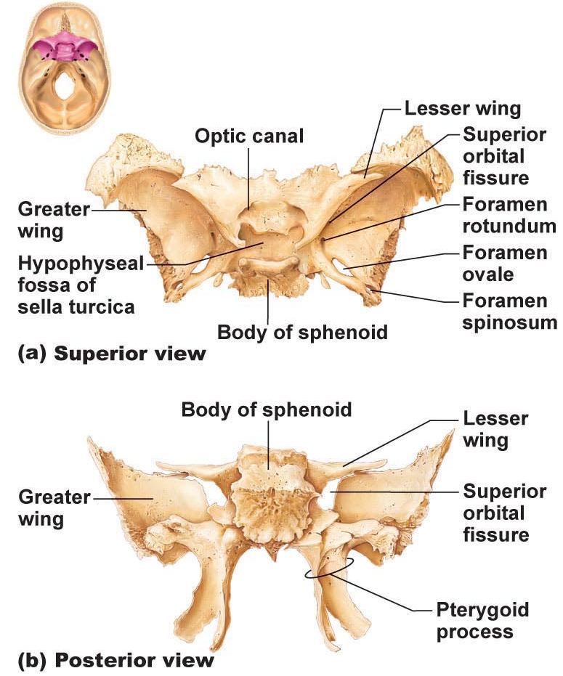
Fig. 7.9
central body which contains sphenoid sinuses
3 projections:
greater & lesser wings (orbits, MCF & ACF)
pterygoid processes (muscles for chewing)
optic foramina (canals): for optic nerves
superior orbital fissure between greater & lesser wings (cranial nerves for eye movement)
Notes:
30:46-35:08 Be guided with only written on the left side. Medial crainial fossa, anterior cranial fossa. Orbital fissure are the two holes near greater and lesser wings.

Slide 13
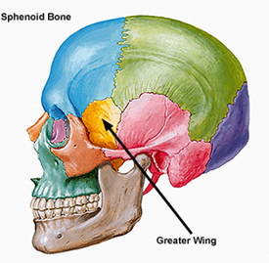
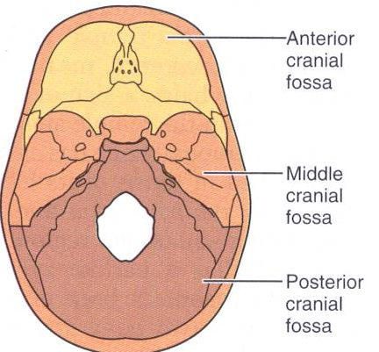
Cranial cavity floor showing major fossae
www.upstate.edu/cdb/ grossanat/imgs/sklatsb1.jpg
Notes:
35:08-37:18 bunches of holds is the ethmoid bone.

Slide 14
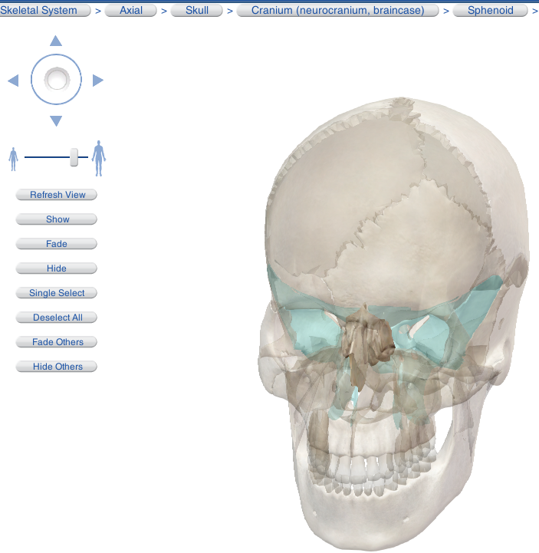
From Visible Body:

Slide 15
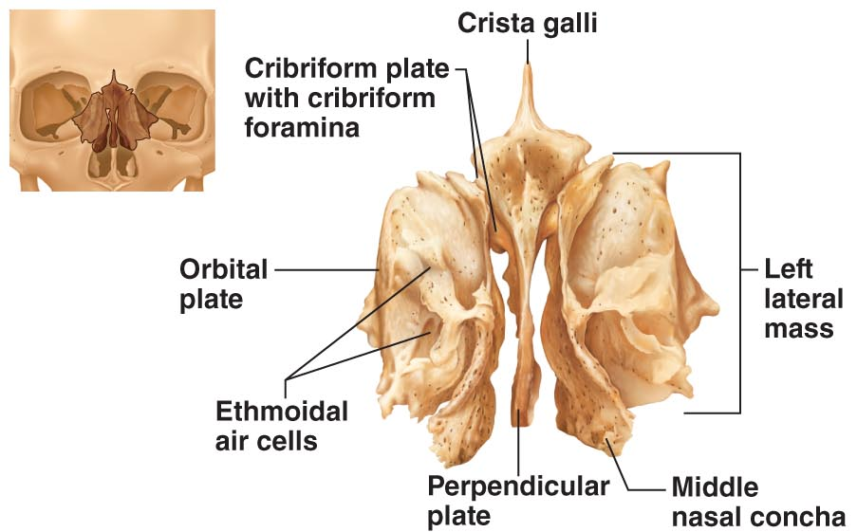
(vi) Ethmoid bone: approximates a cube that lies deep between orbits & nasal cavities
cribriform plate forms roof of nasal cavity & floor of anterior cranial fossa; tiny holes (olfactory foramina) transmit olfactory nerves
perpendicular plate projects inferiorly to contribute to nasal septum
crista galli projects superiorly to attach to dura mater of brain
Fig. 7.10
lateral masses contain ethmoid sinuses
medially are superior & middle nasal conchae
laterally are orbital plates - contribute to medial walls of orbits
Notes:
37:18-43:10 nasal concave 3 sets. 41:15 important crista galli attach to the..?

Slide 16
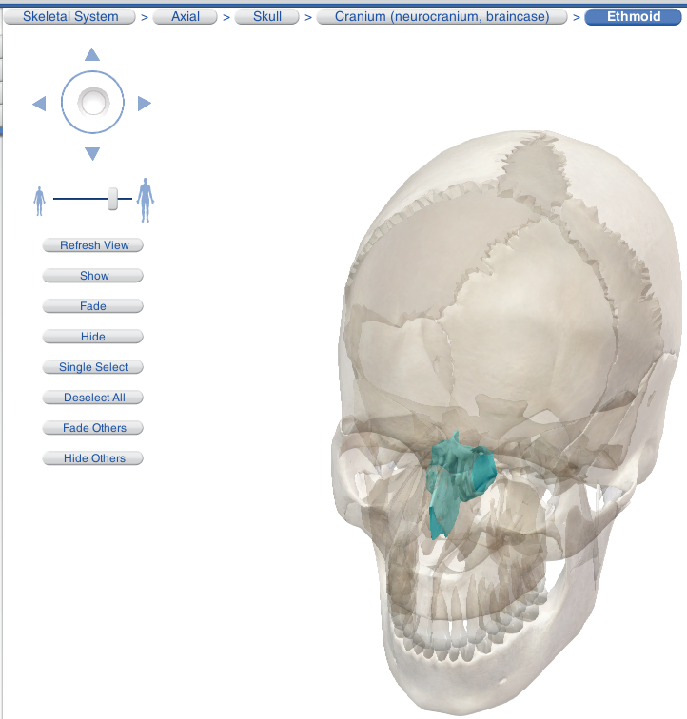
From Visible Body:
Notes:
ethmoid

Slide 17
Major Cranial Sutures:
• bones of the adult skull are firmly united by sutures
• 4 main sutures that connect the cranial bones
(1) Coronal suture: frontal bone & 2 parietal bones
(2) Squamous suture: parietal bone & temporal bone
(3) Lambdoid suture: occipital bone & 2 parietal bones
Fig. 7.5c: Midsagittal view of skull
Notes:
43:10-44:44 only need to know 4 sutures?? Coronal connects the frontal with the parietal.

Slide 18
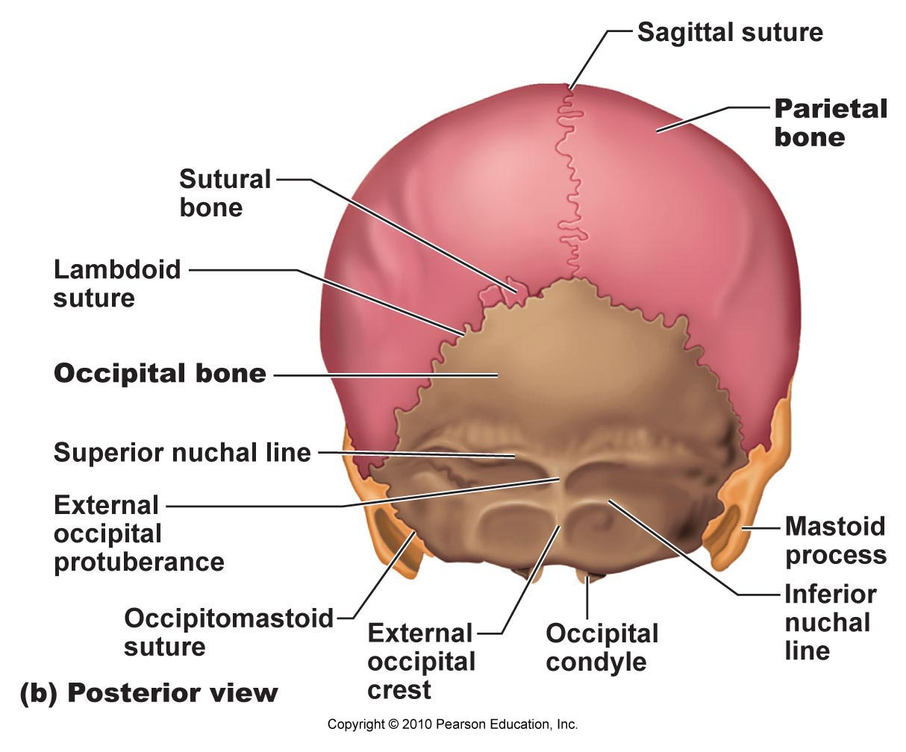
(4) Sagittal suture: 2 parietal bones
Sutural bones: tiny irregular bones; can occur within cranial suture
additional ossification centres that appeared rapidly during fetal development
Fig. 7.4b
Notes:
44:44-44:58 could be asked to label the 4 sutures.

Slide 19
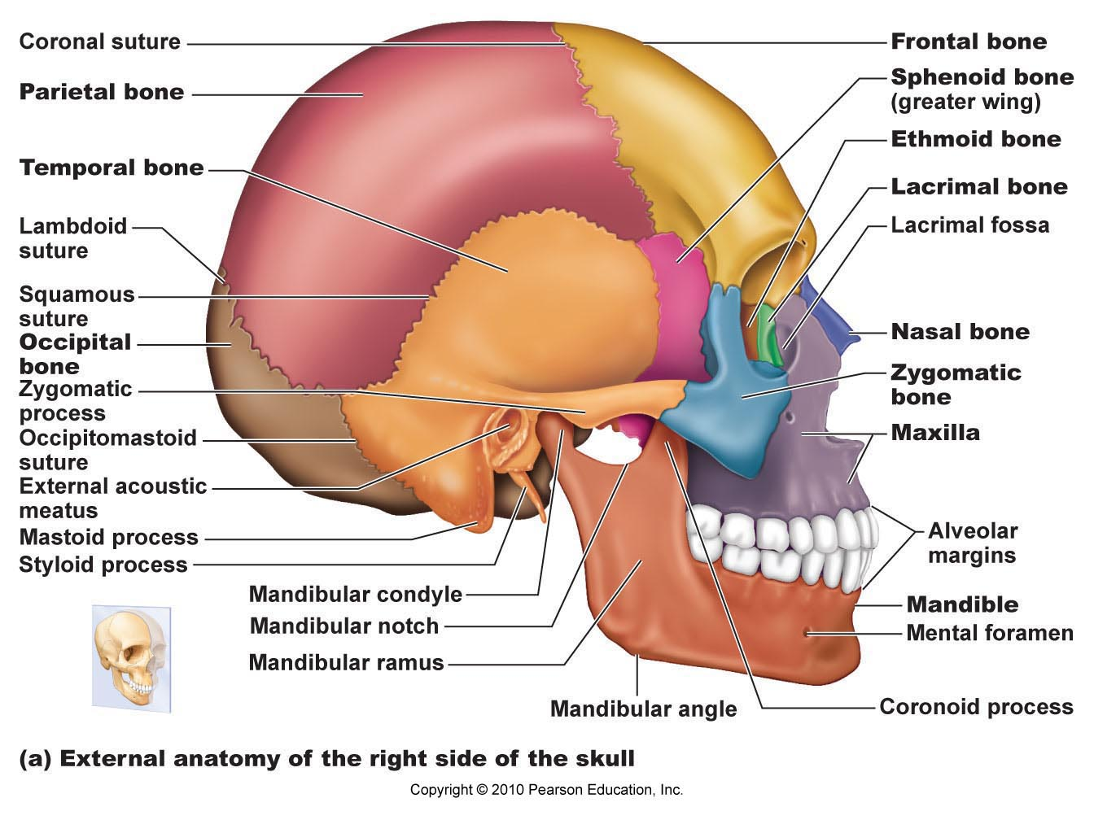
Notes:
48:58-47:10 don’t have to know occipitomastoid suture. Diagram is fair game.

Slide 20
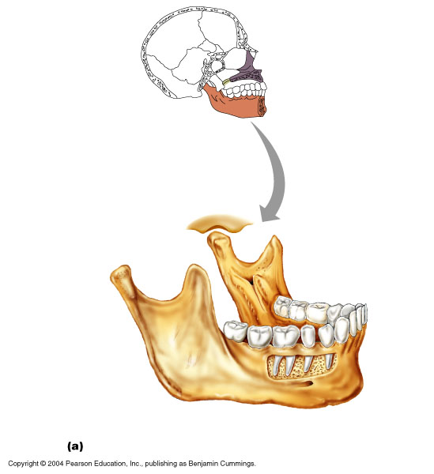
Facial Bones: 14 bones of which mandible & vomer are unpaired
paired bones are: maxillae, zygomatic, nasal, lacrimal, palatine & inferior conchae
(i) Mandible: lower jaw bone - strongest & largest bone of the face
• body is horizontal part & contains chin; left & right rami join body at mandibular angle
note: mandibular notch, coronoid process (insertion of temporalis muscle), mandibular condyle, alveolar margin (contains tooth sockets), mandibular foramina (nerves to teeth in lower jaw) & mental foramina (blood vessels & nerves to chin & lower lip)
Fig. 7.11a
Notes:
47:10-52:56 lacrimal bones circular? Yellow mandible only moveable bone in face and largest. Body forms chin. Ramus (rami) the arms the come up on both sides. Temoralis muscle red arrow and is a chewing muscle not formation of …mandibular joint. Alveolar margin is the where the teeth sit in the sockets. Opening at top are where dentists nut the novocaine in to freeze. Mental= chin. Mental foramen is the bottom hole.

Slide 21
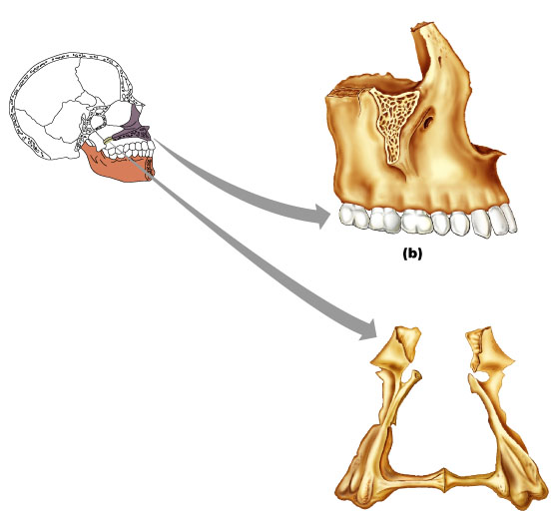
Fig. 7.8
(ii) Maxillary bones:
• fused medially
• alveolar margins hold teeth of upper jaw
• palatine processes project posteriorly forming anterior 2/3 of hard palate
note: (incisive fossa) (passage of blood vessels & nerves), frontal processes & zygomatic processes
main portion of bone on each side has maxillary sinus - these are the sinuses that get infected
Notes:
52:56-55:55 palatine bone is the bottom bone? Maxillary are the sinus that get infected more often.

Slide 22
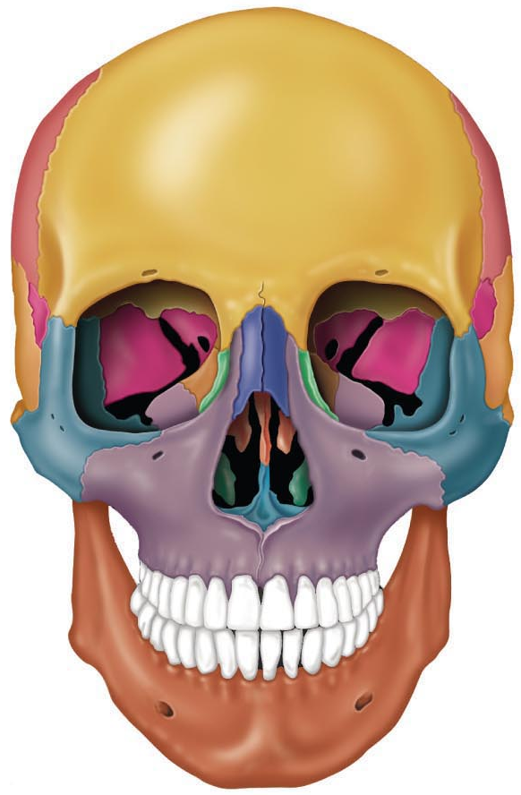
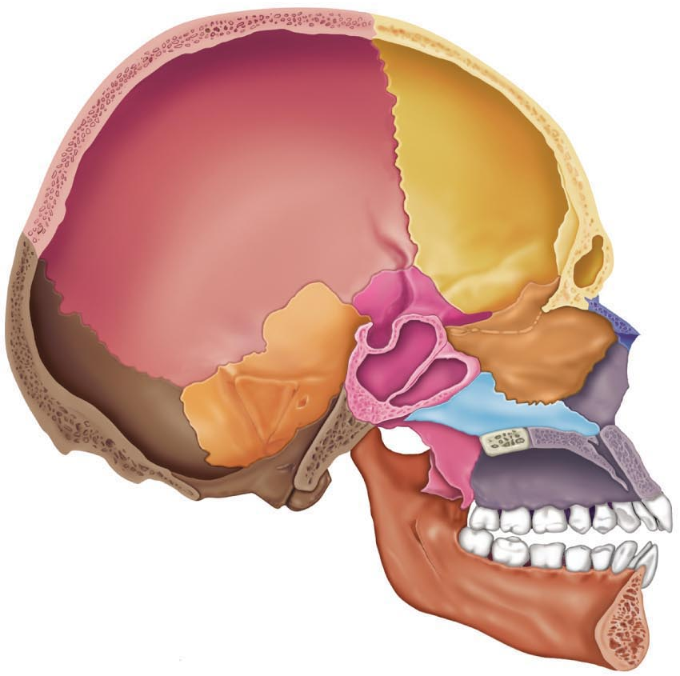

Slide 23
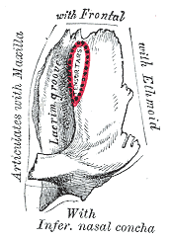
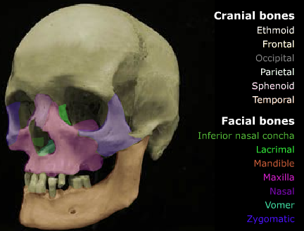
(iii) Zygomatic bones: = cheekbones
• articulate with zygomatic processes of maxilla, frontal & temporal bones
• contribute to inferolateral margins of orbit
(iv) Nasal bones:
• 2 tiny, rectangular bones that fuse medially to form bridge of nose
• articulate with frontal bone superiorly & maxillary bones laterally
(v) Lacrimal bones:
• 2 fingernail-shaped bones in anterior, medial portion of orbit –
articulate with:
frontal bone
ethmoid bone
maxillae
each has a depression (lacrimal fossa) for lacrimal sac
Notes:
55:55-59:05 zygomatic is cheek bones. Lacrimal something about tears.

Slide 24
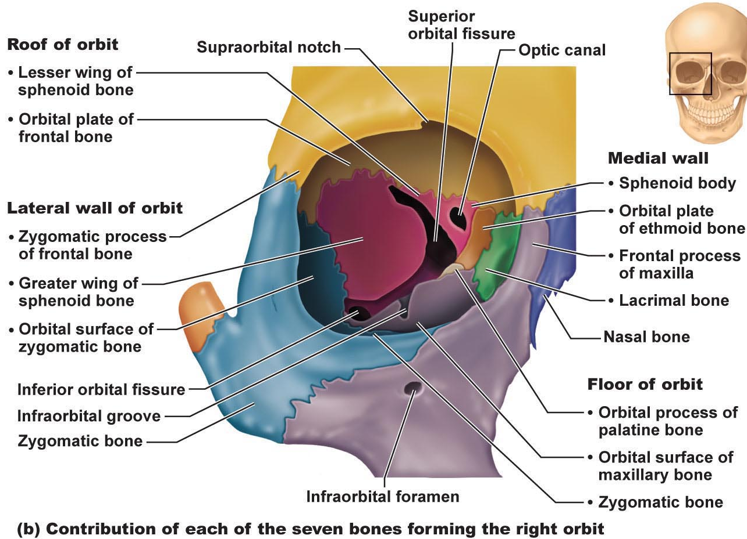
Orbits:
zygomatic
frontal
maxilla
ethmoid
lacrimal
sphenoid
palatine (orbital process)
Fig. 7.13

Slide 25
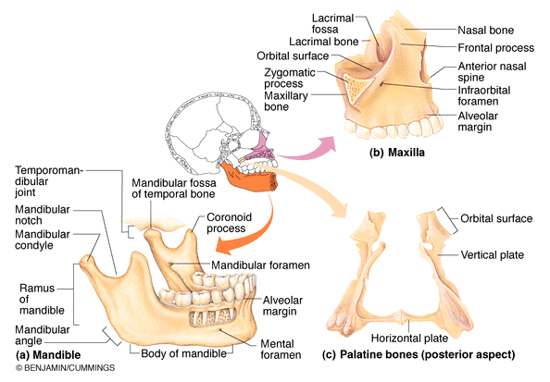
(vi) Palatine bones:
2 L-shaped bones
horizontal plates form part of hard palate
vertical plates - nasal cavity & orbit
(vii) Vomer:
single thin bone forms nasal septum
(see Fig. 7.4a)
From Fig. 7.8
(viii) Inferior nasal conchae:
[superior and middle nasal conchae from ethmoid bone]
thin, curved bones - project medially
largest of 3 pairs of conchae
Fig.7.6a

Slide 26
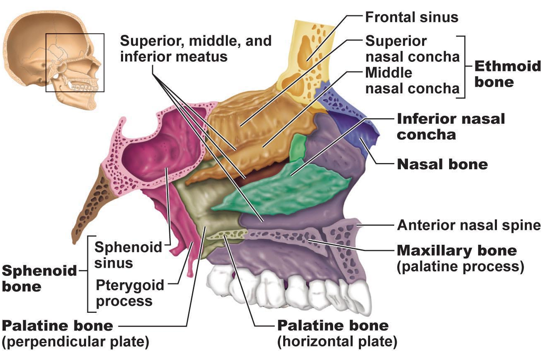
Fig. 7.14a: Bones forming the left lateral wall of the nasal cavity:

Slide 27
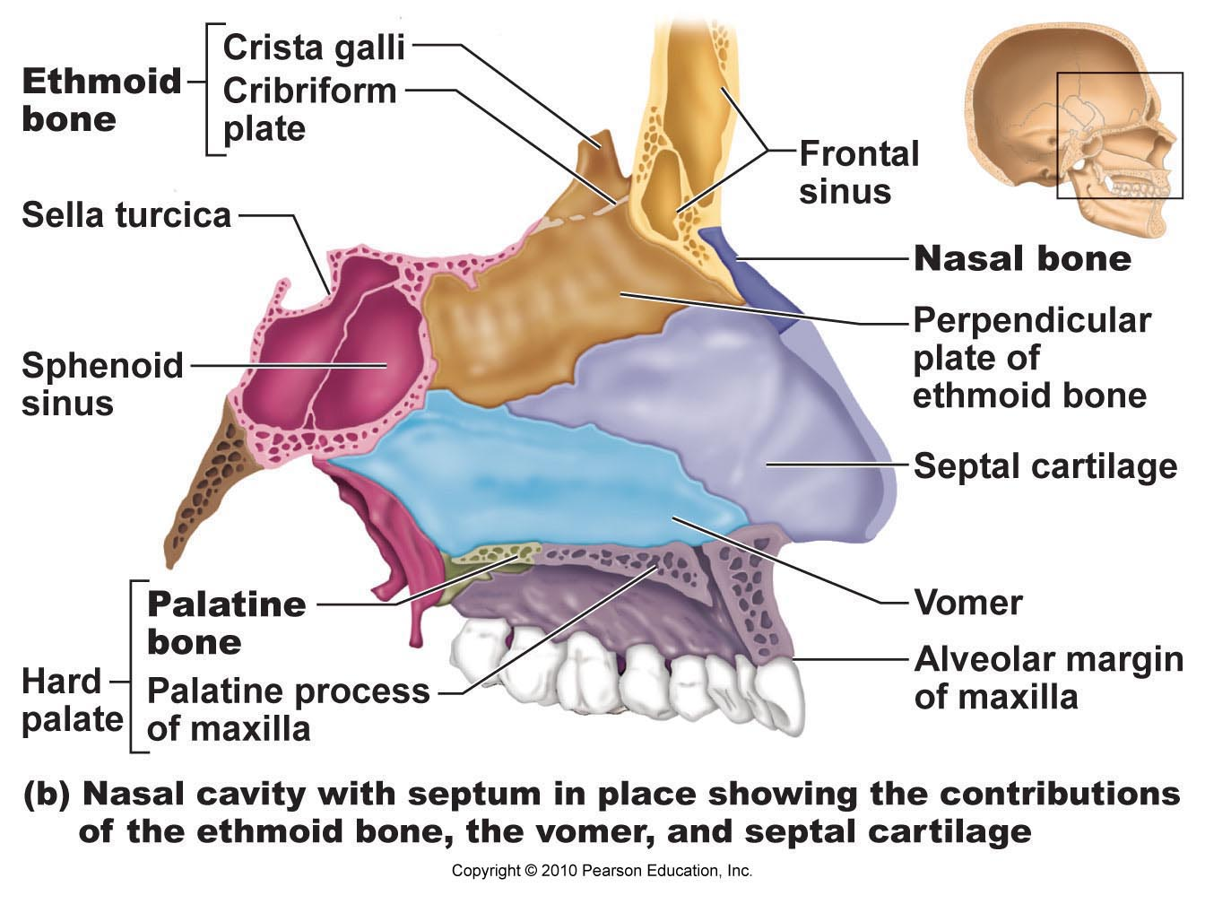
Fig. 7.14b: Contributions of ethmoid & vomer bones & cartilage to nasal septum:

Slide 28
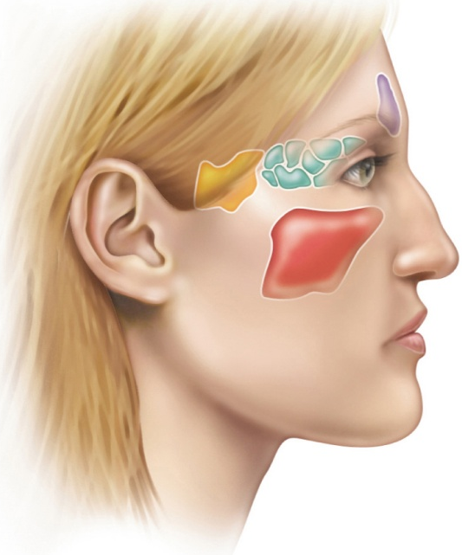
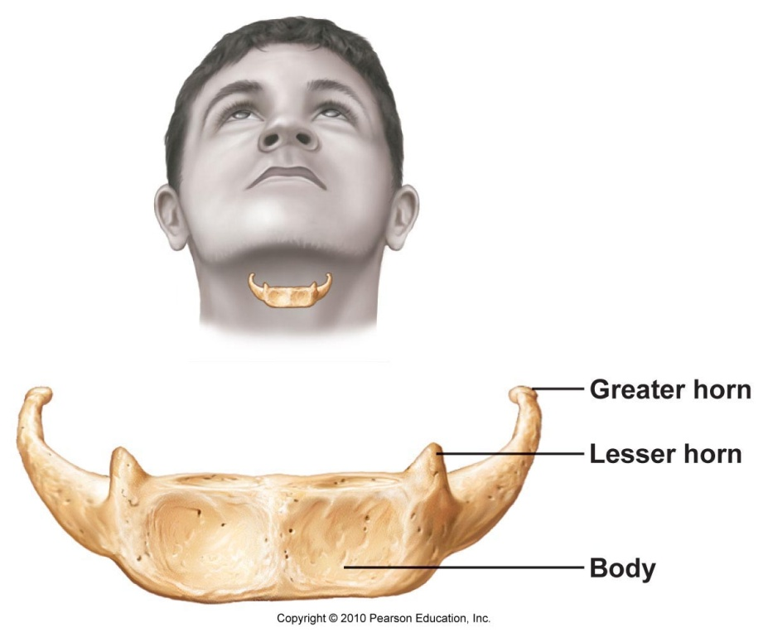
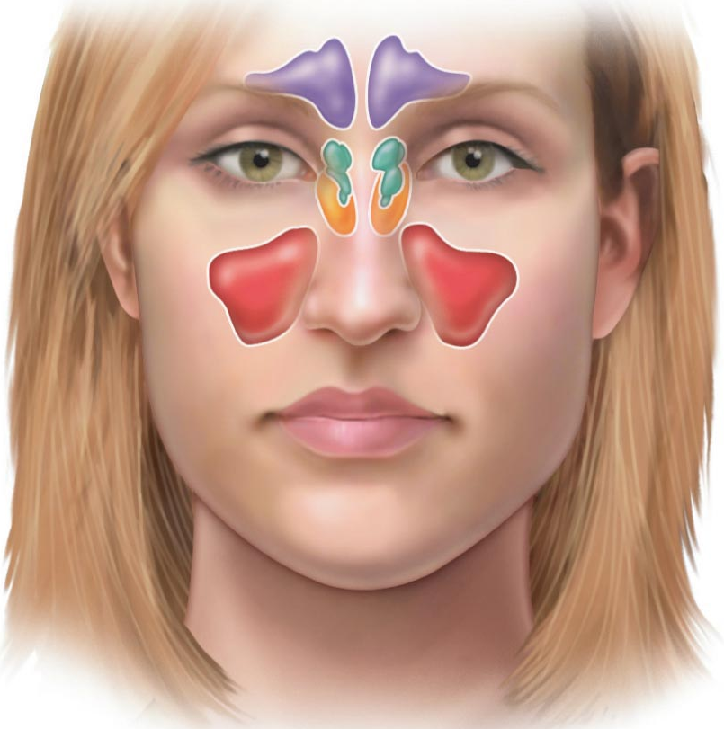
Fig. 7.15
Fig. 7.12
F
E
S
M
Paranasal Sinuses:
frontal
maxillary
sphenoid
ethmoid
mucosa-lined, air-filled
lighten skull and enhance resonance of voice; connect to nasal cavity so also help to warm & humidify incoming air
Hyoid:
• only bone of the body that does not articulate with any other bone
• supports tongue & gives attachment to muscles for swallowing & speech
• horseshoe-shaped with a body + 2 pairs of horns

