Slide 1
BSTA 378
ANALYSIS OF COVARIANCE
Fall 2016
Dr Morin

Slide 2
Analysis of Covariance
GOAL: To test for differences between group means when we know that an extraneous continuous variable affect the continuous outcome variable.

Slide 3
Analysis of Covariance
Assess different groups differences of one dependent variable while controlling for the effect of one or more covariate

Slide 4
Analysis of Covariance
It is a statistical technique to isolate the variance in the dependent variable attributable to variables that are not the subject of the study.
Those variables are called Covariate or Control variables
ANCOVA evaluates whether population means on the dependent variable are the same across the levels of a factor adjusting for the difference on the covariate or whether the adjusted group means differ significantly from each other.

Slide 5
Advantages of ANCOVA
Reduce error variance by explaining some of the unexplained variance
Greater experimental control
Part of the original SSE is explained by SSCovariate and the rest is the new SSE (smaller)

Slide 6
We need:
We need score on a factor or independent variable (classification)
on a covariate (X)
on a dependent variable (Y)

Slide 7
Assumptions of ANCOVA
Normality
Linearity
Homoscedasticity
No interaction between the independent variable and covariate

Slide 8
ANCOVA Steps
Descriptive Statistics
Run ANOVA Model with no covariate
Run ANCOVA
Compare the results

Slide 9

Example: Impact of teaching format
Format | Exam
InClass | 3 2 5 2 2 2 7 2 4
Hybrid | 7 5 3 4 4 7 5 4
Online | 9 2 6 3 4 4 4 6 4 6 2 8 5
A Mathematic seminar is offered in three different formats:
InClass,
Hybrid
Online
Based on an exam taken by students, which teaching format is more effective?
$$H_{0}: μ_{1}=μ_{2}=μ_{3}$$

Slide 10
Means (Standard deviation)
Format | Mean of Exam | Std. Dev. of Exam
Overall | 4.36667 | 1.9561
Hybrid | 4.875 | 1.4577
Inclass | 3.2222 | 1.7873
Online | 4.8462 | 2.1152

Slide 11

ANOVA
$$H_{0}:μ_{1}=μ_{2}=μ_{3}$$
Source | DF | Sum of Squares | Mean Square | F Value | Pr > F
Model | 2 | 16.844 | 8.4219 | 2.42 | 0.1083
Error | 27 | 94.123 | 3.4860
Corrected Total | 29 | 110.967
Cannot reject Ho
Source | DF | Anova SS | Mean Square | F Value | Pr > F
Format | 2 | 16.844 | 8.4219 | 2.42 | 0.11

Slide 12
INCLUDE A PRE TEST
Format | Pre Test | Exam
InClass | 4 1 5 1 2 2 7 4 5 | 3 2 5 2 2 2 7 2 4
Hybrid | 5 3 1 2 2 6 4 2 | 7 5 3 4 4 7 5 4
Online | 1 3 5 4 3 3 2 0 1 3 0 1 0 | 9 2 6 3 4 4 4 6 4 6 2 8 5
Pre Test | Exam | Format
4 | 3 | Inclass
1 | 2 | Inclass
5 | 5 | Inclass
1 | 2 | Inclass
2 | 2 | Inclass
2 | 2 | Inclass
7 | 7 | Inclass
4 | 2 | Inclass
5 | 4 | Inclass
5 | 7 | Hybrid
3 | 5 | Hybrid
1 | 3 | Hybrid
2 | 4 | Hybrid
2 | 4 | Hybrid
6 | 7 | Hybrid
4 | 5 | Hybrid
2 | 4 | Hybrid
1 | 9 | Online
3 | 2 | Online
5 | 6 | Online
4 | 3 | Online
3 | 4 | Online
3 | 4 | Online
2 | 4 | Online
0 | 6 | Online
1 | 4 | Online
3 | 6 | Online
0 | 2 | Online
1 | 8 | Online
0 | 5 | Online
Perhaps Math aptitudes could influence the results ?

Slide 13
ANCOVA
Source | DF | Sum of Squares | Mean Square | F Value | Pr > F
Model | 3 | 31.9196 | 10.6399 | 3.50 | 0.0295
Error | 26 | 79.0471 | 3.0403
Corrected Total | 29 | 110.9667
Source | DF | Type III SS | Mean Square | F Value | Pr > F
Pre Test | 1 | 15.0757 | 15.076 | 4.96 | 0.0348
Format | 2 | 25.1852 | 12.593 | 4.14 | 0.0274
R-Square | Coeff Var | Root MSE | Exam Mean
0.288 | 39.931 | 1.744 | 4.367

Slide 14
ANCOVA
Source | DF | Sum of Squares | Mean Square | F Value | Pr > F
Model | 3 | 31.9196 | 10.6399 | 3.50 | 0.0295
Error | 26 | 79.0471 | 3.0403
Corrected Total | 29 | 110.9667
Source | DF | Type III SS | Mean Square | F Value | Pr > F
Pre Test | 1 | 15.0757 | 15.076 | 4.96 | 0.0348
Format | 2 | 25.1852 | 12.593 | 4.14 | 0.0274
R-Square | Coeff Var | Root MSE | Exam Mean
0.288 | 39.931 | 1.744 | 4.367

Slide 15
ANOVA - ANCOVA
Source | DF | Sum of Squares | Mean Square | F Value | Pr > F
Model | 2 | 16.844 | 8.4219 | 2.42 | 0.1083
Error | 27 | 94.123 | 3.4860
Corrected Total | 29 | 110.967
ANOVA
Source | DF | Sum of Squares | Mean Square | F Value | Pr > F
Model | 3 | 31.9196 | 10.6399 | 3.50 | 0.0295
Error | 26 | 79.0471 | 3.0403
Corrected Total | 29 | 110.9667
ANCOVA
79.0471 + 15.0757 = 94.123
Source | DF | Type III SS | Mean Square | F Value | Pr > F
Pre Test | 1 | 15.0757 | 15.076 | 4.96 | 0.0348
Format | 2 | 25.1852 | 12.593 | 4.14 | 0.0274

Slide 16
POST HOC TESTS / ARITHMETIC The GLM Procedure Tukey's Studentized Range (HSD) Test for Exam
Alpha | 0.05
Error Degrees of Freedom | 26
Error Mean Square | 3.040274
Critical Value of Studentized Range | 3.51405

Slide 17
POST HOC TESTS / LEAST SQUARES
Format | Exam LSMEAN
Hybrid | 4.712050
Inclass | 2.926370
Online | 5.151251
Covariates appearing in the model are evaluated at the following values: Pretest = 2.73 = average of all Pretest results

Slide 18
Adjustment for Multiple Comparisons: Tukey-Kramer
Least Squares Means for Effect Format
i | j | Difference Between Means | Simultaneous 95% Confidence Limits for LSMean(i)-LSMean(j)
1 | 2 | 1.785680 | -0.324803 | 3.896164
1 | 3 | -0.439201 | -2.454929 | 1.576527
2 | 3 | -2.224881 | -4.219711 | -0.230052
4.71205-2.92637
Format | Exam LSMEAN | 95% Confidence Limits
Hybrid | 4.712050 | 3.435984 | 5.988117
Inclass | 2.926370 | 1.700854 | 4.151886
Online | 5.151251 | 4.118076 | 6.184427
Covariates appearing in the model are evaluated at the following values: Pretest = 2.73 = average of all Pretest results

Slide 19
Test for differences in means
Least Squares Means for effect Format Pr > |t| for H0: LSMean(i)=LSMean(j) Dependent Variable: Exam
i/j | 1 | 2 | 3
1 |  | 0.1089 | 0.8517
2 | 0.1089 |  | 0.0266
3 | 0.8517 | 0.0266

Slide 20
Test for Homogeneity of Exam Variance
Brown and Forsythe's Test for Homogeneity of Exam Variance ANOVA of Absolute Deviations from Group Medians
Source | DF | Sum of Squares | Mean Square | F Value | Pr > F
Format | 2 | 1.4592 | 0.7296 | 0.33 | 0.7249
Error | 27 | 60.5075 | 2.2410
Bartlett's Test for Homogeneity of Exam Variance
Source | DF | Chi-Square | Pr > ChiSq
Format | 2 | 1.1104 | 0.5740

Slide 21
Example Grocery
A manager is about to introduce a new product to be sold in grocery stores, but she is unsure about the appropriate price to charge.
She decides to conduct a market research by introducing the product in a limited number of stores at different levels of price and advertising.
After tracking sales for six months following the introduction of the product at three price levels, she finds the following:

Slide 22
Advertising / Price
Advertising | Low price | Medium price | High Price
Low | 620 | 475 | 413
Low | 774 | 544 | 556
Low | 623 | 579 | 395
Low | 776 | 706 | 382
High | 955 | 472 | 294
High | 669 | 701 | 378
High | 596 | 482 | 355
High | 1208 | 388 | 373

Slide 23
Analysis Variable : Sales
Advertising | Price | N | Mean | Std Dev | Minimum | Maximum
High Adv | High Pr | 4 | 350.000 | 38.61778 | 294 | 378
 | Low Pr | 4 | 857.000 | 280.6361 | 596 | 1208
 | Med Pr | 4 | 510.750 | 133.6547 | 388 | 701
Low Adv | High Pr | 4 | 436.500 | 80.67424 | 382 | 556
 | Low Pr | 4 | 698.250 | 88.63548 | 620 | 776
 | Med Pr | 4 | 576.000 | 96.84007 | 475 | 706

Slide 24
ANOVA Results
Source | DF | Sum of Squares | Mean Square | F Value | Pr > F
Model | 5 | 674295.333 | 134859.067 | 6.64 | 0.0011
Error | 18 | 365562.500 | 20309.028
Corrected Total | 23 | 1039857.833
R-Square | Coeff Var | Root MSE | Sales Mean
0.648450 | 24.9397 | 142.5097 | 571.4167
Source | DF | Type III SS | Mean Square | F Value | Pr > F
Price | 2 | 600412.58 | 300206.292 | 14.78 | 0.0002
Advertising | 1 | 32.67 | 32.667 | 0.00 | 0.9685
Price*Advertising | 2 | 73850.08 | 36925.042 | 1.82 | 0.1909

Slide 25
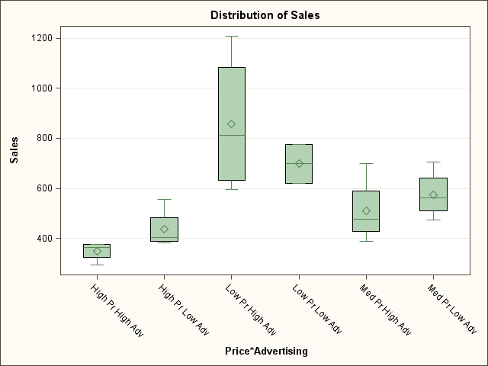

Slide 26
Tukey's Studentized Range (HSD) Test for Sales
Advertising
Alpha | 0.05
Error Degrees of Freedom | 18
Error Mean Square | 20309.03
Critical Value of Studentized Range | 2.97105
Minimum Significant Difference | 122.23
Comparisons significant at the 0.05 level are indicated by ***.
Advertising Comparison | Difference Between Means | Simultaneous 95% Confidence Limits
High Adv - Low Adv | 2.333 | -119.893 | 124.559
Low Adv - High Adv | -2.333 | -124.559 | 119.893

Slide 27
The GLM Procedure
Tukey's Studentized Range (HSD) Test for Sales
Prices
Alpha | 0.05
Error Degrees of Freedom | 18
Error Mean Square | 20309.03
Critical Value of Studentized Range | 3.60930
Minimum Significant Difference | 181.85
Comparisons significant at the 0.05 level are indicated by ***.
Price Comparison | Difference Between Means | Simultaneous 95% Confidence Limits
High Pr - Low Pr | -384.38 | -566.23 | -202.52 | ***
High Pr - Med Pr | -150.13 | -331.98 | 31.73
Low Pr - High Pr | 384.38 | 202.52 | 566.23 | ***
Low Pr - Med Pr | 234.25 | 52.40 | 416.10 | ***
Med Pr - High Pr | 150.13 | -31.73 | 331.98
Med Pr - Low Pr | -234.25 | -416.10 | -52.40 | ***

Slide 28
More data
The manager is concerned that the assignment of stores to treatment groups did not ensure their equivalence with respect to their average size. Therefore she introduces the covariate variable Store size in the model as in the table below:

Slide 29
Include Store size
Advertising | Low price | Store size | Medium price | Store size | High Price | Store size
Low | 620 | 36 | 475 | 40 | 413 | 34
Low | 774 | 38 | 544 | 36 | 556 | 32
Low | 623 | 42 | 579 | 35 | 395 | 41
Low | 776 | 34 | 706 | 41 | 382 | 35
High | 955 | 26 | 472 | 25 | 294 | 25
High | 669 | 25 | 701 | 26 | 378 | 25
High | 596 | 32 | 482 | 28 | 355 | 27
High | 1208 | 37 | 388 | 27 | 373 | 29

Slide 30
SAS
covariate
Advertising | Price | Store size | Sales
Low Adv | Low Pr | 36 | 620
Low Adv | Low Pr | 38 | 774
Low Adv | Low Pr | 42 | 623
Low Adv | Low Pr | 34 | 776
Low Adv | Med Pr | 40 | 475
Low Adv | Med Pr | 36 | 544
… High Adv | Med Pr | 26 | 701
High Adv | Med Pr | 28 | 482
High Adv | Med Pr | 27 | 388
High Adv | High Pr | 25 | 294
High Adv | High Pr | 25 | 378
High Adv | High Pr | 27 | 355
High Adv | High Pr | 29 | 373
Dependant variable
Classification

Slide 31
ANCOVA
Source | DF | Sum of Squares | Mean Square | F Value | Pr > F
Model | 6 | 686853.708 | 114475.618 | 5.51 | 0.0025
Error | 17 | 353004.125 | 20764.949
Corrected Total | 23 | 1039857.833
Source | DF | Type III SS | Mean Square | F Value | Pr > F
Store size | 1 | 12558.38 | 12558.38 | 0.60 | 0.4474
Advertising | 1 | 9478.32 | 9478.32 | 0.46 | 0.5084
Price | 2 | 471506.64 | 235753.32 | 11.35 | 0.0007
Advertising*Price | 2 | 60484.78 | 30242.39 | 1.46 | 0.2607
R-Square | Coeff Var | Root MSE | Sales Mean
0.660527 | 25.218 | 144.10 | 571.42

Slide 32
Arithmetic / Price levels
Alpha | 0.05
Error Degrees of Freedom | 17
Error Mean Square | 20764.95
Critical Value of Studentized Range | 3.62796
Minimum Significant Difference | 184.83

Slide 33
The GLM Procedure Tukey's Studentized Range (HSD) Test for Sales
Alpha | 0.05
Error Degrees of Freedom | 18
Error Mean Square | 20309.03
Critical Value of Studentized Range | 3.60930
Minimum Significant Difference | 181.85
Means with the same letter are not significantly different.
Tukey Grouping | Mean | N | Price
A | 777.63 | 8 | Low Pr
B | 543.38 | 8 | Med Pr
B
B | 393.25 | 8 | High Pr

Slide 34
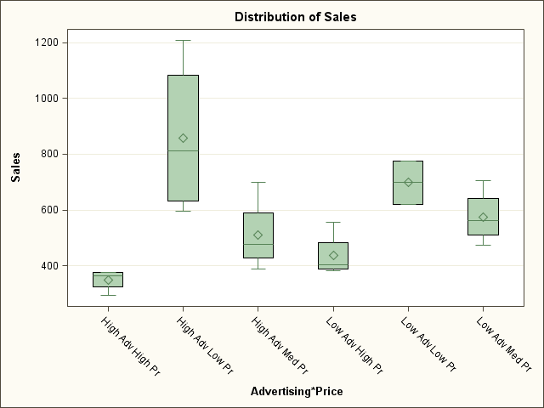
Overall

Slide 35
The GLM Procedure
Least Squares Means
Price | Sales LSMEAN | LSMEAN Number
High Pr | 397.353311 | 1
Low Pr | 773.265232 | 2
Med Pr | 543.631457 | 3
Least Squares Means for effect Price Pr > |t| for H0: LSMean(i)=LSMean(j) Dependent Variable: Sales
i/j | 1 | 2 | 3
1 |  | <.0001 | 0.0614
2 | <.0001 |  | 0.0056
3 | 0.0614 | 0.0056

Slide 36
The GLM Procedure
Least Squares Means
Price | Sales LSMEAN | 95% Confidence Limits
High Pr | 397.353311 | 287.910031 | 506.796592
Low Pr | 773.265232 | 663.691608 | 882.838856
Med Pr | 543.631457 | 435.200661 | 652.062253
Least Squares Means for Effect Price
i | j | Difference Between Means | 95% Confidence Limits for LSMean(i)-LSMean(j)
1 | 2 | -375.911921 | -532.292264 | -219.531578
1 | 3 | -146.278146 | -300.250178 | 7.693886
2 | 3 | 229.633775 | 75.383883 | 383.883667

