Slide 1
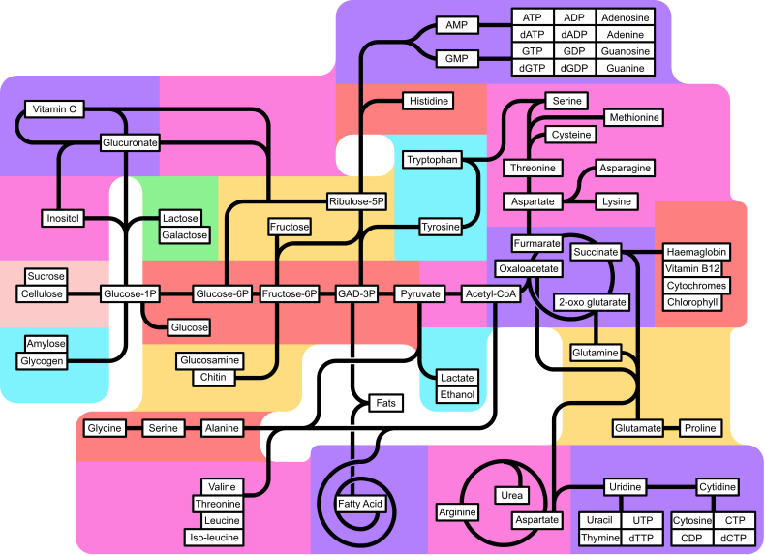
Chapter 24: Regulation of Metabolism & Body Temperature

Slide 2

Regulation of Metabolism & Body Temperature
2.1 Review the metabolic pathways and their interactions
2.2 Define the absorptive state and justify the key role of insulin in its metabolic regulation
2.3 Define the postabsorptive state; describe the roles of glucagon & other supporting mechanisms in the maintenance of blood glucose levels
2.4 Describe the metabolic consequences of the two types of diabetes mellitus
2.5 List the various hepatic functions associated with metabolism
2.6 List and describe the 4 major types of lipoproteins
2.7 Describe the synthesis of thyroid hormones and its regulation
2.8 List the metabolic processes regulated by thyroid hormones
2.9 Define basal metabolism and total metabolism and identify the factors that influence them
2.10 Discuss the mechanisms of appetite regulation
2.11 Describe and explain the mechanisms of heat exchange
2.12 Explain the mechanisms for the control of body temperature

Slide 3
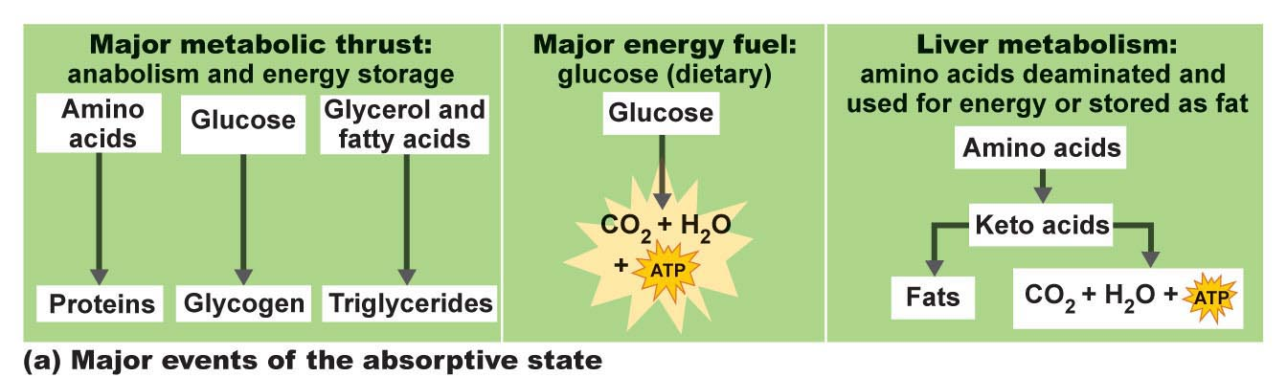
2.2 Define the absorptive state and the key role of insulin in its metabolic regulation
Absorptive state:
Anabolism exceeds catabolism
Glucose major fuel
Dietary amino acids and fats – used for anabolic processes
(make new proteins/fat stores)
Excess metabolites of all sources used to make fat once anabolic
and energy demands are met
Fig. 24.19a

Slide 4
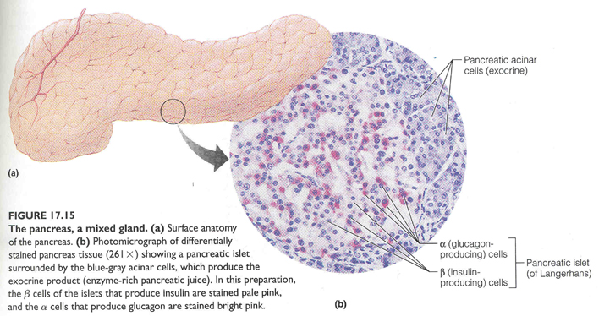
2.2 Define the absorptive state and the key role of insulin in its metabolic regulation
Hormonal Control:
INSULIN
• insulin directs essentially all events of absorptive state
produced by ß cells of pancreatic islets of Langerhans (endocrine pancreas; 2% of gland)

Slide 5
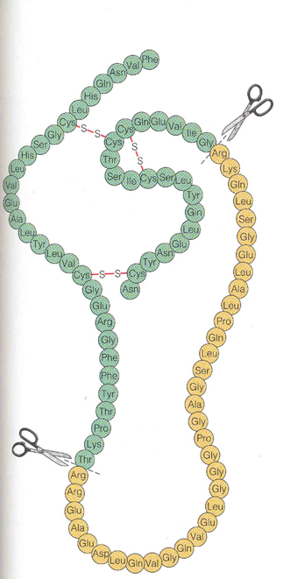
Insulin (cont):
- Structure: small (51 aa) protein consisting of 2 amino acid chains connected by disulfide bonds
Initially synthesized as proinsulin; middle portion excised to make active hormone just before release
Synthesized as by pancreatic β-cells. Primary stimulation for insulin secretion is a rise in blood _______
- secretion also stimulated by increased blood amino acids, by glucose-dependent insulinotropic pepide (GIP – produced by GI tract) and parasympathetic stimulation.

Slide 6
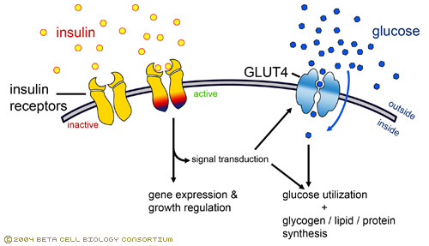
2.2 Define the absorptive state and the key role of insulin in its metabolic regulation
The principal effect of insulin is to activate carrier-mediated facilitated diffusion of glucose into cells (increases 15-20 fold within minutes via translocation of glucose transporter). This is especially true for skeletal muscle and adipose tissue
Why `translocation`?
NOTE: insulin is not needed for glucose entry into liver, kidney, brain, or intestinal epithelial cells. These cell types all readily absorb glucose irrespective of insulin levels.
www.betacell.org/images/CMS/insulin-receptor-...

Slide 7
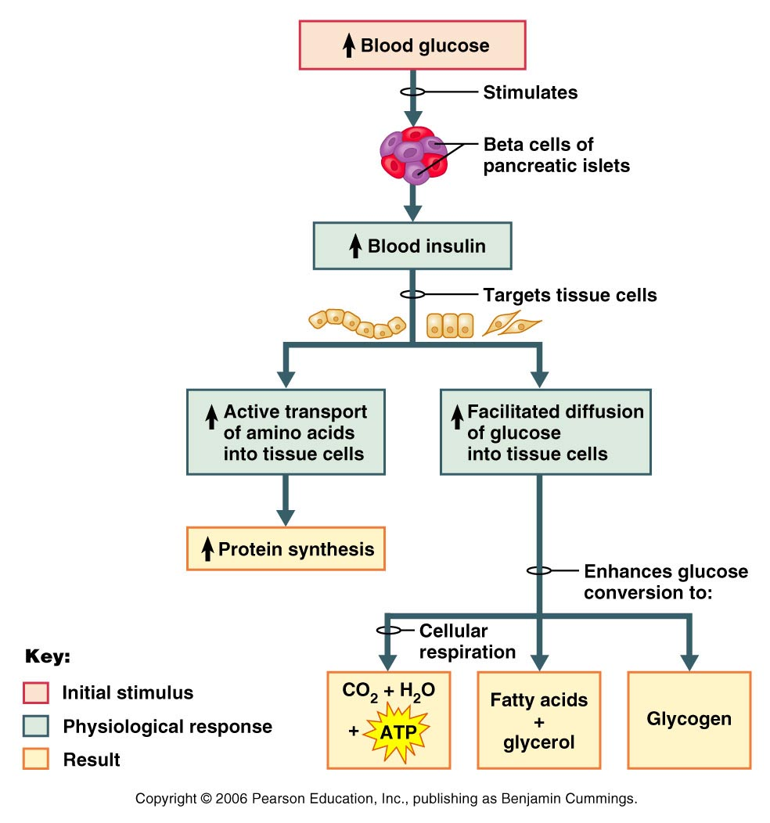
2.2 Define the absorptive state and the key role of insulin in its metabolic regulation
Other Effects of Insulin (in addition to glucose transport):
(1) Enhances glucose oxidation for energy
(2) Stimulates conversion of glucose to glycogen and triglycerides (in adipose tissue)
(3) Increases active uptake of amino acids & promotes protein synthesis
Inhibits virtually all liver enzymes that promote gluconeogenesis (what is this?) and inhibits hydrolysis of glycogen to glucose (glycogenolysis )
Insulin is an anabolic, hypoglycemic hormone: it takes glucose out of the circulation and uses it for energy or converts it to storage forms
Fig. 24.20

Slide 8
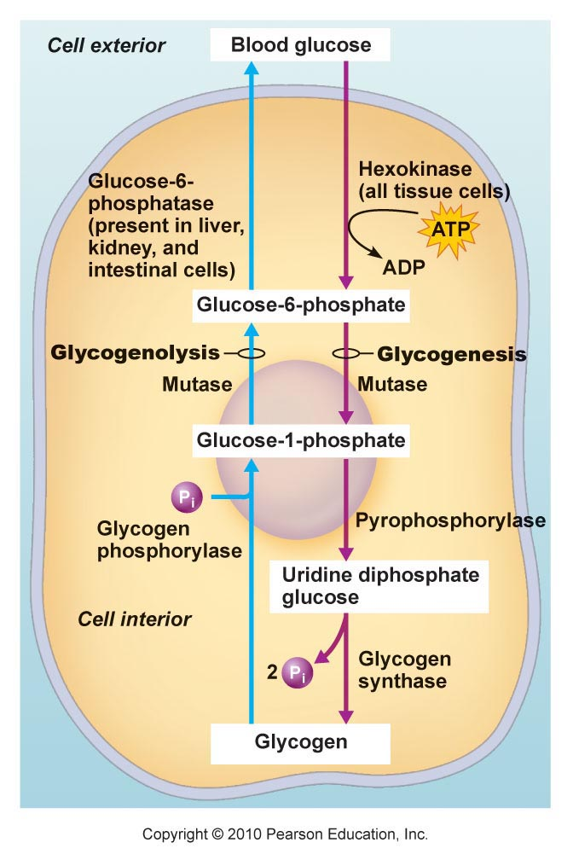
2.2 Define the absorptive state and the key role of insulin in its metabolic regulation
Fig. 24.13

Slide 9
If a statement about the absorptive state is TRUE, write the letter T in the blank. If it is FALSE, change the underlined word(s) and write the correct answer in the answer blank.
1. Major metabolic events are catabolic.
2. The major energy fuel is glucose.
3. Excess glucose is stored in muscle cells as glucagon or in adipose cells as fat.
4. The major energy source of skeletal muscle cells is glucose.
5. Most amino acids pass through the liver to other cells, where they are used to produce ATP.
6. The hormone most in control of the events of the absorptive state is insulin.
7. The sympathetic ns signals the pancreatic beta cells to secrete insulin.
8. Insulin stimulates the active transport of glucose into tissue cells.
9. Insulin inhibits lipolysis and glycogenolysis.

Slide 10
2.3 Define the postabsorptive state;describe the roles of glucagon and other supporting mechanisms in the maintenance of blood glucose
Postabsorptive State:
• between meals, blood glucose drops, net synthesis of fat, proteins, glycogen stops, and catabolism of these substances begins; primary goal is to maintain blood glucose within homeostatic range (70-100 mg glucose/100 ml) during times of fasting.
• important because brain must use glucose as its energy source
• most events geared toward: (i) sparing glucose for brain cells; (ii) making more glucose available to the circulatory system

Slide 11
2.3 Define the postabsorptive state;describe the roles of glucagon and other supporting mechanisms in the maintenance of blood glucose
Making glucose available to the blood:
Potential sources: stored glycogen, tissue proteins, fat (really only glycerol)
(i) Glycogenolysis in liver:
• liver has ~100 g of glycogen reserves = first source of glucose
• can normally maintain blood glucose for ~ 4 h during postabsorptive state
(ii) Glycogenolysis in skeletal muscle:
• again, ~100 g of glycogen reserves
• glycogen is oxidized to pyruvic acid or lactic acid (via glycolysis) ⇒ to blood ⇒ to liver ⇒ to glucose. Why doesn’t skeletal muscle directly provide glucose to the circulation?..........................

Slide 12
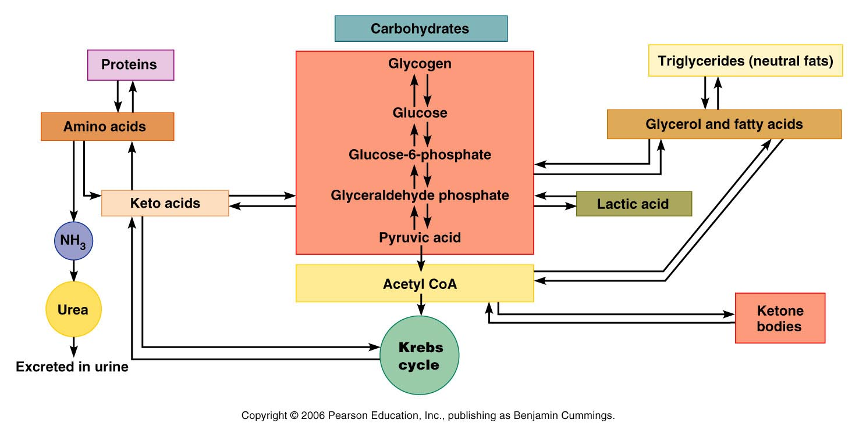
2.3 Define the postabsorptive state;describe the roles of glucagon and other supporting mechanisms in the maintenance of blood glucose
Muscle cells lack glucose-6-phosphatase, therefore cannot produce glucose for circulation. Instead, they metabolize G-6-P by glycolysis to pyruvate or lactic acid, which enter the circulation, and are taken up for conversion ot glucose by the liver. In this way, skeletal muscle is an indirect source of blood glucose in the post-absorptive state.
Lactic
acid
Fig. 24.13

Slide 13
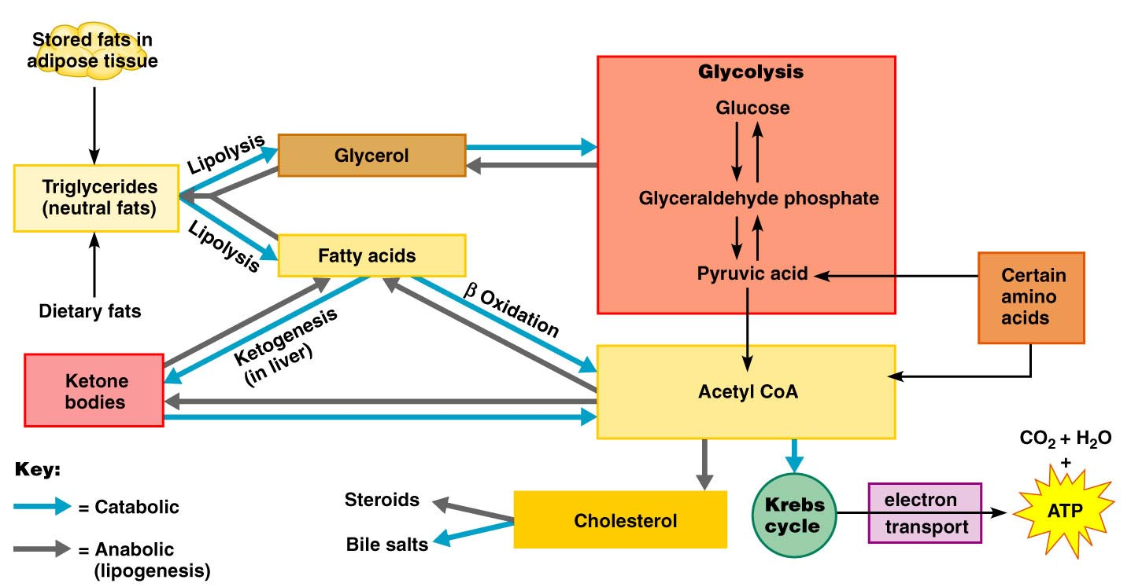
2.3 Define the postabsorptive state;describe the roles of glucagon and other supporting mechanisms in the maintenance of blood glucose
Making glucose available to the blood (continued)
Lipolysis in adipose tissues and liver:
adipose tissue & liver cells produce glycerol by lipolysis
liver converts glycerol to glucose (gluconeogenesis)
but free fatty acids can only feed into the Kreb’s cycle
Fig. 24.15

Slide 14
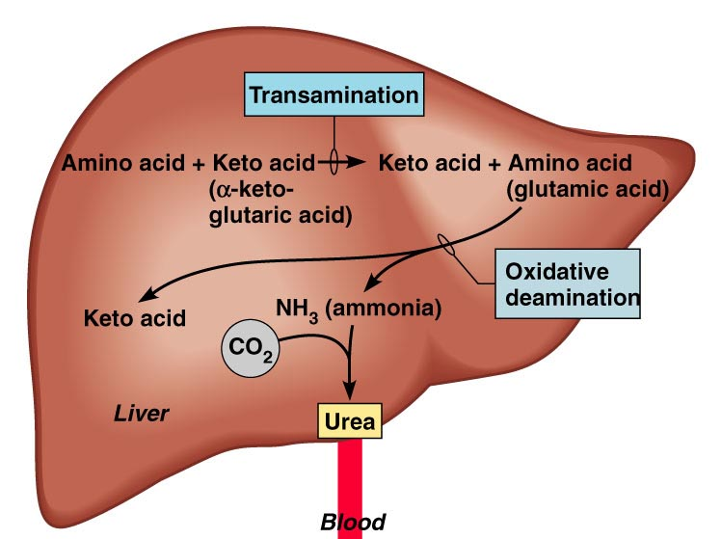
2.3 Define the postabsorptive state;describe the roles of glucagon and other supporting mechanisms in the maintenance of blood glucose
B1. Making glucose available to the blood (continued)
(iv) Catabolism of cellular protein:
last resort!! - used only if fasting is prolonged and during stress (due to the secretion of glucocorticoids)
• process requires deamination of amino acids in liver to generate keto acid followed by their conversion to glucose.

Slide 15
2.3 Define the postabsorptive state; describe the roles of glucagon and other supporting mechanisms in the maintenance of blood glucose
Glucose sparing:
• Mechanisms which use noncarbohydrate fuel molecules for energy (especially: triglycerides) in order to conserve glucose
• as body moves into the postabsorptive state, essentially all tissues & organs except the brain switch to using fats as their major energy source:
(1) lipolysis in adipose tissue releases free fatty acid to cells which can be oxidized for energy via Krebs cycle/oxidative phosphorylation
(2) liver oxidizes free fatty acids to ketone bodies - released into blood & used by cells for energy
(3) if fasting is prolonged (4-5 days) the brain will also start to use some ketone bodies for energy

Slide 16
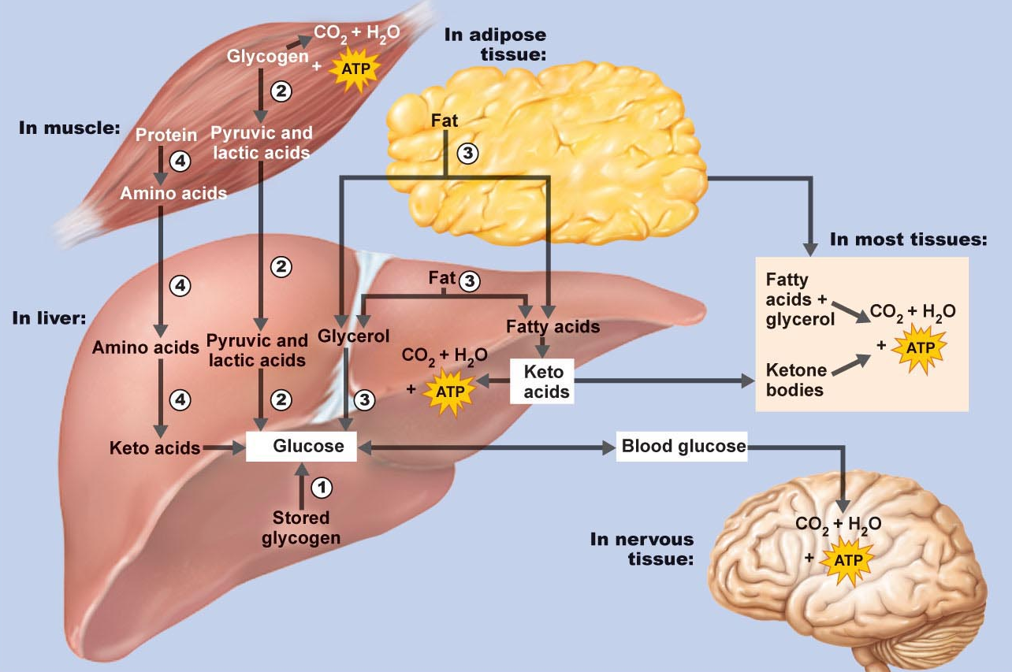
2.3 Define the postabsorptive state;describe the roles of glucagon and other supporting mechanisms in the maintenance of blood glucose

Slide 17
2.3 Define the postabsorptive state; describe the roles of glucagon and other supporting mechanisms in the maintenance of blood glucose
Hormonal & Neural Controls:
• interaction of sympathetic nervous system and several hormones regulate postabsorptive state (can be variable in length)
• initiation of postabsorptive state: as with absorptive state, principal key is a change in blood glucose: drop in blood glucose signals entry into postabsorptive state, and leads to inhibition of secretion of insulin
• decreasing blood glucose also stimulates secretion of glucagon

Slide 18
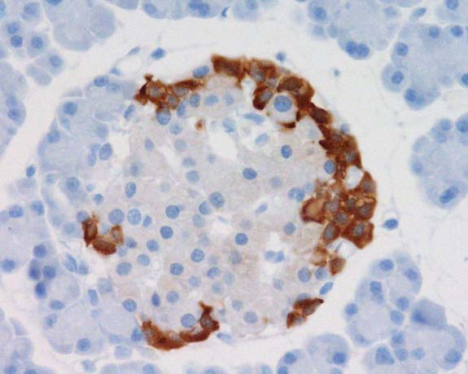
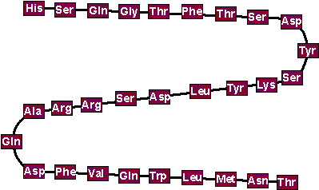
2.3 Define the postabsorptive state; describe the roles of glucagon and other supporting mechanisms in the maintenance of blood glucose
GLUCAGON
a 29-amino acid polypeptide hormone produced by alpha cells of pancreatic islets of Langerhans
potent hyperglycemic agent (1 molecule glucagon can cause release of 100 million molecules of glucose into blood!)
GLUCAGON: project.bio.iastate.edu/.../ Images/Glucagon.gif
www.ventanamed.co.jp/ gallery/images/Glucagon-...

Slide 19
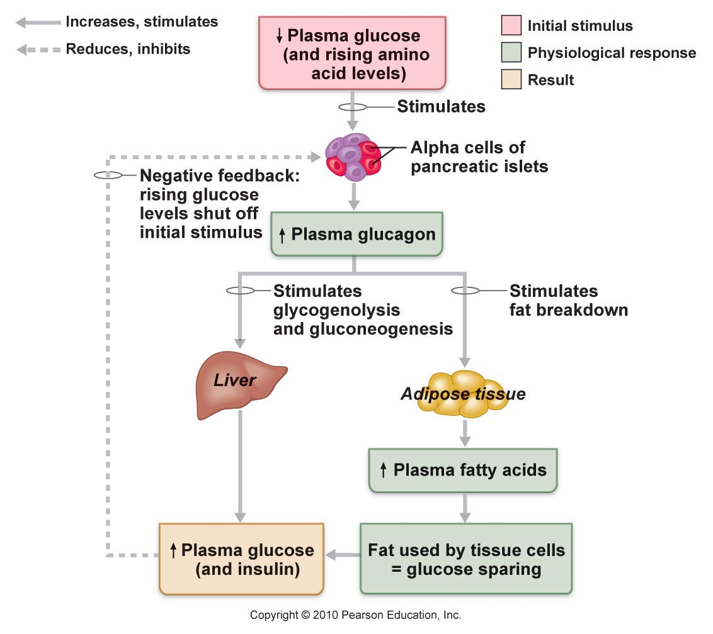
2.3 Define the postabsorptive state; describe the roles of glucagon and other supporting mechanisms in the maintenance of blood glucose
major target of glucagon is liver and adipose tissue.
Promotes:
(a) glycogenolysis
(b) glucose synthesis from lactic acid and via gluconeogenesis from glycerol and amino acids
(c) in adipose cells, stimulates lipolysis causing release of FFA & glycerol into blood
glucagon secretion inhibited when glucose levels rise
What happens when we eat a high protein/low carbohydrate meal??
Fig. 24.22

Slide 20
2.3 Define the postabsorptive state; describe the roles of glucagon and other supporting mechanisms in the maintenance of blood glucose
Sympathetic Nervous System:
also responds to sudden drop in blood glucose
other stimuli include bodily injury, anxiety, anger, other stressors associated with the “fight-or-flight response” : glucose levels rise, blood vessels constrict, heart beats faster, blood shunted to brain, heart, and skeletal muscle)
Sympathetic stimulation results in lipolysis & fat mobilization from adipose tissue and stimulates glycogenolysis (i.e. response is quite similar to glucagon)

Slide 21
2.3 Define the postabsorptive state; describe the roles of glucagon and other supporting mechanisms in the maintenance of blood glucose
Adrenal Gland:
responds to sympathetic stimulation as part of “fight or flight” response
adrenal medulla contains chromaffin cells which secrete epinephrine & norepinephrins - stimulate glycogenolysis, lipolysis & fat mobilization, gluconeogenesis
adrenal cortex secretes glucocorticoid cortisol - essential for life. Helps body adapt to external changes and intermittent food consumption by keeping blood glucose levels constant
» stimulates lipolysis & fat mobilization
» stimulates gluconeogenesis
» stimulates protein catabolism

Slide 22
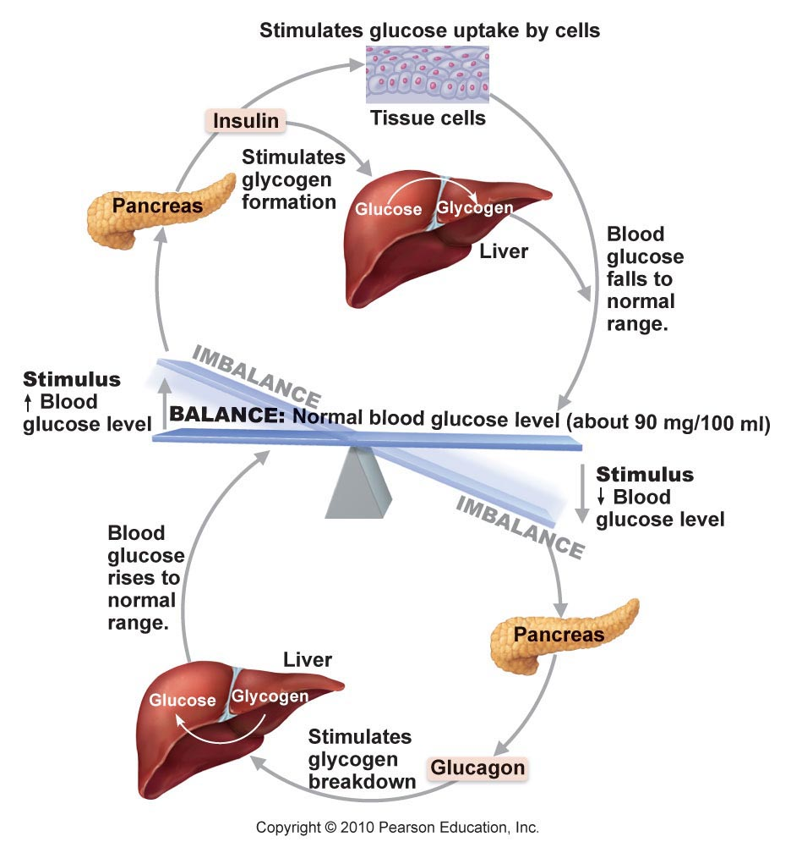
Fig. 16.18: Regulation of blood sugar by insulin & glucagon

Slide 23
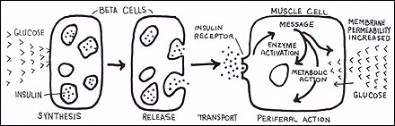

2.4 Describe the metabolic consequences of the
2 types of diabetes mellitus
Diabetes Mellitus:
• insulin activity deficient or absent; insulin has no “back-up” hormone
• blood glucose is high, but it is unable to get into most cell types - cells are unable to utilize glucose for energy production: “starving in the land of plenty”
www.diabetic.com/ children/cellgraphic.jpg
Frederick Banting and Charles Best: The discovery of insulin (The Nobel Prize in Physiology or Medicine 1923 awarded to Frederick Banting and John McLeod
http://www.utoronto.ca/bandb/insulin.htm

Slide 24
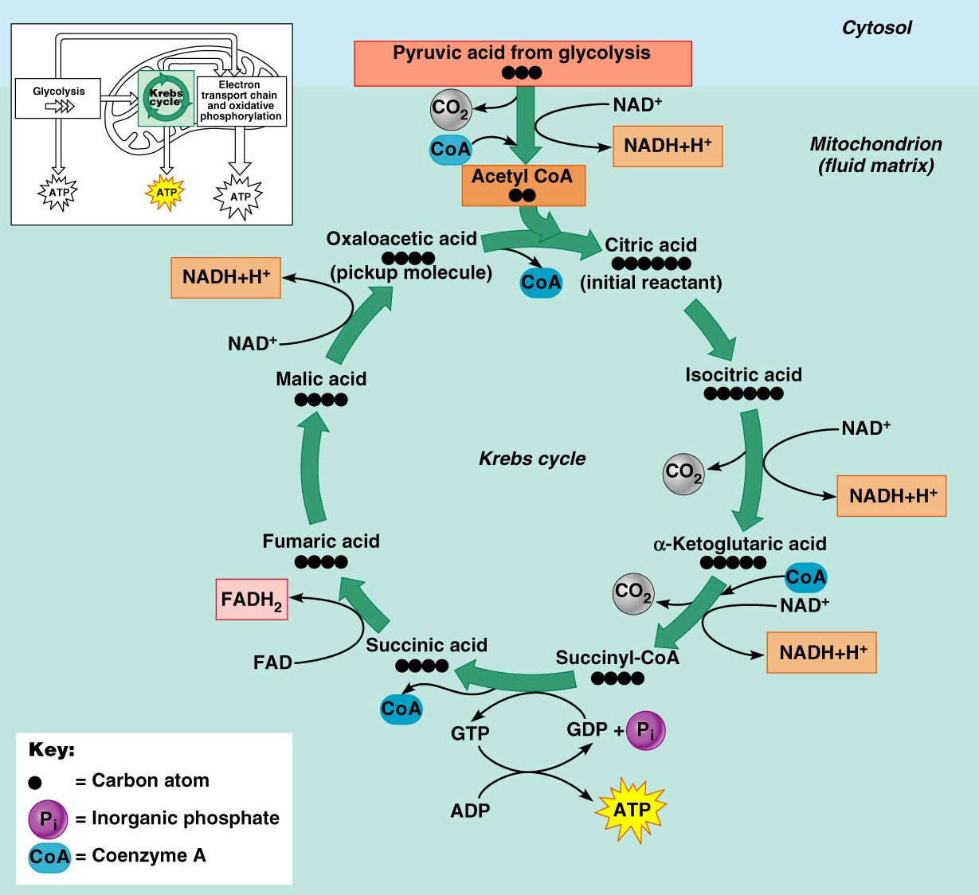
2.4 Describe the metabolic consequences of the
2 types of diabetes mellitus
In the absence of an insulin signal, glucose cannot enter cells.
The body responds by mobilizing fats. This can lead to build-up of ketone bodies in the blood; FFA cannot make glucose, and cannot enter the Krebs cycle when carbohydrate sources are low, due to loss of the acetyl-CoA “acceptor” molecule oxaloacetate.
The accumulation of ketone bodies leads to ketoacidosis (pH of blood is lowered). If this becomes too severe it can disrupt processes including heart activity and O2 transport, leading to coma and death.
Fig. 24.18
Fig. 24.7

Slide 25
2.4 Describe the metabolic consequences of the
2 types of diabetes mellitus
3 key signs of diabetes mellitus:
polyuria: excess glucose in urine leads to inhibition of water resorption by the kidney, resulting in decreased blood volume and dehydration. Also have severe electrolyte imbalance due to excretion of ketone bodies (negatively charged; carry positive ions such as Na and K from body)
(2) polydipsia: dehydration stimulates hypothalamic thirst centers
(3) polyphagia: excessive hunger: diabetic person is actually starving due to inability to use ingested carbs

Slide 26
2.4 Describe the metabolic consequences of the
2 types of diabetes mellitus
Two Main Types of Diabetes Mellitus:
Type 1 (Juvenile Diabetes, Insulin-Dependent Diabetes): Less common of the two forms; aproximately 1 million in America. Loss of β cells & therefore no insulin production whatsoever. May be due to an autoimmune reaction resulting in destruction of β cells (perhaps viral-induced through “molecular mimicry”). Must take exogenous insulin for survival – long term vascular (atherosclerosis, stroke, heart attack, gangrene) and neurological (loss of sensation, impaired bladder function, impotence) complications.

Slide 27
2.4 Describe the metabolic consequences of the
2 types of diabetes mellitus
Type 2 Diabetes (Non-insulin-Dependent; Adult-Onset Diabetes): More common form; approximately 12 million in the US. Reduction in insulin secretion &/or target cell sensitivity. Risk increases with age, lifestyle (typically T2 are overweight and sedentary), strong genetic component in many cases. Insulin often produced, but target cell response is insufficient: insulin resistance - receptor or post-receptor defects.
Ketoacidosis is typically not a major problem with type two diabetics, but they are at risk for most other complications associated with type I; heart disease, impaired circulation, etc.
Type 2 diabetes can often be managed by diet, weight loss and exercise…eventually may need exogenous insulin.

Slide 28

1. Hormones that act to decrease blood glucose levels include:
a) insulin
b) glucagon
c) epinephrine
d) growth hormone
2. During the postabsorptive state:
a) glycogenesis occurs in the liver
b) FFA are used for fuel
c) amino acids are converted to glucose
d) lipolysis occurs in adipose tissue
3. Chemicals that can be used for gluconeogenesis include:
a) amino acids
b) glycerol
c) FFA
d) alpha ketoglutaric acid (a Kreb’s cycle intermediate)

