Slide 1
Solvents in Process Chemistry (Overview)
A solvent is a substance which can be used to dissolve (partially or completely) one or more solutes; other than water, solvents in process chemistry are normally relatively volatile, low molecular weight organic compounds available as commodity chemicals
Solvents are chosen so as to be non-participating (unreactive) with the process reactants and reagents
Residual solvents in finished APIs are usually impurities (unless the API is intended to be solvated stoichiometrically) and need to be reduced to acceptable concentrations
Solvents are also used for work-up of reaction mixtures (e.g. in extractions of aqueous layers, crystallizations) and for cleaning processing equipment (reactors, dryers) between batches
Solvents are classified as processing aids, not reagents

Slide 2
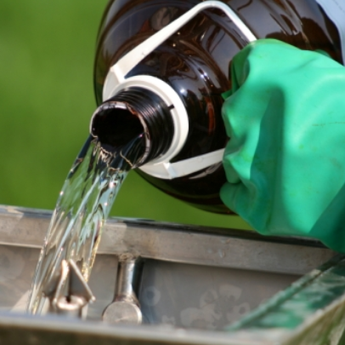
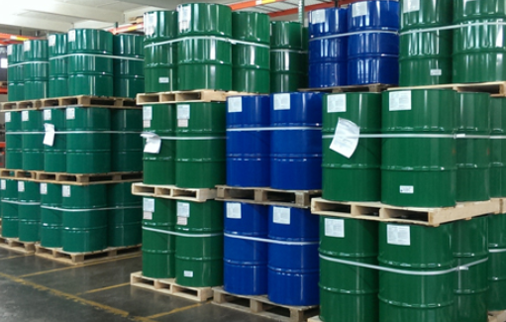
Solvent Selection
Major cost consideration
Solvents 85-90% of the mass in API development
About 50% of the solvents are recovered and recycled.
Safety
Minimize waste
Minimize escape into the environment. (air/water)
Categories
protic, or hydrogen bond-donating solvents (Lewis acids), such as H₂O, EtOH, AcOH, and NH₃
hydrogen bond-accepting solvents (Lewis bases), such as H₂O, Et₃N, EtOAc, acetone, and DMF
polar aprotic solvents, not hydroxylic, such as DMSO, DMF and DMAc
chlorocarbon solvents, such as dichloromethane, CHCl₃, and CCl₄
fluorocarbon solvents, such as hexafluoroisopropanol
hydrocarbon solvents, such as heptanes, iso-octane, and toluene
ionic liquids
supercritical fluids, such as supercritical CO₂
http://www.cleanway.com.au/Solvents
http://www.envirotechint.com/industrial-solvents/

Slide 3
Why does a solute dissolve in a solvent?

Slide 4







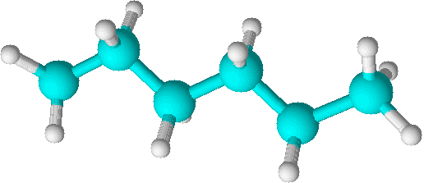

Solvation
ΔG° = ΔH° - TΔS°
change in entropy of the system or change in disorder
total or
free energy
change
change in enthalpy of the surroundings or change in enthalpy (bond energy) of the system
The solubility of diethyl ether in water is 69 g/L (20 °C) and it completely miscible in hexane, why?
Strong hydrogen bonding between water molecules requires energy to break the bonds.
For the solute to dissolve the solute must interact almost as strongly as the bonds that where broken. (ΔH°)
Like dissolves like.
Hydrophobic interactions similar in strength. Interchangeable
To dissolve, water must from a cage around the hydrophobic ethyl groups of ether (ΔS°)

Slide 5
If you have a negatively charged nucleophile how do change the solvent to make it more reactive?

Slide 6
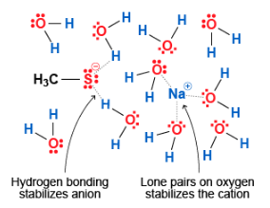
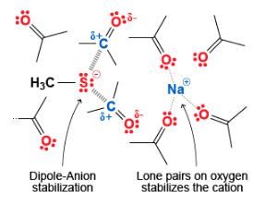
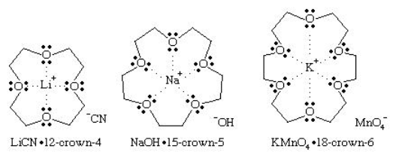
Solvation
https://www.britannica.com/science/ether-chemical-compound
Protic solvent
Aprotic solvent
Solvation by water called hydration.
Solvation number: number of solvent molecules surrounding an ion
Solvation number generally increases with increasing charge and decreasing ion size.
Increased solvation decreases reactivity of ion.
Aprotic solvents create “naked” anions making them more reactive. Crown ethers have the same affect.

Slide 7
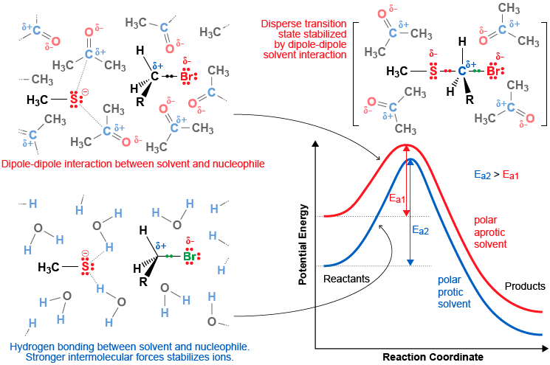
Change in Free Energy (Thermodynamics)
If you change the solvent from protic to aprotic the solvent will not effectively solvate the nucleophile and will have a higher potential energy than in a protic solvent.
The energy barrier between the reactants and products will also decrease.

Slide 8
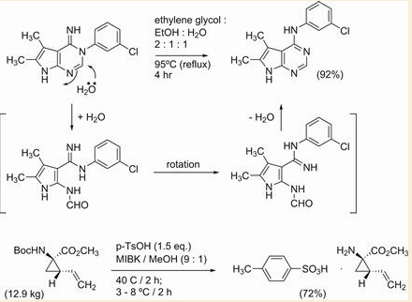
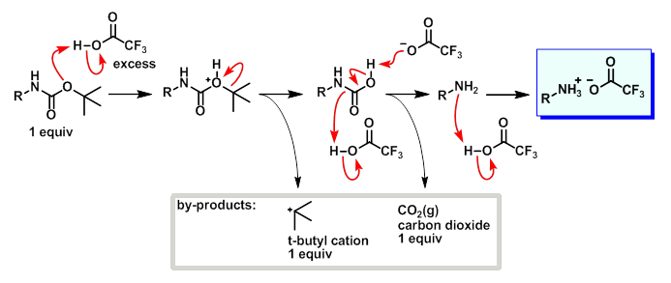
Solvent Selection
Best solvent maybe the one in which the product is not soluble so that it crystalizes out.
Mixed solvent
Upon Cooling product crystallized out.
Deprotection with TFA
NOTE: without p-TsOH precipitate out with entrapment of impurities or oil out.
http://www.commonorganicchemistry.com/Rxn_Pages/Boc_Protection/Boc_Protection_TFA_Mech.htm
p-TsOH was used instead of TFA because after deprotection a tosylate salt was formed with the product, that was then crystallized

Slide 9
What problems occur with heterogeneous reactions, especially with scaling up?

Slide 10
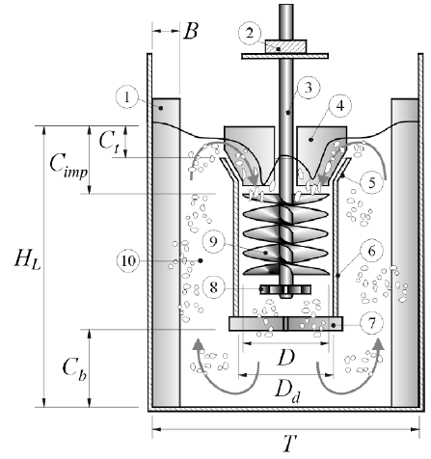
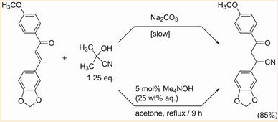
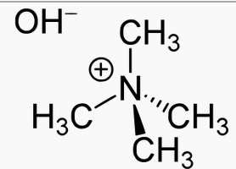
Solvent Selection
GAS–LIQUID–SOLID OPERATION OF
A VORTEX-INGESTING STIRRED
TANK REACTOR
Scale up can be difficult.
Homogenous reactions easier and faster than heterogeneous
Heterogeneous reactions needs be able to be mixed well with the solids and easily separated after the process.
K. CONWAY, A. KYLE and C. D. RIELLY
Department of Chemical Engineering, Loughborough University, Loughborough,UK
Example: scaling of solid Na₂CO₃ in the vortex reactor causing poor mixing. The process needed to be changed.
Phase transfer catalyst in a mixture of acetone/water
Batch reactor
Why must this reaction always be kept basic?
http://www.sciencedirect.com/science/article/pii/S0263876202722612

Slide 11
Heterogeneous reaction can be advantageous to facilitate a reaction or to minimize side products or degradation of products
What can you do to make the heterogeneous reaction more efficient?

Slide 12
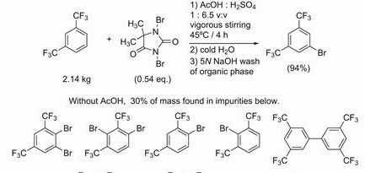
Solvent Selection
Heterogeneous reaction conditions are sometimes developed with the thought that the starting materials will dissolve as they react.
Solvents can be selected to provide partial solubility or better suspension of the reagents which allows for better mixing of reagents. PTC often used.
Dibromodimethylhydantoin (DBDMH) widely used as a disinfectant used for drinking water purification, recreational water treatment, as a bleaching agent in pulp and paper mills, and for treating industrial/commercial water cooling systems.
Suspension in
conc. H₂SO₄
DBDMH is a source of bromine, which is equivalent to hypobromous acid (HOBr).
  Br₂X + 2 H₂O → 2 HOBr + H₂X
(Where H₂X is 5,5-dimethylhydantoin)
With a pK_{a} of 8.6, hypobromous acid partially dissociates in water:
  HOBr ⇌ H⁺ + BrO⁻
Hypobromous acid serves as a source of "Br⁺," which produces bromide ions in the process of disinfection:
  HOBr + live pathogens → Br ⁻ + dead pathogens
  HOBr + HBr ⇌ Br₂ + H₂O
https://en.wikipedia.org/wiki/DBDMH
When a small volume of AcOH was added the reaction mixture was agitated more readily and the aryl bromide was produced in high yield?

Slide 13
How do counter ions affect solubility?
LiCl and LiI or both soluble in acetone but when you change Li⁺ to Na⁺ the solubility changes
What is more soluble in acetone NaI or NaCl

Slide 14

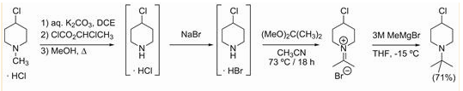
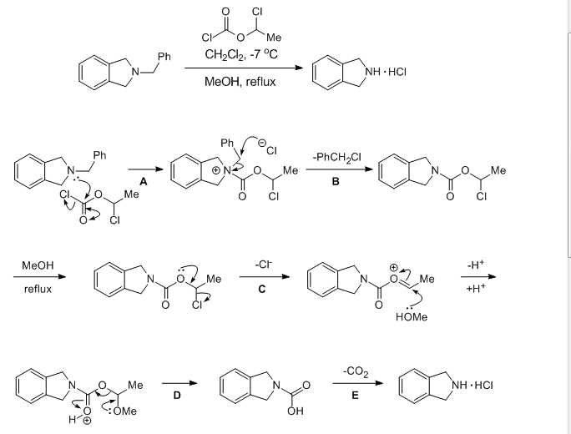
Solvent Selection
Solubility problems
4-chloro-piperidine HCl salt
Iminium ion
2,2-dimethoxypropane
Too insoluble in 2,2-dimethoxypropane for good conversion to the desired iminium salt.
Screen various salts and
Triflic acid salt worked but expensive
But only partially soluble, however allowed for purification by filtration and washing
1-chloroethyl carbonochloridate
Process was improved by performing the react in the presence of NaCl thus avoiding isolation of the HBr salt of 4-chloro-piperidine.
Yang, B. V.; O'Rourke, D.; Li, J. Synlett. 1993, 195

Slide 15
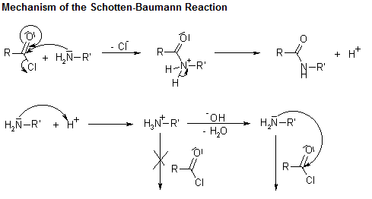
Solvent Selection
Schotten– Baumann conditions: large scale preparation of amides
Condensation reaction of an amine with an acid chloride or anhydride using aqueous alkali to neutralize the acid that is formed
If no organic co-solvent is used the amide product may precipitate and occlude starting materials so organic solvents are often used.
Water immiscible solvents can also be use to reduce the decomposition of the reagents and product. Dissolution of the product into the organic phase decreases hydrolysis of the amide with the base.
http://www.organic-chemistry.org/namedreactions/schotten-baumann-reaction.shtm
Without additional base the theoretical yield of the reaction of one equivalent each of an amine with an acid chloride is only 50%.

Slide 16
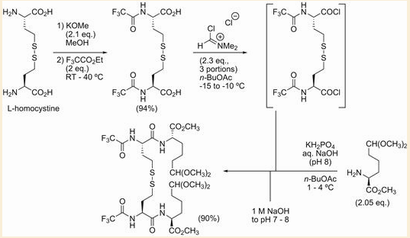
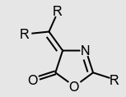
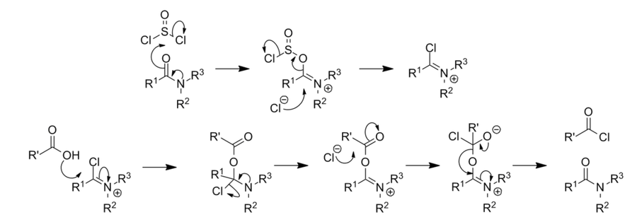
Solvent Selection
Tried n-BuOAc. The reagent was relatively insoluble.
Soluble in CH₂Cl₂. However the acid chloride formation was very exothermic in dichloromethane as temperatures above
− 10 °C led to racemization through azlactone formation
DMF was also unsuitable for acid chloride formation, as racemization was quite high.
Why else would you not use DMF with the Vilsmeier reagent
Schotten– Baumann conditions: large scale preparation of amides
Amine protection
Vilsmeier reagent
azlactone
Vilsmeier reagent
https://en.wikipedia.org/wiki/Thionyl_chloride

Slide 17

Solvent Selection
Schotten– Baumann conditions: large scale preparation of amides
So the kept with n-BuOAc
Above pH 8 during the Schotten– Baumann coupling more hydrolysis of the acid chlorides, azlactone formation, and racemization were seen, and below pH 7 the coupling was slowed as more of the amine was protonated.
For optimal performance the reaction was buffered to pH 8 and maintained at pH 7– 8 during the acid chloride addition by the simultaneous addition of 1 M NaOH. This coupling to make the vanlev intermediate was successfully carried out with inputs of over 100 kg of bis-trifluoroacetyl homocystine.
Vanlev being the trade name for Omapatrilat: novel antihypertensive agent, but was not approved do to angioedema effects (Rapid swelling of dermis and mucosa tissue)
azlactone
Schotten– Baumann
coupling

Slide 18
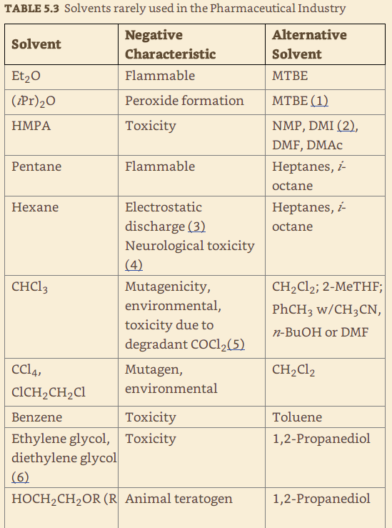
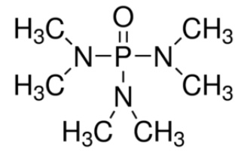
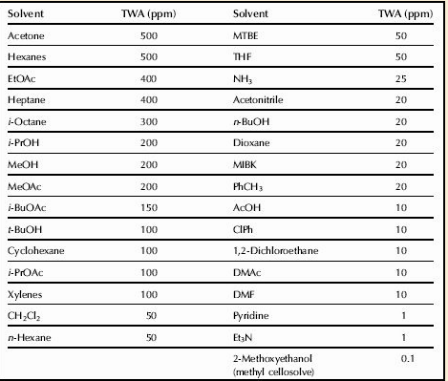
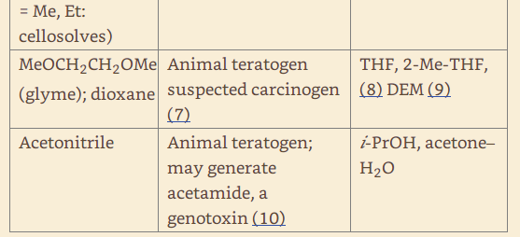
Any solvent can be used in academia or a research lab but not in industry.
Flashpoint, corrosiveness, toxicity, restriction of transport
Hexamethylphosphoramide
TWA: time-weighted averages of Threshold limit values
Notes:
Start here
If pregnant, you should not be working in the lab because there’s so much things the lab can interefere with the fetus.
CH2CL2 is a more common solvent that is not really toxic which is good
Peroxides should be treated with caution when used in larger volumes

Slide 19
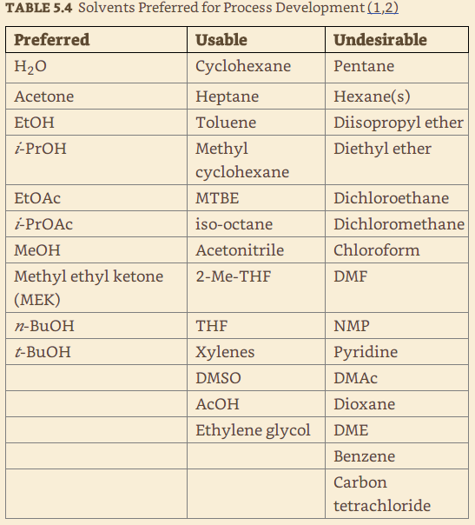
Dichloromethane
Dichloromethane solubilizes many organic compounds and is a great solvent
Least toxic of the simple chlorohydrocarbons, but is a suspected carcinogen.
It’s low boiling point of 42 ° C makes it easy to remove but makes it an inhalation hazard
Easy to escape into the environment
Environmental impact
Difficult to recovery and reuse
Substitutes: MIBK or EtOAc
Unfortunately there may be no adequate substitute for dichloromethane for some reactions.
Only choice develop another route
(Dimethyl formamide)
N-methyl pyrrolidinone
N,N-Dimethylacetamide
1,2-Dimethoxyethane
Notes:
Less toxic so easier to remove
Since low boiling point, easy to recover and reuse
Different solvent and hold on to that

Slide 20
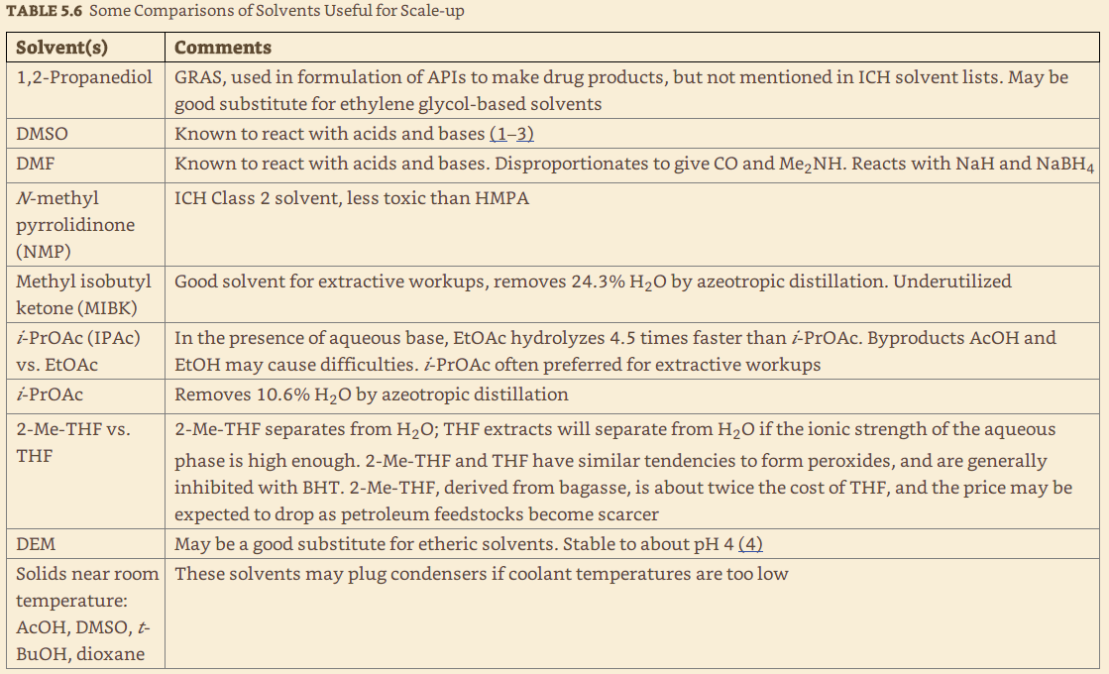
GRAS: generally recognized as safe
DEM: 1,2-Diethoxymethane
(Bagasse: fiber remaining after the extraction of the sugar-bearing juice from sugarcane. )
Notes:
Solids near room temperature are not good.

Slide 21
What concentration of solvent is permissible in the API?

Slide 22
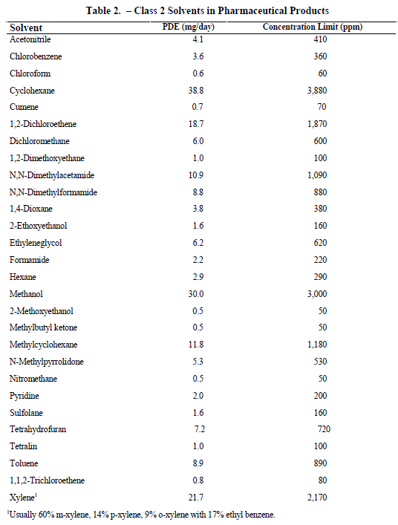

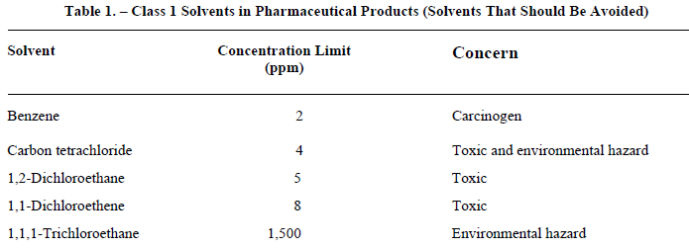
Solvent Selection
Toxicity
Class 1 solvents: Solvents to be avoided Known human carcinogens, strongly suspected human carcinogens, and environmental hazards.
Class 2 solvents: Solvents to be limited Non-genotoxic animal carcinogens or possible causative agents of other irreversible toxicity such as neurotoxicity or teratogenicity. Solvents suspected of other significant but reversible toxicities.
Class 3 solvents: Solvents with low toxic potential. Solvents with low toxic potential to man; no health-based exposure limit is needed. Class 3 solvents have PDEs of 50 mg or more per day. (PDE: permitted daily exposure)
http://www.ich.org/products/guidelines/quality/quality-single/article/impurities-guideline-for-residual-solvents.html IMPURITIES: GUIDELINE FOR RESIDUAL SOLVENTS Q3C(R5)
Notes:
Gives you guidelines about 3 classes of solvents. Real bad ones (Carcinogenic-these are benzene cholrinated solvents). Instead of using benzene, you can use toluene
Class 2: not so bad (better than class 1):
Can do some calculation here

Slide 23
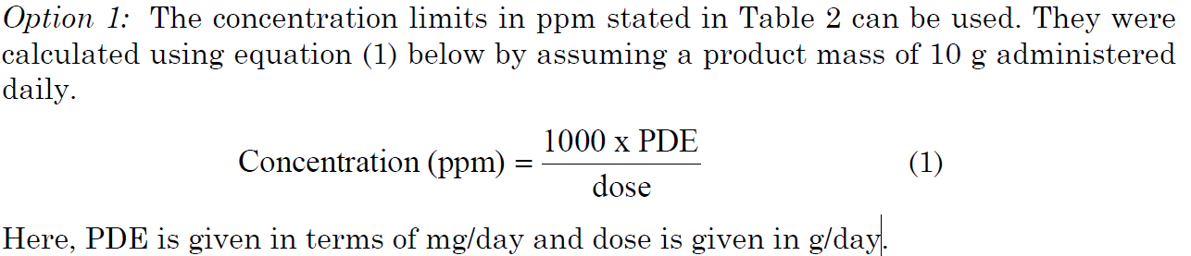
Two options for setting limits for Class 2 solvents in API
PDE: permitted daily exposure
These limits are considered acceptable for all substances, excipients, or products.
Excipient: an inactive substance that serves as the vehicle or medium for a drug or other active substance.
Therefore this option may be applied if the daily dose is not known or fixed.
If all excipients and drug substances in a formulation meet the limits given in Option 1, then these components may be used in any proportion. No further calculation is necessary provided the daily dose does not exceed 10 g. Products that are administered in doses greater than 10 g per day should be considered under Option 2.
http://www.ich.org/products/guidelines/quality/quality-single/article/impurities-guideline-for-residual-solvents.html IMPURITIES: GUIDELINE FOR RESIDUAL SOLVENTS Q3C(R5)
Notes:
Don’t know the dose. Asusume 10g/day. PDE: mg/ day
This is the concentration that is allowed for the uptake before it had effects.
Everything that you’re putting into the tablet because there may be traced items.
If everything you’re putting adds up to be less than the concentration in ppm, then it’s okay.

Slide 24
Option 2: It is not considered necessary for each component of the drug product to comply with the limits given in Option 1.
The PDE in terms of mg/day as stated in Table 2 can be used with the known maximum daily dose and equation (1) above to determine the concentration of residual solvent allowed in drug product. Such limits are considered acceptable provided that it has been demonstrated that the residual solvent has been reduced to the practical minimum. The limits should be realistic in relation to analytical precision, manufacturing capability, reasonable variation in the manufacturing process, and the limits should reflect contemporary manufacturing standards.
Option 2 may be applied by adding the amounts of a residual solvent present in each of the components of the drug product. The sum of the amounts of solvent per day should be less than that given by the PDE.
http://www.ich.org/products/guidelines/quality/quality-single/article/impurities-guideline-for-residual-solvents.html IMPURITIES: GUIDELINE FOR RESIDUAL SOLVENTS Q3C(R5)
Notes:
What if the concentration exceeds?
Another option
Option 2 may be applied if you know these things

Slide 25


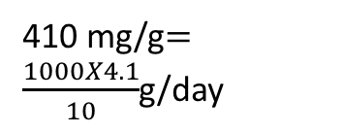
Consider an example of the use of Option 1 and Option 2 applied to acetonitrile in a drug product. The permitted daily exposure to acetonitrile is 4.1 mg per day; thus, the Option 1 limit is 410 ppm. The maximum administered daily mass of a drug product is 5.0 g, and the drug product contains two excipients. The composition of the drug product and the calculated maximum content of residual acetonitrile are given in the following table.
Component Amount in formulation Acetonitrile content Daily exposure
Drug substance 0.3 g (pretty big dose) 800 ppm 0.24 mg
Excipient 1 0.9 g 400 ppm 0.36 mg
Excipient 2 3.8 g 800 ppm 3.04 mg
Drug Product 5.0 g 728 ppm 3.64 mg
10.0 g 7.28/2=3.64 mg/day
Excipient 1 meets the Option 1 limit, but the drug substance, Drug substance, excipient 2, and drug product do not meet the Option 1 limit.
Nevertheless, the product meets the Option 2 limit of 4.1 mg per day and thus conforms to the recommendations in this guideline.
410 mg/g$=\frac{1000X4.1}{10}$g/day
http://www.ich.org/products/guidelines/quality/quality-single/article/impurities-guideline-for-residual-solvents.html IMPURITIES: GUIDELINE FOR RESIDUAL SOLVENTS Q3C(R5)
Notes:
410mg/g is the concentration limit
Get 5.0g/day. HAVE 10 g of the tablet. In each one of these tablets, we have these acetonitrile contents and the daily dosage
Excipient 1 meets the less than 410ppm per day and the others don’t. If we add up the daily exposure and divide by 2, which is below 4.1mg/d. If all these were under 400, then you can use any one without any problems. But since the concentration limit is exceeded, you can
Divide by 2 because the amount in formulation is 10.0g but the maximum administered daily mass of the drug product is 5.0g.

Slide 26
Consider another example using acetonitrile as residual solvent. The maximum administered daily mass of a drug product is 5.0 g, and the drug product contains two excipients. The composition of the drug product and the calculated maximum content of residual acetonitrile are given in the following table.
Component Amount in formulation Acetonitrile content Daily exposure
Drug substance 0.3 g 800 ppm 0.24 mg
Excipient 1 0.9 g 2000 ppm 1.80 mg
Excipient 2 3.8 g 800 ppm 3.04 mg
Drug Product 5.0 g 1016 ppm 5.08 mg
10.0 g 10.06/2=5.08 mg/day
In this example, the product meets neither the Option 1 nor the Option 2 limit according to this summation. The manufacturer could test the drug product to determine if the formulation process reduced the level of acetonitrile.
If the level of acetonitrile was not reduced during formulation to the allowed limit, then the
manufacturer of the drug product should take other steps to reduce the amount of acetonitrile in the drug product.
If all of these steps fail to reduce the level of residual solvent, in exceptional cases the manufacturer could provide a summary of efforts made to reduce the solvent level to meet the guideline value, and provide a risk-benefit analysis to support allowing the product to be utilised with residual solvent at a higher level.
http://www.ich.org/products/guidelines/quality/quality-single/article/impurities-guideline-for-residual-solvents.html IMPURITIES: GUIDELINE FOR RESIDUAL SOLVENTS Q3C(R5)
Notes:
This is in a 10.0g sample. The acetonitrile content is all greater than 410 ppm and the daily exposure sum is greater than 4.1mg/d. If you make this, you would not be able to sell this.

Slide 27
How important is solvent costs in the initial development and production?
Notes:
As soon as you go ino the industry, the cost will be huge

Slide 28
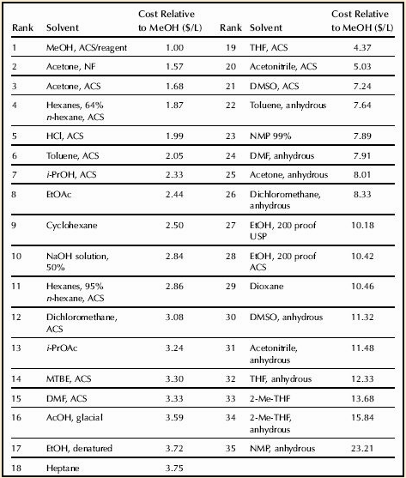
Solvent Selection
Cost
Initial development of cost of new chemical entities (NCIs) solvents is disregarded because of small volumes and the cost of labor is proportionately much higher.
Large-scale manufacturing cost of solvent more critical
Some solvents are ranked by their bulk cost are given in the table relative to the cost of MeOH ($/ L).
Factors influencing the cost are the grades and water contents of the solvents.
Notes:
Methanol is one of the cheapest solvents

Slide 29
How can you change the boiling point of a solvent besides changing the pressure?
One of the best ways to remove water from a solvent in industry is to?
Notes:
Add another solvent. aNother way to remove the water

Slide 30
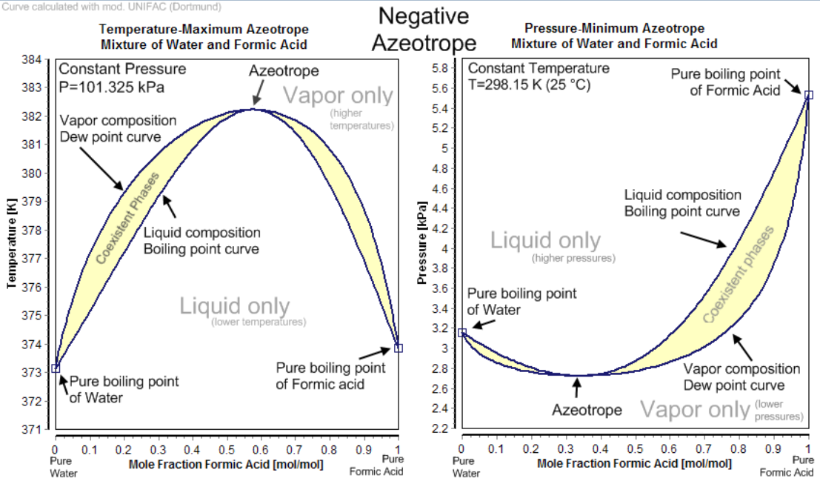
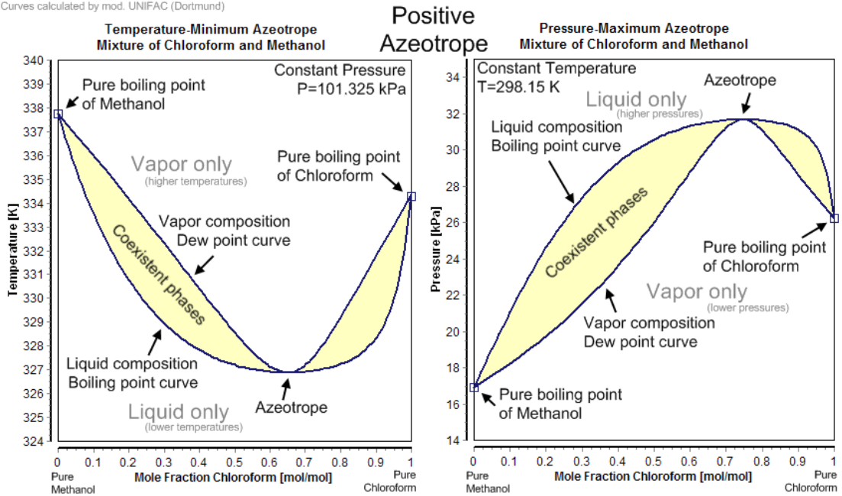
Solvent Selection
Using Azeotropes to Select Solvents
https://en.wikipedia.org/wiki/Azeotrope
Minimum-boiling azeotropes most important phenomena to process chemists.
A solution that shows greater positive deviation from Raoult's law forms a minimum boiling azeotrope at a specific composition.
Negative azeotrope: HCl at a concentration of 20.2% and 79.8% water (by weight).
Hydrogen chloride boils at −84 °C and water at 100 °C, but the azeotrope boils at 110 °C, which is higher than either of its constituents.
Efficiently remove volatile components of reaction mixtures.
Solvents mixtures allows the process chemist to lower the boiling point of a solvent.
Azeotropic removal of volatile components can drive reactions.
Notes:
It doesn’t change. As heating up the liquid, the vapour composition is this and it comes back down and as we let the vapour escape, the mole concentration will eventually reach the azeotrope (highest or lowest bp) and this azeotrope value cannot change.
Noramlly, You try to lower the bp when mixing because you weaken the intermolecular forces. The mole fraction will change until it reaches azeotrope where it will act as a pure compound.

Slide 31
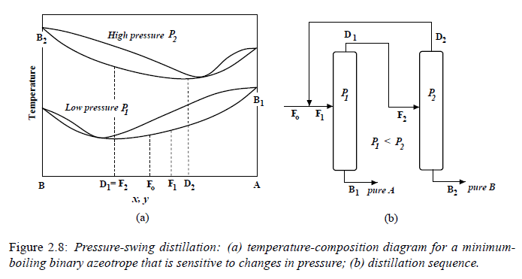
A not B1
Separation of Azeotropic Mixtures:
Tools for Analysis and Studies
on Batch Distillation Operation
Eva-Katrine Hilmen
A Thesis Submitted for the Degree of Dr. Ing.
Norwegian University of Science and Technology
Department of Chemical Engineering
November 2000
B₂ > B₁
B₁ > B₂
Increase in pressure
“A binary homoazeotropic mixture is introduced as feed F_{o} to the low-pressure column. The bottom product from this P1 column is relatively pure A, whereas the overhead is an azeotrope with xD1 . This azeotrope is fed to the high-pressure column, which produces relatively pure B2 in the bottom and an azeotrope with composition xD2 in the overhead. This azeotrope is recycled into the feed of the low-pressure column. The smaller the change in azeotropic composition with pressure, the larger is the recycle in Figure 2.8b. According to Smith (1995), a change in azeotropic composition of at least 5 percent with a change in pressure is usually required. Examples of industrial mixtures that can be separated by pressure-swing distillation are given by Schweitzer (1979). For example, the tetrahydrofuran-water azeotrope may be separated by using two columns operated at P1 = 1 atm and P2 = 8 atm.”

Slide 32
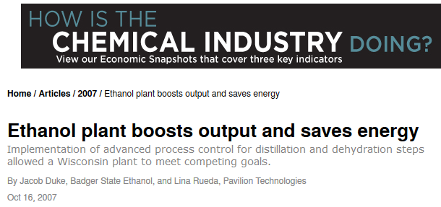
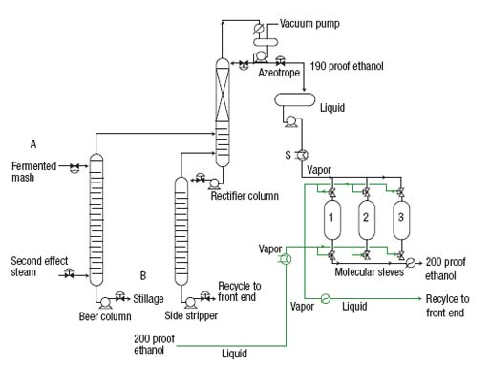
10% to 14% alcohol, water and all non-fermentable solids from the corn and yeast cells
Type 3A zeolite beads, which require regeneration.
Notes:
In industry, chemical engineers deal with this all the time.

Slide 33
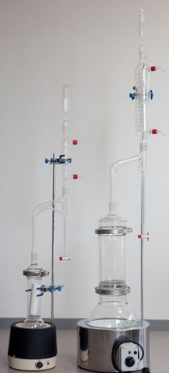
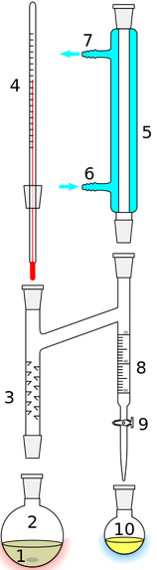
Dean-Stark apparatus
Toluene water azeotrope
97.8% toluene 110.8ºC
Toluene
H₂O
https://en.wikipedia.org/wiki/Dean-Stark_apparatus
http://www.vinci-technologies.com/products-explo.aspx?IDM=536746&IDR=82292&IDR2=82545
Notes:
Dean-stark apparatus: when doing dehydration, 2 will boil and the vapour will come back down to form h2o and as h2o builds up, toluene will fall back down into 2 to be reused.

Slide 34
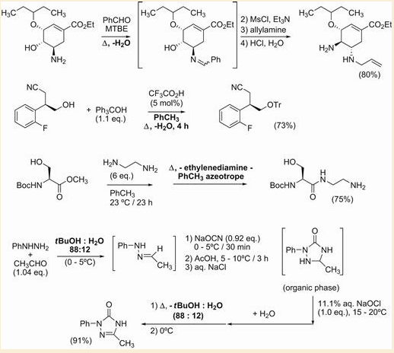
Azeotropic removal of volatile components can drive reactions or may facilitate separations and workups.
Azeotropic removal of water formed an imine key to a to amino sequence that led to an oseltamivir
Azeotropic removal of water led to the protection of an alcohol as the trityl ether
transesterification
Excess to drive reaction
Excess ethylenediamine was removed by azeotropic distillation with toluene in the hydrazinolysis and isolation S-serine methyl ester.
An azeotrope may also be an economical solvent if the solvent can be recovered and reused
recycle
Add water
Notes:
Why is removal of water the key? This is a dehydration reaction. –H2o with heat using dean-stark then the reaction. Et3N will act asa nucleophile and attack N-Ph in SN2 reaction.
Why was water removed? Because it’s a dehydration reaction.

Slide 35
Choosing Solvents to Increase Reaction Rates
The Rate of a reaction will change depending on the solvent you are using
Solvents and S_{N}2 Reactions
If you change the solvent from protic to aprotic the solvent will not effectively solvate the nucleophile and will have a higher potential energy than in a protic solvent.
The energy barrier between the reactants and products will also decrease.
Notes:
Sn2 reaction going from polar solvent to polar aprotic. The activation energy decreases and goes faster.

Slide 36
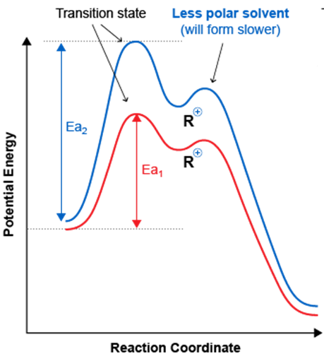
Solvents and S_{N}1 Reactions
100% H₂O
Relative Rate
400,000
1
more polar solvent
(CH₃)₃CBr (CH₃)₃OH + HBr
less polar solvent
90% acetone
10% H₂O
(CH₃)₃CBr (CH₃)₃OH + HBr
Notice the rate of reaction for the more polar solvent is greater (Kinetic) and goes through the more stable intermediate (Thermodynamics)
Remember kinetics vs thermodynamics: for most reactions we can say the rate of the formation of the most stable product or intermediate will be faster than the formation of the less stable product or intermediate because the most stable product or intermediate follows a pathway that has a more stable, lower energy transition state and will have a smaller energy barrier or free energy of activation
Notes:
The rate of rxn is dependent on the activation energy

Slide 37
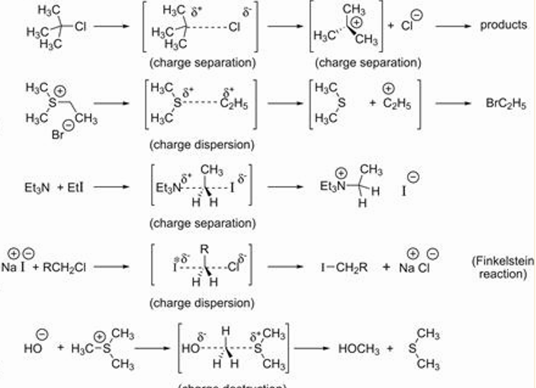
Choosing Solvents to Increase Reaction Rates
Effect on reaction rate by increasing the solvent polarity
Polar solvents preferentially solvate ions or intermediates with the greatest concentration of charge.
Concentration of charge increase with decreasing size and increasing charge
If the concentration of charge is greater in the transition state than in the starting materials, a polar solvent stabilizes the transition state and encourages its formation, thus increasing the reaction rate.
1
2
3
Cl⁻ is a better nucleophile than I⁻ how do you shift the equilibrium to products
4
Ppt in acetone
5
Polar solvent stabilizes reagents
Notes:
Effect on reaction rate by increasing the solvent polarity: Just think about the activation energy. Anything that helps to stabilize the transition state will lower the activation energy, so it increases the rate of reaction. (sn1:increase)
Going from polar to less polar, decrease the rate of reaction (sn1: small decrease)
Increase (SN2: increase)
Non polar → charge dispersed. You can stabilize the rate of reaction. This is insoluble so make sure that this is insoluble. Kinetically, the reaction is favoured to the right side, but overtime, this would react faster since CL- is a stronger base. (SN2=Small decrease). Cl- is more soluble than I-.
Sn2: large decrease. Going from polar to less polar. Ionic to polar.
Changing reagents, can really change the rate of reactions

Slide 38
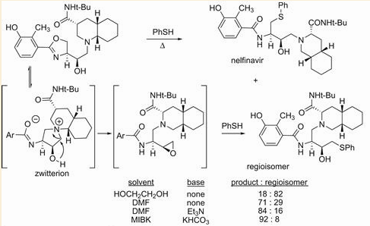
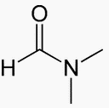

Solvents can influence the product formed
By changing to less-polar solvents and incorporating a base to remove acid that is produced the amount of the desired regioisomer increased markedly.
DMF
MIBK
Polar solvents would stabilize the zwitterions

Slide 39
Impurities in Solvents and Reactions of Solvents
Water may be the solvent impurity causing the most unforeseen difficulties (violent reactions)
Removal of water: molecular sieves may be the most universally useful
Anhydrous solvents are more expensive and easily handle in the lab but industrial process hard to keep dry because of the moisture in atmosphere and moisture content of the equipment
For scale-up solvents and equipment are generally azeotroped dry,
Use excess reagents to consume any H₂O present. Cost
Develop reactions that can tolerate some H₂O but is not always feasible.
Peroxides: can form in many solvents commonly used in the laboratory and on scale, through the exposure to air and light which can generate hydroperoxides and peroxides.
Problems can arise with the formation of some peroxides, that crystallize near the bottle cap of the solvent, or during the concentration of a solvent which enriches the concentration of peroxides.
Why are peroxides a problem?

Slide 40
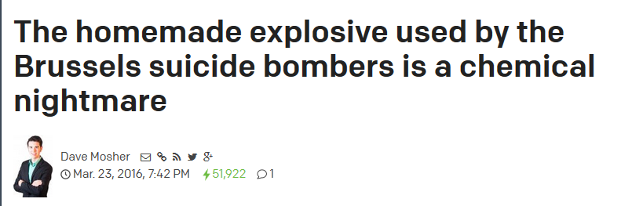
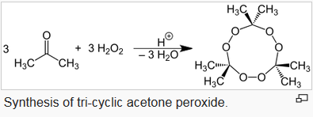
TATP is easy to make and hard to detect, but it is also incredibly unstable. In fact, all it takes is a firm tap to explode TATP with a force that's about 80% as strong as that of TNT. (That is why it has gained a reputation as "the Mother of Satan" among terrorists who make it
http://www.techinsider.io/brussels-attack-tatp-chemical-bombs-2016-3
Acetone peroxide
(TATP)
https://en.wikipedia.org/wiki/Acetone_peroxide

Slide 41

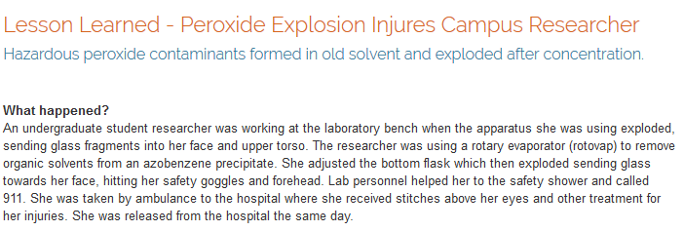
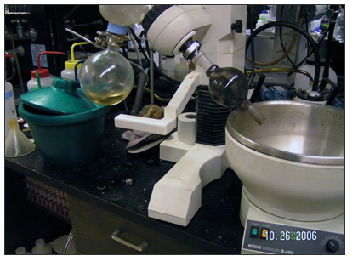
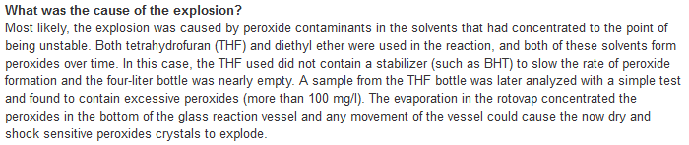
http://ehs.berkeley.edu/lessons-learned/lesson-learned-peroxide-explosion-injures-campus-researcher

Slide 42
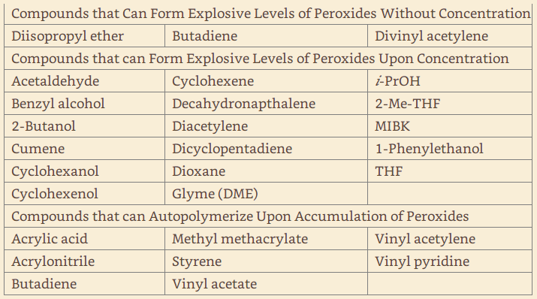
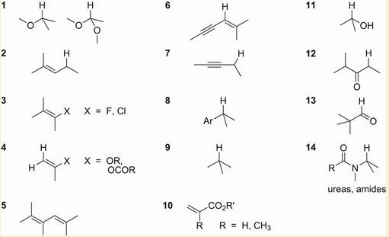
In general compounds with hydrogen atoms that are abstracted in radical reactions are prone to form peroxides
Frequently check solvents for peroxides. A simple approach is to moisten a peroxide test strip with water and add a drop of solvent. Iodometric titration is a quantitative approach
General structures of functional groups likely to form peroxides, with greatest propensity to form peroxides for those with lowest numbers.( Kelly, R. J. Chem. Health Saf. 1996, September/ October, 28.)

Slide 43
Antioxidants are used in many product from oils, lubricants to the food industry to stop the formation of peroxides
What do antioxidants do?

Slide 44
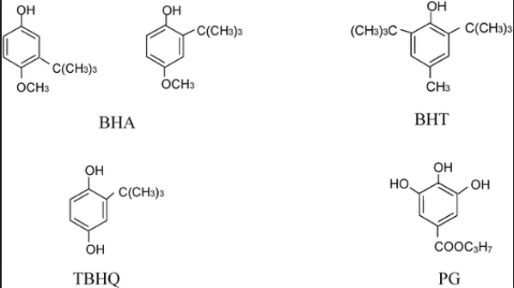

Antioxidants are used in many product from oils, lubricants to the food industry
Form stable phenoxy resonance stabilized radicals. Slow free radical chain reactions and stops radical production by participating in termination reactions.
tri-tert-butylphenol (BHT) is a very important antioxidant additive used in plastics, elastomers, petroleum products, and food preservatives.
The use of BHT as a food preservative is a potential health risk.
BHT (about 250 ppm) is often added to commercial shipments of THF and 2-Me-THF as a SAFETY precaution. On scale BHT may be added to condensates of THF and 2-Me-THF for SAFETY. Removing solvent from a reaction using BHT-stabilized THF and 2-Me-THF will afford a concentrate rich in BHT, which may interfere with HPLC and other analyses. A yellow dimer has been identified from oxidation of BHT

Slide 45



Risks due to static discharge is always a concern, especially in low humidity environments.
http://www.csb.gov/csb-finds-static-spark-set-off-fire-and-explosions-at-barton-solvents-des-moines-facility-investigation-finds-equipment-not-intended-for-flammable-service-or-properly-bonded-and-grounded/
Non-metallic additives, such as Statsafe ®, have been developed to reduce the conductivity of solvents and minimize the risk of static discharge
These additives, proprietary mixtures of polymers and amines, may be considered as impurities in an API if solvents with these additives were used to prepare the API.
The risk of static discharge may also be reduced by adding small amounts of a polar solvent, such as i-PrOH.

Slide 46

Dichloromethane a very common laboratory solvent far more reactive than you expect.
Source of impurities.
Possible side reactions

Slide 47

Common and not-so-common reactions with solvents

Slide 48
Does Water as a Solvent Enable “Greener” Process Chemistry?
Some Advantages | Some Disadvantages
Non-flammable | Weak solubilizing power for most organic compounds
Relatively High Molar Heat Capacity | Some limitations for low temperature chemistry (reaction freezing)
Relatively Low cost | Can be reactive (hydrolysis) when present as an impurity in water sensitive reagents and solvents
Non-toxic to humans | Water can be difficult to remove from products when low levels are required; may form undesirable hydrates
Easily available in large volumes | Pre treatment and testing for control of microorganisms (energy use, cost)
Environmentally benign | Treatment of aqueous process streams usually required before discharging used water to the environment – energy usage, material and other costs

Slide 49


How would a polar protic solvent affect these reactions?
Claisen Rearrangement
Diels Alder

Slide 50


Water as Solvent: “Green solvent”
The rate of reaction can be accelerated, by increasing the reactivity of the starting material, stabilizing the transitions state or stabilizing the formation of the products
Claisen rearrangement
Diels-Alder
This functional group has roles in coordination chemistry as a ligand, in medicinal chemistry as a metabolically stable surrogate for a carboxylic acid group
[1-3] dipolar cycloaddition
J. Org. Chem. 2001, 66, 7945-7950
Organic solvent free

Slide 51


Addition of
surfactants;
A Lewis acid-surfactant-combined catalyst (LASC) has been developed and applied to Lewis acid catalyzed organic reactions in water.
Aldol reaction: Under these conditions the TMS group is protected from hydrolysis
After running products are extracted into an organic solvent, and the aqueous phase containing the surfactant can be reused for a subsequent reaction.
The PTS surfactant has been generally recognized as safe (GRAS), (used as a beverage additive), there is no need to treat residual amounts of this PTS reagent in APIs as especially toxic.
Substituent effects and the mechanism of alkene metathesis catalyzed by ruthenium dichloride catalysts
Athanassios C. Tsipis,a A. Guy Orpena and Jeremy N. Harvey*a
Dalton Trans., 2005, 2849-2858

Slide 52

https://www.epa.gov/greenchemistry/presidential-green-chemistry-challenge-2011-academic-award

Slide 53

Solvent Selection
Solvent Substitutions
“green” solvents

Slide 54


Ionic liquids
“Green solvents”
High boiling points greatly reduces evaporative loss
Results from toxicology studies have raised questions regarding the “greenness” of these compounds as solvents.
Could be used several steps away from the final step to prepare an API.
http://www.sigmaaldrich.com/technical-documents/articles/chemfiles/ionic-liquids1.html

Slide 55
What is a supercritical fluid?

Slide 56





Supercritical CO₂ (scCO₂) Can be used as solvent
Has solubility similar to hexane
Here we can see the separate phases of carbon dioxide. The meniscus is easily observed.
Phase Diagram of CO₂
With an increase in temperature the meniscus begins to diminish.
Increasing the temperature further causes the gas and liquid densities to become more similar. The meniscus is less easily observed but still evident
Once the critical temperature and pressure have been reached the two distinct phases of liquid and gas are no longer visible. The meniscus can no longer be seen. One homogenous phase called the "supercritical fluid" phase occurs which shows properties of both liquids and gases.
Good for extraction of products, reagents or contaminants.
The primary drawback of using scCO₂ appears to be the expense of equipment and energy costs to control the condensation and release of the CO₂.
Taken from: http://www.chem.leeds.ac.uk/
People/CMR/criticalpics.html

Slide 57
Solvent-Free Processes
In solvent-free (neat) processes a small excess of a liquid reagent may function as a solvent, and the products are often non-crystalline
Since solvents were not added in any significant amount to increase the mass of the reaction, quenching such reactions may readily produce high temperatures.
Solid – gas phase reactions (e.g. solid drug substance reacting with HCl gas under dry mixing) have been used, for example, to successfully form pharmaceutical salts without the need for solvents

Slide 58



