Slide 1
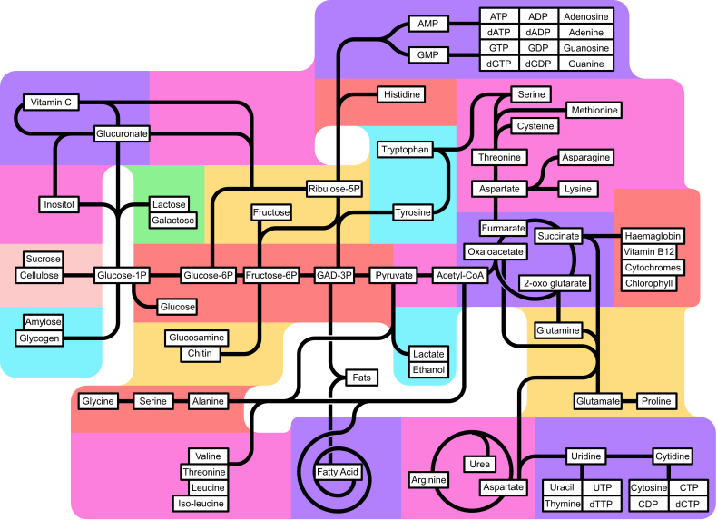
Chapter 24: Regulation of Metabolism & Body Temperature

Slide 2
Bile Salt recycling occurs in the ileum
The stomach`s contracting rhythm is set by pacemaker cells found in the spinal cord
Enteropeptidase is a brush boder enzyme
The first teeth to appear are the deciduous teeth
The main digestive activity of the stomach is to begin the digestion of protein
Another term for swallowing is deglutition
Fats significantly delay the emptying of the stomach
There is a salivary amylase and a pancreatic amylase
The myenteric nerve plexus controls GI motility
Saliva secretion can be increased by chewing a rubber band
Pepsingen is secreted by parietal cells
Dentin anchors the tooth in place
Most nutrients are absorbed through the mucosa of the intestinal villin by active transport

Slide 3

Regulation of Metabolism & Body Temperature
2.1 Review the metabolic pathways and their interactions
2.2 Define the absorptive state and justify the key role of insulin in its metabolic regulation
2.3 Define the postabsorptive state; describe the roles of glucagon & other supporting mechanisms in the maintenance of blood glucose levels
2.4 Describe the metabolic consequences of the two types of diabetes mellitus
2.5 List the various hepatic functions associated with metabolism
2.6 List and describe the 4 major types of lipoproteins
2.7 Describe the synthesis of thyroid hormones and its regulation
2.8 List the metabolic processes regulated by thyroid hormones
2.9 Define basal metabolism and total metabolism and identify the factors that influence them
2.10 Discuss the mechanisms of appetite regulation
2.11 Describe and explain the mechanisms of heat exchange
2.12 Explain the mechanisms for the control of body temperature

Slide 4
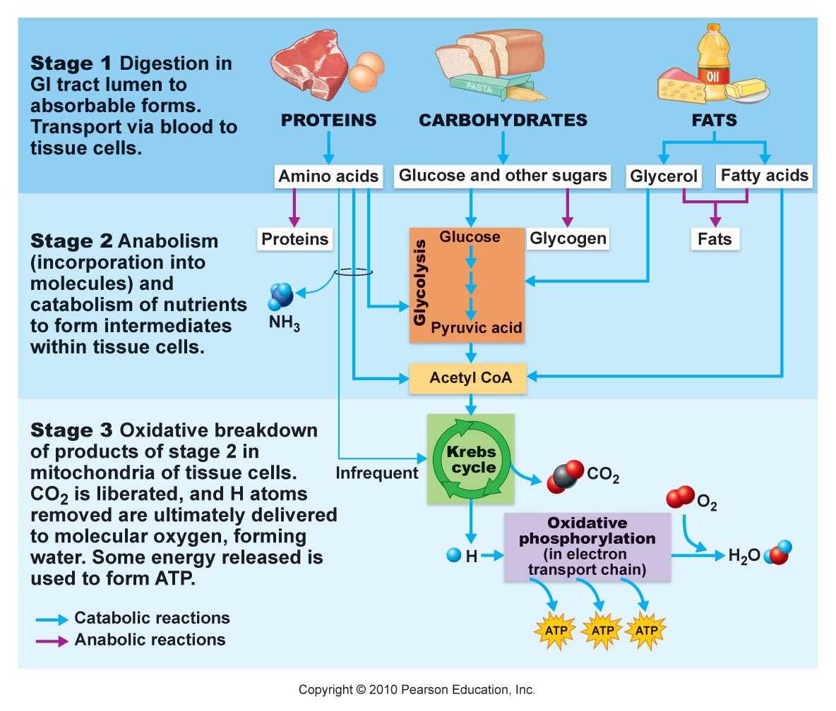
2.1 Review the metabolic pathways and their interactions
Metabolism – anabolism and catabolism.
Used to: (i) construct
bodies molecules or: (ii) generate energy mostly in the form of ATP through cellular respiration (stages 2 and 3).
Three steps in processing energy-containing nutrients:
Fig. 24.3

Slide 5
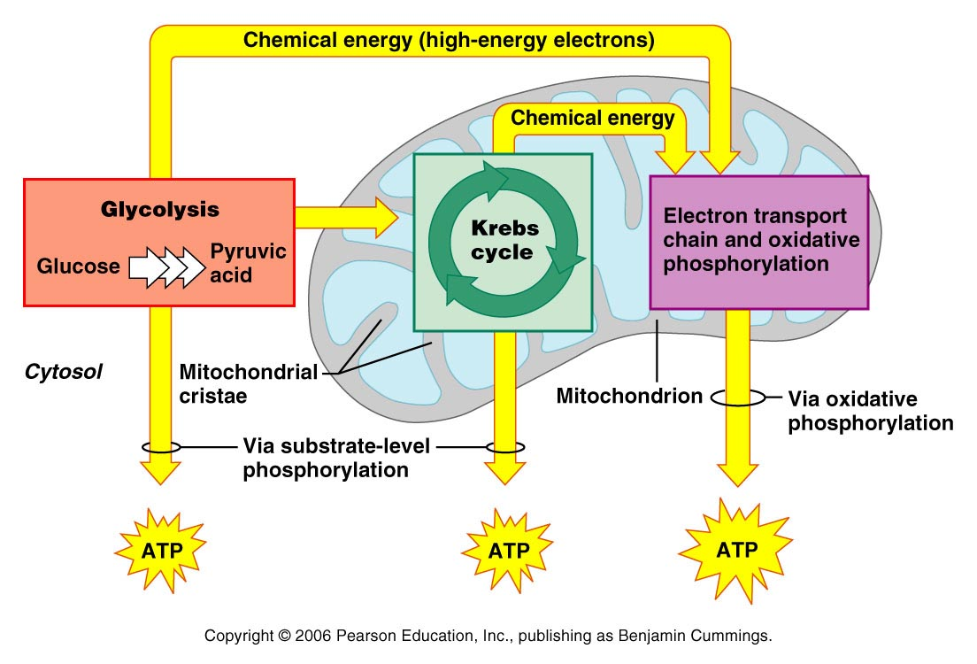
Review the metabolic pathways and their interactions
Carbohydrates:
Metabolized first via glycolysis; produces some energy via substrate-level phosphorylation
Typically followed by the Kreb’s cycle; produces some ATP via substrate-level phosphorylation. However, most ATP is produced via high energy electons used in the electron transport chain via oxidative phosphorylation: Complete oxidation of one molecule of glucose produces 32 molecules of ATP, heat, + 6H2O + 6 CO2.
note that amino acids and glycerol (from fats) can also feed into glycolysis
Fig. 24.5

Slide 6
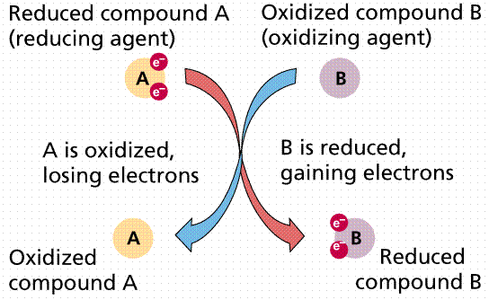
2.1 Review the metabolic pathways and their interactions
Redox reactions
FAD FADH2
NAD NADH + H

Slide 7
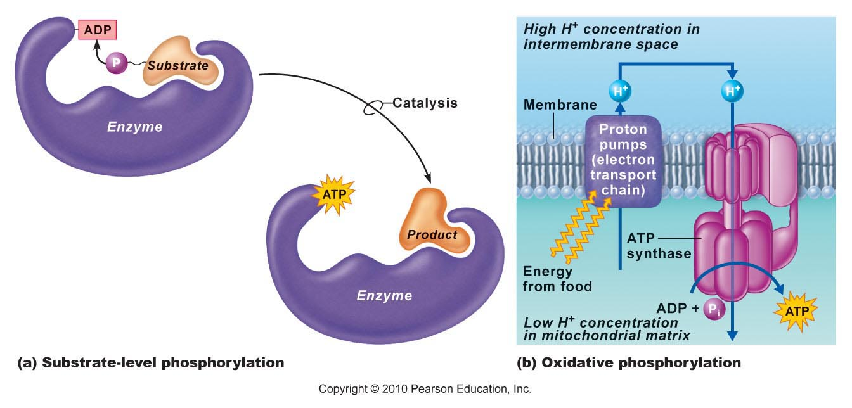
Review the metabolic pathways and their interactions

Slide 8
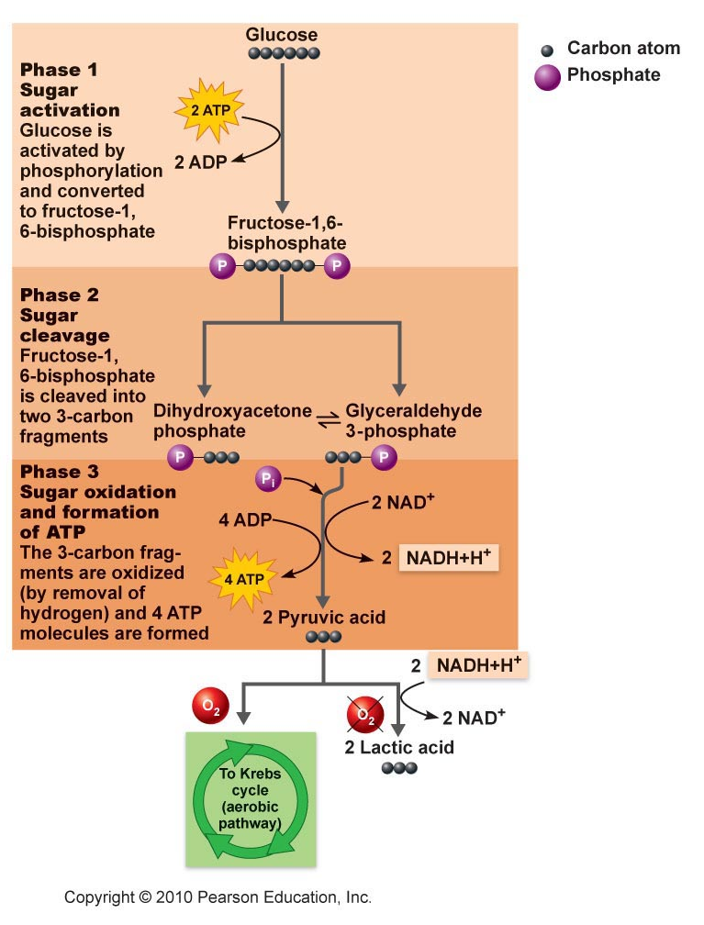
Review the metabolic pathways and their interactions
Why “activate” glucose?
Glycolysis – 10 steps
Anaerobic process
Glycolysis:
Glucose – 2 pyruvates
C6H12O6 – 2X(C3H4O3)
What has happened here?
NAD⁺ is limiting – what
does this imply? When might
you encounter anaerobic
metabolism?

Slide 9
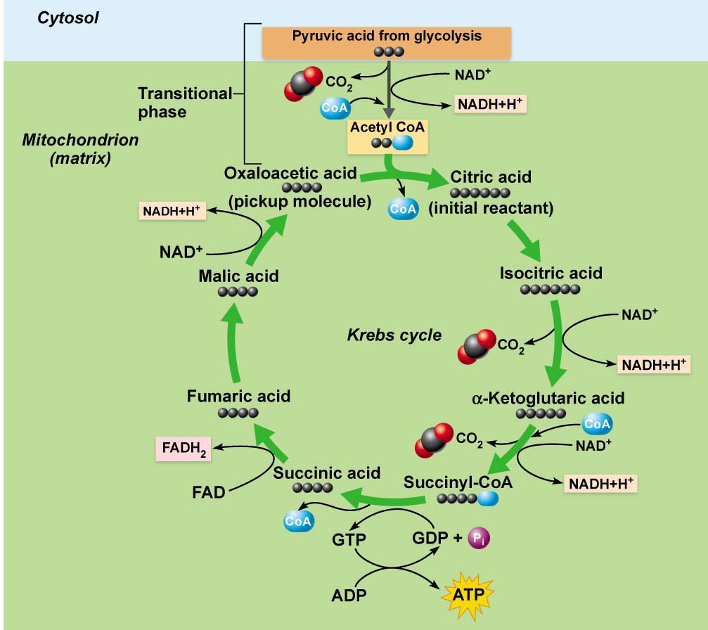
Review the metabolic pathways and their interactions
In Mitochondrial matrix
entry via decarboxylation
(– C02) of pyruvate to
form acetic acid –CoA to
form acetyl CoA.
Oxaloacetic acid “picks up”
Acetyl CoA.
Intermediates (keto acids)
decarboxylated (X2) and
Oxidized (X4)– forming ___
Oxaloacetate regenerated.
Some intermediates can be
used to make amino acids or
fats, and Krebs cycle can also burn triglycerides and, if needed, amino acids

Slide 10
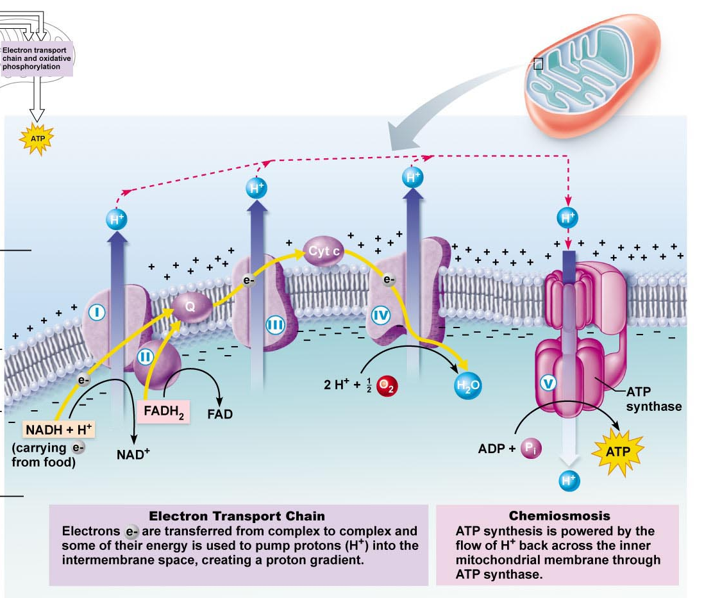
Review the metabolic pathways and their interactions
Oxicative Phosphorylation:
FADH2 and NADH carry energy
- must be converted
Coupled to formation of water
from oxygen and H.
STEPWISE passage of
electrons coupled to H+
chemiosomotic gradient
ATP synthase H+ reentry,
driving a “motor” which drives
ADP + Pi to from ATP. Reverse
ion pump.

Slide 11
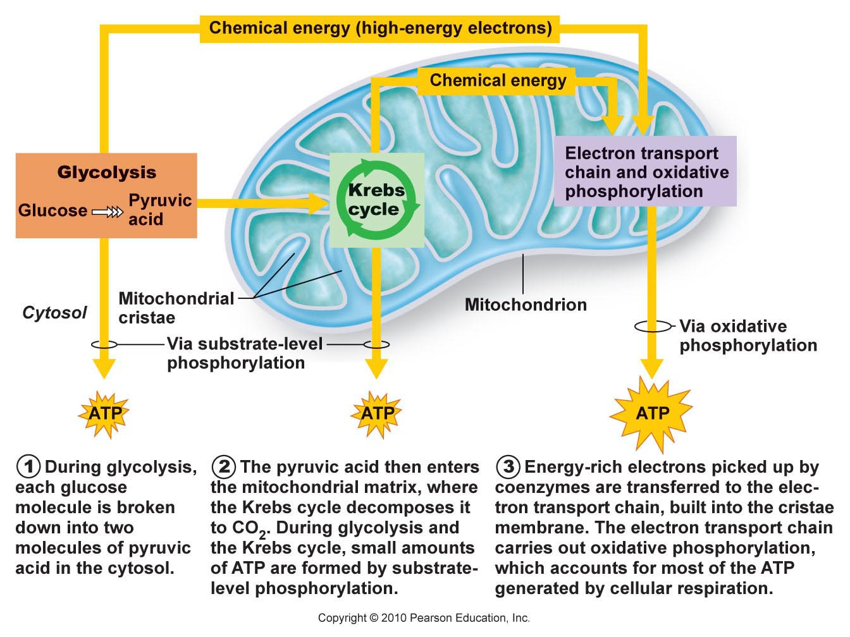
Review the metabolic pathways and their interactions
“Burning” one molecule of glucose yields ~32 molecules of ATP-
approximately 38% energy recovery. Rest lost as ?
Generate approximately 55 Kg of ATP every day – where does all this go?

Slide 12
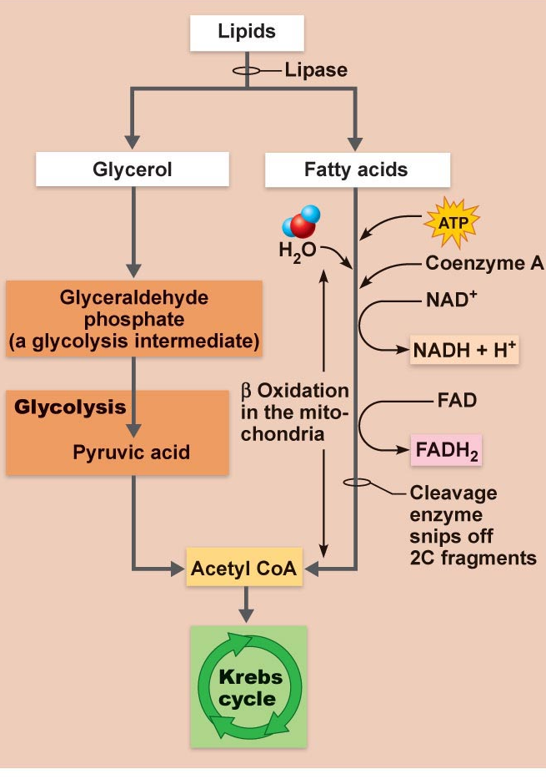
Review the metabolic pathways and their interactions
Fat – very efficient energy store; ~2x versus glycogen.
Both glycerol and free fatty acid side chains can be used for energy.
ONLY glycerol enters glycolytic pathway
Both fatty acids and glycerol products enter Krebs cycle.
Β-oxidation (2 carbon `snips`) of fatty acids yields acetic acid which is converted to acetyl CoA – Krebs.
Fatty acids cannot be used to generate glucose.
Fig. 24.14

Slide 13
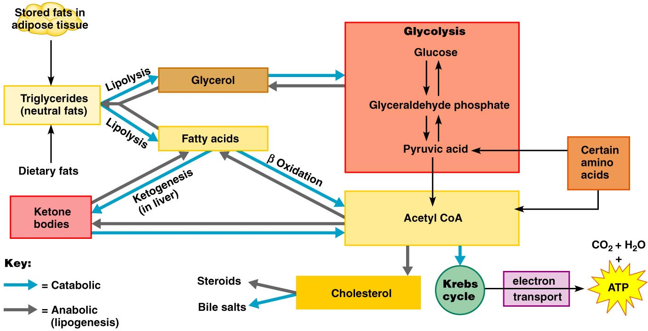
Review the metabolic pathways and their interactions
What are possible fates for glycerol? For FFA?
What are Ketone Bodies? Metabolic Acidosis?

Slide 14
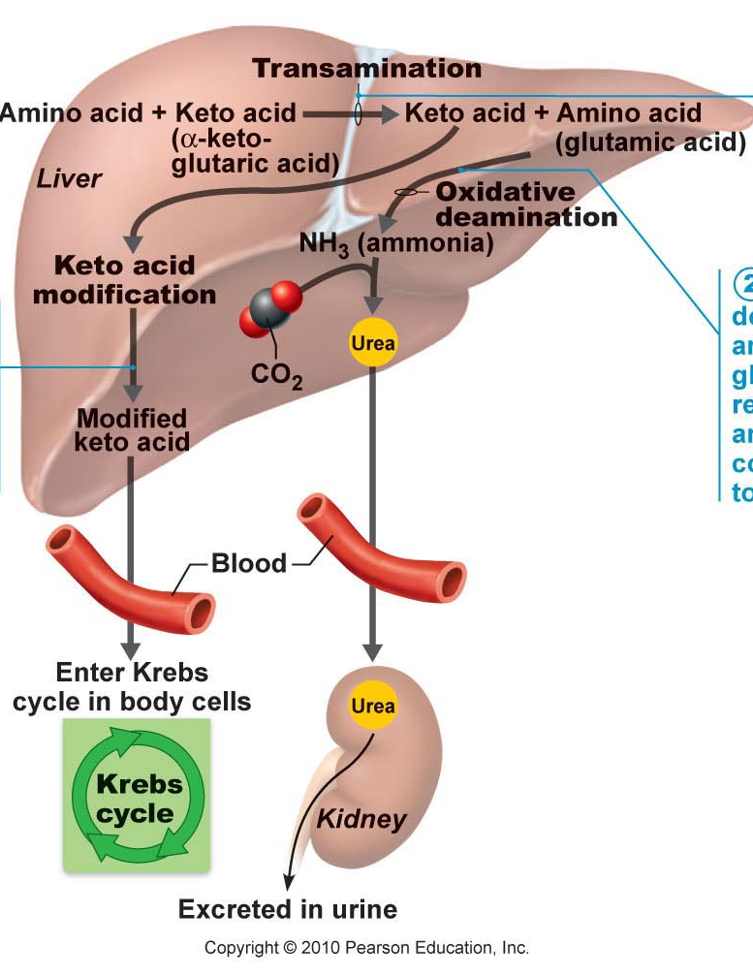
Review the metabolic pathways and their interactions
Proteins are not “stable” or stored;
excess converted to fat or burned
for energy.
Undergo transamination and
deamination reactions
to generate keto acid –Krebs
Cycle intermediates – as a source
of energy (e.g. pyruvate, acetyl
CoA, ketoglutaric acid). Conversely, non-essential amino acids can be derived from Krebs cycle.
Ammonia is generated via deamination as a byproduct
of this cycle - converted to urea.
Why?
Fig. 24.15

Slide 15
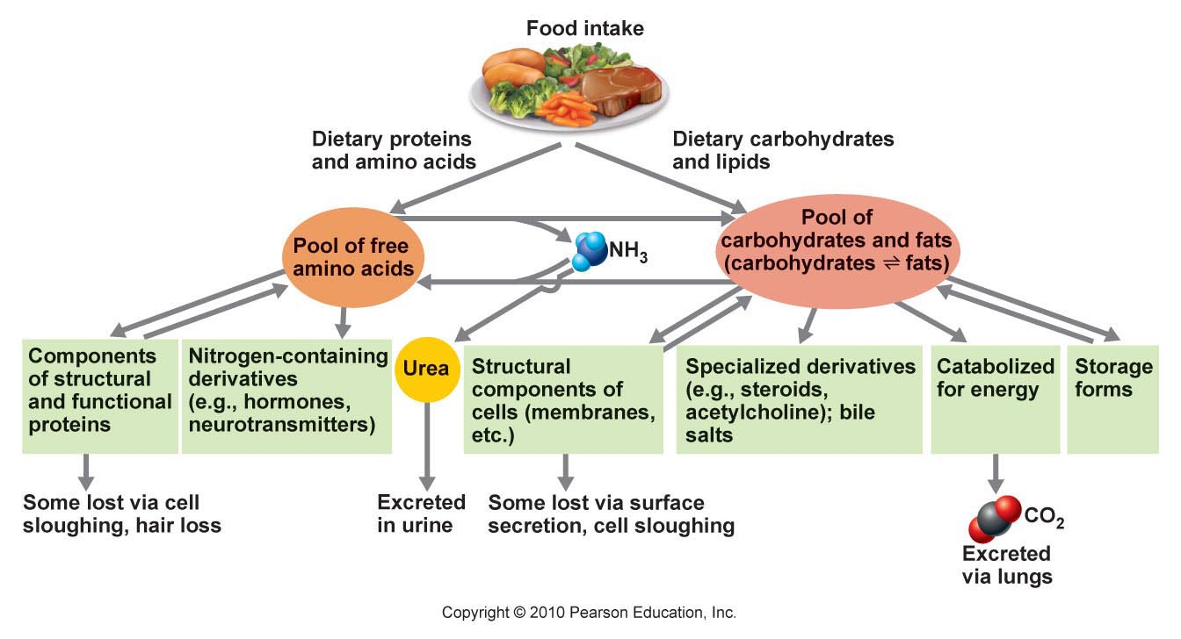
Review the metabolic pathways and their interactions
Fig. 24.17: Carbohydrate, fat and amino acid pools
Body in constant dynamic flux - can draw on nutrient pools to supply needs.
Pools linked by key intermediates for interchangibility. Fat/carbohydrates
more readily interchanged, and directly used for fuel - a common pool, and
can be stored. Amino acids used for fuel indirectly and cannot be stored.

Slide 16
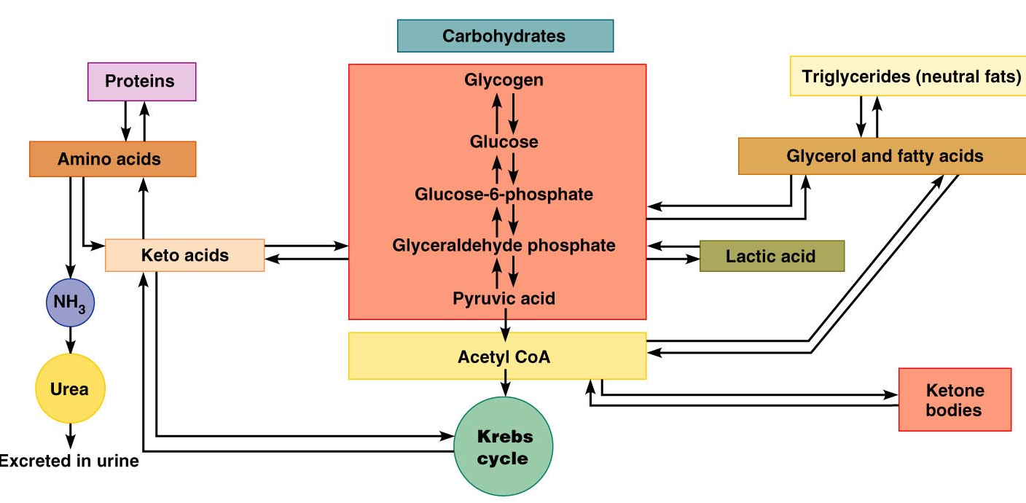
Trace the pathway by which lipolysis produces glucose. What triglyceride building block can’t be used to make glucose)?
List 4 possible noncarbohydrate fates for glucose and work with the diagram to see how these fates can be achieved.
List 2 possible nonprotein fates for amino acids and show how these fates are achieved.
Distinguish between: ketone body and keto acid. When is lactic acid a product of glycolysis?

Slide 17
2.2 Define the absorptive state and the key role of insulin in its metabolic regulation
1. Absorptive & Postabsorptive States: Events & Controls
Absorptive State (fed state): time during and shortly after eating - nutrients entering circulation provide an energy supply
Postabsorptive State (fasting state): GI tract empty; energy needs are met by breakdown of food reserves
Metabolic controls act to equalize blood concentrations of nutrients during all time intervals associated with these 2 very different nutritional states

Slide 18
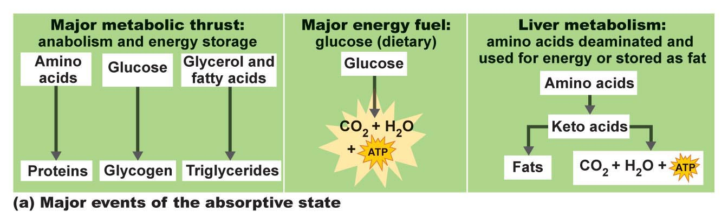
2.2 Define the absorptive state and the key role of insulin in its metabolic regulation
Absorptive state:
Anabolism exceeds catabolism
Glucose major fuel
Dietary amino acids and fats – used for anabolic processes
(make new proteins/fat stores)
Excess metabolites of all sources used to make fat once anabolic
and energy demands are met
Fig. 24.19a

Slide 19
2.2 Define the absorptive state and the key role of insulin in its metabolic regulation
Carbohydrates:
absorbed monosaccharides delivered directly to liver; fructose and galactose converted to glucose (isomerization)
glucose in liver: released into blood or converted directly in liver to glycogen or fat
glycogen produced in liver is stored there, however, most fats synthesized in the liver are packaged with proteins to form very low density lipoproteins (VLDL) which are released into the circulation and picked up by adipose tissue for storage
glucose released by liver into the circulation is taken up by cells and metabolized for energy; excess stored in skeletal muscle (glycogen) or in adipose cells (fat)

Slide 20
2.2 Define the absorptive state and the key role of insulin in its metabolic regulation
Triglycerides:
fat is absorbed into the lymph as chylomicrons - hydrolyzed to free fatty acids & glycerol by lipoprotein lipase on endothelial cells in order to pass out of capillary walls and into cells
adipose cells, skeletal muscle & liver cells all use triglycerides as their primary energy source; many other cells can use TGs for energy when dietary carbohydrates are limiting.
Some fatty acids/glycerol is used for alternative anabolic pathways, but most enters adipocytes for storage as TGs.

Slide 21
2.2 Define the absorptive state and the key role of insulin in its metabolic regulation
Amino Acids:
Amino acids absorbed and delivered to liver
Most are not taken up by liver, but remain in circulation for delivery to other body cells (eg: muscle) for protein synthesis
Some amino acids absorbed by liver are deaminated to keto acid which can enter glycolysis/krebs cycle for generation of ATP or storage as fat
Some amino acids used by liver cells for synthesis of plasma (blood) proteins (eg: albumin, clotting proteins, transport proteins)

Slide 22
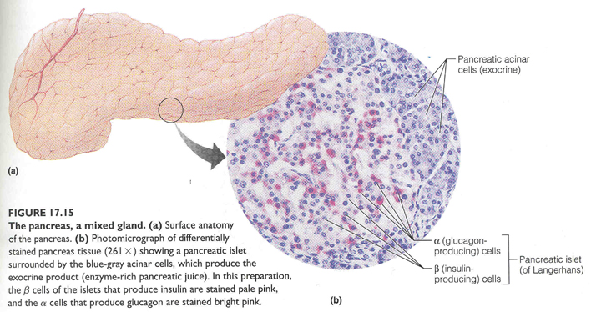
2.2 Define the absorptive state and the key role of insulin in its metabolic regulation
Hormonal Control:
INSULIN
• insulin directs essentially all events of absorptive state
produced by ß cells of pancreatic islets of Langerhans (endocrine pancreas; 2% of gland)

Slide 23
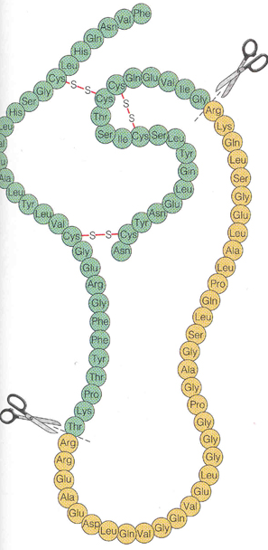
Insulin (cont):
- Structure: small (51 aa) protein consisting of 2 amino acid chains connected by disulfide bonds
Initially synthesized as proinsulin; middle portion excised to make active hormone just before release
Synthesized as by pancreatic β-cells. Primary stimulation for insulin secretion is a rise in blood _______.
- secretion also stimulated by increased blood amino acids, by glucose-dependent insulinotropic pepide (GIP – produced by GI tract) and parasympathetic stimulation

Slide 24
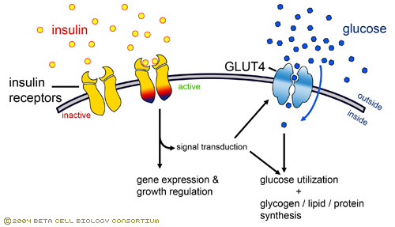
2.2 Define the absorptive state and the key role of insulin in its metabolic regulation
Insulin (cont):
The principal effect of insulin is to activate carrier-mediated facilitated diffusion of glucose into cells (increases 15-20 fold within minutes via translocation of glucose transporter).
This is especially true for skeletal muscle/adipose tissue
NOTE: insulin is not needed for glucose entry into liver, kidney, brain, or intestinal epithelial cells. These cell types all readily absorb glucose irrespective of insulin levels
www.betacell.org/images/CMS/insulin-receptor-...

Slide 25
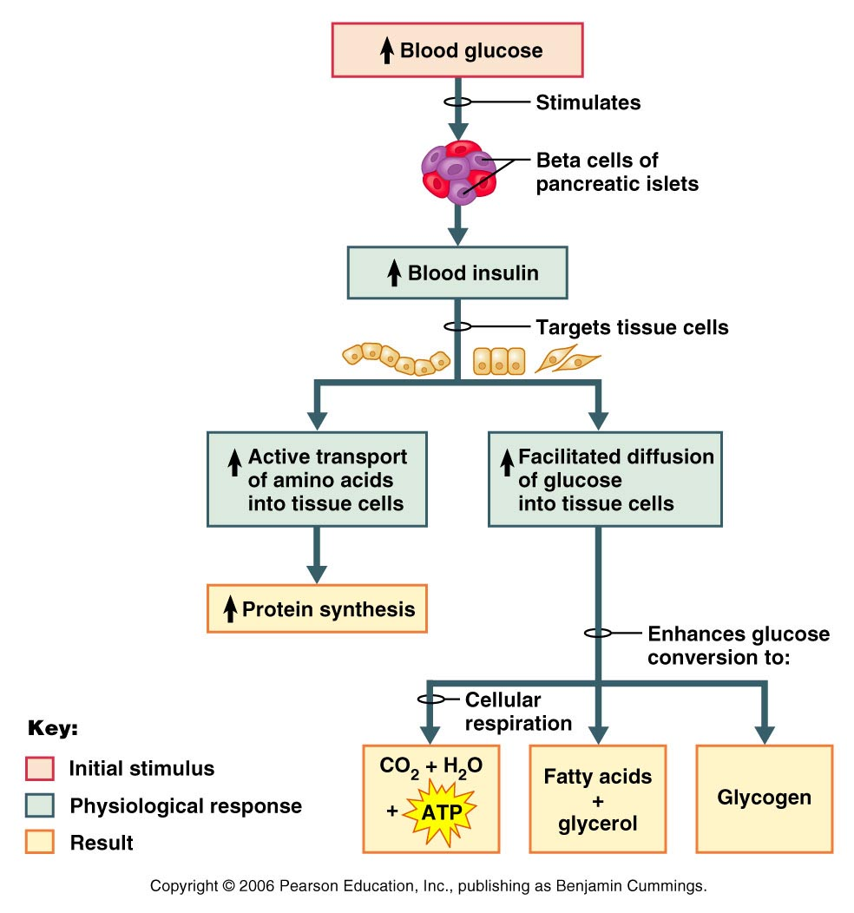
2.2 Define the absorptive state and the key role of insulin in its metabolic regulation
Other Effects of Insulin (in addition to glucose transport):
(1) Enhances glucose oxidation for energy
(2) Stimulates conversion of glucose to glycogen and TGs (in adipose tissue)
(3) Increases active uptake of amino acids & promotes protein synthesis
(4) Inhibits virtually all liver enzymes that promote gluconeogenesis (what is this?) and inhibits hydrolysis of glycogen to glucose (glycogenolysis )
Insulin is an anabolic, hypoglycemic hormone: it takes glucose out of the circulation and uses it for energy or converts it to storage forms
Fig. 24.20

