Slide 1
Physical education: Pedagogy and Designing the learning experience
Please sign into Echo 360
Rink, J.E. (2005). Chapter 4. (Reserve Desk).

Slide 2


Slide 3
Lecture outline
Re-visit growth mindset and equity
Introduction to Physical Education
Designing learning experiences
Review for midterm

Slide 4
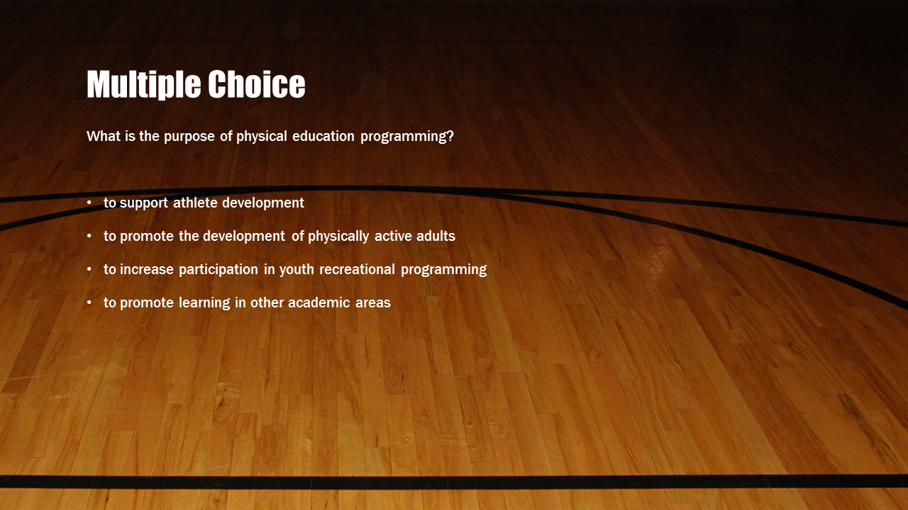
Multiple Choice
{"PollType":"multiple_choice","Question":"What is the purpose of physical education programming?","Solutions":[{"isCorrect":false,"Text":"to support athlete development"},{"isCorrect":true,"Text":"to promote the development of physically active adults"},{"isCorrect":false,"Text":"to increase participation in youth recreational programming"},{"isCorrect":false,"Text":"to promote learning in other academic areas"}],"Justification":false,"EmbedMedia":false,"EmbedUrl":null,"EmbedImageLocation":null}

Slide 5
Dweck, C. S. (1986). Motivational processes affecting learning
Children's theories of intelligence influence their goal orientation:
intelligence is a fixed trait → performance goals (fixed mindset)
intelligence is a malleable quality → learning goals (growth mindset)

Slide 6
Malcolm Gladwell - Human Capitalization

Slide 7
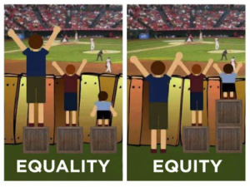
Equity and the determinants of health
Health disparities
  preventable differences in the burden of disease, injury, violence, or opportunities to achieve optimal health that are experienced by socially disadvantaged populations
  http://www.cdc.gov/healthyyouth/disparities/
  Health Equity Impact and Assessment tool
    support improved health equity
    including the reduction of avoidable health disparities
Notes:
You need to add and provide or provide a intervention for the smaller guy then the bigger guy.

Slide 9
Classifying Intervention Approaches: A Typology
INFORMATIONAL
BEHAVIORAL
SOCIAL
ENVIRONMENTAL & POLICY
PEDAGOGICAL & COACHING
  instruct people to move more competently by creating contexts that facilitate motor learning, motor performance and sport performance
  create inclusive contexts for PA or sport participation
  create contexts for development of high performance sport
Notes:
Now we are looking at a pedagogical and coaching

Slide 10
Pedagogy
Teaching – the skills and strategic behaviors exhibited by instructors as they engage in their work
Learning – a change in behavior or perception that is a result of experience
Pedagogy – the study of how a teacher skillfully arranges an environment in such a way that participants acquire specifically intended learnings
  must examine what the teacher is doing and what then happens to students as a result of it
Notes:
Pedagogy

Slide 11
Pedagogical Intervention
an intervention that has been intentionally planned by a teacher and that is delivered in an interactive manner to facilitate student learning on identifiable and evaluative outcomes

Slide 12
Purpose of Physical Education
The overall goal of physical education:
  the development of physically active individuals
Physical Literacy (Higgs, Balyi, Way, Cardinal, Norris, & Bluechardt, 2008)
  the development of fundamental movement skills and fundamental sport skills that permit a child to move confidently and with control, in a wide range of physical activity, rhythmic (dance) and sport situations. Physical literacy also includes the ability to ‘read’ what is going on around them in an activity setting and react appropriately to those events” (p. 5).
Current curricular goals in PE are built around the “whole child” (i.e., physical, cognitive, and affective domains).

Slide 13
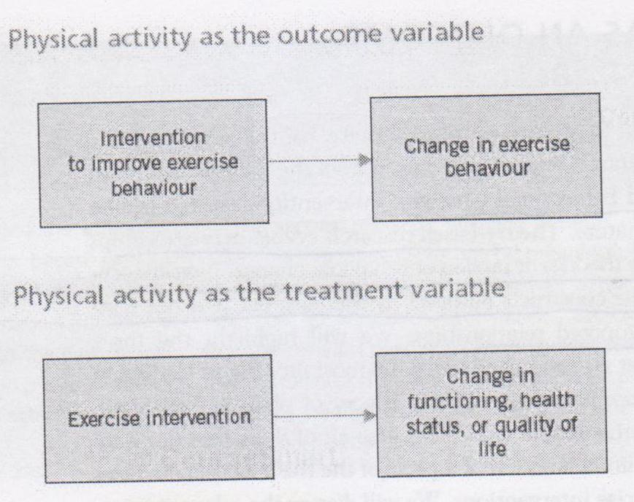
Classifying Intervention Approaches: PE teachers apply both strategies
Notes:
PE is a bit both outcome and a treatment

Slide 14
Physical and Health Education Canada
https://www.youtube.com/watch?v=OZRDGhwYRi4

Slide 15
Teaching as a Goal-Oriented Activity
Teaching is goal oriented – designed with a clear goal regarding what the student will learn
Instructional processes are specific to an intent – selected based on the purpose of the exercise

Slide 16
Teaching as a Goal-Oriented Activity
Psychomotor – fundamental movements, actions; motor skills and complex sport skills, fitness outcomes – ‘is able to perform…’
Cognitive – ‘demonstrates understanding’; knowledge of rules, of stats, of how to assess a peer, includes knowledge of strategies, and problem-solving capabilities (such as transferring knowledge from one context to another)
Affective – emotional or social goals, attitudes toward an activity, feelings (self-efficacy), ability to work with others (coach others, referee without dispute)
Notes:
Cognitive any type of learning; strategy, learning , problem solving

Slide 17
National content standards for PE – applied to the development of program goals (Rink, 2005)
Standard 1: competency in motor skills and movement patterns to perform a variety of PA
Standard 2: understanding of movement concepts, principles, strategies and tactics as they apply to PA
Standard 3: regular participation in physical activity
Standard 4: achieves and maintains a health enhancing level of physical fitness
Standard 5: responsible personal and social behaviour in PA settings
Standard 6: values physical activity for health, enjoyment, challenge, self-expression and or social interaction
Moving into the future: National Standards for Physical Education (2004)
Notes:
2) cognitive
3)Psychomotor principle
4)Psychomotor principle D.D
5)Effective
6)Effective

Slide 18
Alignment
the degree of consistency in purpose shown by an instructor across activity design, teaching processes, and assessment of student outcomes
  activity selection should be driven by objectives
  instructional processes should be intentionally chosen to meet goals
  assessment should provide valid evidence that student outcomes improved in relation to the stated objectives
Notes:
Alignment relates to how the goal and evaluation fit together

Slide 19
Goal-oriented teaching practice
Curriculum guides instruction
Program goals refer to broad outcomes (long-term student impacts)
Program objectives refer to more specific outcomes (e.g. lesson outcomes)
Curriculum goals need to be realistic
Notes:
Program goals are the impacts you want to see on your students closer to when you are finishing the program

Slide 20
Instructional processes
Criteria for instructional processes differ among:
  Open motor skills
  Closed motor skills
  Learning transfer
  Cognitive objectives
  Affective objectives
Cognitive and affective skills often taught in conjunction with psychomotor

Slide 21
Cognitive and affective instructional processes need to be explicit
sport PYD and negative impacts (Fraser-Thomas, Cote & Deakin, 2005)
  sport-related injuries and eating disorders
  pressure to win, negative self-perceptions, isolation, vulnerability, burnout, low confidence, low self-esteem
  violence and aggression

Slide 22
The instructional process
Pre-lesson and post lesson routines
Movement task – student response unit of analysis
  Set induction: teacher orients the class to the content of the lesson
  Movement task: motor activities related to the content of the lesson; progression of experiences
  Organizational arrangements: arrangements a task (e.g. organizing people, space, time and equipment
  Student response: practice of skill
  Teacher observation: observe and provide feedback
  Teacher redesign: next step (improve performance, increase complexity, assess, new task)

Slide 23
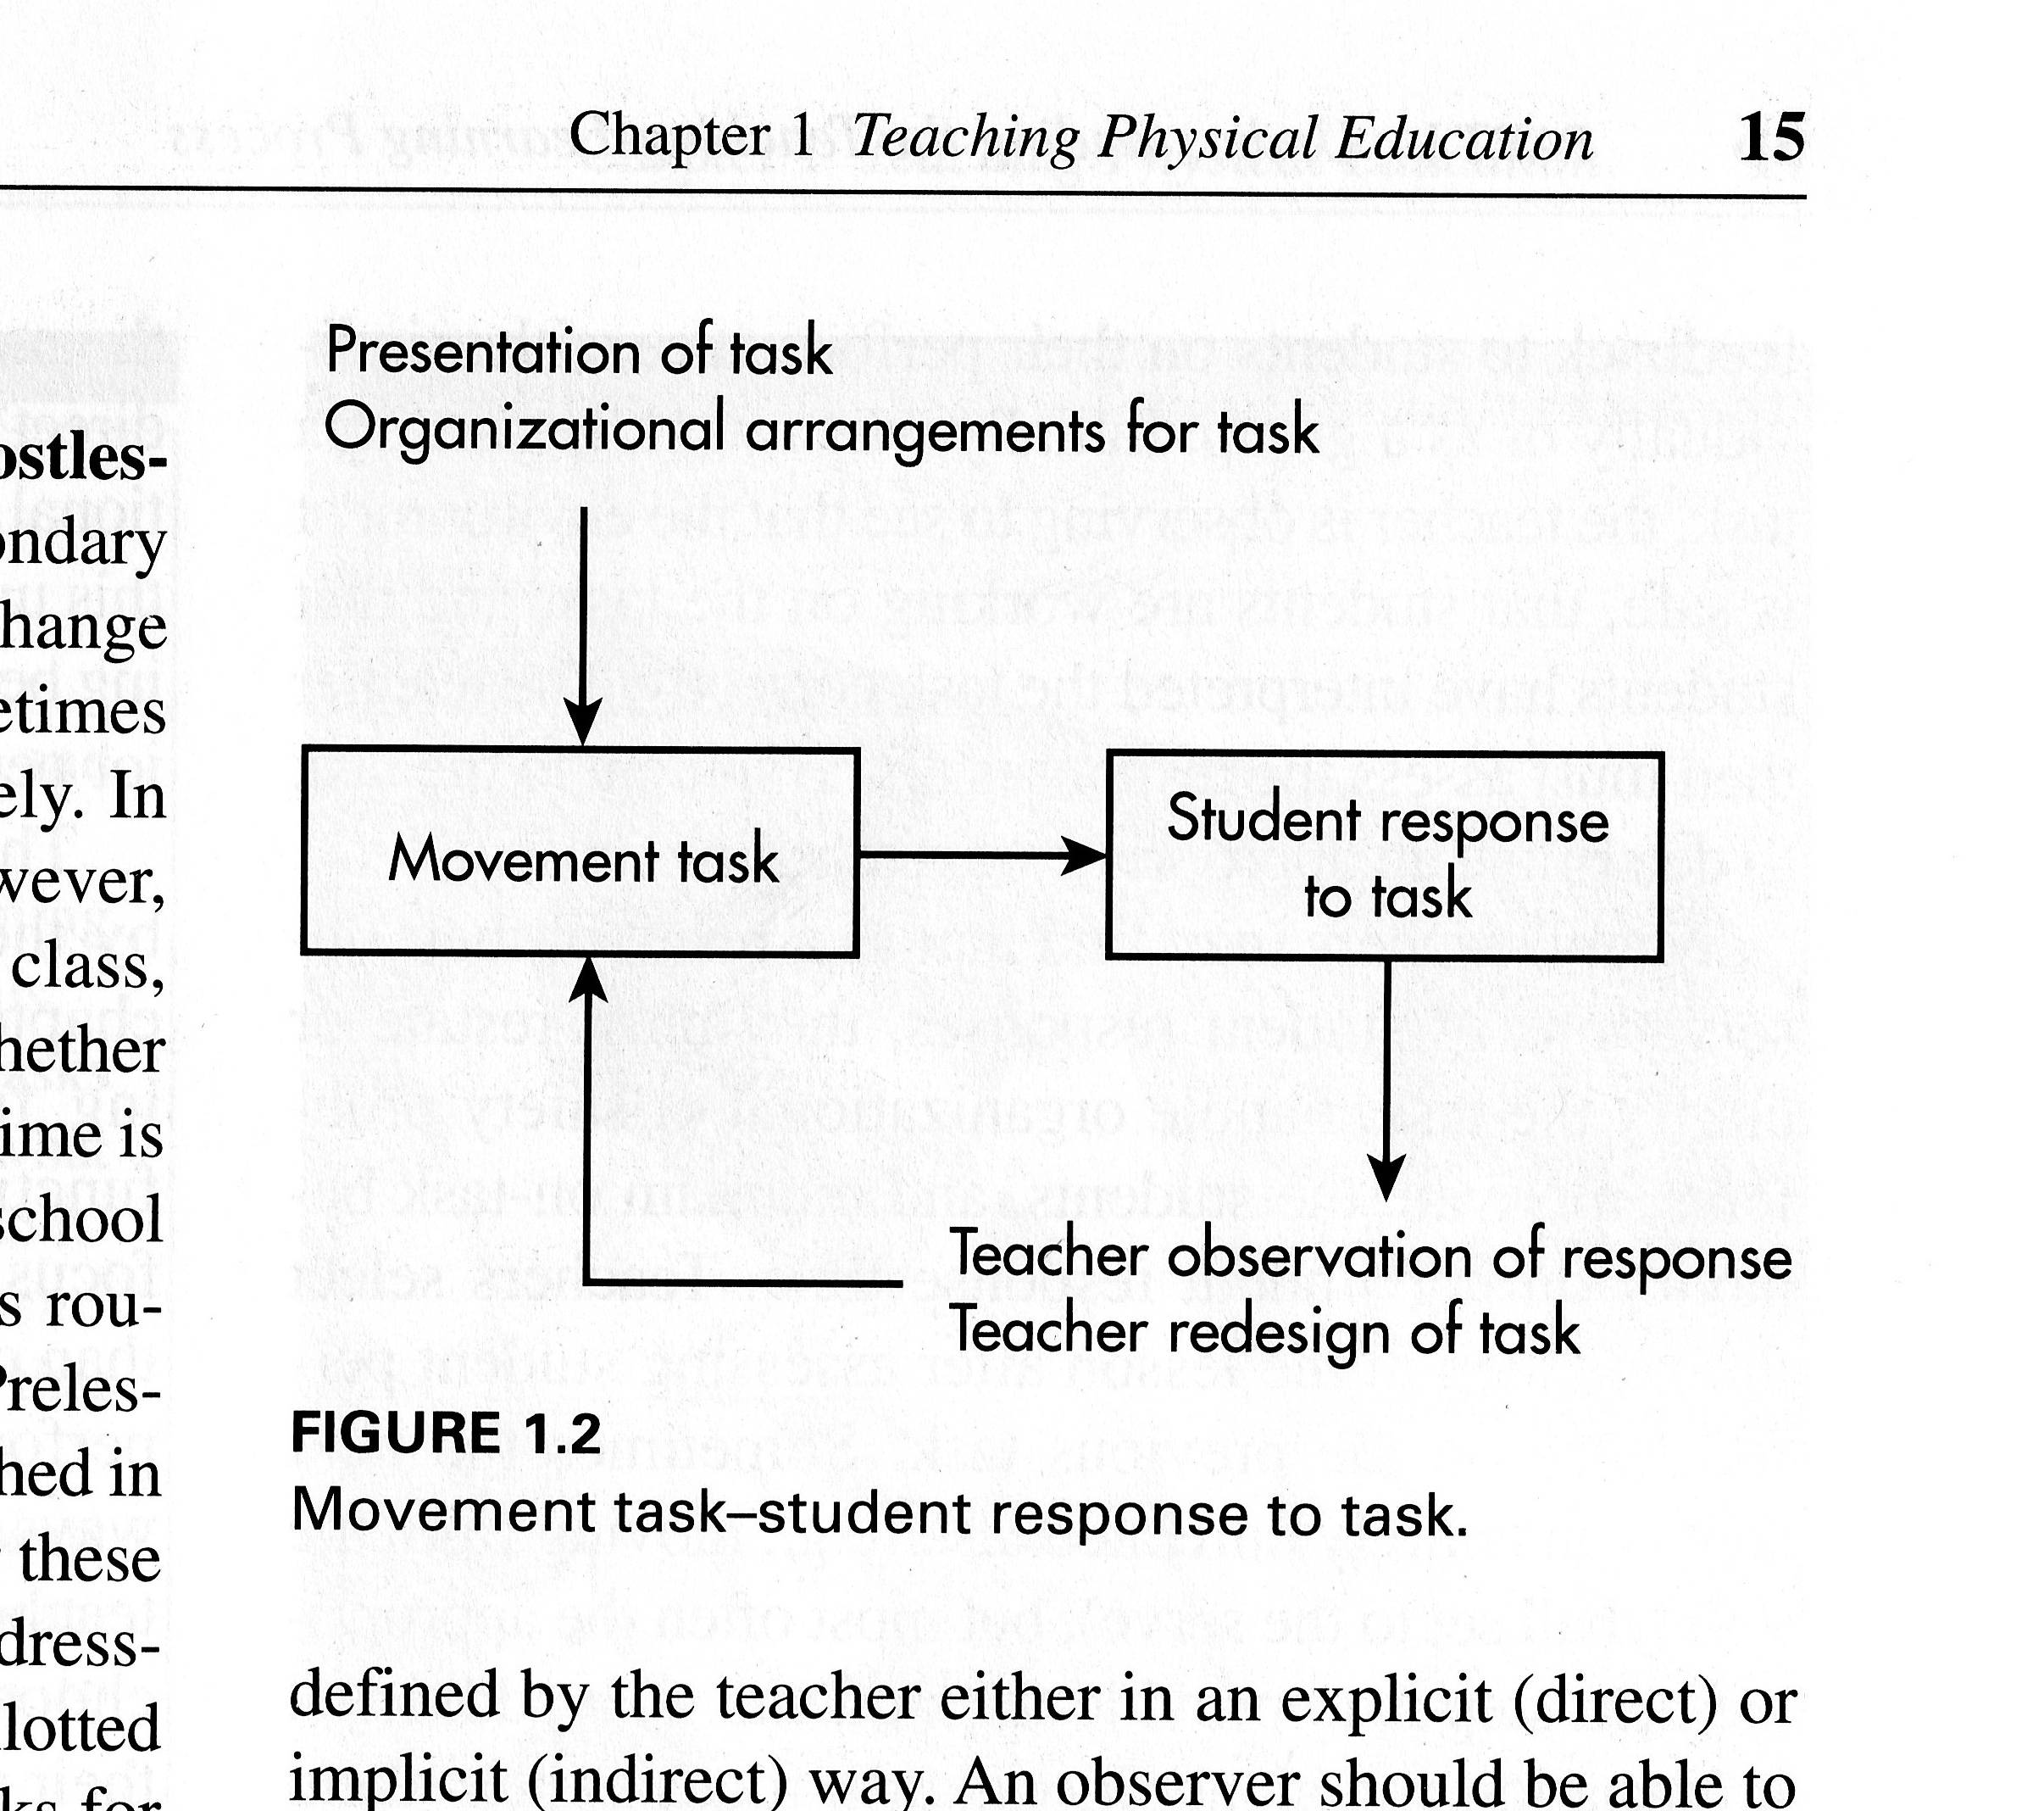
Basic Interactive Unit – Movement task – student response to task (Rink, p. 15)

Slide 24
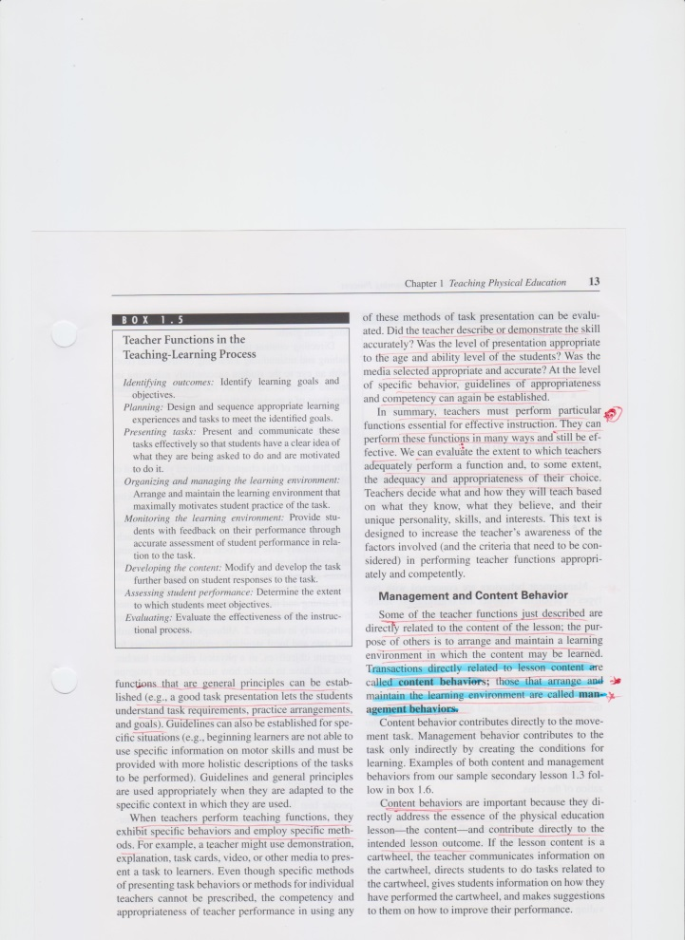
(Rink, p. 17)
Teacher functions - teacher behaviours related to purpose

Slide 25
Teaching functions
Content behaviors: behaviours directly related to lesson content; contributes directly to the movement task
Management behaviors: behaviours related to arranging and maintaining the learning environment; indirectly contributes to the task
  concerned with: conduct and organization

Slide 26
Designing learning experiences and tasks
Learning experience: instructional conditions and events that provide structure to student experience; are related to a specific set of learning objectives
Four criteria of good learning experiences:
  potential to improve motor performance/activity skills
    active adults - competence in motor skills, previous positive experiences
  provide maximal activity or practice time at an appropriate level of ability
  appropriate for the experiential level of all students
    80% success rate is deemed appropriate
  potential to integrate psychomotor, effective, and cognitive educational goals

Slide 27
Movement task - design
Content dimension - movement content with which The students are asked to work
  Content is important for the learning goal
Goal orientation - qualitative or goal aspect of the movement experience
  Goal should be shared
  Goals should be achievable
  Individualization: learning experiences that allow each student to function at an appropriate level
  Personalization: individualization whereby the specific needs of each individual is considered
Organization of the task - arrangement of time, space, people and equipment

Slide 28
Organizing People
Decisions concerning:
  size of groups
  # of groups
  # active people within groups
  interaction between groups
  grouping criteria

Slide 29
Grouping Criteria
ability grouping –
    use homogeneous groups when psychomotor goals are most important
    avoid continuous use of heterogeneous groups in competitive situations
    heterogeneous groups are useful in peer teaching
    teacher-assigned, or student-selected
other criteria: interest, ethnicity, social compatibility, size, gender, chance
Notes:
Ethnicity: groups are diverse

Slide 30
Organizing Time (per Task)
Proficiency & Consistency of response
Physical capacity for continued practice
Student Interest

Slide 31
Organizing Time (Pacing)
teacher-paced
  can help sequence cues used for a skill
  Useful for developing complex skills (particularly closed skills)
student-paced

Slide 32
Organizing Space
Defining the practice area
  influences demands of movement task
  use markers to define flow of task
  use partitioning for very young children
  the need for large space must be balanced with the need for maximal activity

Slide 33
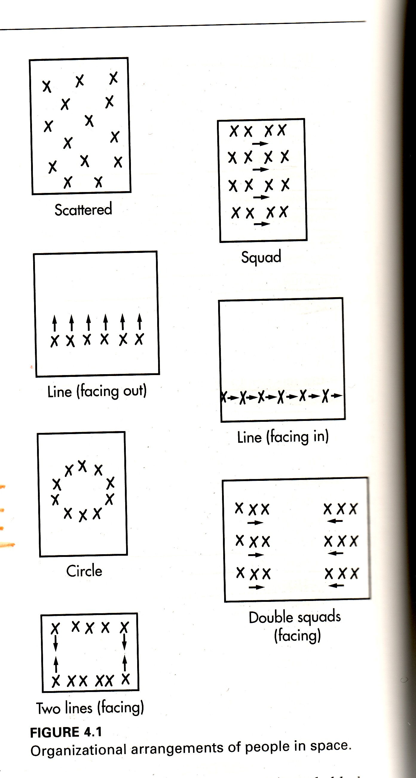
Notes:
Scattered whne not moving to much ( just dribling a ball)
Facing out line : when they are moving in straght line

Slide 34
Equipment
consider student to equipment ratios
consider equipment modifications

Slide 35
Nature of motor content related to the design of a learning experience
Goal in teaching motor skills: the development of skilful performance for participation
Effectiveness of skill performance: Motor skills are effective if they accomplish their purpose
Efficiency of skill performance: Mechanical correctness of a skill based on performer and situation
Adaptation of skill performance: ability to adjust to environmental conditions surrounding performance

Slide 36
Classifying motor skills
Closed skill: a skill performed in a stable environment, (i.e. conditions surrounding the performer during performance do not change)
  some basically closed skills require performer adaptation e.g. golf
Open skills: a skill performed in an environment that is changing during performance
  skill should first be learned under simplified conditions

Slide 37
Classify: open or closed?
Windsurfing : open environment
Football pass: closed but in game its open
Bowling
Diving
Penalty kick : Open

Slide 38
Designing safe learning experiences
Ensure all students have the prerequisites
Ensure students work in control
Provide safety instructions
Create a safe environment
Teacher legal liability
  http://professionallyspeaking.oct.ca/

Slide 39
Midterm review
The first seven lectures and readings (up to September 28)
Common benefits and participation levels in PA
Understand the concept of an intervention and how it relates to health promotion research and programming
Understand the contrast between PA as an intervention variable vs an outcome variable (and how this relates to research)
Understand the different approaches to increasing PA
Understand the major theories that have influenced the field of PA health promotion

Slide 40
Midterm review
Review the multiple interventions and know how they relate to theory, e.g. the relapse prevention model
Understand the benefits and weaknesses of different theories and approaches
Review the Ecological model
Understand the implicated variables and multiple fields that have contributed to ecological models
Notes:
40mc and 2 short answers

Slide 41
References
Dweck, C. S. (1986). Motivational processes affecting learning. American psychologist, 41(10), 1040.
Fraser-Thomas, J. L., Côté, J., & Deakin, J. (2005). Youth sport programs: An avenue to foster positive youth development. Physical Education & Sport Pedagogy, 10(1), 19-40.
Higgs, C., Balyi, I., Way, R., Cardinal, C., Norris, S., Bluechardt, M. (2008). Developing physical literacy: A guide for parents of children ages 0 to 12. Vancouver, BC: Canadian Sport Centres

