Slide 1
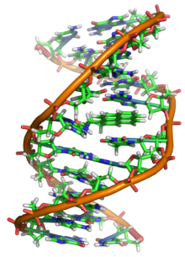
Theme 1: Information molecule that is passed on is DNA: how do we know this?
Text pages: 50-53 (Section 3.1)
Text page: 393 (Section 19.3; Figure 19.20)
BIOL 243: DNA, Inheritance and Evolution
University of Calgary
Gordon Chua
Wikipedia

Slide 2
Important things about BIOL 243 Themes 1 & 2: Molecular Genetics (19 lectures)
Instructor: Dr. Gordon Chua
Email: gchua@ucalgary.ca;
Office Hours: Tuesdays: noon - 2 PM, Wednesdays: 2-4 PM or by appointment (BI 560)
Q. What are the readings for this part of the course?
A. Assigned textbook readings = required; Nature Scitables = recommended
Q. How much detail should I know?
A. Have to know the amount of detail found in textbook readings and lecture notes (certain amount of memorization and conceptual understanding required)
Q. Why should I come to class and pay attention?
A. Lectures supplement the textbook and hints on what you need to know and what you don’t need to know for the midterm will be given
Full lecture notes will not be provided (only what is posted on D2L).
Q. How does this course compare to other courses I have taken?
A. Substantially greater amount of content and detail (i.e. do not fall behind)
If you have a question in lecture and I don’t see your hand, wave and shout.

Slide 3
Tentative Lecture Schedule for BIOL 243 Themes 1 & 2: Molecular Genetics
Jan 9 Theme 1A: Introduction to Molecular Genetics & the Information Molecule DNA
Jan 11 Theme 1A: Introduction to Molecular Genetics & the Information Molecule DNA
Jan 13 Theme 1B: DNA structure and Genomes
Jan 16 Theme 1B: DNA structure and Genomes
Jan 18 Theme 1B: DNA structure and Genomes
Jan 20 Theme 1C: DNA replication and Repair
Jan 23 Theme 1C: DNA replication and Repair
Jan 25 Theme 1C: DNA replication and Repair
Jan 27 Theme 2A Central Dogma of Molecular Biology (DNA→RNA→Protein)
Jan 30 Theme 2B: Transcription and Post-transcription Regulation
Feb 1 Theme 2B: Transcription and Post-transcription Regulation
Feb 3 Theme 2B: Transcription and Post-transcription Regulation
Feb 6 Theme 2C: Translation and Protein Structure
Feb 8 Theme 2C: Translation and Protein Structure
Feb 10 Theme 2C: Translation and Protein Structure
Feb 13 Theme 2D: Mutations and Cell Division (Inheritance)
Feb 15 Theme 2D: Mutations and Cell Division (Inheritance)
Feb 17 Theme 2D: Mutations and Cell Division (Inheritance)
Feb 27: Theme 2D: Mutations and Cell Division (Inheritance)
Mar 4: Midterm exam (covers lecture material from Themes 1 and 2)

Slide 4
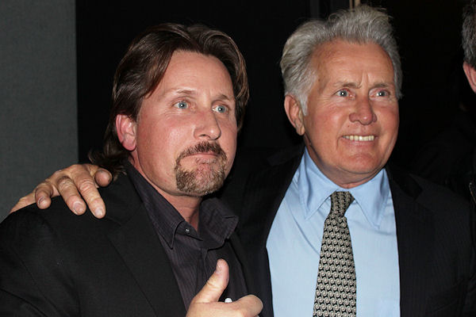
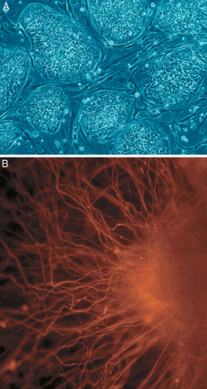
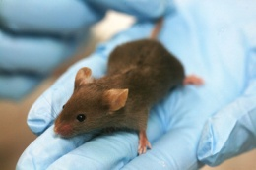
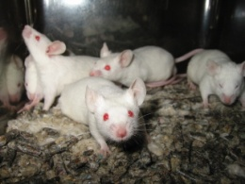
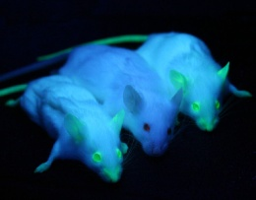
What is Molecular Genetics?
Genetics:
Gene =
Therefore, molecular genetics is the
Course in a nutshell: what are the molecular events involved in how genes are expressed to produce a trait? how are genes transmitted to progeny? how do variation in genes arise?
Stem cells
Nerve cells
Variation in mice
Wikipedia

Slide 5
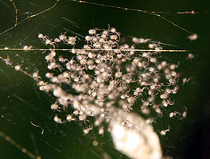
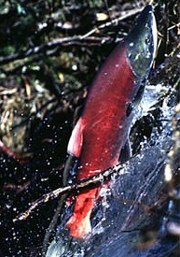

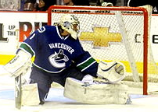
?
Genotype Phenotype
Gene:
Alleles:
Genotype:
Phenotype:
Genome:
ATCGGCATTACGATTTTTCAAGAATTCTTGAACCCGGGTTTGGAA...
Wikipedia

Slide 6
What is gene expression?
Genes:
Gene Expression =
Gene OFF
transcription
RNA
(coding and noncoding)
translation
Protein

Slide 7
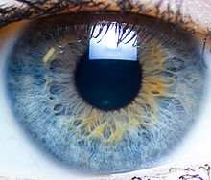
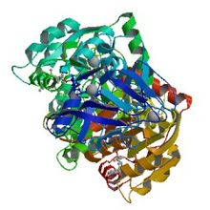
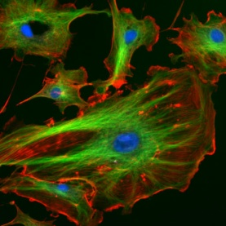

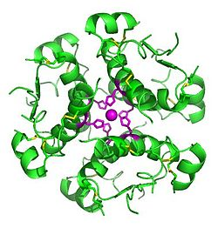
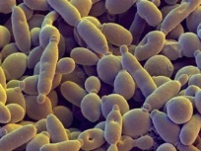
Protein expression specifies phenotype
Protein expression: ________________________________________
Although DNA is the information molecule that directs protein expression, proteins ultimately determine the phenotype of the cell because they control every reaction in the cell.
______________: catalyzing the synthesis and transformation of all biomolecules
___________________: maintenance of cell shape
_________________: hormones and receptors
Q. How do alleles contribute to phenotypic variation?
______________________________________________________________________________________________________________
Wikipedia

Slide 8
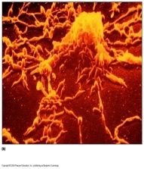
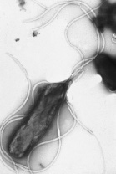
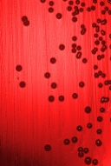
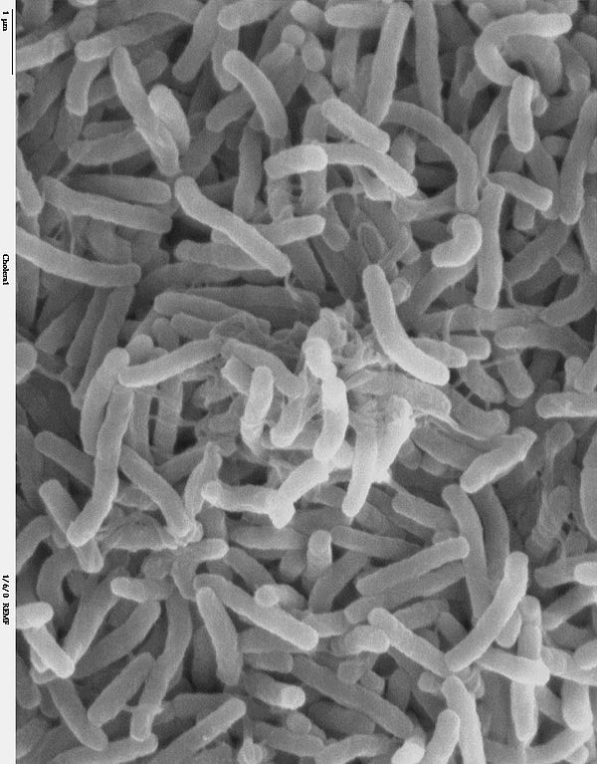
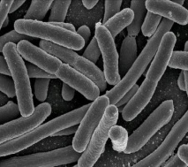
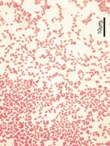
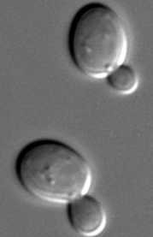
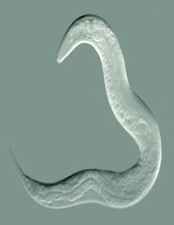
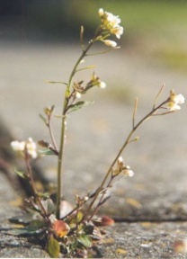
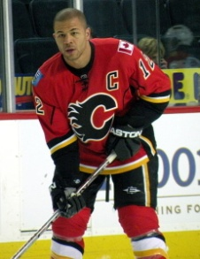
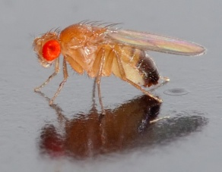
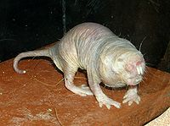
Why sequence genomes?
To understand how the types and abundance of RNA and proteins result in a phenotype of an organism, _________________________________________
Genome Sequence Analysis: 264,945 organisms (January 2017):
(Archaeal: 2,142; eubacterial: 241,428; eukaryotes: 14,733; viruses: 6,615)
M. pneumoniae
0.8 Mb
680 genes
H. pylori
1.7 Mb
1589 genes
H. influenza
1.8 Mb
1738 genes
V. cholerae
4.0 Mb
3890 genes
E. coli
4.6 Mb
4406 genes
P. aeruginosa
6.3 Mb
5570 genes
S. cerevisiae
12.1 Mb
5,860 genes
C. elegans
95.5 Mb
23,209 genes
D. melano.
180 Mb
14,100 genes
A. thaliana
120 Mb
25,498 genes
H. glaber
2700 Mb
22,561 genes
H. sapiens
3200 Mb
25,000 genes
http://www.genomesonline.org
http://www.youtube.com/watch?v=mVZI7NBgcWM

Slide 9
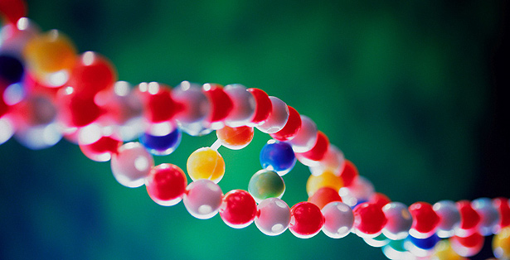
Why is studying molecular genetics important?
_______________: better understanding of human diseases resulting in new therapeutics and diagnostics
_________________: crime, paternity tests, matching organ donors, authenticate consumables, source of food poisoning outbreaks
_____________: superior crops and livestock; “pharm” animals
______________: molecular ecology (species identification and diagnosis for conservation and species-habitat relationships); genetic engineering microbes for bioremediation
________________: phylogenetics and phylogenomics
National Geographic
http://www.youtube.com/watch?v=ubq4eu_TDFc

Slide 10
Establishing DNA as the hereditary molecule (3 classical experiments)
Griffith: found a substance that could
Avery, MacLeod & McCarthy: identified DNA as the molecule that
Hershey and Chase: found the final evidence establishing DNA as the hereditary molecule

Slide 11
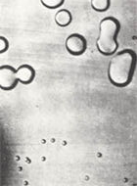
Streptococcus pneumoniae
Bacterial pathogen that causes pneumonia in mammals
Smooth strain(S): bacterium is surrounded by
Capsule protects S strain from the immune system,
Rough strain (R): lacks polysaccharide capsule, cannot evade the immune system, therefore, non-virulent
Wikipedia

Slide 12
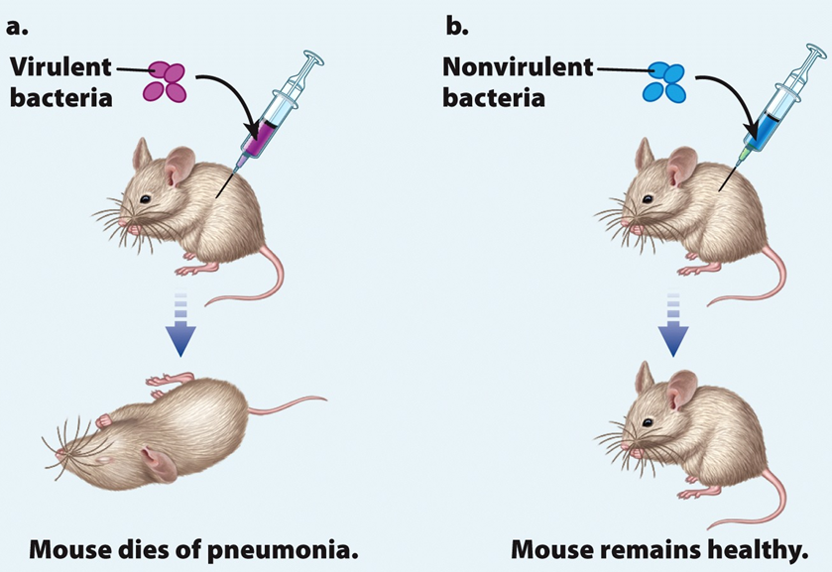
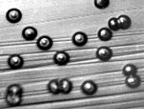
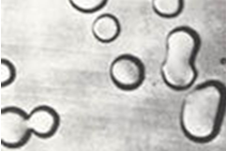
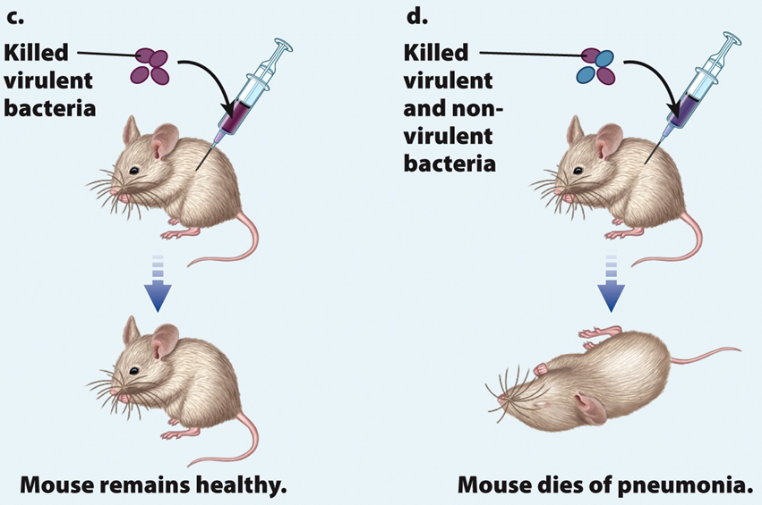
1. Griffith’s experiments (the transforming principle)
Griffith’s conclusion: some molecules (transforming principle)
Transformation was permanent and __________ (all progeny cells in the colony were the same type)
Wikipedia
Fig. 3.1

Slide 13
What is the chemical nature of the transforming principle? (Avery, MacLeod & McCarthy)
Hypothesis: transforming principle could be protein, DNA or RNA – which one?
Experimental approach: _______________________and see whether transformation of R cells into the S virulent form still occurs
Conclusion: ____________________________________, then this molecule is the transforming principle

Slide 14
2. Avery, MacLeod & McCarthy’s experiments
Cell extract/cytoplasm of heat-killed “S” cells
(contains proteins, RNA and DNA)
“R” cells

Slide 15
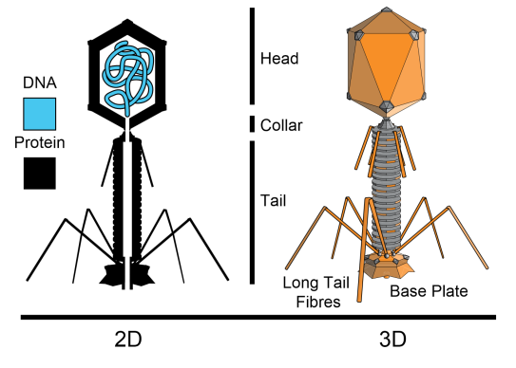
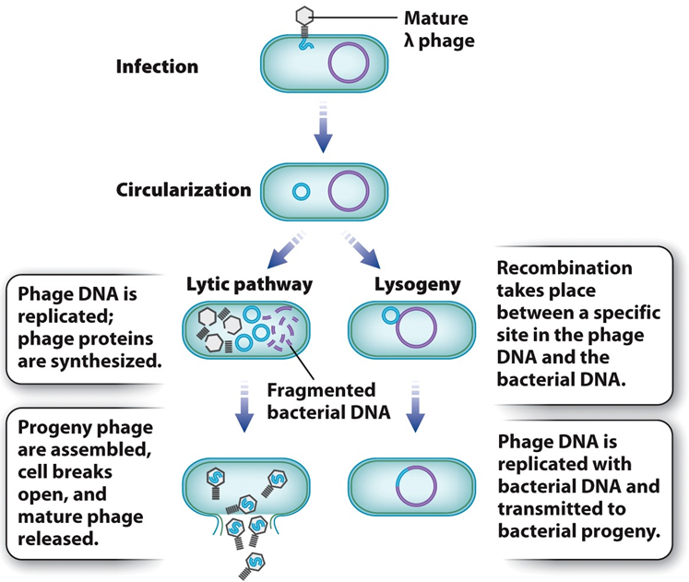
Life cycle of a virus (bacteriophage)
_________________: massive reproduction of virus resulting in host cell lysis (virulent)
Viral DNA ______________________ from bacterial chromosome
____________: replication of viral genome (latent)
Viral DNA is ______________________
Lysogeny can switch to lytic cycle if viral DNA is excised from bacterial chromosome.
Wikipedia
Fig. 19.20
http://www.youtube.com/watch?v=uFXuxGuT7H8
http://www.youtube.com/watch?v=sLkZ9FPHJGM

Slide 16
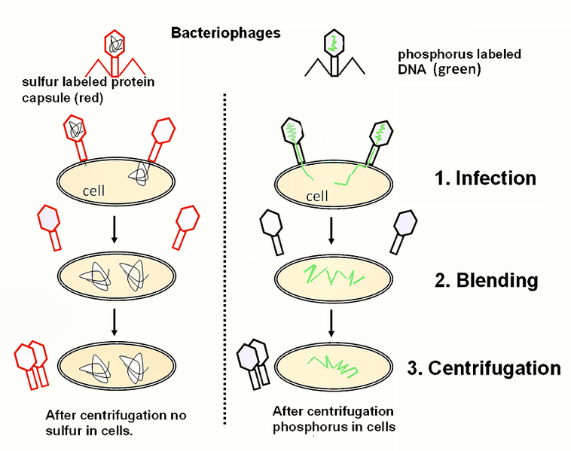
3. Hershey and Chase experiment: Does the bacteriophage inject DNA or protein into E. coli?
Label bacteriophage DNA and proteins with
Allow infection of E.Coli with radioactive bacteriophage
_________________________ and E. coli with blender
_________________of ³²P (DNA) and ³⁵S (protein) in detached bacteriophage, E. coli cells and progeny bacteriophage (not shown)
Wikipedia
RESULTS:

Slide 17
Learning objectives: you should be able to…
Explain in your own words the results of the three classical experiments
Explain how gene expression and protein expression produce a phenotype
Explain how alleles can cause a variation in phenotype
Describe the benefits associated with a better understanding of genes and genomes
Questions to ponder on:
What is the function of the gene involved in transforming R cells to S cells?
Design an experiment that would test if lipids were the transformation molecule.

