Slide 1
Week 3: The Social Construction Approach: Deconstructing Binaries
Introduction to Gender and Women’s Studies

Slide 2
Critical Thinking Skill: Thinking Theoretically
Theories are explanatory frameworks that help us to understand the world around us.
2 theories for today:
  Social construction theory/approach
  Biological determinism
Notes:
Theories are stories we create to understand the world. It should be reviewed and revised .

Slide 3
How do we explain these facts?
Men and women have some physiological similarities and some physiological differences.
Women earn less than men.
67% of all employed women were working in teaching, nursing and related health occupations, clerical or other administrative positions, or sales and service occupations compared to 31% of employed men (Statistics Canada).
Women athletes competing at the International level who are found to have testosterone levels within the “male” range are forced to undergo surgery and/or hormone treatment if they wish to continue to compete with women.
Notes:
Why men earn more than woman? Women are more likely to take maternity leave
Two main competing theories?
Biological determination(gender roles behaviours can be explained by biological) (example women choose teaching services because there initial thinking is be a mother).
social construction (gender roles are not biological it’s cultural and economic which push women and men). (Women become teachers and nurses b/c that is how women are trained from the beginning, from dolls)
Social constructions matter the meaning we make of them. Social insitutions are culture, history which shape raw material to human beings.

Slide 4
The social construction approach
Gender roles, behaviours, and differences are not the natural consequence of minor biological differences, but are instead the result of historical, economic, and cultural forces which have pushed women into particular social and economic roles and men into others.
The social construction perspective sees biology as providing the raw materials, and social institutions, culture, history, and individual personality as what shapes those raw materials into gendered human beings.

Slide 5
Biological Determinism
A theoretical approach that argues that current gender differences and inequalities – including the unequal distribution of political power, wealth, and social status – are the inevitable outcome of nature.
Conservative approach that justifies current inequalities as rooted in biology and nature.
Reductionist approach that does not account for the full diversity of human experience.
Pathologizes trans*, intersex, and LGB people as unnatural.
Notes:
Politically conservative
Men to do some house work.

Slide 6
Biological determinism promotes/Supports 2 kinds of sexism:
Oppositional Sexism
“the belief that female and male are rigid, mutually exclusive categories, each possessing a unique and nonoverlapping set of attributes, aptitudes, abilities and desires.” (Serano 13)
Traditional Sexism
“The belief that maleness and masculinity are superior to femaleness and femininity” (Serano 14)
Source: Julia Serano. Whipping Girl. Berkeley, CA: Seal Press. 2007.

Slide 7
Traditional Sexism (with Steven Goldberg):
"Women follow their own physiological imperatives… In this, and every other society [men] look to women for gentleness, kindness, and love, for refuge from a world of pain and force… In every society basic male motivation is the feeling that the women and children must be protected… The feminist cannot have it both ways: If she wishes to sacrifice all this, all that she will get in return is the right to meet men on male terms. She will lose.”
(http://www.goldberg-patriarchy.com)

Slide 8
But….
“…if male domination is natural, then why must it be held in place by laws, traditions, customs and the constant threat of violence for any women, trans people or sexually non-conforming men who step out of line?” (Cynthia Fuchs Epstein, as cited by Michael Kimmel, 2014)

Slide 9
A Social Constructionist Feminist Approach…
Gender inequality is a result of social forces and not a consequence of universal, unchangeable natural or biological factors.
There is no biological justification for men’s dominance or traditional sexism.
Inequality is a product of society and learned rather than innate.
An incredible diversity of sexed bodies, gender identities and gender expressions exists, which challenges the myth of the gender binary & oppositional sexism.

Slide 10
Sex/Gender Across Cultures
Not all cultures organize sex/gender the same way. Many cultures recognize more than two genders.
Examples:
Two spirit people among the First Nations of North America (men and women).
Hijras (not men or women or gay instead women + men) in India.
Xanith in Oman.
Notes:
The work done by both genders respected equally.

Slide 11
Sex/Gender Across Cultures
“PBS Independent Lens: Two spirits (clip)”:
https://www.youtube.com/watch?v=CZDx9JQUGB0
“Two Spirits One Dance”:
https://www.youtube.com/watch?v=0OB0wdzogy0
“Me Hijra, Me Laxmi”
https://www.youtube.com/watch?v=38uhMPrLrIM

Slide 12
Deconstructing Binaries

Slide 13
Binaries/ Dualisms
Binaries are pairs of opposing concepts, objects or belief systems.
+ -
Good Bad
Light Dark
Male Female
Man Woman
Active Passive
White Black
West East
Mind Body
Human Other
Rational Irrational
Hot Cold
Self Other
Human Animal
Hetero Homo can you think of any more…?
Notes:
Observations about the list
No one in between
Classify
One side is more valued than the other.

Slide 14
Five consequences of binary thinking
Serves as a lens or unquestioned assumption
We automatically value one side over the other
The + side is considered the “norm” and the – side is the “Other”.
That unquestioned assumption is a false dichotomy
Binary thinking is reductionist

Slide 15
1. Serves as a lens or unquestioned assumption
Dualisms are lenses through which we see the world but can you even remember learning them?
Audre Lorde:
“We have, built into all of us, old blueprints of expectation and response, old structures of oppression, and these must be altered at the same time that we alter living conditions which are a result of those structures. For the masters tools will never dismantle the master’s house.” (Lorde “The Master’s Tools”)

Slide 16
2. Different Value
In each dualism (aka binary pair) one side is valued more highly than the other.
This transforms difference into inequality
    Ex. Sport
Notes:
Sports are designed for men so women have hard time competing with the tools designed for men. And women turned to be the “weak”

Slide 17
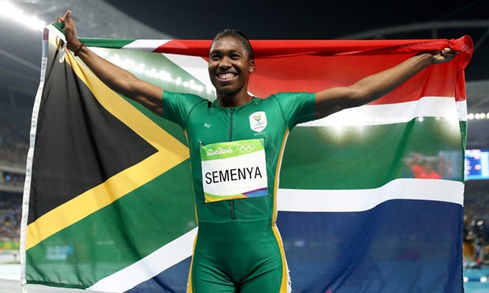
South African Sprinter Caster Semenya has been subjected to oppositional sexism and traditional sexism (along with a large dose of racism) throughout her athletic career.
Notes:
They had to check her if she was a female or male. Female athletes undergo surgery.

Slide 18
3. The + side is considered the norm and the – side is the Other
Audre Lorde: The Mythical Norm
  “white, thin, male, young, white , heterosexual, Christian, and financially secure.” (Lorde “The Master’s Tools”)
  This defines the human
Notes:
Man defines the human.
1929-white women were granted as human.

Slide 19
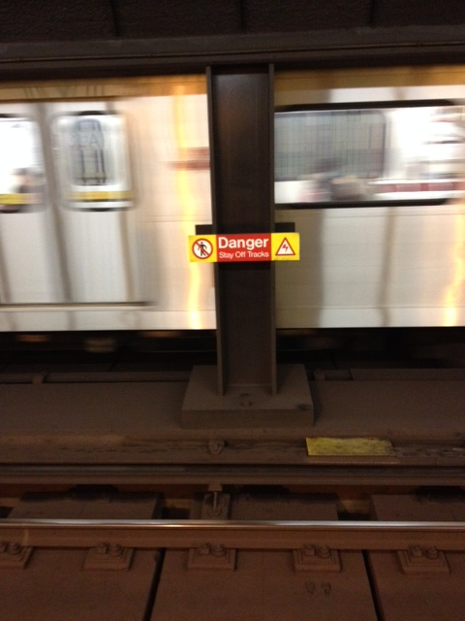
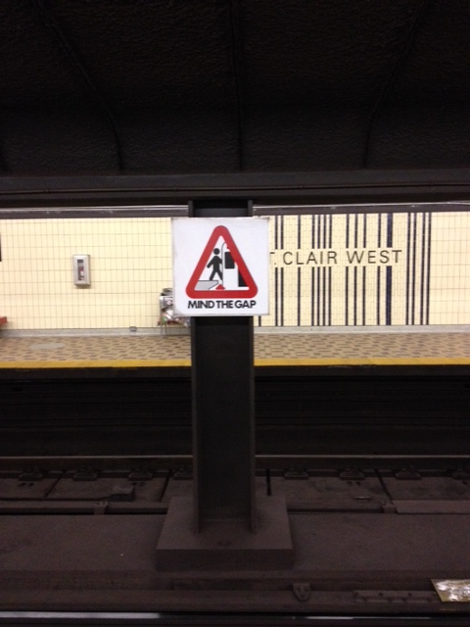
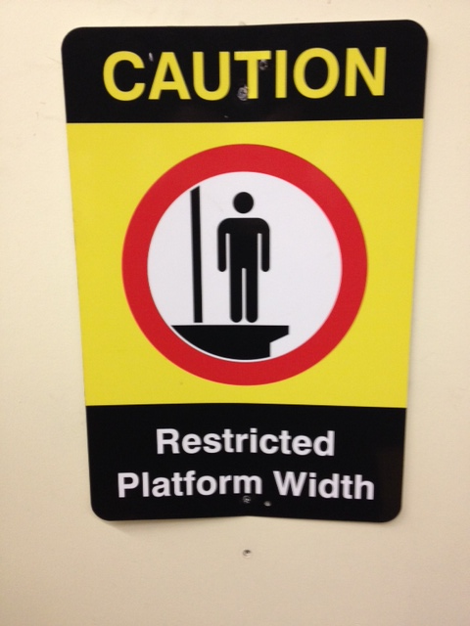
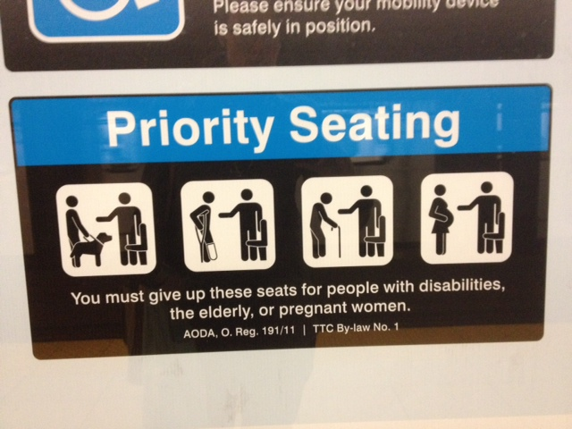
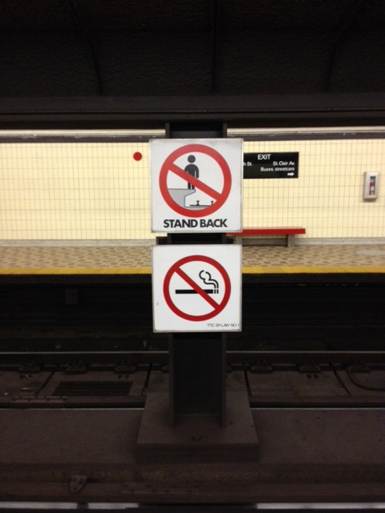
Ex. 2015 TTC Signs
Can you spot the woman?

Slide 20
4. False Dichotomy
We see identity in terms of dualisms
Male/Female, gay/straight, man/woman are seen as either/or
Erases and marginalizes those people whose experiences are in between
  Ex. Bisexuality , intersex, transgender…
.

Slide 21
Intersex
The distinctions between female and male bodies are actually on more of a continuum than a dichotomy.
Every day intersex babies are surgically altered to reflect the sexual anatomy associated with “standard” female or male sex assignment.
Intersex means being born with physical sex characteristsics that are between the binary.
“What its like to be intersex” (by Buzzfeed Video), four intersex people talk about their experiences:
https://www.youtube.com/watch?v=cAUDKEI4QKI
Notes:
Sigma not a problem of gender
All children should be signed as boy or girl.

Slide 22
Trans*
Cisgender, literally means “gender aligned” and refers to people who identify with the gender that they were assigned at birth.
Transgender, or trans* includes people who were sexed female or male at birth, but end up some time later in life, whether its in childhood, teenage years or much later in adulthood, identifying as a different gender.
(“trans*” with the asterisk or * is used as an umbrella to include all gender non-conforming people who want to be included
Notes:
Signed as girl and identify as women
Trans people don’t experience the same.

Slide 23
Oppositional Sexism and violence
The gender binary coerces people (often violently) into fitting themselves and others under categories and stereotypes that may not fit them.
Oppositional sexism marginalizes trans* people, erasing and invalidating their very existence.
True Trans with Laura Jane Grace. Episode 3
https://www.youtube.com/watch?v=wsLimw76m_0
Notes:
2 choices: men or women. Gender neutral bathrooms
Gender binary: force to fit people who might not fit.

Slide 24
5. Reductionist
Humans are extremely complex and diverse. Why would we imagine that our behaviors could be explained by our capacity for sexed reproduction?
Reducing us to our biological functions takes away our full human agency.

