Slide 1
Cash Flow Statement
Chapter 13

Slide 2
Definition of Cash
Cash may include cash equivalents: short-term, highly liquid investments that are readily converted to cash within a short period of time
Examples include:
  Treasury bills
  Money market funds
  Short-term investments
  Short-term debt
Because the definition of “cash” varies, companies must clearly define cash if “cash equivalents” are included

Slide 3
Classification of Cash Flows
Cash receipts and payments are classified into three categories:
  Operating activities
  Investing activities
  Financing activities

Slide 4
Significant Noncash Activities
If it does not affect cash, do NOT report in statement of cash flows
Report in separate note to the financial statements
Examples:
  Issue of debt to purchase assets
  Issue of shares to purchase assets
  Conversion of debt into equity
  Exchange of property, plant, and equipment

Slide 5
Classify each one as Operating, investing or financing cash flows.

Slide 6
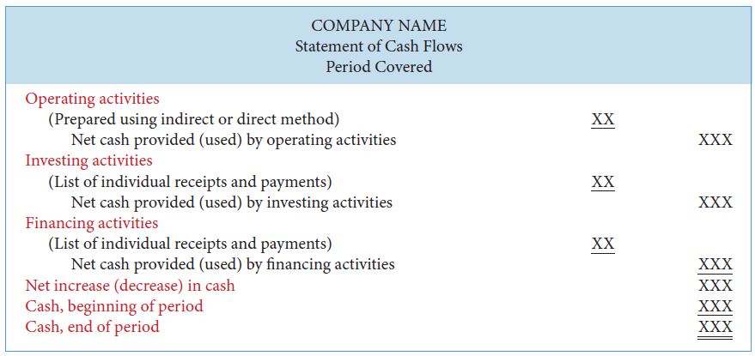
Format of Cash Flow Statement

Slide 7
Step 1: Operating Section
Determine the net cash provided (used) by operating activities by converting profit from an accrual basis to a cash basis
Conversion may be done by either the indirect method or the direct method
  Both methods arrive at the same amount of net cash provided (used) by operating activities
Most companies favour the indirect method for the following reasons
  Easier to prepare
  Reveals less information to competitors

Slide 8
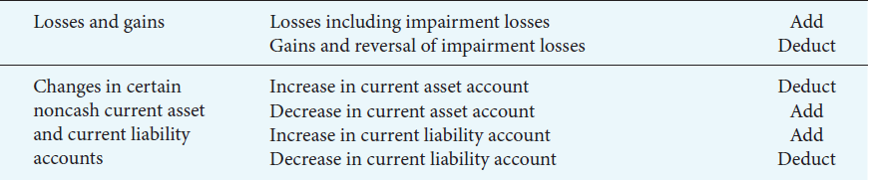
Indirect Method:
Convert profit to operating cash flow

Slide 9
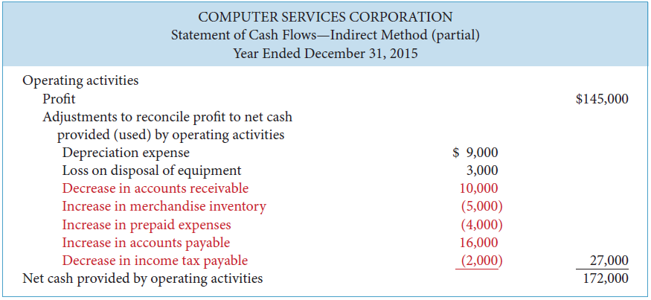
Indirect Method

Slide 10
Direct Method
Standard setters prefer the direct method but allow the use of either method
Details cash receipts and payments
Similar to indirect method:
  Adjusts income statement from accrual basis to cash basis in order to arrive at net cash provided (used) by operating activities
  However, whereas indirect method adjusts total profit, direct method adjusts each individual revenue and expense account

Slide 11




Finding Cash Receipts and Payments – Direct Method

Slide 12
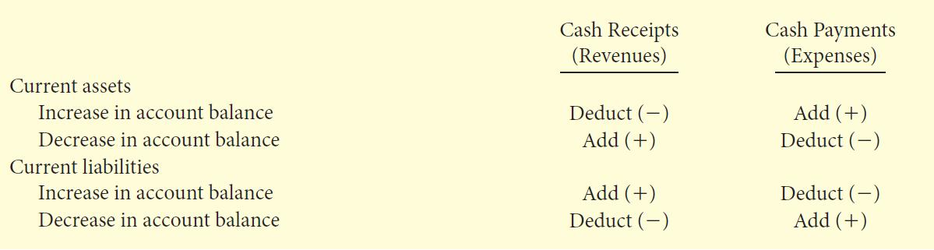
Summary of Conversion of Net Cash
Provided (Used) by Operating Activities
Direct Method

Slide 13
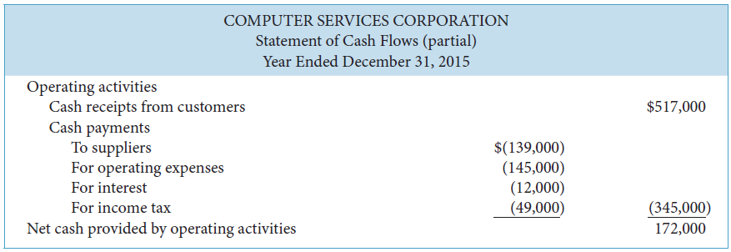
Net Cash Provided (Used) by Operating Activities
Direct Method

Slide 14
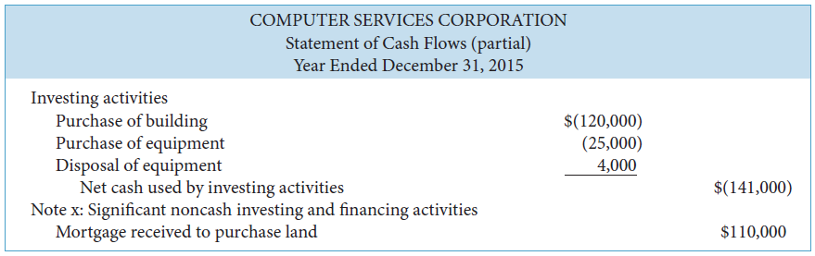
Net Cash Provided (Used) by Investing Activities

Slide 15
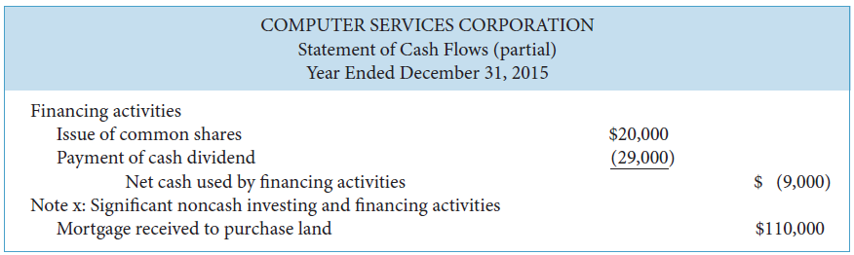
Net Cash Provided (Used) by Financing Activities

Slide 16
Step 4:
Complete the Statement of Cash Flows
Determine increase (decrease) in cash
Ensure ending cash balance agrees to that reported on statement of financial position
Identify any noncash disclosures

Slide 17
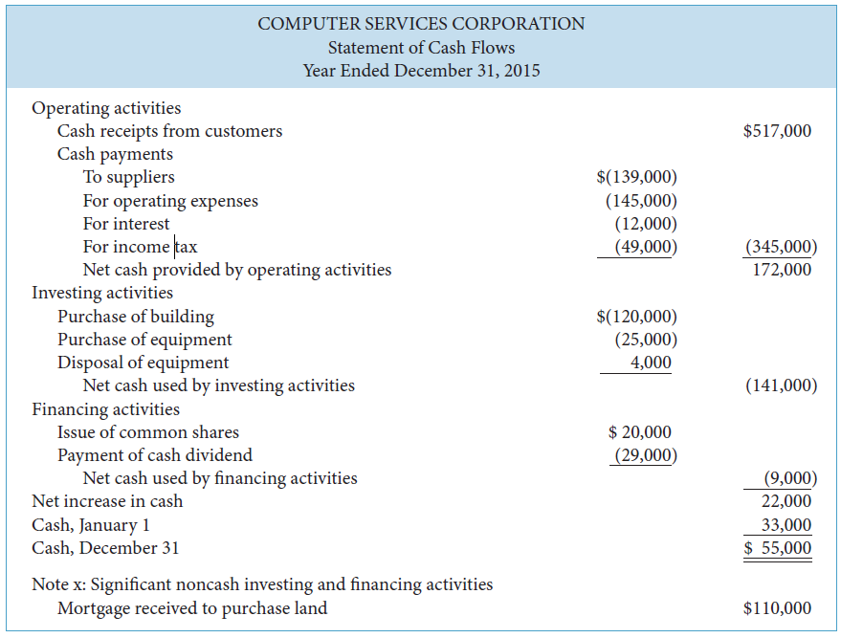
Statement of Cash Flows
Direct Method

Slide 18
Using Cash Flows to
Evaluate a Company
Liquidity
  Cash current debt coverage ratio
Solvency
  Cash total debt coverage ratio
  Free cash flow

Slide 19
Cash Current Debt Coverage Ratio
Measures ability of company to repay obligations coming due within the next year
Net cash provided (used) by operating activities
Average current liabilities

Slide 20
Cash Total Debt Coverage Ratio
Measures ability of company to repay its liabilities from operating activities
Net cash provided (used) by operating activities
Average total liabilities

Slide 21
Free Cash Flow
Measures discretionary cash flow remaining from operating activities available to use to expand operations, reduce debt, go after new opportunities, or pay additional dividends, among other alternatives
Net cash provided (used) by operating activities – net capital expenditures – dividends paid

Slide 22
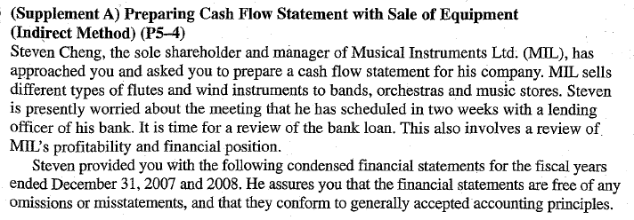
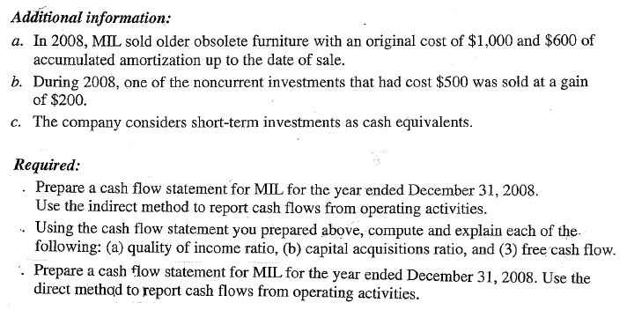

Slide 23


