Slide 1
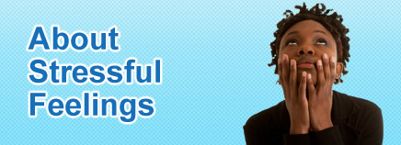
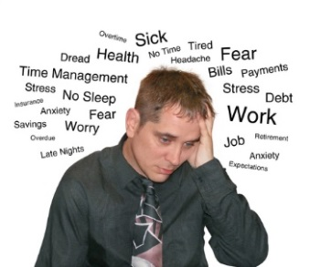

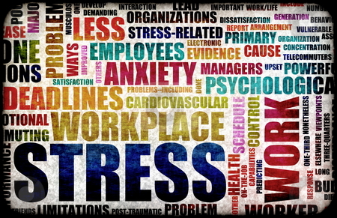
Stress and Health
Stress
  “I am under stress”
  “You are stressing me out!”
  “The stress is getting to me”
  Feeling of anxiety, tension, worry or apprehension
    And physical sensations
  But stress is not always bad
Stress
  The process by which we perceive and respond to certain events that we appraise as threatening or challenging
A) Events
  The stressors
B) Perception/appraisal
  Interpretation
C) Response
  Physiological reaction
    Stress reaction or the stress response
  The feeling
  Behavioural response (coping strategies)
Notes:
Special Info
Stress can also be good, eustress. It has a physiological response, like in distress. Distress triggers anxiety, eustress triggers anticipation and such. Distress is a response to threat, eustress is a response to a challenge, an opportunity where failure is not a concern. Four major differences: unlike distress, eustress is moderate, leaves fast, is less consequential, and any lack of control is entered into willingly.
Basically, eustress is good stress and distress is bad stress.

Slide 2
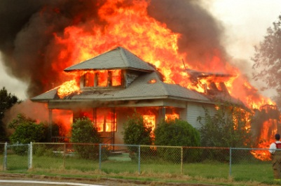
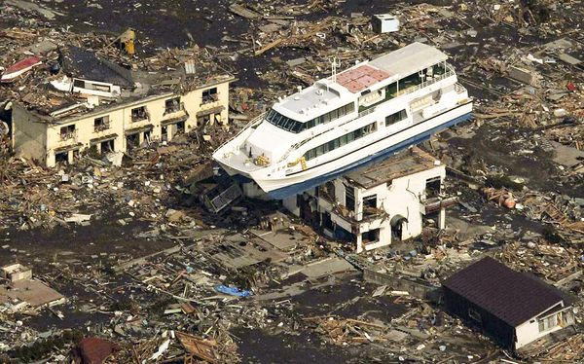
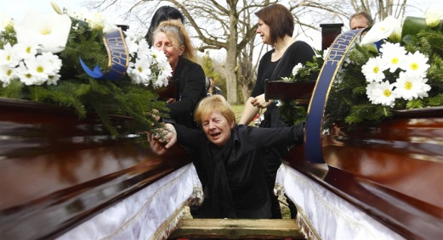
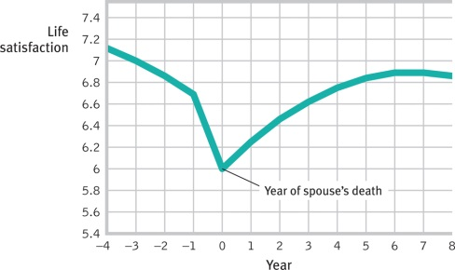
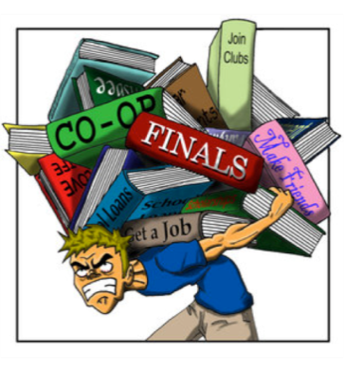
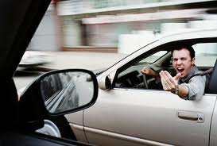
Stressors
Stressor
  Any event capable of producing a stress response
1) Catastrophes
  Large scale, often unpredictable events
  Hurricanes, floods, earthquakes, fires, war, famine
2) Significant life changes
  Leaving home, death of a loved one, loss of job, divorce
3) Daily hassles
  Traffic, aggravating roommates, long lines, money, kids
  Work, unemployment, school, social life
  Prejudice

Slide 3
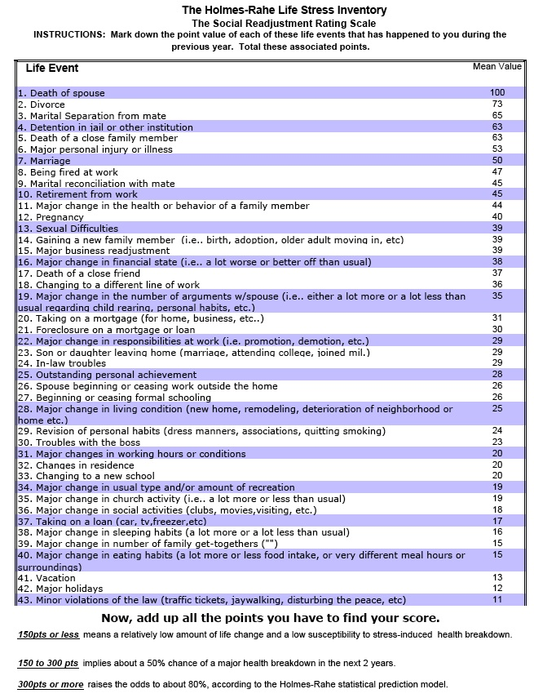
Holmes and Rahe’s Social Adjustment Rating Scale
A measure of stress
  Predictor of illness
43 life events
  Ranked from most to least stressful
  Assigned a point value
    Degree of required change or adjustment
  Cumulative score indicates your risk of stress related illness
Moderate correlation between score and illness
Criticism
  Doesn’t take into account whether change is good or bad
    E.g., divorce, retirement
  Doesn’t take into account coping skills
Notes:
Not important

Slide 4
Video
http://www.youtube.com/watch?v=sPS7GnromGo
  http://www.youtube.com/watch?v=eYG0ZuTv5rs

Slide 5
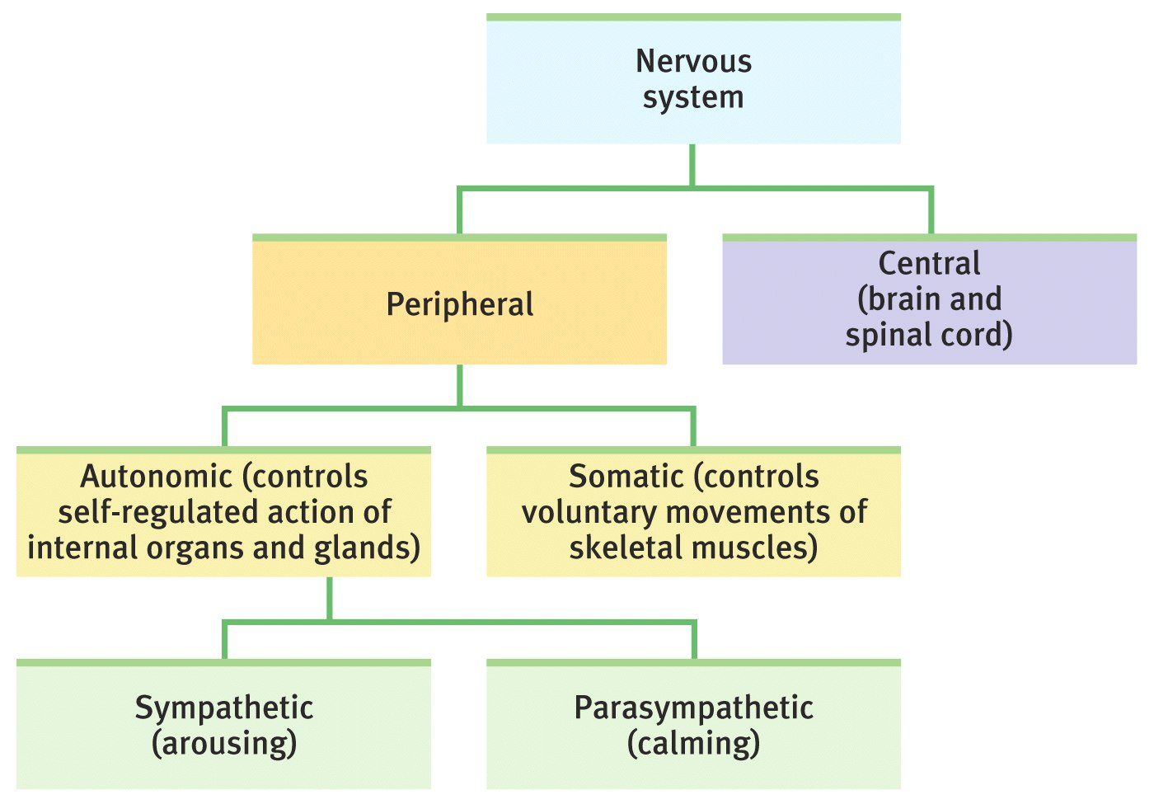
The Nervous System
Notes:
Know the “Sympathetic” and “Parasympathetic” parts:
Sympathetic: makes your body have the physiological response.
Parasympathetic: makes your body calm down, opposite of Sympathetic.

Slide 6
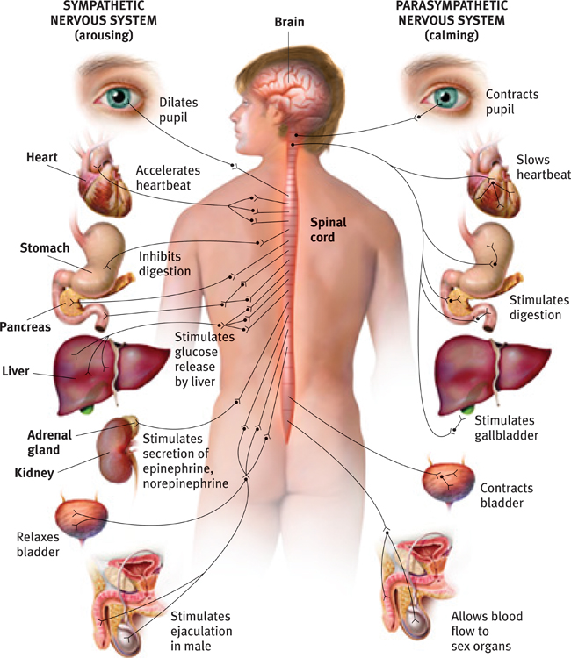
The Stress Response
Walter Cannon
  Common physiological response to a perceived threat or challenge
Response is initiated by the sympathetic nervous system (SNS)
  Fight-or-flight response
    Physiological changes associated with physical exertion
  Stress hormones
    Epinephrine & norepinephrine
      Fast-acting, short-term stress hormone
    Cortisol (glucocorticoid)
      Slower-acting, relatively long-term stress hormone
Short term
  Adaptive
Long-term
  Harmful

Slide 7
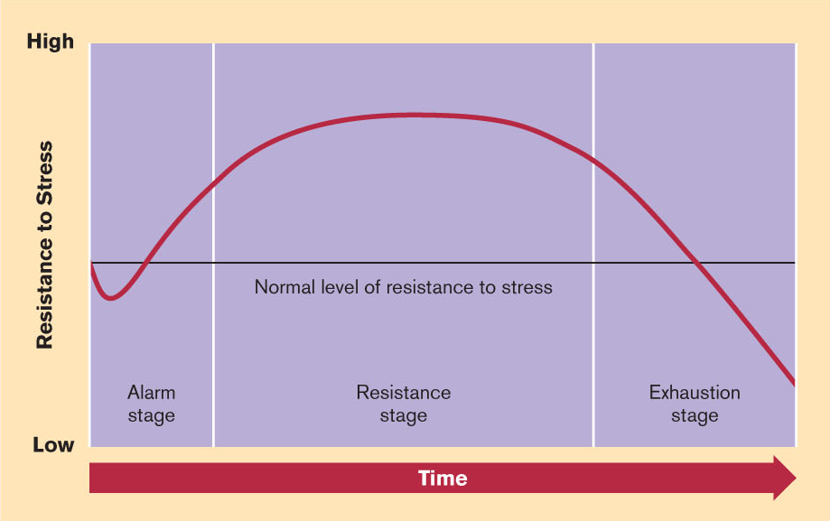
Hans Selye’s General Adaptation Syndrome
General Adaptation Syndrome
  Non-specific SNS response
  3 stages
1) Alarm stage
  Initial fight or flight response
    Shock and anti-shock phases
2) Resistance stage
  If the stressor can not be overcome or avoided
  Continued release of hormones
    Cortisol
  Keeps the body in a constant state of readiness
  Length depends on the stressor and the individual’s ability to adapt
3) Exhaustion stage
  If the stressor continues, eventually exhaustion will result
  Can lead to disease, neural degeneration, and early aging

Slide 8
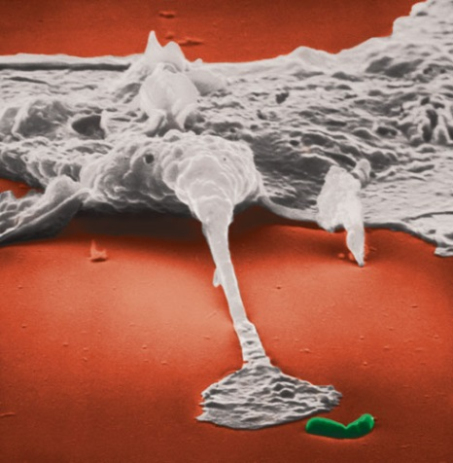
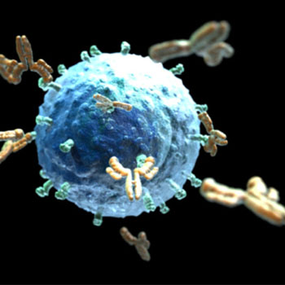
Stress & The Immune System
Pathogens
  Bacteria, viruses, fungi, parasites
A) Macrophages
  Engulf/eat pathogens & dead cells
    Help with cleaning up injury, thus, helps with healing
B) B-Lymphocytes
  Release antibodies (recognize antigens)
  Stimulates WBCs to multiply
C) T-Lymphocytes
  Antibody-like proteins
D) Natural Killer Cells (NK cells)
  Release chemicals that poke holes in tumor cells or cells that have been infected by a virus

Slide 9
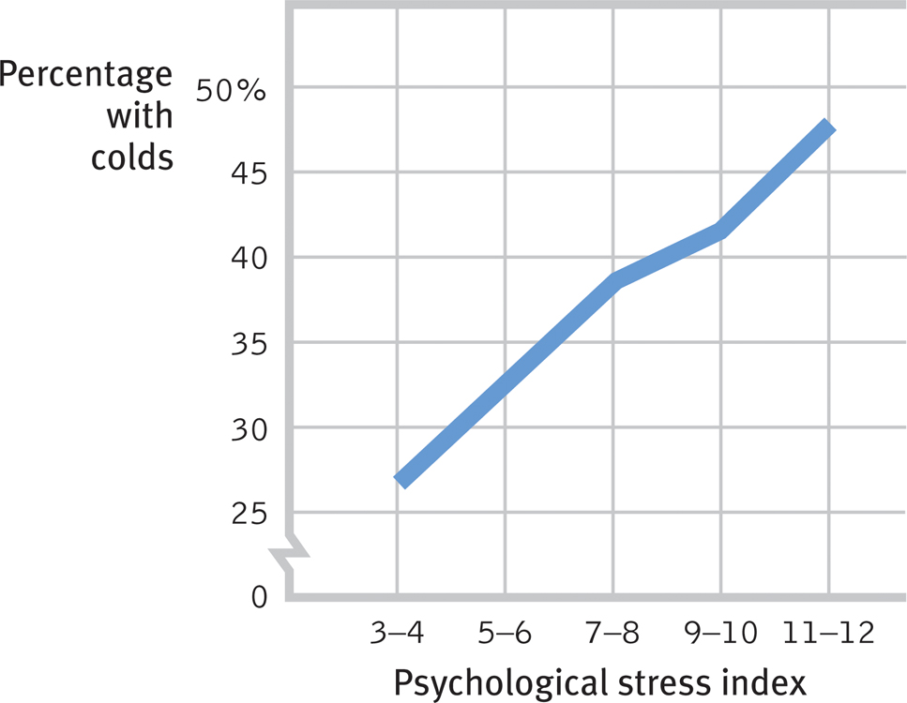
Stress & The Immune System
Stress and Healing
  Puncture wound study
    Healed 40%slower
    See similar results with marriage stress
Stress and Colds
  Cold virus study
  Flu, mononucleosis, herpes outbreaks
Stress and Vaccines
  Vaccines are more effective in those with lower stress

Slide 10
Stress & The Immune System
Sympathetic nervous system activation
  Fight-or-flight
  Low-energy immune response is activated
    Immune cells and antibodies that are already prepared to act are mobilized into the saliva and the blood
  High-energy immune response is suppressed
    Immune cell multiplication is inhibited
Chronic or prolonged stress suppresses immune system functioning
  Both require a lot of energy
  Resolving the stress takes precedence
  Cortisol interferes with messaging between immune cells

Slide 11
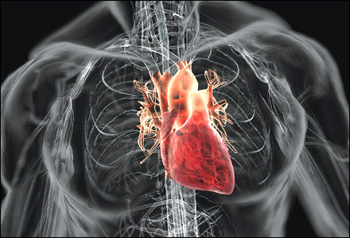
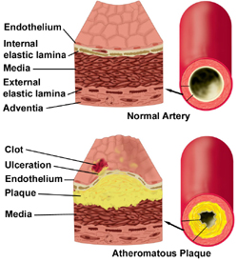
Stress and Heart Disease
http://www.webmd.com/heart-disease/video/atherosclerosis
https://www.youtube.com/watch?v=eYG0ZuTv5rs
  23:00
There is a relationship between stress and heart disease
Heart Disease
  Atherosclerotic plaques
  Diet, high blood pressure, lack of exercise, smoking
Stress accelerates this process
  A) Increases blood pressure
    Damage to artery walls
    Dislodging of plaque
  B) Elevates blood fat and cholesterol
    Reduced blood flow to the liver
    Available for plaque formation

Slide 12
Video
http://www.ted.com/talks/kelly_mcgonigal_how_to_make_stress_your_friend.html
http://www.youtube.com/watch?v=RcGyVTAoXEU
Notes:
Meta stress: being stressed about stress.

Slide 13
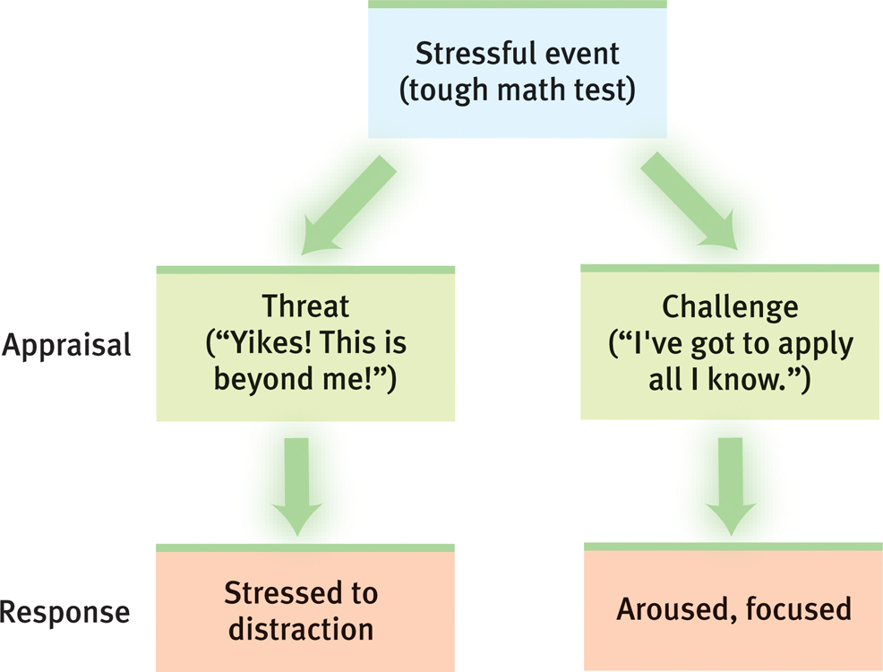
Cognitive Appraisal of Stressor
Primary Appraisal
  An evaluation of the significance of the situation
  It’s effect on our well-being
    1A) Harm/loss
    1B) Threat of harm/loss
      Friend, family, physical harm, property, finances, self-esteem, social position
    2) Challenge – opportunity to grow/gain
Emotional Response
  For harm/loss (threat) experience negative emotions
    Anxiety, fear, anger, resentment
  Challenge appraisal involves positive emotions
    Excitement, hopefulness, eagerness

Slide 14
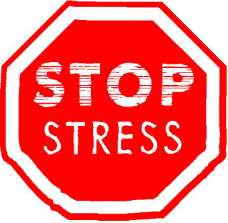

Cognitive Appraisal of Stressor
Secondary Appraisal
  Assess our available resources for coping with the stressor
  1) Physical resources
    Health, energy, stamina
  2) Social
    Social support from family or friends
  3) Psychological
    Self-esteem, intelligence, creativity
    Relaxation skills
  4) Material
    Money, tools
  5) Time
Level of stress depends on these factors
  How much control do we have
  E.g., rats, nursing home residents, workers, prisoners, SES (humans and primates)

Slide 15
  http://www.youtube.com/watch?v=eYG0ZuTv5rs
  9:32 (rank and stress)

Slide 16
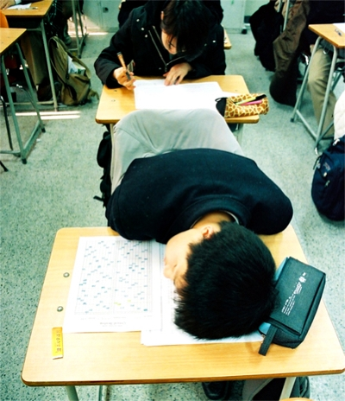
Coping with Stress
Coping
  The method that one uses to alleviate stress
E.g., Exam preparation (fear of a bad grade)
  Drop the course
  More studying
  Distract yourself
  Change thinking

Slide 17
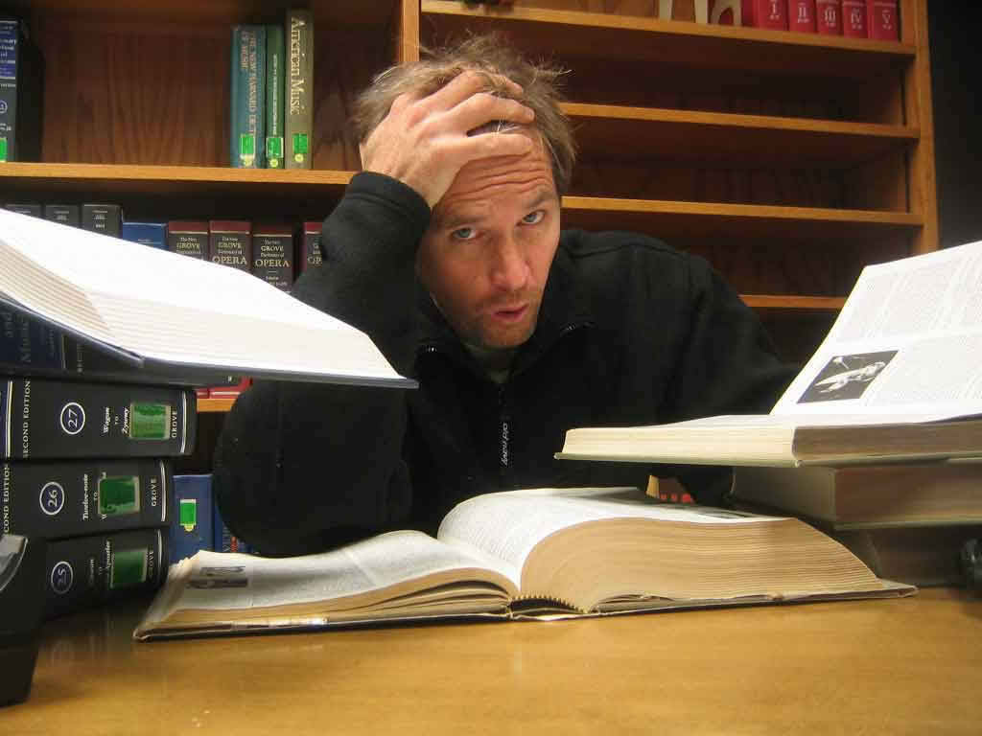

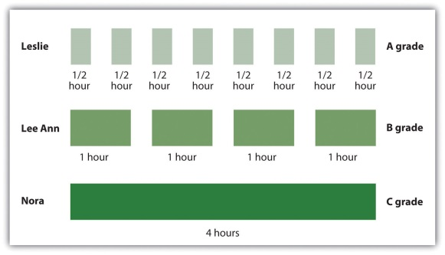

Coping Methods
2 General Categories
1) Problem-Focused Coping
  A response aimed at reducing or eliminating the stressor
  Act to lessen the threat
    Study more
  Enlist the help of others
    Join a study group, hire a tutor
  Work to prevent future occurrences
    Spread your studying
  Remove yourself from the situation
    Drop the course
Requires some control over the situation

Slide 18
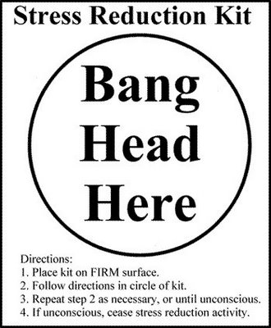
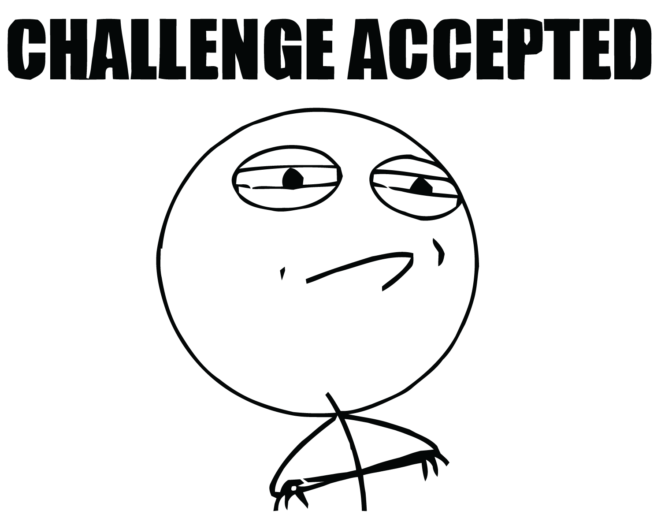
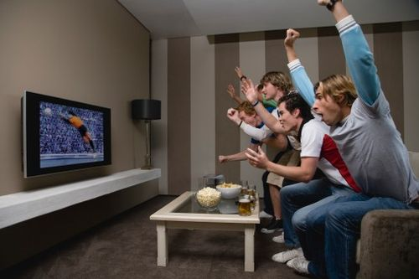
Coping Methods (cont’d)
2) Emotion-Focused Coping
  A response aimed at reducing the emotional distress caused by the stressor
  Modify your appraisal
    View it as a challenge, rather than a threat
  Moderate the stress reaction
    E.g., meditation, prayer, humour, relaxation techniques, exercise, social support
    E.g., denial, wishful thinking, alcohol/drugs, eating, distraction

