Slide 1
Review Nov 25

Slide 2
Projects

Slide 3
Additional Definitions
A project is a unique venture with a beginning and an end, conducted by people to meet established goals within parameters of cost, schedule, and quality.
Buchanan & Boddy 92
Projects are goal-oriented, involve the coordinated undertaking of interrelated activities, are of finite duration, and are all, to a degree unique.
Frame 95

Slide 4
Project Definitions Summarized
A project can be considered any series of activities and tasks that have:
Specific objectives to be completed within certain specifications,
Defined start and end dates,
Funding limits,
Human and nonhuman resources, and
Multifunctional focus.

Slide 5
Elements of Projects
Complex, one-time processes
Limited by budget, schedule, and resources
Developed to resolve a clear goal or set of goals
Customer-focused

Slide 6
Process & Project Management (Table 1.1)
Process
Repeat process or product
Several objectives
Ongoing
People are homogeneous
Systems in place to integrate efforts
Performance, cost, & time known
Part of the line organization
Bastions of established practice
Supports status quo
Project
New process or product
One objective
One shot – limited life
More heterogeneous
Systems must be created to integrate efforts
Performance, cost & time less certain
Outside of line organization
Violates established practice
Upsets status quo

Slide 7
Project Success Rates
Software & hardware projects fail at a 65% rate,
Over half of all IT projects become runaways,
Only 30% of technology-based projects and programs are a success.
Only 2.5% of global businesses achieve 100% project success and over 50% of global business projects fail,
Average success of business-critical application development projects is 32%, and
Approximately 42% of the 1,200 Iraq reconstruction projects were eventually terminated due to mismanagement or shoddy construction

Slide 8
Project Life Cycles
Feasibility - the development of the initial goal and technical specifications. (Determine scope; identify necessary resources and stakeholders)
Planning & Design – all detailed specifications, schedules, schematics, and plans are developed
Execution – the actual “work” of the project is performed
Turnover & Startup – project is transferred to the customer, resources reassigned, project is closed out.

Slide 9
Project Management
Project Management is the application of knowledge, skills, tools and techniques to project activities to meet project requirements. Project management is accomplished through the application and integration of the project management processes of initiating, planning, executing, monitoring and controlling and closing.
PMI

Slide 10
Project Manager Responsibilities
Selecting a team
Developing project objectives and a plan for execution
Performing risk management activities
Cost estimating and budgeting
Scheduling
Managing resources

Slide 11
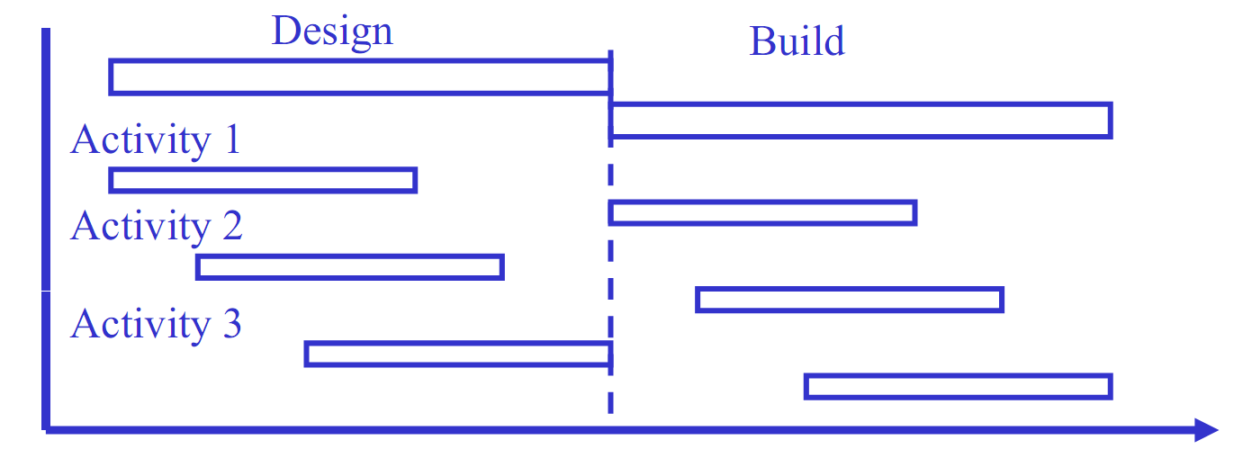
Project Delivery Methods
Traditional
  All Build activities start after all design work is completed

Slide 12
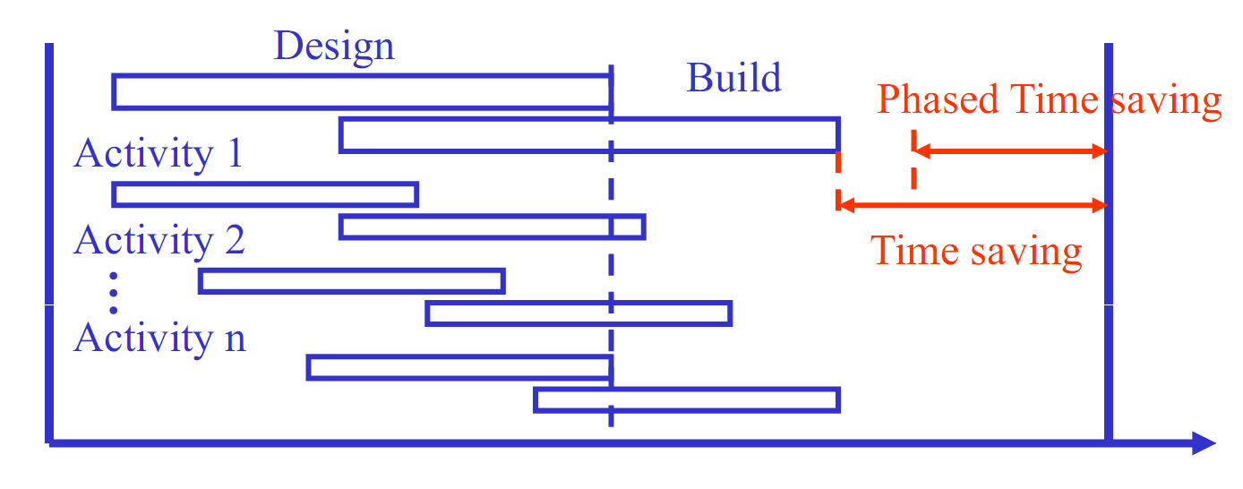
Project Delivery Methods
Fast Track
  Design and Build phases overlap; For each activity Build starts before Design is finalized

Slide 13
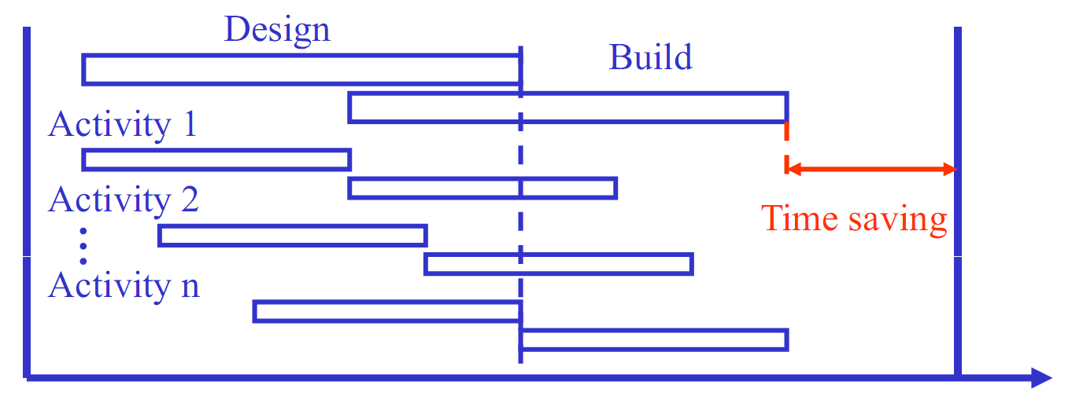
Project Delivery Methods
Phased
  Design and Build phases overlap, but for each activity Build starts after Design ends

Slide 14
Project Delivery Methods Characteristics
Traditional
  Longest overall project duration
  Single contractor
Phased
  Shorter overall project duration
  Multiple contractors; Requires PM
Fast Track
  Shortest overall project duration
  Multiple contractors; Requires PM
  Very difficult to manage
  Inadequate design & schedule
  Inadequate design & schedule

Slide 15
Organizations

Slide 16
Forms of Organization Structure
Functional organizations – group people performing similar activities into departments
Project organizations – group people into project teams on temporary assignments
Matrix organizations – create a dual hierarchy in which functions and projects have equal prominence
  Weak
  Balanced
  Strong
02-16

Slide 17
Functional Structures
Strengths | Weaknesses
High stability. High professional standard. Incorporation of latest technology. Excellent corporate memory Tightest discipline control | Poor communication across functional areas (Silo Effect). Low adaptability. Min. appreciation of overall project objectives. Overly rigid operating rules. Resistance to change.
02-17

Slide 18
Project Structures
Strengths | Weaknesses
Project manager sole authority Improved communication Effective decision-making Creation of project management experts Rapid response | Expensive to set up and maintain teams Change of loyalty to the project rather than the firm No pool of specific knowledge Workers unassigned at project end
02-18

Slide 19
Matrix Structures
Strengths | Weaknesses
Suited to dynamic environments Equal emphasis on project management and functional efficiency Promotes coordination across functional units Maximizes scarce resources | Dual hierarchies mean two bosses Negotiation required in order to share resources Workers caught between competing project & functional demands
02-19

Slide 20
Canadian Business
Organizations

Slide 21
Why are Forms of Business Organizations Important?
The legal structure of a business influences:
  The way it is taxed.
  the extent and distribution of its liability.
  The provincial and federal laws that will govern the business’s operation.
  The business’s ability to raise capital.
05-04

Slide 22
Canadian Forms of Business Organizations
In Canada there are four forms of business organizations
  Sole proprietorships
  Partnerships
  Corporations
  Cooperatives
05-05
Notes:
22

Slide 23
Sole Proprietorships
Is an individual carrying on business under his/her name.
  The individual owns and operates the organization.
The assets of the organization are owned by the individual and are considered as being part of the individual’s personal worth.
  Any profits made by the business belong to the individual.
  Any losses borne by the business are losses that are borne by the individual.
No separation between the individual’s personal assets and those of the business.
Personal assets are at risk for the liabilities of the business.
05-06

Slide 24
Partnerships
Formed when two or more individuals, usually from the same profession, decide to form a business together, such as an engineering consultancy, law firm, and accounting firm
Reason for forming a business partnership:
  Divide risks
  Combine management and financial resources
05-09
Notes:
24

Slide 25
Limited Liability Partnership
Limited partners contribute money or other tangible assets towards the capitalization of the business
  Results in a percentage of ownership
  Shares in profit and loss of the firm according to percentage of ownership
  Extent of loss is limited to the amount invested towards the capitalization of the business
  Also, a limited partner does not actively participate in the management of the business.
05-14

Slide 26
Corporations
Used at both the federal and provincial levels
A separate legal entity created according to federal or provincial statutes.
Businesses must use:
  Corporation, Corp., Incorporated, Inc., Limited, or Ltd. as part of their name
05-17

Slide 27
Corporations
Liability associated with a corporation is not transferred to the individuals (shareholders, officers, directors, or employees) who are associated with it.
Liability for the corporation’s debts and obligations is limited to the corporation’s assets.
In establishing a corporation the initial shareholders provide financial capital and expertise.
  The number of shares given to a founding shareholder is determined based on the shareholder’s level of contribution.
05-18
Notes:
27

Slide 28
Cooperatives
Owned by an association of members.
Suitable when a group of persons or businesses are seeking access to common needs such as the sale of products, services, and even employment.
In Canada, federal legislation referred to as the Canada Cooperatives Act governs the formation and operation of cooperatives.
05-21

Slide 29
Scheduling and Networks

Slide 30
Work Breakdown Structure (WBS)
One output of planning is the work breakdown structure (WBS)
A work breakdown structure is a deliverable-oriented grouping of project elements that organizes and defines the total scope of the project.
Work not in the WBS is outside the scope of the project.
As with the scope statement, the WBS is often used to develop or confirm a common understanding of project scope.
04-26

Slide 31
Critical Path Method (CPM)
CPM is a project network analysis technique used to predict total project duration
Slack or Float is the time the activity can be delayed without delaying the project duration
Critical Path – path with the longest total duration.
  This is the shortest time in which the project can be completed.
Critical Activity – an activity on the critical path with zero float
If a critical activity is delayed, the entire project will be delayed. Close attention must be given to critical activities to prevent project delay.
There may be more than one critical path.
31
Notes:
31

Slide 32
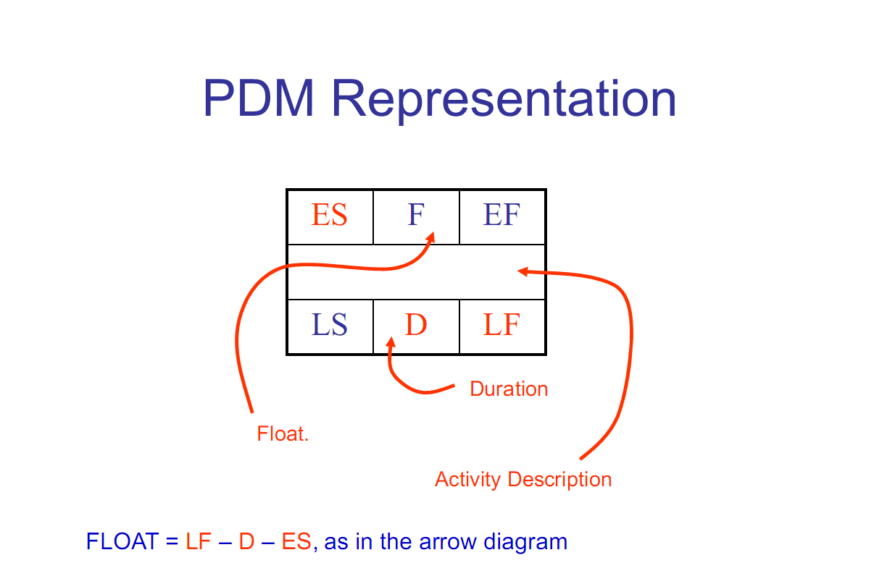
Activity on Node
32
Notes:
32

Slide 33
CPM Calculations
Forward pass – an additive move through the network from start to finish
Forward Pass Rules (ES & EF)
Early start time of first event = 0 (forward pass) E(0) = 0
ES + Duration = EF
EF of predecessor = ES of successor
Largest preceding EF at a merge point becomes ES for successor
33
Notes:
33

Slide 34
CPM Calculations
Backward pass – a subtractive move through the network from finish to start
Backward Pass Rules (LS & LF)
LF – Duration = LS
LS of successor = LF of predecessor
Smallest succeeding LS at a burst point becomes LF for predecessor
For last event EF = LF
After finishing the backward pass, calculate float
Total float TF (i,j) = L(j) – E(i) – Dij
34
Notes:
34

Slide 35
Cost and Budgets

Slide 36
QUIZ 1:
What is difference between price and cost?
The price is described as products or services sold or bought.
The cost is the amount of money the supplier incurred to provide the products or services.
36

Slide 37
TYPES OF COSTS
Direct Vs. Indirect (type of costs)
  Direct Costs: Direct costs are those resources that are expended solely to complete the activity or asset.
  Indirect Costs: Indirect costs are those resources that need to be expended to support the activity or asset but that are also associated with other activities and assets.
37

Slide 38
TYPES OF COSTS
Fixed Vs. Variable (adjustment of costs)
  Fixed Costs: Fixed costs are those cost elements that must be provided independent of the volume of work activity or asset production that they support.
  Variable Costs: Variable costs are those cost elements that must be provided and are dependent on the volume of work activity or asset production that they support.
38

Slide 39
TYPES OF COSTS
Recurring Vs. Nonrecurring (frequency of costs)
  Recurring Costs: Regular cost incurred frequently, or for each item produced or each service performed.
  Nonrecurring Costs: Unusual charge, expense, or loss that is unlikely to occur again in the normal course of a business such as fire or theft losses, lawsuit payments, losses on sale of assets, and moving expenses.
39

Slide 40
TYPES OF COSTS
Normal Vs. Expedited (schedule of costs)
  Normal Costs: Normal costing is used to value products or services with the actual materials costs, the actual direct labor costs, and overhead based on a predetermined rate.
  Expedited Costs: The costs for achieving the desired result as quickly as possible. In fast tracking repairs or replacement of a lost or damaged asset, overtime, express transport, prioritizing will each likely cost extra.
40

Slide 41
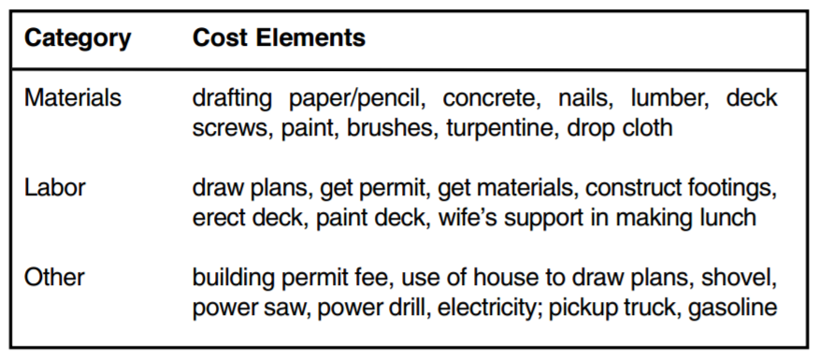
QUIZ 2
John decides to build a deck on the back of his house. He draws up plans for the project, gets the building permit from the city, buys the material, hauls it home, and constructs the deck. The cost elements and categories associated with building this asset are shown in Table below. Notice that some of these cost elements are not part of the physical deck, but are necessary in order to complete the project. Classify the following table into direct, indirect, fixed, and variable costs
41

Slide 42
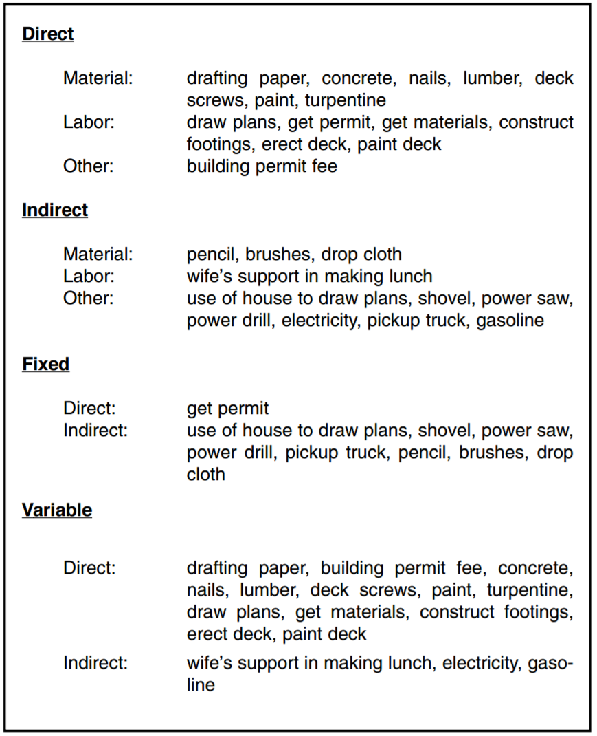
QUIZ 2
42

Slide 43
Earned Value

Slide 44
Earned Value Terminology
Budgeted Cost of Work Scheduled (BCWS) or Planned Value (PV):
  represents the “authorized budget assigned to the work to be accomplished for an activity”.
Budgeted Cost of Work Performed (BCWP) or Earned Value (EV):
  represents how much of the budget should have been spent based on the actual amount of work performed.
  Represents planned expenditures at their actual times
  Obtained by firstly determining actual quantities of work completed.
    Actual quantity of work completed / total quantity of work = % complete
Earned value (EV) = % complete x total budgeted cost
Dr C.J. Willis, CAPM, P.Eng
44
Notes:
The BCWS represents planned cumulative expenditures at planned times, i.e. if the amount of expenditures was exactly as planned, and the timing of expenditures occurred exactly as scheduled, then money would be spent as per the BCWS curve. The total BCWS of a project is the Budget at Completion (BAC).
The BCWP curve represents planned expenditures at their actual times. The earned value of an activity or a project is obtained by determining actual quantities of work completed. Firstly, determine the percentage of work completed:
44

Slide 45
Earned Value Terminology
Actual Cost of Work Performed (ACWP) or Actual Cost (AC):
  is actual cost incurred in accomplishing the work.
Budget at Completion (BAC):
  is the total planned value PV of a project, i.e. it is the total estimated cost of a project.
Dr C.J. Willis, CAPM, P.Eng
45

Slide 46
Earned Value Terminology
Cost Variance (CV): is a measure of the cost performance on a project.
CV = BCWP – ACWP = EV – AC
If CV is positive, project cost is currently under the budgeted or baseline amount, i.e. actual expenditures are less than budgeted. This is desirable performance.
If CV is negative, project cost is currently over the budgeted or baseline amount, i.e. actual expenditures are greater than budgeted. This is undesirable performance.
Dr C.J. Willis, CAPM, P.Eng
46

Slide 47
Earned Value Terminology
Schedule Variance (SV): is a measure of the schedule performance of a project.
SV = BCWP – BCWS = EV - PV
If SV is positive, the project is ahead of schedule in cost terms, i.e. actual amount of work performed is greater than the amount of work scheduled.
If SV is negative, the project is behind schedule in cost terms, i.e. the actual amount of work performed is less than the amount of work scheduled.
Dr C.J. Willis, CAPM, P.Eng
47

Slide 48
Earned Value Terminology
Cost Performance Index (CPI): is an alternative to CV and is an efficiency indicator that measures cost efficiency for work completed.
A CPI measure is more useful than a CV measure when making comparisons in different points in time or across different projects.
CPI = BCWP / ACWP = EV / AC
A CPI value greater than 1 indicates a cost underrun of performance to date.
Dr C.J. Willis, CAPM, P.Eng
48

Slide 49
Earned Value Terminology
Schedule Performance Index (SPI): is an alternative to SV that measures progress achieved compared to progress planned on a project.
A SPI measure is more useful than a SV measure when making comparisons in different points in time or across different projects.
SPI = BCWP / BCWS = EV / PV
A SPI greater than 1 indicates more work was completed than was planned.
Dr C.J. Willis, CAPM, P.Eng
49

Slide 50
Earned Value Terminology
Estimated (remaining cost) To Completion (ETC):
  can be forecasted at any point of the project and can be calculated using one of two methods:
(1) ETC = (BAC – EV) / CPI
This calculation is used when current variances are assumed as being typical of future variances.
It is assumed that the project will be completed at the same level of efficiency or inefficiency encountered to date.
Dr C.J. Willis, CAPM, P.Eng
50

Slide 51
Earned Value Terminology
(2) ETC = BAC – EV
This calculation is used when current variances are assumed to be atypical of future variances, i.e. variances in the future will not be the same as current variances.
Dr C.J. Willis, CAPM, P.Eng
51

Slide 52
Earned Value Terminology
Projected (total cost) Estimated At Completion (EAC), assuming current variances are typical of future variances:
  can be forecasted at any point of the project by using the following expression:
EAC = ETC + AC
With EAC = (BAC – EV)/CPI + AC
And EAC = BAC/CPI – EV/CPI + AC
We get EAC = BAC/CPI = BAC * AC/EV
Dr C.J. Willis, CAPM, P.Eng
52

Slide 53
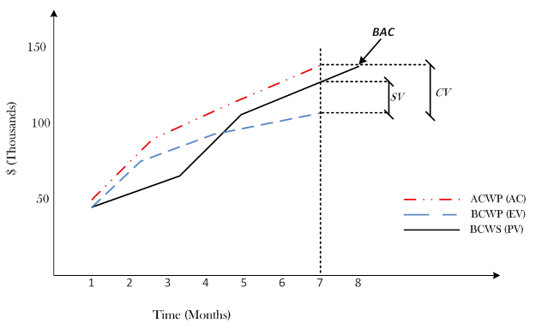
Use of EVM for Performance Reporting
Dr C.J. Willis, CAPM, P.Eng
53
Notes:
Figure 2 below highlights how EVM is used for project performance reporting. The BAC for the project is $140,000 and the planned duration is 8 months. At month 7 the BCWS is $130,000, the ACWP is $140,000 and the BCWP or EV is $108,000. For this reporting period the:
SV is $108,000 – $130,000 = –$22,000
CV is $108,000 – $140,000 = –$32,000
The SV and CV are both negative indicating that the project is behind schedule and over budget, respectively.
The SPI and CPI at month 7 are 0.83 and 0.77, respectively. Based on the SPI and if it is assumed that the current variances are typical and will continue, i.e. underperformance will continue to the end of the project, the forecasted overall duration of the project is:
^{8 months} / _{0.83} = 9.63 months
The ETC at month 7 assuming variances are typical and will continue is:
^{($140,000 - $108,000)} / _{0.77} = $41,558.
Based on this, the EAC for the project is $140,000 + $41,558 = $181,558.
53

Slide 54
Figure on previous page highlights how EVM is used for project performance reporting.
The BAC for the project is $140,000 and the planned duration is 8 months. At month 7 the BCWS or PV is $130,000, the ACWP or AC is $140,000 and the BCWP or EV is $108,000. For this reporting period:
SV = EV – PV = $108,000 – $130,000 = –$22,000
CV = EV – AC = $108,000 – $140,000 = –$32,000
The SV and CV are both negative indicating that the project is behind schedule and over budget, respectively.
Dr C.J. Willis, CAPM, P.Eng
54

Slide 55
Time Value of Money

Slide 56
9.2 Interest and Interest Rates
Interest (I) is compensation for giving up use of money
  difference between the amount loaned and the amount repaid.
An amount of money today, P, can be related to a future amount, F, by the interest amount I, or interest rate i:
Right to P at beginning time period exchanges for right to F at end, where F = P(1+i)
i → interest rate, P → present worth of F
F → future worth of P, base period → interest period
F = P + I = P + Pi = P(1 + i)
Copyright © 2013 Pearson Canada Inc.
2 - 56

Slide 57
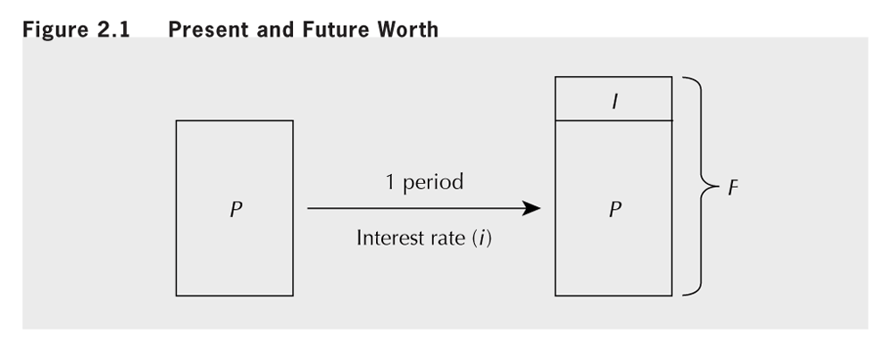
Figure 9.1 Present and Future Worth
Copyright © 2013 Pearson Canada Inc.
2 - 57

Slide 58
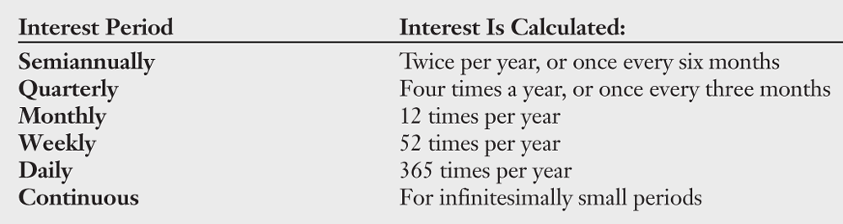
2.2 Interest and Interest Rates (cont’d)
The dimension of an interest rate is (dollars/dollars)/time.
i.e. if $1 is lent at a 9% interest rate then $0.09/year would be paid in interest for that time period
period over which interest calculated is interest period.
CLOSE-UP 2.1 Interest Periods
Copyright © 2013 Pearson Canada Inc.
2 - 58

Slide 59
2.3 Compound and Simple Interest
If amount P is lent for one interest period at the interest rate, i, the amount that must be repaid at the end of the period is F = P(1 + i).
If number of periods is greater than one, interest usually compounded (at the end of each period, interest is added to principal that there was at the beginning of that period).
The interest accumulated is:
F = P(1 + i)^{N}
I_{C} = F − P = P(1 + i)^{N} − P
Copyright © 2013 Pearson Canada Inc.
2 - 59

Slide 60
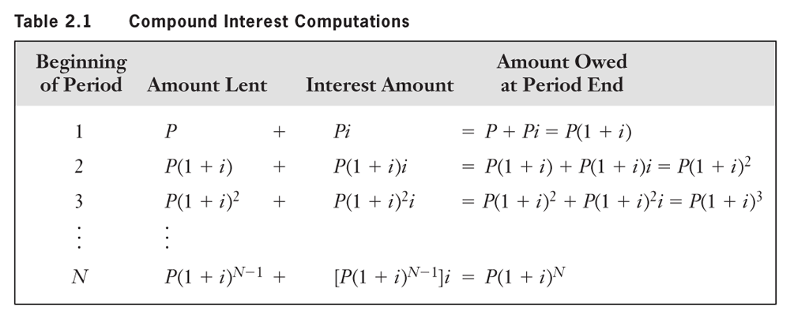
Table 9.1 Compound Interest Computations
Copyright © 2013 Pearson Canada Inc.
2 - 60

Slide 61
Practice Problem, Example 9.3
With i = 10% per year, how much is owed on a loan of $100 at the end of 3 years?
What is the compound interest amount?
F = P(1 + i)^{N} = 100(1 + 0.10)³ = $133.10
I_{C} = F − P = $133.10 − $100.00 = $ 33.10
The amount owed is $133.10. The interest owed is $33.10.
What is the amount owed at each year end?
Copyright © 2013 Pearson Canada Inc.
2 - 61

Slide 62
9.3 Compound and Simple Interest (cont’d)
Simple Interest – interest without compounding (interest is not added to principal at end of each period)
Compound and simple interest amounts equal if N = 1.
As N increases, difference between accumulated interest amounts for the two methods increases exponentially.
The conventional approach for computing interest is the compound interest method. Simple interest rarely used.
I_{S} = P i N
Copyright © 2013 Pearson Canada Inc.
2 - 62

Slide 63
9.4 Effective and Nominal Interest Rates
Interest rates stated for some period, like a year.
Computation based on shorter compounding subperiods
In this section we consider the relation between:
  The nominal interest rate stated for the full period.
  The effective interest rate that results from the compounding based on the subperiods.
Unless otherwise noted, rates are nominal annual rates
Suppose: r is nominal rate stated for a period (1 year) consisting of m equal compounding periods (sub-periods)
If i_{s} = r/m… then F = P(1 + i_{S})^{m} = P(1 + i_{e})
Copyright © 2013 Pearson Canada Inc.
2 - 63

Slide 64
9.4 Effective and Nominal Interest (cont’d)
Effective interest rate, i_{e}, gives same future amount, F, over the full period as when subperiod interest rate, i_{S}, is compounded over m subperiods. F = P(1 + i_{S})^{m} = P(1 + i_{e})
EXAMPLE 9.6 Cardex Credit Card Co. charges a nominal 24 percent interest on overdue accounts, compounded daily. What is the effective interest rate?
Since F = P(1 + i_{S})^{m} = P(1 + i_{e}), i_{e} = (1 + i_{S})^{m} − 1
where i_{s} = r/m = 0.24/365 = 0.0006575
then i_{e} = (1 + i_{S})^{m} − 1 = (1 + 0.0006575)³⁶⁵ - 1 = 0.271
The effective interest rate is 27.1%
Copyright © 2013 Pearson Canada Inc.
2 - 64

Slide 65
9.5 Continuous Compounding
Suppose that the nominal interest rate is 12% and interest is compounded semi-annually.
We compute the effective interest rate as follows: where r = 0.12, m = 2
i_{s} = r/m = 0.12/2 = 0.06
i_{e} = (1 + i_{S})^{m} − 1 = (1 + 0.06)² - 1 = .1236 (12.36%)
What if interest were compounded monthly?
i_{e} = (1 + i_{S})^{m} − 1 = (1 + 0.01)¹² − 1 = 0.1268 (12.68%)
Daily? i_{e} = 0.127475 or about 12.75%
More than daily? …Continuous Compounding
Copyright © 2013 Pearson Canada Inc.
2 - 65

Slide 66
9.5 Continuous Compounding (cont’d)
Now, we may compute the effective interest rate for a nominal interest rate of 12% under continuous compounding:
i_{e} = e^{r} − 1 = e^{0.12} − 1 = 0.12750 = 12.75%
Although continuous compounding makes sense in some circumstances (i.e large cash flows), it is not often used
Discrete compounding is the norm.
Copyright © 2013 Pearson Canada Inc.
2 - 66

Slide 67
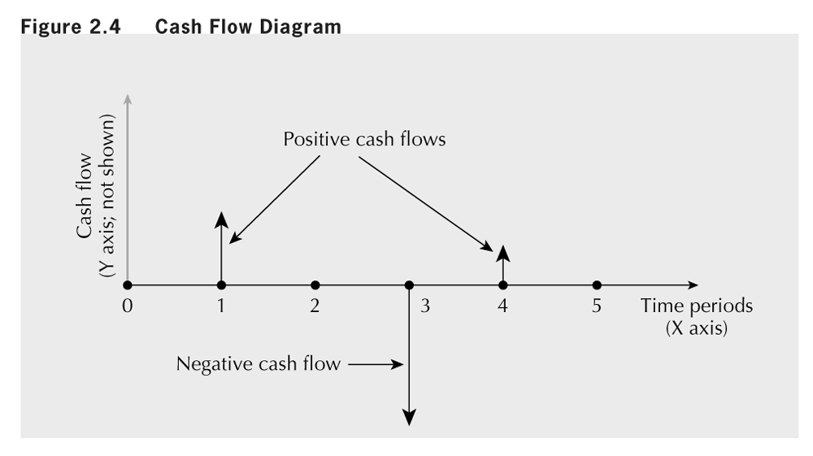
9.6 Cash Flow Diagrams
Cash flow diagram is a graphical summary of the timing and magnitude of a set of cash flows
Copyright © 2013 Pearson Canada Inc.
2 - 67

Slide 68
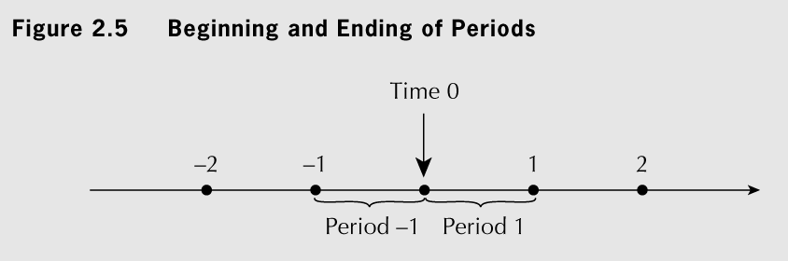
Fig 9.5 Beginning and Ending of Periods
Assumptions:
  Cash flows occur at the ends of periods.
  End of time period 1 = beginning of time period 2, etc.
  Time 0 = “now”
Copyright © 2013 Pearson Canada Inc.
2 - 68

Slide 69
Cash Flow Analysis

Slide 70
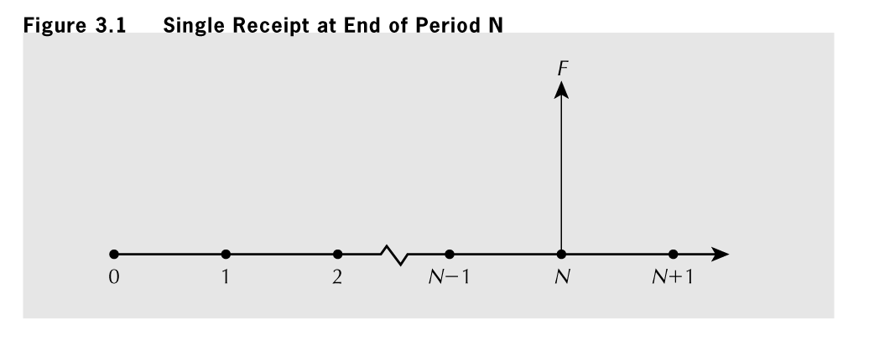
3.4 Compound Interest Factors for Single Disbursements or Receipts
Compound amount factor gives future amount, F, equivalent to a present amount P, interest rate is i and the number of periods until F is N:
F = P(1 + i)^{N} = P (F/P, i, N)
Copyright © 2013 Pearson Canada Inc.
3 - 70

Slide 71
3.4 Compound Interest Factors for Single Disbursements or Receipts (cont’d)
The present worth factor gives the present amount, P, that is equivalent to the future amount, F, when the interest rate is i and the number of periods between F and P is N:
P = F/(1 + i)^{N} = F (P/F, i, N)
Copyright © 2013 Pearson Canada Inc.
3 - 71

Slide 72
3.5 Compound Interest Factors for Annuities
Annuity: series of N receipts or disbursements that begin at end of period 1 and continue to end of period N
  loan payments are classical examples of annuities.
Sinking Fund Factor: series of N receipts/disbursements that should be set aside each period in order to meet a major financial need in the future
Copyright © 2013 Pearson Canada Inc.
3 - 72

Slide 73
3.5 Compound Interest Factors for Annuities (cont’d)
Uniform Series Compound Amount Factor:
  inverse of the sinking fund factor: (A/F, i, N)
  used to compute the total amount saved at the end of a regular savings plan
Copyright © 2013 Pearson Canada Inc.
3 - 73

Slide 74
Practice Problem 3.5a
A Ford Mustang costs $17 000. It can be financed at 5.9% for 48 months, with monthly compounding. How much will the monthly payments be?
Answer
  i = 0.059/12 = 0.00492 per month
  A = P(A/P, i, N) = $17 000(A/P, 0.00492, 48) = $398.50
Copyright © 2013 Pearson Canada Inc.
3 - 74

Slide 75
3.5 Compound Interest Factors for Annuities (cont’d)
Copyright © 2013 Pearson Canada Inc.
3 - 75
The Capital Recovery Factor: (A/P, i, N)
Is used to compute how much to be set aside each period to repay a present use of money.
easily derived from the sinking fund factor and the uniform series compound amount factor:

Slide 78
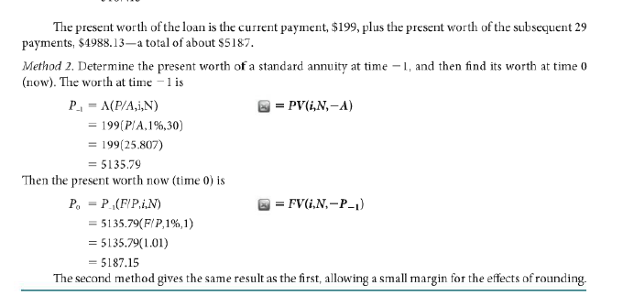

Slide 79
Mortgage

Slide 81
3.6 Conversion Factor for Arithmetic Gradient Series
Arithmetic Gradient to Uniform Series Factor: (A/G, i, N)
A series of N receipts or disbursements that increase by a constant amount from period to period.
Cash flows: 0G, 1G, 2G, ..., (N – 1)G at the end of periods 1, 2, ..., N (note this series does not start at 0)
Or with base annuity A’ added: A', A’ + G, A‘ + 2G, ..., A‘ + (N – 1)G at the end of periods 1, 2, ..., N.
Annuity equivalent to Gradient Series is A = G(A/G, i, N)
If there is base annuity A', A' must be included to give the overall annuity: A_{tot} = A' + G(A/G, i, N)
Copyright © 2013 Pearson Canada Inc.
3 - 81

Slide 82
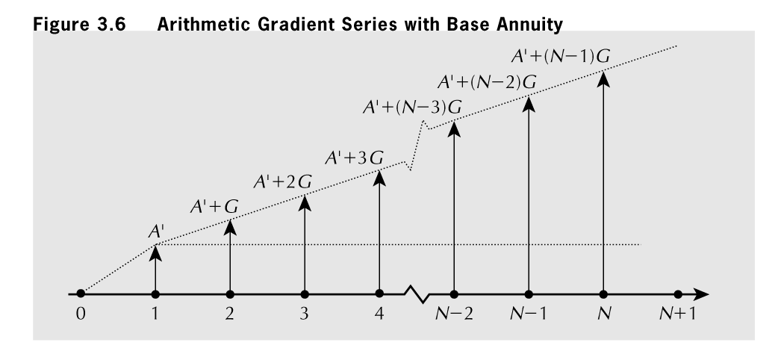
Figure 3.6 Arithmetic Gradient Series with Basic Annuity
Copyright © 2013 Pearson Canada Inc.
3 - 82

Slide 87
Comparison Methods

Slide 88
11.1 Introduction
Investment → exchange something valuable now for expectation of something of greater value later
Estimation of expected costs/returns from investment opportunity (or project) is important
need the appropriate comparison method
If we classify project correctly then we can select appropriate comparison method
Several widely used comparison methods for evaluating opportunities:
  Present Worth (PW)
  Annual Worth (AW)
  Payback Period
Copyright © 2013 Pearson Canada Inc.
4 - 88

Slide 89
11.1 Introduction (cont’d)
Six Assumptions regarding Comparison Methods:
  Costs/Benefits always measurable in terms of money
  Future cash flows are known with certainty
    Uncertainty/Risk is dealt with in Chapters 11 and 12
  Cash flows are unaffected by inflation or deflation
    Inflation is accommodated in Chapter 9
  Sufficient funds available to implement all projects
    Methods of raising capital are found in Appendix 4A
  Taxes are not applicable
    Taxes are included in decision-making by Chapter 8
  All investments have a cash outflow at the start
    These outflows are called first costs/initial investment
Copyright © 2013 Pearson Canada Inc.
4 - 89

Slide 90
11.2 Relations Among Projects
We classify groups of Projects as one of the three:
Independent: expected costs/benefits of each project independent of whether other is chosen
Mutually Exclusive: By virtue of choosing one all other alternatives must be excluded.
Related but not Mutually Exclusive: For such, expected costs/benefits of one depends on other(s) being chosen.
  combine them into an exhaustive list of mutually exclusive sets.
  Special cases of related projects
    One project is contingent on another.
    Resource or financial constraints (all sets of projects that meet the budget form a mutually exclusive set of alternatives)
Copyright © 2013 Pearson Canada Inc.
4 - 90

Slide 91
4.4.3 Annual Worth Comparisons
AW essentially same as PW, except all disbursements & receipts are transformed into uniform series at MARR
AW comparisons may be easier to conceptualize than PW (i.e. present cost or annual cost to operate your car?)
Comparison of two projects by PW or AW methods having the same life always indicate same preferred alternative
Sometimes justification for using one method over the other is computational ease or ease of grasping mentally
  When you communicate such in the “boardroom” which will your audience find easiest to grasp?
Copyright © 2013 Pearson Canada Inc.
4 - 91

Slide 92
11.5 Payback Period
Payback period: number of years it takes for an investment to be recouped (interest assumed 0)
simplest method for judging economic viability of projects (but note its approximation of i=0)
If annual savings are constant, the payback period is usually calculated as follows:
First cost
Payback period =
Annual savings
Copyright © 2013 Pearson Canada Inc.
4 - 92

Slide 93
Practice Problem 11.5
Two independent investment opportunities are shown below. What is the payback period for each? If you require a 3 year payback period, should none, either or both be purchased?
 | Machine A | Machine B
First cost | $15 000 | $20 000
Annual revenues | 9000 | 11000
Annual costs | 6000 | 8000
Scrap value | 1000 | 2000
Service life | 5 years | 10 years
Copyright © 2013 Pearson Canada Inc.
4 - 93

Slide 94
Practice Problem 11.5 (cont’d)
Answer
Machine A:
  First cost = $15 000
  Annual net benefits = 9 000 - 6 000 = $3 000
  Payback period = (15 000)/(3 000) = 5 years
Machine B:
  First cost = $20 000
  Annual net benefits = $11 000 - 8 000 = $3 000
  Payback period = (20 000)/(3 000) = 6.7 years
  (or, 7 years if you assume cash flows occur at year-end).
Therefore Machine A and machine B are rejected.
Copyright © 2013 Pearson Canada Inc.
4 - 94

Slide 95
App 11A MARR and Cost of Capital
How is the cost of capital is determined?
MARR required to get investors to invest in a business is that business’s Cost of Capital.
Cost of Capital also its MARR for projects
Two ways of raising capital: debt and equity
  Debt: from lenders
    Pre-determined interest rates and repayment conditions
    Assets are pledged as security against defaulting
  Equity: from owners
    Dividends are paid on shares sold
    Dividends are paid after all loan obligations are met
Copyright © 2013 Pearson Canada Inc.
4 - 95

Slide 99
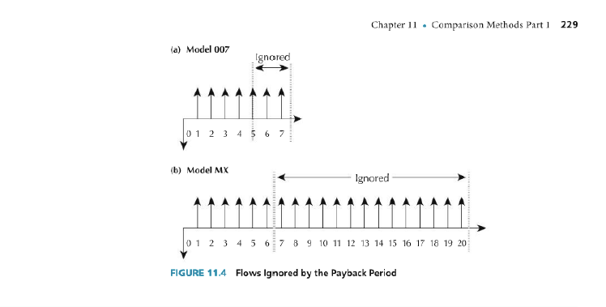

Slide 100
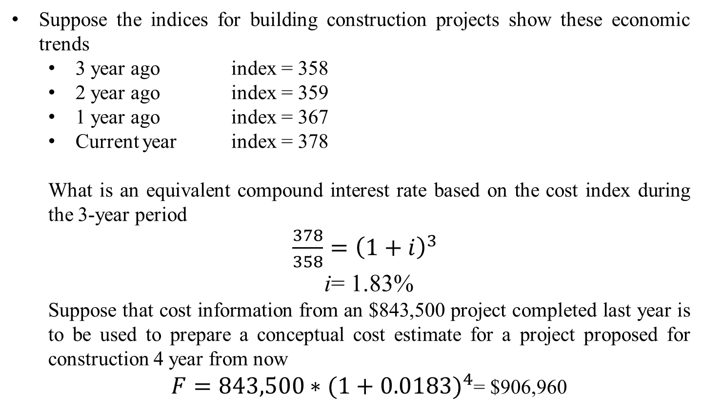
Linear Interpolation

Slide 101
Sinking Funds

Slide 102


