Slide 1
ADM 1300 Section C
Introduction to Business Management Fall 2016
Wednesday September 28, 2016

Slide 2
Planning
Planning: The process of setting objectives and determining how to best accomplish them
Objectives: Identify the specific results or desired outcomes that one intends to achieve
Plan: A statement of action steps to be taken in order to accomplish the objectives

Slide 3
Planning - Steps
  Define your objectives
  Determine where you stand vis-à-vis objectives
  Develop premises regarding future conditions
  Analyze and choose among action alternatives
  Implement the plan and evaluate results

Slide 4
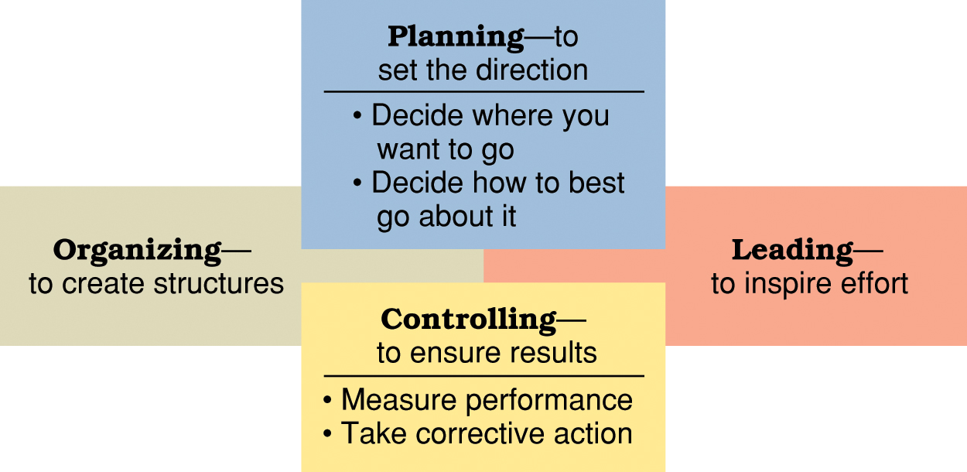
Planning and Control

Slide 5
Why Plan?
Improves focus and flexibility
Improves action orientation
Improves coordination and Control
Improves Time Management

Slide 6
Types of Plans
Short-range plans = 1 year or less
Intermediate-range plans = 1 to 2 years
Long-range plans = 3 or more years

Slide 7
Types of Plans
People vary in their capability to deal effectively with different time horizons
Higher management levels focus on longer time horizons

Slide 8
Types of Plans
Strategic plans: Set broad, comprehensive, and longer-term action directions for the entire organization
Tactical plans: Define what needs to be done in specific functions to implement strategic plans

Slide 9
Types of Plans
Production plans
Financial plans
Facilities plans
Marketing plans
Human Resource plans

Slide 10
Types of Plans
Operational plans: Policies and procedures
Policy: Broad guidelines for making decisions and taking action in specific circumstances
Rules or procedures: Plans that describe exactly what actions are to be taken in specific situations
Budgets: Single-use plans that commit resources to activities, projects, or programs (Fixed, flexible, and zero-based budgets)

Slide 11
Planning Tools and Techniques
Contingency planning: Identifying alternative courses of action that can be implemented if circumstances change
Contingency plans anticipate changing conditions
Scenario planning: A long-term version of contingency planning
Identifying alternative future scenarios
Plans made for each future scenario
“worst-case” and “best-case” scenarios

Slide 12
Planning Tools and Techniques
Benchmarking: Use of external and internal comparisons to better evaluate current performance and identify possible actions for the future
Adopting best practices of other organizations that achieve superior performance

Slide 13
Planning Tools and Techniques
Use of staff planners
  Coordinating and energizing the planning function
  Help bring focus and expertise to accomplish important, often strategic, planning tasks
  Possible communication gaps between staff planners and line management

Slide 14
Implementation: Goal Setting
Can make a big difference in how well management does in pointing people in the right directions and inspiring them to work diligently
Effective goals are SMART:
  Set Specific goals
  Make sure goals are Measurable
  Ensure goals are Attainable
  Goals must be Referred to Regularly
  Goals must be Timely

Slide 15
Implementation
Goal Alignment
  To make sure that goals and plans are well integrated across the many people, work units, and levels of an organization as a whole
  Goals set anywhere in the organization should ideally help advance its overall mission or purpose

Slide 16
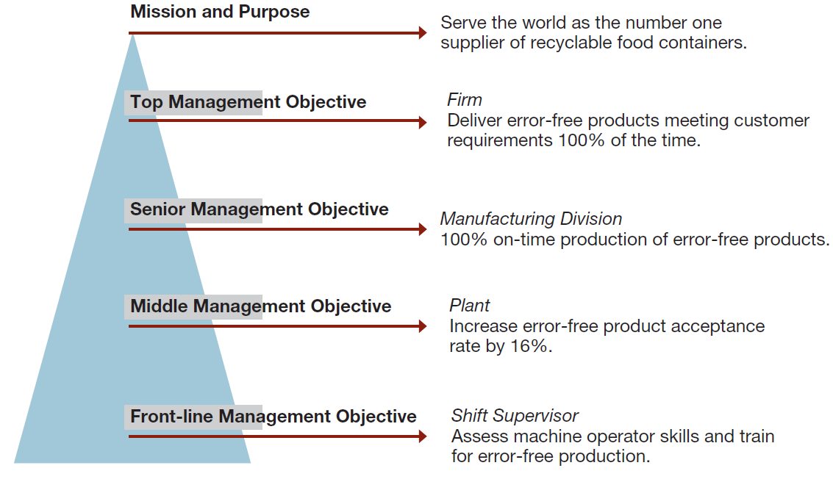
Sample Hierarchy Figure 6.8: p. 182

Slide 17
Management By Objectives (MBO)
  A structured process of regular communication
  Supervisor/team leader and workers jointly set performance objectives
  Supervisor/team leader and workers jointly review results

Slide 18
Management By Objectives (MBO)
Formal agreement specifying:
  Workers’ performance objectives for a specific time period
  Plans through which performance objectives will be accomplished
  Standards for measuring accomplishment of performance objectives Procedures for reviewing performance results

Slide 19
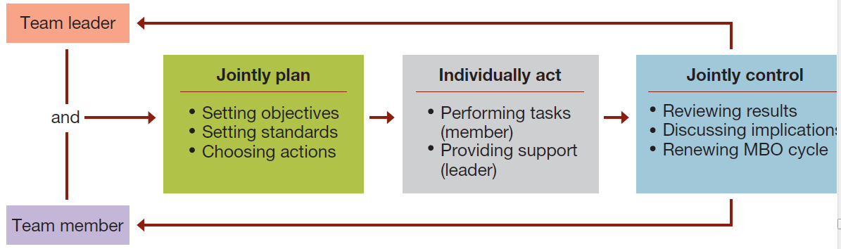
MBO Figure 6.9: p. 182
Management by Objectives as an integrated planning and control framework.

Slide 20
Management By Objectives (MBO)
Types of MBO performance objectives
  Improvement
  Personal development
  Maintenance
Criteria for effective performance objectives
  Specific
  Time defined
  Challenging
  Measurable

Slide 21
Management By Objectives (MBO)
Pitfalls to avoid in using MBO
  Tying MBO to pay
  Focusing too much attention on easily quantifiable objectives
  Requiring excessive paperwork
  Having managers tell workers their objectives

Slide 22
Management By Objectives (MBO)
Advantages of MBO
  Focuses workers on most important tasks and objectives
  Focuses supervisor’s efforts on important areas of support
  Contributes to relationship building
  Gives workers a structured opportunity to participate in decision making

Slide 23
Management By Objectives (MBO)
Participation and involvement
  Participatory planning requires that the planning process include people who will be affected by the plans and/or will help implement them
Benefits of participation and involvement:
  Promotes creativity in planning
  Increases available information
  Fosters understanding, acceptance, and commitment to the final plan

Slide 24
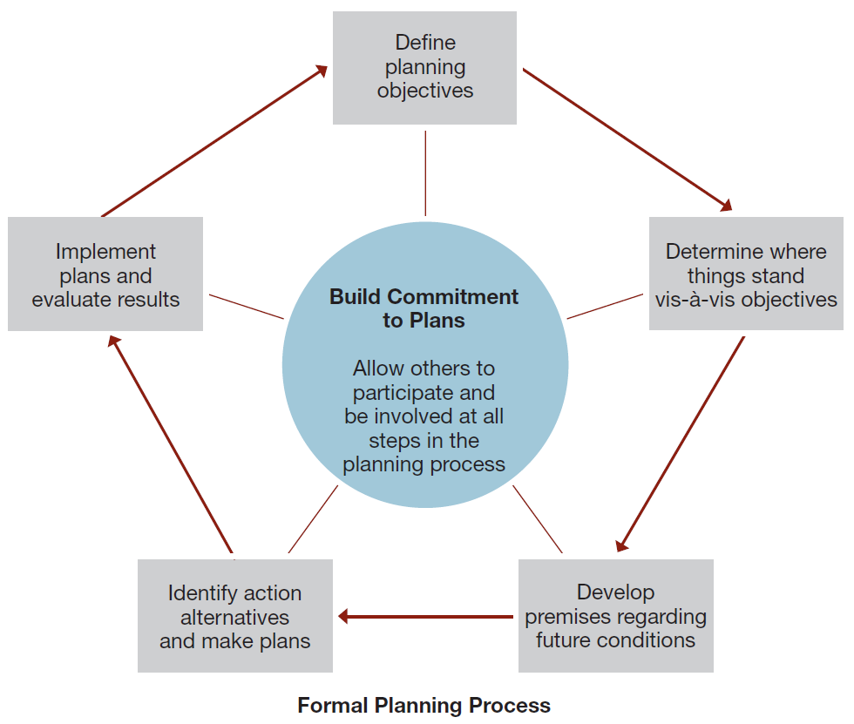
MBO Figure 6.10: p. 184
How Participation and Involvement help Build Commitments to Plans.

