Slide 1
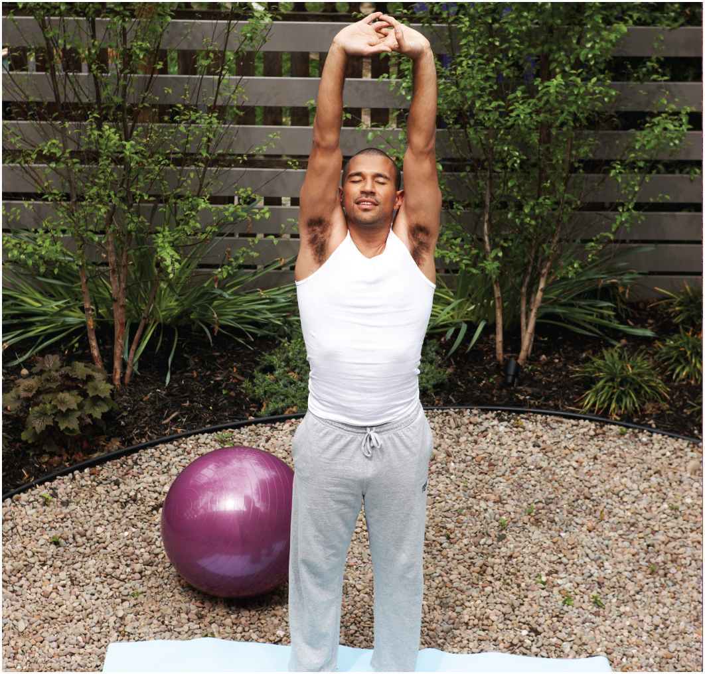
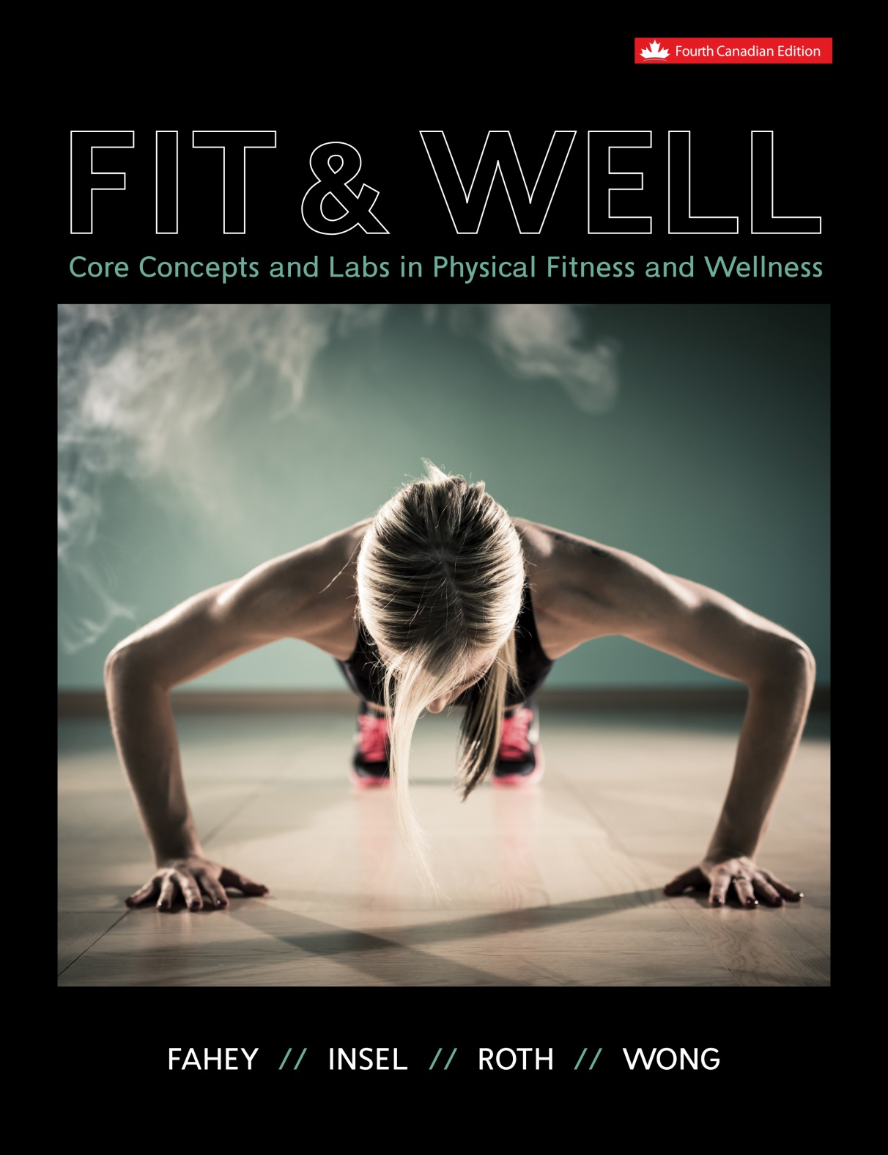
CHAPTER 5
FLEXIBILITY AND LOW-BACK HEALTH
Part 1

Slide 2
LEARNING OBJECTIVES
LO1 List the factors that affect a joint’s flexibility.
LO2 Identify the potential benefits of flexibility and stretching exercises.
LO3 Describe the intensity, duration, and frequency of stretching exercises that will develop the most flexibility with the lowest risk of injury.
LO4 Describe the different types of stretching exercises and how they affect muscles.
LO5 List safe stretching exercises for major joints.
LO6 Explain how low-back pain can be prevented and managed.
Chapter 5
Notes:
2

Slide 3
FLEXIBILITY
is the ability of a joint to move through its full range of motion (ROM).
is extremely important for general fitness & wellness.
is an often neglected component of health-related fitness.
is a highly adaptable physical fitness component.
increases in response to a regular program of stretching exercises.
is specific to the joint.
Chapter 5

Slide 4
BASIC TYPES OF FLEXIBILITY
Static Flexibility
  is the ability to assume & maintain an extended position at one end or point in a joint’s ROM.
Dynamic Flexibility
  is the ability to move a joint through its ROM with little resistance.
Chapter 5

Slide 5
Factors that Affect Static & Dynamic Flexibility
Static Flexibility
  Stretch tolerance
  Joint structure
  Tightness of muscles
  Tightness of tendons
  Tightness of ligaments
Dynamic Flexibility
  Static flexibility
  Strength
  Coordination
  Resistance to movement
    Joint capsule
    Muscle & its fascia
    Tendons
    Ligaments
    Skin
Chapter 5

Slide 6
WHAT DETERMINES FLEXIBILITY?
Joint Structure
  Primary determinant.
Muscle Elasticity & Length
Nervous System Regulation
Chapter 5, L01

Slide 7
Joint Structure
The amount of flexibility in a joint is determined in part by the nature & structure of the joint.
Hinge Joints
  have 1 axis of rotation.
  allow flexion & extension at the joint.
  Examples
    Knee, elbow, ankle, & finger.
Ball and Socket Joints
  have 3 axes of rotation.
  allow flexion, extension, abduction, adduction, circumduction, & rotation at the joint.
  Examples
    Hip & shoulder.
Chapter 5

Slide 8
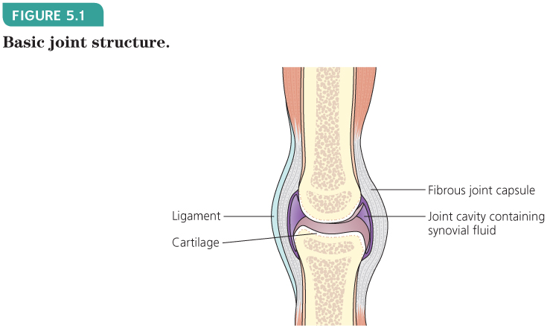
Joint Structure
Major Joints
  are surrounded by joint capsules.
Joint Capsules
  are semi-elastic structures, composed primarily of connective tissue, that give joints strength & stability, but limit movement.
FIGURE 5.1
Basic joint structure.
Chapter 5

Slide 9
Joint Structure
Heredity & Gender
  play a part in joint structure & flexibility.
Gender
  Generally, females are more flexible than males at all ages.
  However, at the same age:
    females have greater hip flexion & lateral spinal flexion than males.
    males have greater hip extension, spinal flexion, & spinal extension than females.
Chapter 5

Slide 10
Muscle Elasticity & Length
What is the key to developing flexibility?
A) | Skin tissue
B) | Tendon tissue
C) | Muscle tissue
D) | Ligament tissue
Chapter 5

Slide 11
Muscle Elasticity & Length
The most important component of muscle tissue related to flexibility:
  is the connective tissue that surrounds & envelops every part of the muscle tissue.
Connective Tissue
  provides structure, elasticity, & bulk to muscle tissue.
  makes up about 30% of muscle mass.
Chapter 5

Slide 12
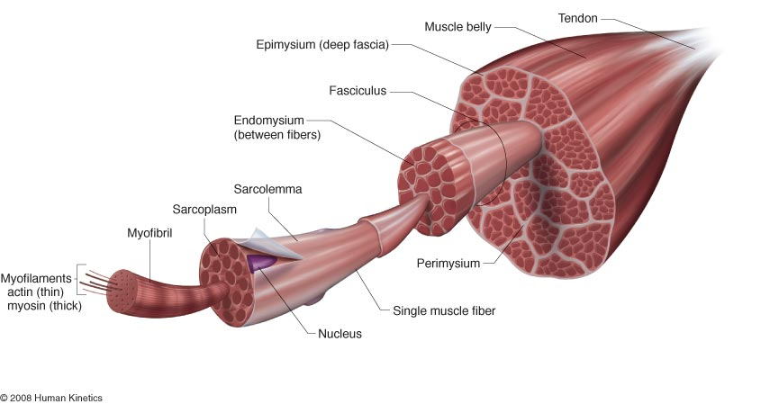
Muscle Elasticity & Length
Chapter 5

Slide 13
Muscle Elasticity & Length
2 Principal Types of Connective Tissue in Muscle
  Collagen
    white fibres that provide structure & support in connective tissue.
  Elastin
    yellow fibres that are elastic making connective tissue flexible.
An Important Structural Protein in Muscle
  Titin
    is a filament in skeletal muscle that helps align proteins that cause muscle contraction.
    has elastic properties & contributes to flexibility.
Chapter 5

Slide 14
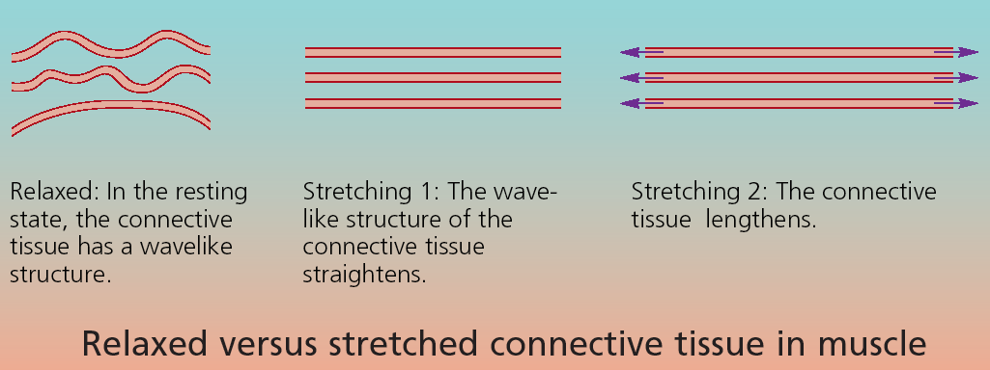
Muscle Elasticity & Length
If gently & regularly stretched, connective tissues may lengthen & flexibility may improve.

Slide 15
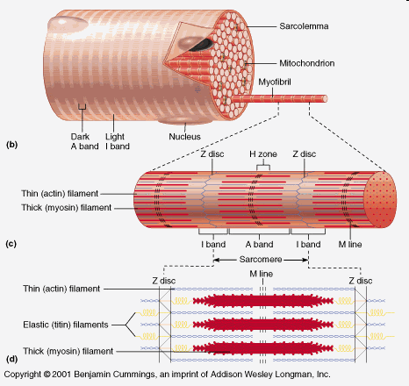
Muscle Elasticity & Length
Regular Stretching
  may contribute to flexibility by lengthening muscle fibres through changes to contractile units called sarcomeres.
Sarcomeres
  are the contractile units of a myofibril.
  are repeating units along the length of a myofibril, occupying the region between Z lines of the myofibril.
  are striped in appearance as a result of the overlapping of thin & thick contractile myofilaments called actin & myosin, respectively.
Chapter 5

Slide 16
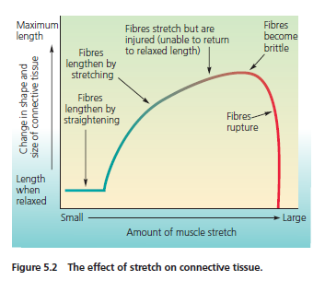
Muscle Elasticity & Length
The amount of stretch a muscle will tolerate is limited.
Chapter 5

Slide 17
Muscle Elasticity & Length
Research has shown that flexibility is improved best:
  by stretching when muscles are warm & when the stretch is applied gradually & conservatively.
Sudden, high-stress stretching
  is less effective & can lead to muscle damage.
Chapter 5

Slide 18
Nervous System Regulation
Proprioception
  means “sense of self.”
  the unconscious perception of movement & spatial orientation arising from stimuli within the body itself.
  the sense that deals with sensations of body position, posture, balance, & motion.
  perception mediated by proprioceptors or proprioceptive tissues.
Proprioceptors
  the sensory nerve receptors situated in the muscles, tendons, & joints that furnish information to the central nervous system concerning the movements & positions of the limbs, trunk, head, & neck.
Chapter 5

Slide 19
Nervous System Regulation
Proprioceptors Involved in Stretching
  Muscle Spindle
    is a small sensory receptor or organ, located in the belly of the muscle, that monitors (senses) changes in muscle length.
  Golgi Tendon Organ
    is a small sensory receptor or organ, located at the junction between a muscle & its tendon, that monitors (senses) muscle tension.
Chapter 5

Slide 20
Important Definitions for Nervous
System Regulation
Reflex
  a predictable, involuntary response to a stimulus.
Spinal Reflex
  is carried out by neurons (nerve cells) in the spinal cord alone & does not involve the brain.
Alpha Motor Neuron
  a motor nerve cell in the spinal cord that leaves the central nervous system (CNS) to establish a functional connection with an effector, a skeletal muscle cell (fibre).
  sends signals to muscle fibres, making them contract.
Chapter 5

Slide 21
Important Definitions for Nervous
System Regulation
Afferent Nerve Fiber
  conveys (carries) nerve impulses (signals) from the periphery to the CNS (spinal cord & brain).
  Example:
    Ia afferents of skeletal muscle spindles carry impulses to the spinal cord.
Efferent Nerve Fiber
  conveys nerve impulses from the CNS to the periphery.
  Example:
    The nerve fibres of an alpha motor neuron carry impulses from the CNS to their skeletal muscle fibres.
Agonist
  a muscle whose contraction opposes the action of another muscle, its antagonist, which relaxes at the same time.
  Example:
    The biceps muscle contracts while its antagonist, the triceps muscle, relaxes.
Antagonist
  a muscle that opposes or resists the action of its agonist.
Chapter 5

Slide 22
Muscle Spindles
are composed of miniature specialized muscle fibres called intrafusal fibres:
  the intrafusal muscle fibres run parallel to the skeletal muscle fibres.
are located in parallel with skeletal muscle fibres.
are sensitive to both the amount & rate of the change in skeletal muscle length.
provide information about the length of skeletal muscle.
control the length of skeletal muscle.
when stimulated, initiate the Stretch Reflex.
Chapter 5

Slide 23
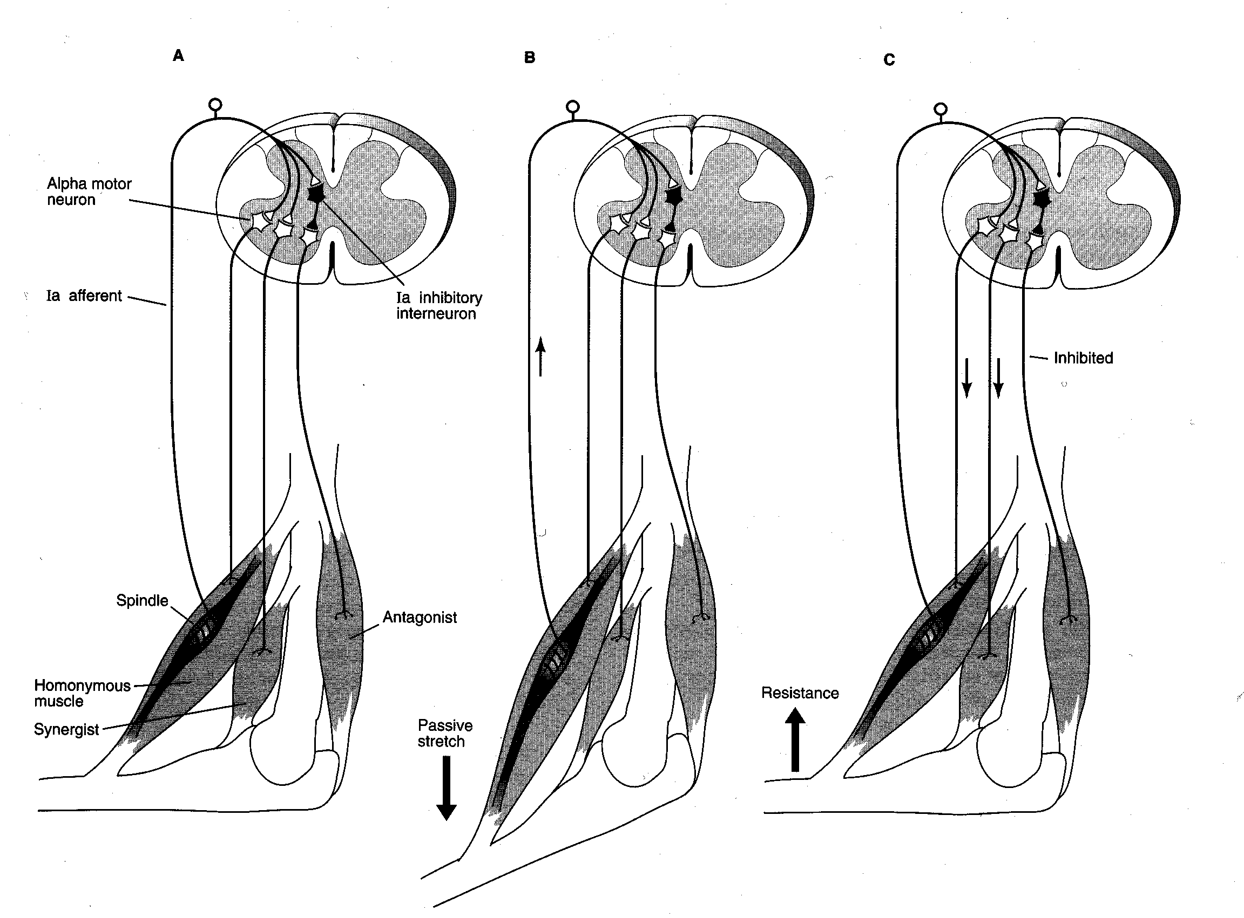
Stretch Reflex & Muscle Spindles
Relieves the stretching of muscle & prevents muscle damage from overstretching.
3
2
4
1
5
Chapter 5

Slide 24
Stretch Reflex & Muscle Spindles
When a muscle is stretched (lengthened),
  the muscle spindles are stimulated & send an electrical signal to the spinal cord through their afferent nerve fibres, called the Ia afferent nerve fibres.
  The electrical signal arriving in the spinal cord is transformed into a chemical signal that is eventually converted back into an electrical signal that is sent to the same muscle by way of the alpha motor neuron.
  The electrical signal that travels down the alpha motor neuron triggers a concentric muscle contraction that resists the change in muscle length.
  While one muscle, the agonist, is being activated, the opposing muscle, the antagonist, is relaxing, which further facilitates the contraction of the muscle that was being stretched.
Example
  A rapid stretching of the biceps brachii (agonist) muscle will result in a concentric muscle action (shortening) in the biceps brachii muscle & relaxation in the triceps brachii (antagonist) muscle.
Chapter 5

Slide 25
Golgi Tendon Organs
are located in series with skeletal muscle fibres.
are activated by muscular contractions that stretch the tendons.
monitor all degrees of muscle tension, but they are most sensitive to tension forces generated by muscle contraction.
provide information about the tension in skeletal muscle.
when stimulated, initiate the Inverse Stretch Reflex.
  also called the Inverse Myotatic Reflex.
Chapter 5

Slide 26
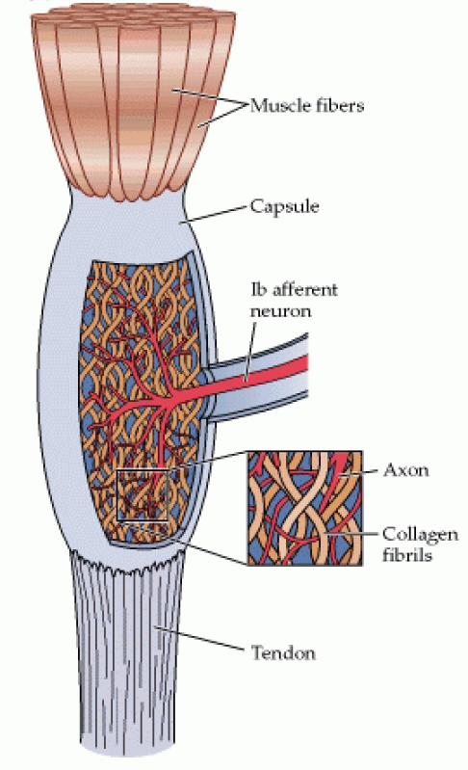
Golgi Tendon Organs
are composed of small bundles of tendon fibres enclosed in a layered capsule with dendrites (fine branches of neurons) coiling between & around the fibres.
(Source: Purves et al., Neuroscience, 2nd Ed., 2001.)
Chapter 5

Slide 27
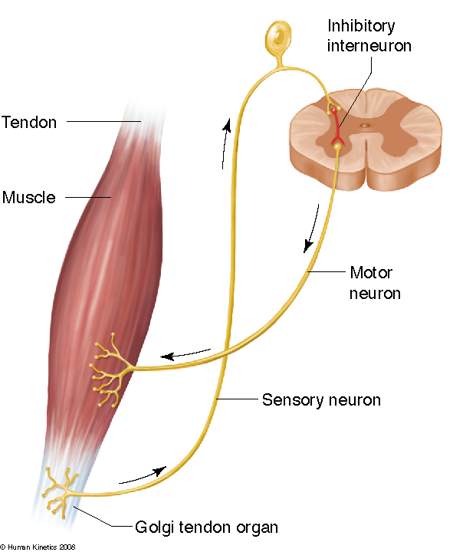
Inverse Stretch Reflex & Golgi Tendon Organs
Inverse Stretch Reflex
  protects muscles & their corresponding muscles from the damage that could result from excessive tension.
Chapter 5

Slide 28
Inverse Stretch Reflex & Golgi Tendon Organs
When a muscle performs a concentric muscle action (shortens),
  the Golgi tendon organs are stimulated & send an electrical signal to the spinal cord through their afferent nerve fibres, called the Ib afferent nerve fibres.
  The electrical signal arriving in the spinal cord is transformed into a chemical signal that activates an inhibitory interneuron.
  The electrical signal from the inhibitory interneuron results in the release of another chemical signal that inhibits the efferent nerve cell, the alpha motor neuron.
  As a consequence, the muscle that was experiencing the increase in muscle tension will relax.
Example
  The biceps brachii muscle is performing a concentric muscle action, which activates the Golgi tendon organs resulting in a reflexive relaxation in the biceps brachii muscle.
Chapter 5

Slide 29
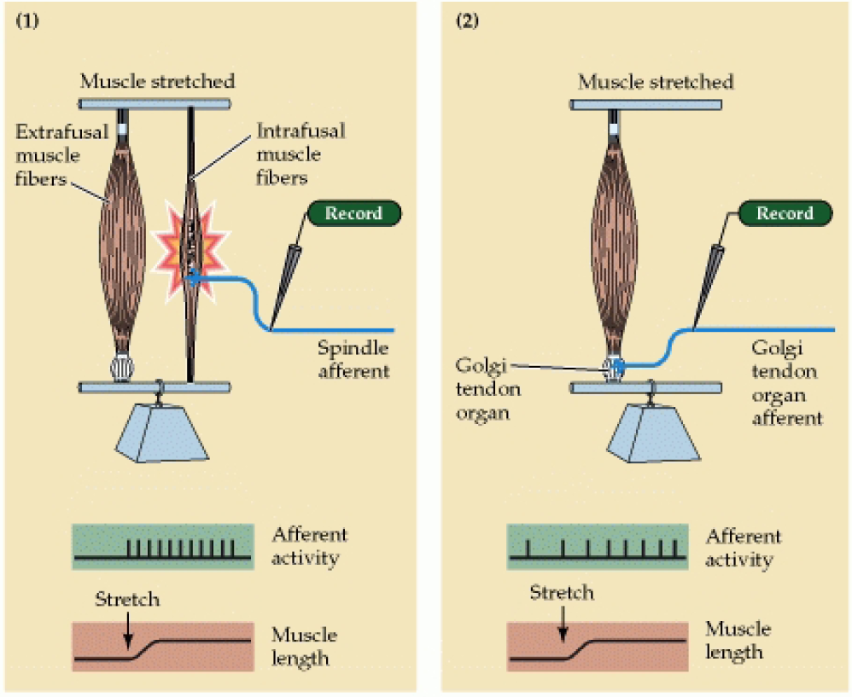
Functional Comparison of Muscle Spindles &
Golgi Tendon Organs
MUSCLE PASSIVELY STRETCHED
(Source: Purves et al., Neuroscience, 2nd Ed., 2001.)
Chapter 5

Slide 30
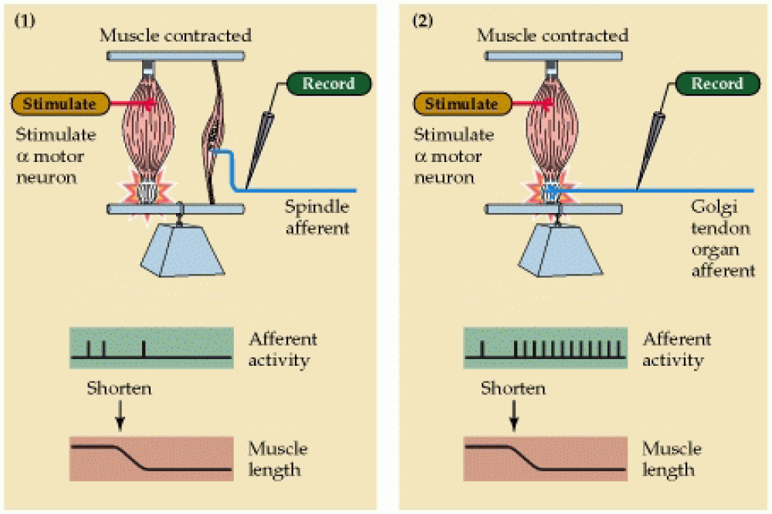
Functional Comparison of Muscle Spindles &
Golgi Tendon Organs
MUSCLE ACTIVELY CONTRACTED
(Source: Purves et al., Neuroscience, 2nd Ed., 2001.)
Chapter 5

Slide 31
Summary of the Muscle Spindles &
Golgi Tendon Organs
Variable | Muscle Spindles | Golgi Tendon Organs
Location | Belly of the muscle | Myotendinous junction
Location Relative to the Skeletal Muscle Fibres | Parallel | Series
Sense, Monitor, or Detect | Muscle length | Muscle tension
Muscle Response | Reflexive muscle action | Reflexive muscle relaxation
Afferent Never Fibre | Ia afferent | Ib afferent
Efferent Nerve Fibre | Alpha motor neuron | Alpha motor neuron
Activated Reflex | Stretch reflex | Inverse stretch reflex
Chapter 5

Slide 32
BENEFITS OF FLEXIBILITY
Good Flexibility
  provides benefits for the entire musculoskeletal system.
Flexibility Training
  increases ROM.
  may prevent muscle strains.
  will increase strength & quality of movement.
  might decrease the risk of some injuries.
  does not prevent overuse injuries.
Chapter 5, L02

Slide 33
BENEFITS OF FLEXIBILITY
Joint Health
Prevention of Low-Back Pain & Injuries
Additional Potential Benefits
Chapter 5

Slide 34
Joint Health
Good Flexibility
  is essential to good joint health.
  prevents joint deterioration caused by the tightness of soft tissues such as muscles & other tissues.
  prevents abnormalities in joint lubrication caused by poor joint flexibility.
  may prevent arthritis.
  increases balance & stability in older adults.
Chapter 5

Slide 35
Joint Health
Lack of Exercise
  which tends to occur as people age, decreases flexibility.
Age
  decreases the natural elasticity of muscles, tendons, & joints, resulting in stiffness.
Chapter 5

Slide 36
Prevention of Low–Back Pain
Low-Back Pain
  can be related to muscle imbalances resulting in poor spinal alignment.
  is most commonly caused by muscle imbalances between the abdominals & posterior spinal muscles.
  may be prevented by strength & flexibility in the back, pelvis, & thighs.
Research Studies
  Research studies have not yet clearly defined the relationship between back pain & lack of flexibility.
  Few studies have found that trunk flexibility improves back health or reduces the risk of injury.
  Some studies show that poor flexibility does increase one’s risk for injury.
Chapter 5

Slide 37
Prevention of Low–Back Pain
In Some People
  greater spinal mobility may increase the risk of low-back problems.
Overstretching
  may decrease the stability of a joint, which in turn may increase the risk of injury during the performance of physical activities.
Stretching
  before a high-intensity activity may increase the risk of injury interfering with neuromuscular control & reducing the natural ability of muscles to stretch and
Chapter 5

Slide 38
Additional Potential Benefits
Relief of aches & pains.
Relief of muscle cramps.
Improved body position & strength for sports & life.
Maintenance of good posture & balance.
Relaxation
  Flexibility exercises reduce mental tension, decrease the breathing rate, & reduce blood pressure.
Improving impaired mobility.
Chapter 5

Slide 39
Assessing Flexibility
Flexibility
  is specific to each joint.
  as a consequence, tests of general flexibility do not exist.
Chapter 5

Slide 40
Assessing Flexibility
Static Flexibility
  is assessed in field & clinical settings.
  tests measure ROM directly & indirectly.
  is easier to measure & better researched than dynamic flexibility.
Dynamic Flexibility
  testing is limited to the research setting.
  tests measure the increase in resistance during the lengthening of skeletal muscle.
  testing is more costly than static flexibility because of the use of expensive equipment.
Chapter 5

Slide 41
Methods of Assessing Static Flexibility
Direct Methods
  Goniometer
  Flexometer
  Inclinometer
Indirect Methods
  Sit-and-Reach Tests
  Skin Distraction Test
Chapter 5

Slide 42
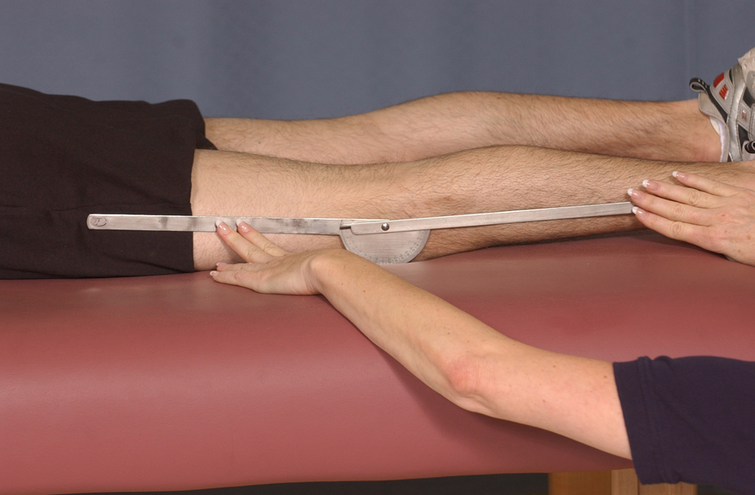
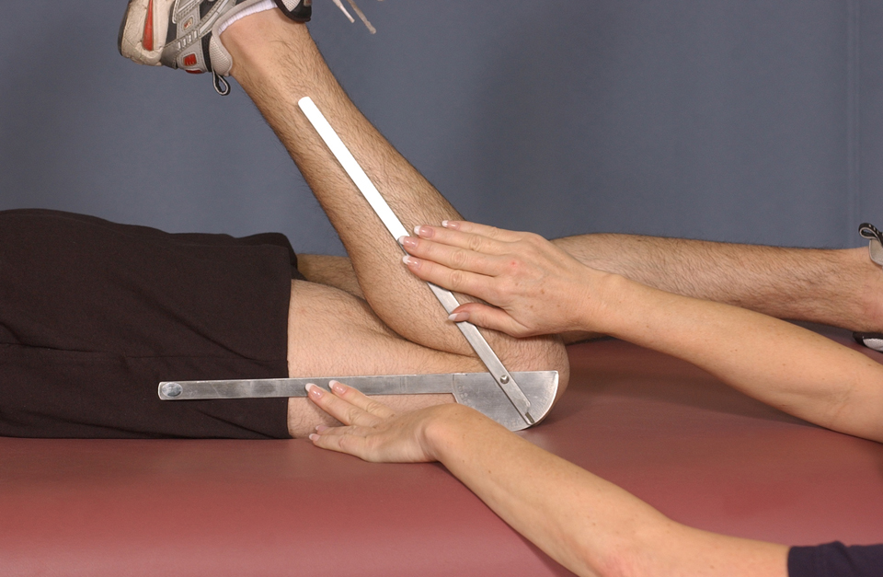
Direct Methods of Assessing Static Flexibility
Goniometer
  is a protractor-like device with 2 steel or plastic arms that measures the ROM as the difference between the joint angles in units of degrees at the extremes of the ROM.
Example: measuring the ROM at the knee joint.
Chapter 5

Slide 43
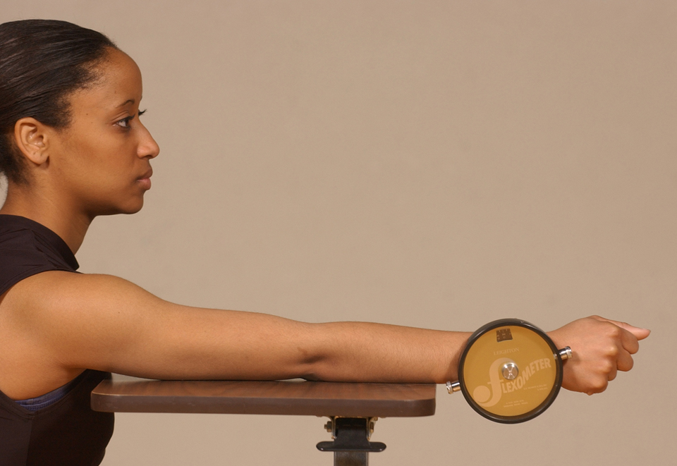
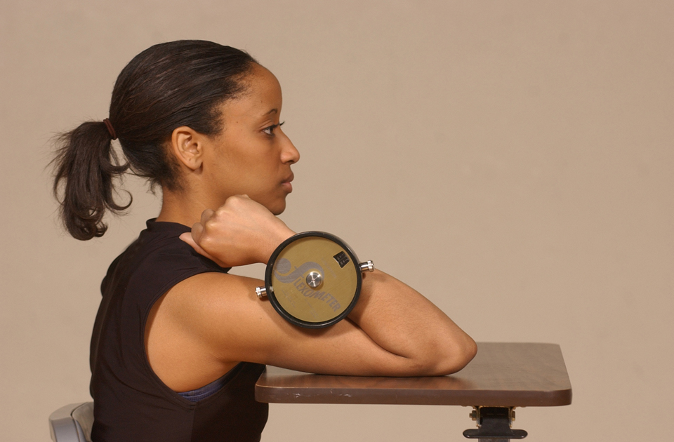
Direct Methods of Assessing Static Flexibility
Flexometer
  is a device composed of a weighted 360 degree dial & weighted pointer that measures the ROM for a given joint in relation to the downward pull of gravity on the dial & pointer.
Example: measuring the ROM at the elbow joint.
Chapter 5

Slide 44
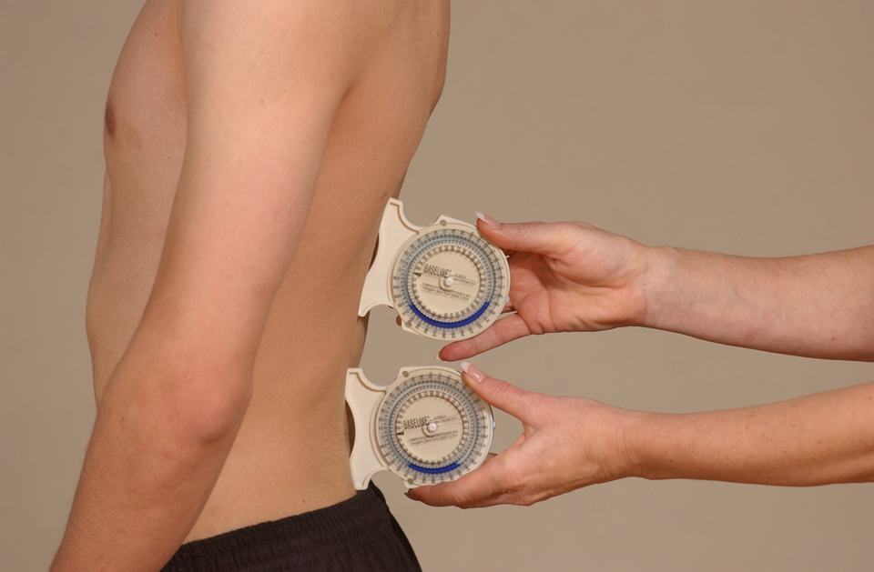
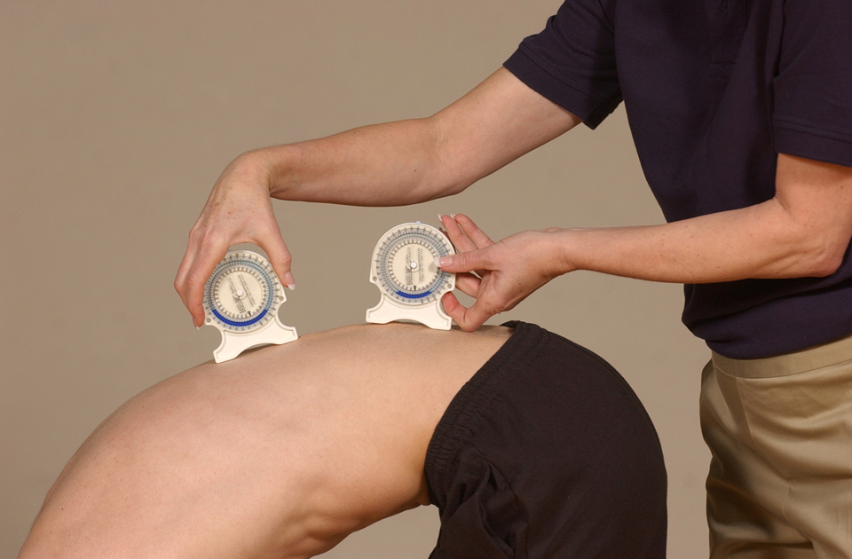
Direct Methods of Assessing Static Flexibility
Inclinometer
  is another type of gravity-dependent goniometer that measures the angle between the long axis of the moving segment & the line of gravity.
Example: double inclinometer technique used to measure low back flexibility (lumbosacral flexion).
Chapter 5

Slide 45
Direct Methods of Assessing Static Flexibility
A goniometer, flexometer, or other instrument to measure ROM can be used to assess static flexibility in the following joints:
Shoulder
  Abduction & Adduction
  Flexion & Extension
Elbow
  Flexion & Extension
Wrist
  Flexion & Extension
Trunk / Low Back
  Lateral Flexion
Hip
  Flexion (Bent Knee or Straight Leg) & Extension
  Abduction & Adduction
  Medial & Lateral Rotation
Knee
  Flexion & Extension
Ankle
  Dorsiflexion & Plantar flexion
Refer to Lab 5.1 on pages 243 to 249 in your textbook.
Chapter 5

Slide 46
Key Flexibility Terms
Abduction
  Movement away from the midline of the body.
Adduction
  Movement toward the midline of the body.
Flexion
  Bending; bringing 2 bones together; reducing the angle at a joint.
  Exception: flexion at the shoulder joint.
Extension
  Straightening; moving bones apart; increasing the angle at a joint.
  Exception: extension at the shoulder joint.
Chapter 5

Slide 47
Key Flexibility Terms
Medial Rotation
  Rotation of a limb toward the midline of the body.
Lateral Rotation
  Rotation of a limb away from the midline of the body.
Dorsiflexion
  Flexion only at the ankle joint (bringing the toes towards the shin bone).
Plantar Flexion
  Extension only at the ankle joint (pointing the foot downwards).
Circumduction
  Circular movements at a joint.
Chapter 5

Slide 48
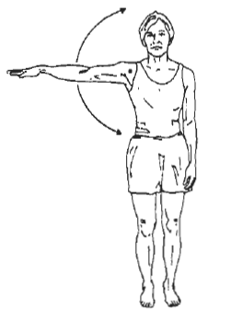
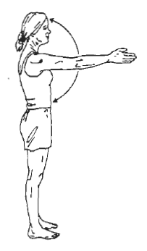
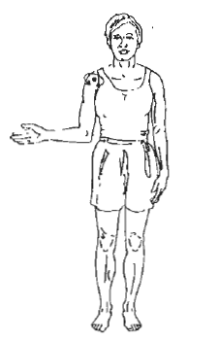
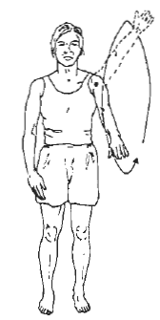
Examples of Key Flexibility Terms
Shoulder Joint
Abduction
Flexion
Circumduction
Lateral
Rotation
Adduction
Extension
Medial
Rotation
Chapter 5

Slide 49
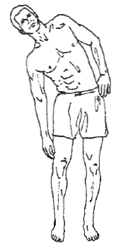
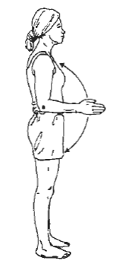
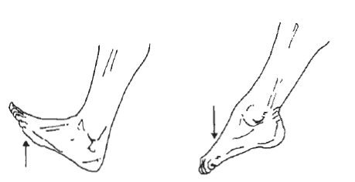
Examples of Key Flexibility Terms
Spinal Joint
Elbow Joint
Ankle Joint
Flexion
Dorsiflexion
Plantar flexion
Extension
Lateral Flexion
Chapter 5

Slide 50
Indirect Methods of Assessing Static Flexibility
Sit-and-Reach Test
  is the most commonly used flexibility test.
  provides an indirect, linear measurement of the ROM.
  is included in most health-related fitness test batteries.
  is used to evaluate the static flexibility of the lower back & hamstring muscles.
  according to recent research, is not a valid measure of low back & hamstring flexibility.
Chapter 5

Slide 51
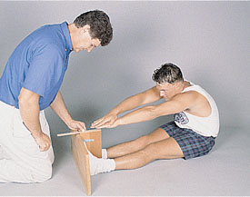
Sit-and-Reach Test
Warm-Up
  First, perform a low-intensity activity such as walking or easy jogging.
  Then perform slow stretching movements.
Performance of the Test
  Remove your shoes.
  Sit facing the flexibility measuring device with your knees fully extended & your feet flat against the device 10 cm apart.
  On an exhale, reach as far forward as possible with the palms down, arms evenly stretched, & knees fully extended.
  Hold this position for about 2 seconds.
  Perform the test a second time.
  Record both trials of the test to the nearest 0.5 cm.
  Select the best score & rate your flexibility score by referring to the table of norms on slide 52 or page 244 of your textbook.
Lab 5.1
Chapter 5

Slide 52
Ratings for the Sit–and–Reach Test
Men Age | Needs Improvement | Fair | Good | Very Good | Excellent
15-19 20-29 30-39 40-49 50-59 60-69 | ≤ 23 ≤ 24 ≤ 22 ≤ 17 ≤ 15 ≤ 14 | 24 – 28 25 – 29 23 – 27 18 – 23 16 – 23 15 – 19 | 29 – 33 30 – 33 28 – 32 24 – 28 24 – 27 20 – 24 | 34 – 38 34 – 39 33 – 37 29 – 34 28 – 34 25 – 32 | ≥ 39 ≥ 40 ≥ 38 ≥ 35 ≥ 35 ≥ 33
Women Age | Very Poor | Poor | Fair | Good | Excellent
15-19 20-29 30-39 40-49 50-59 60-69 | ≤ 28 ≤ 27 ≤ 26 ≤ 24 ≤ 24 ≤ 22 | 29 – 33 28 – 32 27 – 31 25 – 29 25 – 29 23 – 26 | 34 – 37 33 – 36 32 – 35 30 – 33 30 – 32 27 – 30 | 38 – 42 37 – 40 36 – 40 34 – 37 33 – 38 31 – 34 | ≥ 43 ≥ 41 ≥ 41 ≥ 38 ≥ 39 ≥ 35
SOURCE: The Canadian Physical Activity, Fitness, & Lifestyle Approach: CSEP Health & Fitness Program’s Health-Related Appraisal & Counselling Strategy, 3rd edition, 2003. Footline is set at 26 cm.
Chapter 5

Slide 53
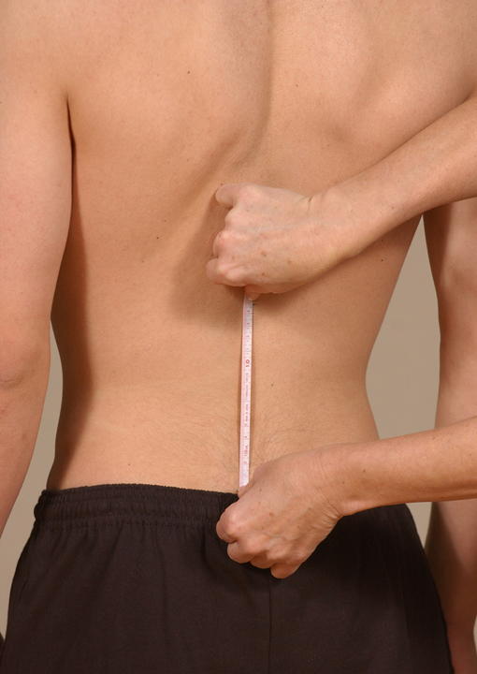
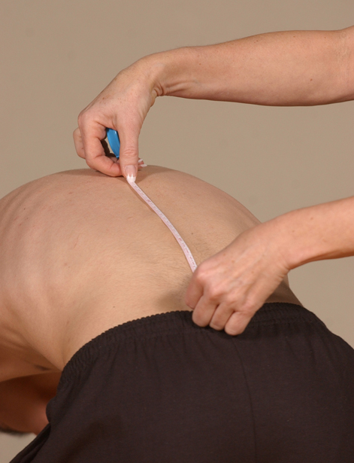
Skin Distraction Test
Midline of lumbar spine.
15-cm mark
0-cm mark
Assesses low back flexibility.
Chapter 5

