Slide 1

PowerPoint Presentations for
Principles of Macroeconomics
Sixth Canadian Edition
by Mankiw/Kneebone/McKenzie
Adapted for the
Sixth Canadian Edition by
Marc Prud’homme
University of Ottawa

Slide 2

Aggregate demand and aggregate supply
Chapter 14

Slide 3
AGGREGATE DEMAND
AND AGGREGATE SUPPLY
Economic activity fluctuates from year to year.
Recession: a period of falling incomes and rising unemployment
Depression: a severe recession
The variables that we study in this chapter are largely those we have already seen in previous chapters.
  GDP – Unemployment – Interest rates – Exchange rates – Prices
Notes:
An example of such a downturn in economy occurred in 2008 and 2009. This should be fresh in the mind of many students. From the fourth quarter of 2008 to the second-quarter 2009, real GDP for the Canadian economy fell by 3 percent. The national rate of unemployment rose from 6.1 percent in October 2008 to 8.7 percent in August 2009. In Ontario, for example, unemployment increased from 5.9 percent to 10 percent.

Slide 4
AGGREGATE DEMAND
AND AGGREGATE SUPPLY
The model of aggregate demand and aggregate supply is often used by economists to analyze short-run fluctuations in the economy.

Slide 5
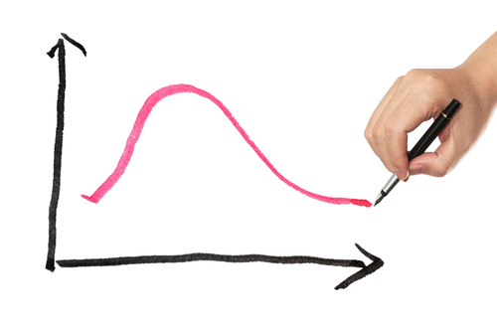
THREE FACTS ABOUT
ECONOMIC FLUCTUATIONS
FACT 1: Economic fluctuations are irregular and unpredictable.
  Business cycles
FACT 2: Most macroeconomic quantities fluctuate together.
FACT 3: As output falls, unemployment rises.
Thinkstock
Notes:
FACT 1: Economic fluctuations are irregular and unpredictable. Fluctuations in the economy are called business cycles. The term business cycle is somewhat misleading. Economic situations are not at all regular and are almost impossible to predict with much accuracy. See Figure 14.1.
FACT 2: Most macroeconomic quantities fluctuate together. Real GDP is the variable that is most commonly used to monitor short-run changes in the economy because it is the most comprehensive measure of economic activity. However, as it turns out, for monitoring short-run fluctuations, it does not really matter which measure of economic activity you choose. Most macroeconomic variables that measure some type of income, spending, or production fluctuate closely together. Although many variables fluctuate together, they fluctuate by different amounts. Investment spending varies greatly over the business cycle. Even though investment averages only about 1/5 of GDP, declines in investment accounted for about 80 percent of the declines in GDP during Canada’s last three sessions.
FACT 3: As output falls, unemployment rises. Changes in the economy’s output of goods and services are strongly correlated with changes in the economy’s utilization of its labour force. In other words, when real GDP declines the rate of unemployment rises. See Figure 14.1.

Slide 6
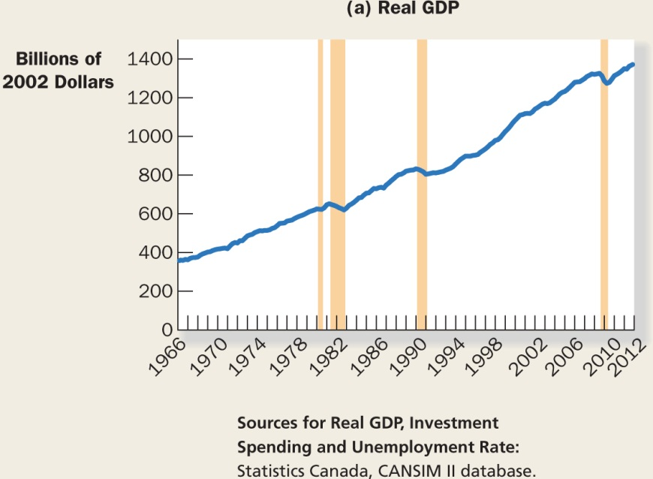
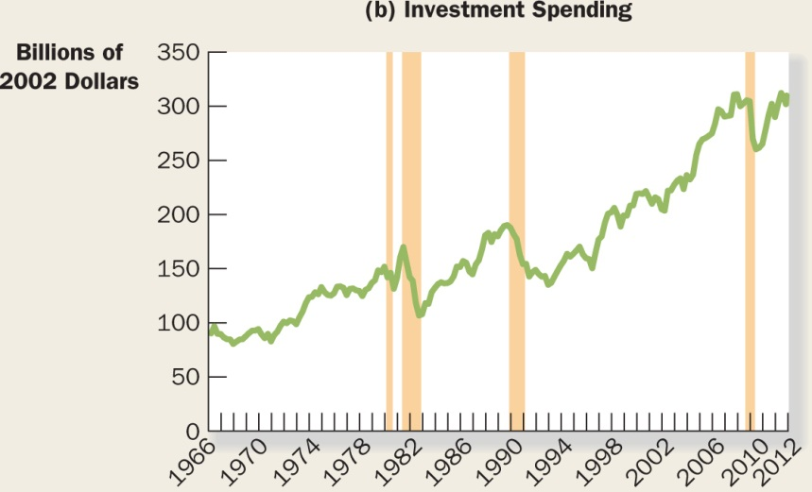
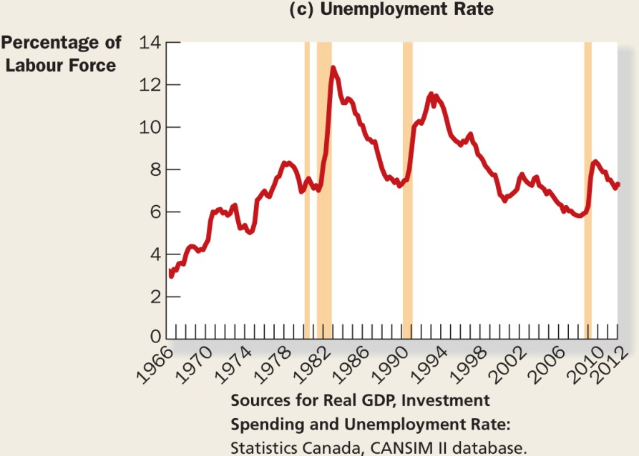
FIGURE 14.1:
A Look at Short-Run Economic Fluctuations

Slide 7
List and discuss three key facts about economic fluctuations.

Slide 8
EXPLAINING
SHORT-RUN FLUCTUATIONS
Describing the patterns that economies experience as they fluctuate over time is easy.
Explaining what causes these fluctuations is more difficult.
The theory of economic fluctuations remains controversial.
Notes:
This chapter and the next two chapters will develop the model that most economists use to explain short run fluctuations.

Slide 9
The Assumptions of Classical Economies
The classical view is sometimes described by saying, “Money is a veil.”
What is important, however, are the real variables and the economic forces that determine them.
Notes:
“Money is a veil”: Nominal variables may be the first things we see when we observe an economy because economic variables are often expressed in units of money.

Slide 10
The Reality of Short-Run Fluctuations
Most economists believe that classical theory describes the world in the long run but not in the short run.
To understand how the economy works in the short run, we need a new model.
The new model focuses on how real and nominal variables interact.

Slide 11
The Model of
Aggregate Demand and Aggregate Supply
Model of aggregate demand and aggregate supply: the model most economists use to explain short-run fluctuations in economic activity around its long-run trend
Aggregate-demand curve: a curve that shows the quantity of goods and services that households, firms, and the government want to buy at each price level
Aggregate-supply curve: a curve that shows the quantity of goods and services that firms choose to produce and sell at each price level

Slide 12
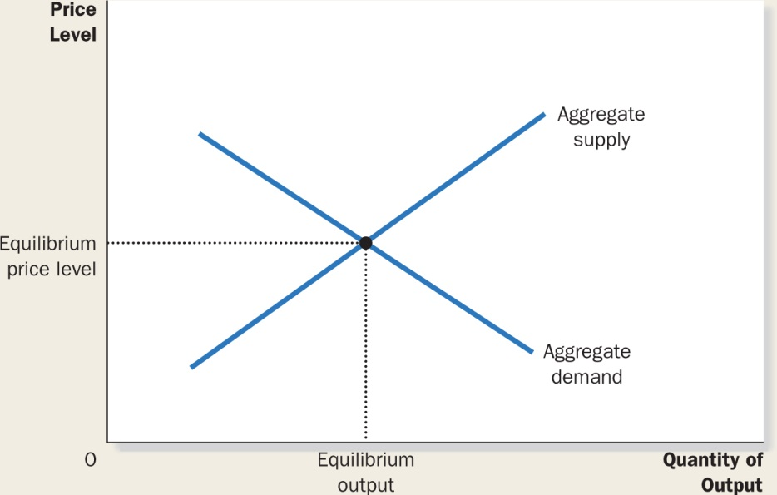
FIGURE 14.2:
Aggregate Demand and Aggregate Supply
Notes:
The aggregate demand and aggregate supply model is used to analyze economic fluctuations. On the vertical axis is the overall level of prices. On the horizontal axis is the economy’s total output of goods and services. Output and the price level adjust to the point at which aggregate-supply and aggregate-demand curves intersect.
This model is quite different from the market demand and market supply model, which was covered in Chapter 4. In this model, there is no microeconomic substitution from one market to another because we are analyzing the economy as a whole. To understand why the aggregate-demand curve is downward sloping and why the aggregate-supply curve is upward sloping, we need a macroeconomic theory.
Developing such a theory is the next task.

Slide 13
How does the economy’s behaviour in
the short run differ from its behaviour in
the long run?
Draw the model of aggregate demand
and aggregate supply. What variables are on the two axes?

Slide 14
THE AGGREGATE-DEMAND CURVE
The aggregate-demand curve tells us the quantity of all goods and services demanded in the economy at any given price level.
andromina/Shutterstock

Slide 15
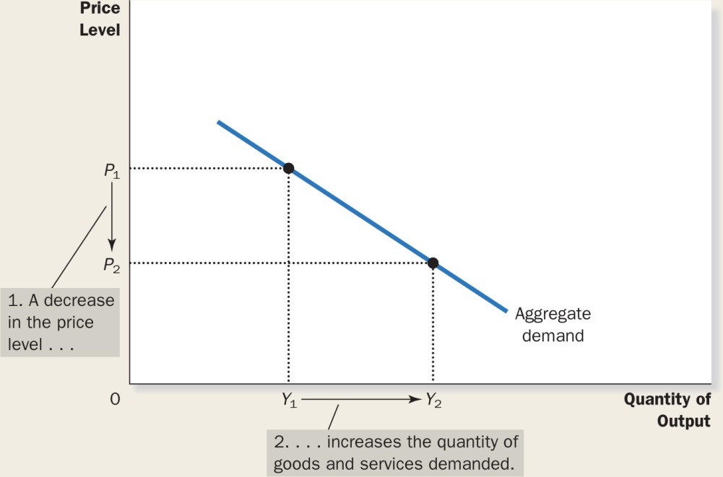
FIGURE 14.3:
The Aggregate-Demand Curve
Notes:
A fall in the price level from P₁ to P₂ increases the quantity of goods and services demanded from Y₁ to Y₂. There are three reasons for this negative relationship. As the price level falls, real wealth rises, interest rates fall, and the exchange rate depreciates. These effects stimulate spending on consumption, investment, and net exports. Increased spending on these components of output means a larger quantity of goods and services demanded.

Slide 16
Why the Aggregate-Demand
Curve Slopes Downward
The price level and consumption: The Wealth Effect
The price level and investment: The Interest Rate Effect
The price level and net exports: The Real Exchange Rate Effect
Notes:
The Price Level and Consumption: The Wealth Effect
A decrease in the price level makes consumers wealthier, which in turn encourages them to spend more. The increase in consumer spending means a larger quantity of goods and services demanded.
The Price Level and Investment: The Interest Rate Effect
A lower price level reduces the interest rate, encourages greater spending on investment goods, and thereby increases the quantity of goods and services demanded.
The Price Level and Net Exports: The Real Exchange Rate Effect
A fall in the Canadian price level causes the real exchange rate to depreciate, and this depreciation stimulates Canadian net exports and thereby increases the quantity of goods and services demanded. Remember that the aggregate-demand curve is drawn holding “other things equal.” For instance, the money supply is fixed.

Slide 17
Why the Aggregate-Demand
Curve Might Shift
Changes in consumption
Changes in investment
Changes in government purchases
Changes in net exports
Notes:
Changes in consumption: Any event that changes how much people want to consume at the given price level shifts the aggregate demand.
Changes in Investment: Any event that changes how much firms want to invest at the given price level also shifts the aggregate demand.
Changes in government purchases: The most direct way that policy makers shift the aggregate demand curve is through government purchases. Increases in government spending lead to an increase in the quantity of goods and services demanded at any price level.
Changes in net export: Any event the changes that exports for a given price level also shifts aggregate demand.

Slide 18
Explain the three reasons why the aggregate-demand curve slopes downward.
Give an example of an event that would shift the aggregate-demand curve.
Which way would this event shift the curve?

Slide 19
Active Learning
Aggregate-Demand Curve
What happens to the aggregate-demand curve in each of the following scenarios?
  A. A ten-year-old investment tax credit expires.
  B. The Canadian exchange rate falls.
  C. A fall in prices increases the real value of consumers’ wealth.
  D. Provincial governments replace their sales taxes with new taxes on interest, dividends, and capital gains.

Slide 20
Active Learning
Answers
A. A ten-year-old investment tax credit expires.
I falls, AD curve shifts left.
B. The Canadian exchange rate falls.
NX rises, AD curve shifts right.
C. A fall in prices increases the real value of consumers’ wealth.
Move down along AD curve (wealth-effect).
D. Provincial governments replace sales taxes with new taxes on interest, dividends, and capital gains.
C rises, AD shifts right.

Slide 21
THE AGGREGATE-SUPPLY CURVE
The aggregate-supply curve tells us the total quantity of goods and services that firms produce and sell at any given price level.
Notes:
Unlike the aggregate-demand curve, which is always downward sloping, the aggregate-supply curve shows a relationship that depends crucially on the time horizon being examined.

Slide 22
Why the Aggregate-Supply
Curve Is Vertical in the Long Run
In the long run, an economy’s production of goods and services (i.e., its real GDP) depends on its supplies of labour, capital, and natural resources and on the available technology used to turn these factors of production into goods and services.
Notes:
Because the price level does not affect these long-run determinants of real GDP, the long-run aggregate-supply curve is vertical as in Figure 14.5.

Slide 23
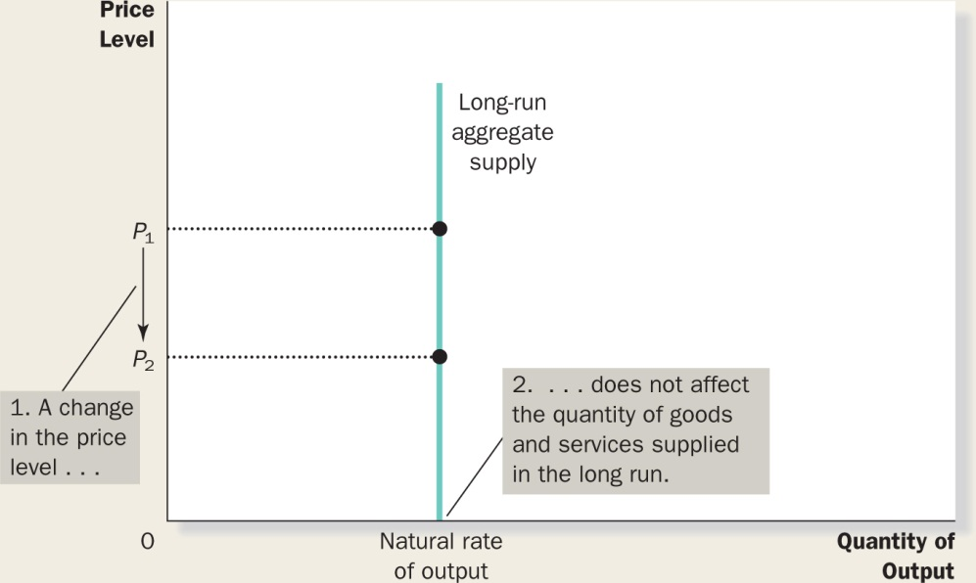
FIGURE 14.5:
The Long-Run Aggregate-Supply Curve

Slide 24
Why the Long-Run
Aggregate-Supply Curve Might Shift
Natural rate of output: the production of goods and services that an economy achieves in the long run when unemployment is at its normal rate
  Potential output
  Full-employment output
Notes:
Classical macroeconomic theory predicts the quantity of goods and services produced by an economy in the long run, so it explains the position of the long-run aggregate-supply curve.
Any change in the economy that alters the natural rate of output shifts the long-run aggregate-supply curve.
Because output in the classical model depends on labour, capital, natural resources, and technological knowledge, we can categorize shifts in the long-run aggregate-supply curve as arising from the following four sources (see next slide).

Slide 25
Why the Long-Run
Aggregate-Supply Curve Might Shift
Changes in labour
Changes in capital
Changes in natural resources
Changes in technological knowledge
Notes:
Changes in labour
Number of workers
Natural rate of unemployment
Changes in capital
An increase in the economy’s capital stock increases productivity and, thereby, the quantity of goods and services supplied. As a result, the long-run aggregate-supply curve shifts to the right.
Changes in natural resources
A discovery of a new mineral deposit or other natural resource shifts the long-run aggregate-supply curve to the right. An increase in imports of natural resources will also shift aggregate-supply curve to the right.
Changes in technological knowledge
Advances in technological knowledge is probably one of the major reasons why we can produce more today than we did in the past.

Slide 26
Using Aggregate Demand and Aggregate Supply to Depict Long-Run Growth and Inflation
With the introduction of the aggregate-demand
curve and the long-run aggregate-supply curve
we are now in a position to describe the economy’s long-run trends.

Slide 27
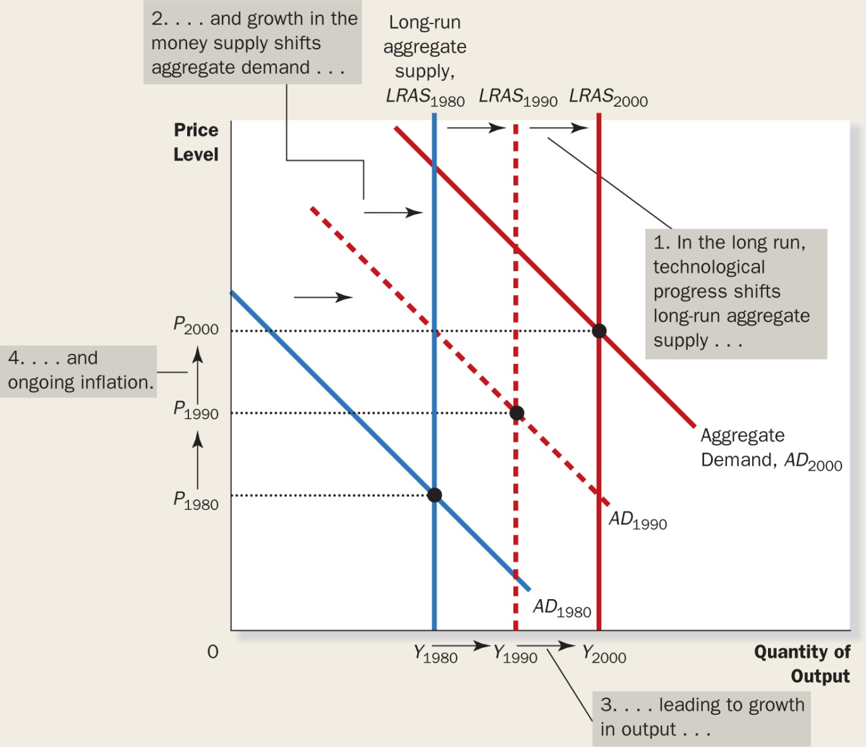
FIGURE 14.6:
Long-Run Growth and Inflation in the Model of Aggregate Demand and Aggregate Supply
Notes:
As the economy becomes better able to produce goods and services overtime, primarily because of technological progress, the long-run aggregate-supply curve shifts to the right. At the same time, as the Bank of Canada increases the money supply, the aggregate-demand curve also shifts to the right. In the above figure, output grows from Y₁₉₈₀ to Y₁₉₉₀ and then to Y₂₀₀₀ and the price level rises from Y₁₉₈₀ to Y₁₉₉₀ and then to Y₂₀₀₀. Thus, the model of aggregate demand and aggregate supply offers a new way to describe the classical analysis of growth and inflation.

Slide 28
Why the Aggregate-Supply
Curve Slopes Upward in the Short Run
In the short run, the price level does affect the economy’s output.
An increase in the overall level of prices tends to
raise the quantity of goods and services supplied
and vice versa.

Slide 29
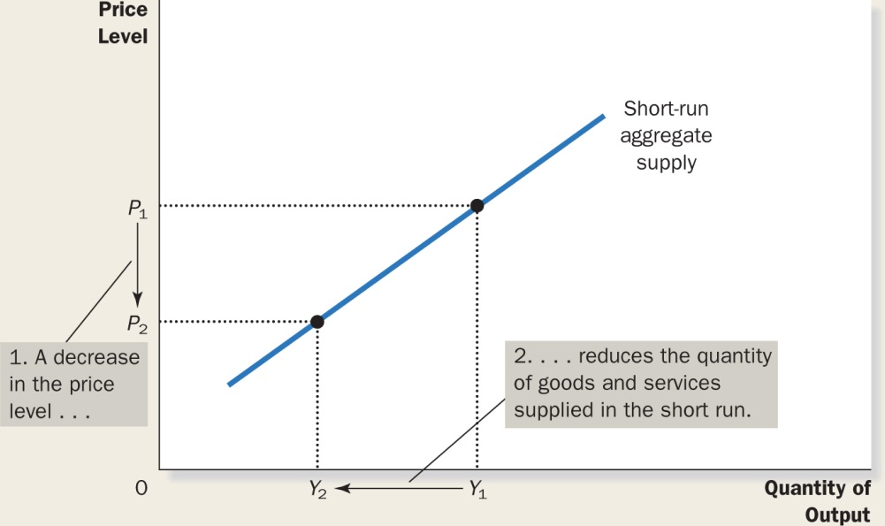
FIGURE 14.7:
The Short-Run Aggregate-Supply Curve
Notes:
In the short run, a fall in the price level from P₁ to P₂ reduces the quantity of output supplied from Y₁ to Y₂. This positive relationship could be due to sticky wages, sticky prices, or misperceptions. Over time, wages, prices, and perceptions adjust, so this positive relationship is only temporary.

Slide 30
Why the Aggregate-Supply
Curve Slopes Upward in the Short Run
Why do changes in the price level affect output in the short run?
Macroeconomists have proposed three theories for the upward slope of the short-run aggregate supply curve.
Notes:
In each theory, a specific market imperfection causes the supply side of the economy to behave differently in the short run than it does in the long run.

Slide 31
Why the Aggregate-Supply
Curve Slopes Upward in the Short Run
The Sticky Wage Theory
The Sticky Price Theory
The Misperceptions Theory
Notes:
The Sticky Wage Theory: According to this theory, the short-run aggregate-supply curve is upward sloping because nominal wages are based on expected prices and do not respond immediately when the actual price level turns out to be different from what was expected. As an example, imagine that a year ago, a firm expected the price level to be 100 and, based on this expectation, it signed a contract with its workers agreeing to pay them $20 per hour. In reality the price level turns out to be only 95. As a result of the fall in prices, the firm gets 5 percent less than expected for each unit of its product that it sells. The cost of labour is stuck at $20 per hour, production is less profitable, so firms hire fewer workers and the quantity of output supplied declines.
The Sticky Price Theory: The sticky price theory emphasizes that the prices of some goods and services also adjust sluggishly in response to changing economic conditions. The slow adjustment of prices is often the result of the existence of menu costs. Suppose that each firm in the economy announces its prices in advance based on the economic conditions it expects to prevail over the coming year. Then after the prices are announced, the economy experiences an unexpected contraction in the money supply, which reduces the overall price level in the long run. Some firms may reduce their prices immediately while other firms may lag in adjusting prices because of the existence of menu costs. Their prices are relatively higher and as a result sales decline, leading to cutbacks on production and employment and thus reducing the quantity of goods and services produced by these firms.
The Misperceptions Theory: According to this theory, changes in the overall price level can temporarily mislead suppliers about what is happening in the individual markets in which they sell their product. As a result of these short-run misperceptions, suppliers respond to changes in the level of prices, and this response leads to an upward-sloping aggregate-supply curve.
To see how this might work, suppose the overall price level falls below the level that people expected. When suppliers see the prices of their products fall, they may mistakenly believe that their relative prices have also fallen. For example, wheat farmers may notice a fall in the price of wheat before they notice a fall in the prices of the many items they buy as consumers. They may infer from this observation that the reward from producing wheat is temporarily low and they may respond by reducing the quantity of wheat they supply. Similarly workers may notice a fall in their nominal wages before noticing a fall in the price of goods they buy. They may infer that the reward from work is temporarily low and react by reducing the quantity of labour they supply in the labour market.

Slide 32
Why the Aggregate-Supply
Curve Slopes Upward in the Short Run
SUMMARY
All three theories suggest that output deviates from its natural rate when the price level deviates from the price level that people expected.
Mathematically, this is expressed as:
where a is the number that determines how much output responds to unexpected changes in the price level.

Slide 33
Why the Aggregate-Supply
Curve Slopes Upward in the Short Run
SUMMARY
In the long run, wages and prices are flexible rather than sticky and people are not confused about relative prices.

Slide 34
Why the Short-Run
Aggregate-Supply Curve Might Shift
We can think of the short-run aggregate-supply curve as similar to the long-run aggregate-supply curve but made upward sloping by the presence of sticky wages, sticky prices, and misperceptions.
When thinking about what shifts the short-run aggregate supply curve, we have to consider all those variables that shift the long-run aggregate-supply curve plus a new variable—the expected price level—that influences the wages that are stuck, the prices that are stuck, and the perceptions about relative prices.
Notes:
An increase in the economy’s capital stock increases productivity; therefore, both the long-run and short-run aggregate-supply curves shift to the right. When an increase in the minimum wage raises the natural rate of unemployment, both the long-run and short-run aggregate-supply curves shift to the left. When people change their expectations of the price level, the short-run aggregate-supply curve shifts.
As an example, let’s look at the sticky wage theory. When workers and firms expect the price level to be high, they are more likely to negotiate high nominal wages. High wages raise firms’ costs and, for any given actual price level, reduce the quantity of goods and services that the firms supply. Plus, when the expected price level rises, wages are higher, costs increase, and firms supply a smaller quantity of goods and services at any given actual price level. Thus, the short-run aggregate-supply curve shifts to the left.

Slide 35
Explain why the long-run aggregate supply curve is vertical.
Explain three theories for why the short-run aggregate supply curve is upward sloping.

Slide 36
TWO CAUSES OF
ECONOMIC FLUCTUATIONS
To keep things simple, we assume the economy begins in the long-run equilibrium, as shown in
Figure 14.8.
Notes:
In equilibrium, output is at its natural rate. The short-run aggregate-supply curve passes through this point as well, indicating that wages, prices, and perceptions have fully adjusted to this long-run equilibrium.

Slide 37
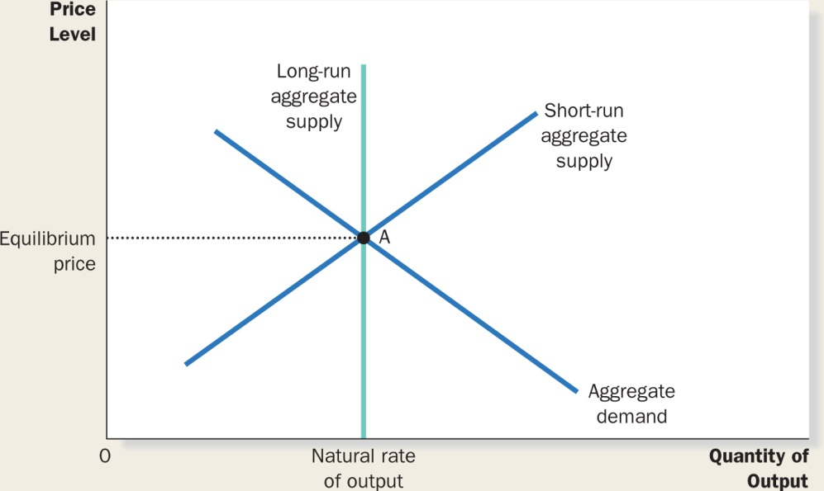
FIGURE 14.8:
The Long-Run Equilibrium
Notes:
The long-run equilibrium of the economy is found where the aggregate-demand curve crosses the long-run aggregate-supply curve – Point A. When the economy reaches this long-run equilibrium, wages, prices, and perceptions will have adjusted so that the short-run aggregate-supply curve crosses this point as well.

Slide 38
The Effects of a Shift in Aggregate Demand
Suppose a wave of pessimism overtakes the economy.
What is the macroeconomic impact of such a phenomenon?
Notes:
The first three steps were first introduced in Chapter 4. The fourth step is to analyze macroeconomic equilibrium.

Slide 39
The Effects of a Shift in Aggregate Demand
Four steps for analyzing this impact:
  Does the event affect aggregate demand or
  aggregate supply?
  Determine the direction of the shift.
  Use the diagram of aggregate demand and aggregate supply to compare the initial and new equilibrium.
  Keep track of the new short-run equilibrium, the new long-run equilibrium, and the transition between them.

Slide 40
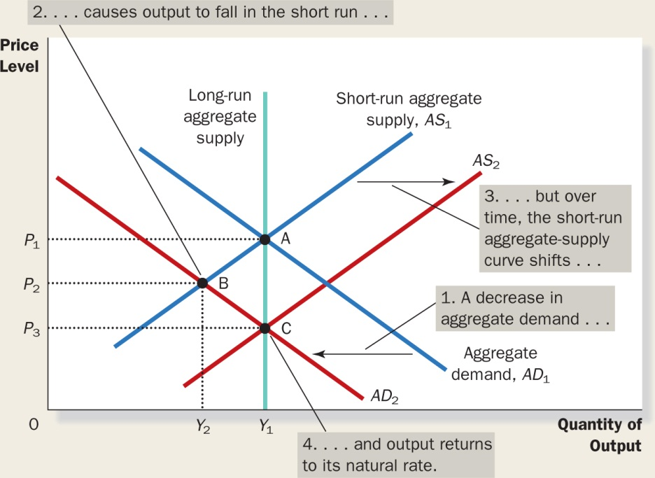
FIGURE 14.9:
A Contraction in Aggregate Demand
Notes:
A fall in aggregate demand, which might be due to a wave of pessimism in the economy, is represented with a leftward shift in the aggregate demand curve from AD₁ to AD₂. The economy moves from point A to point B. Output falls from Y₁ to Y₂, and the price level falls from P₁ to P₂. Over time, as wages, prices, and perceptions adjust, the short-run aggregate-supply curve shifts to the right from AS₁ to AS₂, and the economy reaches point C, where the new aggregate-demand curve crosses the long run aggregate-supply curve. The price level falls to P₁, and output returns to its natural rate, Y₁. Policy makers can mitigate the fluctuations in aggregate demand by increasing, for example, government spending or increasing the money supply.

Slide 41
The Effects of a Shift in Aggregate Demand
To sum up, there are three important lessons to remember here:
  In the short run, shifts in aggregate demand cause fluctuations in the economy’s output of goods and services.
  In the long run, shifts in aggregate demand affect the overall price level but do not affect the level of output.
  Policy makers who influence aggregate demand can potentially mitigate that severity of economic fluctuations.

Slide 42
The Effects of a Shift in Aggregate Supply
Suppose firms experience an increase in their costs
of production.
What is the macroeconomic impact of such a phenomenon?
The same four steps are used for analyzing this impact:
  Does the event affect aggregate demand or aggregate supply?
  Determine the direction of the shift.
  Use the diagram of aggregate demand and aggregate supply to compare the initial and new equilibrium.
  Keep track of the new short-run equilibrium, the new long-run equilibrium, and the transition between them.

Slide 43
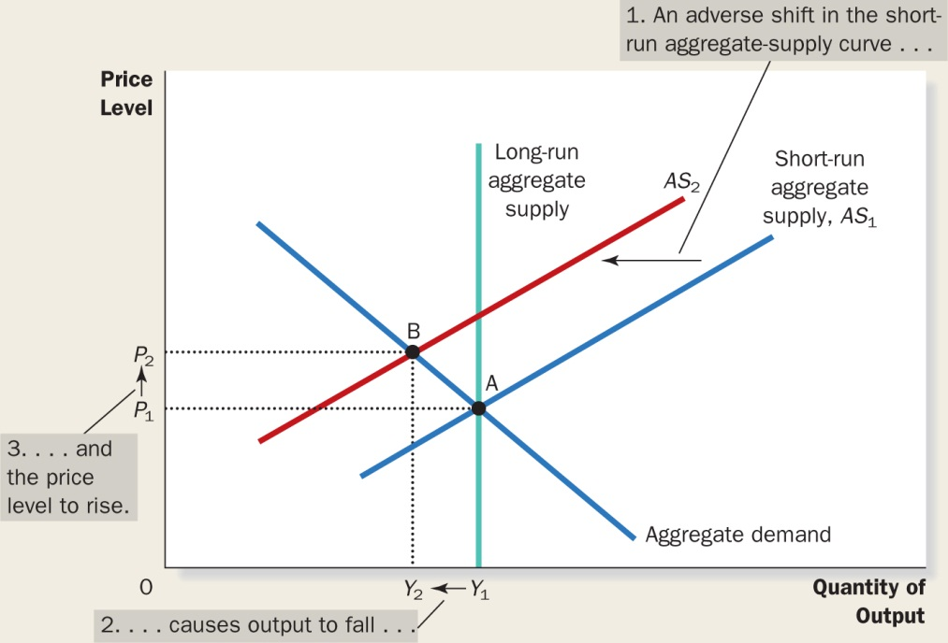
FIGURE 14.11:
An Adverse Shift in Aggregate Supply
Notes:
When some event increases firms’ costs, the short-run aggregate-supply curve shifts to the left from AS₁ to AS₂. The economy moves from point A to point B. The result is stagflation; output falls from Y₁ to Y₂ and the price level rises from P₁ to P₂.
Let’s consider step four, the transition from the short-run equilibrium to the long-run equilibrium. According to the sticky-wage theory, the key issue is how stagflation affects nominal wages. Firms and workers may at first respond to the higher level of prices by raising their expectations of the price level and setting higher nominal wages. In this case, firms’ costs will rise yet again, and the short-run aggregate-supply curve will shift farther to the left, making the problem of stagflation even worse. Higher prices leading to higher wages and in turn leading to even higher prices is often called the wage-price spiral.
Eventually the low level of output and employment will put downward pressure on workers’ wages. As nominal wages fall, producing goods and services becomes more profitable, and the short-run aggregate-supply curve shifts to the right. As it shifts back toward AS₁, the price level falls, and the quantity of output approaches its natural rate. In the long run, the economy returns to point A, where the aggregate-demand curve crosses the long-run aggregate-supply curve.

Slide 44
The Effects of a Shift in Aggregate Supply
To sum up, there are two important lessons to remember here:
  Shifts in aggregate supply can cause stagflation—a combination of recession (falling output) and inflation (rising prices).
  Policy makers who can influence aggregate demand can potentially mitigate the adverse impact on output but only at the cost of exacerbating the problem of inflation.

Slide 45
Suppose that the election of a popular prime minister suddenly increases people’s confidence in the future. Use the model of aggregate demand and aggregate supply to analyze the effect on the economy.

Slide 46
Classroom Activity
The Economics of War
Is war good or bad for the economy?
What are the opportunity costs of using resources in wars?
How would a war affect aggregate supply?
Graph the shift in aggregate supply. What happens to output and the price level?
How would a war affect aggregate demand?
Graph the shift in aggregate demand. What happens to output and the price level?
Is peace good or bad for the economy?
Notes:
Activity 2—The Economics of War
Type: In-class assignment
Topics: National Income, price levels, total spending, resources
Materials needed: None
Time: 20 minutes
Class limitations: Works in any size class
Purpose: This assignment asks students to examine their beliefs about the impact of war on the economy. It can be used to examine aggregate-demand shifts and aggregate-supply shifts. This assignment can generate lively discussion.
Instructions: Ask the class to answer the following questions. Give them time to write an answer to a question, then discuss their answers before moving to the next question.
1. Is war good or bad for the economy?
2. What are the opportunity costs of using resources in wars?
3. How would a war affect aggregate supply?
4. Graph the shift in aggregate supply. What happens to output and the price level?
5. How would a war affect aggregate demand?
6. Graph the shift in aggregate demand. What happens to output and the price level?
7. Is peace good or bad for the economy?
Common Answers and Points for Discussion
1. Is war good or bad for the economy?
A surprising number of students say war is good—many use WWII and its stimulative impact on the Canadian economy for support. Other students, particularly international students, see negative economic results.
2. What are the opportunity costs of using resources in wars?
Lost civilian production is an important opportunity cost. Rationing, price controls, and black markets are common in time of war. In poor countries, shifting resources from consumption to military use can lead to starvation. People displaced by fighting will be unlikely to continue their regular activities—causing unemployment. Any resources destroyed in the war—deaths, bombed factories or bridges, burned crops—will be unavailable for any use.
3.How would a war affect aggregate supply?
This question has a variety of correct answers. The resources destroyed by war are unavailable for productive purposes. This would decrease aggregate supply. Some wars begin as attempts to seize resources—more land, mines, petroleum reserves. If this is successful, it increases the aggregate supply of the winning country, but reduces that of the losing country. If countries develop new technologies, or invest in strategic industries, aggregate supply could increase.
4. Graph the shift in aggregate supply. What happens to output and the price level?
If aggregate supply decreases, output falls and the price level rises. If aggregate supply increases, output rises and the price level falls.
5. How would a war affect aggregate demand?
This question also has several answers. In many cases, high levels of military spending will increase aggregate demand. In areas where fighting is active, other spending sectors will be suppressed—less consumption, less investment, and perhaps a decrease in international trade. This would decrease aggregate demand.

Slide 47

The end
Chapter 14

