Slide 1
Why environmental forecasting?
Answer the questions about the future of environmental issues:
What actions to take to reduce the pollution?
How to preserve the future natural resources?
What will be the future consequences as a result of today’s actions?
Need to forecast environmental trends and know the key factors affecting these trends for policy making.

Slide 2
What is the scope and objectives of environmental forecasting?
Examples of environmental concerns:
Prediction of changes in ozone depletion: how would future ozone
level change?
Prediction in climate change: how GHGs emissions will change?
•
•
•
For example, estimation of pollutant concentrations in the future can be used to:
Anticipate problems that require taking action now
to access future compliance with current regulations and standards
Assessment of future impacts on human health and ecological systems

Slide 3
Future changes in the land use such as residential areas, agriculture, etc. that affect human health and welfare is also important
Difference between forecast and scenario:
Forecast
Tries to determine as accurately as possible, an outcome at some time in the future such as weather forecast (what the forecaster will think to happen)
Scenario
Tries to describe what would happen under given specified set of circumstances. A scenario, describes a possible outcome following an assumption about a factor affecting the outcome.
Scenarios are specially useful in long terms when environmental forecasts become less reliable.

Slide 4
Time scale
An important aspects of forecasting: short-term, long-term forecasting? Such as short or long terms environmental impacts.
Time scale determines the type of models and methods used for analysis:
Detailed models ⇒ short to medium term (perhaps 10-30 years)
Simpler models ⇒ long term (several decades to several centuries)
Also, other factors affect the model complexity:
Questions to be answered
Available data and models
Time and required resources for analysis

Slide 5
Spatial scale
Environmental problems can be different regarding spatial scales: i.e. water and air pollution are concerns for urban areas (scale 50km or less) while acid rain and impact on land due to human activities are regional issues (scale: hundreds of kilometers)
The choice of scale affects the feasibility and accuracy of environmental analysis
Geographic scale
Local
Regional or
national
Global

Slide 6
What factors influence the environmental change?
1- Population
Extent of environmental impacts are strongly dependent on the number of people. Models to predict the future populations are required
Major factors
Population
Standard of living
Technological change

Slide 7
2- Standard of living (economic growth)
This is usually measured in economic terms such as gross domestic product (GDP) per capita. The more affluent the population, the more demand for goods and services and, therefore, higher environmental impacts per person.
3- Technological change
Methods to provide food, shelter, comfort, transportation, consumer products, and other services such as education and health care.
Design and use of technology has its own environmental impacts (Chapter 2)
Technological change over time will change the environmental emissions and needs for energy and natural resources.

Slide 8
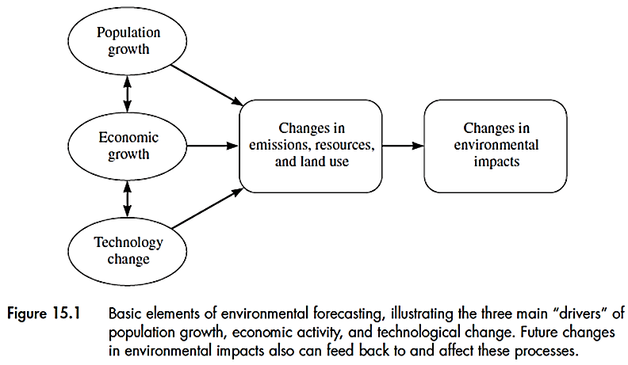
Modeling environmental processes
The 3 factors mentioned above, determine:
The future land use pattern
Natural resource requirements
Pollution emission to air, water and land.
Need science-based process models and data to predict the resulting environmental impacts due to anthropogenic emissions

Slide 9
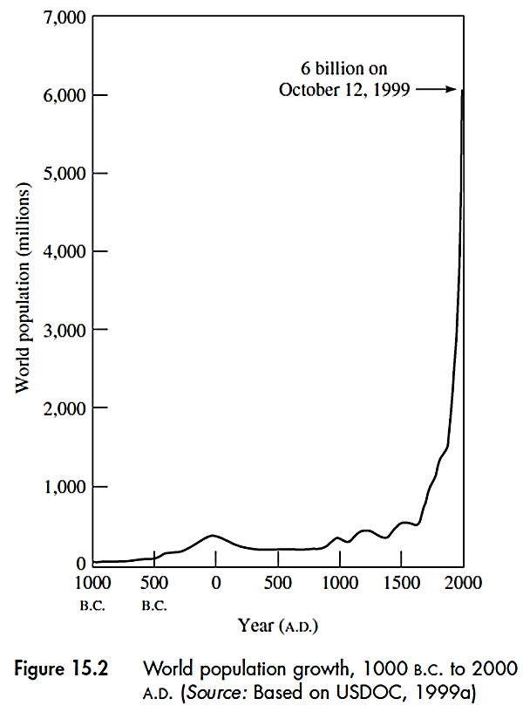
Population growth models
Need mathematical models to predict the population growth

Slide 10
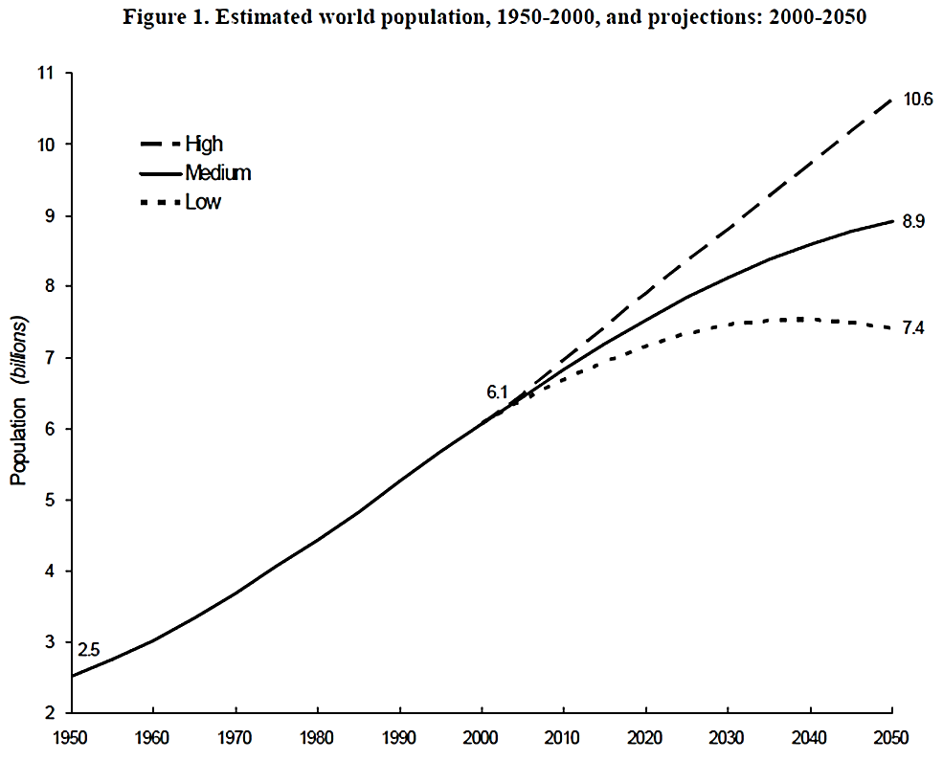
Estimated world population, 1950-2000, and projections: 2000-2050
UN Department of Economic and Social Affairs. Population Division (Source: http://www.un.org/esa/population/publications/longrange2/WorldPop2300final.pdf)
Year

Slide 11
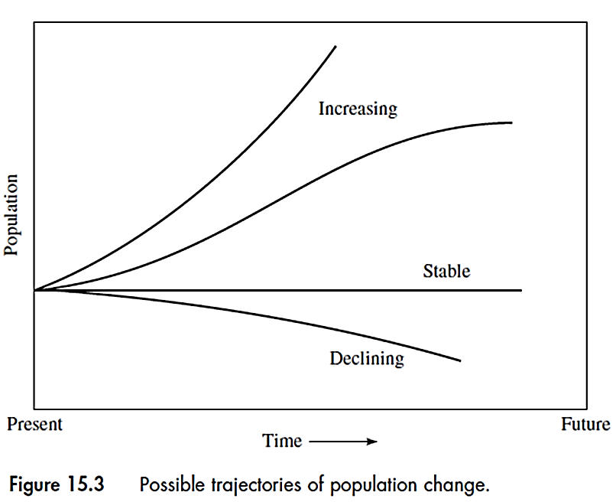
Population change depends on the time frame and geographical factors
Each population trajectory can be represented by a mathematical model
How to model
population change?

Slide 12
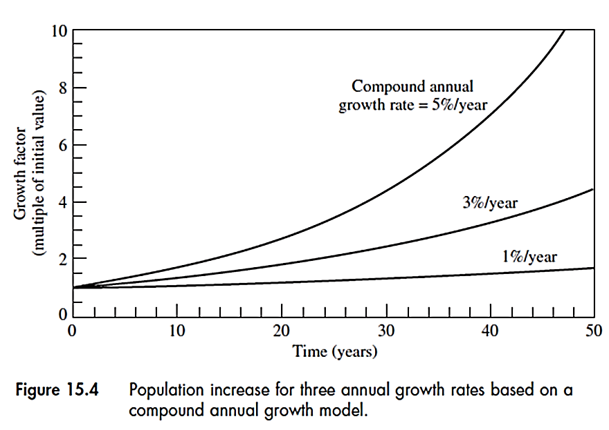
Annual growth rate model
Constant annual growth rate is one of the most common and simplest model for population growth:
P = P₀ (1+r)^{t}
P₀ = population at time zero, t=0
P = population at any time, t
r = Annual growth rate (fraction)

Slide 13
In this model, the population is ever-rising. The simplest model frequently used in environmental forecasting.
Example
If the population of a city is currently 200,000 people, with an annual growth rate of 6 percent/year, what will be the population increase after 15 years if this rate continue over the next 15 years?
P = P₀ (1+0.06)¹⁵ = 2.4P₀
⇒ Population increase = P – P₀ = 2.4 P₀ – P₀ = 1.4P₀
or 1.4 (200,000) = 280,000 people

Slide 14
Example
In the previous example is if the city currently produces 1.2 × 10⁶ tons of municipal solid waste (MSW) per year, how much MSW will be generated annually after 15 years if the rate of waste generation remains the same?
Rate of MSW generation = 1.2 × 10⁶ tons/year /200,000
= 6 tons/year.capita
Population after 15 years: 280,000 people
MSW generated annually 15 years from now:
= 6 tons/capita.year × 280,000 people = 1.7 ×10⁶ tons/year
or (1.7-1.2) ×10⁶ tons/year = 500,000 tons/year additional MSW

Slide 15

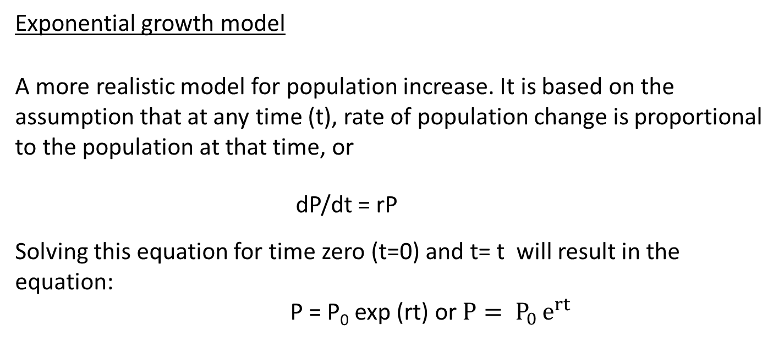
Exponential growth model
A more realistic model for population increase. It is based on the assumption that at any time (t), rate of population change is proportional to the population at that time, or
dP/dt = rP
Solving this equation for time zero (t=0) and t= t will result in the equation:
P = P₀ exp (rt) or $P= P_{0 }e^{rt}$
P
$$P= P_{0 }e^{rt}$$
P₀
t

Slide 16
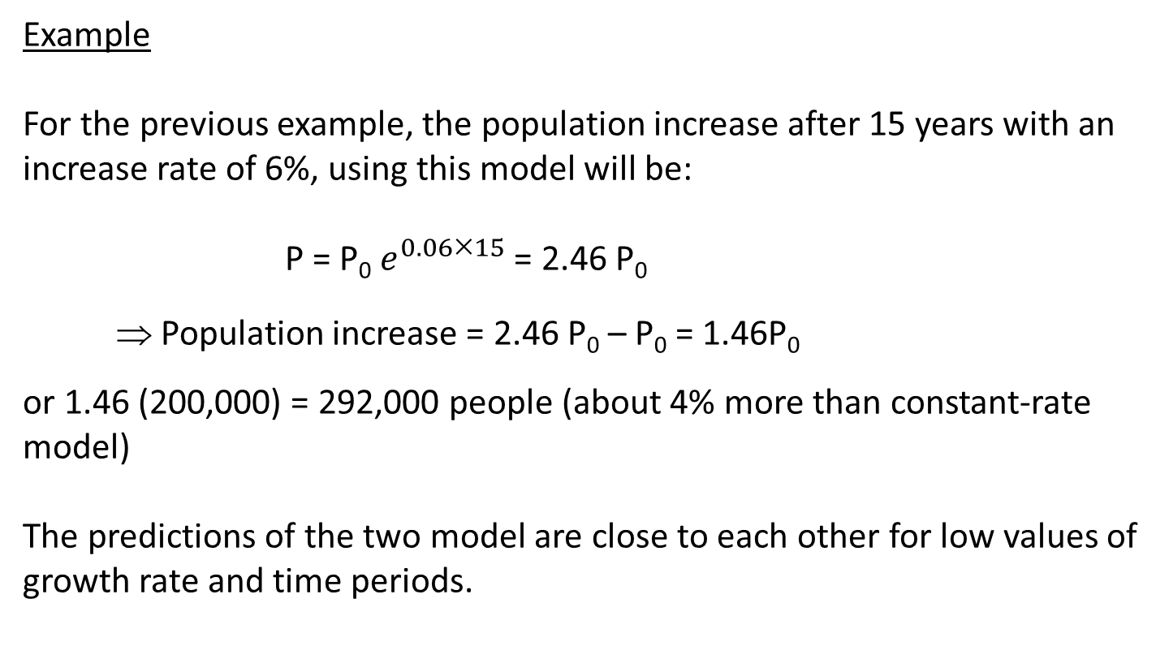
Example
For the previous example, the population increase after 15 years with an increase rate of 6%, using this model will be:
P = P₀ $e^{0.0615}$ = 2.46 P₀
⇒ Population increase = 2.46 P₀ – P₀ = 1.46P₀
or 1.46 (200,000) = 292,000 people (about 4% more than constant-rate model)
The predictions of the two model are close to each other for low values of growth rate and time periods.

Slide 17
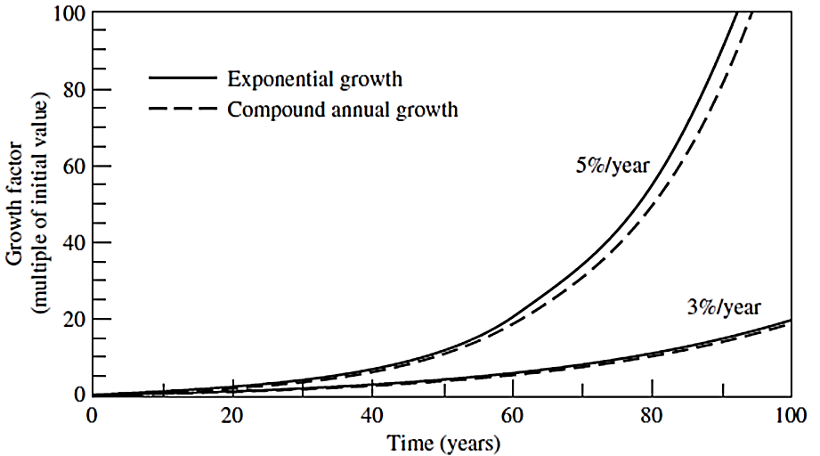
Exponential growth cannot continue forever. Due to finite space and resources to support the population’s needs, growth is eventually limited.
Logistic growth model
The population growth for many living organisms follows as S-shaped curve: initially grows exponentially, but finally reaches a limit, P_{max}, and the growth rate becomes zero.

Slide 18
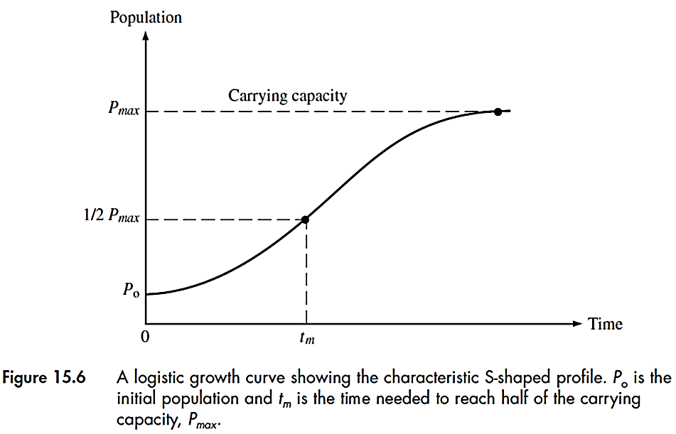
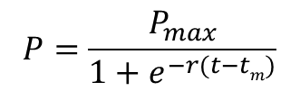
$$P=\frac{P_{max}}{1+e^{−r(t−tm)}}$$
The population limit (P_{max}) is called “carrying capacity” of the environment
This population defines an equilibrium condition where the total demand of the population for food, water, waste disposal, and natural resources are in balance with the capability of the environment to supply those needs.

Slide 19
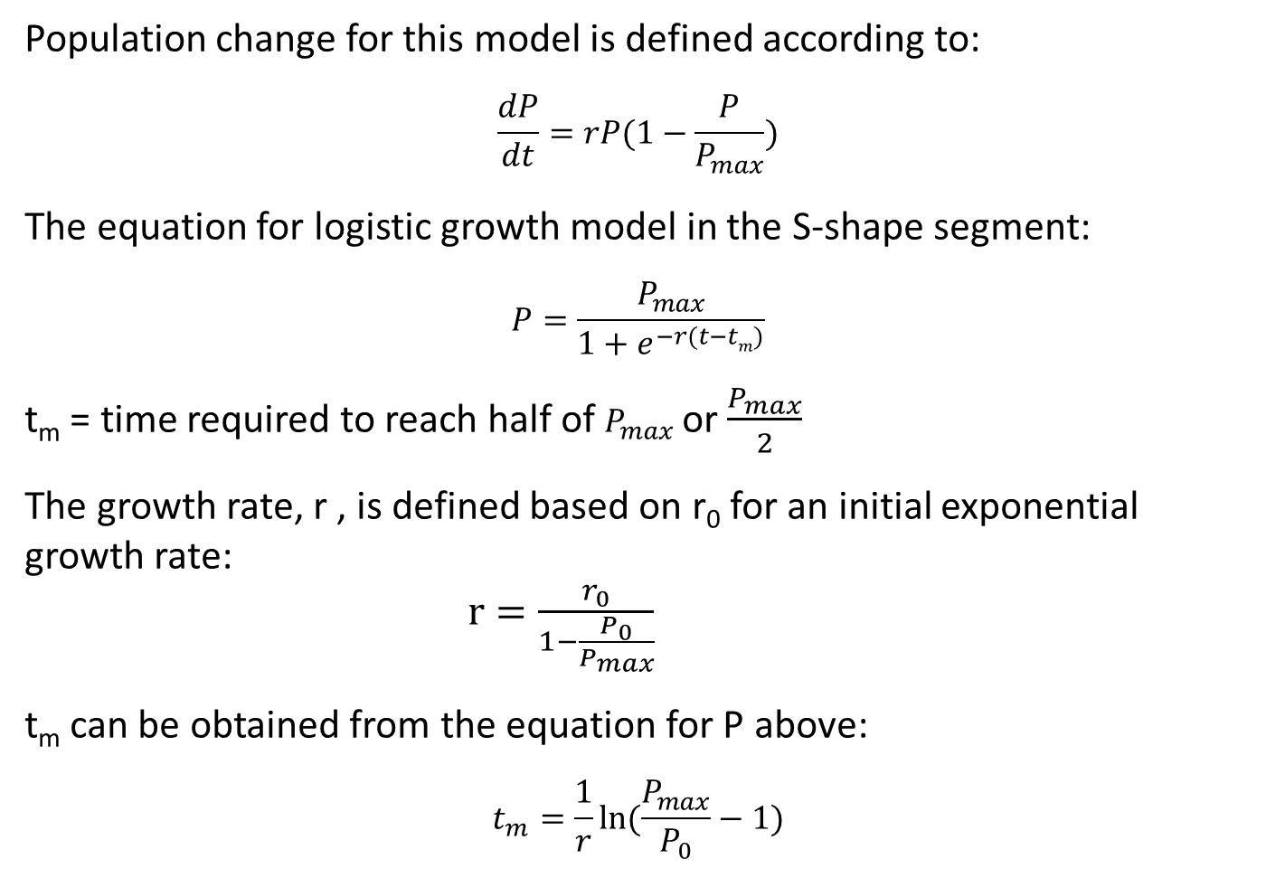
Population change for this model is defined according to:
$$\frac{dP}{dt}=rP(1−\frac{P}{P_{max}})$$
The equation for logistic growth model in the S-shape segment:
$$P=\frac{P_{max}}{1+e^{−r(t−tm)}}$$
t_{m} = time required to reach half of $P_{max}$ or $\frac{P_{max}}{2}$
The growth rate, r , is defined based on r₀ for an initial exponential growth rate:
$r=\frac{r_{0}}{1−\frac{P_{0}}{P_{max}}}$
t_{m} can be obtained from the equation for P above:
$$t_{m}=\frac{1}{r}ln⁡(\frac{P_{max}}{P_{0}}−1)$$

Slide 20
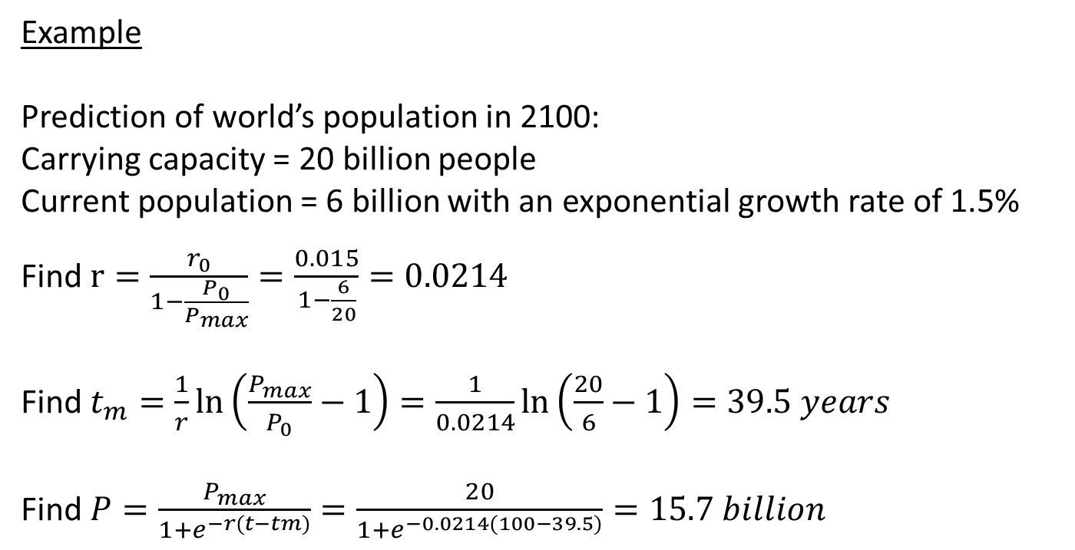
Example
Prediction of world’s population in 2100:
Carrying capacity = 20 billion people
Current population = 6 billion with an exponential growth rate of 1.5%
Find $r=\frac{r_{0}}{1−\frac{P_{0}}{P_{max}}}=\frac{0.015}{1−\frac{6}{20}}=0.0214$
Find $t_{m}=\frac{1}{r}\ln\left(\frac{P_{max}}{P_{0}}−1\right)=\frac{1}{0.0214}\ln\left(\frac{20}{6}−1\right)=39.5 years$
Find $P=\frac{P_{max}}{1+e^{−r(t−tm)}}=\frac{20}{1+e^{−0.0214(100−39.5)}}=15.7 billion$

Slide 21
These models are desirable since they are observed for the long-term growth patterns for microorganisms
They offer a long-term limit to growth and stabilization of population
However, they are less successful for human populations due to variations of carrying capacity and growth rates

Slide 22
Demographic models
Demography: study of characteristics of human populations including their size, age, gender, geographic distributions, and other statistics
The crude rates (apply to whole population) of births and deaths and immigration rates are used for prediction of population and are expressed annually per 1000 people:
Growth arte = (Birth rate) – (Death rate) – (Immigration rate)
Example
A country with crude rates of birth, death and immigration of 20, 9 and 1 person respectively per year per 1000 people, has growth rate of:
20-9+1 = 12 persons per 1000 people or 12/1000 × 100 = 1.2% growth rate

Slide 23
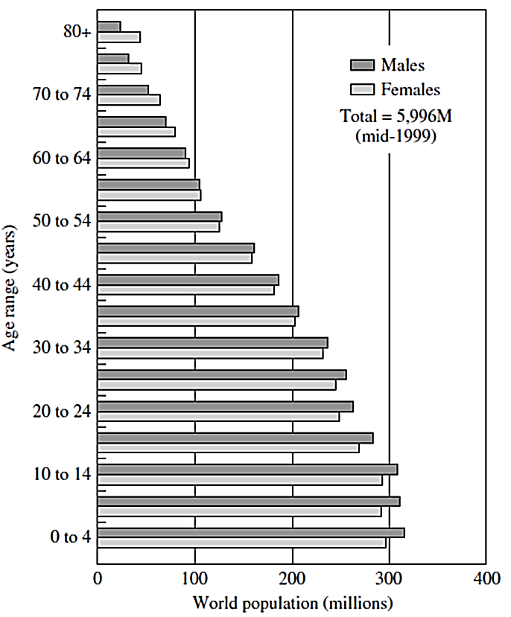
Age-specific rates
Instead of crude rates, these rates which are based on gender, are more useful in estimation of population growth rates.

Slide 24
Fertility rates
A key factor in population projection is the total fertility rate of women
The average number of children born per each woman during her life time.
A higher fertility rates is likely to lead to a higher future population
Replacement fertility rate is the average number of live births needed to replace each female in the current population with one female in the next generation
If fertility rate exceeds the replacement rate a population momentum is generated that leads to a sustained increase in population (such as in developing countries)

Slide 25
Limitations of demographic models
Future fertility and death rates and immigration patterns are uncertain since they depend on assumptions about future economic development and standards of living
They are limited in long-term forecasting of the changes in population
However,
These models are useful for analyzing scenarios of future populations
They provide information about size and age structure of the available labor force of the future which is important for economic projections
The can provide useful information applicable for other models for population growth

Slide 26
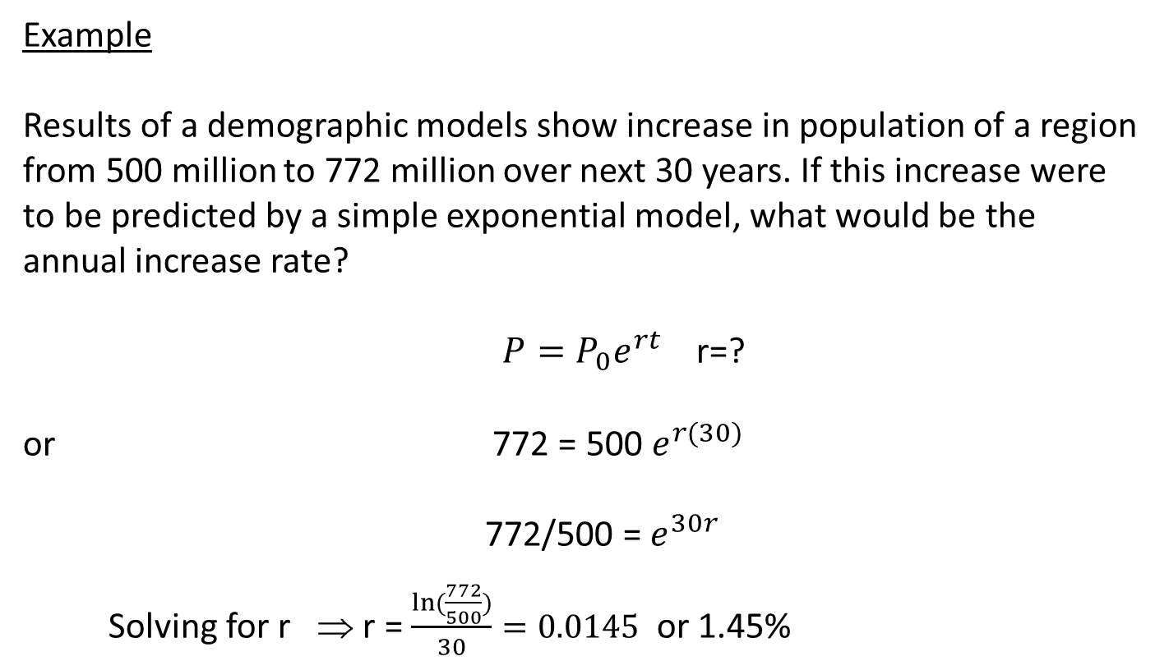
Example
Results of a demographic models show increase in population of a region from 500 million to 772 million over next 30 years. If this increase were to be predicted by a simple exponential model, what would be the annual increase rate?
$P=P_{0}e^{rt}$ r=?
or 772 = 500 $e^{r(30)}$
772/500 = $e^{30r}$
Solving for r ⇒ r = $\frac{ln({\frac{772}{500})}}{30}=0.0145$ or 1.45%

Slide 27
Economic Growth Models
Forecasting for the environmental impacts can be based on the development of economic models
These models develop a relationship between economic growth and the resulting demands for goods and services
The most common measure of economic activity is gross domestic product (GDP): the monetary value of all final goods and services produced during a year
GDP per capita is a measure of the average wealth of the population. Change in GDP/capita over time is a measure of economy growth

Slide 28
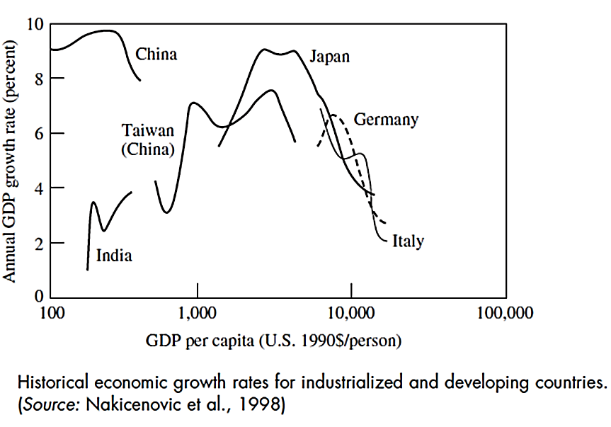
Prediction of future changes in GDP can be done, but, with uncertainty and based on historical trends of a country.
By making assumptions such as annual percentage increase in the overall GDP or in the related factors, GDP growth rate can be predicted.
How to relate the economic well-being to other environmental implications?

Slide 29
Activity coefficients
Amount of products and services per person
These coefficients are related to the level of economic development and directly or indirectly influence the environmental impacts
Examples
Number of cars per 1000 people
Per capita residential housing (m²/person)
Solid waste generated per year (kg/person-year)
Useful for many types on environmental analysis
However, these coefficients are not explicitly linked to the economic development, but they are related to the economic well being

Slide 30
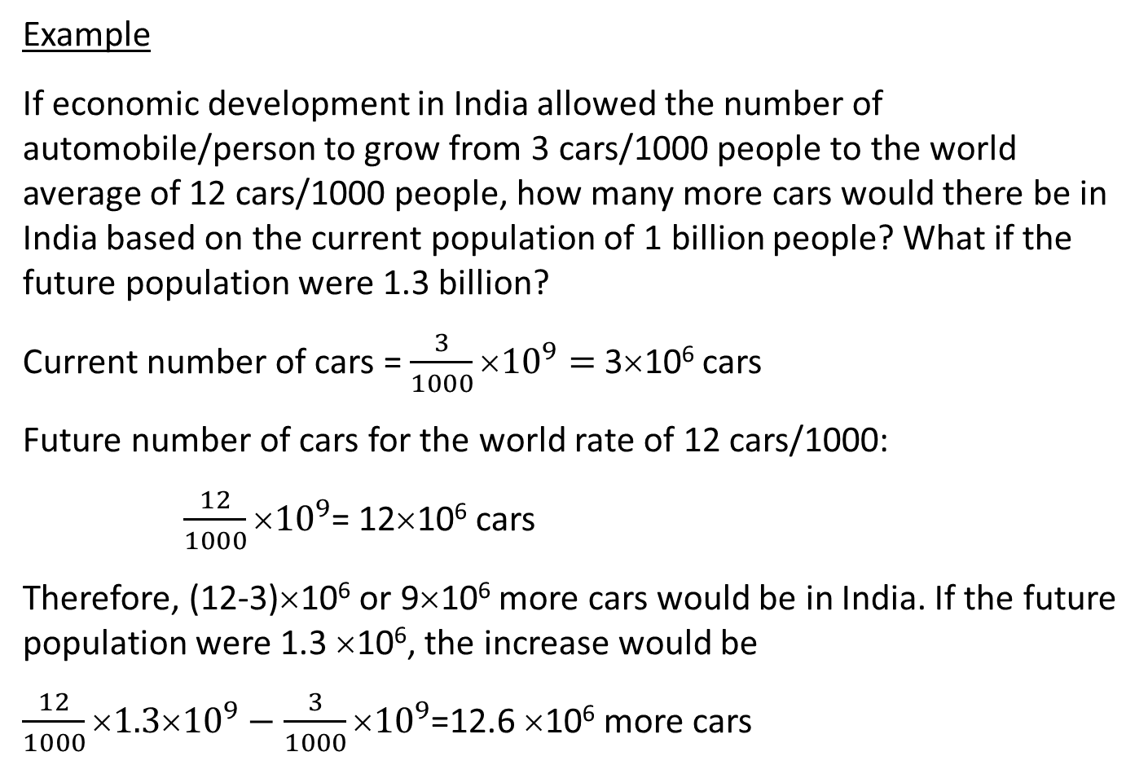
Example
If economic development in India allowed the number of automobile/person to grow from 3 cars/1000 people to the world average of 12 cars/1000 people, how many more cars would there be in India based on the current population of 1 billion people? What if the future population were 1.3 billion?
Current number of cars = $\frac{3}{1000}{10}^{9}=$3×10⁶ cars
Future number of cars for the world rate of 12 cars/1000:
$\frac{12}{1000}×{10}^{9}$= 12×10⁶ cars
Therefore, (12-3)×10⁶ or 9×10⁶ more cars would be in India. If the future population were 1.3 ×10⁶, the increase would be
$\frac{12}{1000}×{1.3×10}^{9}−\frac{3}{1000}×{10}^{9}$=12.6 ×10⁶ more cars

Slide 31
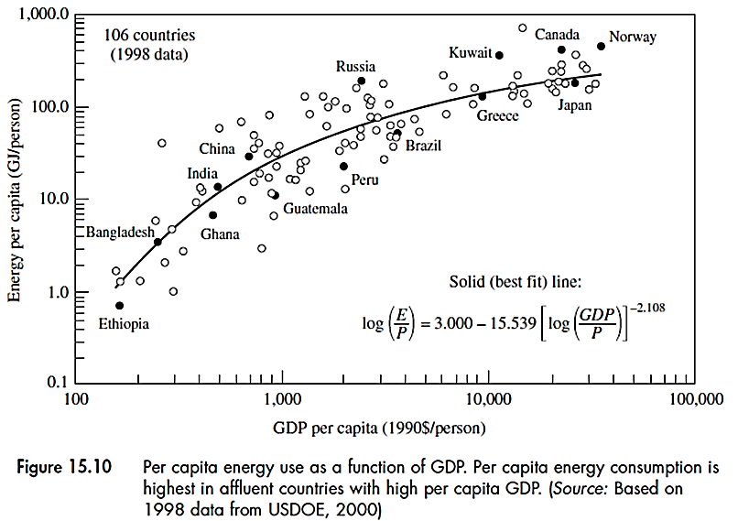
Economic growth and energy use
This approach relates the GDP to the energy use that is related to environmental impacts.

Slide 32
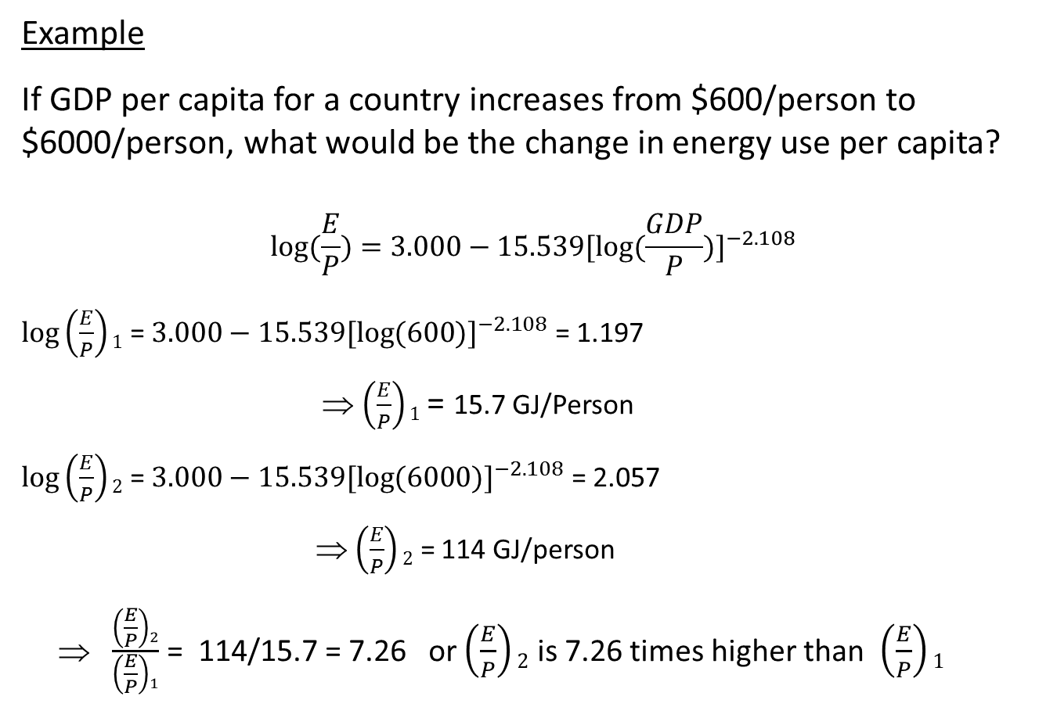
Example
If GDP per capita for a country increases from $600/person to $6000/person, what would be the change in energy use per capita?
$$log⁡(\frac{E}{P})=3.000−15.539[log(\frac{GDP}{P}{)]}^{−2.108}$$
$\log\left(\frac{E}{P}\right)1$ = $3.000−15.539[log(600{)]}^{−2.108}$ = 1.197
⇒ $\left(\frac{E}{P}\right)1$ = 15.7 GJ/Person
$\log\left(\frac{E}{P}\right)2$ = $3.000−15.539[log(6000{)]}^{−2.108}$ = 2.057
⇒ $\left(\frac{E}{P}\right)2$ = 114 GJ/person
⇒ $\frac{\left(\frac{E}{P}\right)2}{\left(\frac{E}{P}\right)1}$ = 114/15.7 = 7.26 or $\left(\frac{E}{P}\right)2$ is 7.26 times higher than $\left(\frac{E}{P}\right)1$

Slide 33
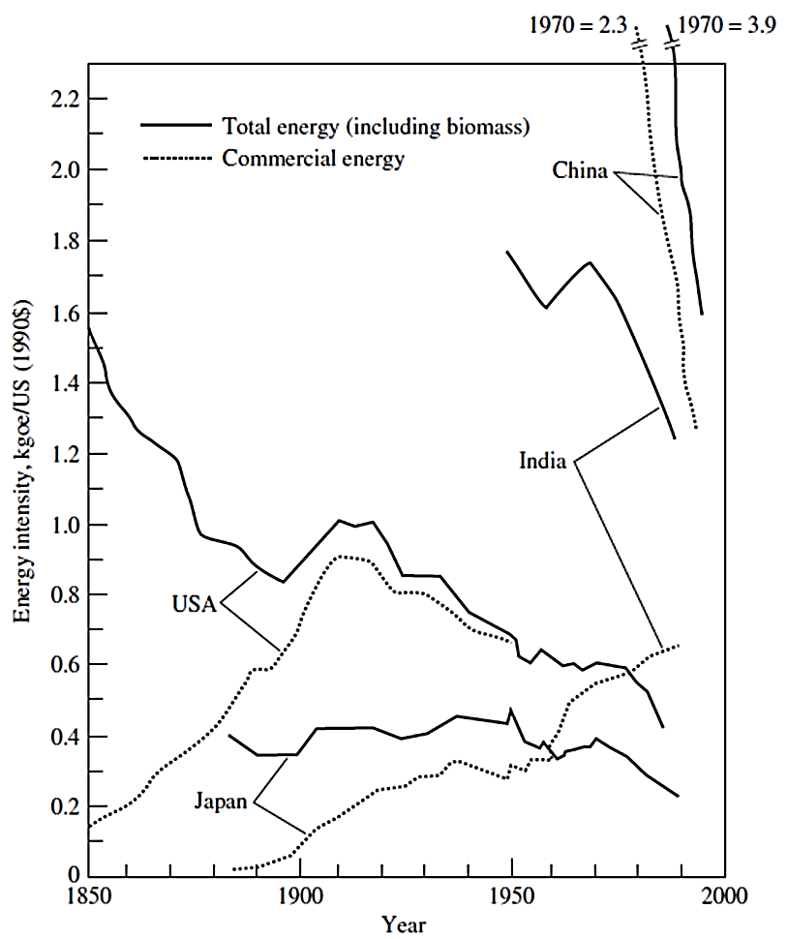
However, the energy use per capita is different for countries even for those with similar GDPs which is due to differences in economic systems, energy efficiencies and other related factors.
Another approach:
Total energy use over time
Over time, a decrease in energy intensity (per year per capita) shows an improvement in energy efficiency and structural changes in economy.
However, the observed trend may not continue in the future

Slide 34
To evaluate the environmental consequences of increased energy use, additional models and methods are required. Two models relate the economic growth to the environmental impacts:
Input-output models
Macroeconomic models
Input-output models
These models relate the interactions among different sectors of an economy and quantify the value of goods and services that each sector requires from other sectors (inputs) to make its own product (output).

Slide 35
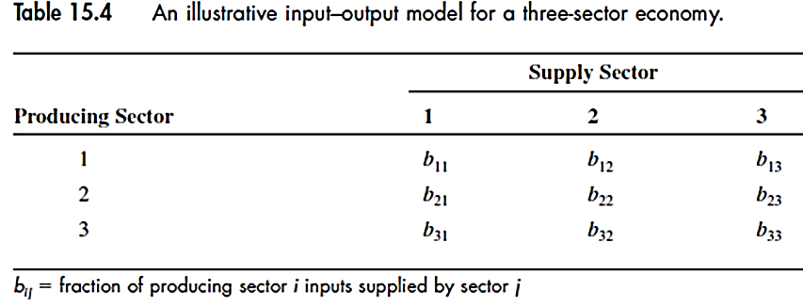
For example, to produce an average automobile, the auto sector requires products such as iron and plastics (inputs) from other industries (sectors).
The amount of goods and services each sector buys from other sectors provides information about their economic interactions.
1
b₁₂
b₂₁
2
3

Slide 36
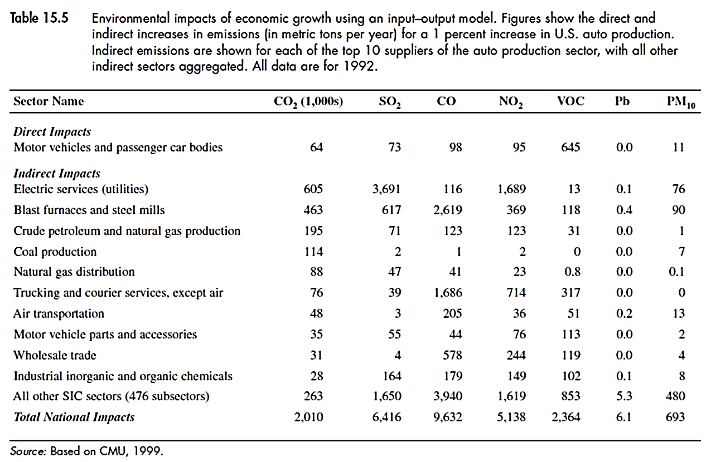
How environmental impacts are accounted for?
Any increase in economic activity will likely to generate more environmental emissions that can be quantified
As an example, EPA publication for release of toxic materials from manufacturing industries

Slide 37
The main benefit of this model:
Accounting for all direct and indirect impacts in the supply chain
which provides a comprehensive method for LCA analysis.
A major limitation of this model:
Economic and environmental parameters considered, are for a
particular year and environmental emissions are assumed to be
proportional to economic growth.
However, in long term(such as 10 years), the structure of an economy
and its environmental impacts will change. These models can be
useful for near-term (next few years) analysis.

Slide 38
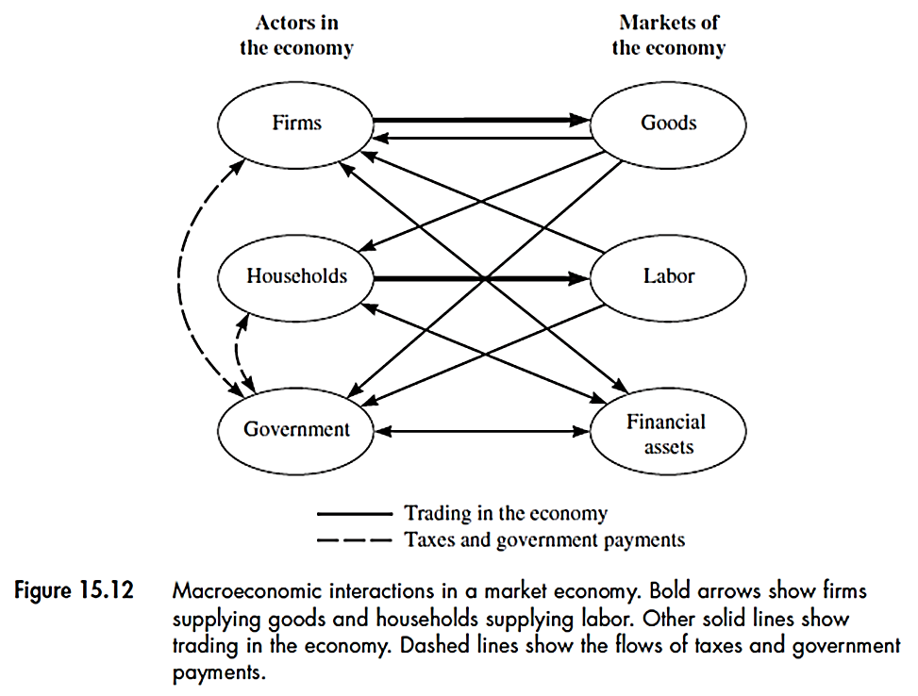
Macroeconomic models
These models are based on the structure and performance of national economies and the effect of governmental policies on economic activity.
Economic activity is expressed in terms of the interactions of 3 sectors: firms, households and government.

Slide 39
These models use data about various interactions (Figure above) to explain overall changes in the economy and to develop e mathematical model
For example, a mathematical model for gross national products (GNP) is developed using the data from these interactions:
Production function: G = P K^{0.3} L^{0.7}
G = Real GNP (billions of dollars)
P = Productivity factor for the economy
K = Annual value of all capital goods for production (billions of dollars)
L = Labor force (millions of workers)

Slide 40
Example
If the GNP for the US was $4,118 billion in 1989 along with total production capital of $3,960 billion and total labor of $117.3 million. How much would the overall economic grow if labor, capital, and productivity each increase by 2% in a given period?
G = P K^{0.3} L^{0.7}
From G = $4118 billion and K= $3960 billion and L= $117.3 million, P value can be estimated:
P= G/(K^{0.3}L^{0.7}) = 12.21
Now, if P, K and L, each increase by 2%,
New G = (12.21 ×1.02) (3960 ×1.02)^{0.3}(117.3×1.02)^{0.7} = $4283 billion
Overall, 4% increase in GNP

Slide 41
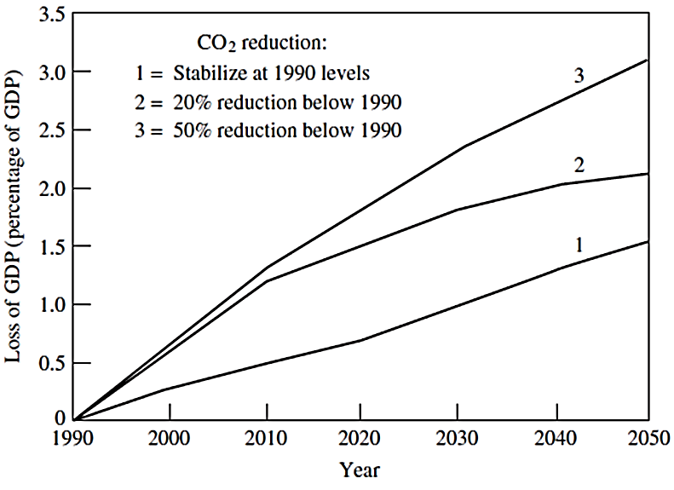
These models are also used to predict the economic consequences of proposed environmental policy measures such as for modeling of impacts of carbon tax to reduce CO₂ emissions.
Increase in fuel prices
lower consumption
Carbon
tax
Increase in price of goods
Less consumer demand
Loss of GDP

Slide 42
Conjunction of macroeconomic models with energy models can predict changes in the demand for specific energy supplies and fuels and therefore, subsequent environmental emissions
These models also have limitations since they are also based on assumptions about the input parameters such as fuel prices and growth rates that will change over time and they have simplifications that limit their predictive capabilities.

Slide 43
Technological change
Technological changes can directly influence environmental forecast or scenarios.
Types of technology change
Improvements to a current technology design can reduce its environmental impacts, i.e. by improvement in its energy efficiency such as new car engines to reduce nitrogen oxides emissions
Alternative technologies can reduce environmental emissions, i.e. replacing a coal-fired power plant with an advanced gas-powered plant
New technologies that are totally different than current technologies such as automobiles in comparison with bicycles.
Change in technology utilization determines its environmental impacts, so it has to be considered in environmental forecasting.

Slide 44
Scenarios of alternative technologies
Question: what would be the impacts on air pollution if the future automobiles use batteries instead of fuels?
The mathematical model can characterize alternative technologies in terms of direct impacts (emissions to air, water, solid waste generation) and indirect impacts (energy, materials, etc.)
Example
If future power plants use coal gasification combined cycle instead of current coal-fired cycle, the plant efficiency will improve from 30% to 50%. This will reduce CO₂ emissions by a factor of 30/50 or 60% since it is inversely related to the plant efficiency.
Plant efficiency = Electrical energy output/coal energy input
Current CO₂ emission rate = 1.1 kg /kW-hr
Future CO₂ emission rate = 1.1 × 0.6 = 0.66 kg /kW-hr

Slide 45
Technology adaptation
How long will it take for a new technology to be widespread?
The answer is important in predicting the environmental impacts such as emissions and energy use.
Price, useful lifetime and number of competing options are 3 important factors to determine how fast a technology is adopted.
3 methods to model the rate of adoption of a new technology :
Specific rate of change
Specific market share
Consumer choice method

Slide 46
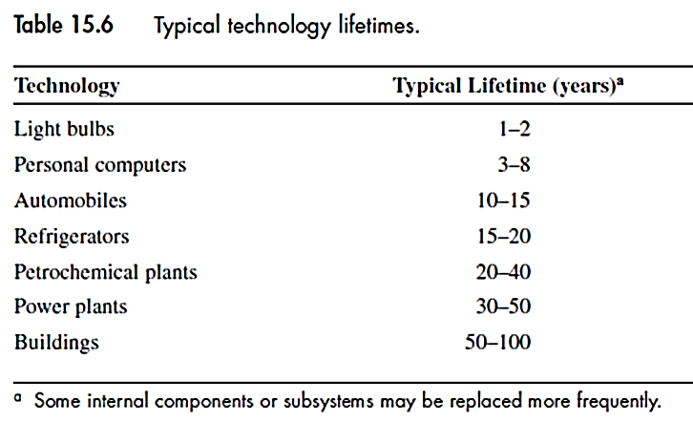
Specific rate of change
It depends on the growth of new markets for the technology, plus the opportunity to replace existing technologies at the end of their useful lives.
Typical life-time of several technologies

Slide 47
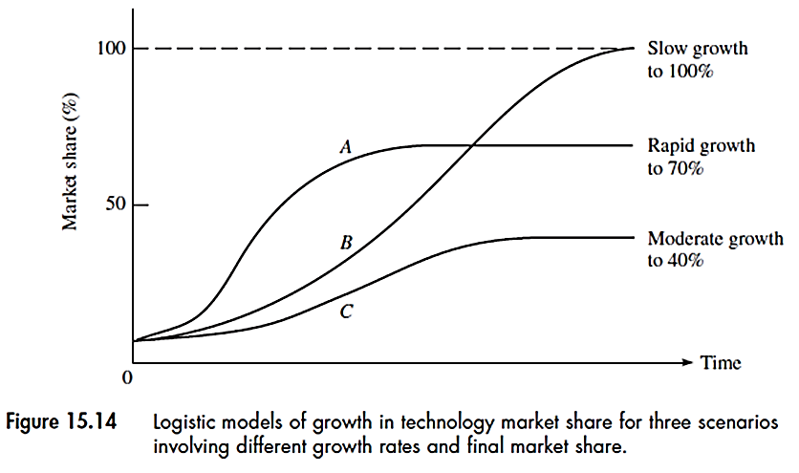
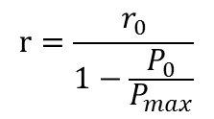

Specified market share
A new or improved technology must compete with alternative options in the market. Therefore, the adoption rate of a new technology depends also on its market share.
Prediction of market share using S-shaped logistic function for gradual diffusion of a technology in the market.
P = percent market share
P_{max} = maximum market share
t_{m} = time to reach half P_{max}
r₀ = initial growth rate
r = composite growth rate
$$P=\frac{P_{max}}{1+e^{−r(t−tm)}}$$
$$r=\frac{r_{0}}{1−\frac{P_{0}}{P_{max}}}$$

Slide 48
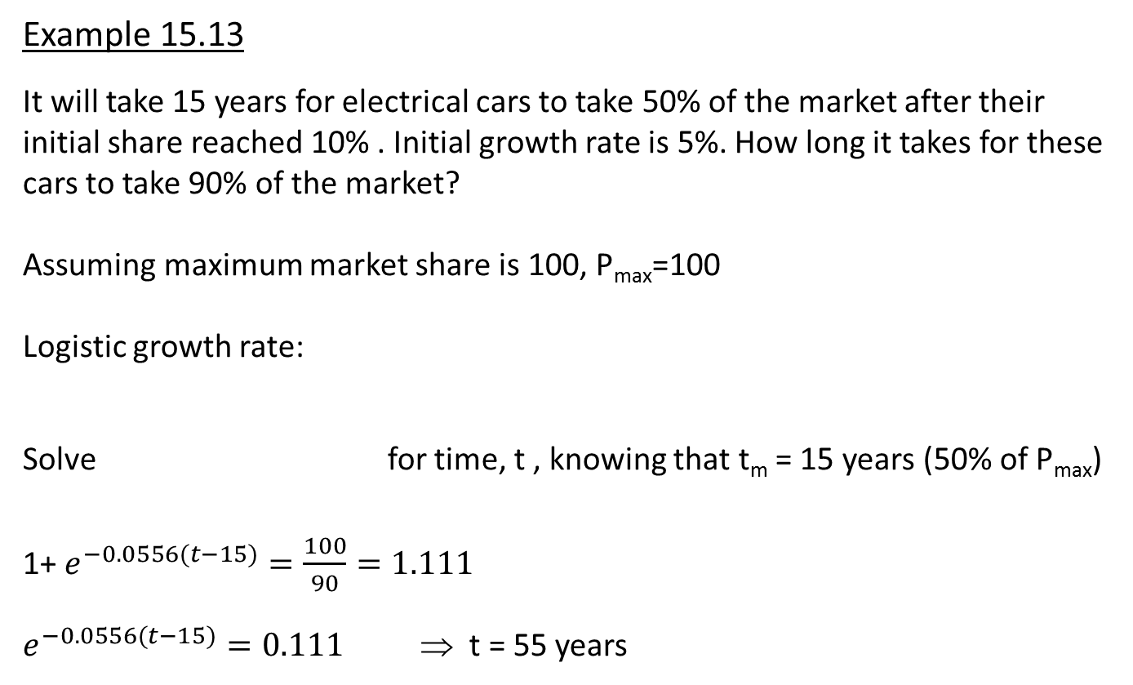
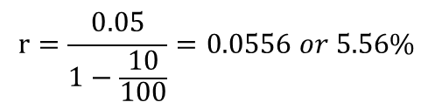

Example 15.13
It will take 15 years for electrical cars to take 50% of the market after their initial share reached 10% . Initial growth rate is 5%. How long it takes for these cars to take 90% of the market?
Assuming maximum market share is 100, P_{max}=100
Logistic growth rate:
Solve for time, t , knowing that t_{m} = 15 years (50% of P_{max})
1+ $e^{−0.0556(t−15)}=\frac{100}{90}=1.111$
$e^{−0.0556(t−15)}=0.111$ ⇒ t = 55 years
$$r=\frac{0.05}{1−\frac{10}{100}}=0.0556 or 5.56\%$$
$$P=\frac{P_{max}}{1+e^{−r(t−tm)}}$$

Slide 49
Consumer choice model
This model is based on consumer preferences. The capital and operating costs of a new technology is assessed along with the other competitive technologies. The choice is the cheapest.
The cost of new technology may change over time
There could be a limit for maximum market share of a technology due to non-economic factors in the assessment.
These models have often been used to analyze energy technologies and their environmental implications (such as electric power generation).
One disadvantage is lack of transparency due to many assumptions and not being clear which assumption is most influential

Slide 50
Rate of technology innovation
Environmental forecasting mostly assumes that technologies will improve in the future. What factors affect this improvement?
Factors that technology innovation depend on? How the new innovations come into effect?
Some factors are market forces, organizational structure and government research funds
But, effective models are needed to predict technology innovation.

Slide 51
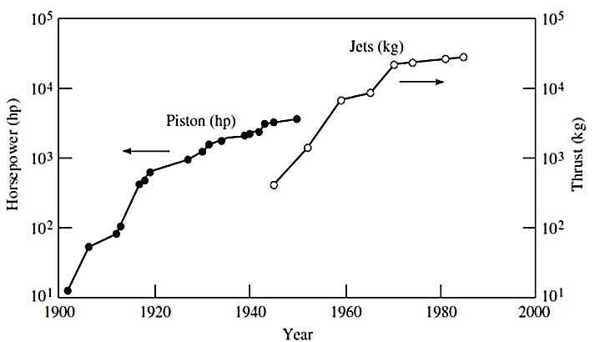
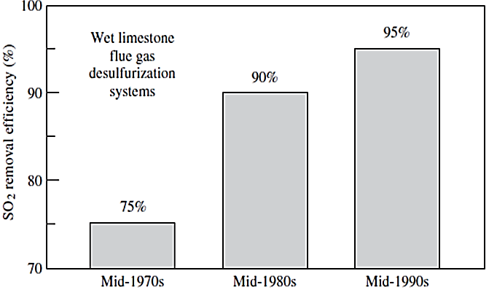
But the future predictions are based on the past trends; two examples:
Aircraft engine technology b) pollution removal technology
Many mathematical models based on historical trends, are not reliable for the prediction of future trends, but can suggest the types and rates of technology innovations used in the scenario analysis.
Prediction of technology trends should be in conjunction with economic and population trends.

