Slide 1
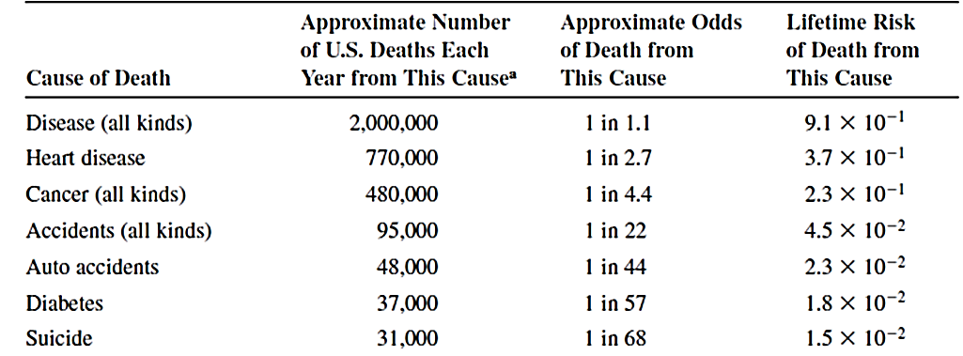
Environmental Risks
Risk is the potential of injury or loss due to an action. If the loss is well defined such as death, then risk is defined as (first definition):
Risk = Probability of a specific undesired consequence
An example is the risk of death due to hearth disease: if the risk of dying from hearth disease is 0.37, that means there is 37% chance that death will happen because of hearth disease.
Part of Table 14.1: Risk of death for Americans from various activities

Slide 2
If several different kinds or magnitudes of injury or loss may occur, then (second definition):
Risk = Probability of an undesired consequence × size of the loss
An example is the risk of nuclear power plant accident that is assessed differently for a location near a populated urban area than a remote area.
However, other factors are involved such as how well the risk in understood and how well the people’s exposure to the risk can be controlled.
We consider the first risk definition and focus on the assessing environmental risks to human health due to chemicals and carcinogens in the environment

Slide 3
Two categories of health risk are assessed:
Risk of cancer from
carcinogenic chemicals
Risk of other non-carcinogenic
chemicals
highest concern
related to other all human diseases
such as damage to an organ

Slide 4
Is risk acceptable?: no reduce or eliminate the risk
What level of risk is acceptable?
EPA has approved numerical criteria to access if a particular exposure to chemicals poses acceptable or unacceptable risk to public health
Different criteria for carcinogenic and non-carcinogenic materials
1 in 10⁶ of additional human
cancer over a 70-year lifetime
is acceptable

Slide 5
How to do a risk assessment? 4 steps:
Hazard assessment
Dose-response
assessment
Exposure
assessment
Risk characterization
1-Hazard Assessment
Is there any potential problem due to exposure to a chemical ? To determine if there is an observable increase in some illness or health condition by determining the nature and severity of any effect
Can be done by laboratory analyses or real data from people and results determine the nature and severity of any possible effects

Slide 6
2- Dose-response assessment
If the previous step reveals that a chemical has some adverse health effects, a relationship is to be established to quantify the dose and response or adverse affects. This step is done for the two categories of effects: carcinogenic and noncarcinogenic.
Carcinogenic effect
Results of lab studies from testing a chemical on animals such as rats applicable for human? Tests cannot be conducted on humans.
Dose-response assessment can determine the incremental risk of cancer above the normal or background level (Fig. 14.2)
Dose of chemical per body weight per day (mg/kg.day): a measure of long-term (chronic) or short-term (acute) exposure

Slide 7
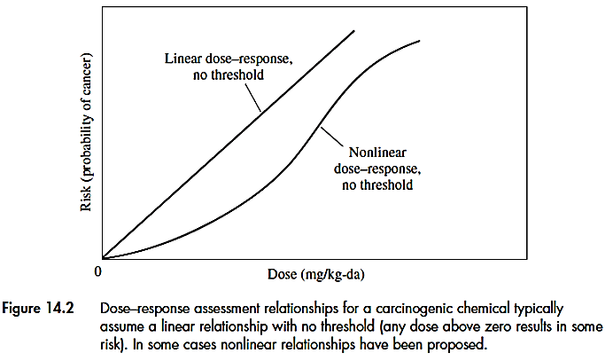
There is no low limit for carcinogens and only when the concentration of the carcinogen is zero there is no risk.
Example 14.1
In a test of a carcinogenic chemical with a daily dose of 1 mg/kg.da on rats, 2 rats out of 100 developed tumors. The dosage for typical human exposure is 10⁻⁵ mg/kg.da. Assuming a linear dose-response relationship, how many animals would have to be tested to detect the expected cancer rate at the lower dose?

Slide 8
The risk (probability) of cancer is estimated from the test which is 2%. With a linear dose-response, the slope of the dose-response line can be calculated as 2%/1 (mg/kg.d).
For the dosage of human exposure, 10⁻⁵, the risk will be 2%×10⁻⁵ or
2× 10⁻⁷. This means 2 rats per 10⁷ rats. Therefore, minimum 10⁷ rats required.
Noncarcinogenic Chemical Effects:
Chemicals that do not induce tumors in test animals even at high dosage but can cause other adverse health effects such as liver or kidney damage.
These chemicals have different dose-response relationship and they have a threshold value

Slide 9
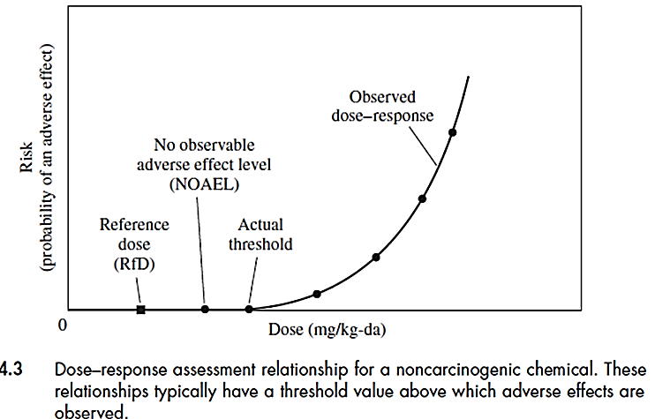
A threshold dose is a dose below which, there is no observable adverse health effects. It is the intersection of the curve with x axis.

Slide 10
3- The exposure assessment
This step is to quantify the dose received in a particular situation: to measure: the frequency, intensity and duration of human exposure to a chemical.
How people are exposed to chemicals? What are the pathways?
Frequency
Intensity
Duration
Total exposure

Slide 11
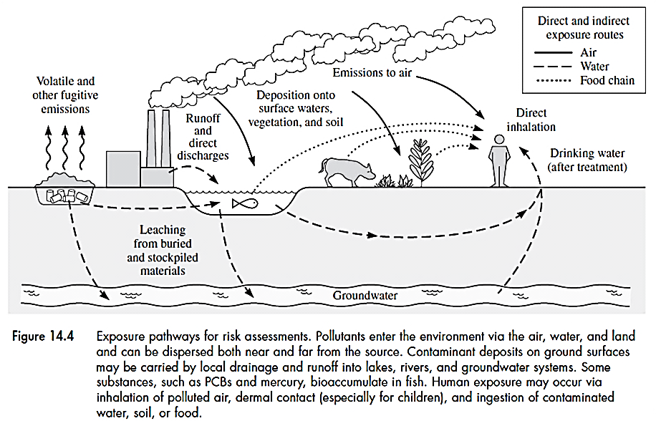
Different exposure pathways of humans to chemicals

Slide 12
Exposure routes
Inhalation:
the most common
Skin: contact with
contaminated
water or soil
Oral ingestion:
Contaminated food
Bioaccumulation: accumulation and storage of certain chemicals from foods that are found in water and soil such as bioaccumulation of mercury in fish

Slide 13
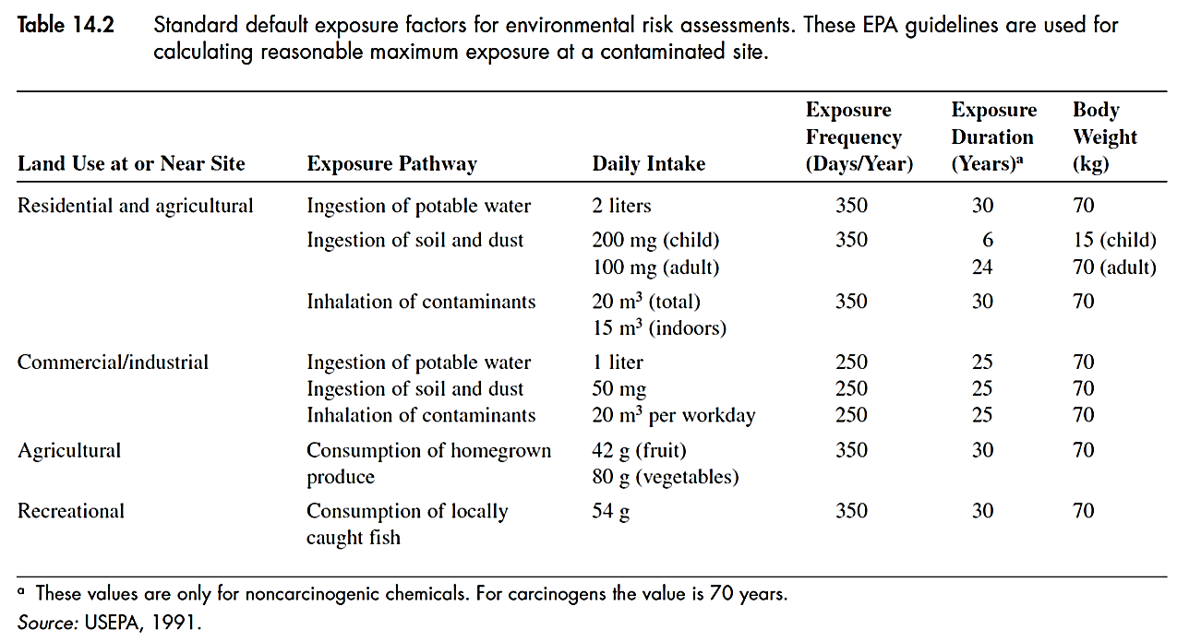
In the absence of actual measurement, exposure assessment can be done using mathematical models. Exposure factors are shown in Table 14.2 which include the quantities of air, water and soil ingested by adults and children

Slide 14
Example 14.2: using exposure factors
The average ambient air concentration of formaldehyde in urban region is estimated to be 4.6 μg/m³ of air. What is the average daily dose (mg/kg.d) received by an average adult, assuming that all the inhaled material is taken up by the body?
From Table 14.2 ⇒ an adult weighs 70 kg and inhale 20 m³air/day
Therefore, the daily mass of formaldehyde inhaled per weight of an adult can be estimated as:
4.6 μg/m³ × 20 m³/day × 10⁻³μg/mg
70 kg
= 1.3×10⁻³ mg/kg.d

Slide 15
4- Risk Characterization
The final (4th ) step is combining the results of exposure assessment and dose-response function. It determines the probability of an adverse effect to a humans by a toxic substance and outlines permissible exposure levels for decision making.
Quantitative assessment of risk for carcinogenic and noncarcinogenic chemicals:
Assessing risk for carcinogens
Chronic daily intake (CDI)
It is defined for carcinogenic chemicals and it is the average daily dose of a carcinogen over the life time of an individual per body weight in (mg/kg.da)

Slide 16
EPA assumption of 70 years life time is applied. Typical body weight of 70 kg is also used.
Potency factor (PF)
CDI is multiplied by another factor called potency factor (PF) to estimate the risk of cancer
This factor is based on the dose-response curve and represents the incremental lifetime cancer risk corresponding to a chronic daily intake of 1 mg/kg-da of a particular chemical.
PF (mg/kg.d)⁻¹= incremental cancer risk for a CDI of 1 mg/kg.da
This is the slope of the dose- risk graph when dose is 1 mg/kg.da

Slide 17
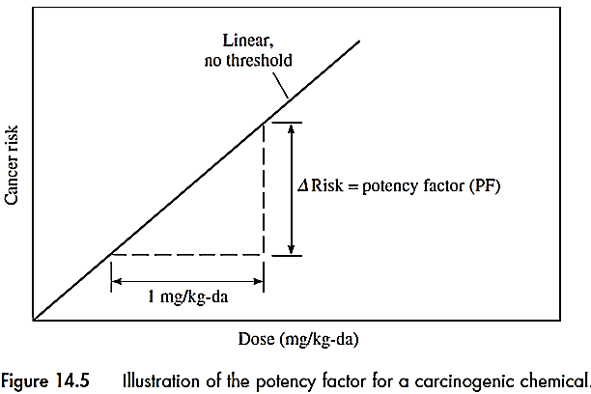
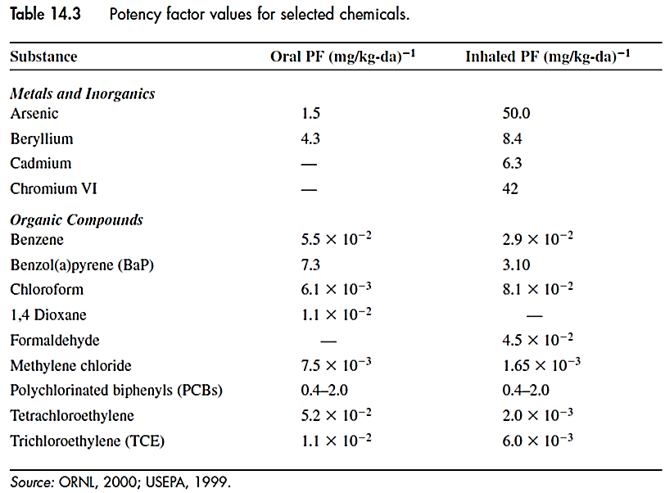
Slope
PF also called slope factor

Slide 18
Incremental Risk
Based on the linear model: Incremental risk = CDI × PF
Example 14.3 how to estimate incremental risk
An industrial facility in a community emits formaldehyde in the atmosphere with a peak concentration in the surrounding community of 4.6 μg/m³. What is the lifetime cancer risk to a maximally exposed individual?
The average daily dose (mg/kg.d) received by an adult was already calculated in example 14.2:
CDI = 1.3×10⁻³ mg/kg.d
PF for formaldehyde from Table 14.3 ⇒ PF = 4.5 ×10⁻² (mg/kg.d)⁻¹
Therefore, incremental risk = 1.3×10⁻³ × 4.5 ×10⁻² = 5.8 × 10⁻⁵

Slide 19
Is this risk acceptable? Need to compare with acceptable risk levels:
Levels of acceptable risk
EPA has estimated a lifetime risk level of 10⁻⁶ (One chance in a million) or less is acceptable and risk levels of 10⁻³ and above are serious and need attention
Between 10⁻⁶ and 10⁻⁴ may be acceptable and it is case-specific
For the above example, 5.8 × 10⁻⁵ is greater than 1 × 10⁻⁶ but still between 10⁻⁶ and 10⁻⁴

Slide 20
Example 14.4 how to judge acceptability of the risk:
For the example 14.2, estimate the total number of expected additional cancers per year from inhalation of formaldehyde based on a population of 30,000 people. Compare the results to the average risk of cancer deaths in Table 14.1
Based on incremental risk calculated in Example 14.3, the total additional death for this community is:
30,000 × 5.8 × 10⁻⁵ = 1.74
For a life time of 70 years, the increase in annual cancer rate is 1.7/70 or 0.024 cancer/year.
Compare to Table 14.1: the average (background) cancer rate:
30,000 × 480,000/245 ×10⁶ = 59 cancer/year
0.024 cancer/year is negligible compared to 59 cancer/year for this community

Slide 21
Application to contaminated sites
Assessment of the risk from contaminated sites or leaking underground tanks due to ingestion of contaminated water or soil
Example 15.4: risk assessment for a portion of life-time exposure compared to the whole life time used for CDI
Benzene concentration in soil of a contaminated site is 0.9 mg/kg (0.9 ppmw). Is the cancer risk low enough for the site to be used as a playground for children? Assume that a child would use it 4 hours/day, 350 days/year for 10 years.
Need to estimate incremental risk = CDI × PF
CDI can be estimated using Table 14.2 (for a child): has to be
corrected for exposure time instead of lifetime
PF is taken from Table 14.3 (for oral ingestion)

Slide 22
Risk assessment for non-carcinogens
A threshold value is defined: No observable adverse effects level (NOAEL): Dose of a chemical below which no adverse health effect is observed. But there are uncertainties to define this value.
Reference dose
To account for uncertainties, a reference dose is considered:
Reference dose (RfD) is a key parameter used in risk assessment to characterize the safe dose of a noncarcinogenic chemical
RfD = NOAEL/(UF × MF)
UF = an uncertainty factor
MF = a modifying factor

Slide 23
UF increases by a factor of 10 in the following cases:
Extrapolating data of NOAEL from animals to humans
Extrapolating from a subchronic exposures (weeks to few years) to exposures over time
Variable responses in the affected population (intraspecies effects such as different responses in males, females, elderly, pregnant women, etc.)
Lack of NOAEL data and using lowest dose with observed adverse effects (LOAEL)
If all of 4 above applied, the calculated RfD factor will be 10,000 time smaller than the lowest dose causing adverse effects. UF is usually in the range of 10-1000.
MF depends on the different professional judgment about the quality and uncertainties in data. Nominally, MF =1.0

Slide 24
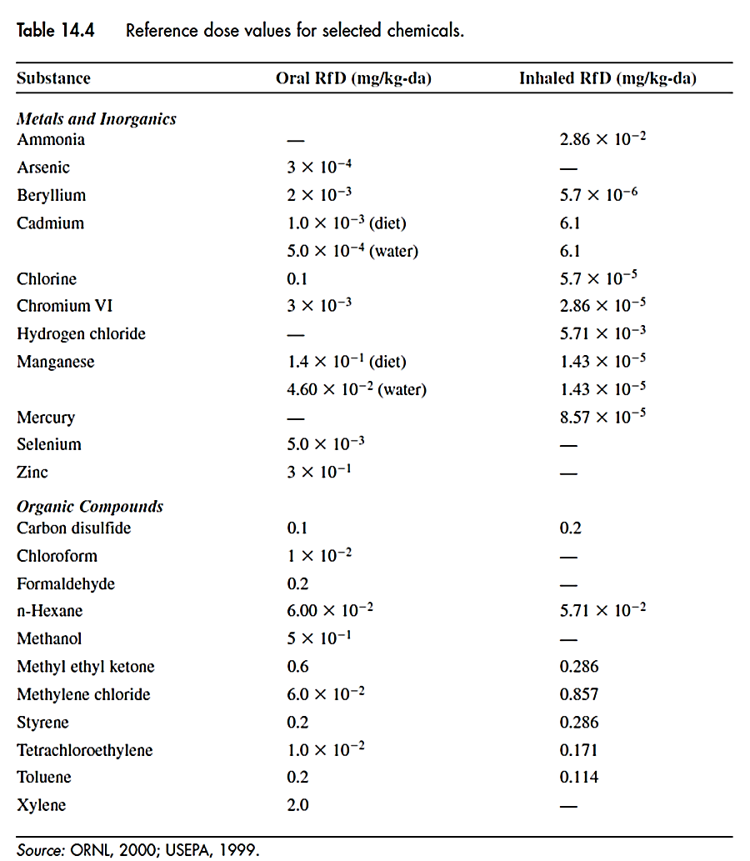
(RfD values for some chemicals)

Slide 25
Example 15.6: using UF and MF factors
Animal tests for acetone exposure show no observable effects (NOAEL) at or below 100 mg/kg.d. The data reflect subchronic exposure and indicate some intraspecies variability among the test animals. Determine the reference dose (RfD) for this case, assuming a modifying factor (MF) value of 1.0.
RfD = NOAEL/(UF × MF)
UF = 10 ×10 ×10 = 1000 due to incorporation of 3 factors
Therefore, RfD = 100/(1000×1.0) = 0.1 mg/kg.d

Slide 26
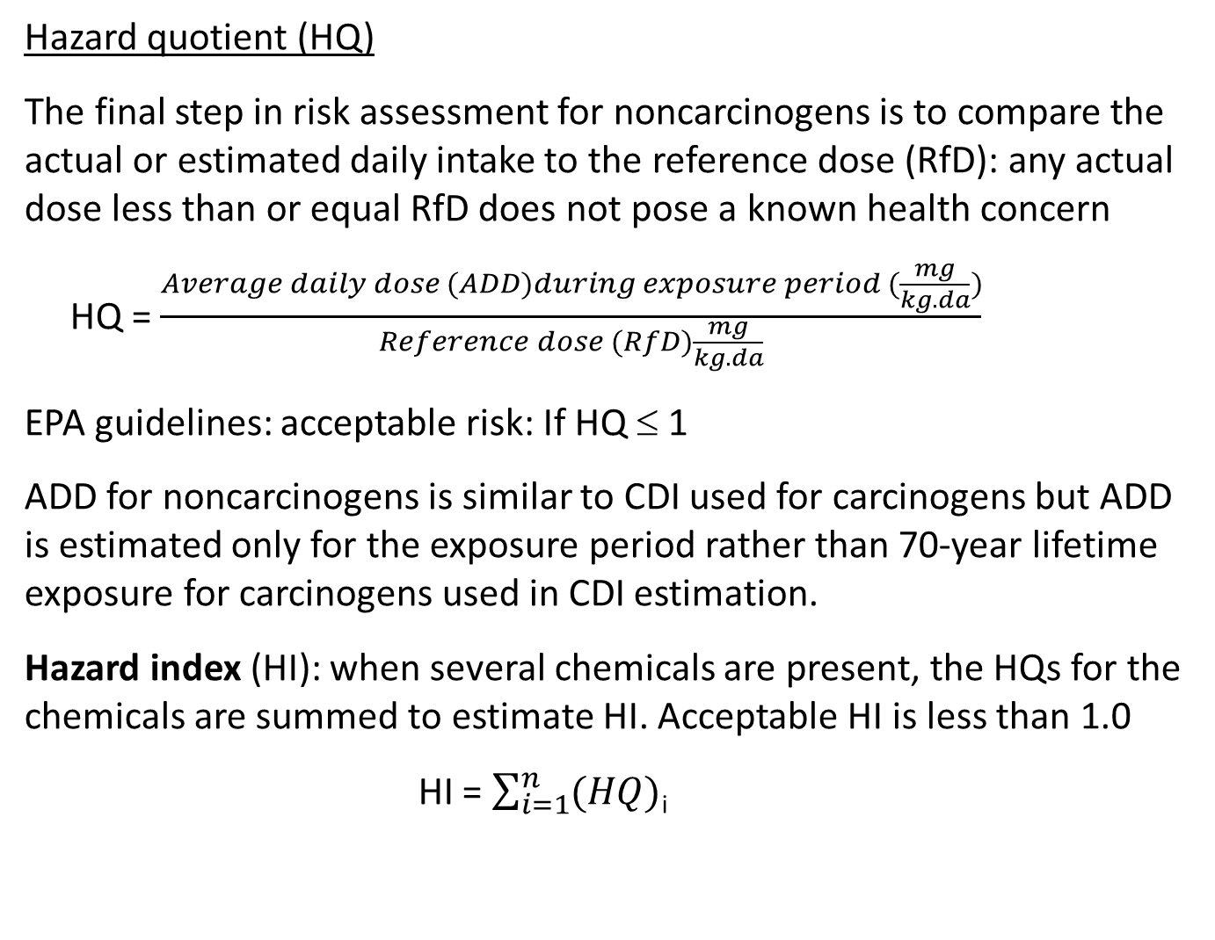
Hazard quotient (HQ)
The final step in risk assessment for noncarcinogens is to compare the actual or estimated daily intake to the reference dose (RfD): any actual dose less than or equal RfD does not pose a known health concern
HQ = $\frac{Average daily dose (ADD)during exposure period (\frac{mg}{kg.da})}{Reference dose (RfD)\frac{mg}{kg.da}}$
EPA guidelines: acceptable risk: If HQ ≤ 1
ADD for noncarcinogens is similar to CDI used for carcinogens but ADD is estimated only for the exposure period rather than 70-year lifetime exposure for carcinogens used in CDI estimation.
Hazard index (HI): when several chemicals are present, the HQs for the chemicals are summed to estimate HI. Acceptable HI is less than 1.0
HI = $\sum_{i=1}^{n}{(HQ)}$_{i}

Slide 27
Example 14.7: estimation of HI for multiple chemicals
Trace concentrations of arsenic (0.2 µg/L), chloroform (70 µg/L) and toluene (2.5 mg/L) have been found in a well water. Would these levels trigger a concern about noncarcinogenic health effects?
Need values of ADD in order to calculate HI
ADD can be estimated using intake values from Table 14.1: each adult of 70 kg, drinks 2 L water per day. Therefore, ADDs can be calculated:
For arsenic: ADD = 0.2 × 10⁻³ mg/L × 2 L/d / 70 kg = 5.7 × 10⁻⁶ mg/kg.d
For chloroform: ADD = 70 × 10⁻³ mg/L × 2 L/d / 70 kg = 2 × 10⁻³ mg/kg.d
For toluene: ADD = 2.5 mg/L × 2 L/d / 70 kg = 0.071 mg/kg.d
Using Table 14.4, HQs can be calculated:
HQ (arsenic) = 5.7 × 10⁻⁶ / 3.0 × 10⁻⁴ = 0.019
HQ (chloroform) = 2 × 10⁻³ / 1 × 10⁻² = 0.2
HQ (toluene) = 0.071/0.2 = 0.36

Slide 28
All HQs are less than 1.0. Hazard Index, HI for the mixture can be calculated:
HI = 5.7 × 10⁻⁶ / 3.0 × 10⁻⁴ + 2 × 10⁻³ / 1 × 10⁻² + 0.071/0.2 = 0.57 < 1.0
Which is also less than 1.0, therefore, no obvious health concern from the exposure levels of chemicals in water.

Slide 29
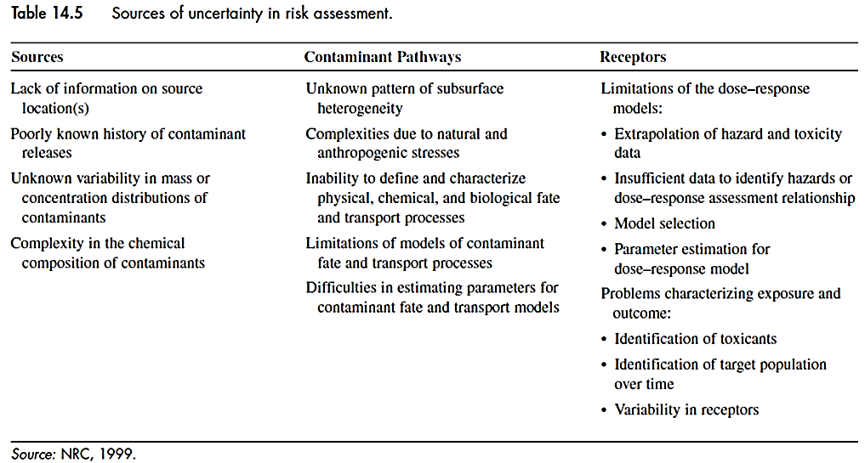
Limitations of risk assessments
Although being a systematic and scientifically based process to identify and prioritize the problems of concern, it requires personal judgment and interpretation of data and mathematical models. As a results, there are many uncertainties in the process steps
Uncertainties for waste disposal sites

Slide 30
Uncertainties in waste disposal:
Lack of good record of wastes buried or spilled
Types, amounts and location of contaminants in place
Errors in sampling and inability to characterize large areas and identify buried toxic chemicals
Modeling the relationship between contaminant sources and concentrations reaching the receptors (source-receptor relationship)
Also uncertainties in
Source-receptor modeling are due to complex situation such as multiple exposure pathways and pollutants
Different effects of contaminants on people and ecological systems
Actual exposure to contaminants and actual dose received
Health outcome from a particular dose or exposure due to factors such as health status and age.
Dose-response relationship for different doses and different time periods

Slide 31
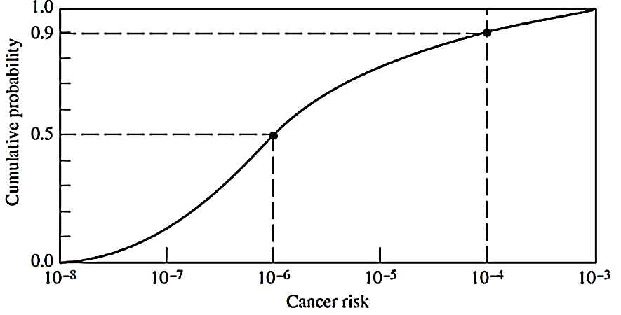
Dealing with uncertainty
Traditional risk analysis that are based on safety factors such as uncertainty and modifying factors (UF and MF) is limited since there is little or no information about confidence in the risk analysis or the probability of a higher or lower risk
Probabilistic risk assessment is a more advanced method where risk results are presented as a probability distribution instead of a single value
An example of cumulative
distribution function for
cancer risk

Slide 32
An advantage of this method is that it reflects quantitative measure of the confidence or conservatism in a risk estimate.
It is specially useful for decision makers who must judge the implications of risk analysis results for a specific situation
It can also identify which factor contribute most in the overall uncertainty so measures can be taken to reduce key uncertainties
The disadvantage of this method is that it is more-time consuming and data-intensive than the traditional risk analysis
Risk management
The process for defining an acceptable risk in a situation and decide to take appropriate action to reduce, control or eliminate the unacceptable risk

Slide 33
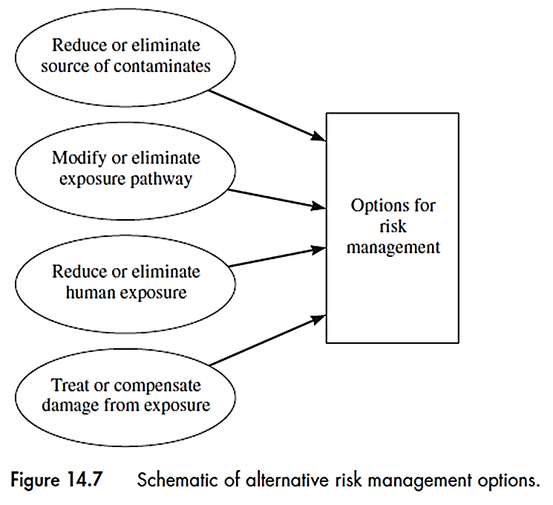
Dealing with unacceptable risk:
Elimination or reduction of source of risk such as reducing emissions or using control technologies
Modify or avoid exposure pathway such as tall chimney to disperse pollutants
Elimination or reduction of human exposure to contaminants such as relocating the affected population
(least desirable option): treating the effects or make compensations after they occur such as medical treatment
More desirable

Slide 34
Defining goals and procedures
Hazardous waste disposal sites and contaminated sites due to underground storage tanks are the main subject of risk management.
The most severely contaminated sites are listed by EPA as highest priority for cleanup under federal program (Superfund)
Cleanup goals for contaminated groundwater and soil are sometimes unreachable due to lack of technological capabilities or very high cost of treatment
Sometimes the actions taken create another environmental problem such as dredging sediments in a river that can disperse the contaminants

Slide 35
The goal of risk management is to identify the level of risk reduction by different alternative approaches and choose the most feasible and cost effective one
The actual use of particular site is important to know since it affects the criteria for cleanup goals and acceptable risk
It must also involve the affected communities such as formation of citizens’ advisory panel for making decisions

Slide 36
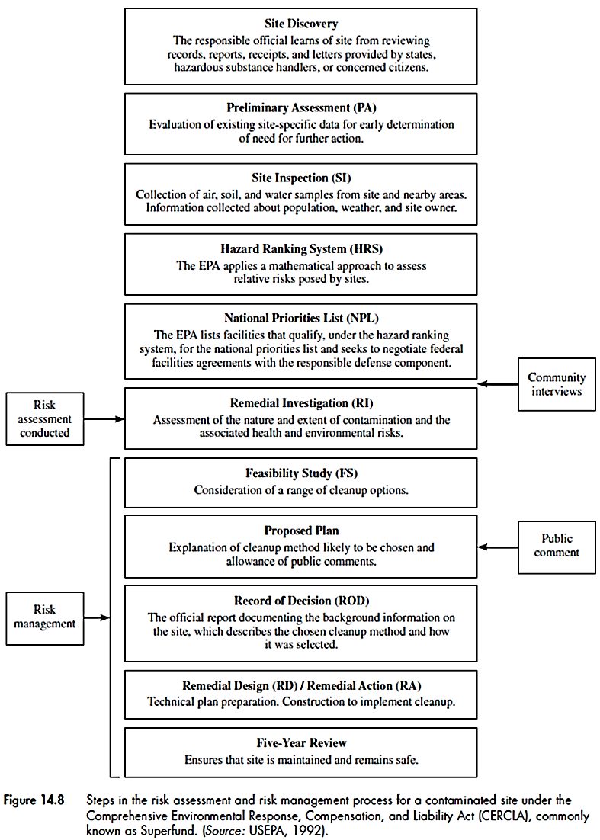
Risk management and assessment
for a contaminated site

Slide 37
Finding workable solutions
Risk management procedures have been modified to include more effective follow-up monitoring and more complicated analysis methods to better predict unforeseen consequences
Decision analysis
Making decisions from different options about waste disposal sites including “doing nothing”.
It is a tool not only to assist making a decision, but also structuring and identifying information relevant to the decision to be made.
Two techniques for decision analysis:
1- Influence diagram
2- Decision trees

Slide 38
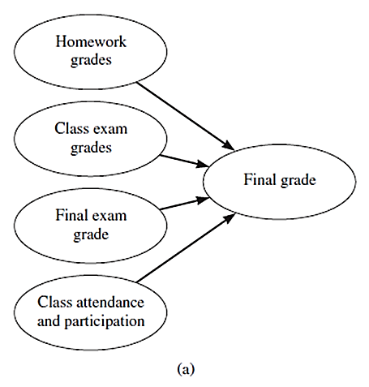
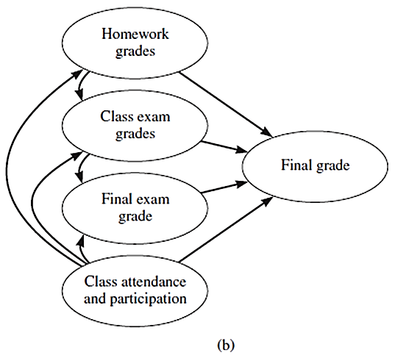
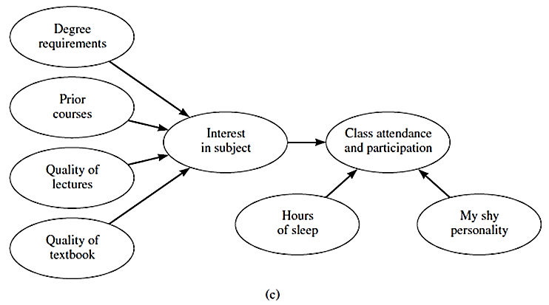
Influence diagrams
Visualization of important connections among different elements of a problem. Key variables that influence a decision are connected to each other.
Example: Influence diagrams for grade of a course

Slide 39
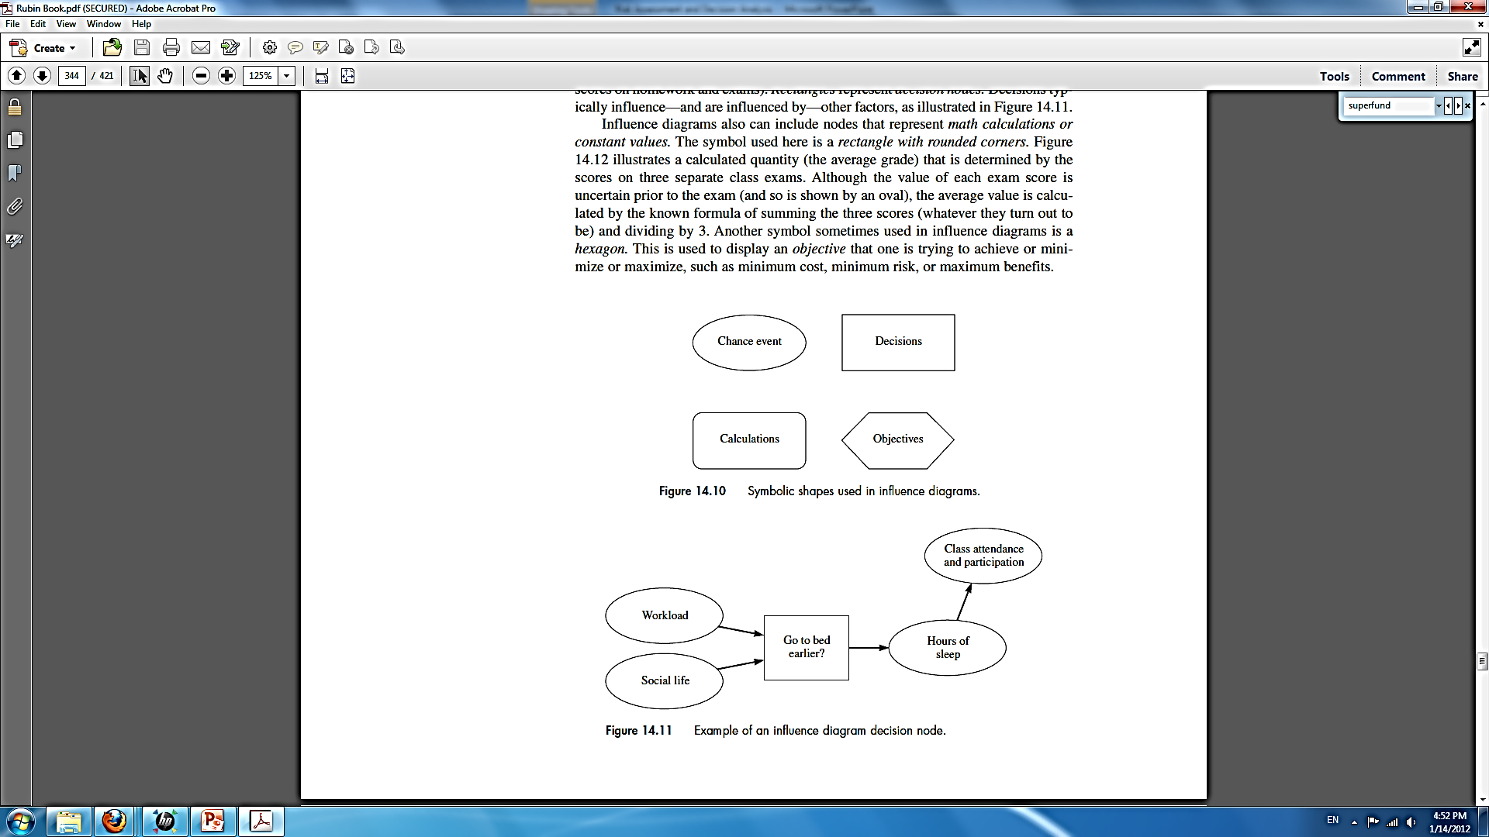
Symbols and conventions
The influence diagram is developed using symbols with different shapes representing different elements.
Chance event: Variable factors or uncertain values
Decisions: influence other elements and are affected by other factors
Objectives: what we are trying to achieve or minimize or maximize, such as minimizing costs or maximizing benefits
Calculations: mathematical calculations or constant values

Slide 40
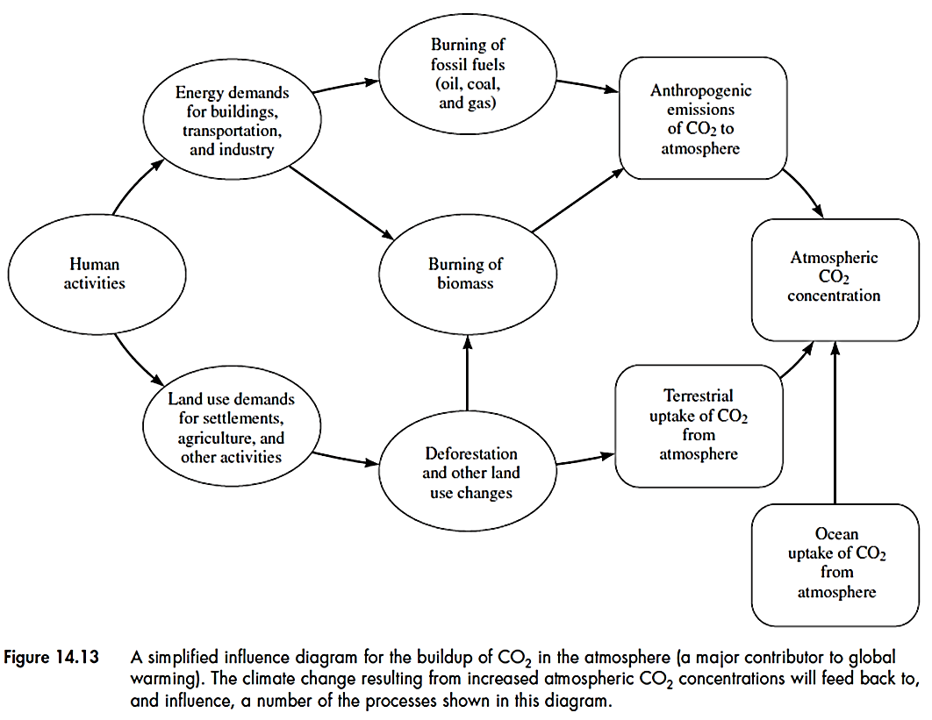
An environmental example
Simplified influence diagram for global warming

Slide 41
These diagrams can further be used for quantitative analysis and model making. For example estimation of CO₂ produced each year by determining the type and amount of fossil fuels for energy production.
Decision nodes also can be added in case there is an influence of a decision on other elements such as using alternative fuels can influence the CO₂ emissions and atmospheric CO₂ concentration.
There could be variety of these diagrams for a particular problem
They can help structure, explain and analyze complex problems and decisions
It is very important that key variables and their relationship be identified and included in the diagram

Slide 42
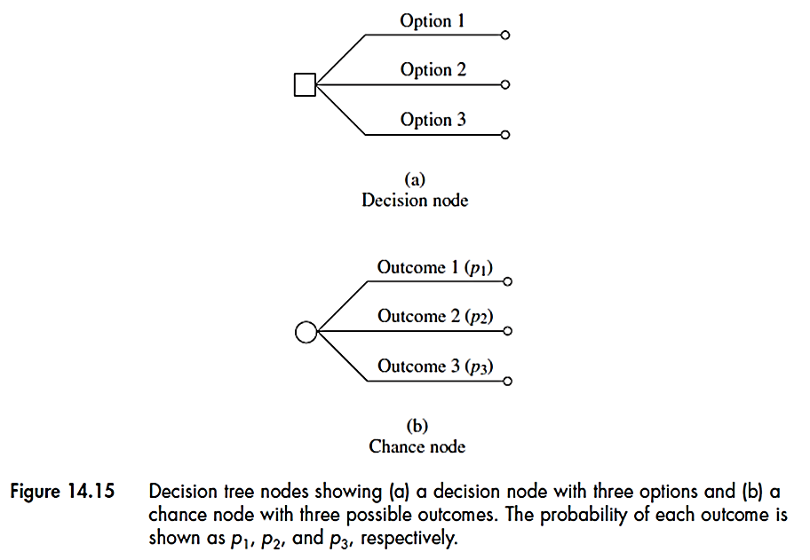
Decision trees
Another decision analysis tool that uses a tree-like graph of decisions and their possible consequences. It can be used both quantitatively and qualitatively.
A decision tree is built using two types of nodes: decision node (square) and chance node (circle)
At the decision node, we must choose which branch (a discrete choice) to follow.
At a chance node, there is uncertainty about outcome of future event

Slide 43
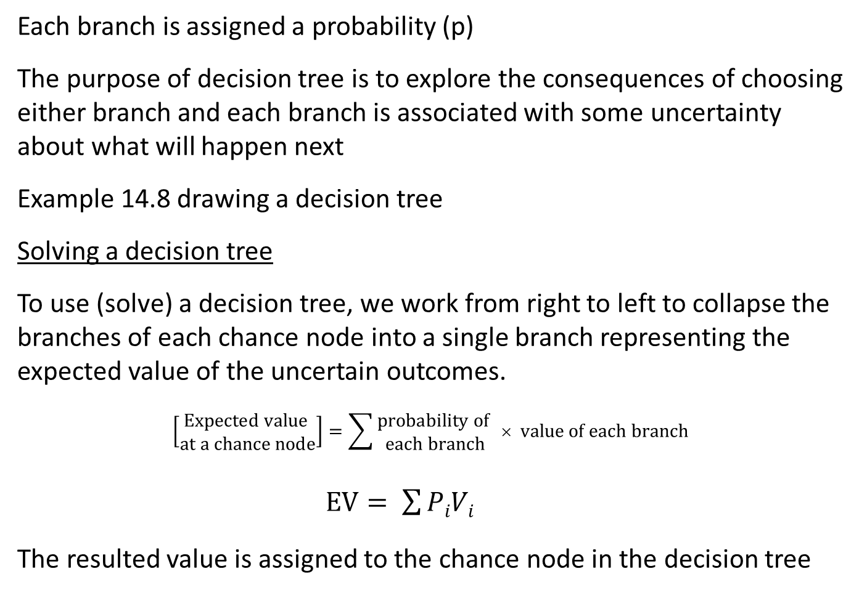
Each branch is assigned a probability (p)
The purpose of decision tree is to explore the consequences of choosing either branch and each branch is associated with some uncertainty about what will happen next
Example 14.8 drawing a decision tree
Solving a decision tree
To use (solve) a decision tree, we work from right to left to collapse the branches of each chance node into a single branch representing the expected value of the uncertain outcomes.
$$\left[\begin{aligned}Expected value \\ at a chance node\end{aligned}\right]=\sum{\begin{aligned}probability of \\ each branch\end{aligned}} × value of each branch$$
$EV= \sum{PiVi}$
The resulted value is assigned to the chance node in the decision tree

Slide 44
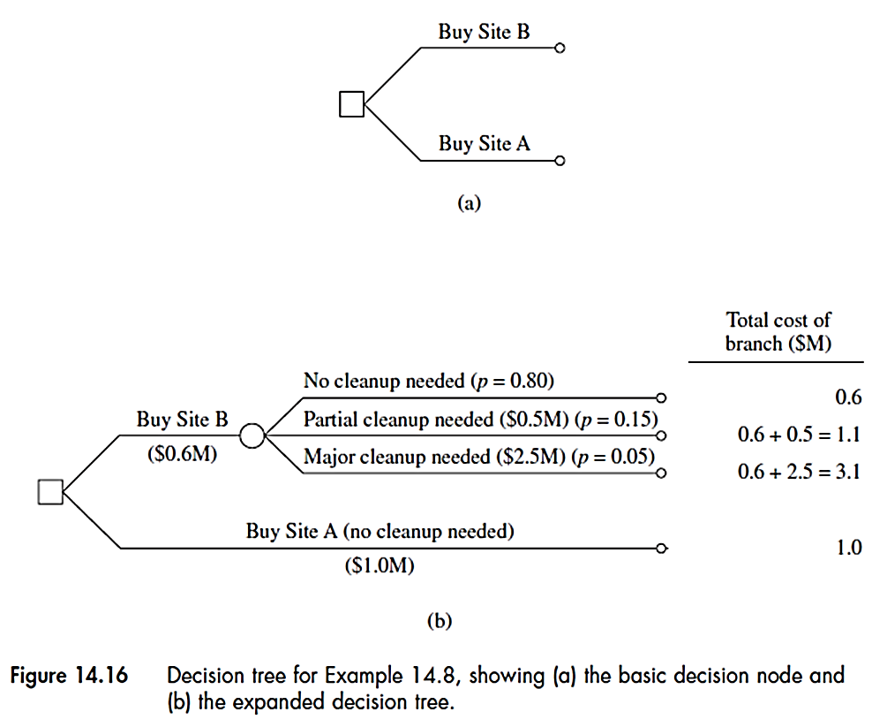
Example: Decision for selection of a site A or B: Land price A = $1.0M, B=$0.6M
A is not contaminated
Modeling results show B needs 20% (15% partial and 5% major) cleanup
Cleanup cost: $0.5 M for minor and & $2.5M for major cleanup

Slide 45
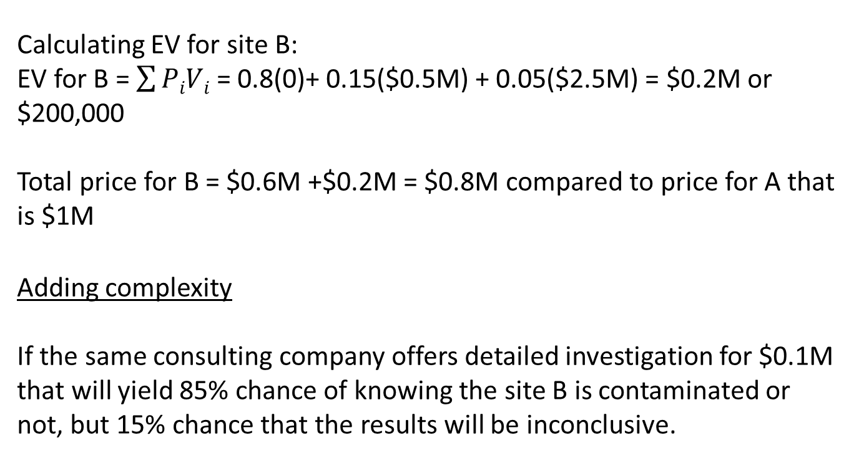
Calculating EV for site B:
EV for B = $\sum{PiVi}$ = 0.8(0)+ 0.15($0.5M) + 0.05($2.5M) = $0.2M or $200,000
Total price for B = $0.6M +$0.2M = $0.8M compared to price for A that is $1M
Adding complexity
If the same consulting company offers detailed investigation for $0.1M that will yield 85% chance of knowing the site B is contaminated or not, but 15% chance that the results will be inconclusive.

Slide 46
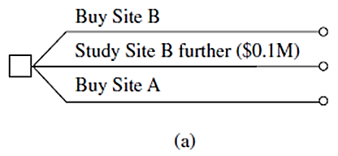
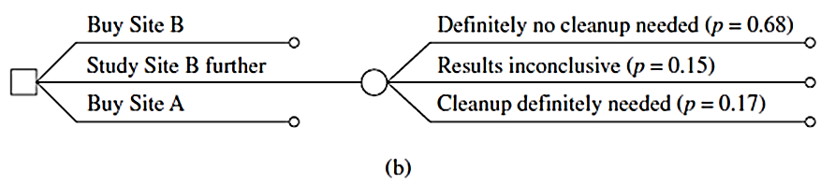
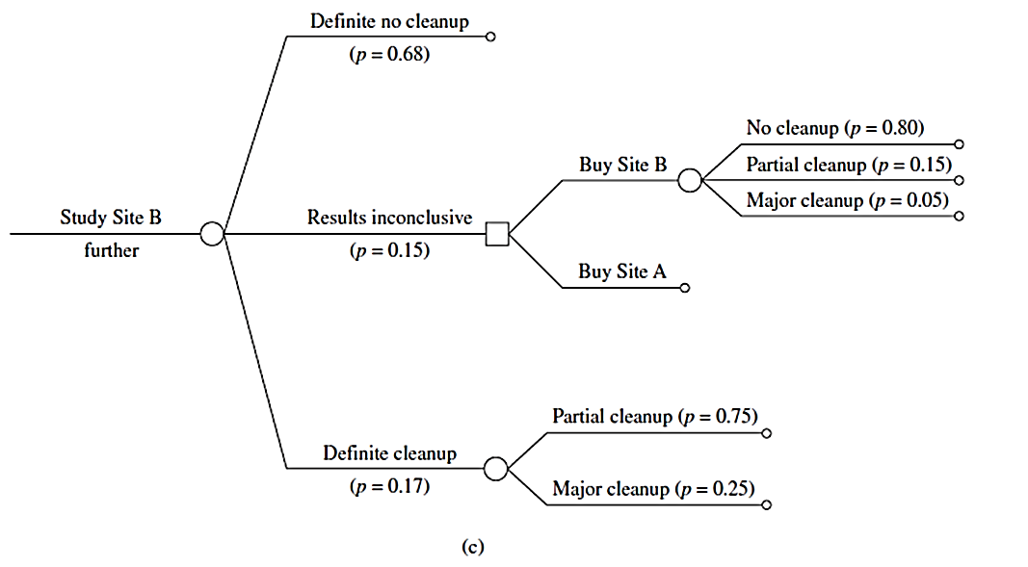
New probabilities
No cleanup: 85% of 80% = 68%
Cleanup: 85% of 20% = 17%
15% inconclusive
For the inconclusive case, the
previous modeling predictions
apply
75%/25% = 15% partial/5% major cleanup

Slide 47
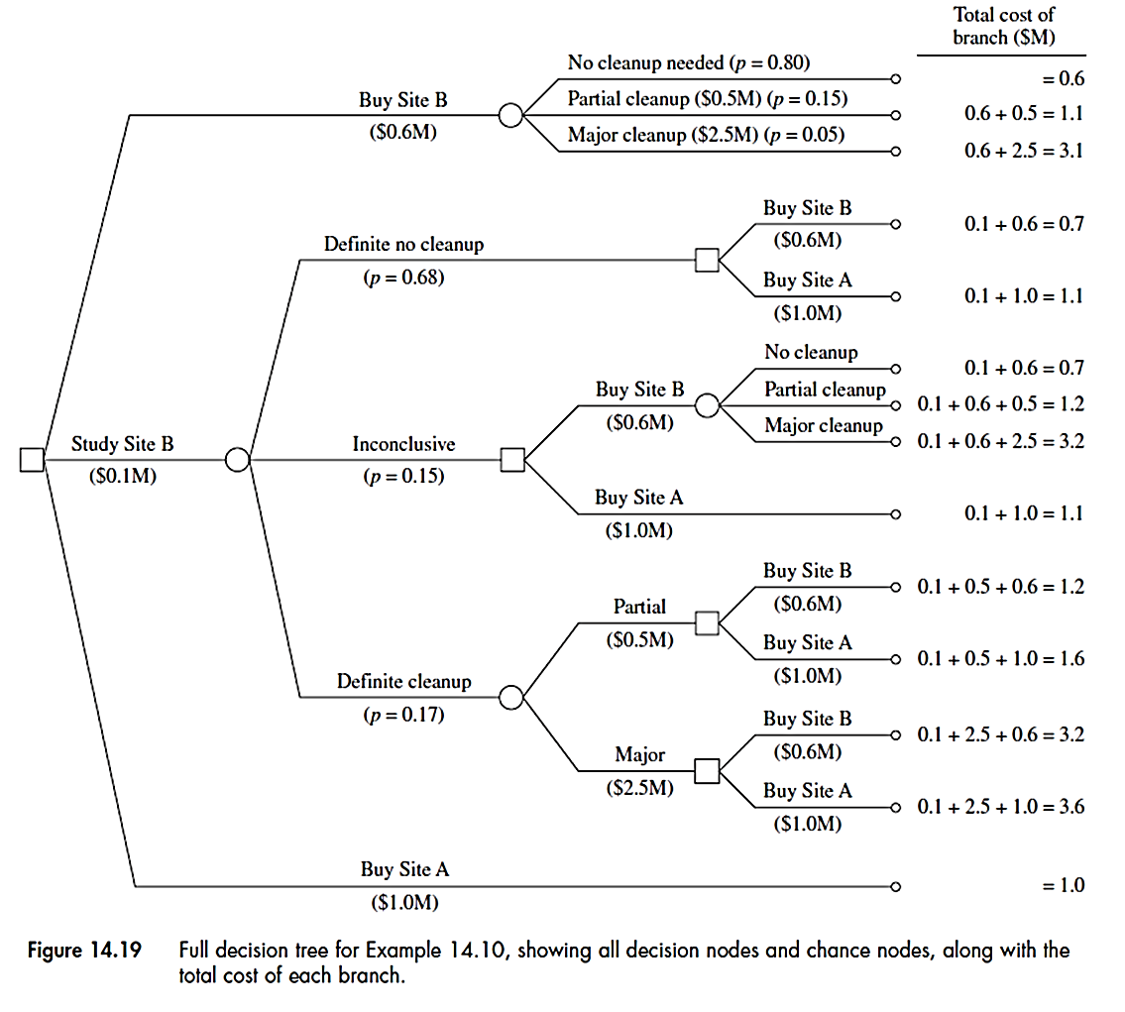
1.1
Correction
1.1
Correction

