Slide 1
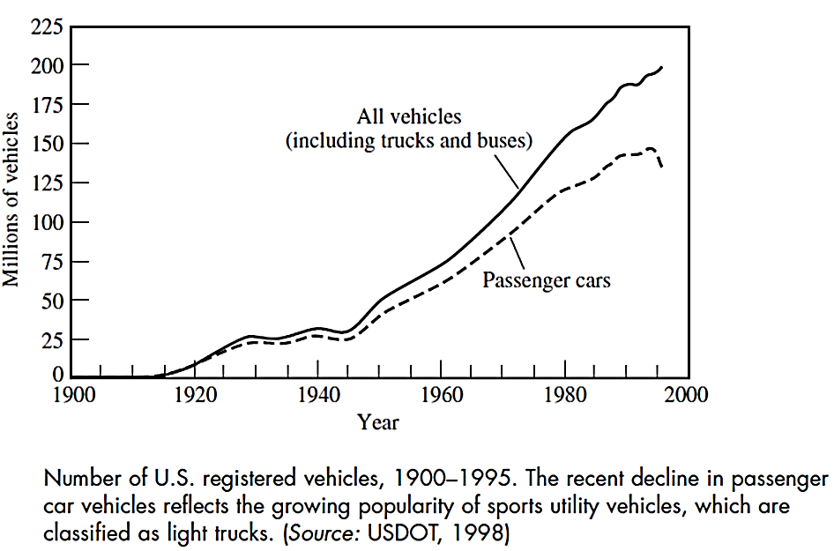
The Automobile and Society
Great economic and social impacts of the automobile: Fast and easy transportation, growth of suburbs, development of roads and economy, etc.

Slide 2
Downside:
Death and fatalities due to traffics accidents
Cars blamed for many environmental impacts affecting human health
Environmental impacts of the automobile
Land impacts: construction of the roads, parking lots, etc.
Technological impacts: release of pollutants to the environment
1-Urban Air Pollution
Los Angeles an example of air pollution due to automobiles: LA smog in late 1940s and 1950s resulted in:
Reduction in visibility
Irritating eyes and throats

Slide 3
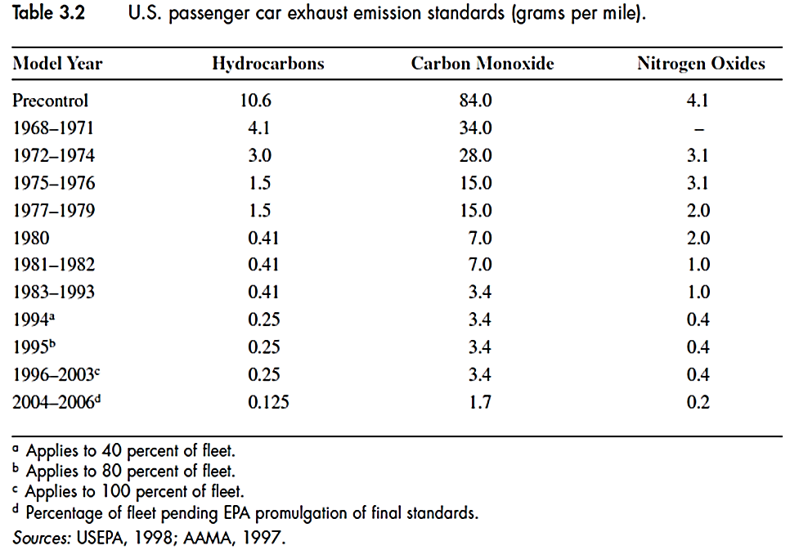
Reaction of emitted volatile organic compounds (VOCs) and nitrogen oxide (NO_{X}) under sunlight creates ozone (O₃) and other chemical compounds that form photochemical smog.
Incomplete combustion of fuel emits CO and hydrocarbons
Gasoline vapors emitted from engines and fuel tanks
Three main air pollutants: NO_{X}, CO and HC

Slide 4
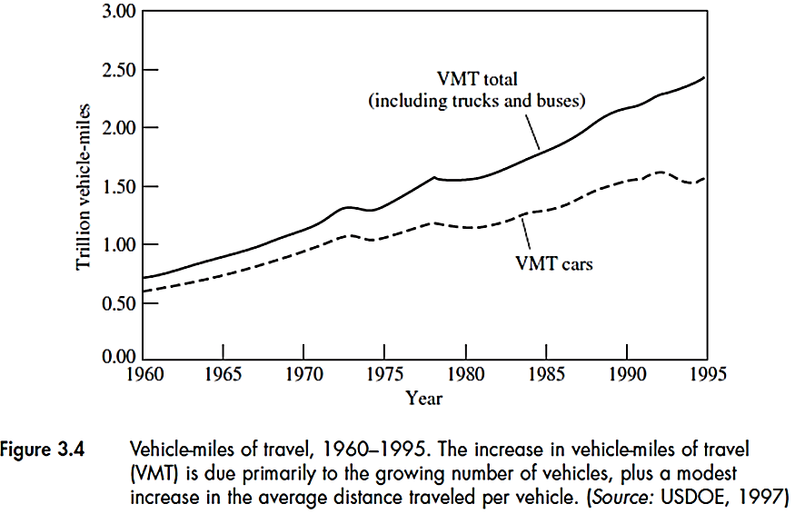
Factors that increase emissions:
Increased number of vehicles
Increased travel per vehicle
Departures from federal standards:
  Different on-road conditions than those of federal test
  Improper maintenance
  Technical problems such as dirty spark plugs
Increased use of light trucks (SUVs, Pickup trucks, vans)

Slide 5
Example
If in 1980, the total CO emission from passenger cars was 24 g/mi, the total CO emissions can be estimated using Fig. 3.4:
(1.15 ×10¹² mi) × 24 g/mi = 27.6 × 10¹² g
Compared to precontrol era (84 g/mi), there is a (84-24)/84 × 100 = 71% reduction in CO emissions.
Compared to the year 1967, the total CO emissions:
(0.7 ×10¹² mi) × 84 g/mi = 59 × 10¹² g
which is more than twice the total CO emissions in 1980 although the mileage in 1980 has increased by more than 60%.

Slide 6
2-Greenhouse gas emissions
CO₂ emission is major cause due to fossil fuel (oil, coal, natural gas) consumption
CO₂ is very stable gas and traps heat similar to a glass wall in a greenhouse causing the global warming
Consequences of global warming:
Increased sea level
Intense storm
Ecological impacts
Spread of infectious diseases
Carbon and hydrogen in automobile gasoline is converted to CO₂ and H₂O. For each g of fuel, approximately 3g CO₂ (352/114) is released.

Slide 7
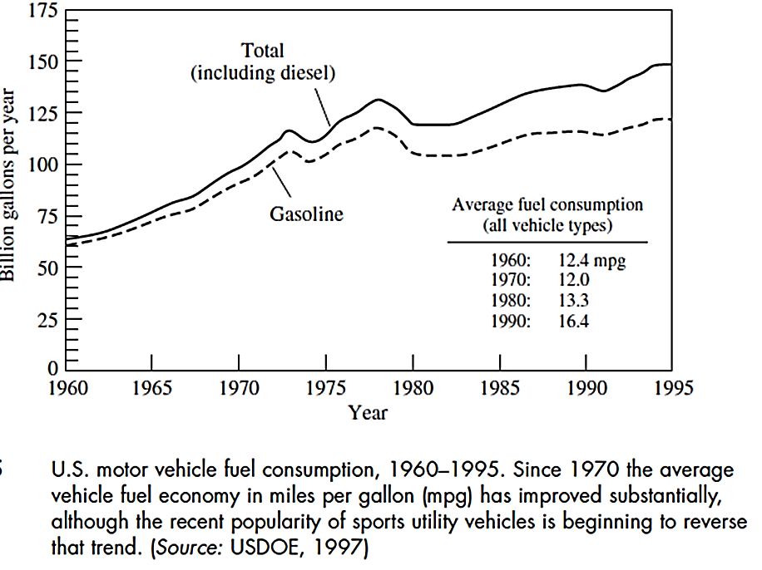
Total CO₂ emission for each year can be estimated using the above graph.

Slide 8
Example
Total CO₂ emission in 1980 from gasoline-burning vehicle can be estimated as below (gasoline density 739 g/L):
From Fig. 3.5, the total gasoline consumption = 102 × 10⁹ gal/year
Total CO₂ released:
=102×10⁹ gal/year×3.79 L/gal×739 g/L×352/114 gCO₂/g gasoline
= 8.8 × 10¹⁴ gCO₂ /year= 0.88 billion metric tons/year
CO₂ emissions per mile:
If car fuel consumption was 25 mi/gal or 10.6 km/L in 1980, the CO₂ emission per km:
(1/10.6) L/km ×739 g/L × 352/114 gCO₂/g gasoline = 215 gCO₂/km

Slide 9
3- Solid waste disposal
Waste resulted from cars after their life time is a problem specially with limited land for disposal.
Most of this waste can be recycled. Tables 3.3 and 3.4 can be used to determine total raw materials used and waste generated for automobiles.
The important change has been using plastic materials instead of metals to reduce the weight of the cars
The environmental impacts also exist in every step: mining of raw material, their transportation and processing into other materials.
Engineering decision about materials (choice, quantity, etc.) can have significant environmental impacts.

Slide 10
4- Other environmental impacts
In addition to solid waste and atmospheric emissions, other impacts include:
Lead in gasoline to prevent “engine knocking” as a result of early combustion of fuel. Car engines are designed to operate on unleaded fuel.
CFC used in air conditioning system causing ozone layer depletion. Replace with new coolants.
Waste motor oil: If disposed of, it can enter water supply through runoffs or seep into groundwater. Used motor oils can be recycled by processes to remove contaminants such as heavy metals
Other impacts as a result of production, manufacturing, use and disposal of materials used in automobiles (or life cycle impacts) and production of fuels, oil, etc. Also, PM emissions from tires, breaks, etc.

Slide 11
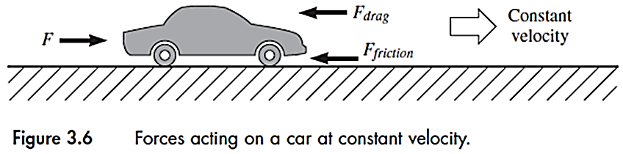
Fuel and energy requirements
To reduce emissions from cars need to know where and how fuel and energy are used and how engineering design can reduce the emissions
1- Power and energy for cruising
F = total pushing force required = F_{drag} + F_{friction}
= 1/2 ρC_{D}AV² + µW
Weight
Density
Rolling friction
coefficient
Area
Velocity
Drag coefficient

Slide 12
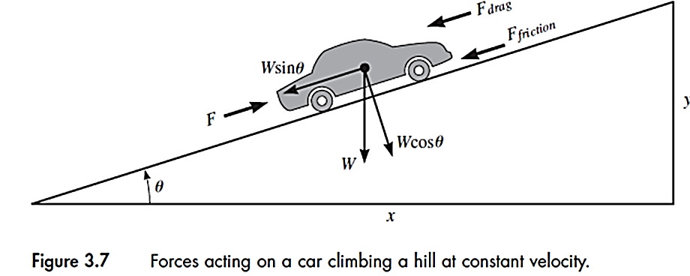
Energy requires = E = F d = (½ ρC_{D}AV² + µW) d
Power required = F V = (½ ρC_{D}AV² + µW) V
For a car going up a hill, more power and energy is required:
E = (½ ρC_{D}AV² + µWCosθ + WSinθ) d
P = (½ ρC_{D}AV² + µWCosθ + WSinθ) V

Slide 13
Example
Power required for a car to climb a 5 percent grade at a constant speed of 25 m/s. Car weight is 15000 N, its cross-sectional area is 2.0 m². Coefficients for drag and rolling friction are 0.5 and 0.02 respectively. Air density is 1.2 kg/m³.
5 percent grade: tanθ=0.05 ⇒ θ = 2.86°
P = (½ ρC_{D}AV² + µWCosθ + WSinθ) V
= [ 1/2×1.2×0.5×2.0×25² + 0.02×15000×Cos (2.86)+ 15000×Sin (2.86)]×25
P = (375+300+750)×25 = 35600 watts or 35.6 kW
In comparison to the flat road, or θ=0:
P = [ 1/2×1.2×0.5×2.0×25² + 0.02×15000] ×25 = 16900 watts or 16.9 kW
There is an increase of (35.6-16.9)/16.9 × 100 = 111 %

Slide 14
2- Energy and Power for acceleration
In the absence of air resistance and road friction:
E_{accel}= W(V²_{f}- V²_{i})/2g , P = E/t = W( V²_{f}- V²_{i})/2gt
t= time for acceleration to the final velocity (V_{f})
With air resistance and road friction:
E_{accel}= (aW/g + µW + 1/4 C_{D} A ρV²_{f}) d, a= V_{f}/t, d= distance travelled
Example
For the car in previous example, estimate the required power if it accelerates from rest to 25 m/s in 10 seconds (assume no air resistance and road friction)
P= Wv_{f}²/(2gt) = (15000×25²)/(2×9.8×10) = 47,800 W or 47.8 kW

Slide 15
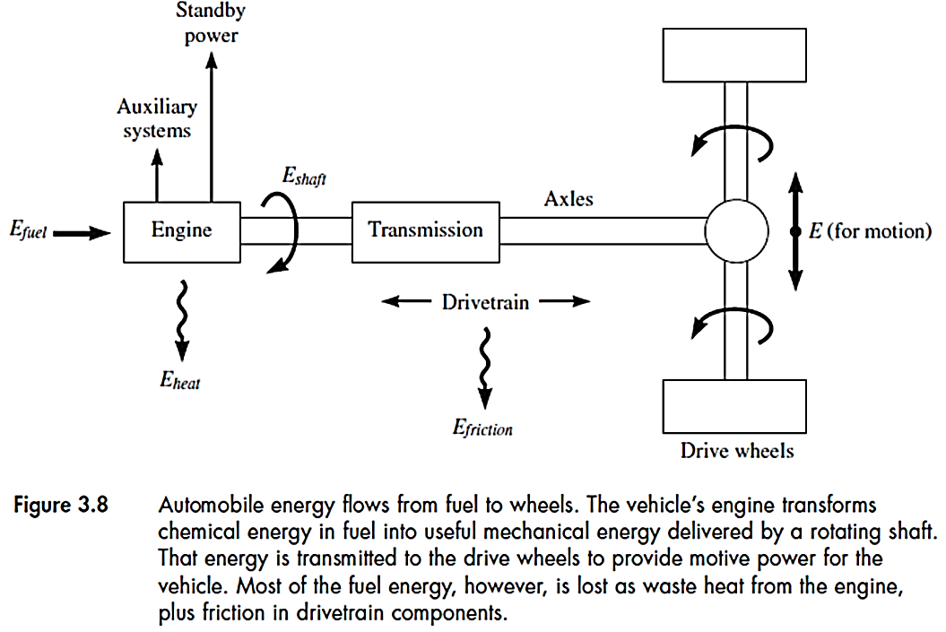
Energy efficiency
How much fuel is needed to deliver required energy?
About 60-70 percent of energy is wasted as heat. Other losses
are due to auxiliary systems such as power steering and AC as well as for
idling, friction in car, etc. Finally, 15%-20% remains as useful energy.
Overall efficiency = η =E/E_{fuel}
For engine: η_{engine} = E_{shaft}/E_{fuel}

Slide 16
η can be calculated for each component: η₁, η₂, etc. and overall η
can be determined from : η = η₁ × η₂ …..
Example:
A car engine consumes 1.7 L of gasoline in 15 minutes and the power
at the engine drive shaft is measured 20 kW. Estimate the engine
efficiency.
The shaft energy can be calculated:
E_{shaft} = P_{shaft} × t = 20 ×10³ W ×15 min× 60 sec/min = 1.8 × 10⁷ joules
Assuming the fuel energy is 3.5×10⁷ joules/L, the fuel energy is:
E_{fuel} = 1.7 × 3.5 × 10⁷ = 5.95 × 10⁷ joules
⇒ η_{shaft} = 1.8 × 10⁷ / 5.95 × 10⁷ = 0.3 or 30%

Slide 17
If the standby and auxiliary systems use 6 kW of the engine power, the
available power for the shaft would be 20-6 = 14 kW and therefore:
η_{shaft} =0.3 × 14/20 = 21%
Also If the shaft is connected to a drivetrain with efficiency of 80%,
the overall efficiency for the car will be:
η = η₁ × η₂ = 21% × 80% = 16.8% ∼ 17%

Slide 18
Fuel consumption
Can be estimated from fuel efficiency:
Overall efficiency = η =E/E_{fuel} ⇒ E_{fuel} = E/η
For a given distance (d): E_{fuel} /d= (E/η)/d
“E” is determined from equations for a constant speed travel or during acceleration.
E = (½ ρC_{D}AV² + µWCosθ + WSinθ) d (for flat road)
Once E_{fuel} is determined, the fuel consumption can be estimated knowing the fuel energy content (energy per volume of fuel).
Fuel consumption (i.e. in L) = E_{fuel} (i.e. in J)/Fuel energy content (i.e. in J/L)

Slide 19
Example
For the car in previous example, determine the fuel required to drive 100 km at 25 m/s on a flat road. Assume overall efficiency is 20% and fuel energy content is 3.5 × 10⁷ J/L.
E = (½ ρC_{D}AV² + µW)= (375+300)=675 J (already calculated)
E_{fuel} /d= (675/0.2)=3375 L/m
⇒ E_{fuel} = 3375 J/m ×100 km ×1000 m/km = 3.375×10⁸ J
Fuel consumption = 3.375×10⁸ J/3.5 × 10⁷ J/L = 9.64 L (per 100 km)
If the car accelerates from rest to 25 m/s in 15 sec.,
E_{accel}= (aW/g + µW + 1/4 C_{D} A ρV²_{f}) d, a= V_{f}/t, d= distance travelled

Slide 20
E_{accel}= (aW/g + µW + 1/4 C_{D} A ρV²_{f}) d, a= V_{f}/t, d= distance travelled
Replacing all previous values:
a = 25/15 = 1.67 m/s2
E_{accel.} = (1.67/9.8×15000 + 0.02×15000 + 1/4×0.5×2.0×1.2×25²)=3044 J
E_{fuel} /d = 3044/0.2 = 15200 J/m
⇒ E_{fuel} = 15200 J/m ×100 km ×1000 m/km = 1.52×10⁹ J
Fuel consumption = 1.52×10⁹ J/3.5 × 10⁷ J/L = 43.4 L (per 100 km)
or 43.4/9.64= 4.5 time more than the constant-velocity period

Slide 21
Engineering Cleaner Cars
Ways to reduce the environmental impacts of automotive technology by engineers.
1- Energy-efficient Design
Benefits:
Less CO₂ emissions (reduce global warming effect)
Les impacts as a result of indirect fuel cycle impacts of petroleum production, refining, storage and distribution
Reduction in depletion of natural resources used throughout the automotive life cycle.
Engine efficiency being the most important factor affecting the overall efficiency. Other factors are overall weight, aerodynamic design, radial tires, etc.)

Slide 22
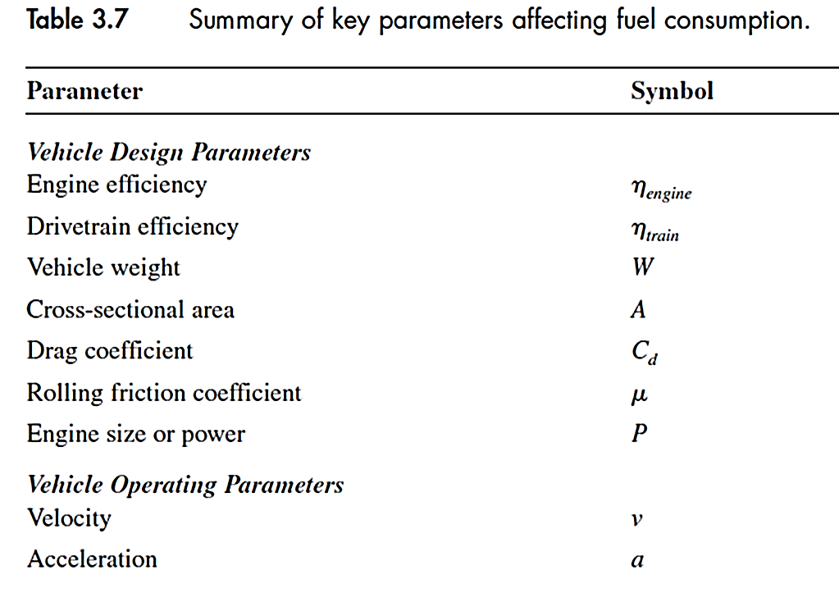

Slide 23
For example, if the weight of the car in the example is reduced by 10%, or new weight is 0.9 (15000 N) = 13500 N, it will result in increased fuel efficiency and reduction of fuel consumption by 4.5%. This translates into reduction of CO₂ emission by 4.5% as well.
If for the same example, the car speed is increases from 25 m/s to 35 m/s, assuming the same overall efficiency of 20%, fuel consumption as well as CO₂ emissions will increased by 53%.

Slide 24
2-Pollution formation
CO₂ is a product of complete combustion while CO and HC are due to incomplete combustion as a result of insufficient air.
Also, the engine design affects CO and HC emissions
Air/fuel ratio is a key parameter for complete fuel combustion
(Octane)C₈H₁₈ + 12.5 (O₂+3.76N₂) 8CO₂ + 9H₂O +47N₂
If Air/fuel <12.5, incomplete fuel burning happens.
Air

Slide 25
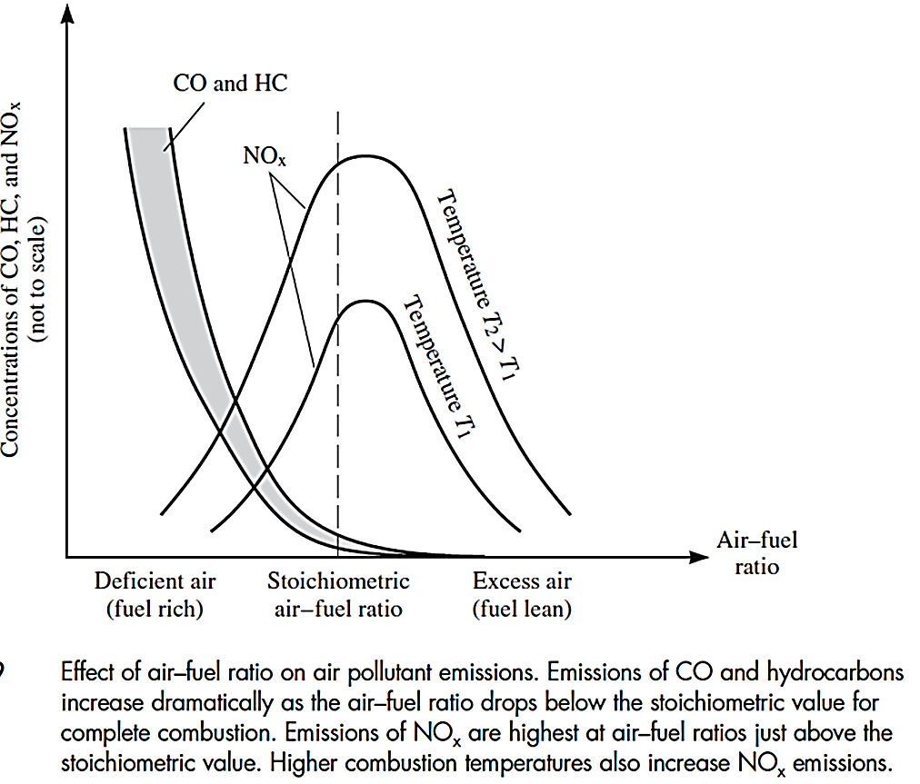
Effect of air/fuel ratio and NO_{x} formation

Slide 26
NO_{x} formation
NO is formed during fuel combustion at high temperature,
O₂ + N₂ 2NO
Also NO₂ can be formed:
2NO + O₂ 2NO₂
NO_{x}: sum of NO and NO₂ which increases with temperature and maximum NO_{x} happens slightly above stoichiometric air/fuel ratio.
NO_{x} formation strongly depend on the combustion time.
By reducing the peak temperature, NO_{x} formation can be controlled.

Slide 27
Overall combustion reaction
C_{x}H_{y} + ϕ (O₂+3.76N₂) CO₂ + H₂O + N₂ + O₂ + CO + HC + NO + NO₂
( ϕ = molar ratio of air to fuel)
If ϕ is greater than stoichiometry, excess air is consumed such as in diesel engines.
Some CO, HC can be formed even with excess air, due to uneven temperatures, poor air-fuel mixing, etc.
normal combustion products
incomplete combustion
nitrogen
oxides

Slide 28
Example
A car engine burns 123 g of octane fuel and produces 3.0 g CO. What percentage of the carbon in fuel is converted to CO?
Percent of carbon in octane, C₈H₁₈ = 8 ×12/(8 ×12 + 18× 1) =0.84
Amount of carbon in 123 g fuel = 123 ×0.84 = 103.6 g C
Percent of carbon in CO = 12/(12+16)= 0.43
Amount of carbon in 3 g CO = 3 × 0.43 = 1.29 g C
Percent C converted = 1.29/103.6 ×100 = 1.24 %

Slide 29
3- Design for low emissions
New engines are designed to improve the combustion efficiency and reduce CO and HC emissions such as installation of sensors to accurately measure air/fuel at different conditions.
A challenge is to reduce CO, HC and NO_{x} at the same time.
Catalytic converters are installed in the exhaust duct to reduce CO and HC emissions. The catalysts such as platinum to oxidize CO and HC, and Rhodium to convert NO_{x} to N₂ and O₂.
Catalysts act at high exhaust temperatures
Sulfur and lead should not be present in gasoline as they adversely affect the catalysts.

Slide 30
4- Alternative fuels
Modified forms of gasoline and other fuels such as diesel, methanol, ethanol (produced from biomass) and natural gas
CAA amendments require different gasoline formulations during:
Summer: to reduce the HC emissions and O₃ formation
winter: to increase fuel oxygen content and reduce CO formation
Low emission vehicles (LEVs) running on clean fuels such as compressed natural gas or liquid petroleum gas (LPG)

Slide 31
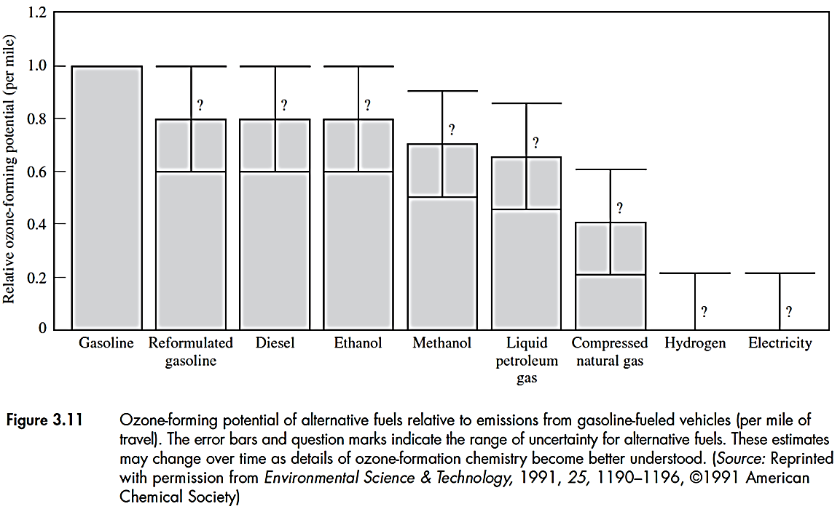
Alternative fuels provide some benefits in terms of less ozone formation, but there is uncertainties.
Also, some toxic compound may be emitted from alternative fuels such as formaldehyde from ethanol combustion or MTBE (an oxygenator) leaked from fuel storage tanks.

Slide 32
4- Alternative Vehicles
Battery-powered electric vehicles: emit no pollutants, but:
expensive
lower driving range
Indirect environmental impacts such as energy demand for recharging the batteries, production and recycling of battery materials such as lead. Even Ni-Cd batteries use toxic materials
Example: reduction in air emissions due to using electric vehicles.
If the electric car replaces a conventional car of 1997, how the annual emissions of CO, HC and NO_{x} will change? Assume both cars run 16,000 km and recharging the battery of the electrical car needs 0.18 kW-hr for each kilometer

Slide 33
Since there is no direct emissions from the electric car, refer to Table 3-2, the reduction in emissions will be:
In CO = 3.4 g/mi ×10⁴ mi/year = 34 kg/year
In HC = 0.25 g/mi ×10⁴ mi/year = 2.5 kg/year
In NO_{x} = 0.4 g/mi ×10⁴ mi/year = 4.0 kg/year
But there are some indirect emissions using the electrical car: if the electricity for charging the battery comes from coal-fired power plants with the emission standards of:
2.6 g SO₂/kW-hr, 1.7 g NO_{x}/kW-hr and 0.43 g PM/kW-hr
Increase in indirect emissions will be:
SO₂ = 2.6 g/kW-hr × 0.18 kW-hr/km × 16000 km/yr = 7.5 kg/yr
NO_{x} = 1.7 g/kW-hr × 0.18 kW-hr/km × 16000 km/yr = 4.9 kg/yr
PM = 0.43 g/kW-hr × 0.18 kW-hr/km × 16000 km/yr =1.2 kg/yr

Slide 34
Hybrid vehicles
Combination of electric and fuel-burning cars.
Increased driving range
zero emissions in urban areas
No need for recharge stations for batteries (can be recharged at homes)
Reduction in fuel consumption and related emissions
Yet expensive
The Partnership for a New Generation of Vehicles (PGV)
cooperative research program between the U.S. government and major auto corporations, to generate fuel-efficient vehicles

Slide 35
Fuel Cells : Using fuel cells in electric cars
Electric energy is generated when hydrogen and oxygen are combined to form water
Much more efficient than fuel-burning engines
Need compact fuel cell panels that are practical to use
costly

